Slide 1
Reconsidering Strongly Typed Programming for the Information-Rich World
23 March 2012
Don Syme
Principal Researcher, Microsoft Research UK

Slide 2

F# and Open Source
F# 2.0 compiler+library open source drop
Apache 2.0 license
Runs on Linux, Mac, Windows, Browsers (IE/Opera/Firefox/Chrome/…)
http://fsharppowerpack.codeplex.com

Slide 3
Part 0
A quick retrospective

Slide 4
Time Warp…
1992
…
2012

Slide 5
1998 to 2010…
C# LINQ
SIGMOD2006
C# 3.0 Spec
F# Metaprog
ML 2006
F# 1.0
.NET Generics
PLDI 2001
POPL 2004
ECMA 2005
C#/VB Generics
PLDI 2001
C# 2.0
ECMA 2005
F# Active Patterns
ICFP 2007
.NET CLI
2.0-4.0
C#/VB
1.0-5.0
F#
2.0
F# Core Lang
ML 2004
F# 1.0
F# Async/Parallel/
Agents
F# 2.0
PADL 2010
.NET 4.0 Tasks
OOPSLA ‘09
C# Async
C# 5.0
F# Units of
Measure
POPL 2009
F# 2.0
Notes:
.NET 2.0-4.0, C# 2.0-4.0: .NET Generics: deep innovation, heavily inspired by functional programming design & implementation, deeply empowering for C#/VB programmers. Generic programming, with total simplicity, with debugging, with runtime types, with unboxed efficiency, with precompilation. Assert this has put Microsoft 10-20 years ahead in this aspect of VM implementation: there is still no sign of JVM or other implementations or designs that rival the CLR on this design point. IMHO anyone who builds a typed VM language on anything less is building on sand.
C# 3.0-4.0: Lambda Expressions, LINQ. I had less to do with this, but it is fundamentally enabled by .NET generics. It is a wonderful and ground-breaking embedding of queries into languages
F# 2.0: Strongly typed functional programming for .NET, built on .NET Generics
F# 2.0: Units of Measure with effective type inference. Again, it feels Microsoft is 10-20 years ahead of the competition for this feature. Take that as a challenge, if you like.
F# 2.0: Asynchronous + parallel + agent programming. Smoothly integrated asynchronous programming and agents on a VM through local CPS rewriting. Similar to Kilim, predates it a little (2007).
C# 5.0: Look for a sneak preview next week!

Slide 6
1998 to 2010…
The dark days of object fundamentalism are past us ☺
Mixed OO/FP languages are now industry standard
(C#, C++, VB, Java, Javascript, Scala, F#, …)
MSR has played its part in this transformation

Slide 7
Part 1
Introducing F# and F# 3.0

Slide 8
Today’s talk is very simple

Slide 9
Proposition 1
The world is information-rich

Slide 10
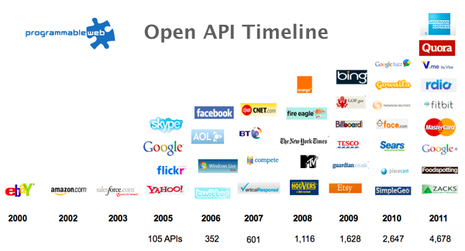
The Information Revolution

Slide 11
Proposition 2
Our languages are information-sparse

Slide 12
Proposition 3
This is a problem
(especially for strongly typed languages)

Slide 13
Today
(1) Demonstrate F# 3.0
(2) Themes in Information Rich Programming

Slide 14
Paradigm Locator
Statically Typed
Dynamically Typed

Slide 15
Paradigm Locator
Statically Typed
Dynamically Typed
A major search is on!
make statically typed langs more dynamic
make dynamically typed langs more static
moderate static typing in limited ways

Slide 16
But first, F# 1.0/2.0…
(Visual Studio 2008 & 2010)

Slide 17
F# is…
...a productive, supported, interoperable, functional language that allows you to write simple code to solve complex problems.

Slide 18
F#
C#
let swap (x, y) = (y, x)
let rotations (x, y, z) =
[ (x, y, z);
(z, x, y);
(y, z, x) ]
let reduce f (x, y, z) =
f x + f y + f z
Tuple<U,T> Swap<T,U>(Tuple<T,U> t)
{
return new Tuple<U,T>(t.Item2, t.Item1)
}
ReadOnlyCollection<Tuple<T,T,T>> Rotations<T>(Tuple<T,T,T> t)
{
new ReadOnlyCollection<int>
(new Tuple<T,T,T>[]
{new Tuple<T,T,T>(t.Item1,t.Item2,t.Item3);
new Tuple<T,T,T>(t.Item3,t.Item1,t.Item2);
new Tuple<T,T,T>(t.Item2,t.Item3,t.Item1); });
}
int Reduce<T>(Func<T,int> f,Tuple<T,T,T> t)
{
return f(t.Item1)+f(t.Item2)+f(t.Item3);
}

Slide 19
Example (power company)
I have written an application to balance the national power generation schedule for a portfolio of power stations to a trading position for an energy company. ...the calculation engine was written in F#.
The use of F# to address the complexity at the heart of this application clearly demonstrates a sweet spot for the language within enterprise software, namely algorithmically complex analysis of large data sets.
Simon Cousins (power company)

Slide 20
language taster
Notes:
If you would like to host your demo on the Virtual Server, please use the myVPC demo slide, not this slide.

Slide 21
Fundamentals - Whitespace Matters
let computeDerivative f x =
let p1 = f (x - 0.05)
let p2 = f (x + 0.05)
(p2 – p1) / 0.1
Offside (bad indentation)

Slide 22
Fundamentals - Whitespace Matters
let computeDerivative f x =
let p1 = f (x - 0.05)
let p2 = f (x + 0.05)
(p2 – p1) / 0.1

Slide 23
F# - Objects + Functional
type Vector2D (dx:double, dy:double) =
let d2 = dx*dx+dy*dy
member v.DX = dx
member v.DY = dy
member v.Length = sqrt d2
member v.Scale(k) = Vector2D (dx*k,dy*k)
Inputs to object
construction
Object internals
Exported properties
Exported method

Slide 24
taster: units
Notes:
If you would like to host your demo on the Virtual Server, please use the myVPC demo slide, not this slide.

Slide 25

1985
Mirror on underside of shuttle
SDI experiment: The plan
Big mountain in Hawaii

Slide 26
1985
SDI experiment:
The reality

Slide 27
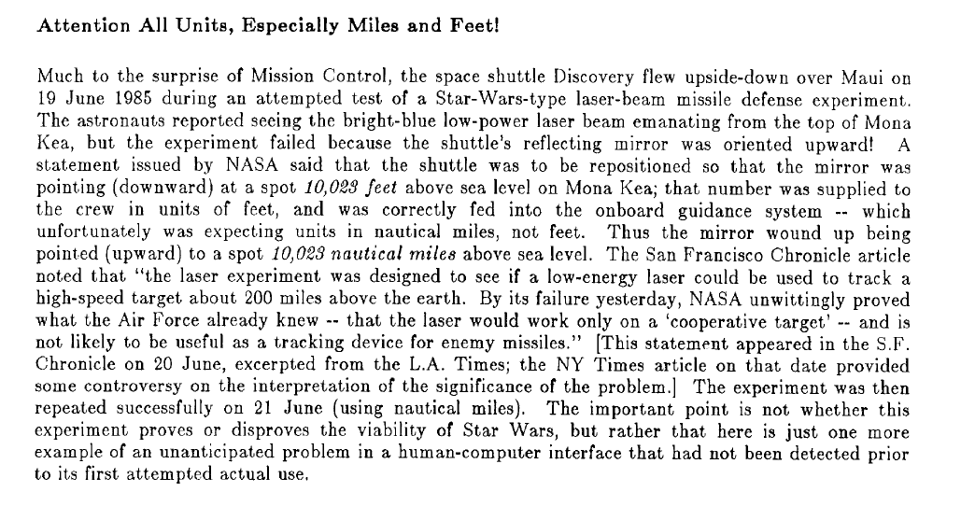
1985

Slide 28
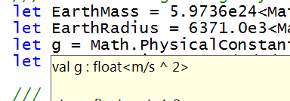
Units of Measure
let EarthMass = 5.9736e24<kg>
// Average between pole and equator radii
let EarthRadius = 6371.0e3<m>
// Gravitational acceleration on surface of Earth
let g = PhysicalConstants.G * EarthMass / (EarthRadius * EarthRadius)

Slide 29
Now, F# 3.0…
(currently in Beta, available from www.fsharp.net)

Slide 30
A Challenge!
Task #1: A Chemistry Elements Class Library
Task #2: A Biology Class Library
Task #3: Repeat for all fields of human knowledge and endeavour…

Slide 31
Language Integrated Web Data
demo

Slide 32
Language Integrated World Bank REST API
demo

Slide 33
Units of Measure from the Web
demo

Slide 34
A Type Provider is….
“Just like a library”
“A design-time component that computes a space of types and methods…”
“An adaptor between data/services and the .NET type system…”
“Staged, on-demand type macros…”

Slide 35
Note: Language still contains no data
Open architecture
You can write your own type provider

Slide 36
Part 1 – Summary
At MSR our job is to take languages forward
F# 1.0-2.0 focused on FP+OO+Parallel+Units
F# 3.0 focuses on information integration

Slide 37
Part 2
Themes in Information Rich Programming

Slide 38
Recap: the problem…
Languages do not integrate information
  Non-intuitive
  Not simple
  Disorganised
  Static
  High friction

Slide 39
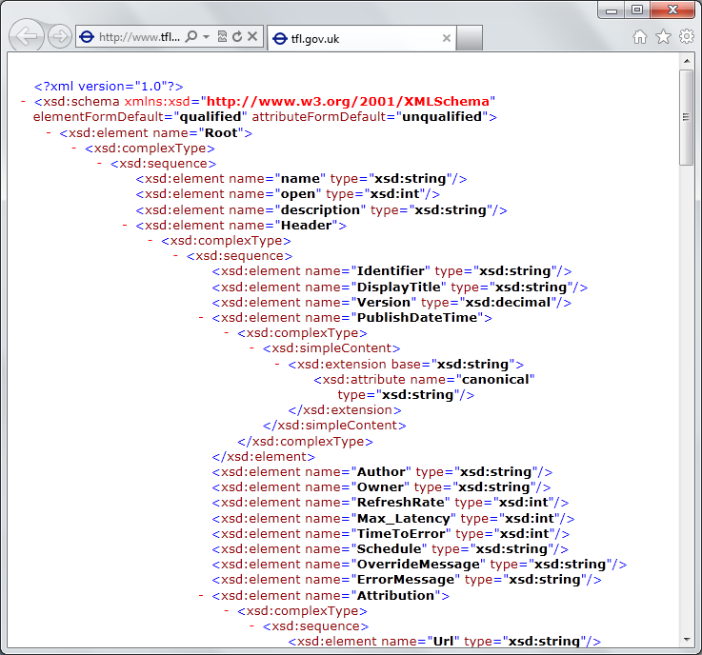
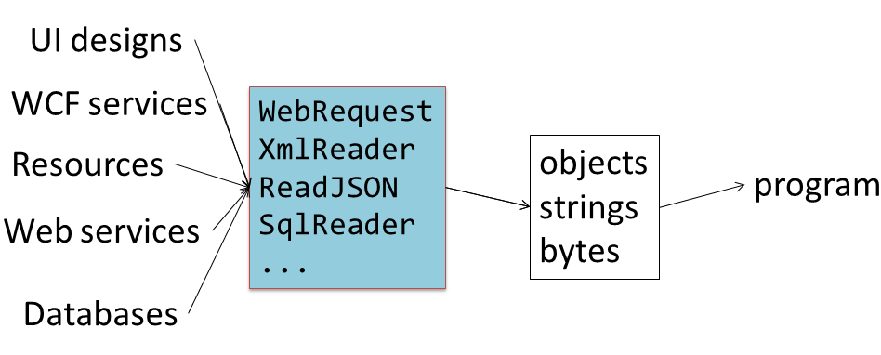
Recap: the problem…
Existing techniques have major problems
  Over-reliance on code-generation
  Do not scale
  No tooling
  No strong types
  Lowest-common-denominator

Slide 40
Time for a paradigm shift?

Slide 41

Γ $⊢ e$ : τ
The neglected child?

Slide 42
Definition #1
Information-rich programming is where external schematized information sources are integral to the operation of the programs being constructed.
These may be as simple as textual DSLs embedded as strings in the program itself, as familiar as SQL databases, as massive as a service exposing Wikipedia data, or the world-wide-web of HTML documents itself.

Slide 43
Definition #2
A (strongly-typed) information-rich programming language integrates external information sources, where the schema and content of these sources are presented in a (strongly-typed) idiomatic form

Slide 44
Theme #1
Big Data → Big Metadata
Strongly typed languages and tooling must have a role here, surely!

Slide 45
Theme #2
Huge Information Spaces can and should be viewed as Software Components example: schema change <-> component versioning <-> source compatibility <-> binary compatibility example: software component engineering <-> information space engineering

Slide 46
Theme #3
Multiple Data Standards with One Simple Mechanism
Rich type systems, importing rich metadata where it exists

Slide 47
Theme #4
Measure languages by their effectiveness at working with rich external information spaces
Example: queries, JSON, XML, type providers, async…

Slide 48
Theme #5
Programming Type Systems v.
Information Space Metadata
Synergy or Conflict?
Examples: Types, Schema, Constraints, Units of Measure, Security Information, Documentation, Definition Locations, Help , Provenance, Privacy, Ratings, Rankings, Search…

Slide 49
Some Sample Research Questions
Can provided probabilistic metadata be useful for tooling?
Can we design type systems which incorporate schema change policies?
Can we automatically find bugs in provider components?
Can we automatically provide all the data in the enterprise?
Can we plug and play more language logic?
Can we provide and verify richer constraints?
Can security, privacy and provenance annotations be provided?
Can we usefully provide massive quantities of geo data + geo metadata?

Slide 50
Summary
The world is information rich, our programming needs to be information-rich too
Big Data → Big Metadata
Information-richness changes how we think about strongly-typed programming languages

Slide 51
Thank you!
Questions? dsyme@microsoft.com www.fsharp.net
@dsyme #fsharp

