Slide 1
Succeeding with Functional-First Languages in Practice
Dr. Don Syme
Principal Researcher
Microsoft Research

Slide 2
Some technical talks….
PDC 2008, Luca Bolognese
An Overview of F# 2.0
channel9.msdn.com/blogs/pdc2008/tl11
//BUILD 2011, Don Syme
F# 3.0: Data, Services, Web, Cloud, at your fingertips
channel9.msdn.com/Events/BUILD/BUILD2011/SAC-904T

Slide 3
Today: Some Simple Observations About
Calculation Engines
Trading Platforms
Bioinformatics
Data Scripting
Quantitative Finance
… with
F#
(and associated technologies)

Slide 4
Will focus on the business perspective and its correspondence to the technical features of F#
Based on informal observations of many F# adoptions, nearly all successful many of the same lessons hold for
OCaml, Erlang, Haskell, Scala, …

Slide 5
When talking about the business perspective, I will use a standard marketing methodology for selling “complex” products.
S
P
Situation
Problem
I
Implication
N
Need
TM
“SPIN Selling”, Rackham

Slide 6
Part 1 –
Business Situation?
Business Problems?
Business Implication?
Business Needs?

Slide 7
The Recurring Business Situation
“I lead a team developing…”
Financial Models
Trading Platforms
…
Insurance Calculation Engines
Bio-informatics Algorithms
Algorithmic Trading Systems
Online Recommendation Engines

Slide 8
The Recurring Business Situation
“I lead a team developing…”
Analytical Components
…
Analytical Components
Analytical Components
Analytical Components
Analytical Components

Slide 9
The Recurring Business Problems
Time to Market
Efficiency
Correctness
Complexity
for analytical components

Slide 10
Is Time to Market a Problem?
Late Models → Missed Business Opportunities
Late Services → Missed Markets
Late Products → Business Failure
Notes:
“Take a moment to stop and think about the ramifications of time-to-market problems through software delays in analytical components for QF, FE, Trading and Calculation Engines more broadly”

Slide 11
Is Correctness a Problem?
Buggy Models → Incorrect Values/Risks/Trades
Buggy Services → Reputation Loss
Buggy Products → Lost Customers
Notes:
“Take a moment to stop and think about the ramifications of correctness problems through software delays in analytical components for QF, FE, Trading and Calculation Engines more broadly”

Slide 12
Is Efficiency a Problem?
Slow Models → Out-of-date Valuations/Risks
Slow Services → Can’t Scale Out
Slow Products → Customer Complaints
Notes:
“Take a moment to stop and think about the ramifications of efficiency problems through software delays in analytical components for QF, FE, Trading and Calculation Engines more broadly”

Slide 13
Is Complexity a Problem?
Intractable Models →
No product or Failed Projects
Intractable Services →
No product or Failed Projects
Intractable Products →
No product or Failed Projects
Notes:
We don’t talk enough about the software we were never able to write. We don’t talk enough about why good analytical programmers leave their jobs.

Slide 14
The Recurring Business Problems
Time to Market
Efficiency
Correctness
Complexity
for analytical components

Slide 15
What’s the Need?
Analytical programmers delivering correct, efficient components in the enterprise, on-time
This is the set of problems that F# helps solve

Slide 16
Part 2 - But why?
The Observations

Slide 17
Observation #1
At the core of every functional-first language is this: simple, correct, robust code for complex problems

Slide 18
Observation #2
A highly interoperable language allows rapid, non-intrusive deployment and integration of components
Functional code is a part of a larger solution. Your code can be rapidly integrated and deployed.

Slide 19
Observation #2 cont.
Interoperable languages remove entire phases from the analytical software development process
No R → C#
No Mathematica → C++
Notes:
Functional programming tools empower when combined with other technologies

Slide 20
Observation #3
Strongly-typed functional languages maintain efficiency comparable to C# and Java, and sometimes C++
Notes:
Functional programming tools empower when combined with other technologies

Slide 21
Observation #4
Strongly-typed functional languages help analytical programmers tackle more complex problems
Notes:
Functional programming tools empower when combined with other technologies

Slide 22
Recap – How Functional-first Helps
Simple, correct, robust code
Interoperability eliminates entire phases
Strong-typing gives efficiency
Analytical developers empowered to solve complex problems

Slide 23
Part 2 - But why?
The Examples and Case Studies

Slide 24
Example #1 (power company)
I have written an application to balance the national power generation schedule … for an energy company.
...the calculation engine was written in F#.
The use of F# to address the complexity at the heart of this application clearly demonstrates a sweet spot for the language … algorithmic analysis of large data sets.
Simon Cousins (Eon Powergen)
http://fsharp.net

Slide 25
Example #1 (power company)
Time to Market
Efficiency
Interoperation ... Seamless. The C# programmer need never know.
Units of measure … a huge time saver...it eradicates a whole class of errors…
Exploratory programming …Working with F# Interactive allowed me to explore the solution space more effectively.
Unit testing …a joy to test. There are no complex time-dependent interactions to screw things up….
Parallelism …The functional purity ... makes it ripe for exploiting the inherent parallelism in processing vectors of data.
Code reduction… … vectors and matrices…higher order functions eat these for breakfast with minimal fuss, minimal code. Beautiful.
Lack of bugs… Functional programming can feel strange. .. once the type checker is satisfied that’s often it, it works.
Correctness
Time to Market
Time to Market
Correctness
Correctness

Slide 26
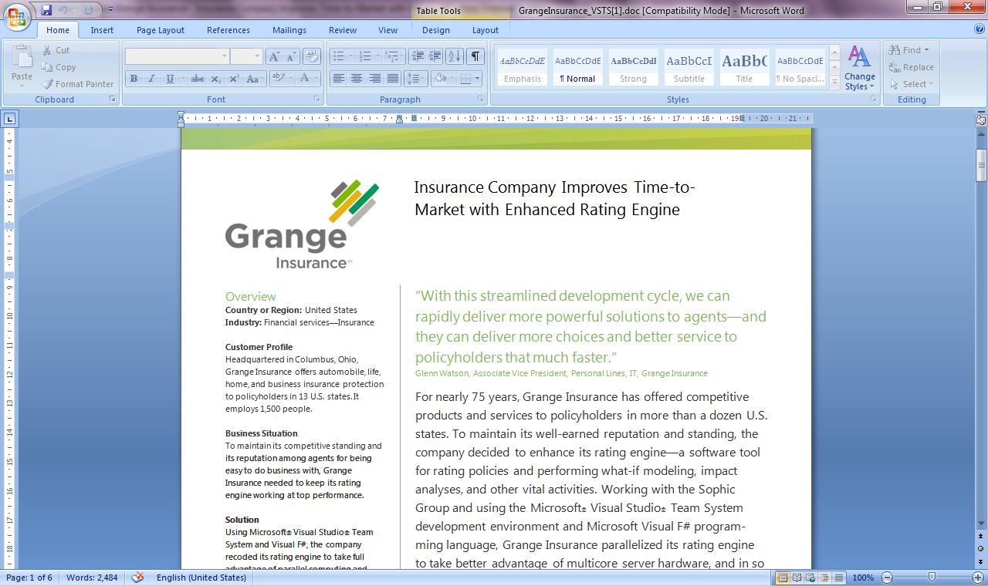
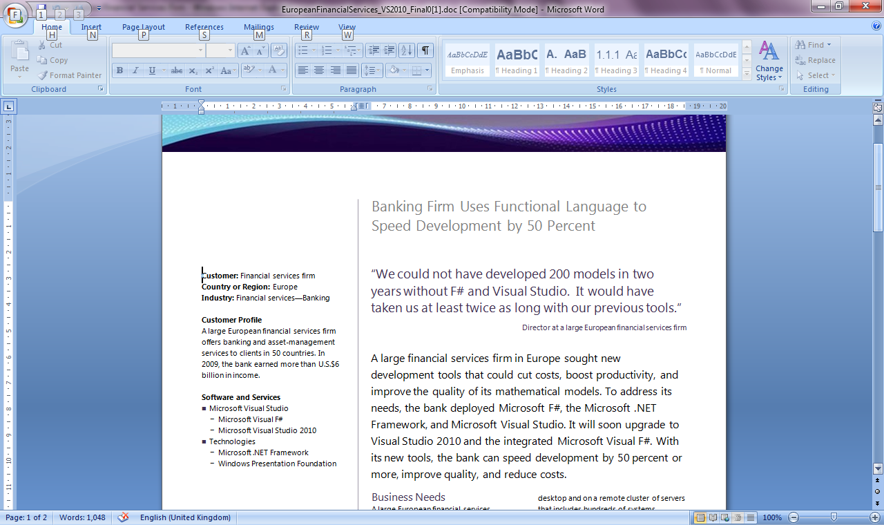
Example #2/#3: F# in Finance
Time to Market
Correctness
Time to Market
Correctness
Efficiency
http://fsharp.net

Slide 27
Example #3: F# in Insurance
I work for a large actuarial company... …Despite adopting Agile/Scrum …the usual delays, complications and sometimes …failures.
We used F#, and quickly created a system which would perform the necessary calculations highly efficiently, in parallel, and with a perfect match to the spreadsheet results.
All of the advantages which are commonly touted for F# do play out in practice. Immutability, Easy Parallelisation, Expressiveness, Testability, Conciseness, Flexibility, Productivity
[ Company name omitted ]
Time to Market
Efficiency
Correctness

Slide 28
Example #4: Finance trading platform
F# + C# for Trading Front End in London
Leverage F#’s features:
  - extensive type system
  - asynchronous workflows, agents and immutable types
  - rich pattern matching and parser support
“Experienced F# developers regularly solve problems in days that would take weeks using more traditional languages…solving complex problems in an elegant and highly maintainable manner”
Time to Market
Complexity

Slide 29
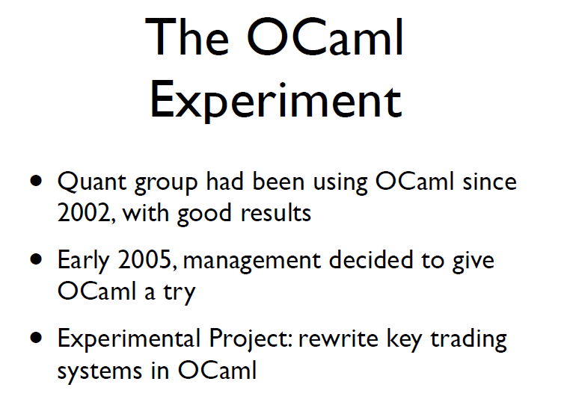
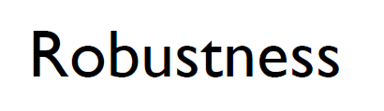
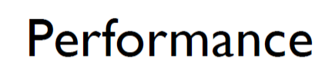
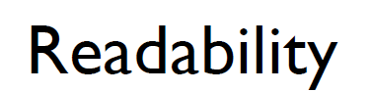
Example #5: OCaml @ Jane St
source: http://www.janestcapital.com/yaron_minsky-cufp_2006.pdf

Slide 30
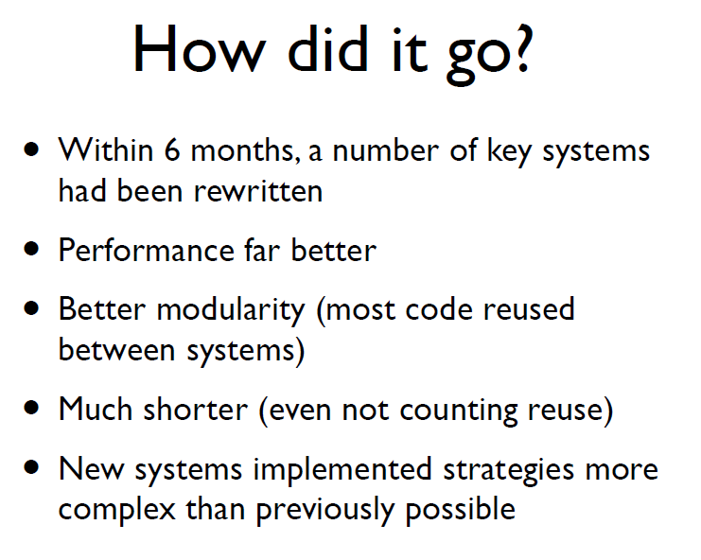
Example #5: OCaml @ Jane St
Efficiency
Solve complex problems
source: http://www.janestcapital.com/yaron_minsky-cufp_2006.pdf

Slide 31
Example #6: F# in Biotech
Efficiency
...F# rocks - building algorithms for DNA processing and it's like a drug. 12-15 at Amyris use F#... A complete genome resequencing pipeline with interface, algs, reporting in ~5K lines and it has been incredibly reliable, fast and easy to maintain.. A suffix tree in 150 lines that can index 200,000 bases a second ;)
F# v. Python: F# has been phenomenally useful. I would be writing a lot of this in Python otherwise and F# is more robust, 20x - 100x faster to run and faster to develop.
Units of measure: I started labelling the coordinates as one or zero based and immediately found a bug where I'd casually mixed the two systems. Yay F#!
Darren Platt, Amyris BioTechnologies
Correctness
Time to Market
Correctness

Slide 32
Example #7: F# in Advertisement Ranking & Rating @ Microsoft
Around 95% of the code in these projects has been developed in F#.
F# allowed for rapid development of prototypes, and thus also rapid verification or falsification of the underlying mathematical models.
Complex algorithms, for example to compute Nash equilibria in game theory, can be expressed succinctly.
Units of measure reduced the chance of errors dramatically: Prices, probabilities, derivatives, etc. can already be kept apart at compile time.
Time to Market
Taming Complexity
Correctness

Slide 33
Summary – The Data Agrees
Simple, correct, robust code
Interoperability improves time-to-market
Strong-typing gives efficiency
Analytical developers empowered to solve more complex problems

Slide 34
Part 3 – F# in Practice

Slide 35
Crossing boundaries
“Fresh Code” Performance
Professional Development
Programming
C++
Financial engineering
C#
Java
F#
Modelling
Dynamic…
Math tools
Programming
Expressivity for
Mathematical tasks

Slide 36
Simplicity: Functions as Values
abstract class Command {
public virtual void Execute();
}
abstract class RoverCommand : Command {
protected Rover Rover { get; private set; }
public RoverCommand(MarsRover rover) {
this.Rover = rover;
}
}
class BreakCommand : RoverCommand {
public BreakCommand(Rover rover)
: base(rover) { }
public override void Execute() {
Rover.Rotate(-5.0);
}
}
class TurnLeftCommand : RoverCommand
{
public TurnLeftCommand(Rover rover)
: base(rover) {
}
public override void Execute() {
Rover.Rotate(-5.0);
}
}
OO
F#
type Command = Command of (Rover -> unit)
let BreakCommand =
Command(fun rover -> rover.Accelerate(-1.0))
let TurnLeftCommand =
Command(fun rover -> rover.Rotate(-5.0<degs>))

Slide 37
Simplicity: Functional Data
C#
let swap (x, y) = (y, x)
let rotations (x, y, z) =
[ (x, y, z);
(z, x, y);
(y, z, x) ]
let reduce f (x, y, z) =
f x + f y + f z
Tuple<U,T> Swap<T,U>(Tuple<T,U> t)
{
return new Tuple<U,T>(t.Item2, t.Item1)
}
ReadOnlyCollection<Tuple<T,T,T>> Rotations<T>(Tuple<T,T,T> t)
{
new ReadOnlyCollection<int>
(new Tuple<T,T,T>[]
{ new Tuple<T,T,T>(t.Item1,t.Item2,t.Item3);
new Tuple<T,T,T>(t.Item3,t.Item1,t.Item2);
new Tuple<T,T,T>(t.Item2,t.Item3,t.Item1); });
}
int Reduce<T>(Func<T,int> f,Tuple<T,T,T> t)
{
return f(t.Item1) + f(t.Item2) + f (t.Item3);
}
F#

Slide 38
Lesson: Combining with the right tools is key

Slide 39
Examples
A quant model
A trading engine
F# + existing C++ components
A calculation engine with GPU execution
F# + FCore Math
A scalable web service
Data Services + F# + ASP.NET
A scalable big-data service
F# + Hadoop + ServiceStack
A Web 2.0 startup
F# (Server) + SQL Server + DataFeeds + ASP.NET + F# (WebSharper) + HTML5
Oracle + F# (Server) + F#/C# (Silverlight)

Slide 40
F# in Practice: More Lessons
Build capabilities in functional-first techniques
Training is key
Trial on specific components, prototyping, testing and exploration
✗ Don’t rewrite stable, working components in F#
✗ Always reuse C++ high-performance components.

Slide 41
Recent Developments in F# @ Microsoft
F# 3.0
F# + Azure
F# + Azure Hadoop
F# + Azure Cloud Numerics
queries, powerful data integration, better tooling, portable libraries
for scalable service programming
for scalable big-data programming
for scalable math programming

Slide 42
F# 3.0 – Information Rich Programming

Slide 43
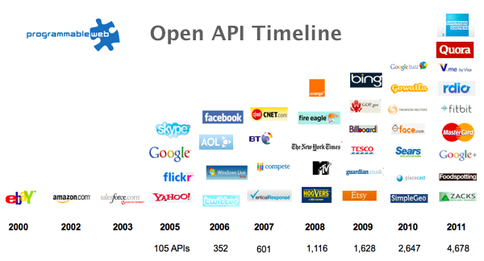
F# 3.0 - The Information Revolution

Slide 44
F# 3.0 - Paradigm Locator
Statically Typed
Dynamically Typed

Slide 45
F# 3.0 - Paradigm Locator
Statically Typed
Dynamically Typed
A major search is on!
make statically typed langs more dynamic
make dynamically typed langs more static
moderate static typing in limited ways

Slide 46
F# 3.0 - A Challenge!
Task #1: A Chemistry Elements Class Library
Task #2: A Biology Class Library
Task #3: Repeat for all fields of human knowledge and endeavour…

Slide 47
F# 3.0 = Language Integrated Web Data
demo

Slide 48
Some Other Developments in F#
F# + WebSharper
F# + FCore
F# + m-brace
F# + …
very powerful cross-platform HTML5 web/mobile programming
for statistical/math programming + GPU
a cloud-execution framework
many other { open-source, .NET, C#, … }

Slide 49
In Summary – F#
F#
Ready for supported use in VS2010 + VS11
Code correctness, efficiency and interoperation in the modern enterprise
A bright future ahead for web/data/cloud
Improved time-to-market for analytical and data-rich components

Slide 50
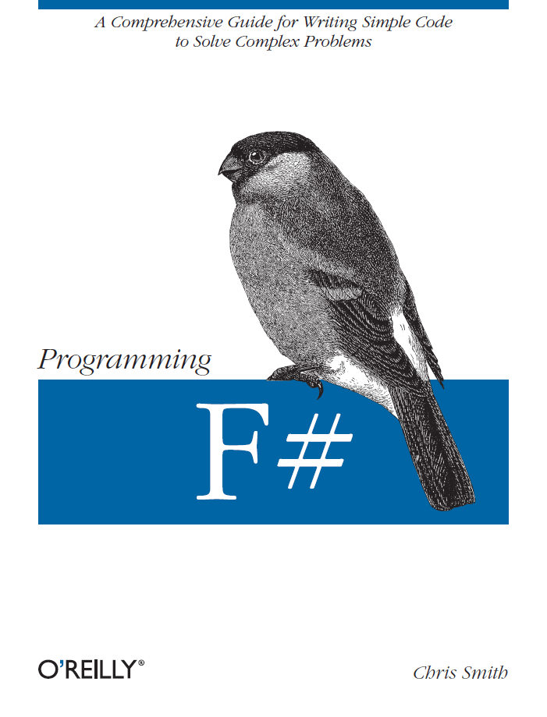
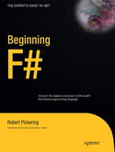
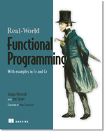

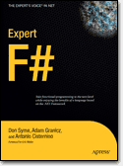
Some Books about F#
Visit www.fsharp.net

Slide 51
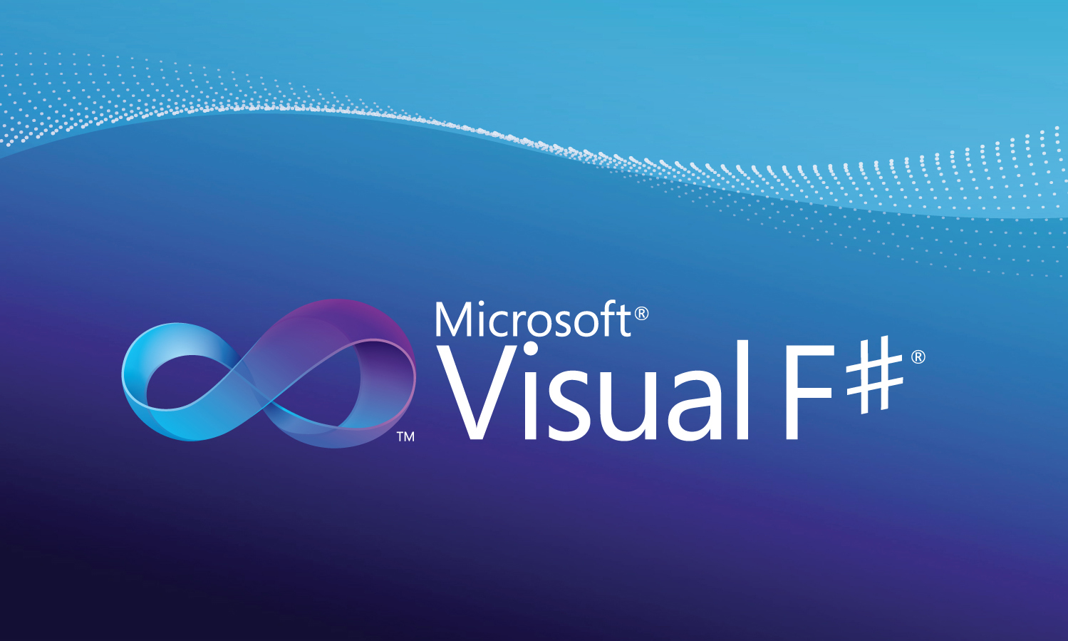
Learn more at http://fsharp.net
Questions?

