Slide 1
F# 3.0 and the Future of Information-Rich Functional Programming Data, Services, Web, Cloud, at your fingertips!
Don Syme
MonkeySpace 2012

Slide 2
Join the F# Open Source Community ☺ http://fsharp.github.com

Slide 3
fsharp.github.com/fsharp
F# 3.0 compiler+library open source
Apache 2.0 license
Mac, Linux, Windows, Browsers
2.0, 4.0 profiles
2.1 profile for MonoAndroid (MonoTouch?)
fsharp.github.com/fsharp

Slide 4
fsharp.github.com/fsharpbinding
F# bindings for MonoDevelop 3.0
Apache 2.0 license
Simple feature set
Works with F# 2.0 and F# 3.0
ASP.NET?
Type Providers?
MonoAndroid?
fsharp.github.com/fsharpbinding

Slide 5
Part 0 A quick retrospective

Slide 6
Time Warp…
1998
…
2012

Slide 7
1998 to 2012…
C# LINQ
SIGMOD2006
C# 3.0 Spec
F# Metaprog
ML 2006
F# 1.0
.NET Generics
PLDI 2001
POPL 2004
ECMA 2005
C#/VB Generics
PLDI 2001
C# 2.0
ECMA 2005
F# Active Patterns
ICFP 2007
.NET CLI
2.0-4.0
C#
1.0-5.0
F#
2.0
F# Core Lang
ML 2004
F# 1.0
F# Async/Parallel/
Agents
F# 2.0
PADL 2010
.NET 4.0 Tasks
OOPSLA ‘09
C# Async
C# 5.0
F# Units of
Measure
POPL 2009
F# 2.0
Notes:
.NET 2.0-4.0, C# 2.0-4.0: .NET Generics: deep innovation, heavily inspired by functional programming design & implementation, deeply empowering for C#/VB programmers. Generic programming, with total simplicity, with debugging, with runtime types, with unboxed efficiency, with precompilation. Assert this has put Microsoft 10-20 years ahead in this aspect of VM implementation: there is still no sign of JVM or other implementations or designs that rival the CLR on this design point. IMHO anyone who builds a typed VM language on anything less is building on sand.
C# 3.0-4.0: Lambda Expressions, LINQ. I had less to do with this, but it is fundamentally enabled by .NET generics. It is a wonderful and ground-breaking embedding of queries into languages
F# 2.0: Strongly typed functional programming for .NET, built on .NET Generics
F# 2.0: Units of Measure with effective type inference. Again, it feels Microsoft is 10-20 years ahead of the competition for this feature. Take that as a challenge, if you like.
F# 2.0: Asynchronous + parallel + agent programming. Smoothly integrated asynchronous programming and agents on a VM through local CPS rewriting. Similar to Kilim, predates it a little (2007).
C# 5.0: Look for a sneak preview next week!

Slide 8
Scala Extractors
(see F# active patterns)
Python Comprehensions
(see F# workflows)
Java Generics
(see .NET generics)
Java
Scala
Haskell
Python
Scala “Virtualization”
(see F# metaprog)
Haskell Monads
(see F# workflows)
Java Lambdas
(see Lisp/C#/F#...)
Scala “React”
(see F# async)
.NET CLI
2.0-4.0
C#
1.0-5.0
F#
2.0
C++ Lambdas
(see Lisp ☺)
WebSharper
Javascript
HTML5
C
C++

Slide 9
1998 to 2012…
The dark days of object fundamentalism are past us ☺
Mixed OO/FP languages now industry standard
(C#, C++, VB, Java, Javascript, Scala, F#, …)
Microsoft Research has been part of this transformation

Slide 10
Part 1 Introducing F# and F# 3.0

Slide 11
Proposition 1 The world is information-rich

Slide 12
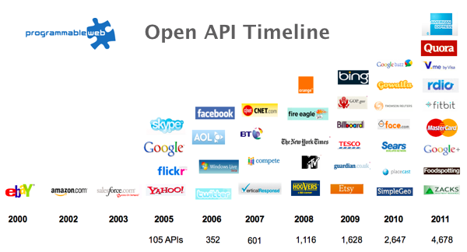
The Information Revolution

Slide 13
Proposition 2 Modern applications are information-rich

Slide 14
Proposition 3 Our languages are information-sparse

Slide 15
Proposition 4 F# 3.0 starts to fix this

Slide 16
Paradigm Locator
Statically Typed
Dynamically Typed

Slide 17
Paradigm Locator
Statically Typed
Dynamically Typed
The search is on!
make statically typed languages more dynamic
make dynamically typed languages more static
moderate static typing but apply it more broadly

Slide 18
But first, F# 1.0/2.0…

Slide 19
F# is…
...a productive, supported, interoperable, functional language that allows you to write simple code to solve complex problems.

Slide 20
F#
Java-style-OO
type Command = Command of (Rover -> unit)
let BreakCommand =
Command(fun rover -> rover.Accelerate(-1.0))
let TurnLeftCommand =
Command(fun rover -> rover.Rotate(-5.0<degs>))
abstract class Command
{
public virtual void Execute();
}
abstract class RoverCommand : Command
{
protected Rover Rover { get; private set; }
public RoverCommand(MarsRover rover)
{
this.Rover = rover;
}
}
class BreakCommand : RoverCommand
{
public BreakCommand(Rover rover)
: base(rover)
{
}
public override void Execute()
{
Rover.Rotate(-5.0);
}
}
class TurnLeftCommand : RoverCommand
{
public TurnLeftCommand(Rover rover)
: base(rover)
{
}
public override void Execute()
{
Rover.Rotate(-5.0);
}
}

Slide 21
F#
C#
let swap (x, y) = (y, x)
let rotations (x, y, z) =
[ (x, y, z);
(z, x, y);
(y, z, x) ]
let reduce f (x, y, z) =
f x + f y + f z
Tuple<U,T> Swap<T,U>(Tuple<T,U> t)
{
return new Tuple<U,T>(t.Item2, t.Item1)
}
ReadOnlyCollection<Tuple<T,T,T>> Rotations<T>(Tuple<T,T,T> t)
{
new ReadOnlyCollection<int>
(new Tuple<T,T,T>[]
{new Tuple<T,T,T>(t.Item1,t.Item2,t.Item3);
new Tuple<T,T,T>(t.Item3,t.Item1,t.Item2);
new Tuple<T,T,T>(t.Item2,t.Item3,t.Item1); });
}
int Reduce<T>(Func<T,int> f,Tuple<T,T,T> t)
{
return f(t.Item1)+f(t.Item2)+f(t.Item3);
}

Slide 22
Understanding F#
F# 1.0
F# 2.0
C# (designers)
F# (code)
WebSharper/
Javascript (HTML5)
F# 3.0
Code
Analysis
Algorithms
Parallel
Data
Information
Services
Presentation
Publication
UI

Slide 23
Fundamentals - Whitespace Matters
let computeDerivative f x =
let p1 = f (x - 0.05)
let p2 = f (x + 0.05)
(p2 – p1) / 0.1
Offside (bad indentation)

Slide 24
Fundamentals - Whitespace Matters
let computeDerivative f x =
let p1 = f (x - 0.05)
let p2 = f (x + 0.05)
(p2 – p1) / 0.1

Slide 25
F# - Objects + Functional
type Vector2D (dx:double, dy:double) =
let d2 = dx*dx+dy*dy
member v.DX = dx
member v.DY = dy
member v.Length = sqrt d2
member v.Scale(k) = Vector2D (dx*k,dy*k)
Inputs to object
construction
Object internals
Exported properties
Exported method

Slide 26
Fundamentals - Queries
let avatarTitles =
query { for t in netflix.Titles do
where (t.Name.Contains "Avatar")
select t }
LINQ Queries using
F# workflows

Slide 27
Now, F# 3.0…

Slide 28
A Challenge! Task #1: A Chemistry Elements Class Library Task #2: A Biology Class Library Task #3: Repeat for all fields of human knowledge and endeavour…

Slide 29
Language Integrated Web Data
demo

Slide 30
Update: Freebase Provider
github.com/fsharp/fsharpx
Freebase is API to (some of) Google Knowledge Graph
20 million objects, 3 million books, 300K films, …
GET/POST to http://api.freebase.com, JSON back
MQL query language & entity model
Data usable in app programming and elsewhere
Sample Freebase provider
maps “commons” into .NET types/values top level organization by type
read-only access works with Try F# 3.0
multiple inheritance snapshot dates
query translation connects to latest Google API
units of measure propagation sample individuals
better organization
released as sample

Slide 31
A Challenge! Task #1: Debt statistics from World Bank Task #2: University enrolments for different countries

Slide 32
F# + World Bank
demo

Slide 33
A Challenge! Task: Do strongly typed big-data programming with Hadoop and Hive

Slide 34
F# Data Scripting for Hadoop and Hive
demo

Slide 35
What is in F# 3.0?

Slide 36
SQL
type Data = SqlDataConnection<"Server='.\\SQLEXPRESS'..">
let db = SQL.GetDataContext()
db.Customers
Fluent, Typed Access To SQL

Slide 37
OData
type Netflix = ODataService<"http://odata.netflix.com">
let service = Netflix.GetDataContext()
service.Titles
Fluent, Typed Access To OData

Slide 38
Web Services
type Data = WsdlService<"http://www.xignite.com/xFutures.asmx?WSDL">
let financials = Data.GetServiceContext()
financials.GetQuotes "IBM"
Fluent, Typed Access To WSDL

Slide 39
F# 3.0: Queries
let avatarTitles =
query { for t in netflix.Titles do
where (t.Name.Contains "Avatar")
select t }

Slide 40
F# 3.0: Queries
let avatarTitles =
query { for t in netflix.Titles do
where (t.Name.Contains "Avatar")
sortBy t.Name
select t }

Slide 41
F# 3.0: Queries
let avatarTitles =
query { for t in netflix.Titles do
where (t.Name.Contains "Avatar")
sortBy t.Name
select t
take 100 }

Slide 42
Not in the box: SharePoint
type EmeaSite = SharePointSite<"http://myemea/">
let site = EmeaSite.GetDataContext()
site.Announcements
Fluent, Typed Access To SharePoint Lists

Slide 43
Not in the box: WMI
type Machine = ManagementData< @"\\mymachine" >
let data = MyMachine.GetDataContext()
data.Win32_DiskDrives
Fluent, Typed Access To WMI data

Slide 44
Update: RProvider
r provider f#
Open source community provider for interop with R
discovers installed R packages
Access > 2,000 R packages
projects them as .NET namespaces
underneath the parent namespace RProvider

Slide 45
Example community providers R Provider github.com/fsharp/fsharpx/tree/TypeProviders /AppSettingsProvider /FileSystemProvider /CsvProvider /NamespaceProvider /RegexProvider /RegistryProvider /GraphProvider /XamlProvider

Slide 46
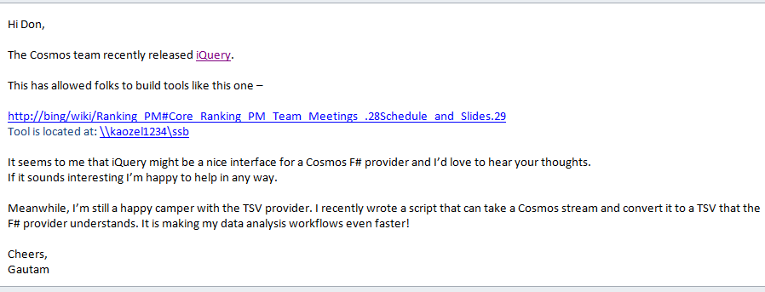
Potential: Cosmos Provider?
Cosmos is Microsoft OSD’s Big Table
Opportunity for better programming/query/data-scripting

Slide 47
Potential: SAP or Dynamics Provider?
SAP and Dynamics are enterprise CRM/ERP/… products
Data and Schema galore
Richer constraints
Real business imperative
Use endless codegen
Seems perfect for a type provider

Slide 48
Part 2 Themes in Information Rich Programming

Slide 49
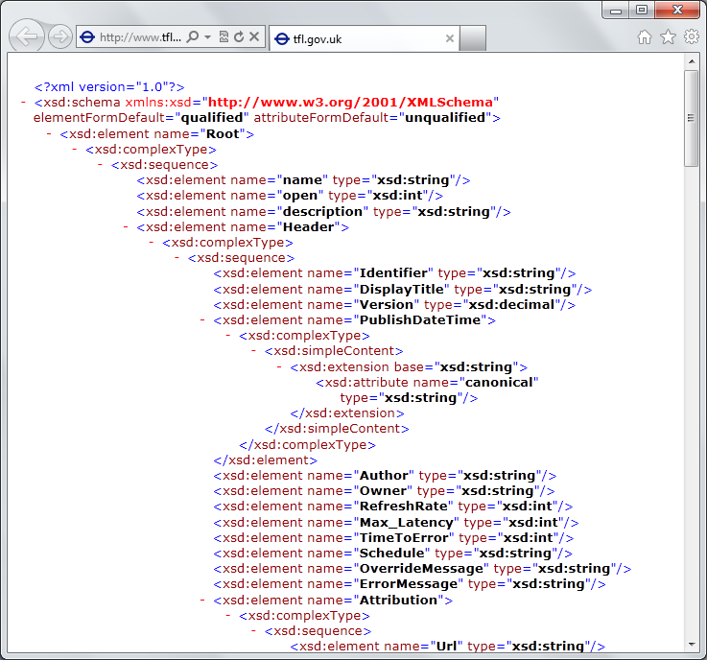
Recap: the problem…
Languages do not integrate information
Non-intuitive
Not simple
Disorganised
Static
High friction

Slide 50
A Type Provider is…. “Just like a library” “A design-time component that computes a space of types and methods…” “An adaptor between data/services and the .NET type system…”

Slide 51
Note: Language still contains no data Open architecture You can write your own type provider

Slide 52
Theme #1 Big Data → Big Metadata Strongly typed languages and tooling must have a role here, surely!

Slide 53
Theme #2 Information Spaces viewed as Software Components example: schema change <-> component versioning <-> source compatibility <-> binary compatibility

Slide 54
Theme #3 Future languages must work with internet-scale information spaces Example: queries, JSON, XML, type providers, async…

Slide 55
Theme #4 Programming v. Information Spaces Synergy or Conflict? Examples: Types, Schema, Constraints, Units of Measure, Security Information, Documentation, Definition Locations, Help , Provenance, Privacy, Ratings, Rankings, Search…

Slide 56
Summary
heterogeneous data and services
strongly typed
language-integrated
without explicit codegen
internet-scale
extensible, open

Slide 57
Summary The world is information rich Programming needs to be information-rich too F# 3.0 integrates information more seamlessly than any other language

Slide 58
fsharp.net tryfsharp.org fsharp.github.com Questions?

