Slide 1
Meditations on Type Providers Applications of Type providers
Boston FSUG, 18 Oct 2012

Slide 2
Join the F# Open Source Community ☺ http://fsharp.github.com

Slide 3
fsharp.github.com/fsharp
F# 3.0 compiler+library open source
Apache 2.0 license
Mac, Linux, Windows, Browsers
2.0, 4.0 profiles
2.1 profile for MonoAndroid (MonoTouch?)
fsharp.github.com/fsharp

Slide 4
fsharp.github.com/fsharpbinding
F# bindings for MonoDevelop 3.0
Apache 2.0 license
Simple feature set
Works with F# 2.0 and F# 3.0
ASP.NET?
Type Providers?
MonoAndroid?
fsharp.github.com/fsharpbinding

Slide 5
Agenda
Type providers feel like the start of a journey
For applied, interoperable typed languages
For connected programming
Informal Chat a bit about
Philosophy and themes of the work
Research and application directions
Update on what we’ve been doing
What’s to wrestle with

Slide 6
What’s to wrestle with
Scale
Sparseness
Unbelievable breadth of application
Ease of authoring provider components
Incremental and mutually recursive type provision
The tangle between usability and provision
Meaning of soundness and correctness in a heterogeneous, evolving world
Next directions, concretely

Slide 7
Understanding F#
F# 1.0
F# 2.0
C# (designers)
F# (code)
WebSharper/
Javascript (HTML5)
F# 3.0
Code
Analysis
Algorithms
Parallel
Data
Information
Services
Presentation
Publication
UI

Slide 8
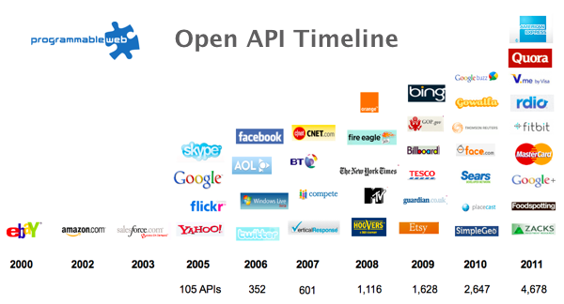
Recap: The Information Revolution

Slide 9
Recap: the problem…
Languages do not integrate information
Non-intuitive
Not simple
Disorganised
Static
High friction

Slide 10
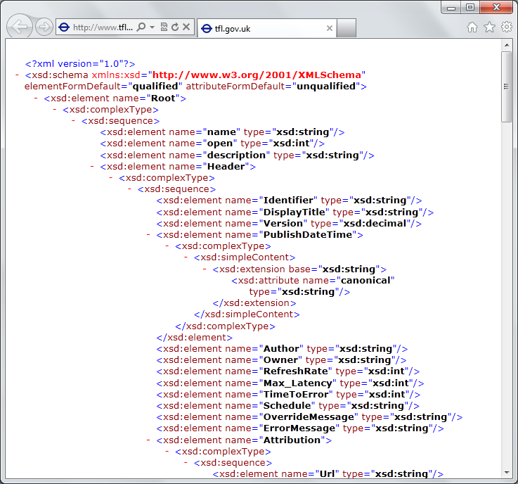
Recap: the problem…
Existing techniques have major problems
Over-reliance on code-generation
Do not scale
No tooling
No strong types
Lowest-common-denominator

Slide 11
Recap: the approach…
Integrate information spaces “directly”
An adaptor/provider model for “the outside world”
Scalable, on-demand expansion of elements of symbols
Type erasure for scalability
Reuse visual language tooling for discovery, navigation, documentation, …
Focus on usability, scalability, discoverability, productivity, robustness

Slide 12
Update: Freebase Provider
http://codebox/openfsharp
Freebase is API to (some of) Google Knowledge Graph
20 million objects, 3 million books, 300K films, …
GET/POST to http://api.freebase.com, JSON back
MQL query language & entity model
Data usable in app programming and elsewhere
Sample Freebase provider
maps “commons” into .NET types/values top level organization by type
read-only access works with Try F# 3.0
multiple inheritance snapshot dates
query translation connects to latest Google API
units of measure propagation sample individuals
better organization
released as sample

Slide 13
Definition #1 Information-rich programming is where external schematized information sources are integral to the operation of the programs being constructed. These may be as simple as textual DSLs embedded as strings in the program itself, as familiar as SQL databases, as massive as a service exposing Wikipedia data, or the world-wide-web of HTML documents itself.

Slide 14
Definition #2 A (strongly-typed) information-rich programming language integrates external information sources, where the schema and content of these sources are presented in a (strongly-typed) idiomatic form

Slide 15
Recap: this is different…
“The idea of integrating internet-scale information services directly into the program's variable and type space that is in F# 3.0 is probably the most innovative programming language idea I have heard of in a decade” (Jim Cordy, Queens U., faculty summit 2012)
Perhaps, perhaps not…
But if something so simple is perceived as so different, it is worth taking a long think about why
We need to prise apart assumptions
(What follows is somewhat whimsical)

Slide 16
Recap: this is different…
We like to see PL systems as logical systems
Traditional logical systems exclude interaction with reality
This is a powerful and simplifying assumption
It is also fundamentally wrong for modern applied programming languages

Slide 17
Γ $⊢ e$ : τ
Lots of work here
Lots of work here
The exclusion of reality
But what about here?
Γ₀ = 0

Slide 18
Meditations on Γ₀
Γ₀ is the ever-growing ocean of digital reality around us
Γ₀ is big. Really big.
Γ₀ defies imagination for its enormity
Γ₀ is other. It doesn’t speak your language
Γ₀ is being organized at an incredible rate
Γ₀ is just ready and waiting to be tamed. (We’re hitting the limit with e and tau)
Γ₀ is surprisingly “human”

Slide 19
Meditations on Γ₀
Γ₀ is full of uncertainty and probabilities.
You are mutually recursive with Γ₀. You are part of it.
Γ₀ has many open doors, many locked doors
Γ₀ has many, many parts that do not get on particularly well.
Γ₀ is so real you want to touch it, explore it
Don’t look too long.
It’s like staring at infinity

Slide 20
Some Research Questions
Can provided probabilistic metadata be useful for typing or tooling?
Can we design library/provider mechanisms which incorporate schema change policies?
Can we prove correctness or find bugs in provider components?
Can we provide all the data in the enterprise, wikipedia, bing or google?
Can we plug and play more language logic?
Can we provide and check richer constraints?
Can we build a truly heterogeneous language?
Can security, privacy and provenance annotations be provided?
Can we flow types into the providers?
Can we go mutually recursive?

Slide 21
Theme #1 Big Data → Big Metadata Big Data → Broad Data Strongly typed languages and tooling must have a role here, surely!

Slide 22
Theme #2 Huge Information Spaces can (and should?) be viewed as Software Components example: schema change <-> component versioning <-> source compatibility <-> binary compatibility example: software component engineering <-> information space engineering

Slide 23
Theme #3 Multiple Data Standards through One Simple Mechanism Rich type systems, importing rich metadata where it exists

Slide 24
Theme #4 Measure languages by their effectiveness at working with rich external information spaces Example: queries, JSON, XML, type providers, async…

Slide 25
Theme #5 Programming Type Systems v. Information Space Metadata Synergy or Conflict? Examples: Types, Schema, Constraints, Units of Measure, Security Information, Documentation, Definition Locations, Help , Provenance, Privacy, Ratings, Rankings, Search…

Slide 26
Update: World Bank Provider
http://codebox/openfsharp
World Bank aggregates country statistics
4,000 time series, 250 countries…
GET/POST to http://api.worldbank.com, JSON back
Weak cube-like queries
Data usable in app programming and elsewhere
Sample World Bank Provider
maps data cube into .NET types/values top level organization by type
read-only access works with Try F# 3.0
to be updated soon as sample

Slide 27
Update: Hadoop Provider
http://codebox/openfsharp
Hive provides data-scripting queries over Hadoop
ODBC network data protocol
Metadata provided by “DESCRIBE TABLE EXTENDED;”
HDFS provides distributed file system over Hadoop
WinHdfsManaged.dll API
64-bit only
Sample Hadoop/Hive Provider
maps tables into .NET types/values read-only access
proxy access from Visual Studio works with Try F# 3.0
todo: query translation
to be release sometime as sample , possible product path

Slide 28
Update: CSV Provider
http://codebox/openfsharp
General provider for tabular data
int, bool, float, date, string, etc. options for delimiters, quotes
optional schema optional schema inference
no queries/indexing works with Try F# 3.0
to be release as sample

Slide 29
Update: RProvider
r provider f#
Open source community provider for interop with R
discovers installed R packages
Access > 2,000 R packages
projects them as .NET namespaces
underneath the parent namespace RProvider

Slide 30
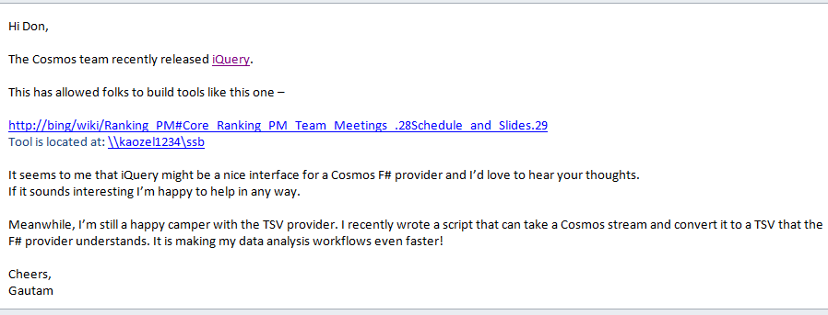
Potential: Cosmos Provider?
Cosmos is Microsoft OSD’s Big Table
Opportunity for better programming/query/data-scripting

Slide 31
Potential: SAP or Dynamics Provider?
SAP and Dynamics are enterprise CRM/ERP/… products
Data and Schema galore
Richer constraints
Real business imperative
Use endless codegen
May motivate many extensions to the mechanism, and to F# type/constraint checking
No idea if we’ll really do this

Slide 32
What to wrestle with
Scale
Sparseness
Unbelievable breadth of application
Ease of authoring provider components
Incremental and mutually recursive type provision
The tangle between usability and provision
Meaning of soundness and correctness in a heterogeneous, evolving world
Next directions, concretely

Slide 33
Paradigm Locator
Statically Typed
Dynamically Typed

Slide 34
Paradigm Locator
Statically Typed
Dynamically Typed
A major search is on!
make statically typed langs more dynamic
make dynamically typed langs more static
moderate static typing in limited ways

Slide 35
Summary
heterogeneous data and services
strongly typed
language-integrated
without explicit codegen
internet-scale
extensible, open

Slide 36
Summary The world is information rich Programming needs to be information-rich too F# 3.0 integrates information more seamlessly than any other language

Slide 37
fsharp.net tryfsharp.org fsharp.github.com Questions?

