Slide 1
A Bit About…. Data, Information, Data Science and F#
@dsyme, F# Community Contributor, Researcher, Microsoft
@moloneymb, Data Scientist

Slide 2
Informal Agenda
F# and Internet-Scale Data Integration
Demos!
A tour of the F# exosystem for data-science

Slide 3
F# is Open Source F# is Cross Platform
fsharp.org/use/mac
fsharp.org/use/linux
fsharp.org/use/android
fsharp.org/use/ios

Slide 4
Proposition 1 The world is information-rich

Slide 5
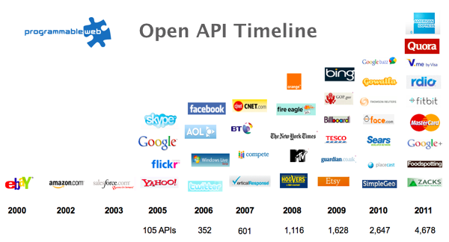
The Information Revolution

Slide 6
Proposition 2 Modern programming is intensely information-rich

Slide 7
Proposition 3 Our languages are information-sparse

Slide 8
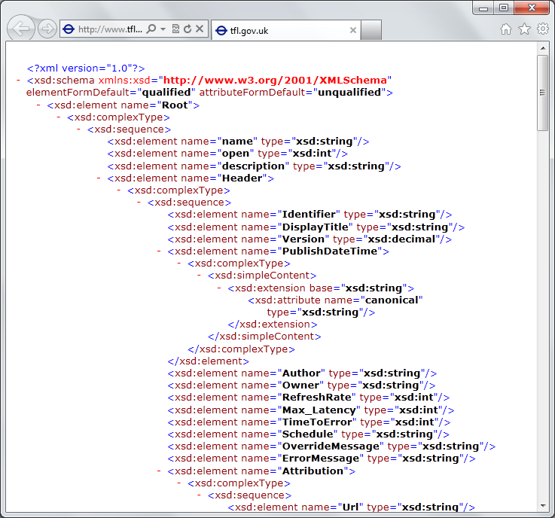
The developer’s perspective
Languages do not integrate information
Non-intuitive
Not simple
Disorganised
Static
High friction

Slide 9
We need to bring information into the language… At internet-scale, strongly tooled, strongly typed

Slide 10
But before we get into that…
What is F#?

Slide 11
A strongly typed, data-immersive functional-first language for…. simple code to solve complex problems

Slide 12
data.Countries.Brazil.Indicators.``Population ages 0-14 (% of total)``

Slide 13
type Rating = { UserId: int; DishId: int; Rating: int }

Slide 14
let svd = data.Svd(true) let U, S, Vt = svd.U(), svd.S(), svd.VT() let reconstructed = U * S * Vt let userToCategory = U * S let categoryToDish = S * Vt
Latent Semantic Indexing with F#

Slide 15
10 Reasons Not to Use a Strongly Typed Functional Language

Slide 16
F# at Kaggle
At Kaggle we initially chose F# for our core data analysis algorithms because of its expressiveness.
We’ve been so happy with the choice that we’ve found ourselves moving more and more of our application …into F#.
The F# code is shorter, easier to read, easier to refactor, and, because of the strong typing, contains far fewer bugs.
As our data analysis tools have developed, we’ve seen domain-specific constructs emerge very naturally
As our codebase gets larger, we become more productive.

Slide 17
F# is changing…
F# runs on many platforms
“F# is for Windows”

Slide 18
Overview
F# is changing…
“F# has many contributors”
“Microsoft
makes F#”

Slide 19
Overview
F# is changing…
Many perspectives
http://fsharp.org
One perspective
(Microsoft’s)
http://msdn.microsoft.com

Slide 20
The F# Exosystem for Data Science

Slide 21
nuget.org

Slide 22
11,500 unique packages Windows, Mac, Linux

Slide 23
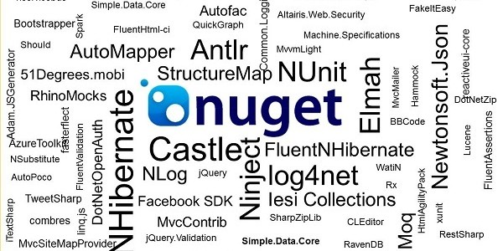
www.nuget.org

Slide 24
Learn more
fsharp.org/math
fsharp.org/data-science
fsharp.org/machine-learning
fsharp.org/cloud
fsharp.org/data-access

Slide 25
Back to the main topic…

Slide 26
How F# Learned to Stop Worrying and Love the Data

Slide 27
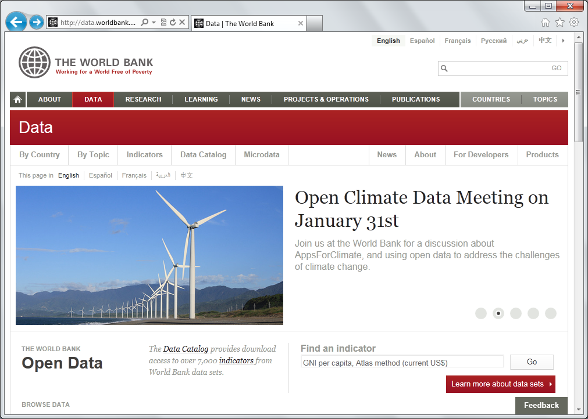
Auto-complete for Data, in the Language

Slide 28
Demo: F# to WorldBank

Slide 29
All your types are belong to us….
types

Slide 30
SQL

Slide 31
CSV

Slide 32
JSON

Slide 33
XML

Slide 34
OData

Slide 35
Hadoop/Hive

Slide 36
World Bank

Slide 37
Azure Data Market

Slide 38
WSDL

Slide 39
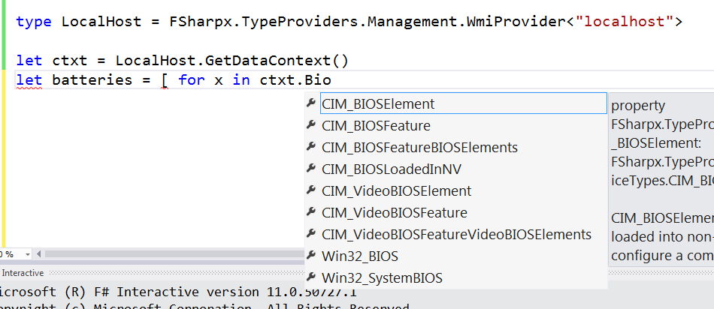
WMI

Slide 40
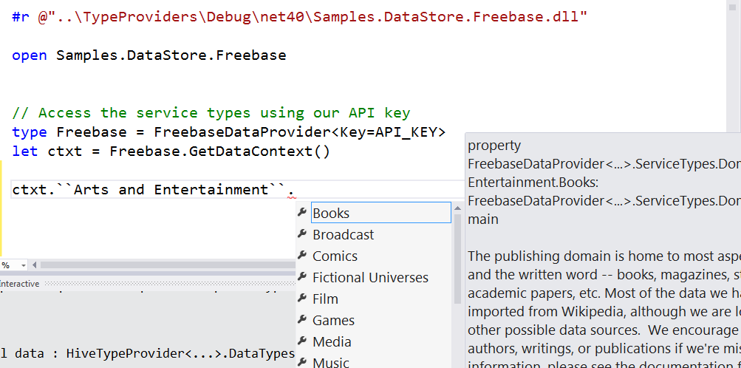
Freebase

Slide 41
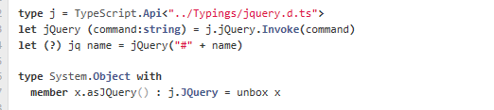
JavaScript/TypeScript

Slide 42
R

Slide 43
Update: RProvider
r provider f#
Open source community provider for interop with R
discovers installed R packages
Access > 2,000 R packages
projects them as .NET namespaces
underneath the parent namespace RProvider

Slide 44
Demo: F# to R

Slide 45
Over to Matt..

Slide 46
Learn more
tryfsharp.org
fsharp.org/math
fsharp.org/data-science
fsharp.org/machine-learning
fsharp.org/cloud
fsharp.org/data-access

Slide 47
fsharp.org tryfsharp.org Questions?

Slide 48
Demo: Tsunami Scripting Tools http://tsunami.io demo videos

Slide 49
Tour: Cloud Programming

Slide 50
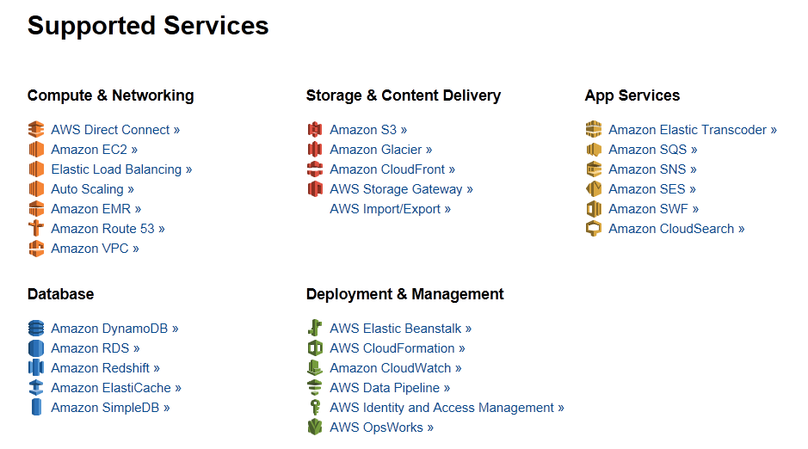
Amazon Web Services .NET SDKs http://aws.amazon.com/tools https://github.com/aws (Apache 2.0)

Slide 51
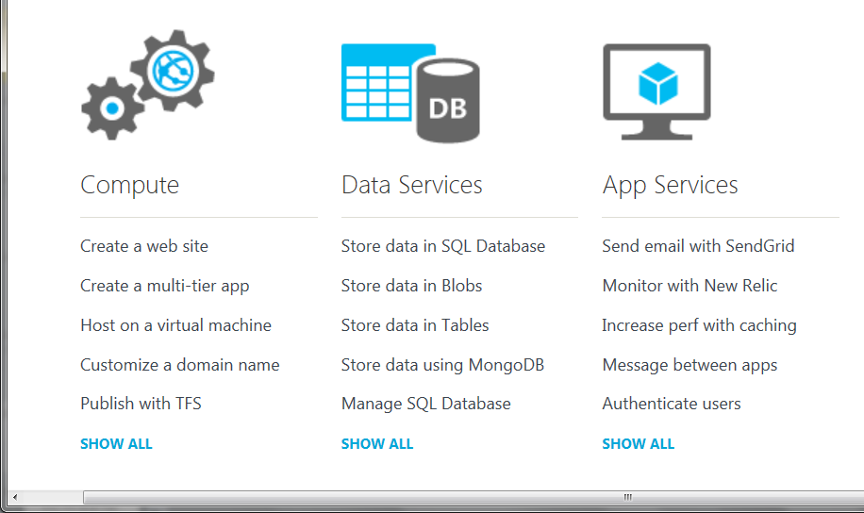
Azure .NET SDKs http://www.windowsazure.com https://github.com/WindowsAzure/ (Apache 2.0)

Slide 52
Tour: GPGPU Programming
search on nuget for GPU or CUDA!
search on google for “C# GPGPU”

Slide 53
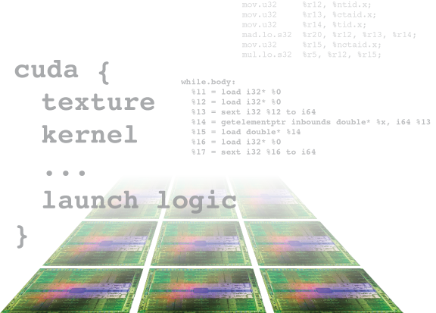
Alea.cuBase
Complete solution to develop CUDA accelerated GPU applications
Used “for real” in finance institutions
Based on LLVM and CUDA 5 technology
Uses F# code quotation
Source code solution
No wrappers, no post build process to transform IL code
Dynamic code
generation
GPU algorithm
scripting
Industry grade
performance
Rapid
development
Solid framework
for reusability
Advanced CUDA programming

Slide 54
Example #2/#3: F# in Finance
Time to Market
Correctness
Time to Market
Correctness
Efficiency
http://fsharp.net

Slide 55
Example #3: F# in Insurance
I work for a large actuarial company... …Despite adopting Agile/Scrum …the usual delays, complications and sometimes …failures.
We used F#, and quickly created a system which would perform the necessary calculations highly efficiently, in parallel, and with a perfect match to the spreadsheet results.
All of the advantages which are commonly touted for F# do play out in practice. Immutability, Easy Parallelisation, Expressiveness, Testability, Conciseness, Flexibility, Productivity
[ Company name omitted ]
Time to Market
Efficiency
Correctness

Slide 56
Overview
F# is changing…
“F# is
one language with many tools”
“F# is part of
Visual Studio”

Slide 57
New think…
Visual Studio, .
.NET, SDKs, Tools
…
Visual F# Tools
F# Language
F# Open Source
Group
tryfsharp.org
F# Software
Foundation
F# Community
Groups
fpish.net
tryfs.org
fssnip.net
tryfs.org
fsharpforfunandprofit.com
Xamarin Studio

Slide 58
At the core of every functional-first language is this: simple, correct, robust code for complex problems

Slide 59
Interoperable languages remove entire phases from the analytical software development process No R → C# No Mathematica → C++
Notes:
Functional programming tools empower when combined with other technologies

Slide 60
Strongly-typed functional languages help analytical programmers tackle more complex problems
Notes:
Functional programming tools empower when combined with other technologies

Slide 61
Example (power company)
I have written an application to balance the national power generation schedule … for an energy company.
...the calculation engine was written in F#.
The use of F# to address the complexity at the heart of this application clearly demonstrates a sweet spot for the language … algorithmic analysis of large data sets.
Simon Cousins (Eon Powergen)
http://fsharp.net

Slide 62
Example (power company)
Time to Market
Efficiency
Interoperation ... Seamless. The C# programmer need never know.
Units of measure … a huge time saver...it eradicates a whole class of errors…
Exploratory programming …Working with F# Interactive allowed me to explore the solution space more effectively.
Unit testing …a joy to test. There are no complex time-dependent interactions to screw things up….
Parallelism …The functional purity ... makes it ripe for exploiting the inherent parallelism in processing vectors of data.
Code reduction… … vectors and matrices…higher order functions eat these for breakfast with minimal fuss, minimal code. Beautiful.
Lack of bugs… Functional programming can feel strange. .. once the type checker is satisfied that’s often it, it works.
Correctness
Time to Market
Time to Market
Correctness
Correctness

