Slide 1
F# in the Open Source World
@dsyme, F# Community Contributor
Microsoft Research

Slide 2
this talk has some slides provided by other people i’ll try to remember to tell you when that’s the case

Slide 3
Agenda
A tour through our broadening horizons
Some thoughts on type providers, heterogeneous languages and functional programming…

Slide 4
Part I
F# is changing…
…in subtle but important ways
F# runs on many platforms
“F# is for Windows”

Slide 5
Overview
F# is changing…
…in subtle but important ways
“F# has many contributors”
“Microsoft
makes F#”

Slide 6
Overview
F# is changing…
…in subtle but important ways
“F# is
one language with many tools”
“F# is part of
Visual Studio”

Slide 7
Overview
F# is changing…
…in subtle but important ways
Many perspectives
http://fsharp.org
One perspective
(Microsoft’s)
http://msdn.microsoft.com

Slide 8
Old think…

Slide 9
New think…
Visual Studio, .
.NET, SDKs, Tools
…
Visual F# Tools
F# Language
F# Open Source
Group
tryfsharp.org
F# Software
Foundation
F# Community
Groups
fpish.net
tryfs.org
fssnip.net
tryfs.org
fsharpforfunandprofit.com
Xamarin Studio

Slide 10
http://fsharp.org

Slide 11
Why do Microsoft contribute to F#?

Slide 12
functional-first = simple code to solve complex problems = improved time-to-market for code-heavy programming

Slide 13
better programmability = better platforms = make money

Slide 14
But let’s look more broadly…

Slide 15
Tour: Core Components

Slide 16
F# open source group fsharp.github.com e.g. F# Compiler “Open Edition”

Slide 17
fsharp.github.com/fsharp
F# 3.0
Apache 2.0 license
Mac, Linux, Windows, Browsers, Android, iOS
Compiler, Library, Build, F# Interactive, Compiler API
Run by the F# Open Source Group
fsharp.github.com/fsharp

Slide 18
Tour: Libraries and Packages

Slide 19
nuget.org

Slide 20
11,500 unique packages Windows, Mac, Linux

Slide 21
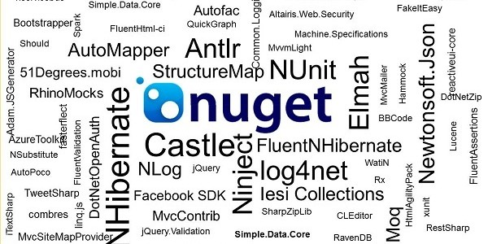
www.nuget.org

Slide 22
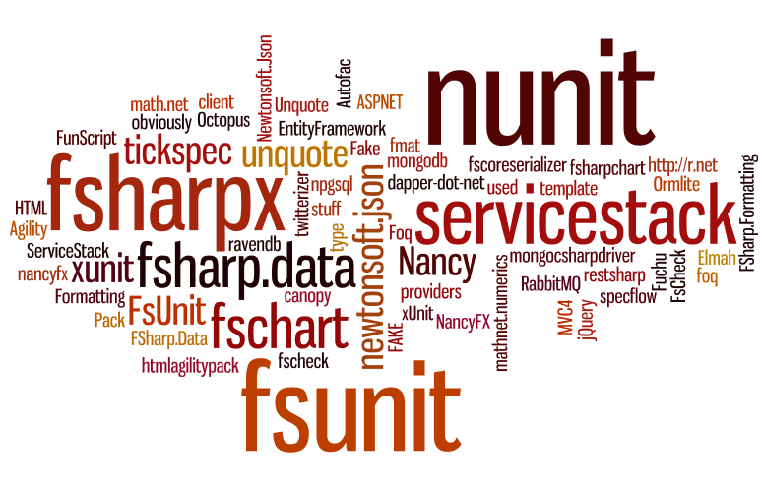

Slide 23
FSharp.Data, FSharpx, …

Slide 24
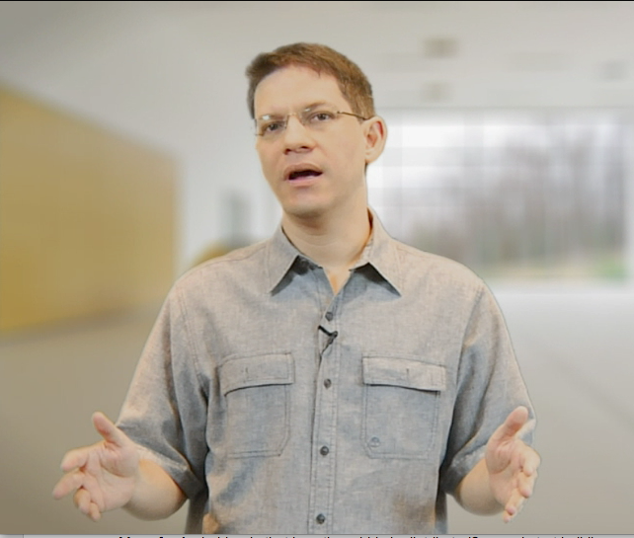
Tour: IDEs

Slide 25
F# in Emacs https://github.com/fsharp/fsharpbinding/

Slide 26
fsharp.github.com/fsharpbinding
F# editing components, bindings, templates etc.
Apache 2.0 license
Simple feature set,
Works with F# 3.0
API for other editors
MonoDevelop 3.0 Emacs Xamarin Studio and more

Slide 27
New: Tsunami Scripting Tools http://tsunami.io demo videos

Slide 28
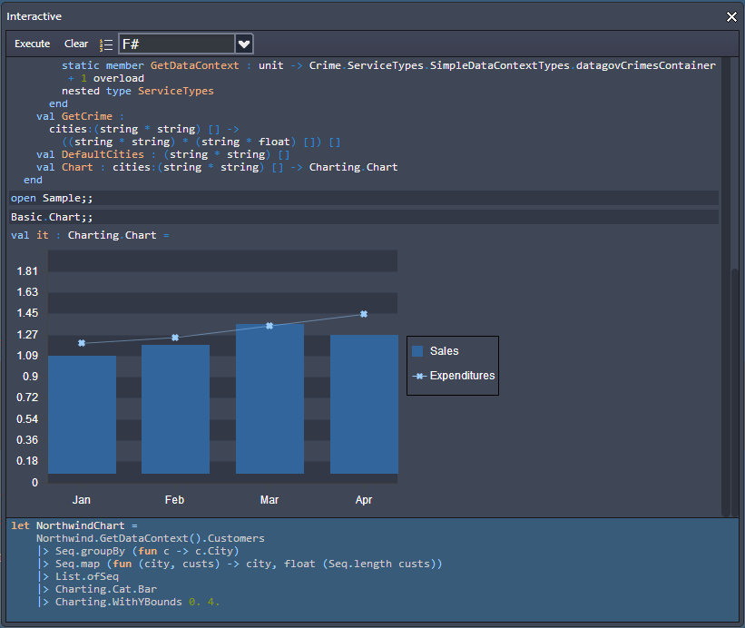
Upcoming:CloudSharper
http://cloudsharper.com
F# Development Environment in the Cloud
Full F# language support
Multi-project solutions
Web and mobile Apps
Syntax highlighting
On the fly type checking
Interactive exploration
Integration with data
Support for type providers

Slide 29
Tour: Web and Service Programming

Slide 30
Demo: F# + ASP.NET in Xamarin Studio

Slide 31
FunScript
Converts F# to Javascript through F# quotations
Community made, open-source
Open source license
TypeScript Type Provider for interop

Slide 32
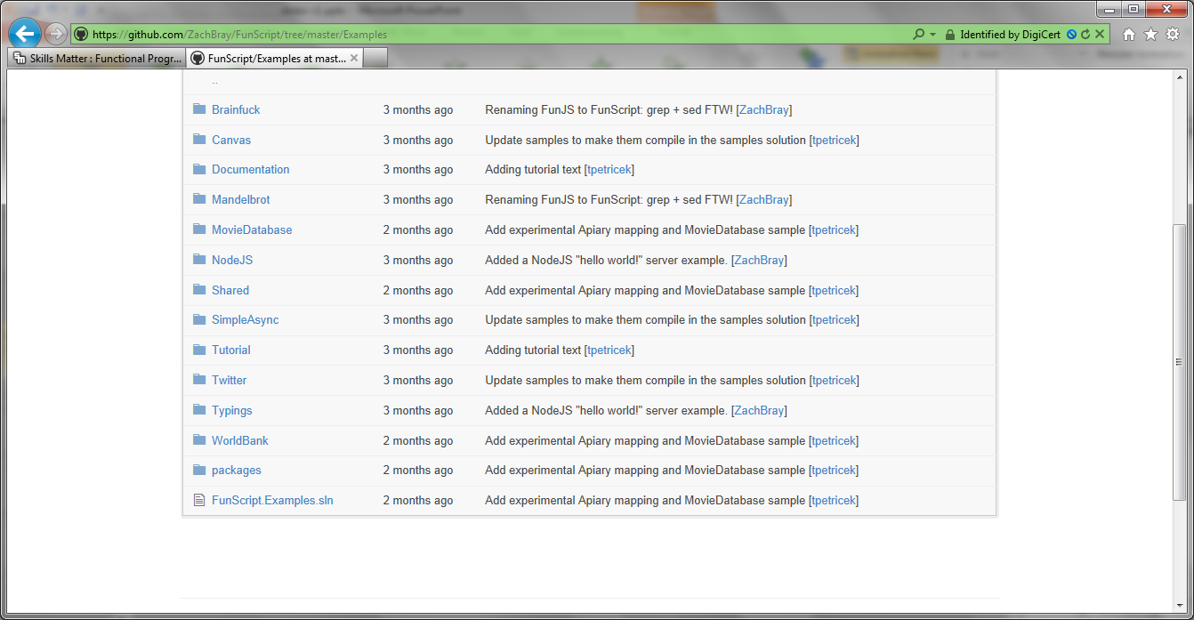

Slide 33
www.servicestack.net

Slide 34
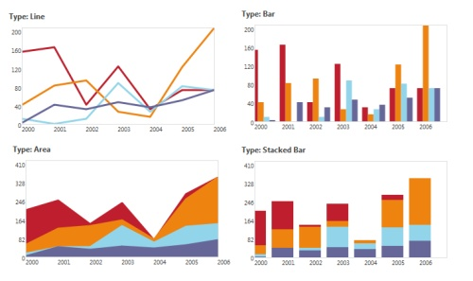
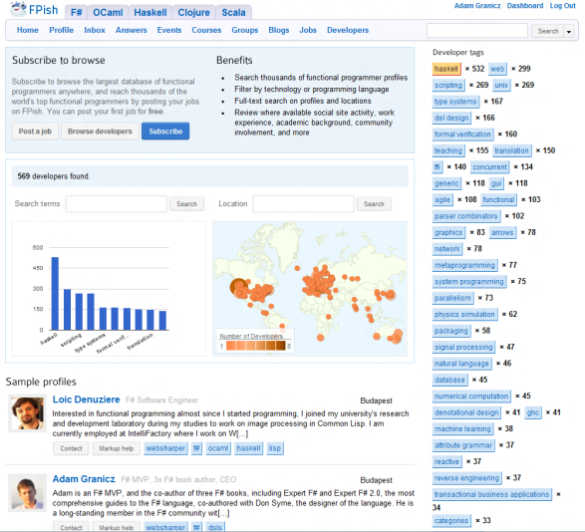
WebSharper
Web and Mobile Framework for F#
http://websharper.com
#websharper
Mature, enterprise-ready
Write all your server+client code in F#
Get a complete web or mobile application
Interface with any client-side JS library via F#
Powerful functional web abstractions
Automatic resource management
Safe URLs, type-safe URLs
and much-much more…
Develop applications with
Less code - 50-90% less
Quicker to develop – on average we find 2-3x
Easier to maintain – Significant $$ savings

Slide 35
Tour: Cloud Programming

Slide 36
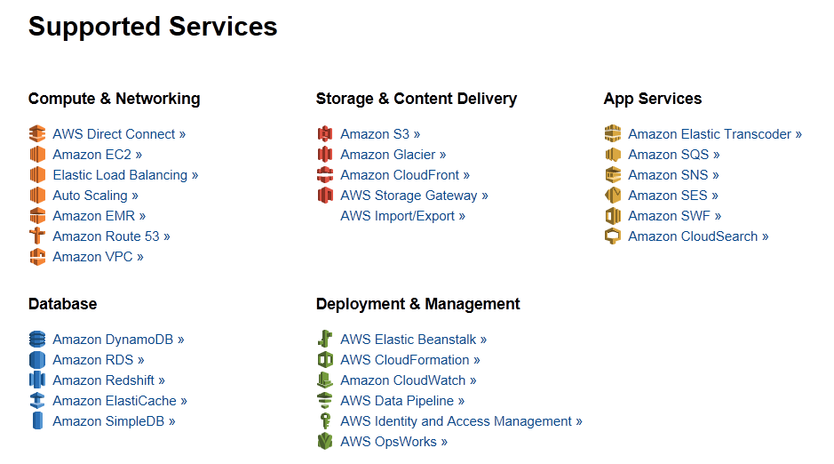
Amazon Web Services .NET SDKs http://aws.amazon.com/tools https://github.com/aws (Apache 2.0)

Slide 37
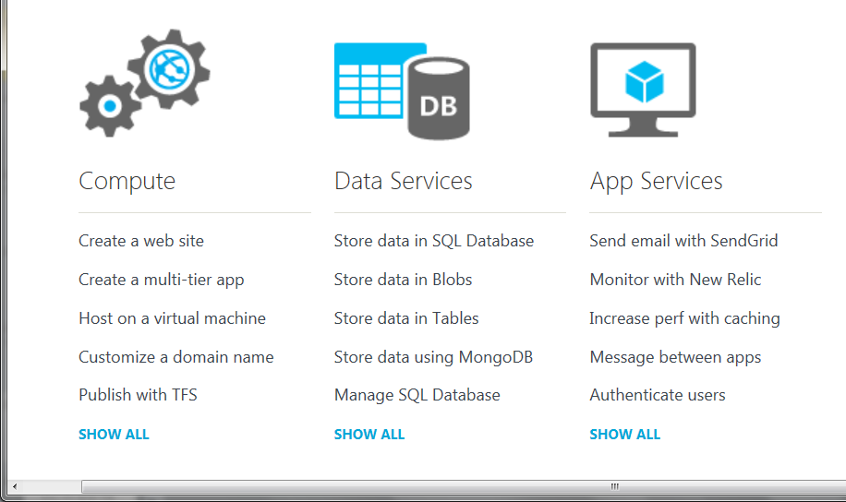
Azure .NET SDKs http://www.windowsazure.com https://github.com/WindowsAzure/ (Apache 2.0)

Slide 38
http://m-brace.net
A big data framework for private and public clouds

Slide 39
Tour: Building, Mocking, Testing, …
FAKE, Moq, Foq, Nunit, XUnit, TestSpec, FsUnit, …

Slide 40
Tour: GPGPU Programming
search on nuget for GPU or CUDA!
search on google for “C# GPGPU”

Slide 41
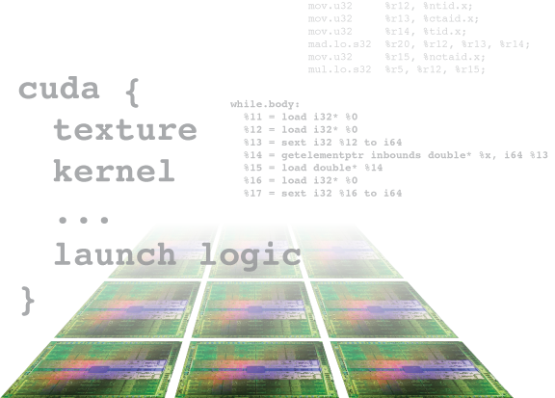
Alea.cuBase
Complete solution to develop CUDA accelerated GPU applications in .NET
Based on LLVM and CUDA 5 technology
Uses F# code quotation
Source code solution
No wrappers, no post build process to transform IL code
Our base technology for GPU projects
Dynamic code
generation
GPU algorithm
scripting
Industry grade
performance
Rapid
development
Solid framework
for reusability
Advanced CUDA programming

Slide 42
Tour: Math and Statistics Packages
See http://fsharp.org
Search on nuget for statistics
Math.NET, ExtremeOptimization, F# for Numerics, FCore, NMath, …

Slide 43
Part I: Summary
F# is open source, cross-platform with many contributors
The core compiler and library are done at Microsoft using a “code drop” model
The fsharp.org community are OK with that
The F# Exosystem is big, rich, active and multi-faceted

Slide 44
Part II From Broad, to Really, Really Broad

Slide 45
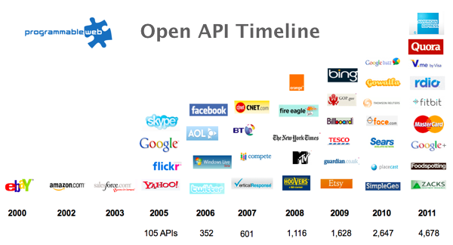
Recap: The Information Revolution

Slide 46
All your types are belong to us….
types

Slide 47
SQL

Slide 48
CSV

Slide 49
JSON

Slide 50
XML

Slide 51
OData

Slide 52
Hadoop/Hive

Slide 53
World Bank

Slide 54
Azure Data Market

Slide 55
WSDL

Slide 56
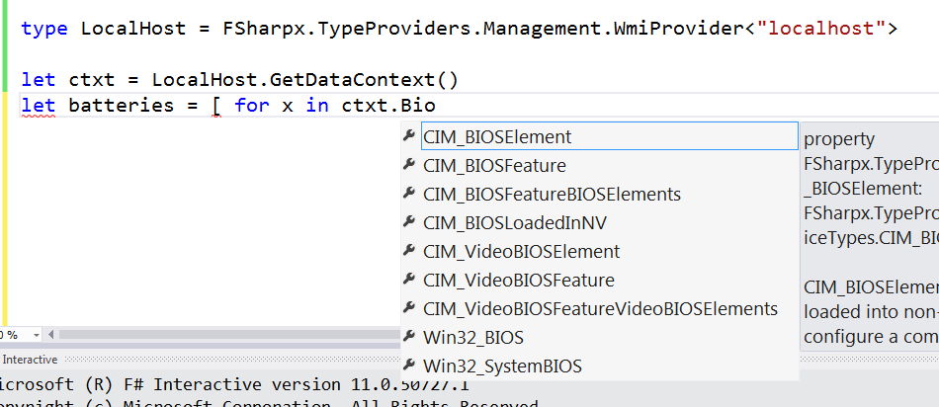
WMI

Slide 57
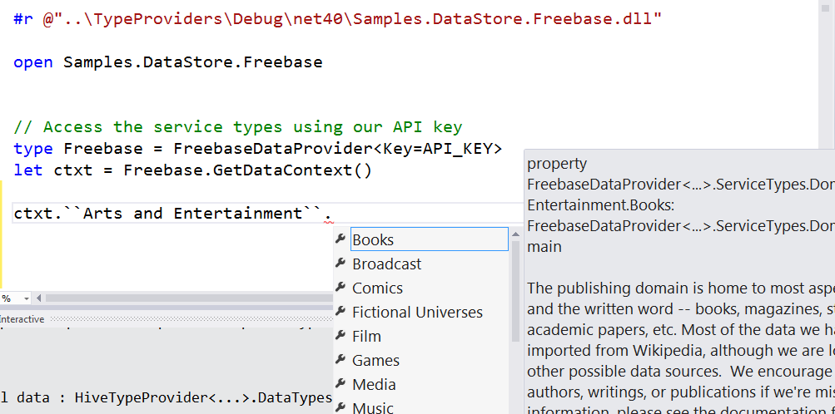
Freebase

Slide 58
R

Slide 59
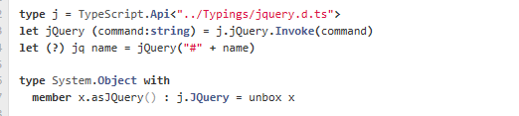
TypeScript

Slide 60
Update: RProvider
r provider f#
Open source community provider for interop with R
discovers installed R packages
Access > 2,000 R packages
projects them as .NET namespaces
underneath the parent namespace RProvider

Slide 61
Demo: F# to R

Slide 62
Summary
F# has always been about leveraging and integrating external functionality
Through the wonderful lens of FP
Next Directions?
F# as a Language: FF + interop
F# at Microsoft: tooling, platforms, data
F# broadly: many, many things going on!
Now a much broader, community-led vision
First .NET+Visual Studio

Slide 63
fsharp.org tryfsharp.org Questions?

