Slide 1


Succeeding with Functional-First Languages in Finance
Dr. Don Syme
Principal Researcher, Microsoft
dsyme@microsoft.com

Slide 2
Today: Some Simple Observations About
Quantitative Finance
Analytical Programming
Calculation Engines
Financial Engineering
Trading Engines with
F#
(and associated technologies)

Slide 3
Let’s focus on the business perspective and its correspondence to the technical features of F#
Mostly based on informal observations of >50 successful F# adoptions fsharp.org/testimonials some of the same lessons hold for
OCaml, Erlang, Clojure, Scala, …

Slide 4
I will use a standard methodology for communicating “complex” products.
S
P
Situation
Problem
I
Implication
N
Need
TM
“SPIN Selling”, Rackham

Slide 5
Part 1
What’s the Situation? What’s the Problem?

Slide 6
The Recurring Business Situation
“I lead a team developing…”
Financial Models
Trading Platforms
Insurance Calculation Engines
Algorithmic Trading Systems
Online Recommendation Engines
Bio-informatics Algorithms
…

Slide 7
The Recurring Business Situation
“I lead a team developing…”
Analytical Components
…
Analytical Components
Analytical Components
Analytical Components
Analytical Components

Slide 8
Understanding the Situation
Analytical Programmers/ Data Scientists
Design
Data Engineers
Code
Analysis
Algorithms
Parallel
Data
Information
Services
Presentation
Publication
UI

Slide 9
The Recurring Business Problems
Time to Market
Efficiency
Correctness
Complexity
for analytical components

Slide 10
Is Time to Market a Problem?
Late Models → Missed Trading Opportunities
Late Services → Missed Information Markets
Late Products → Software Business Failure
Notes:
“Take a moment to stop and think about the ramifications of time-to-market problems through software delays in analytical components for QF, FE, Trading and Calculation Engines more broadly”

Slide 11
Is Correctness a Problem?
Buggy Models → Incorrect Values/Risks/Trades
Buggy Services → Reputation Loss
Buggy Products → Lost Customers
Notes:
“Take a moment to stop and think about the ramifications of correctness problems through software delays in analytical components for QF, FE, Trading and Calculation Engines more broadly”

Slide 12
Is Efficiency a Problem?
Slow Models → Out-of-date Valuations/Risks
Slow Services → Can’t Scale Out
Slow Products → Customer Complaints
Notes:
“Take a moment to stop and think about the ramifications of efficiency problems through software delays in analytical components for QF, FE, Trading and Calculation Engines more broadly”

Slide 13
Is Complexity a Problem?
Intractable Models → Failed Projects
Intractable Services → Failed Projects
Intractable Products → Failed Projects
Notes:
We don’t talk enough about the software we were never able to write. We don’t talk enough about why good analytical programmers leave their jobs.

Slide 14
The Recurring Business Problems
Time to Market
Efficiency
Correctness
Complexity
for analytical components

Slide 15
What’s the Need?
Analytical programmers delivering correct, efficient components in the enterprise, on-time
This is the set of problems that functional-first programming helps solve

Slide 16
Part 2 - Why?
Observations and Examples

Slide 17
Observation #1
At the core of every functional-first language is this:
simple, correct, robust code for solving complex problems

Slide 18
What do we mean by
“functional-first”?
Programming models and tools that embrace functional programming as the primary tool for solving problems
OCaml
F#
Clojure
Lisp
Scala

Slide 19
Observation #2
A highly interoperable language allows rapid, non-intrusive deployment and integration of components
… functional-first code is a part of a larger solution. With F# your code can be rapidly integrated and deployed.

Slide 20
Observation #2 cont.
Interoperable languages remove entire phases from the analytical software development process.
…no R → C#
…no Mathematica → C++
…no Excel → Java
Notes:
Functional programming tools empower when combined with other technologies

Slide 21
Observation #3
Strongly-typed functional-first languages maintain efficiency
…as good as C# and Java, and sometimes C++
Notes:
Functional programming tools empower when combined with other technologies

Slide 22
Observation #4
Strongly-typed functional languages help analytical programmers tackle more complex problems
…more time in the domain, less time on nulls and object hierarchies.
Notes:
Functional programming tools empower when combined with other technologies

Slide 23
Recap – How Functional-first Helps
Simple, correct, robust code
Interoperability eliminates entire phases
Strong-typing gives efficiency
Analytical developers empowered to solve complex problems

Slide 24
Example #1 (power company)
I have written an application to balance the national power generation schedule … for an energy company.
...the calculation engine was written in F#.
The use of F# to address the complexity at the heart of this application clearly demonstrates a sweet spot for the language … algorithmic analysis of large data sets.
Simon Cousins (Eon Powergen)

Slide 25
Example #1 (power company)
Time to Market
Efficiency
Interoperation ... Seamless. The C# programmer need never know.
Units of measure … a huge time saver...it eradicates a whole class of errors…
Exploratory programming …Working with F# Interactive allowed me to explore the solution space more effectively.
Unit testing …a joy to test. There are no complex time-dependent interactions to screw things up….
Parallelism …The functional purity ... makes it ripe for exploiting the inherent parallelism in processing vectors of data.
Code reduction… … vectors and matrices…higher order functions eat these for breakfast with minimal fuss, minimal code. Beautiful.
Lack of bugs… Functional programming can feel strange. .. once the type checker is satisfied that’s often it, it works.
Correctness
Time to Market
Time to Market
Correctness
Correctness

Slide 26
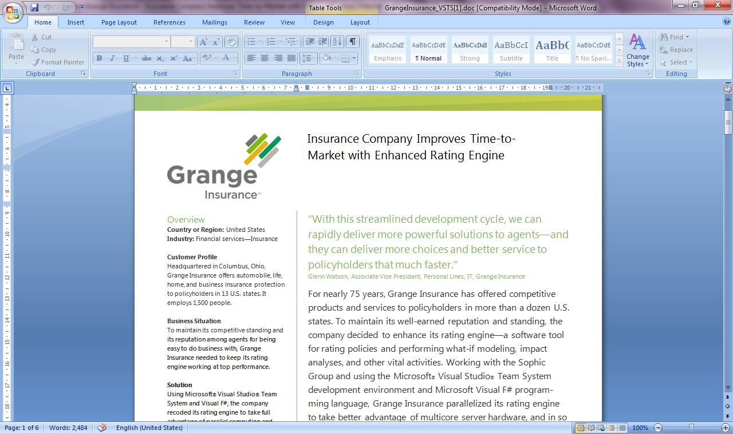
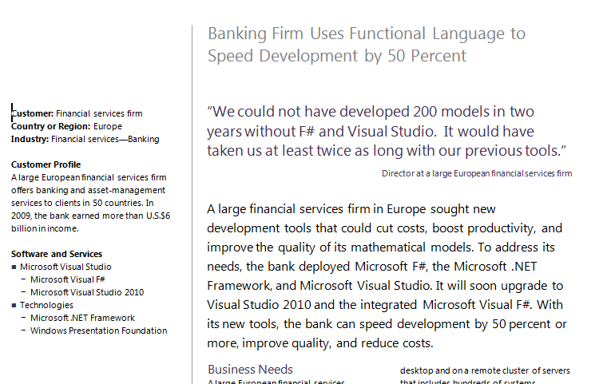
Example #2/#3: F# in Finance
Time to Market
Correctness
Time to Market
Correctness
Efficiency
http://fsharp.net

Slide 27
Example #3: F# in Insurance
Time to Market
Complexity
I work for a large actuarial company... …Despite adopting Agile/Scrum …the usual delays, complications and sometimes …failures.
We used F#, and quickly created a system which would perform the necessary calculations highly efficiently, in parallel, and with a perfect match to the spreadsheet results.
All of the advantages which are commonly touted for F# do play out in practice. Immutability, Easy Parallelisation, Expressiveness, Testability, Conciseness, Flexibility, Productivity
[ Company name omitted ]
Efficiency
Correctness
fsharp.org/testimonials

Slide 28
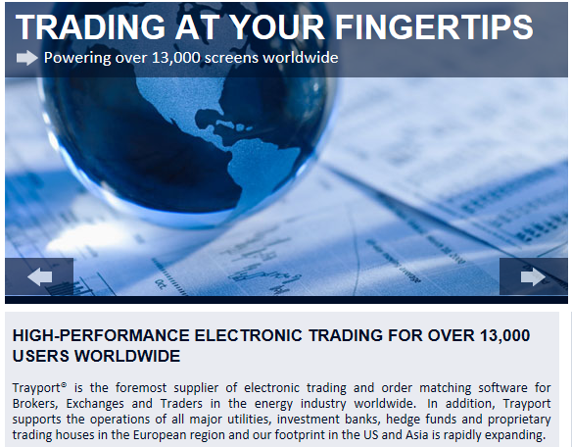
Example #4: Finance trading platform
F# + C# for Trading Front End
Leverage F#’s features:
  - extensive type system
  - asynchronous workflows, agents and immutable types
  - rich pattern matching and parser support
“Experienced F# developers regularly solve problems in days that would take weeks using more traditional languages…solving complex problems in an elegant and highly maintainable manner”
Time to Market
Complexity

Slide 29
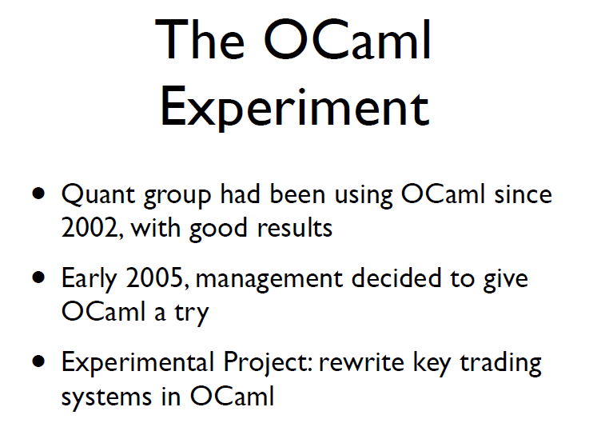
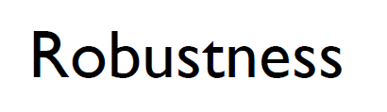
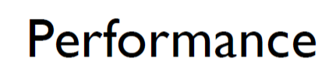
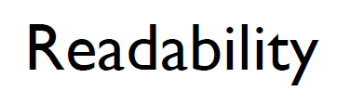
Example #5: OCaml @ Jane St
source: http://www.janestcapital.com/yaron_minsky-cufp_2006.pdf

Slide 30
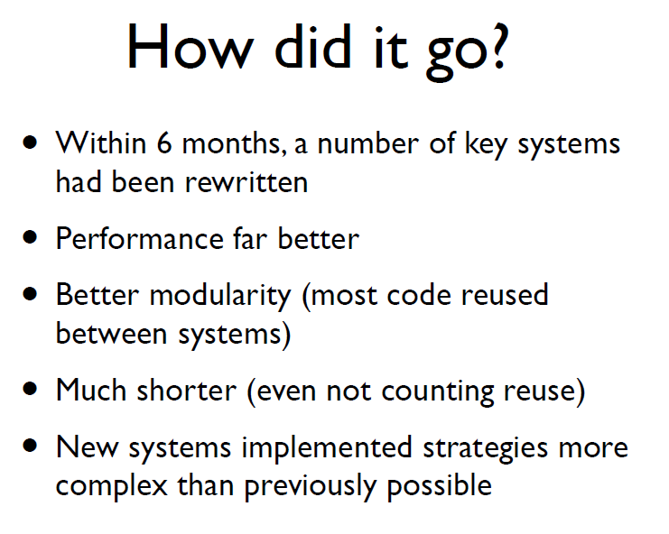
Example #5: OCaml @ Jane St
Efficiency
Solve complex problems
source: http://www.janestcapital.com/yaron_minsky-cufp_2006.pdf

Slide 31
Example #6: F# in Biotech
Efficiency
...F# rocks - building algorithms for DNA processing and it's like a drug. 12-15 at Amyris use F#... A complete genome resequencing pipeline with interface, algs, reporting in ~5K lines and it has been incredibly reliable, fast and easy to maintain.. A suffix tree in 150 lines that can index 200,000 bases a second
F# v. Python: F# has been phenomenally useful. I would be writing a lot of this in Python otherwise and F# is more robust, 20x - 100x faster to run and faster to develop.
Darren Platt, Amyris BioTechnologies
Correctness
Time to Market

Slide 32
Example #7: F# in Advertisement Ranking & Rating @ Microsoft
Time to Market
Around 95% of the code in these projects has been developed in F#.
F# allowed for rapid development of prototypes, and thus also rapid verification or falsification of the underlying mathematical models.
Complex algorithms, for example to compute Nash equilibria in game theory, can be expressed succinctly.
Units of measure reduced the chance of errors dramatically: Prices, probabilities, derivatives, etc. can already be kept apart at compile time.
Taming Complexity
Correctness

Slide 33
Example #8: F# at Kaggle
Taming
Complexity
At Kaggle we initially chose F# for our core data analysis algorithms because of its expressiveness.
We’ve found ourselves moving more and more of our application …into F#. The F# code is shorter, easier to read, easier to refactor, and, because of the strong typing, contains far fewer bugs.
As our data analysis tools have developed, we’ve seen domain-specific constructs emerge very naturally. As our codebase gets larger, we become more productive.
Correctness
Time to Market
fsharp.org/testimonials

Slide 34
Example #9: F# for Machine Learning at Microsoft
I wrote the first prototype of the click prediction system deployed in Microsoft AdCenter in F# in a few days.
For a machine learning scientist, speed of experimentation is the critical factor to optimize.
Unlike C# and C++, F# was designed for this mode of interaction. Switching to F# was liberating and exhilarating.
The world is moving toward functional programming with good justifications: the code is cleaner and easier to debug in a distributed environment.
Time to Market/Insight
Correctness
Dr. Patrice Simard, Microsoft Distinguished Engineer, fsharp.org/testimonials

Slide 35
Summary – The Data Agrees
Simple, correct, robust code
Interoperability improves time-to-market
Strong-typing gives efficiency
Analytical developers empowered to solve more complex problems

Slide 36
Part 3 – F# in Practice

Slide 37
Today you will hear about…
FF for GPUs
FF for Trading Engines
Scaling FF to the Cloud
FF for DSLs in Insurance
FF for Data Science
FF + Excel
FF + QuantLib
FF for DSLs in Risk
F# Deep Data Integration

Slide 38
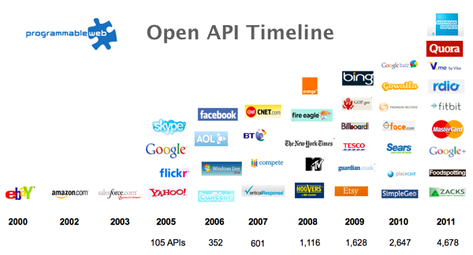
The Information Revolution

Slide 39

Financial Markets Data is like water…

Slide 40
Financial Markets Data is like water…
Everyone needs it. Everyone knows where to get it.
Nobody is sure where it really came from, or goes to.
…really knows its true cost, or true value.
…likes to pay for it, or to share it.
…knows how much is wasted.
You might get washed away by it.
You only find out it was bad after you have drunk it.

Slide 41
Market Data
Derived Data
Reference Data
Data Distribution Platform
Orders – Trades – Positions - Risk Management - Regulation/Compliance - General Ledger - Confirmations - Payments
Market Access Providers
Front Office
(Sales and Trading)
Middle Office (Market Risk, Credit Risk etc.)
Back Office (Clearing, Settlement etc.)
Clients and Counterparties

Slide 42
So What is Needed?
Ease of finding data
Ease of manipulating data
Ease of integrating data
Ease of analyzing data
Ease of sharing data
Ease of controlling data

Slide 43
The Problem for Financial Data Scripting?
Our programming tools are data-sparse getting financial data into a programming language is tiresome, error prone and boring

Slide 44
We need to bring financial data into the language…
At full market-scale, strongly tooled, strongly typed

Slide 45
Demo
F# + Xenomorph TimeScape
An F# type provider gives deep, simple, robust integration of financial data, at massive, worldwide-scale, both in-cloud and on-premise

Slide 46
In Summary – F#
F#
The safe choice for enterprise functional-first programming
Unbeatable financial data integration
Visual F# - Functional-first tooling you can trust from Microsoft
Open, cross-platform, strongly typed, efficient, rock-solid stable

Slide 47
Questions?

Slide 48
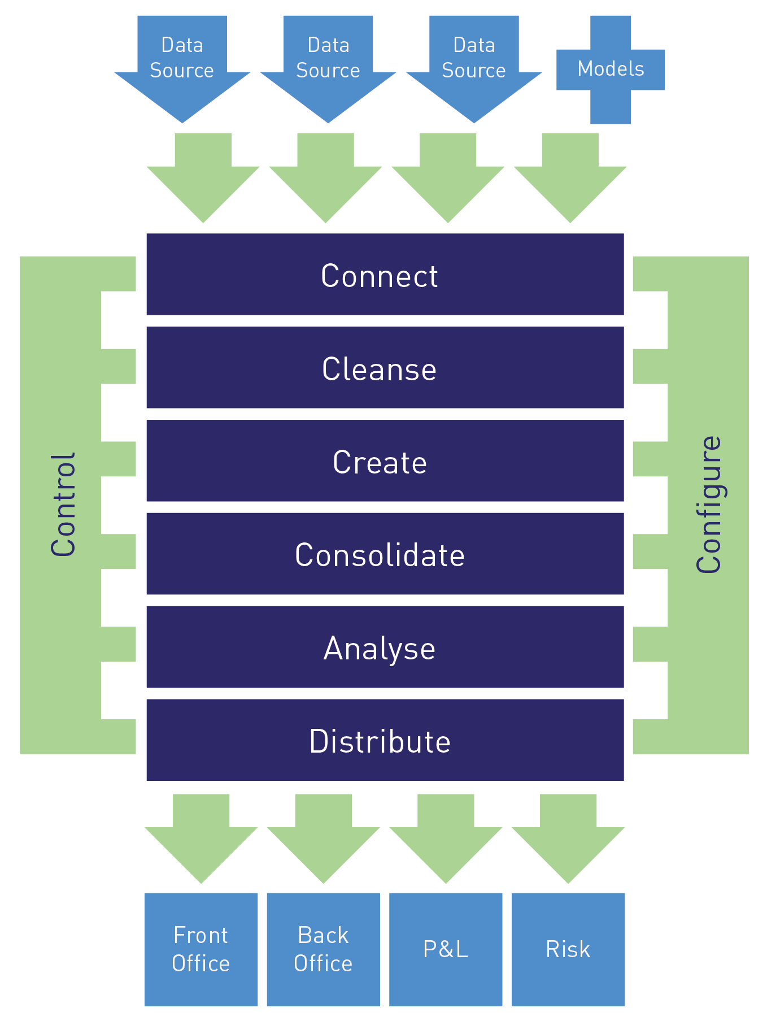
What does TimeScape do?

Slide 49
F# is changing…
F# runs on many platforms
“F# is for Windows”

Slide 50












New think…
Visual Studio, .
.NET, SDKs, Tools
…
Visual F# Tools
F# Language
F# Open Source
Group
tryfsharp.org
F# Software
Foundation
F# Community
Groups
fpish.net
tryfs.org
fssnip.net
tryfs.org
fsharpforfunandprofit.com
Xamarin Studio

Slide 51
Some technical talks….
Over 100 videos at
fsharp.org/videos
TechEd 2013 - An Overview of F# 3.0, Dustin Campbell
NDC 2013 - F# Information Rich Programming, Don Syme

Slide 52
Strengths of TimeScape
All data types, all databases look the same
It is designed for change in data needs
Data can be manipulated easily
Analytics can be added easily
It is easy to share data
TimeScape offers the flexibility of a spreadsheet with the control of an enterprise data warehouse

Slide 53
TimeScape + Azure + Power BI = ?
Simple, powerful access to financial markets analytics anywhere.

Slide 54
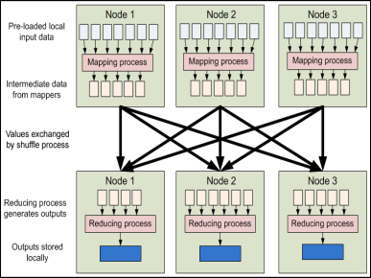


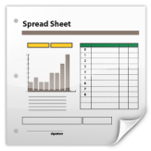
Data Provider
Data Provider
Data Access Layer
Data Provider
Data Provider
Data Provider
Data Provider
Analytics
Provider
Analytics Provider
Data Analytics Layer
Data
Analytics Provider
HPC Server
Model Provider
Model Provider
Instrument Analytics Layer
Instrument
Analytics Provider
Query Layer
Layer
Layer
Third Party Services
Risk App
Trading App
Spreadsheet
Risk App
Trading App
Spreadsheet

Slide 55

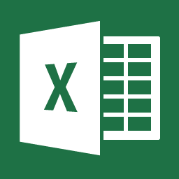
IDC Sourced Data
Six Sourced Data
Data Access Layer
Data Analytics Layer
Query Layer
DatabaseItems('XENO', 'GB Equity')
.VALUES(Description, Close.Volatility(30).LastValue, CORREL(Close,Index('Internal').Close,30).LastValue).SORTBY(DESCRIPTION ASC)
LOAD = [DATA_SOURCES = IDC: SIX]

Slide 56
The Alternative View
10 Reasons Not to Use a Strongly Typed Functional Language

Slide 57
Examples
A quant model
A trading engine
F# + existing C++ components
A calculation engine with GPU execution
F# + Alea.cuBase GPU Framework
A scalable web service
Data Services + F# + ASP.NET
A scalable big-data service
F# + Hadoop + ServiceStack
A Web 2.0 startup
F# (Server) + SQL Server + DataFeeds + ASP.NET + F# (WebSharper) + HTML5
Oracle + F# (Server) + F#/C# (Silverlight)

