Slide 1
Making Magic with F# Type Providers
Combining Data, Information, Services and Programming, at Internet-Scale
Dr. Don Syme
Principal Researcher, Microsoft, F# Community Contributor
@dsyme

Slide 2
Proposition 1 The world is information-rich

Slide 3
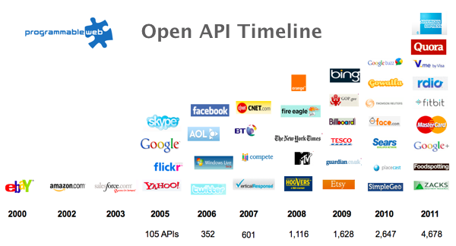
The Information Revolution

Slide 4
Proposition 2 Modern programming is intensely information-rich

Slide 5
Proposition 3 Our languages are information-sparse

Slide 6
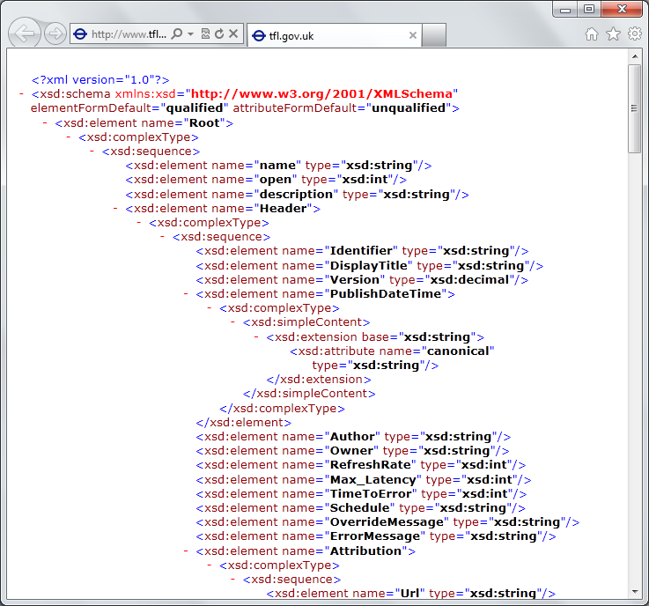
The developer’s perspective
Languages do not integrate information
Non-intuitive
Not simple
Disorganised
Static
High friction

Slide 7
We need to bring information into the language… At internet-scale, strongly tooled, strongly typed

Slide 8
Paradigm Locator
Statically Typed
Dynamically Typed

Slide 9
Paradigm Locator
Statically Typed
Dynamically Typed
A major search is on!
make statically typed langs more dynamic
make dynamically typed langs more static
moderate static typing in limited ways

Slide 10
But before we get into that…
A bit about F#

Slide 11
F# is Open Source, is Cross Platform
fsharp.org
fsharp.org/use/mac
fsharp.org/use/linux
fsharp.org/use/android
fsharp.org/use/ios
fsharp.org/use/windows
fsharp.org/use/freebsd

Slide 12
A strongly typed, data-immersive functional-first language for…. simple code

Slide 13
F#
C#
let swap (x, y) = (y, x)
let rotations (x, y, z) =
[ (x, y, z);
(z, x, y);
(y, z, x) ]
let reduce f (x, y, z) =
f x + f y + f z
Tuple<U,T> Swap<T,U>(Tuple<T,U> t)
{
return new Tuple<U,T>(t.Item2, t.Item1)
}
ReadOnlyCollection<Tuple<T,T,T>> Rotations<T>(Tuple<T,T,T> t)
{
new ReadOnlyCollection<int>
(new Tuple<T,T,T>[]
{new Tuple<T,T,T>(t.Item1,t.Item2,t.Item3);
new Tuple<T,T,T>(t.Item3,t.Item1,t.Item2);
new Tuple<T,T,T>(t.Item2,t.Item3,t.Item1); });
}
int Reduce<T>(Func<T,int> f,Tuple<T,T,T> t)
{
return f(t.Item1)+f(t.Item2)+f(t.Item3);
}

Slide 14
type Rating = { UserId: int; DishId: int; Rating: int }

Slide 15
data.Countries.Brazil.Indicators.``Population ages 0-14 (% of total)``

Slide 16
10 Reasons Not to Use a Strongly Typed Functional Language

Slide 17
Example (power company)
fsharp.org/testimonials
I have written an application to balance the national power generation schedule for a portfolio of power stations to a trading position for an energy company. ...the calculation engine was written in F#.
The use of F# to address the complexity at the heart of this application clearly demonstrates a sweet spot for the language within enterprise software, namely algorithmically complex analysis of large data sets.
Simon Cousins (power company)

Slide 18
F# at Kaggle
fsharp.org/testimonials
At Kaggle we initially chose F# for our core data analysis algorithms because of its expressiveness.
We’ve been so happy with the choice that we’ve found ourselves moving more and more of our application …into F#.
The F# code is shorter, easier to read, easier to refactor, and, because of the strong typing, contains far fewer bugs.
As our data analysis tools have developed, we’ve seen domain-specific constructs emerge very naturally
As our codebase gets larger, we become more productive.

Slide 19
F# is changing…
F# runs on many platforms
“F# is for Windows”

Slide 20
Overview
F# is changing…
“F# has many contributors”
“Microsoft
makes F#”

Slide 21
Overview
F# is changing…
Many perspectives
http://fsharp.org
One perspective
(Microsoft’s)
http://msdn.microsoft.com

Slide 22
New think…
Visual Studio, .
.NET, SDKs, Tools
…
Visual F# Tools
F# Language
F# Open Source
Group
tryfsharp.org
F# Software
Foundation
F# Community
Groups
fpish.net
tryfs.org
fssnip.net
tryfs.org
fsharpforfunandprofit.com
Xamarin Studio

Slide 23
On Windows, Microsoft recommend F# and the Visual F# tools for your functional-first programming needs

Slide 24
Functional-first programming is a general-purpose programming technique particularly suited to tasks where Time-to-deployment, Efficiency, Correctness and Taming Complexity dominate.

Slide 25
Examples include ETL pipelines, general data-manipulation, calculation engines, programmatic UIs and data science. While these problems can be solved using other programming paradigms, they are particularly amenable to functional-first programming.

Slide 26
Functional-first programming uses functional programming as the initial paradigm for most purposes, but employs other techniques such as objects and state as necessary.

Slide 27
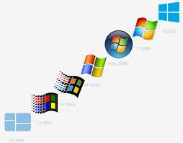
Give your
iOS
world some F# spice!

Slide 29
Exosystem: Cloud Programming

Slide 30
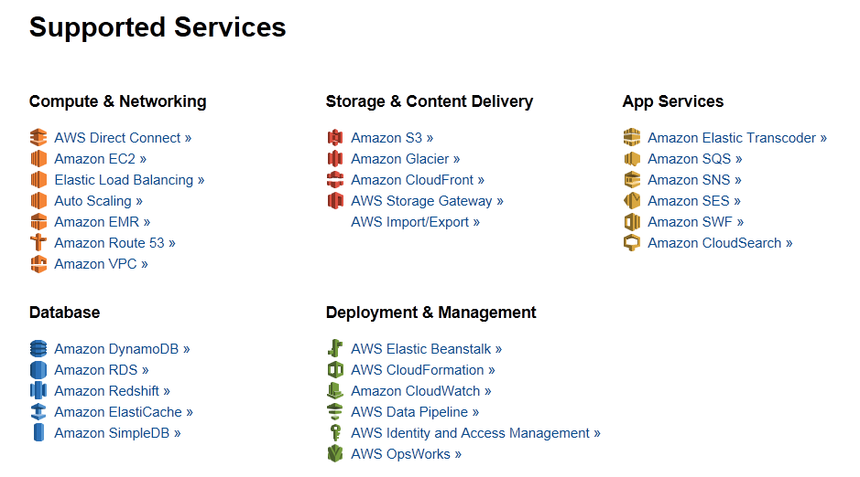
Amazon Web Services .NET SDKs http://aws.amazon.com/tools https://github.com/aws (Apache 2.0)

Slide 31
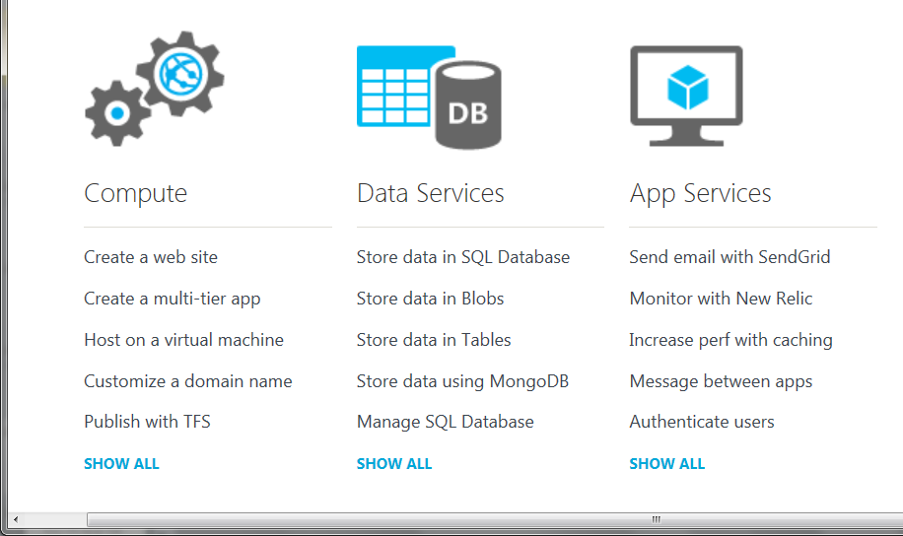
Azure .NET SDKs http://www.windowsazure.com https://github.com/WindowsAzure/ (Apache 2.0)

Slide 32
Learn more
fsharp.org
fsharp.org/math
fsharp.org/data-science
fsharp.org/machine-learning
fsharp.org/cloud
fsharp.org/data-access
fsharp.net (MSDN pages)

Slide 33
Back to the main topic…

Slide 34
We need to bring information into the language… At internet-scale, strongly tooled, strongly typed

Slide 35
Demo: Integrate all of freebase.com “as if it were a library” 40M entities, 1Billion facts, 24,000 types, 65,000 properties

Slide 36
Demo: F# to WorldBank

Slide 37
A Type Provider is…. “Just like a library” “A design-time component that computes a space of types and methods on-demand…” “An adaptor between data/services and the .NET type system…” “On-demand, scalable compile-time provision of type/module definitions…”

Slide 38
Data is like water…

Slide 39
Data is like water…
Everyone needs it. Everyone knows where to get it.
Nobody is sure where it really came from, or goes to.
…really knows its true cost, or true value.
…likes to pay for it, or to share it.
…knows how much is wasted.
You might get washed away by it.
You only find out it was bad after you have drunk it.

Slide 40
Theme #1 On-Demand Types = Internet Scalable Magic

Slide 41
On-Demand Type Provision
let data = Freebase.GetDataContext()
1. Compiler/IDE requests metadata for symbol GetDataContext
Provider reports return type of FreebaseDataContext
data.
2. Compiler/IDE requests contents of type FreebaseDataContext
Provider asks Freebase metadata service for top-level domains
Provider reports top-level domains of Freebase as properties of the type
data.Society
3. Compiler/IDE requests metadata for symbol Society
...

Slide 42
Theme #2 Many Data Sources, One Mechanism

Slide 43
All your types are belong to us….
types

Slide 44
SQL

Slide 45
CSV

Slide 46
JSON

Slide 47
XML

Slide 48
OData

Slide 49
Hadoop/Hive

Slide 50
World Bank

Slide 51
Azure Data Market

Slide 52
WSDL

Slide 53
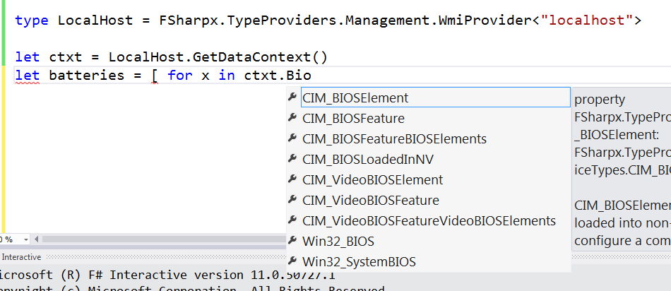
WMI

Slide 54
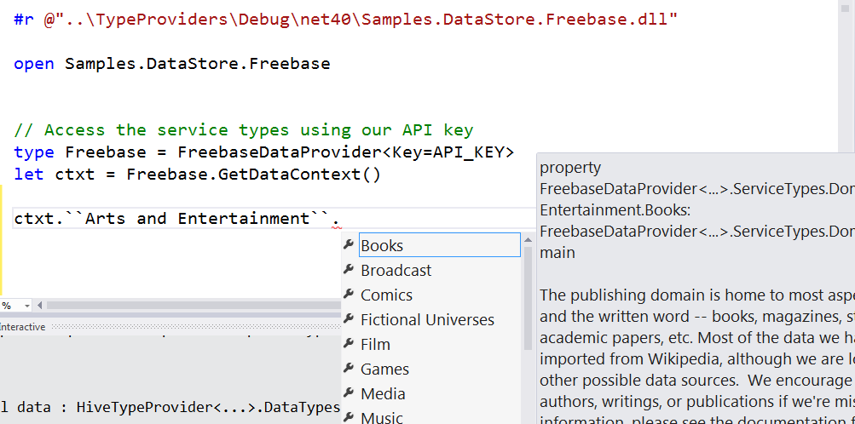
Freebase

Slide 55
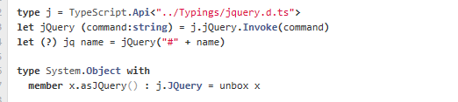
JavaScript/TypeScript

Slide 56
R

Slide 57
Demo
F# + Xenomorph TimeScape
An F# type provider for deep, robust integration of financial data

Slide 58
Theme #3 Data and Types at Multiple Scales

Slide 59
Data at Multiple Scales
From Everything to Individuals
Data Scripters need to work with different granularities of schematization
data.AllEntites
data.Automotive.``Automobile Models``
data.Automotive.``Automobile Models``.Individuals.``Porsche 911``
…Only a language that supports massively scalable metadata can operate at all these levels
Every stable entity can get a unique type

Slide 60
Providing Units of Measure
If the metadata contains units…
via F#’s Units of Measure
…then these can be projected into the programming language.

Slide 61
Theme #4 Schema Change

Slide 62
A problem, but…
Many, many data sources are surprisingly stable
Some data sources support “snapshot dates”
F# supports “invalidation signals” from providers at design-time
Erasure makes compiled code much less fragile

Slide 63
FSharp.Data fsharp.github.io/FSharp.Data on NuGet, use it in Visual Studio today

Slide 64
In Summary
F#
The safe choice for enterprise data programming
Unbeatable data integration
Visual F# - tooling you can trust from Microsoft
Open, cross-platform, strongly typed, efficient, rock-solid stable

Slide 65
Questions?
Give your .NET
an F# edge!

