Slide 1
Scalable Integration of Heterogeneous Financial Data and Programming
A world of financial data, at your fingertips
Dr. Don Syme
Principal Researcher, Microsoft Research
F# Community Contributor, @dsyme

Slide 2
Agenda
The “Information Rich Programming” Problem
- broadly conceived
- and for financial data specifically
A bit about F#
Applying F# scalable data/metadata integration techniques to financial data integration

Slide 3
Proposition 1 We are living in an Information Revolution

Slide 4
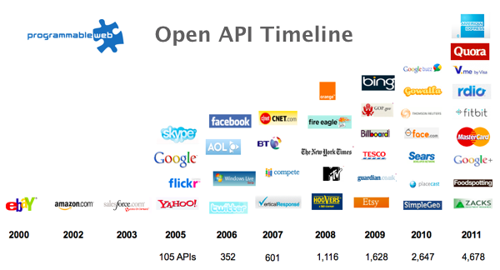
The Information Revolution
2012
2013
6,432
10,537

Slide 5
Proposition 2 Modern programming is intensely information-rich

Slide 6
Proposition 3 Our programming languages are information-sparse

Slide 7
Financial data is like water…

Slide 8
Financial data is like water…
Everyone needs it. Everyone knows where to get it. Simple.
But…
… nobody is sure where it really came from, or goes to.
… nobody really knows its true cost, or true value.
… nobody likes to pay for it, or to share it.
… nobody knows how much is wasted
… nobody knows a good plumber
… nobody knows how bad it is until after you have drunk it

Slide 9
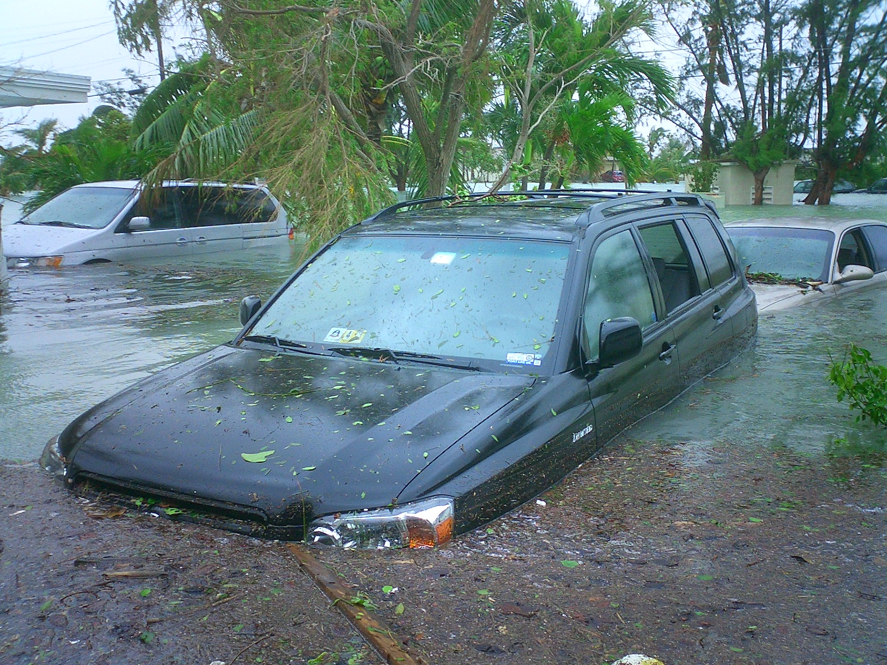
Actually these days it’s more like a flood…

Slide 10
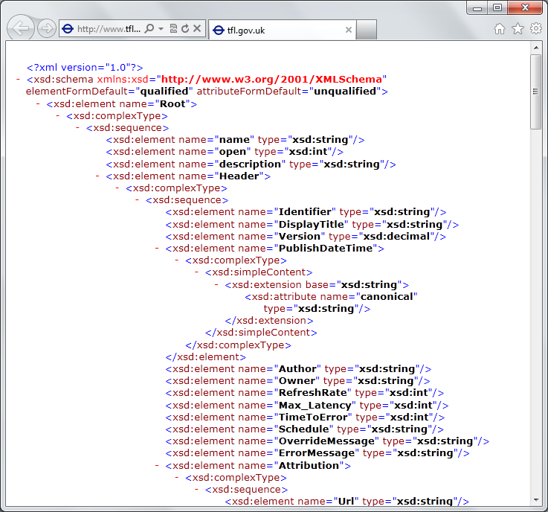
The financial data plumber’s perspective
Languages do not integrate information
Weakly typed
Not at scale
Non-intuitive
Not simple
Disorganised
Static
High friction

Slide 11
We need to bring information into our “data plumbing” languages… At market-scale, in-cloud or on-premise, strongly tooled, strongly typed

Slide 12
This R&D is done in the context of the open language F#
But before we get into that…
Lots of good reasons for that, see our tech report
“Strongly Typed Language Support for Internet-Scale Information Spaces”

Slide 13
A bit about F#....

Slide 14
F# is a great data plumbing language

Slide 15
F# is open source, cross platform fsharp.org

Slide 16
F# has an intelligent, fun, contributing community fsharp.org fsharpforfunandprofit.com

Slide 17
F# helps address real business problems around Time to Market, Efficiency, Correctness and Tackling Complexity See: “Succeeding with Functional-first Programming in Finance”, Don Syme

Slide 18
F# has a particularly strong following in finance, including leading London-based banks and hedge funds fsharp.org/testimonials meetup.com/FSharpLondon

Slide 19
F# is used to make lots of money fsharp.org/testimonials

Slide 21
Example: F# for Quant Consulting
Complexity
Our bids for tendered contracts in quantitative finance are regularly half the price of competitors because of the increased productivity we get from F#.
We are regularly able to deliver correct, robust, performant solutions on-time, which is what our customers value most.
Daniel Egloff, QuantAlea Consulting, Zurich
Efficiency
Time to Market
Correctness
http://fsharp.org/testimonials

Slide 22
Microsoft recommend F# and the Visual F# tools for your functional-first programming needs

Slide 23
Back to the main topic…

Slide 24
Typical F# Topics
F# Basics
F# for Cloud Data
F# for DSLs in Risk and Insurance
F# for GPUs
F# for Pricing
F# + R
F# for Data Science
F# Deep Data Integration

Slide 25
The Problem We’re Addressing Our data plumbing tools are data-sparse. We need to bring financial information into the language… At market-scale, strongly tooled, strongly typed

Slide 26
Which data? Xenomorph Timescape is a major Microsoft partner for Financial Data in the Azure Cloud Platform
Data like this enables entire cloud-based industries in financial analytics

Slide 27
The specific questions: Can we use F#’s unique “type provider” capabilities to integrate Xenomorph data at fine granularity? Can we specifically tackle the quantity of instruments and the sparseness of the data in a programming language integration.

Slide 33
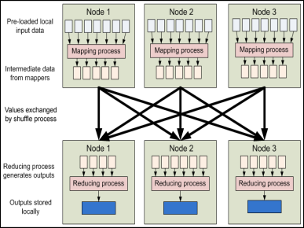
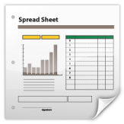
Data Provider
Data Provider
Data Access Layer
Data Provider
Data Provider
Data Provider
Data Provider
Analytics
Provider
Analytics Provider
Data Analytics Layer
Data
Analytics Provider
HPC Server
Model Provider
Model Provider
Instrument Analytics Layer
Instrument
Analytics Provider
Query Layer
Layer
Layer
Third Party Services
Risk App
Trading App
Spreadsheet
Risk App
Trading App
Spreadsheet

Slide 34
The problem is this: the data is still weakly integrated into our data plumbing languages

Slide 35
The Technique: “F# Type Providers” Allow scalable, robust, deep integration

Slide 36
Similar Problem: Integrate all of freebase.com “as if it were a library” 40M entities, 1Billion facts, 24,000 types, 65,000 properties

Slide 37
Similar Problem: Integrate all of worldbank.org/data “as if it were a library” 10,000+ time series for hundreds of countries/regions

Slide 38
Demo
F# + Freebase
An F# type provider for deep, robust integration of web data

Slide 39
A Type Provider is…. “Just like a library” “A design-time component that computes a space of types and methods on-demand…” “An adaptor between data/services and the F# type system…” “On-demand, scalable compile-time provision of type/module definitions…”

Slide 40
But what about financial data?

Slide 41
Demo
F# + Xenomorph TimeScape
An F# type provider for deep, robust integration of financial data

Slide 42
Theme #1 On-Demand Types = Internet Scalable Magic

Slide 43
On-Demand Type Provision
let data = RiskLab.GetDataContext()
1. Compiler/IDE requests metadata for symbol GetDataContext
Provider reports return type of RiskLabDataContext
data.Categories
2. Compiler/IDE requests contents of RiskLabDataContext and property Categories
Provider asks Freebase metadata service for top-level domains
Provider reports top-level domains of Freebase as properties of the type
data.Categories.``GB Equities``
3. Compiler/IDE requests metadata for symbol ``GB Equities``
...

Slide 44
Theme #2 Many Data Sources, One Mechanism

Slide 45
SQL

Slide 46
CSV

Slide 47
JSON

Slide 48
XML

Slide 49
Hadoop/Hive

Slide 50
World Bank

Slide 51
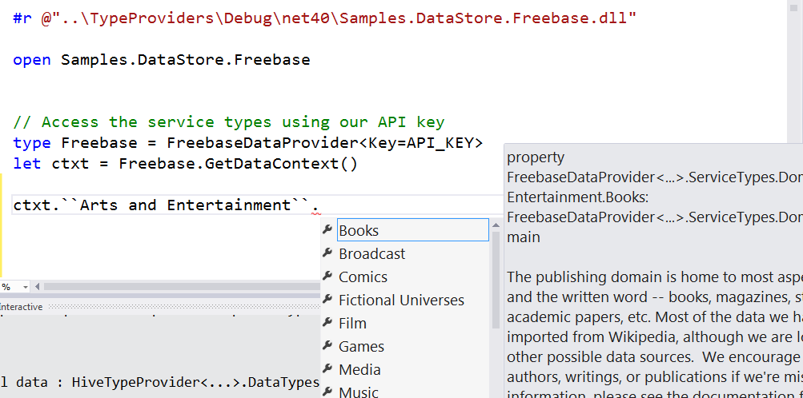
Freebase

Slide 52
WSDL

Slide 53
R

Slide 54
Demo
F# + R

Slide 55
Theme #3 Data and Types at Multiple Scales

Slide 56
Data at Multiple Scales
From Everything to Individuals
Data Scripters need to work with different granularities of schematization
data.AllEntites
data.Categories.``GB Equity``
data.Categories.``GB Equity``.``SAINSBURY(J) (SBRY.L, Reuters)``
…Only a language with massively scalable metadata integration can operate at all these levels
Every stable entity can get a unique type

Slide 57
Providing Units of Measure
If the metadata contains units (including currencies)…
via F#’s Units of Measure
…then these can be projected into the programming language.

Slide 58
Theme #4 Type Systems Encounter Reality

Slide 59
This is different…
“The idea of integrating internet-scale information services directly into the program's variable and type space is probably the most innovative programming language idea I’ve heard of in a decade” (Jim Cordy, Queens U)
Perhaps, perhaps not…
But if something so simple is perceived as so different, we need think why
(What follows is somewhat whimsical)

Slide 60
This is different…
We like to see PL systems as logical systems
Traditional logical systems exclude interaction with reality
This is a powerful and simplifying assumption
It is also fundamentally wrong for modern applied programming languages

Slide 61
Γ $⊢ e$ : τ
Lots of work here
Lots of work here
The exclusion of reality!
The neglected child
Γ₀ = 0

Slide 62
Meditations on Γ₀
Γ₀ is the ever-growing ocean of digital reality around us
Γ₀ is big. Really big.
Γ₀ defies imagination for its enormity
Γ₀ is other. It doesn’t speak your language
Γ₀ is being organized at an incredible rate
Γ₀ needs us. We’re hitting the limit with e and tau
Γ₀ is surprisingly “human”

Slide 63
Meditations on Γ₀
Γ₀ is full of uncertainty and probabilities.
You are mutually recursive with Γ₀. You are part of it.
Γ₀ has many open doors, many locked doors
Γ₀ has many, many parts that do not get on particularly well.
Γ₀ is so real you want to touch it, explore it
Don’t look too long.
It’s like staring at infinity

Slide 64
Theme #5 Queries Full XTS QL not yet supported in prototype Similar query languages (Freebase MQL) are well explored

Slide 65
Theme #6 Reaction, Asynchrony and Streaming Not covered today, but F# has excellent compositional primitives for reactive, streaming data, and provided data sources can easily make use of these

Slide 66
Some Research Questions Which Arise
Can we incorporate schema change policies into these type systems?
Can historical and probabilistic metadata be useful for typing or tooling?
Can we apply these techniques at the scale of Bloomberg and Reuters?
Temporal types? Probabilistic types? Table types?
Can we apply these techniques to real-time data streams?
Is there an interplay between provided types and machine learning models?
Can richer constraints and provenance annotations be provided?

Slide 67
Summary
Financial programming is ever more integrated with data
I presented applications of techniques for scalable, intuitive data/metadata integration to financial data
Integrating data+programming has many challenges
You can use these techniques for real and in production through F#

Slide 68
Questions?

Slide 69
In Summary
F#
The safe choice for functional-first
Unbeatable data integration
Visual F# - tooling you can trust from Microsoft
Open, cross-platform, strongly typed, efficient, rock-solid stable

Slide 70
Theme #5 Schema Change

Slide 71
A problem, but…
Many, many data sources are surprisingly stable
Some data sources support “snapshot dates”
F# supports “invalidation signals” from providers at design-time
Erasure makes compiled code much less fragile

Slide 72
Functional-first programming is a general-purpose programming technique particularly suited to tasks where Time-to-deployment, Efficiency, Correctness and Taming Complexity dominate.

Slide 73
Examples include ETL pipelines, general data-manipulation, calculation engines, programmatic UIs and data science. While these problems can be solved using other programming paradigms, they are particularly amenable to functional-first programming.

Slide 74
Functional-first programming uses functional programming as the initial paradigm for most purposes, but employs other techniques such as objects and state as necessary.

Slide 75
The Recurring Business Problems
Time to Market
Efficiency
Correctness
Complexity
for analytical components

Slide 76
Is Time to Market a Problem? Late Models → Missed market opportunities Late Services → Users have gone elsewhere Late Components → Millions evaporate
Financial model
Gaming service
Ad ranking engine
Notes:
“Take a moment to stop and think about the ramifications of time-to-market problems through software delays in analytical components for QF, FE, Trading and Calculation Engines more broadly”

Slide 77
Is Correctness a Problem? Buggy Models → Major risks to institutions Buggy Services → Users walk away Buggy Analytical Components → Millions leak away
Quant model
Gaming service
Ad ranking engine
Notes:
“Take a moment to stop and think about the ramifications of correctness problems through software delays in analytical components for QF, FE, Trading and Calculation Engines more broadly”

Slide 78
Is Efficiency a Problem? Slow Models → Can’t assess the institution daily Slow Services → Massive loss of online business Slow Analytical Components → Can’t scale to web
Financial model
Insurance quote service
Ad ranking engine
Notes:
“Take a moment to stop and think about the ramifications of efficiency problems through software delays in analytical components for QF, FE, Trading and Calculation Engines more broadly”

Slide 79
Is Complexity a Problem? Intractable Models → Can’t enter markets Intractable Services → Can’t deliver services Intractable Analytical Components → Can’t deliver
Notes:
“Take a moment to stop and think about the ramifications of efficiency problems through software delays in analytical components for QF, FE, Trading and Calculation Engines more broadly”

Slide 80
The Recurring Business Problems
Time to Market
Efficiency
Correctness
Complexity
for analytical components and services

Slide 81
What’s the Need? Analytical programmers delivering correct, efficient components in the enterprise, on-time This is a primary set of problems that functional-first programming helps solve

Slide 82
Example #1 (power company)
I have written an application to balance the national power generation schedule … for an energy company.
...the calculation engine was written in F#.
The use of F# to address the complexity at the heart of this application clearly demonstrates a sweet spot for the language … algorithmic analysis of large data sets.
Simon Cousins (Eon Powergen)

Slide 83
180,000
lines of OO
became
7,000
lines of robust F#, with
parallel +more features

Slide 84
Example #2: F# in Insurance
Time to Market
Complexity
I work for a large actuarial company... …Despite adopting Agile/Scrum …the usual delays, complications and sometimes …failures.
We used F#, and quickly created a system which would perform the necessary calculations highly efficiently, in parallel, and with a perfect match to the spreadsheet results.
All of the advantages which are commonly touted for F# do play out in practice. Immutability, Easy Parallelisation, Expressiveness, Testability, Conciseness, Flexibility, Productivity
[ Company name omitted ]
Efficiency
Correctness
fsharp.org/testimonials

Slide 85
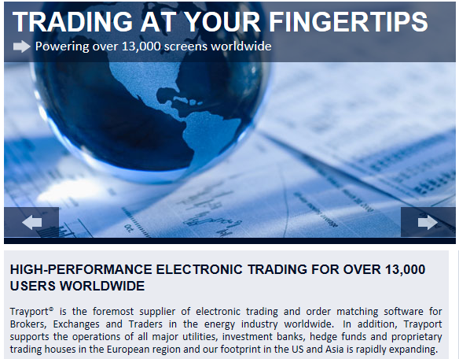
Example #3: Finance trading platform
F# + C# for Trading Front End
Leverage F#’s features:
- extensive type system
- asynchronous workflows, agents and immutable types
- rich pattern matching and parser support
“Experienced F# developers regularly solve problems in days that would take weeks using more traditional languages…solving complex problems in an elegant and highly maintainable manner”
Phil Trelford, Trayport
Time to Market
Complexity

Slide 86
Example #4: F# for Quant Consulting
Our bids for tendered contracts in quantitative finance are regularly half the price of competitors because of the increased productivity we get from F#.
We are regularly able to deliver correct, robust, performant solutions on-time, which is what our customers value most.
Daniel Egloff, QuantAlea Consulting, Zurich
Efficiency
Time to Market
Correctness
http://fsharp.org/testimonials

Slide 87
OData

