Slide 1
Strongly Typed Language Support for Internet-scale Information Spaces Overview + Themes
Dr. Don Syme
Principal Researcher, Microsoft Research, @dsyme
In conjunction with many others

Slide 2
Proposition 1 The world is immensely information-rich

Slide 3
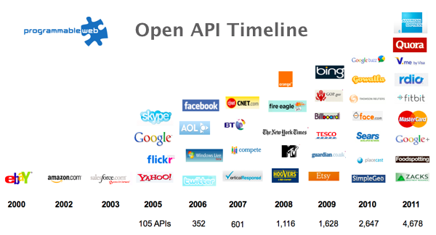
The Information Revolution

Slide 4
Data is like water…

Slide 5
Data is like water…
Everyone needs it. Everyone knows where to get it. Simple.
But…
… nobody is sure where it really came from, or goes to.
… nobody really knows its true cost, or true value.
… nobody likes to pay for it, or to share it.
… nobody knows how much is wasted
… nobody knows a good plumber
… nobody knows how bad it is until after you’ve drunk it

Slide 6
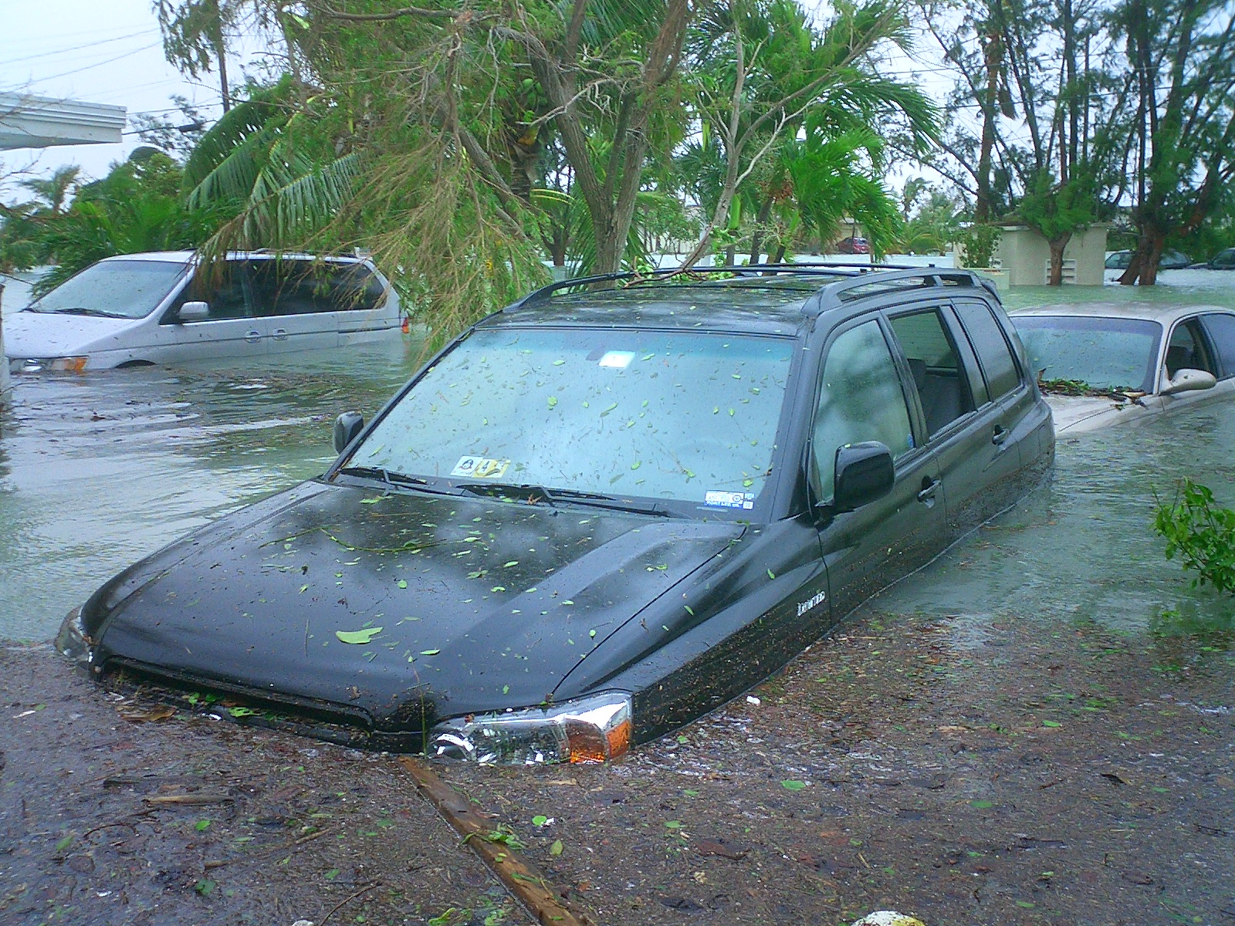
Actually these days it’s more like a flood…

Slide 7
Proposition 2 Modern programming is intensely information-rich

Slide 8
Proposition 3 Our languages are information-sparse

Slide 9
Proposition 4 This is a problem (especially for strongly-typed languages)

Slide 10
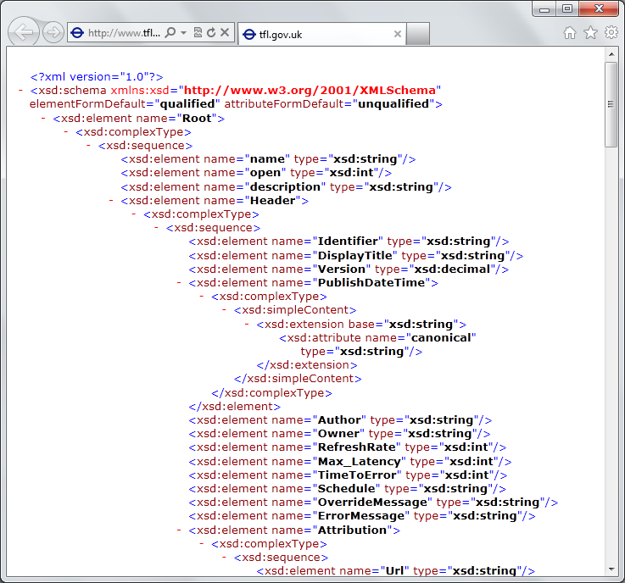
The developer’s perspective
Languages do not integrate information
Non-intuitive
Not simple
Disorganised
Static
High friction

Slide 11
We need to bring information into the language… At internet-scale, strongly tooled, strongly typed

Slide 12
Paradigm Locator
Statically Typed
Dynamically Typed

Slide 13
Paradigm Locator
Statically Typed
Dynamically Typed
A major search is on!
make statically typed langs more dynamic
make dynamically typed langs more static
apply modertated static typing much more broadly

Slide 14
This R&D is done in the context of the open language F#
Lots of good reasons for that, see our tech report
“Strongly Typed Language Support for Internet-Scale Information Spaces”

Slide 15
A bit about F#....

Slide 16
A strongly typed, data-immersive functional-first language for…. simple code to solve complex problems

Slide 17
F# is Open Source F# is Cross Platform
fsharp.org
fsharp.org/use/mac
fsharp.org/use/linux
fsharp.org/use/android
fsharp.org/use/ios
fsharp.org/use/windows
fsharp.org/use/freebsd

Slide 18
F# has an intelligent, fun, contributing community fsharp.org fsharpforfunandprofit.com meetup.com/FSharpLondon

Slide 19
F# helps address real problems around Time to Market, Efficiency, Correctness and Complexity fsharp.org/testimonials See: “Succeeding with Functional-first Programming in Industry”

Slide 20
F# has changed…
F# runs on many platforms
“F# is for Windows”

Slide 21
F# has changed…
F# has many contributors
“Microsoft
makes F#”

Slide 22
Back to the main topic…

Slide 23
We need to bring information into the language… At internet-scale, strongly tooled, strongly typed

Slide 24
Demo: Integrate all of freebase.com “as if it were a library” 40M entities, 1Billion facts, 24,000 types, 65,000 properties

Slide 25
Demo: F# to WorldBank

Slide 26
A Type Provider is…. “Just like a library” “A design-time component that computes a space of types and methods on-demand…” “An adaptor between data/services and the .NET type system…” “On-demand, scalable compile-time provision of type/module definitions…”

Slide 27
Theme #1 On-Demand Type Environment = Internet Scalable

Slide 28
On-Demand Type Provision
let data = Freebase.GetDataContext()
1. Compiler/IDE requests metadata for symbol GetDataContext
Provider reports return type of FreebaseDataContext
data.
2. Compiler/IDE requests contents of type FreebaseDataContext
Provider asks Freebase metadata service for top-level domains
Provider reports top-level domains of Freebase as properties of the type
data.Society
3. Compiler/IDE requests metadata for symbol Society
...

Slide 29
Theme #2 Many Data Sources, One Mechanism

Slide 30
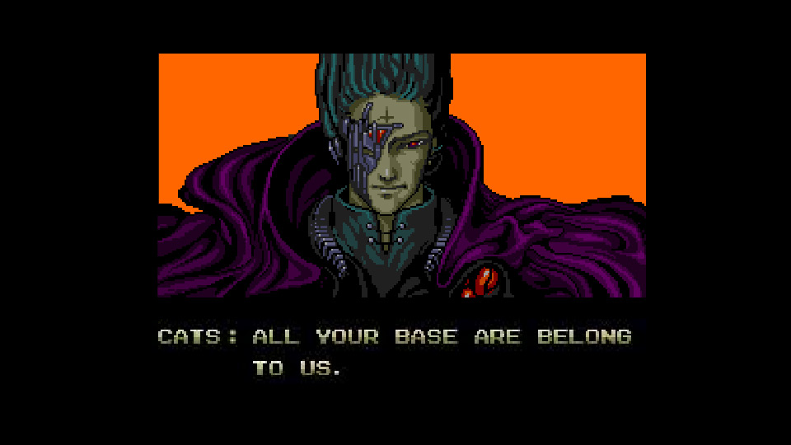
All your types are belong to us….
Segoe UI Light
types

Slide 31
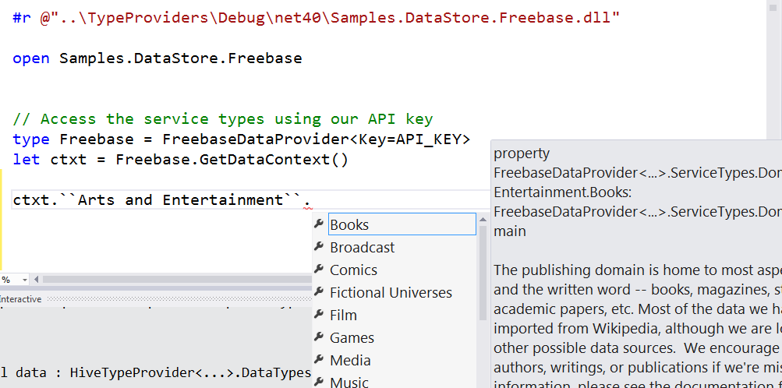
Entity Graphs (e.g. Freebase)

Slide 32
Web Data Sources (e.g. WorldBank)

Slide 33
SQL

Slide 34
Types from Data (e.g. CSV)

Slide 35
Types from Data (e.g. JSON)

Slide 36
Types from Data (e.g. XML)

Slide 37
Hadoop/Hive

Slide 38
Service Protocols (e.g. WSDL)

Slide 39
Service Protocols (e.g. Odata)

Slide 40
Data Markets (e.g. Azure Data Market)

Slide 41
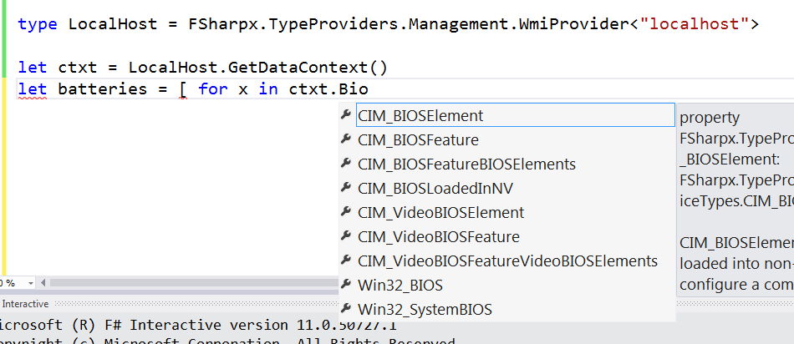
Systems Information (e.g. WMI)

Slide 42
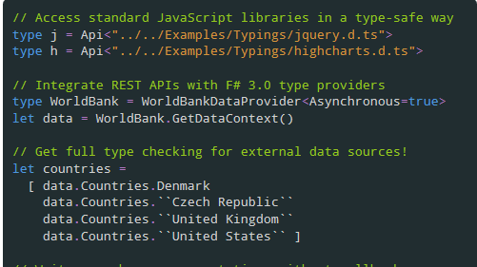
JavaScript/TypeScript

Slide 43
Matlab

Slide 44
R

Slide 45
Note: Language still contains no data Open architecture You can write your own type provider

Slide 46
github.com/fsharp/FSharp.Data (a library of common type providers)

Slide 47
Theme #3 Data and Types at Multiple Scales

Slide 48
Data at Multiple Scales
From Everything to Individuals
Data Scripters need to work with different granularities of schematization
data.AllEntites
data.Automotive.``Automobile Models``
data.Automotive.``Automobile Models``.Individuals.``Porsche 911``
…Only a language that supports massively scalable metadata can operate at all these levels
Every stable entity can get a unique type

Slide 49
Theme #4 Programming Type Systems v. Information Space Metadata Synergy or Conflict? Examples: Types, Schema, Constraints, Units of Measure, Security Information, Documentation, Definition Locations, Help , Provenance, Privacy, Ratings, Rankings, Search…

Slide 50
Providing Units of Measure
If the metadata contains units…
via F#’s Units of Measure
…then these can be projected into the programming language.

Slide 51
Theme #5 Type Systems Encounter Reality

Slide 52
This is different…
“The idea of integrating internet-scale information services directly into the program's variable and type space is probably the most innovative programming language idea I’ve heard of in a decade” (Jim Cordy, Queens U)
Perhaps, perhaps not…
But if something so simple is perceived as so different, we need think why
(What follows is somewhat whimsical)

Slide 53
This is different…
We like to see PL systems as logical systems
Traditional logical systems exclude interaction with reality
This is a powerful and simplifying assumption
It is also fundamentally wrong for modern applied programming languages

Slide 54
Γ $⊢ e$ : τ
Lots of work here
Lots of work here
The exclusion of reality!
The neglected child
Γ₀ = 0

Slide 55
Meditations on Γ₀
Γ₀ is the ever-growing ocean of digital reality around us
Γ₀ is big. Really big.
Γ₀ defies imagination for its enormity
Γ₀ is other. It doesn’t speak your language
Γ₀ is being organized at an incredible rate
Γ₀ needs us. We’re hitting the limit with e and tau
Γ₀ is surprisingly “human”

Slide 56
Meditations on Γ₀
Γ₀ is full of uncertainty and probabilities.
You are mutually recursive with Γ₀. You are part of it.
Γ₀ has many open doors, many locked doors
Γ₀ has many, many parts that do not get on particularly well.
Γ₀ is so real you want to touch it, explore it
Don’t look too long.
It’s like staring at infinity

Slide 57
Theme #6 Schema Change

Slide 58
Hard problem, however…
Many, many data sources are surprisingly stable
Support “invalidation signals” from providers at design-time
Erasure makes compiled code much less fragile
Some data sources support “snapshot dates” (c.f. Datomic, Freebase)
Data scripting has low exposure

Slide 59
Some Research Questions
Can incorporate schema change policies?
Can temporal and probabilistic metadata be useful for typing or tooling?
Can we provide all the data in the enterprise (e.g. SAP or Reuters)?
Temporal types? Probabilistic types? Reactive types?
Can we model and verify provider components?
Can richer constraints, security, privacy and provenance annotations be provided?
Can we provided types be mutually recursive?

Slide 60
Summary
Scalable (meta)data integration into programming is a key challenge of our era
The techniques have many, many applications
I’ve presented “F# type providers” - a simple, powerful point in the design space
People use this “for real” in production F# systems

Slide 61
Related Work
Ur
Gosu
Scala Type Macros
Scheme/Lisp Macros
Idris
Template Haskell
…
Wolfram

Slide 62
Learn more
Questions?
tryfsharp.org
fsharp.org
Our papers and technical reports

