Slide 1
Strongly Typed Language Support for Internet-Scale Information Spaces
Dr. Don Syme, Principal Researcher
MSR Cambridge

Slide 2
Agenda
F# update
F# and Internet-Scale Data Integration
Themes, Meditations, Perspectives on Strongly-Typed Data Integration

Slide 3
Proposition 1
The world is information-rich

Slide 4
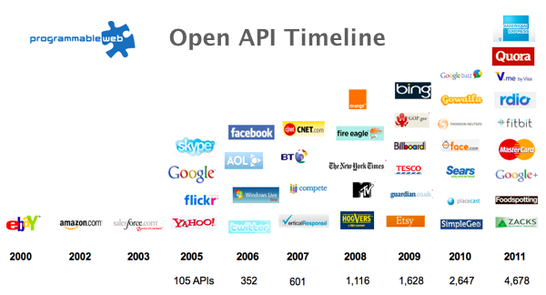
The Information Revolution

Slide 5
Proposition 2
Modern programming is intensely information-rich

Slide 6
Proposition 3
Our languages are information-sparse

Slide 7
Proposition 4
This is a problem
(especially for strongly-typed languages)

Slide 8

Data is like water…

Slide 9
Data is like water…
Everyone needs it. Everyone knows where to get it. Simple.
But…
… nobody is sure where it really came from, or goes to.
… nobody really knows its true cost, or true value.
… nobody likes to pay for it, or to share it.
… nobody knows how much is wasted
… nobody knows a good plumber
… nobody knows how bad it is until after you have drunk it

Slide 10
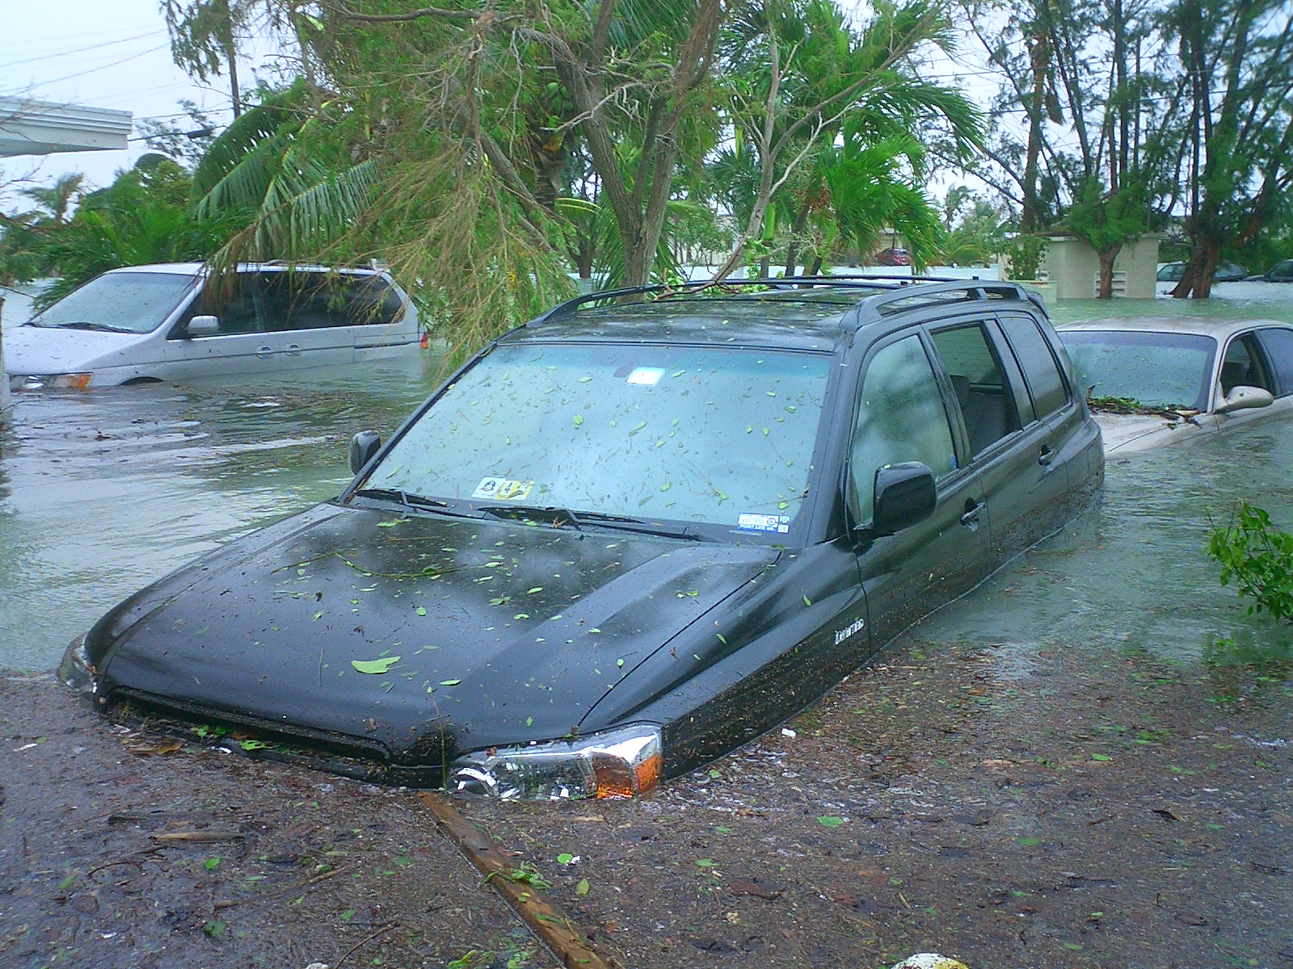
Actually these days it’s more like a flood…

Slide 11
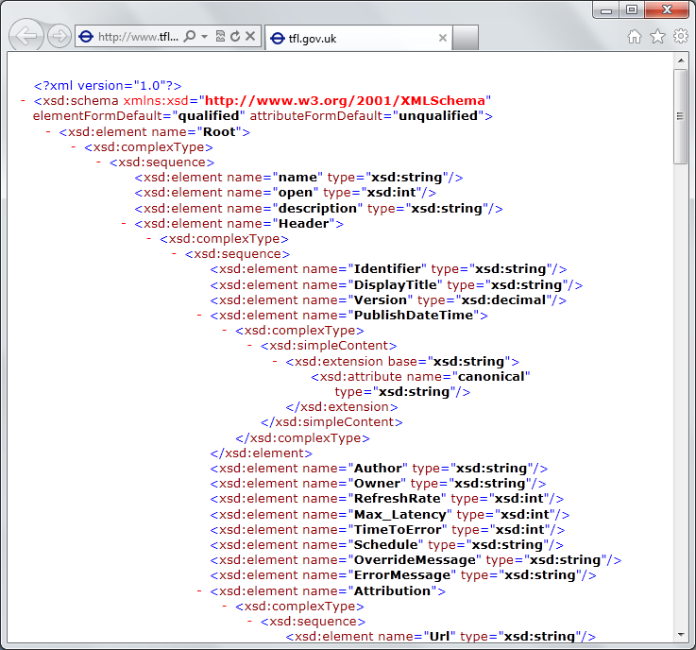
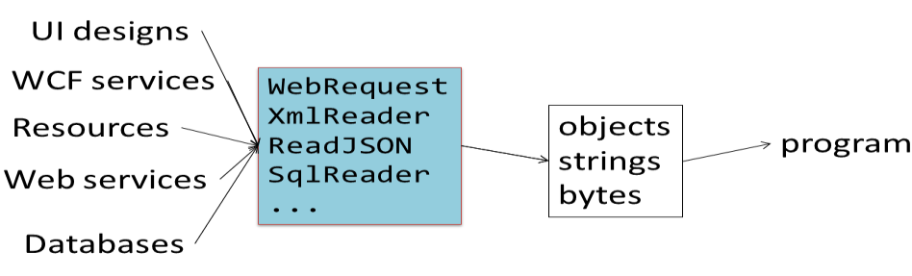
The data plumber’s perspective
Languages do not integrate information
  Weakly typed
  Not at scale
  Non-intuitive
  Not simple
  Disorganised
  Static
  High friction

Slide 12
We need to bring information into the language…
At internet-scale, strongly tooled, strongly typed

Slide 13
Paradigm Locator
Statically Typed
Dynamically Typed

Slide 14
Paradigm Locator
Statically Typed
Dynamically Typed
A major search is on!
make statically typed langs more dynamic
make dynamically typed langs more static
moderate static typing in limited ways

Slide 15
This R&D is done in the context of the open language F#
But before we get into that…
Lots of good reasons for that, see our tech report
“Strongly Typed Language Support for Internet-Scale Information Spaces”

Slide 16
F# is Open Source
F# is Cross Platform
fsharp.org
fsharp.org/use/mac
fsharp.org/use/linux
fsharp.org/use/android
fsharp.org/use/ios
fsharp.org/use/windows
fsharp.org/use/freebsd

Slide 17
A strongly typed, data-immersive functional-first language for…. simple code to solve complex problems

Slide 18
F#
C#
let swap (x, y) = (y, x)
let rotations (x, y, z) =
[ (x, y, z);
(z, x, y);
(y, z, x) ]
let reduce f (x, y, z) =
f x + f y + f z
Tuple<U,T> Swap<T,U>(Tuple<T,U> t)
{
return new Tuple<U,T>(t.Item2, t.Item1)
}
ReadOnlyCollection<Tuple<T,T,T>> Rotations<T>(Tuple<T,T,T> t)
{
new ReadOnlyCollection<int>
(new Tuple<T,T,T>[]
{new Tuple<T,T,T>(t.Item1,t.Item2,t.Item3);
new Tuple<T,T,T>(t.Item3,t.Item1,t.Item2);
new Tuple<T,T,T>(t.Item2,t.Item3,t.Item1); });
}
int Reduce<T>(Func<T,int> f,Tuple<T,T,T> t)
{
return f(t.Item1)+f(t.Item2)+f(t.Item3);
}

Slide 19
10 Reasons Not to Use a Strongly Typed Functional Language

Slide 20
Example (power company)
I have written an application to balance the national power generation schedule for a portfolio of power stations to a trading position for an energy company. ...the calculation engine was written in F#.
The use of F# to address the complexity at the heart of this application clearly demonstrates a sweet spot for the language within enterprise software, namely algorithmically complex analysis of large data sets.
Simon Cousins (power company)
fsharp.org/testimonials

Slide 21
F# at Kaggle
At Kaggle we initially chose F# for our core data analysis algorithms because of its expressiveness.
We are moving more and more of our application into F#.
The F# code is shorter, easier to read, easier to refactor, and contains far fewer bugs.
As our codebase gets larger, we become more productive.
fsharp.org/testimonials

Slide 22
F# is changing…
F# runs on many platforms
“F# is for Windows”

Slide 23
F# is changing…
F# has many contributors
“Microsoft
makes F#”

Slide 24
F# is changing…
Many perspectives
http://fsharp.org
One perspective
(Microsoft’s)
http://msdn.microsoft.com

Slide 25
Learn more
fsharp.org
fsharp.org/math
fsharp.org/data-science
fsharp.org/machine-learning
fsharp.org/cloud
fsharp.org/data-access
fsharp.org/testimonials

Slide 26
Back to the main topic…

Slide 27
We need to bring information into the language…
At internet-scale, strongly tooled, strongly typed

Slide 28
Demo: Integrate all of freebase.com
“as if it were a library”
40M entities, 1Billion facts, 24,000 types, 65,000 properties

Slide 29
Demo: F# to WorldBank

Slide 30
A Type Provider is….
“Just like a library”
“A design-time component that computes a space of types and methods on-demand…”
“An adaptor between data/services and the .NET type system…”
“On-demand, scalable compile-time provision of type/module definitions…”

Slide 31
Theme #1
On-Demand Types = Internet Scalable

Slide 32
On-Demand Type Provision
let data = Freebase.GetDataContext()
1. Compiler/IDE requests metadata for symbol GetDataContext
  Provider reports return type of FreebaseDataContext
data.
2. Compiler/IDE requests contents of type FreebaseDataContext
  Provider asks Freebase metadata service for top-level domains
  Provider reports top-level domains of Freebase as properties of the type
data.Society
3. Compiler/IDE requests metadata for symbol Society
...

Slide 33
Theme #2
Many Data Sources, One Mechanism

Slide 34
Note: Language still contains no data
Open architecture
You can write your own type provider

Slide 35
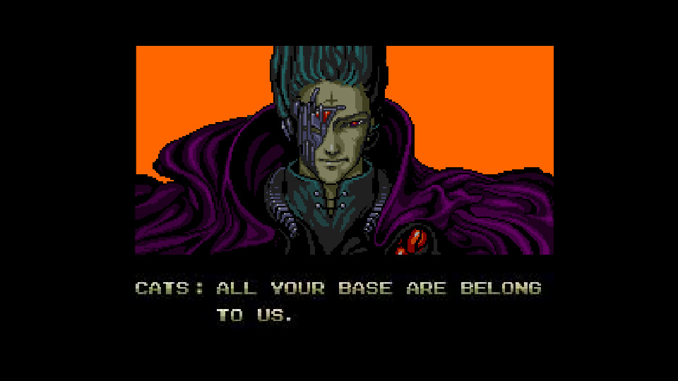
All your types are belong to us….
types

Slide 36
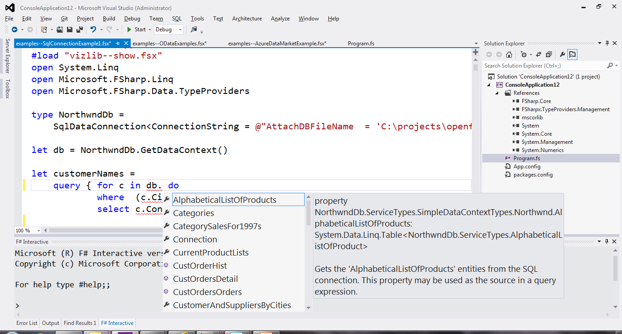
SQL

Slide 37
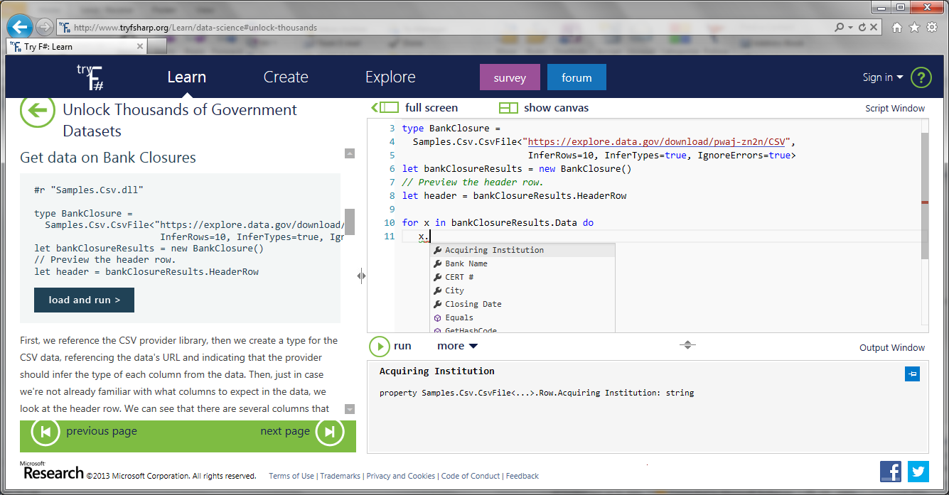
CSV

Slide 38

JSON

Slide 39
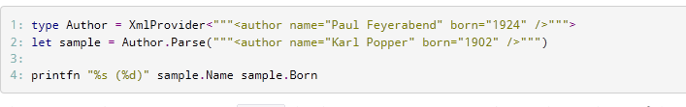
XML

Slide 40
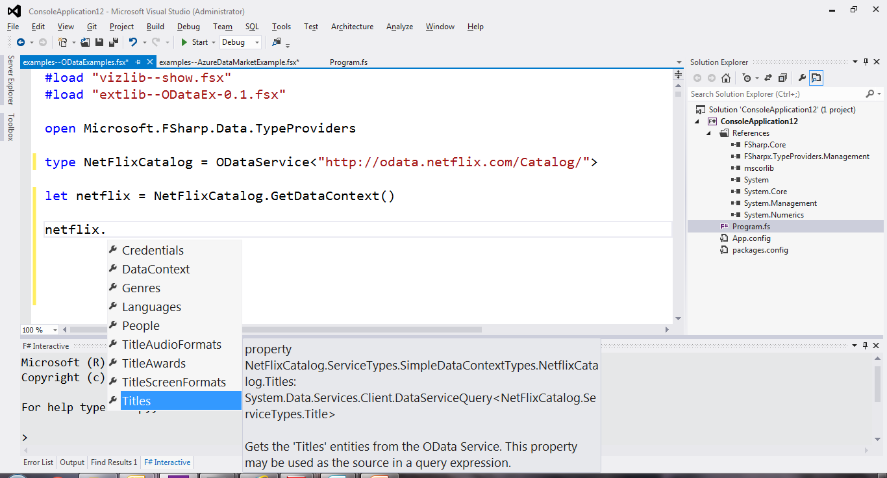
OData

Slide 41
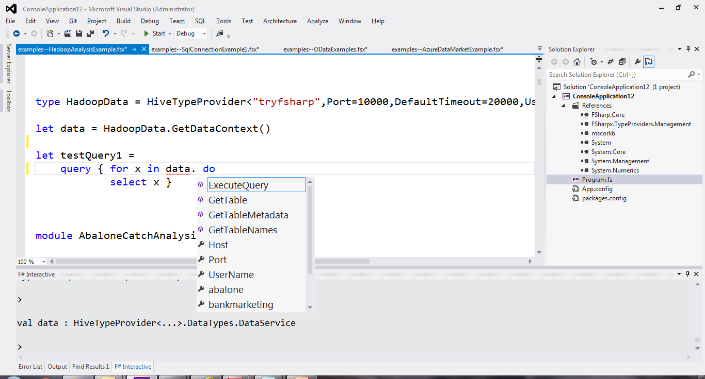
Hadoop/Hive

Slide 42
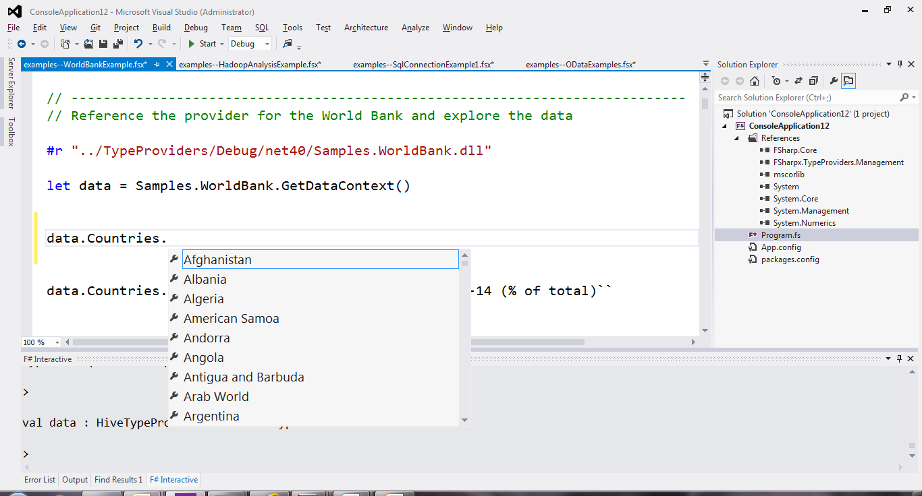
World Bank

Slide 43
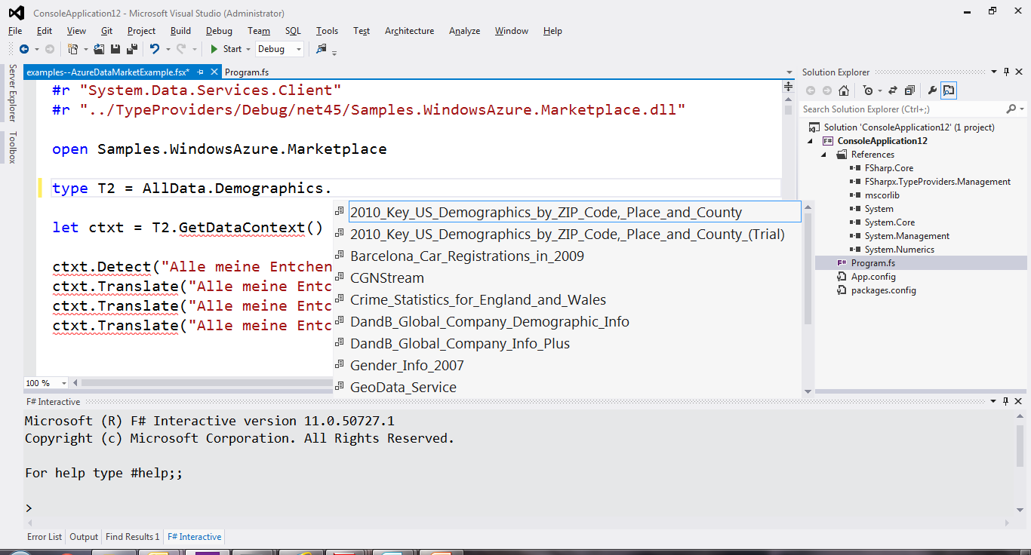
Azure Data Market

Slide 44
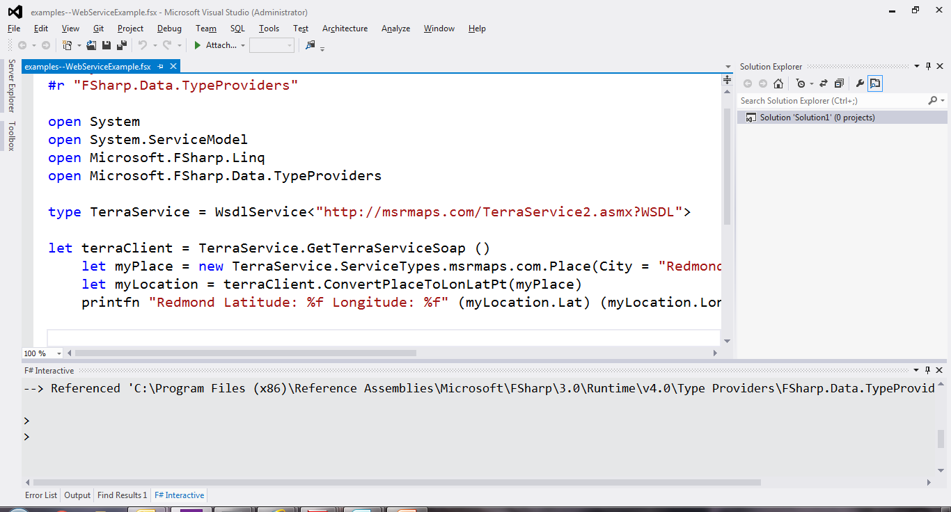
WSDL

Slide 45
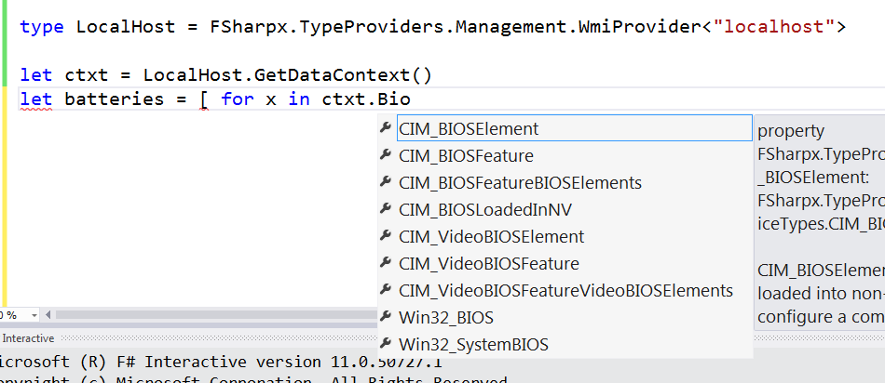
WMI

Slide 46
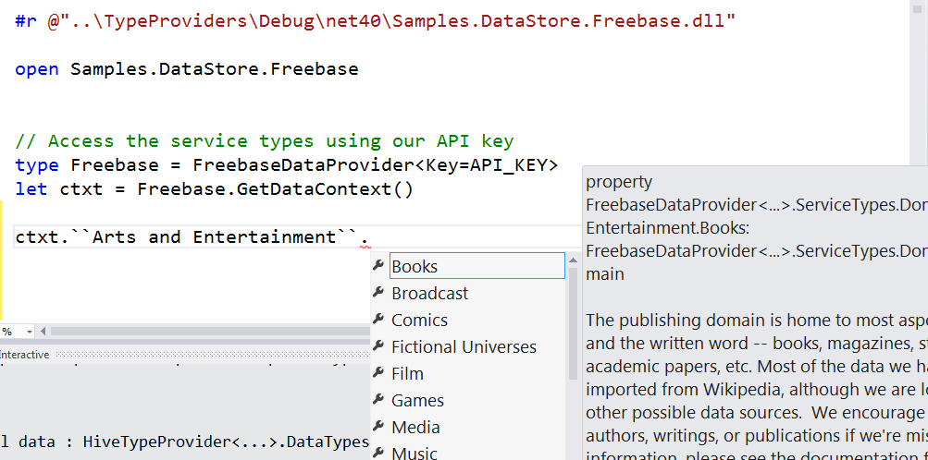
Freebase

Slide 47
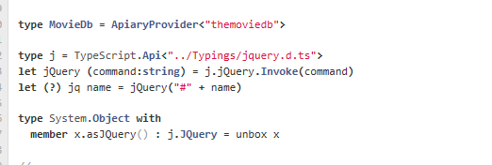
JavaScript/TypeScript

Slide 48
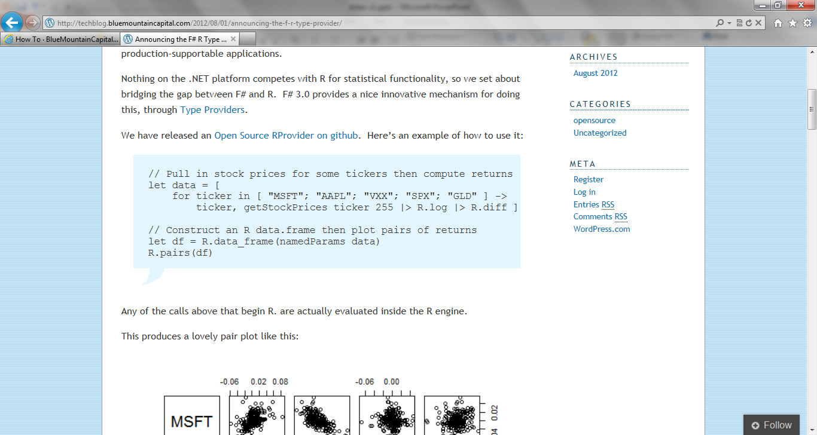
R

Slide 49
Theme #3
Data and Types at Multiple Scales

Slide 50
Data at Multiple Scales
From Everything to Individuals
Data Scripters need to work with different granularities of schematization
data.AllEntites
data.Automotive.``Automobile Models``
data.Automotive.``Automobile Models``.Individuals.``Porsche 911``
…Only a language that supports massively scalable metadata can operate at all these levels
Every stable entity can get a unique type

Slide 51
Theme #4
Programming Type Systems v.
Information Space Metadata
Synergy or Conflict?
Examples: Types, Schema, Constraints, Units of Measure, Security Information, Documentation, Definition Locations, Help , Provenance, Privacy, Ratings, Rankings, Search…

Slide 52
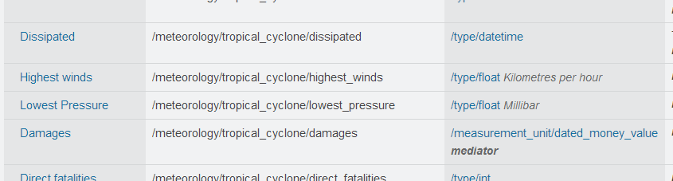
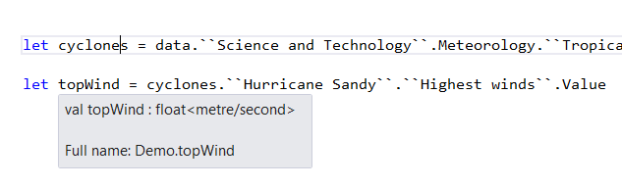
Providing Units of Measure
If the metadata contains units…
via F#’s Units of Measure
…then these can be projected into the programming language.

Slide 53
Theme #5
Type Systems Encounter Reality

Slide 54
This is different…
        “The idea of integrating internet-scale information services directly into the program's variable and type space is probably the most innovative programming language idea I’ve heard of in a decade” (Jim Cordy, Queens U)
Perhaps, perhaps not…
But if something so simple is perceived as so different, we need think why
(What follows is somewhat whimsical)

Slide 55
This is different…
We like to see PL systems as logical systems
Traditional logical systems exclude interaction with reality
  This is a powerful and simplifying assumption
  It is also fundamentally wrong for modern applied programming languages

Slide 56


Γ $⊢ e$ : τ
Lots of work here
Lots of work here
The exclusion of reality!
The neglected child
Γ₀ = 0

Slide 57
Meditations on Γ₀
Γ₀ is the ever-growing ocean of digital reality around us
Γ₀ is big. Really big.
Γ₀ defies imagination for its enormity
Γ₀ is other. It doesn’t speak your language
Γ₀ is being organized at an incredible rate
Γ₀ needs us. We’re hitting the limit with e and tau
Γ₀ is surprisingly “human”

Slide 58
Meditations on Γ₀
Γ₀ is full of uncertainty and probabilities.
You are mutually recursive with Γ₀. You are part of it.
Γ₀ has many open doors, many locked doors
Γ₀ has many, many parts that do not get on particularly well.
Γ₀ is so real you want to touch it, explore it
Don’t look too long.
It’s like staring at infinity

Slide 59
Theme #6
Schema Change

Slide 60
Hard problem, some progress…
Many, many data sources are surprisingly stable
Some data sources support “snapshot dates”
F# supports “invalidation signals” from providers at design-time
Erasure makes compiled code much less fragile

Slide 61
Summary
We live in an information-revolution
We must bring information into languages, at internet-scale
F# breaks new ground in how this can be done
Γ₀ still poses many, many challenges

Slide 62
Some Research Questions
Can incorporate schema change policies?
Can temporal and probabilistic metadata be useful for typing or tooling?
Can we provide all the data in the enterprise (e.g. SAP or Reuters)?
Temporal types? Probabilistic types? Evolving types?
Can we model and verify provider components?
Can richer constraints, security, privacy and provenance annotations be provided?
Can we provided types be mutually recursive?

Slide 63
Learn more
Questions?
Get involved
fsharp.org
tryfsharp.org
fsharp.org/math
fsharp.org/data-science
fsharp.org/machine-learning
fsharp.org/cloud
fsharp.org/data-access

Slide 64
Theme #1
Big Data → Big Metadata
Strongly typed languages and tooling must have a role here, surely!

Slide 65
Theme #2
Huge Information Spaces can and should be viewed as Software Components example: schema change <-> component versioning <-> source compatibility <-> binary compatibility

Slide 66
Theme #3
Multiple Data Standards with One Simple Mechanism
Rich type systems, importing rich metadata where it exists

Slide 67
Scalable information integration, without “blowing up the language”
Database Features
XML Literals
Macro Systems
Dynamic, dynamic, dynamic
Dependent types

Slide 68
Update: RProvider
r provider f#
Open source community provider for interop with R
  discovers installed R packages
  Access > 2,000 R packages
  projects them as .NET namespaces
  underneath the parent namespace RProvider

Slide 69
Demo: F# to R

Slide 70
Tour: GPGPU Programming
search on nuget for GPU or CUDA!
search on google for “C# GPGPU”

Slide 71
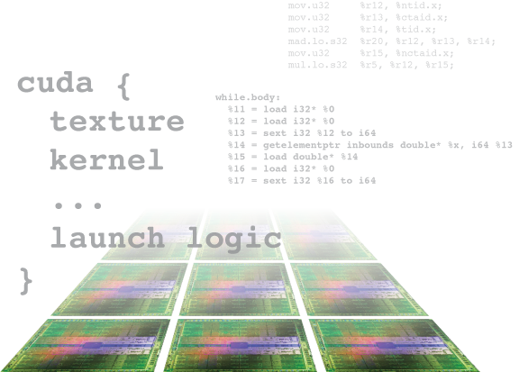
Alea.cuBase
Complete solution to develop CUDA accelerated GPU applications
  Used “for real” in finance institutions
  Based on LLVM and CUDA 5 technology
  Uses F# code quotation
  Source code solution
  No wrappers, no post build process to transform IL code
Dynamic code
generation
GPU algorithm
scripting
Industry grade
performance
Rapid
development
Solid framework
for reusability
Advanced CUDA
programming

Slide 72
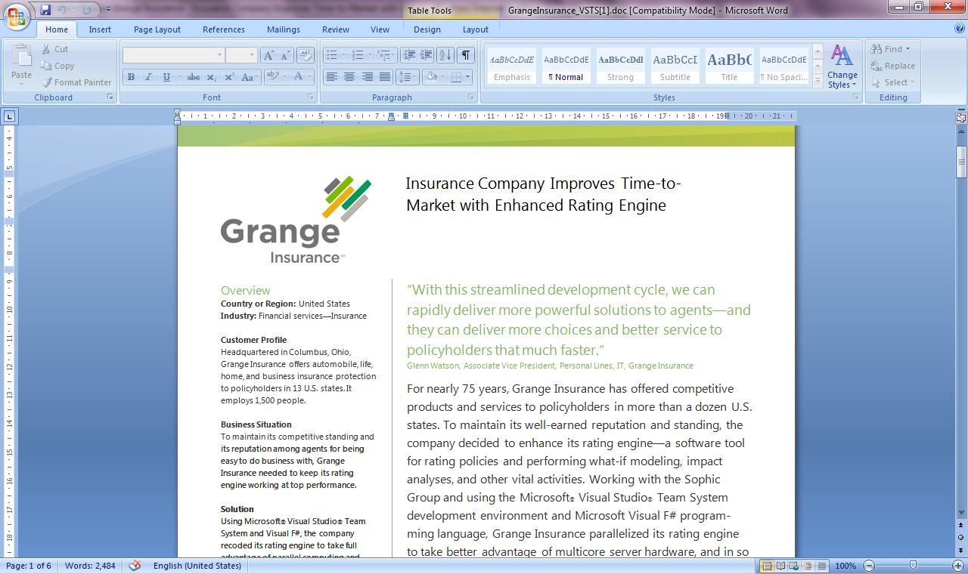
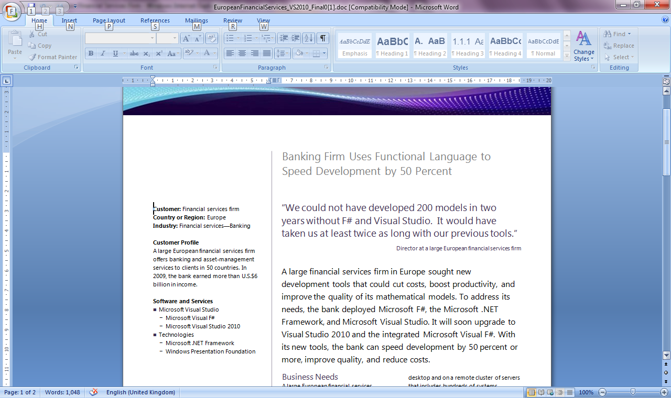
Example #2/#3: F# in Finance
Time to Market
Correctness
Time to Market
Correctness
Efficiency
http://fsharp.net

Slide 73
Example #3: F# in Insurance
I work for a large actuarial company... …Despite adopting Agile/Scrum …the usual delays, complications and sometimes …failures.
We used F#, and quickly created a system which would perform the necessary calculations highly efficiently, in parallel, and with a perfect match to the spreadsheet results.
All of the advantages which are commonly touted for F# do play out in practice. Immutability, Easy Parallelisation, Expressiveness, Testability, Conciseness, Flexibility, Productivity
[ Company name omitted ]
Time to Market
Efficiency
Correctness

Slide 74
Overview
F# is changing…
“F# is
one language with many tools”
“F# is part of
Visual Studio”

Slide 75









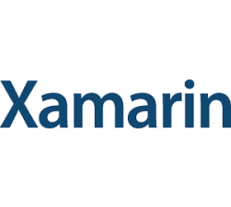


New think…
Visual Studio, .
.NET, SDKs, Tools
…
Visual F# Tools
F# Language
F# Open Source
Group
tryfsharp.org
F# Software
Foundation
F# Community
Groups
fpish.net
tryfs.org
fssnip.net
tryfs.org
fsharpforfunandprofit.com
Xamarin Studio

Slide 76
At the core of every functional-first language is this: simple, correct, robust code for complex problems

Slide 77
Interoperable languages remove entire phases from the analytical software development process
No R → C#
No Mathematica → C++
Notes:
Functional programming tools empower when combined with other technologies

Slide 78
Strongly-typed functional languages help analytical programmers tackle more complex problems
Notes:
Functional programming tools empower when combined with other technologies

Slide 79
Example (power company)
I have written an application to balance the national power generation schedule … for an energy company.
...the calculation engine was written in F#.
The use of F# to address the complexity at the heart of this application clearly demonstrates a sweet spot for the language … algorithmic analysis of large data sets.
Simon Cousins (Eon Powergen)
http://fsharp.net

Slide 80
Example (power company)
Time to Market
Efficiency
Interoperation ... Seamless. The C# programmer need never know.
Units of measure … a huge time saver...it eradicates a whole class of errors…
Exploratory programming …Working with F# Interactive allowed me to explore the solution space more effectively.
Unit testing …a joy to test. There are no complex time-dependent interactions to screw things up….
Parallelism …The functional purity ... makes it ripe for exploiting the inherent parallelism in processing vectors of data.
Code reduction… … vectors and matrices…higher order functions eat these for breakfast with minimal fuss, minimal code. Beautiful.
Lack of bugs… Functional programming can feel strange. .. once the type checker is satisfied that’s often it, it works.
Correctness
Time to Market
Time to Market
Correctness
Correctness

Slide 81
Tour: Cloud Programming

Slide 82
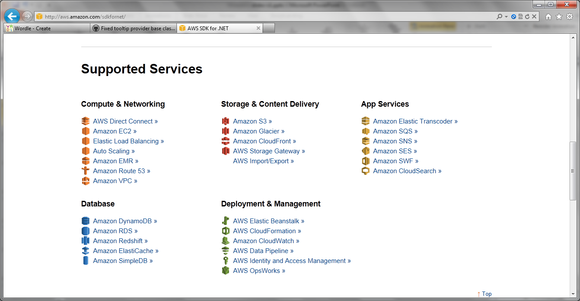
Amazon Web Services .NET SDKs http://aws.amazon.com/tools https://github.com/aws (Apache 2.0)

Slide 83
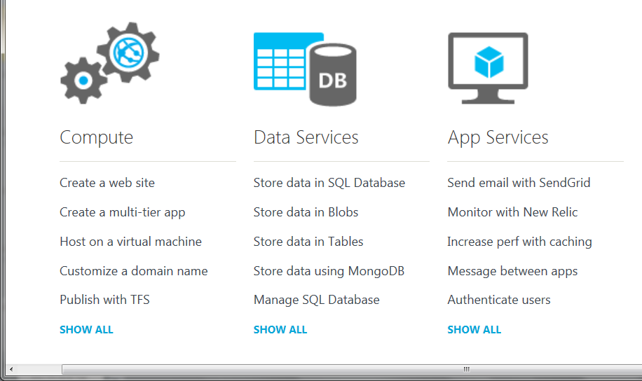
Azure .NET SDKs http://www.windowsazure.com https://github.com/WindowsAzure/ (Apache 2.0)

Slide 84
nuget.org

Slide 85
11,500 unique packages
Windows, Mac, Linux

Slide 86
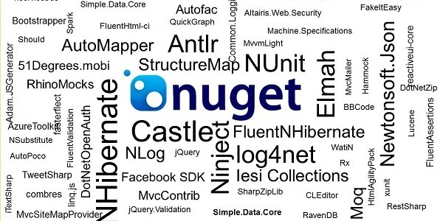
www.nuget.org

Slide 87
type Rating = { UserId: int; DishId: int; Rating: int }

Slide 88
let svd = data.Svd(true) let U, S, Vt = svd.U(), svd.S(), svd.VT() let reconstructed = U * S * Vt let userToCategory = U * S let categoryToDish = S * Vt
Latent Semantic Indexing with F#

Slide 89
data.Countries.Brazil.Indicators.``Population ages 0-14 (%)``

