Slide 1
The F# Path to Relaxation
Language Design, Tools, Platforms, Community, Ecosystem, Exosystem, Openness, Cross-platform, …
Don Syme, F# Community Contributor

Slide 2
A Gentle Stroll Through the Land of Language Design and Delivery

Slide 3
A starting position…. The great disputes of computer science should be struggled with They are chances to make a better, simpler, more relaxed world as much as create opposing camps

Slide 4
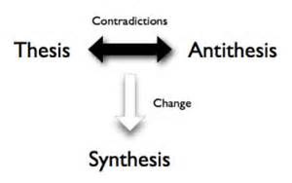
Not a new idea…

Slide 5
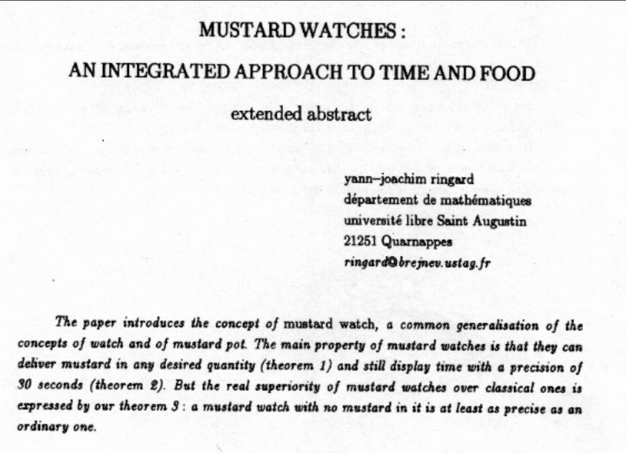
You can of course take this too far ☺

Slide 6
X
Y
?

Slide 7
Functional
Interop

Slide 8
Then (2003) Functional languages were isolated, non-interoperable, using their own VMs. Interop standards like C-calls, COM, CORBA, XML were a mess for language-integration.

Slide 9
And then things changed…

Slide 10
The F# Approach (also Scala, Swift, …) Embrace industry-standard runtime layers, and influence them. Keep exosystem at an appropriate distance. Design with end-to-end interop in mind. Compromise where needed.

Slide 11
Relaxation Achieved ☺ ✓Today’s FP languages are immensely interoperable while staying true to FP principles. ✓ F# type providers raise interop to a completely new level ✗Some tensions remain – not all functional techniques are easily implemented on industry standard VMs
Functional
Interop

Slide 12
X
Y
?

Slide 13
Enterprise
Openness

Slide 14
TL;DR – Where we are now
F# is open, cross-platform, independent
The F# Compiler Service powers many other tools
F# 4.0 is under way, please contribute!
Debian and other packages for Linux
The F# language is accepting contributions
The F# community is very “self-empowered”
fsharp.org
The Visual F# Tools are professional tools for Windows and Azure
Xamarin provide F# tools Android and iOS

Slide 15
In one year, we’ve come a long way!

Slide 16
The Puzzle
In 2014, we now do open engineering on to all of F# and Visual F# Tools
Still packaged in Visual Studio as an enterprise-supported product.
Xamarin, Debian, OSX, WebSharper, FunScript, Alea, …
Language
Openness
Community
Ecosystem
IDE Tools
Cross-platform
The
F# Software Foundation as a voice for F#
fsharp.org
XamarinStudio, Emacs, Vim,
FSharp.Compiler.Service
Visual F# Power Tools …
Embrace an open ecosystem of F# libraries, tools and type-providers

Slide 17
The F# Compiler – 120+ Pull Requests and rising Where to Contribute? See fsharp.github.io

Slide 18
visualfsharp.codeplex.com (Git)
Xamarin.Android/iOS Core Library for F#
Your F# Compiler, Language and Library contributions
Xamarin packaging repos
(internal)
Mono Releases in OSX
Debian Linux Packages
github.com/fsharp
Debian packaging repos
Visual F# Compiler public Git repo
(codeplex)
F# Compiler and Service Open Edition Git repos
(github)
Emacs MELPA package Releases
F# open editing tools repo
(github)
FCS Nuget packages
Xamarin.Studio releases
Visual F# Power Tools repo
(github)
MonoDevelop Releases
Microsoft packaging of Visual F# Tools for Windows
Visual Studio major releases
Visual F# Tools OOB updates
Visual F# Power Tools releases
Visual F# Tools daily builds

Slide 19
The F# Language Design Process fslang.uservoice.com

Slide 20
The F# Compiler Service fsharp.github.io/FSharp.Compiler.Service FsReveal

Slide 21
Relaxation Achieved ☺ Enterprise Quality + Openness + Community + Tooling + Ecosystem + Evolution Path = Goodness
Enterprise
Openness

Slide 22
X
Y
?

Slide 23
Functional
Objects

Slide 24
Then (2003) In the 1990s functional languages were historically anti-OO Even today any mention of objects in some Haskell circles gives people an “urrgghhh…” reaction. Modern Compiler Implementation with Standard ML - Chapter 14, Object Oriented Programming object – to express a dislike or distaste for something (approx. quote)

Slide 25
F# - Objects + Functional
type Vector2D (dx:double, dy:double) =
let d2 = dx*dx+dy*dy
member v.DX = dx
member v.DY = dy
member v.Length = sqrt d2
member v.Scale(k) = Vector2D (dx*k, dy*k)
Inputs to object
construction
Object internals
Exported properties
Exported method

Slide 26
Objects
Constructed Class Types
type ObjectType(args) =
let internalValue = expr
let internalFunction args = expr
let mutable internalState = expr
member x.Prop1 = expr
member x.Meth2 args = expr
Object Expressions
{ new IObject with
member x.Prop1 = expr
member x.Meth1 args = expr }
{ new Object() with
member x.Prop1 = expr
interface IObject with
member x.Meth1 args = expr
interface IWidget with
member x.Meth1 args = expr }
Object Interface Types
type IObject =
interface ISimpleObject
abstract Prop1 : type
abstract Meth2 : type -> type

Slide 27
The F# approach is to embrace objects, make them fit with the expression-oriented typed functional paradigm especially for interop and software engineering purposes but not embrace full “object-orientation”

Slide 28
Functional
 | Expression-oriented | No null | Multiple Args = Tuples | Closure and Capture | First-class Values | Currying | HM Type Inference
void (unit) | ✓ | ✓ | ✓ | ✓ | ✓ | ✓ | ✓
Object Types | ✓ | ✓ | ✓ | ✓ | ✓ | ✓ | ✓
Subtyping | ✓ | ✓ | ✓ | ✓ | ✓ | ✓ | ✓
Dot-notation | ✓ | ✓ | ✓ | ✓ | ✓ | ✓ | ¾
Inheritance | ✓ | ✓ | ✓ | ✓ | ✓ | ✓ | ¾
Method Overloding | ✓ | ✓ | ✓ | ✓ | ¾ | ✗ | ¾
Objects
Relatively Graceful Degradation
(some type annotations needed)
Relatively Graceful Degradation
(some type annotations needed)
Some combinations outlawed for sanity

Slide 29
A functional-first approach makes a huge difference in practice fsharp.org/testimonials

Slide 30
An analysis (Simon Cousins, Energy Sector)
350,000
lines of C# OO
by offshore team
30,000
lines of robust F#, with
parallel +more features
An application to evaluate the revenue due from Balancing Services contracts in the UK energy industry
http://simontcousins.azurewebsites.net/does-the-language-you-use-make-a-difference-revisited/

Slide 31
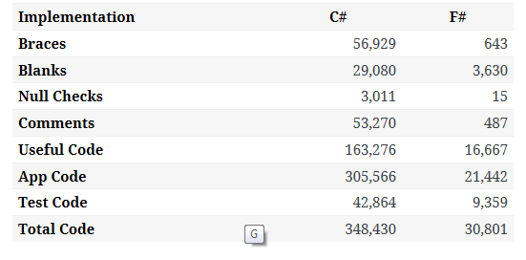

Slide 32
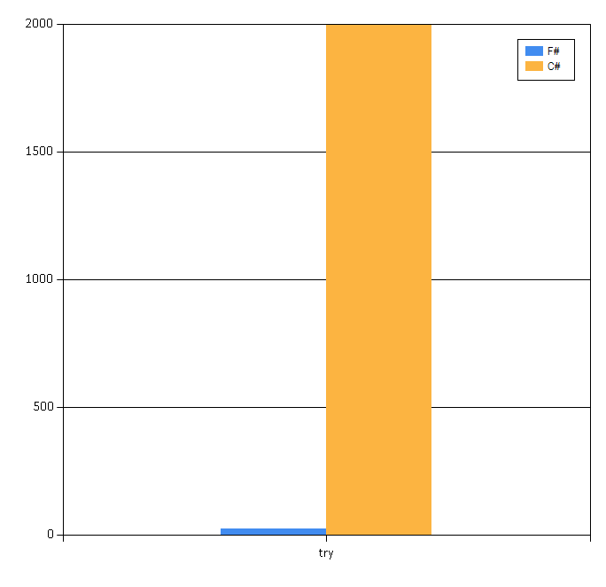

Slide 33
Simon Cousins, Energy Sector
Zero
bugs in deployed system
“F# is the safe choice for this project,
any other choice is too risky”
An application to evaluate the revenue due from Balancing Services contracts in the UK energy industry
http://simontcousins.azurewebsites.net/does-the-language-you-use-make-a-difference-revisited/

Slide 34
Positive Synthesis Achieved some limitations remain… and there is one area in particular that’s worth discussing….
Functional
Objects

Slide 35
Circularities and Modularity in the Wild (Analysis by Scott Wlaschin and F# Community)

Slide 36
Mixed OO/Functional Programming Has Won Lambdas in C#, Java, C++, … Async monadic modality in C#, Javascript, PHP (Hack), … Function types in C#, TypeScript, … Generics in C#, Java, Visual Basic, … …

Slide 37
… except where it hasn’t Inheritance everywhere!!! Nulls everywhere!!! Circularities everywhere!!!!

Slide 38
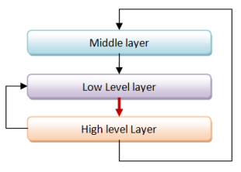
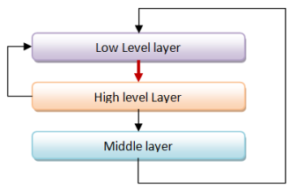
Unnecessary Circularities are Evil
To the functional programmer, it is “obvious” that our software methodology should help minimize and reduce cyclic dependencies in program structure.

Slide 39
The C# approach to circularity
All files in an “assembly” are mutually referential
Arbitrary circularity and dependency between “internal” items in an assembly
[InternalsVisibleTo] can reveal internals of one assembly to another
Mutually recursive “assemblies” are possible if you try hard

Slide 40
The F# approach to circularity
Like Haskell and all Hindley-Milner languages, F# has a file ordering
F# prohibits direct circularities across files
F# encourages minimizing dependencies within a file
Parameterization the preferred technique
F# objects support limited forms of circularity when needed

Slide 41
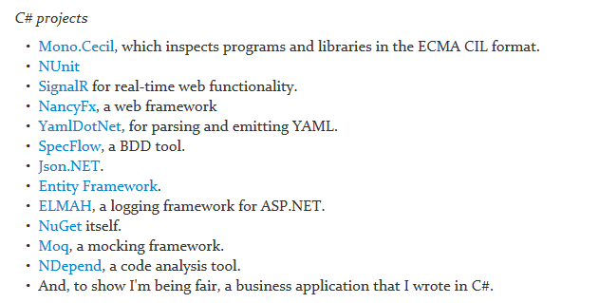
Let’s analyse some C# and F# projects

Slide 42
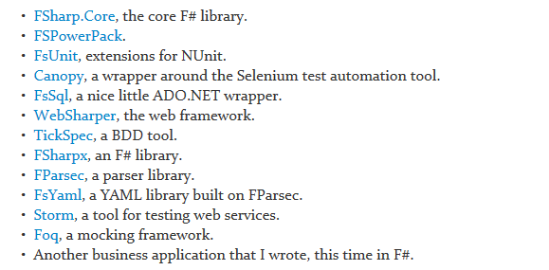
Let’s analyse some C# and F# projects

Slide 43
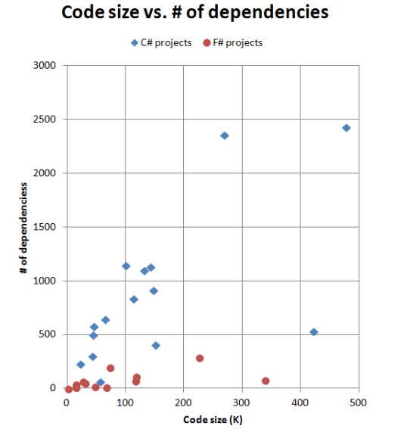
F# code has fewer top-level dependencies

Slide 44
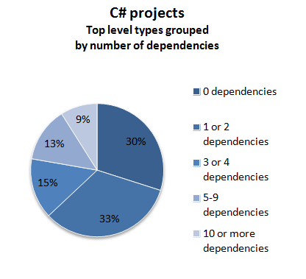
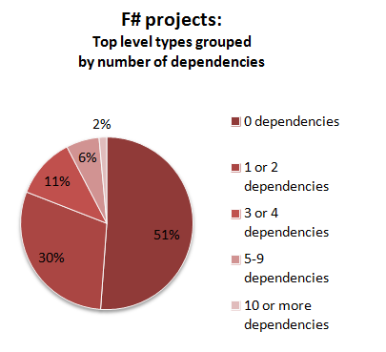

Slide 45
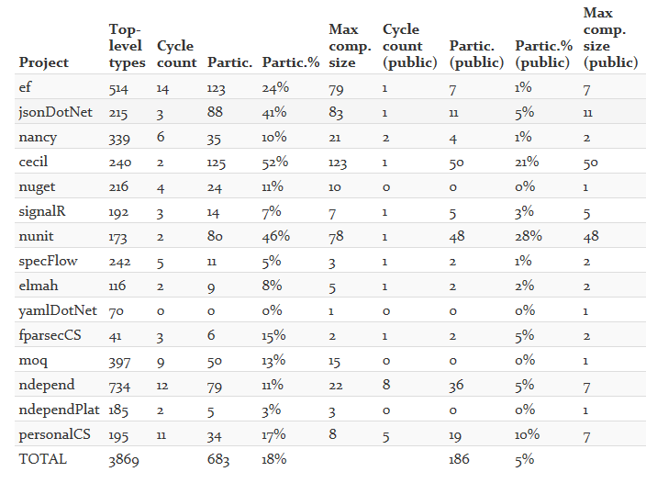

Slide 46
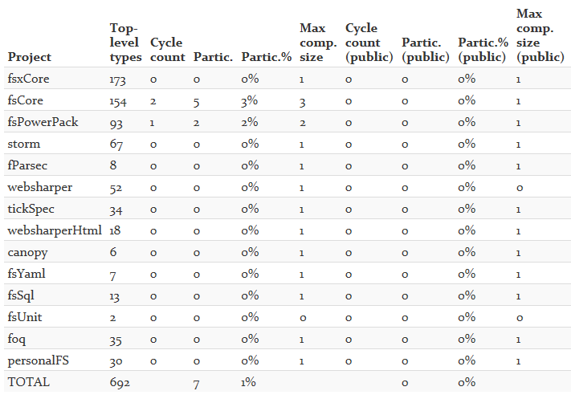

Slide 47
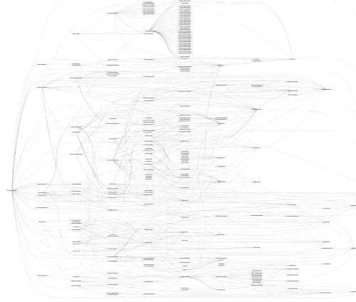
SpecFlow (C#)

Slide 48
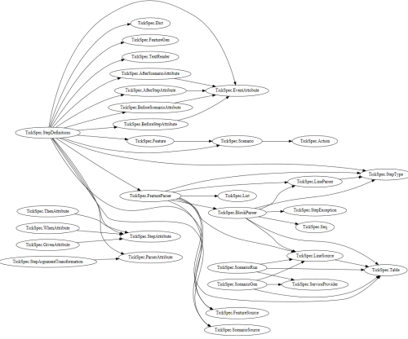
TickFlow (F#)

Slide 49
What about circularity?

Slide 50
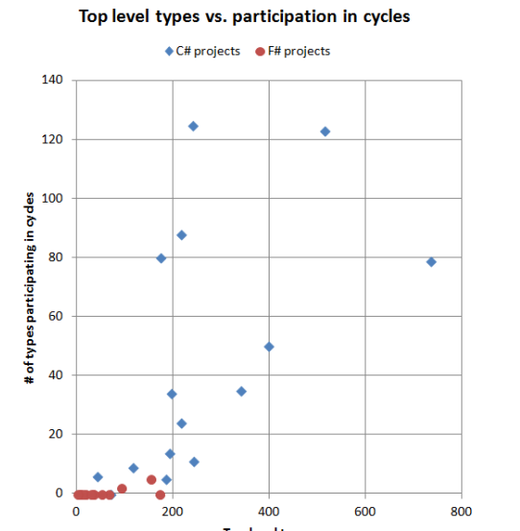
Why the difference between C# and F#?
In C#, there is nothing stopping you from creating cycles. In fact, you have to make a special effort to avoid them.
In F#, you can't easily create cycles at all.

Slide 51
Microsoft Entity Framework
TickFlow

Slide 52
In theory and in practice, unmoderated intra-component cycles are a disaster Language mechanisms that enforce acyclicity are good

Slide 53
Pattern Matching
Abstraction

Slide 56
Pattern matching is a lovely feature but without a way to name, abstract and parameterize patterns, it’s a real problem in practice

Slide 58
Enter F# Active Patterns…. (Similar to Scala extractors, designed at the same time in loose cooperation)

Slide 59
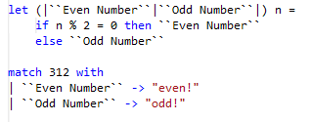

Slide 60
F# active patterns to view F# abstract syntax trees

Slide 61
module BasicPatterns =
let (|Value|_|) (e:FSharpExpr) = ...
let (|Const|_|) (e:FSharpExpr) = ...
let (|TypeLambda|_|) (e:FSharpExpr) = ...
let (|Lambda|_|) (e:FSharpExpr) = ...
let (|Application|_|) (e:FSharpExpr) = ...
let (|IfThenElse|_|) (e:FSharpExpr) = ...
let (|Let|_|) (e:FSharpExpr) = ...
let (|LetRec|_|) (e:FSharpExpr) = ...
let (|NewRecord|_|) (e:FSharpExpr) = ...
let (|NewUnionCase|_|) (e:FSharpExpr) = ...
let (|NewTuple|_|) (e:FSharpExpr) = ...
let (|TupleGet|_|) (e:FSharpExpr) = ...

Slide 62
F# active patterns to view C# abstract syntax trees

Slide 63
let (|IdentifierNameSyntax|_|) (n: CSharpSyntaxNode) =
match n with
| :? IdentifierNameSyntax as t -> Some(t.CSharpKind(), t.Identifier)
| _ -> None
let (|IdentifierName|_|) (n: CSharpSyntaxNode) =
match n.CSharpKind() with
| SyntaxKind.IdentifierName -> ...
| _ -> None
let (|QualifiedNameSyntax|_|) (n: CSharpSyntaxNode) =
match n with
| :? QualifiedNameSyntax as t -> ...
| _ -> None
let (|QualifiedName|_|) (n: CSharpSyntaxNode) =
match n.CSharpKind() with
| SyntaxKind.QualifiedName -> ...
| _ -> None

Slide 65
Relaxation Achieved An extremely useful mechanism that greatly expands the utility of pattern matching in the language
Pattern Matching
Abstraction

Slide 66
Code
Data

Slide 67
We are living through an information revolution

Slide 68
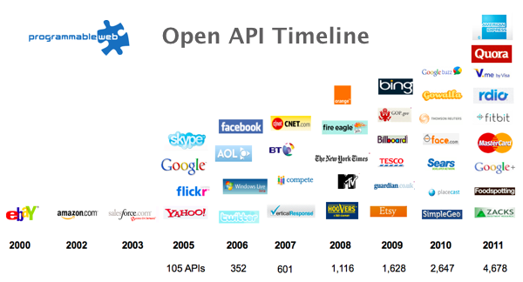
The Information Revolution
2012
2013
6,432
10,537

Slide 69
Paradigm Locator
Statically Typed
Dynamically Typed
Options
make statically typed langs more dynamic
make dynamically typed langs more static
apply moderated static typing much more broadly

Slide 70
We need to bring information into the language… At internet-scale, strongly tooled, strongly typed

Slide 71
http://fsharp.github.io/FSharp.Data/images/csv.gif http://fsharp.github.io/FSharp.Data/images/wb.gif

Slide 72
Relaxation Achieved (200%) F# Type Providers have been a staggeringly successful feature – their range of useful application is enormous. They bring data and typed programming into synthesis like no other feature around
Code
Data

Slide 73
X
Y
?

Slide 74
Sync
Async

Slide 75
Relaxation Achieved (200%) See F# Async
Sync
Async

Slide 76
Numbers
Numbers-with Units

Slide 77
Relaxation Achieved (95%) F# units-of-measure are good, useful and non-intrusive. But there must surely be further ways to generalize the addition of meta-annotations and checking. Haskell work is exploring this.
Units
Non-units

Slide 78
GPU
CPU

Slide 79
fsharp.org/use/gpu
Alea GPU
FSCL

Slide 80
Relaxation Achieved ☺ F# quotations unlock the use of F# as a GPU language
CPU
GPU

Slide 81
What’s Ahead? Well, most major areas of tension have been resolved But there are still some areas that bug me...

Slide 82
REPL
Distribution and Scale
?
github.com/nessos/Vagrant
github.com/nessos/mbrace

Slide 83
In Conclusion
False opposites are worth struggling over
Synthesis incredibly valuable and productive when found
Simplicity and unity is key
It’s fun too ☺

Slide 84
Questions?

