Slide 1
Succeeding with Functional-First Languages in Industry
Dr. Don Syme
F# Community Contributor,
Principal Researcher, Microsoft
@dsyme

Slide 2
F# is free, open source, cross platform, independent fsharp.org

Slide 3
F# is Cross Platform http://fsharp.org/use/linux http://fsharp.org/use/mac http://fsharp.org/use/ios http://fsharp.org/use/android http://fsharp.org/use/windows

Slide 4
F# is Multi Editor Visual Studio, Emacs, Sublime, …

Slide 5
The Recurring Business Situation
“I lead a team developing…”
Data Processing Pipelines
Service Implementations
Trading Platforms
…
Insurance Calculation Engines
Market Simulators
Server-side Game Engines

Slide 6
The Recurring Business Problems
Time to Market
Efficiency
Correctness
Complexity
for analytical components

Slide 7
Is Time to Market a Problem? Late Models → Missed market opportunities Late Services → Users have gone elsewhere Late Components → Millions evaporate
Financial model
Gaming service
Ad ranking engine
Notes:
“Take a moment to stop and think about the ramifications of time-to-market problems through software delays in analytical components for QF, FE, Trading and Calculation Engines more broadly”

Slide 8
Is Complexity a Problem? Intractable Models → Can’t enter markets Intractable Services → Can’t deliver services Intractable Analytical Components → Can’t deliver
Notes:
“Take a moment to stop and think about the ramifications of efficiency problems through software delays in analytical components for QF, FE, Trading and Calculation Engines more broadly”

Slide 9
The Recurring Business Problems
Time to Market
Efficiency
Correctness
Complexity
for analytical components and services

Slide 10
What’s the Need? Programmers delivering correct, efficient components in the enterprise, on-time This is one set of problems that functional-first programming helps solve

Slide 11
Observation #1
At the core of every functional-first language is this:
simple, correct, robust code for solving complex problems

Slide 12
Observation #2
A highly interoperable language allows rapid, non-intrusive deployment and integration of components
… functional-first code is a part of a larger solution. With F# your code can be rapidly integrated and deployed.

Slide 13
Observation #2 cont.
Interoperable languages remove entire phases from the analytical software development process.
…no R → C# …no Mathematica → C++ …no Excel → Java
Notes:
Functional programming tools empower when combined with other technologies

Slide 14
Observation #3
Strongly-typed functional-first languages maintain efficiency
…as good as C# and Java, and sometimes C++
Notes:
Functional programming tools empower when combined with other technologies

Slide 15
Observation #4
Strongly-typed functional languages help analytical programmers tackle more complex problems
…more time in the domain, less time on nulls and object hierarchies.
Notes:
Functional programming tools empower when combined with other technologies

Slide 16
Recap – How Functional-first Helps
Simple, correct, robust code
Interoperability eliminates entire phases
Strong-typing gives efficiency
Analytical developers empowered to solve complex problems

Slide 17
Example #1 (power company)
I have written an application to balance the national power generation schedule … for an energy company.
...the calculation engine was written in F#.
The use of F# to address the complexity at the heart of this application clearly demonstrates a sweet spot for the language … algorithmic analysis of large data sets.
Simon Cousins (Eon Powergen)

Slide 18
Example #1 (power company)
Time to Market
Efficiency
Interoperation ... Seamless. The C# programmer need never know.
Units of measure … a huge time saver...it eradicates a whole class of errors…
Exploratory programming …Working with F# Interactive allowed me to explore the solution space more effectively.
Unit testing …a joy to test. There are no complex time-dependent interactions to screw things up….
Parallelism …The functional purity ... makes it ripe for exploiting the inherent parallelism in processing vectors of data.
Code reduction… … vectors and matrices…higher order functions eat these for breakfast with minimal fuss, minimal code. Beautiful.
Lack of bugs… Functional programming can feel strange. .. once the type checker is satisfied that’s often it, it works.
Correctness
Time to Market
Time to Market
Correctness
Correctness

Slide 19
A related analysis (Simon Cousins, Energy Sector)
350,000
lines of C# OO
by offshore team
30,000
lines of robust F#, with
parallel +more features
An application to evaluate the revenue due from Balancing Services contracts in the UK energy industry
http://simontcousins.azurewebsites.net/does-the-language-you-use-make-a-difference-revisited/

Slide 20
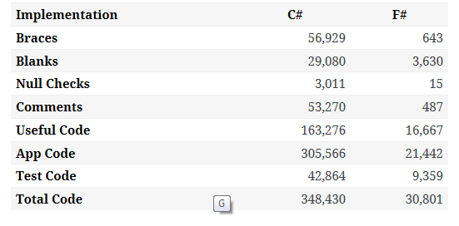

Slide 21
A related analysis (Simon Cousins, Energy Sector)
Zero
bugs in deployed system
“F# is the safe choice for this project,
any other choice is too risky”
An application to evaluate the revenue due from Balancing Services contracts in the UK energy industry
http://simontcousins.azurewebsites.net/does-the-language-you-use-make-a-difference-revisited/

Slide 22
Example #3: F# in Insurance
Time to Market
Complexity
I work for a large actuarial company... …Despite adopting Agile/Scrum …the usual delays, complications and sometimes …failures.
We used F#, and quickly created a system which would perform the necessary calculations highly efficiently, in parallel, and with a perfect match to the spreadsheet results.
All of the advantages which are commonly touted for F# do play out in practice. Immutability, Easy Parallelisation, Expressiveness, Testability, Conciseness, Flexibility, Productivity
[ Company name omitted ]
Efficiency
Correctness
fsharp.org/testimonials

Slide 23
Example #6: F# in Biotech
Efficiency
...F# rocks - building algorithms for DNA processing and it's like a drug. 12-15 at Amyris use F#... A complete genome resequencing pipeline with interface, algs, reporting in ~5K lines and it has been incredibly reliable, fast and easy to maintain.. A suffix tree in 150 lines that can index 200,000 bases a second
F# v. Python: F# has been phenomenally useful. I would be writing a lot of this in Python otherwise and F# is more robust, 20x - 100x faster to run and faster to develop.
Darren Platt, Amyris BioTechnologies
Correctness
Time to Market

Slide 24
Example #7: F# in Advertisement Ranking & Rating @ Microsoft
Time to Market
Around 95% of the code in these projects has been developed in F#.
F# allowed for rapid development of prototypes, and thus also rapid verification or falsification of the underlying mathematical models.
Complex algorithms, for example to compute Nash equilibria in game theory, can be expressed succinctly.
Units of measure reduced the chance of errors dramatically: Prices, probabilities, derivatives, etc. can already be kept apart at compile time.
Taming Complexity
Correctness

Slide 25
Example #11: F# for Social Gaming
Efficiency
F# is becoming an increasingly important part of our server side infrastructure that supports our mobile and web-based social games with millions of active users. F# first came to prominence in our technology stack in the implementation of the rules engine for our social slots games which by now serve over 700,000 unique players and 150,000,000 requests per day at peaks of several thousand requests per second.
The F# solution offers us an order of magnitude increase in productivity and allows one developer to perform the work that are performed by a team of dedicated developers on an existing Java-based solution, and is critical in supporting our agile approach and bi-weekly release cycles.
Yan Cui, Lead Server Engineer
Time to Market
http://fsharp.org/testimonials

Slide 27
Summary – The Data Agrees
Simple, correct, robust code
Interoperability improves time-to-market
Strong-typing gives efficiency
Analytical developers empowered to solve complex problems

Slide 28
Summary – F#
F#
The safe choice for functional-first
Unbeatable, practical, scalable data integration
Tooling for Windows, Linux, OSX, Android, iOS and more
Open, cross-platform, strongly typed, efficient, rock-solid stable

Slide 29
To find out more…
Learn F# at tryfsharp.org (including financial)
Lots of resources at fsharp.org
Join the Copenhagen Functional Meetup Group!
Testimonials at fsharp.org/testimonials
Over 100 videos at fsharp.org/videos

Slide 30
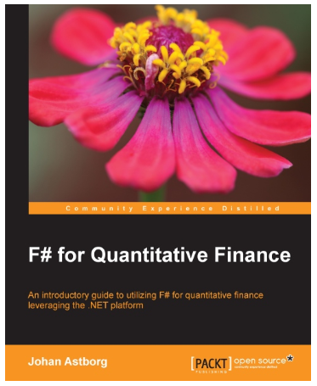
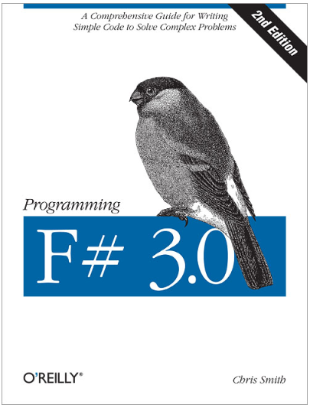
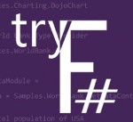
Questions?
tryfsharp.org

