Slide 1
F# Friday in Redmond!

Slide 2
F# Thursday in Redmond!

Slide 3
F# Meetups and How they Work

Slide 4
Learn
Open, Cross-platform,
Less Language, more Doing
Hands-on, Tutorials
Present other people’s work
Focus on Upstack
Be Curious
Contribute
Enjoy
Broad

Slide 5
Very happy to be part of this (F# London)

Slide 6
TL;DR – Where we are now
F# is open, cross-platform, independent
The F# Compiler Service powers many other tools
F# 4.0 is wrapping up
Debian and other packages for Linux
The F# language is accepting contributions
The F# community is very “self-empowered”
fsharp.org
The Visual F# Tools are professional tools for Windows and Azure
Xamarin provide F# tools Android and iOS

Slide 7
A functional-first approach makes a huge difference in practice fsharp.org/testimonials

Slide 8
An analysis (Simon Cousins, Energy Sector)
350,000
lines of C# OO
by offshore team
30,000
lines of robust F#, with
parallel +more features
An application to evaluate the revenue due from Balancing Services contracts in the UK energy industry
http://simontcousins.azurewebsites.net/does-the-language-you-use-make-a-difference-revisited/

Slide 9
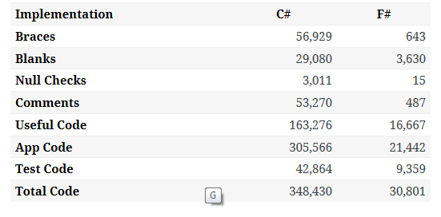

Slide 10
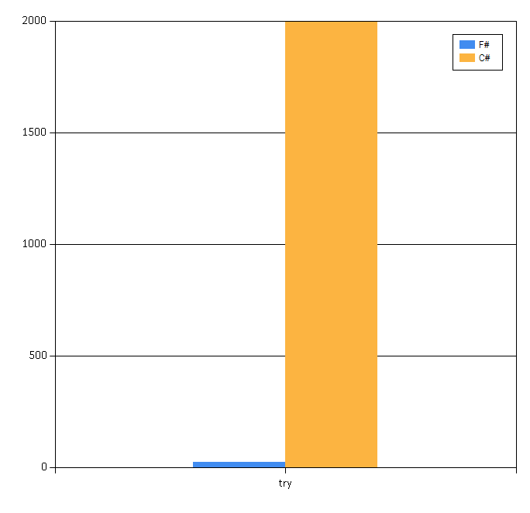

Slide 11
Simon Cousins, Energy Sector
Zero
bugs in deployed system
“F# is the safe choice for this project,
any other choice is too risky”
An application to evaluate the revenue due from Balancing Services contracts in the UK energy industry
http://simontcousins.azurewebsites.net/does-the-language-you-use-make-a-difference-revisited/

Slide 12
The F# Language Design Process fslang.uservoice.com

Slide 13
The F# Compiler Service fsharp.github.io/FSharp.Compiler.Service FsReveal

Slide 14
The F# Language Design Process fslang.uservoice.com

Slide 15
Relaxation Achieved ☺ Enterprise Quality + Openness + Community + Tooling + Ecosystem + Evolution Path = Goodness
Enterprise
Openness

Slide 16
A bit about My Current Focus

Slide 17
REPL
Distribution and Scale
?
github.com/nessos/Vagrant
github.com/nessos/mbrace

Slide 18
F# → Cloud Visual F# → Azure

Slide 19
F# Brings Four Very Unique and Important Things to Cloud Programming
Functional-first Programming
no nulls, great perf, interop, simplicity
REPL in Visual Studio
Playful, experimental, data-oriented
Type Providers
REST, XML, CSV, Azure Storage, DocumentDB…
cloud { … }
m-brace.net

Slide 20
Overview – m-brace, cloud { … }
Many F# users need simple, reliable scale-out frameworks
I have a strong hope that the F# community can converge around one of these frameworks (“Spark for F#” + more)
MBrace + Azure is one combination I am keeping an eye on (giving advice, trialling etc.)

Slide 21
Overview - MBrace
Execution model
cluster -- handle to cluster
Cloud<T> -- piece of cloud computation computing T
cloud { … } -- cloud computation
Job control:
cluster.CreateProcess -- start a job, asynchronously
cluster.Run -- run a job, synchronously
cluster.GetProcess(“fklhewlkjecljkw”) -- fetch a job
job.ShowInfo()/ShowLogs() -- display a job
job.Kill() -- etc.
Data:
CloudCell<T> -- handle to immutable blob in Azure storage
CloudAtom<T> -- handle to transactional blob in Azure storage
CloudFile -- handle to partitioned file in Azure storage
CloudChannel<T> -- Azure queues
Data Flow:
CloudStream.map/groupBy/filter/sort/… -- compositional parallel data flow

Slide 22
Overview – Basic Variations on Scale-out
Actor Frameworks (Akka, Akka.NET, Erlang, …)
Problems: lots of queue state, hard to design, hard to debug, no incremental path
“Azure Solutions” – pre-baked C# templates for Azure
Problems: Much enterprise, “batch” becomes a Windows application, F# fit is poor, data abstractions are Azure-specific
Big data systems (Hadoop, Spark, …)
Problems: OK for PB of data, stupid overkill for anything less. Hype. Linux-oriented. Messy implementations. Batch-only, poor response times. Limited compute models (map-reduce).
“Roll your own” – manage your own pool of VMs on Azure
Problems: you end up writing your own middleware framework, need fulltime dev to manage it, eventually gets retired

Slide 23
Overview - MBrace
MBrace =
an abstract F#/C# distributed programming model (MBrace.Core)
mapped to Azure VMs + Queue + Storage + job control (MBrace.Azure)
with free cheerful provisioning (Elastacloud Brisk)
with serialization of code and data (Vagabond)
with F# Interactive integration (code transport with MBrace.Azure.Client)
Experience
Fun to use, makes me feel empowered as an F# programmer
Azure is “your data/compute slave”
More experimenting and playing, less deploy/design

Slide 24
Overview - MBrace
Cultural Matters
Open Source (Apache 2.0)
Currently an informal partnership between two consultancies + MSR input
Programming model is “independent” of Azure, good for the long term
Likely uses and observations:
Very nice for CPU batch programming
Good for Large-scale Data batch processing
Plausible for incremental/streaming programming (needs work)
Plausible for backend cloud service architecture (not there yet though)
Needs F# experience to use, plus a training session

Slide 25
Questions?

