Slide 1
Fast, Distributed Machine Learning for Python using H2O
Hank Roark
@hankroark
hank@h2o.ai

Slide 2
WHO AMI I
Lead, Customer Data Science @ H2O.ai
John Deere: Research, Software Product Development, High Tech Ventures
Lots of time dealing with data off of machines, equipment, satellites, weather, radar, hand sampled, and on.
Geospatial, temporal / time series data almost all from sensors.
Previously at startups and consulting (Red Sky Interactive, Nuforia, NetExplorer, Perot Systems, a few of my own)
Engineering & Management MIT Physics Georgia Tech
hank@h2oai.com @hankroark https://www.linkedin.com/in/hankroark

Slide 3
IF YOU ARE INTO DATA, THE IOT HAS IT

Slide 4
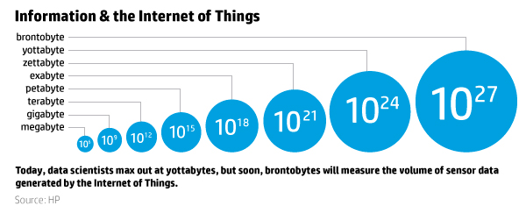
WHY THIS EXAMPLE?
GET READY FOR BRONTOBYTES!!

Slide 5
WOW, HOW BIG IS A BRONTOBYTE?

Slide 6
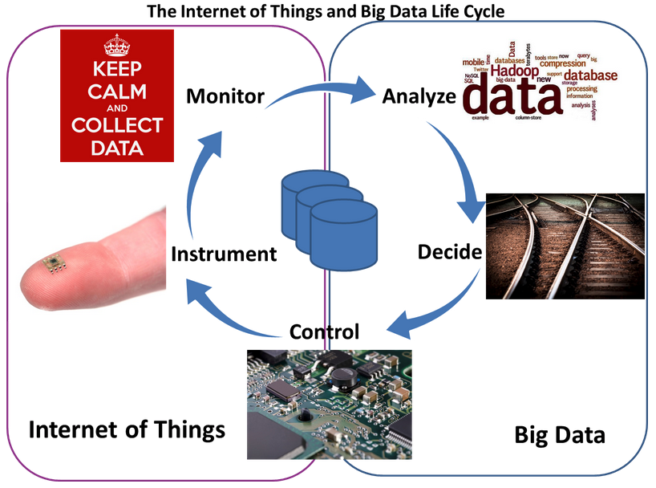
This much data will require a fast OODA loop
Image courtesy http://www.telecom-cloud.net/wp-content/uploads/2015/05/Screen-Shot-2015-05-27-at-3.51.47-PM.png

Slide 7
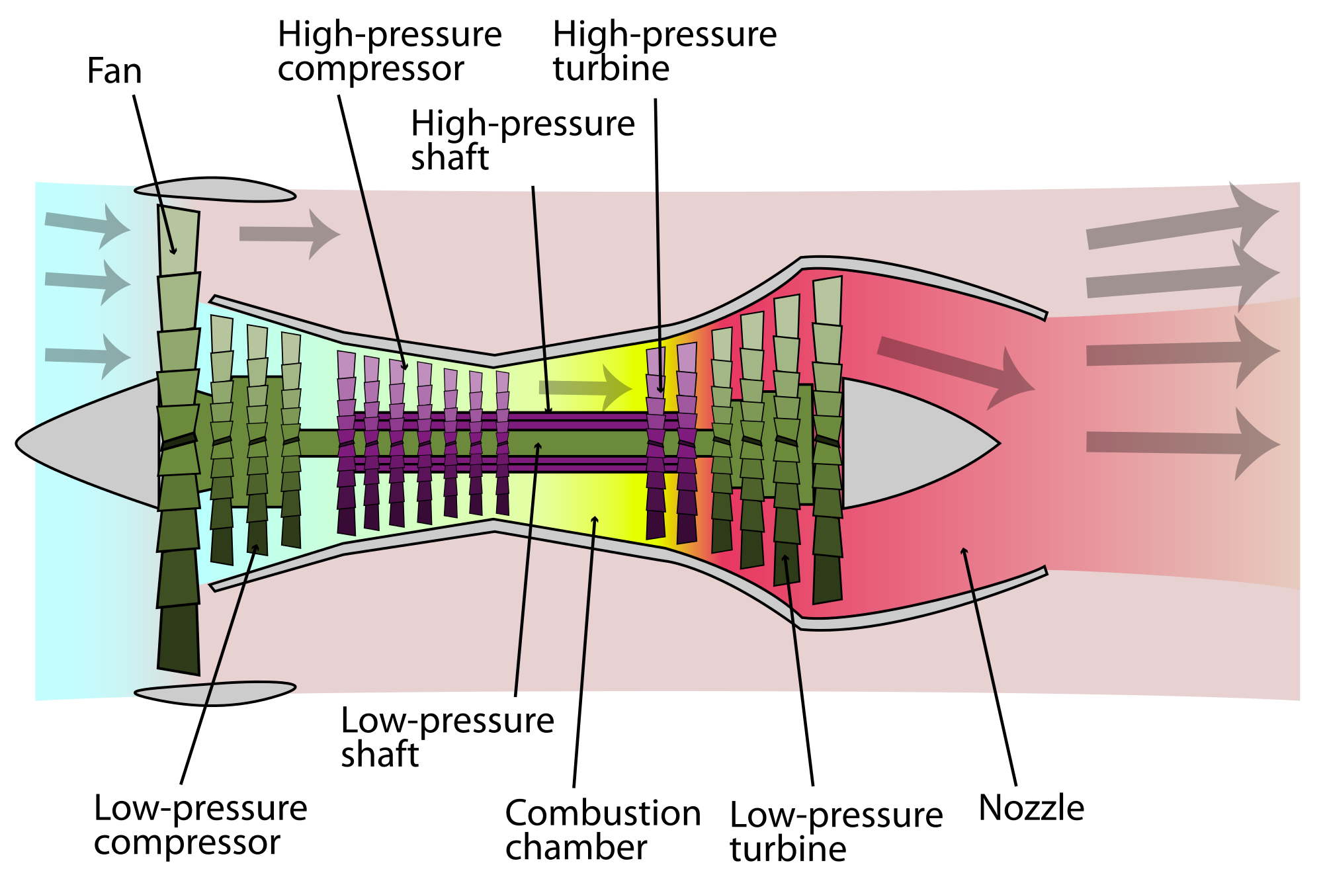
EXAMPLE FROM THE IOT
Domain: Prognostics and Health Management
Machine: Turbofan Jet Engines
Data Set: A. Saxena and K. Goebel (2008). "Turbofan Engine Degradation Simulation Data Set", NASA Ames Prognostics Data Repository
Predict Remaining Useful Life from Partial Life Runs
Six operating modes, two failure modes, manufacturing variability
Training: 249 jet engines run to failure
Test: 248 jet engines

Slide 8
LOADING DATA

Slide 9
PYTHON (AND R) OBJECTS ARE PROXIES FOR BIG DATA
STEP 1
h2o_df = h2o.import_file(“hdfs://path/to/data.csv”)
Python user

Slide 10
PYTHON (AND R) OBJECTS ARE PROXIES FOR BIG DATA
STEP 2
2.3
Initiate distributed ingest
H2O Cluster
2.2
Python
H₂O
HTTP REST API request to H₂O
has HDFS path
H₂O
h2o.import_file()
H₂O
2.1
Python function call
2.4
Request data from HDFS
HDFS
NFS
S3
data.csv
Notes:
Data never goes into or through Python
Python tells H2O what to do
Python has a pointer to the big data that lives in H2O
Operations on the Python object are intercepted using operator overleading and forwarded to H2O via the REST API
H2OFrame object in Python is a proxy for the big data in H2O
Python: df= h2o.import_file(“hdfs://path/to/data.csv”)
h2o_df is an H2OFrame object in R

Slide 11
PYTHON (AND R) OBJECTS ARE PROXIES FOR BIG DATA
STEP 3
3.2
Distributed H₂O
Frame in DKV
H2O Cluster
3.3
Python
H₂O
h2o_df
Return pointer to data in REST API JSON Response
H₂O
H₂O
Frame
Cluster IP
Cluster Port
Pointer to Data
H₂O
3.4
h2o_df object created in Python
3.1
HDFS provides data
HDFS
NFS
S3
data.csv

Slide 12
SUMMARY STATISTICS

Slide 13
FEATURE ENGINEERING
Calculate Total Cycles
For Each Unit

Slide 14
FEATURE ENGINEERING
Append To OriginalFrame

Slide 15
CREATE THE TARGET VARIABLE
Create New Feature of Cycles Remaining

Slide 16
EXPLORATORY DATA ANALYSIS
Boolean Indexing

Slide 17
EXPLORATORY DATA ANALYSIS
Sample the data to local memory

Slide 18
EXPLORATORY DATA ANALYSIS
Use your favorite visualization tools
(Seaborn!)
Ugh, where are trends over time
Zero
Remaining
Useful
Life
Time

Slide 19
MODEL BASED DATA ENRICHMENT
Sensor measurements appear in clusters
Corresponding to operating mode!

Slide 20
FEATURE ENGINEERING
Use H2O k-means to find cluster centers

Slide 21
FEATURE ENGINEERING
Enrich existing data with operating mode membership

Slide 22
MORE FEATURE ENGINEERING
For non-constant sensor measurements within an operating mode,
Standardize each sensor measurement by operating mode
Based on the training data

Slide 23
TRENDS OVER TIME!
Time
Time
Before H2O Data Preparation
Ready for H2O Learning

Slide 24
MODELING - SIMPLE
Configure an
Estimator

Slide 25
MODELING - SIMPLE
Train an Estimator

Slide 26
PYTHON SCRIPT STARTING H2O GLM
TCP/IP
HTTP
HTTP
REST/JSON
REST/JSON
Legend
POST /3/ModelBuilders/glm
/3/ModelBuilders/glm endpoint
Network layer
Job
REST layer
glm_estimator.train()
GLM algorithm
H2O - algos
GLM tasks
H2O - core
Python script
Fork/Join framework
K/V store framework
User process
Standard Python process
H2O process
H2O process

Slide 27
PYTHON SCRIPT STARTING H2O GLM
TCP/IP
HTTP
HTTP
REST/JSON
REST/JSON
Legend
GET /3/Models/model_id
/3/Models endpoint
Network layer
REST layer
glm_estimator.show()
H2O - algos
H2O - core
Python script
Fork/Join framework
K/V store framework
User process
Standard Python process
H2O process
H2O process

Slide 28
MODEL EVALUATION
Evaluate Performance
at a glance in Python

Slide 29
MODEL EVALUATION
Evaluate Performance
at a glance in H2O Flow

Slide 30
MODEL EVALUATION
Evaluate Performance
at a glance graphically in Python

Slide 31
CROSS VALIDATION
Setup
Hyperparameter
Search Options

Slide 32
CROSS VALIDATION
Configure full full grid search

Slide 33
CROSS VALIDATION
Execute grid search

Slide 34
CROSS VALIDATION
Evaluate results & model selection

Slide 35
OPEN– SCIKIT PIPELINES
Create Pipelines
Hyper-parameter Options
Cross validation strategy
Hyper-parameter
Search Strategy
Fit

Slide 36
OPEN - POST PROCESSING

Slide 37
RESOURCES
Download and go: http://www.h2o.ai/download
Documentation: http://docs.h2o.ai/
Booklets, Datasheet: http://www.h2o.ai/resources/
Github: http://github.com/h2oai/
Training: http://learn.h2o.ai/ (Notebook is in this location)
This presentation (look in 2016_01_16_DataDayTexas): https://github.com/h2oai/h2o-meetups/

Slide 38
THANK YOU

