Slide 1
Apache Ambari 2.2
What’s New
December 2015

Slide 2
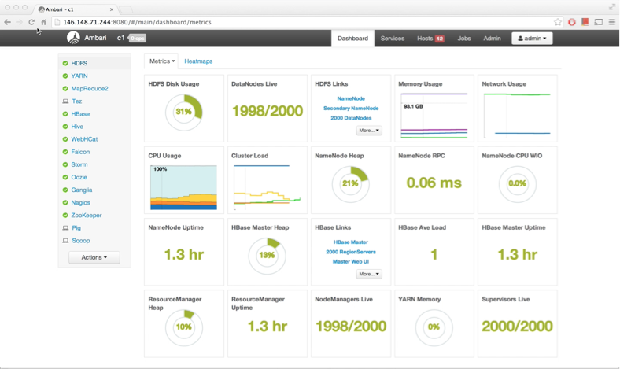
What is Ambari?
Apache Ambari is the open source operational platform to provision, manage and monitor Hadoop clusters

Slide 3
What’s New in Ambari 2.2
Core Features
Express Upgrade (AMBARI-13407)
Export Metrics Widget Graphs (AMBARI-13313)
User Timezones (AMBARI-13293)
Selectable Dashboard Time Range (AMBARI-13331)
HDP Stack Features
Ranger Guided Configs (AMBARI-13263)
Security Features
Ambari Web Inactivity Timeout (AMBARI-13419)
Manage KDC Admin Credentials (AMBARI-13449)
Blueprints API (Tech Preview)
Ranger (AMBARI-13421)
Kerberos (AMBARI-13431)
Recommendations (AMBARI-13487)
For a complete list of changes:
https://issues.apache.org/jira/browse/AMBARI/fixforversion/12333548

Slide 4
Core Features

Slide 5
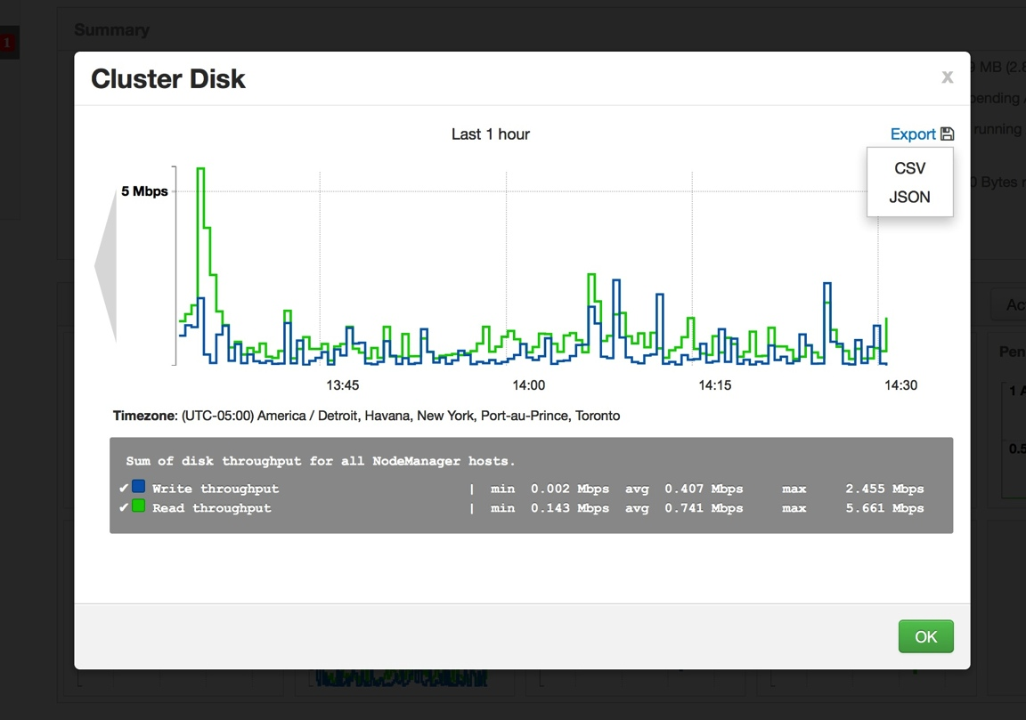
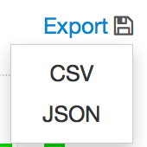
Export Metric Graph Widget Data
Export raw metrics data from the Graph Widgets
CSV or JSON format

Slide 6
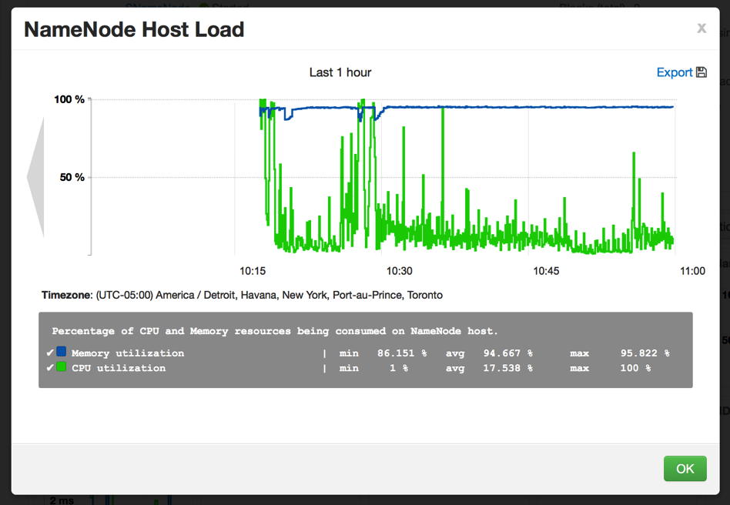
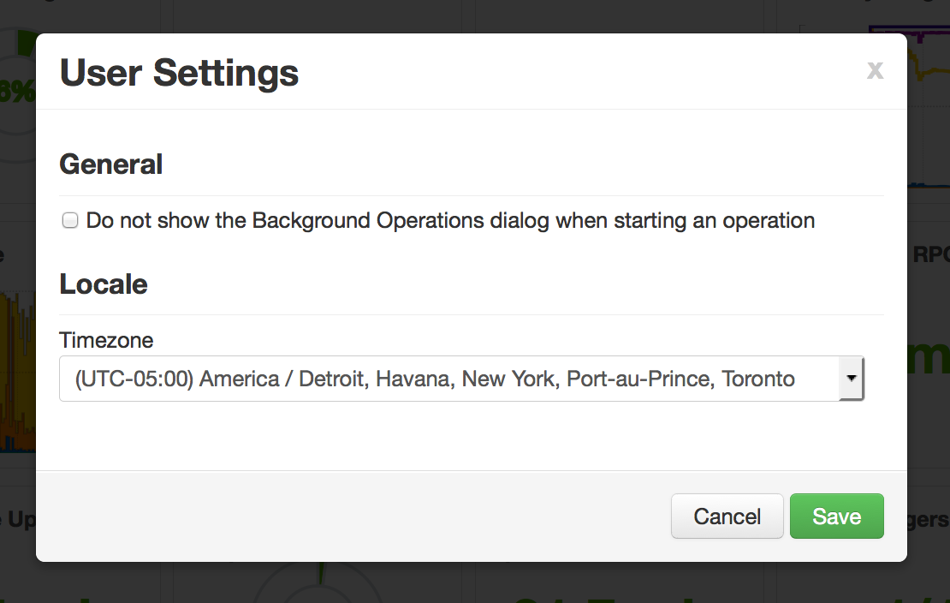
User Timezone
User configurable timezone for Ambari Web
Timezone is used for displaying of Metric Graphs data

Slide 7
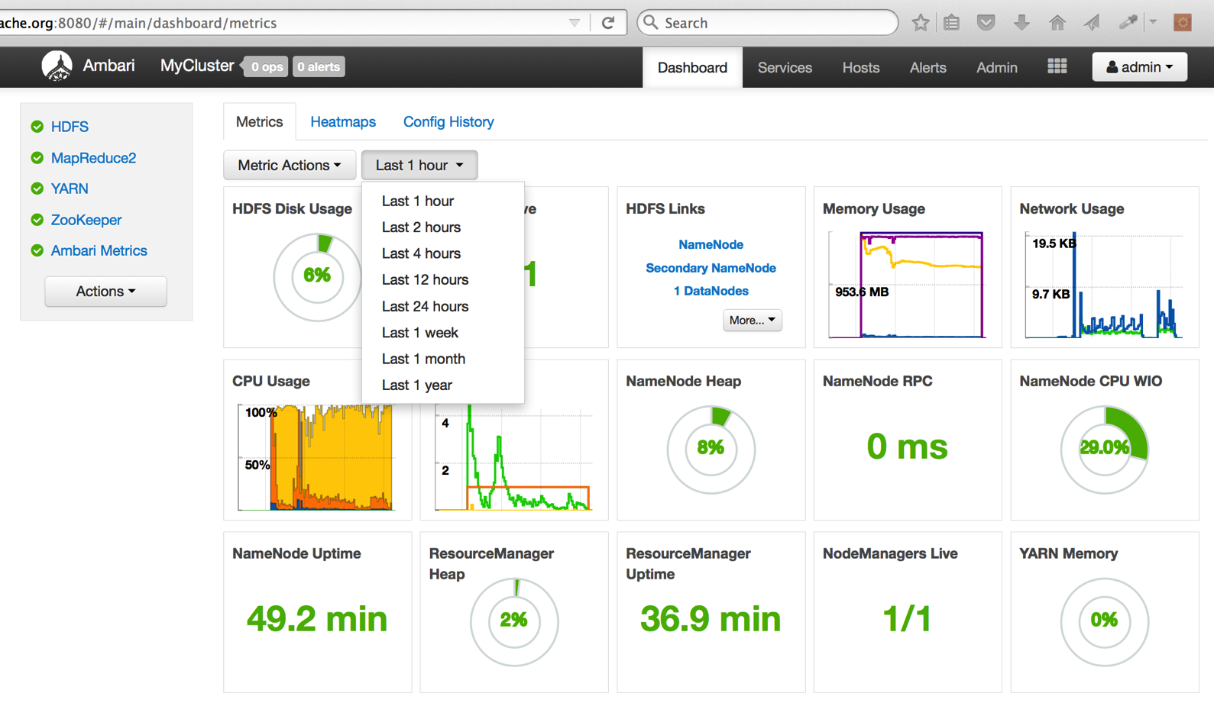
Selectable Dashboard Time Range

Slide 8
Security Features

Slide 9
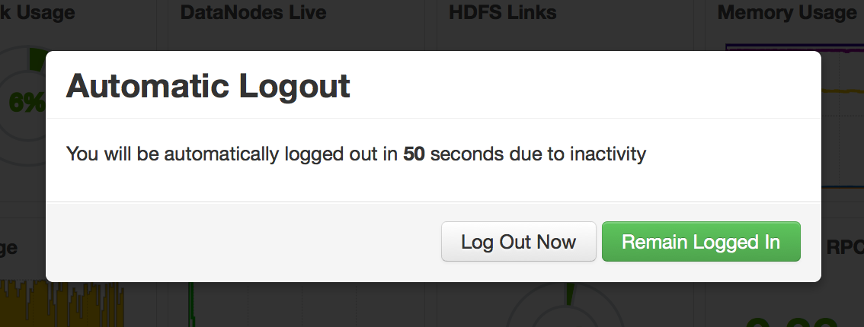
Ambari Web Inactivity Timeout
Automatically “logout” a user after a period of Ambari Web inactivity
Can be split between “operators” and “read-only” users
Configurable in ambari.properties and not enabled by default
/etc/ambari-server/conf/ambari.properties
user.inactivity.timeout.default=0
user.inactivity.timeout.role.readonly.default=0
Set the timeout (in seconds)

Slide 10
Save KDC Admin Credentials
Option for Ambari to “save” KDC Admin credentials
Eliminates need to “re-enter” credential on cluster changes

Slide 11
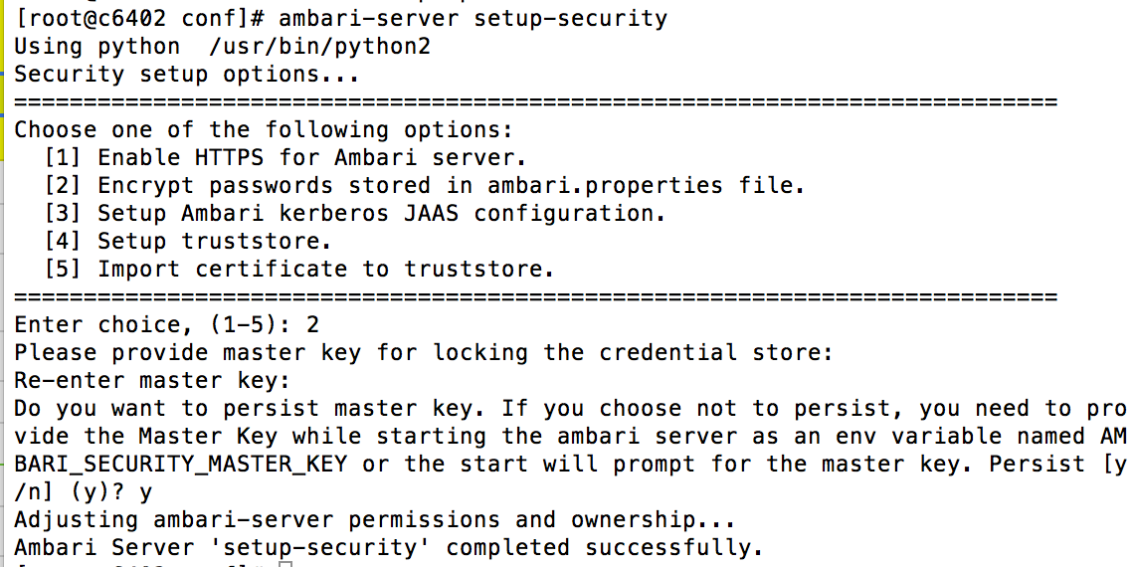
Save KDC Admin Credentials
1
Prerequisite: Ambari Server setup security Option #2 to “encrypt passwords”.
2
“Save Admin Credential” Option available in Enable Kerberos wizard.

Slide 12
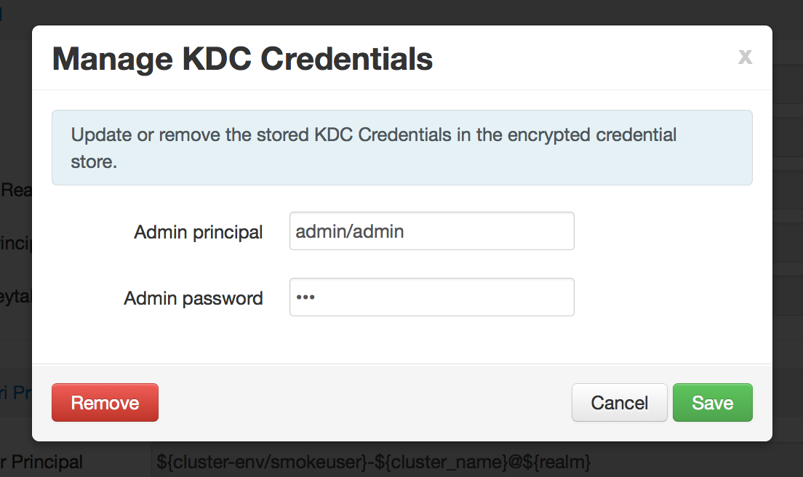
Save KDC Admin Credentials
3
Once Kerberos is enabled, you can manage the saved KDC Credentials.

Slide 13
HDP Express Upgrade

Slide 14
New!!! Ambari 2.2 Introduces HDP Express Upgrade
Express Upgrade…
is an Automated Upgrade alternative to Rolling Upgrade
has a smaller set of prerequisites than Rolling Upgrade, does not require NameNode HA
incurs cluster downtime but can finish faster
provides an Automated Upgrade option for HDP 2.1 clusters

Slide 15
New!!! What’s Possible with Ambari 2.2
Starting HDP | Target HDP | Upgrade Type | Ambari 2.2
HDP 2.3.x | HDP 2.3.y | Maintenance | Rolling Upgrade Express Upgrade
HDP 2.2.x | HDP 2.2.y | Maintenance | Rolling Upgrade Express Upgrade
HDP 2.2.x | HDP 2.3.y | Minor | Rolling Upgrade Express Upgrade
HDP 2.1.x | HDP 2.3.y | Minor | Express Upgrade

Slide 16
Automated Upgrade: Rolling or Express Choice
Check Prerequisites
Prepare
Register + Install
Perform Upgrade
Finalize
Review the prerequisites to confirm your cluster configuration is ready for upgrade
Perform the preparation steps, which include making backups of critical cluster metadata.
Register the HDP repository and install the target HDP version on the cluster.
Perform the HDP upgrade. The steps depend on upgrade method: Rolling or Express.
Finalize the upgrade, making the target version the current version.

Slide 17
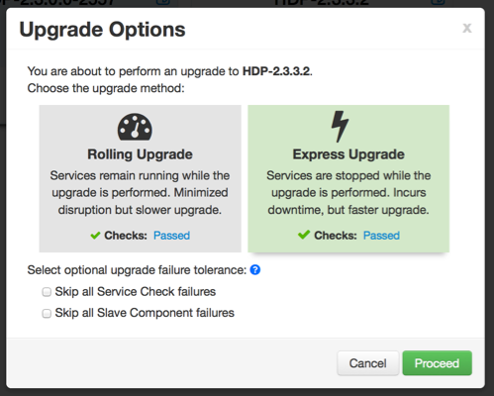
Automated Upgrade: Rolling or Express Choice

Slide 18
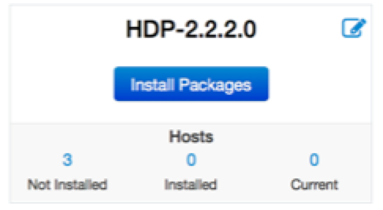
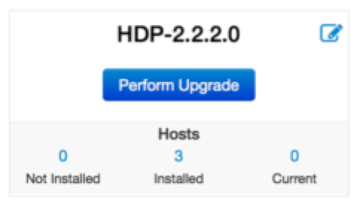
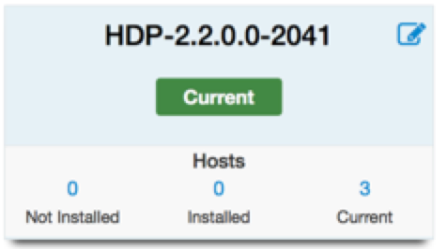
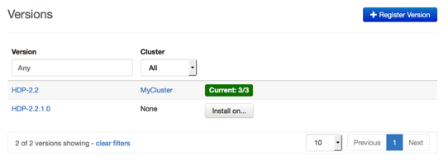
Automated Upgrade: High-Level Generally the Same
Register
Install
Perform
Upgrade
Finalize

Slide 19
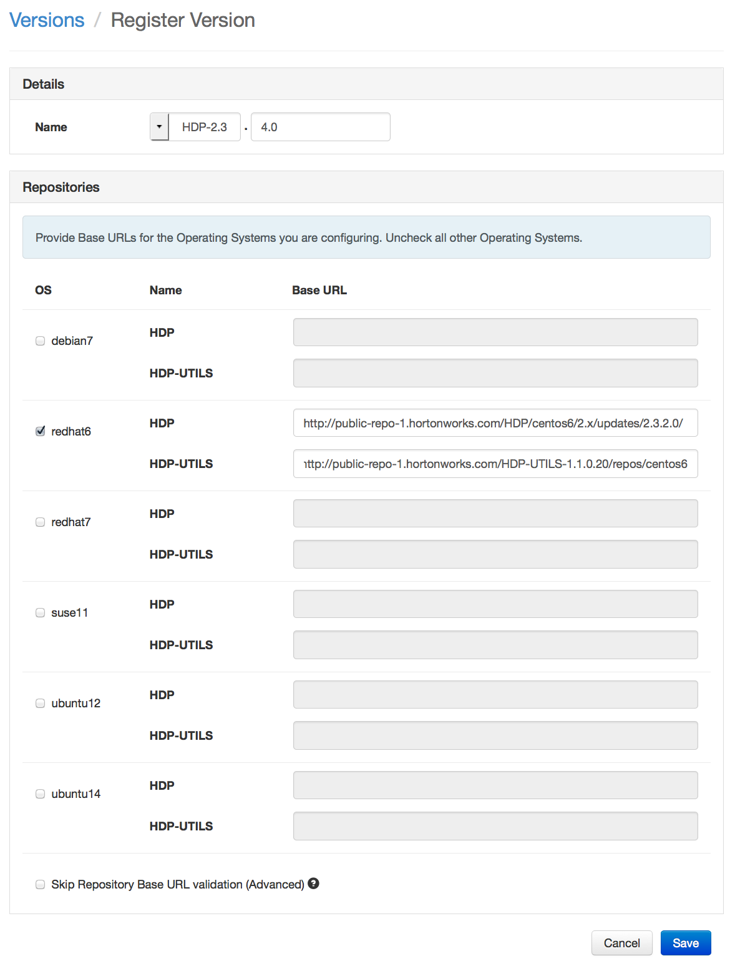
Register New Version
Register
Install
Perform
Upgrade
Finalize
Register new version with Ambari
Provide the Repository Base URLs

Slide 20
New Version Available
Register
Install
Perform
Upgrade
Finalize

Slide 21
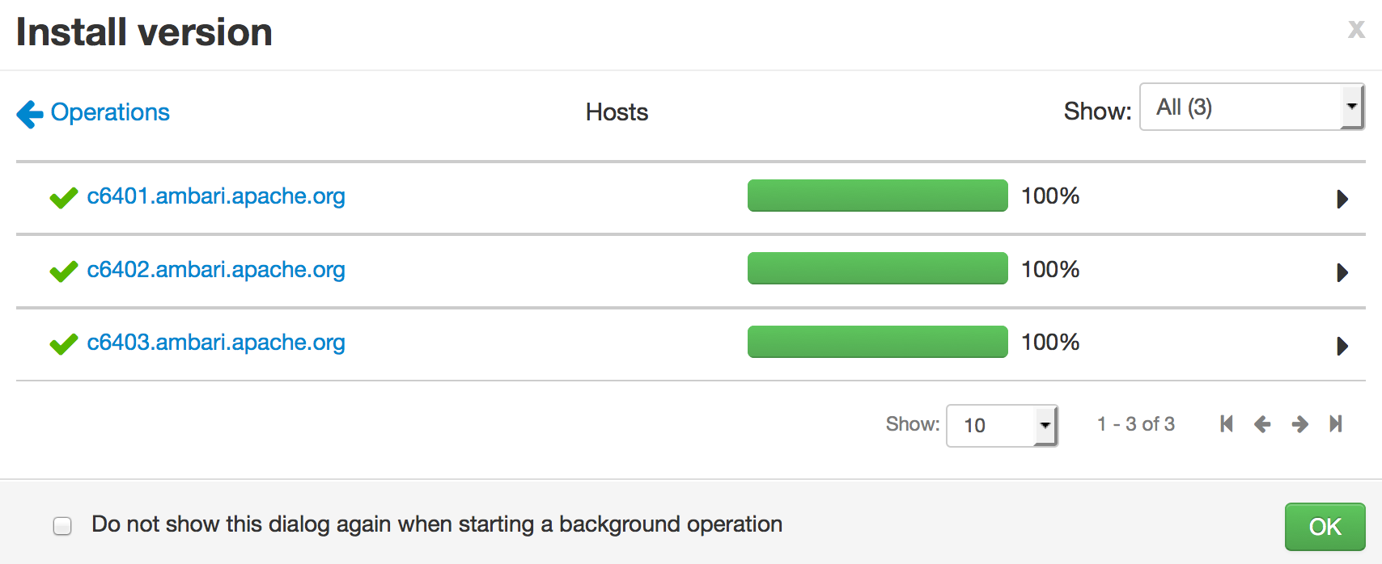
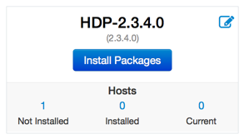
Install Packages
Register
Install
Perform
Upgrade
Finalize
Click “Install Packages” to start the install of the version across hosts

Slide 22
Perform Upgrade
Register
Install
Perform
Upgrade
Finalize

Slide 23
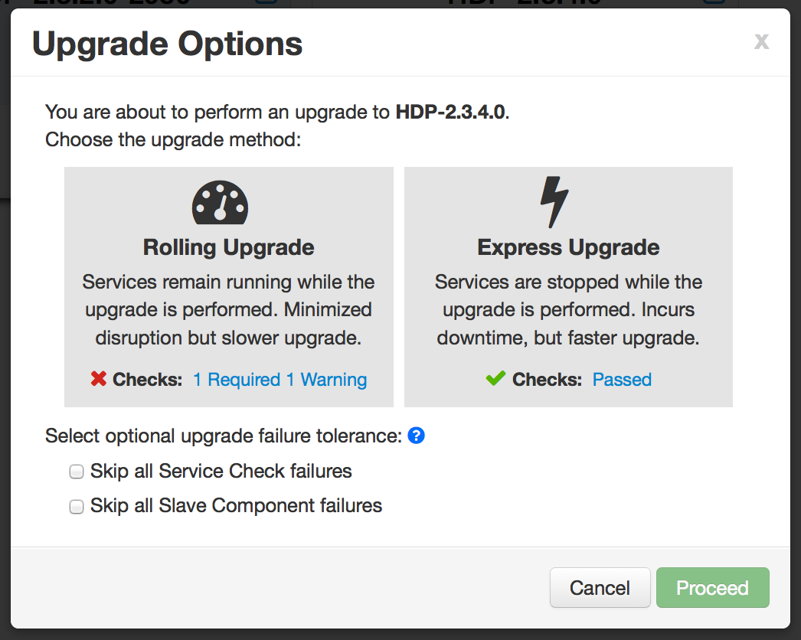
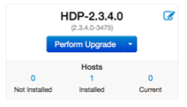
Perform Upgrade: Choose Option
Upgrade Options dialog gives you a choice of method: Rolling or Express

Slide 24
Choose Option: Rolling or Express
Checks indicate if an option is available

Slide 25
Choose Option: Rolling or Express
New options to handle failures

Slide 26
New!!! Upgrade Tolerance Options
Tolerance Option | Description
Skip all Service Check failures | Ambari will automatically skip any Service Check failures and complete the task without requiring user intervention to continue. After all the Service Checks have run in a task, you will be presented with summary of the failures and an option to continue the upgrade or pause.
Skip all Slave Component failures | Ambari will automatically skip any Slave Component failures and complete the task of upgrading Slave components without requiring user intervention to continue. After all Slave Components have been upgraded, you will be presented with a summary of the failures and an option to continue the upgrade or pause.

Slide 27
Express Upgrade Process

Slide 28
Learn More
Resource | Location
Apache Ambari Project Page | http://ambari.apache.org
Ambari Project Wiki | https://cwiki.apache.org/confluence/display/AMBARI
Ambari Project JIRA | https://issues.apache.org/jira/browse/AMBARI
Stacks | https://cwiki.apache.org/confluence/pages/viewpage.action?pageId=38571133
Blueprints | https://cwiki.apache.org/confluence/display/AMBARI/Blueprints
Views | https://cwiki.apache.org/confluence/display/AMBARI/Views

