Slide 1

HPCC Systems Open Source, Big Data Processing and Analytics
See Through Patterns, Hidden Relationships and Networks to Find Opportunities in Big Data.

Slide 2
LexisNexis

Slide 3
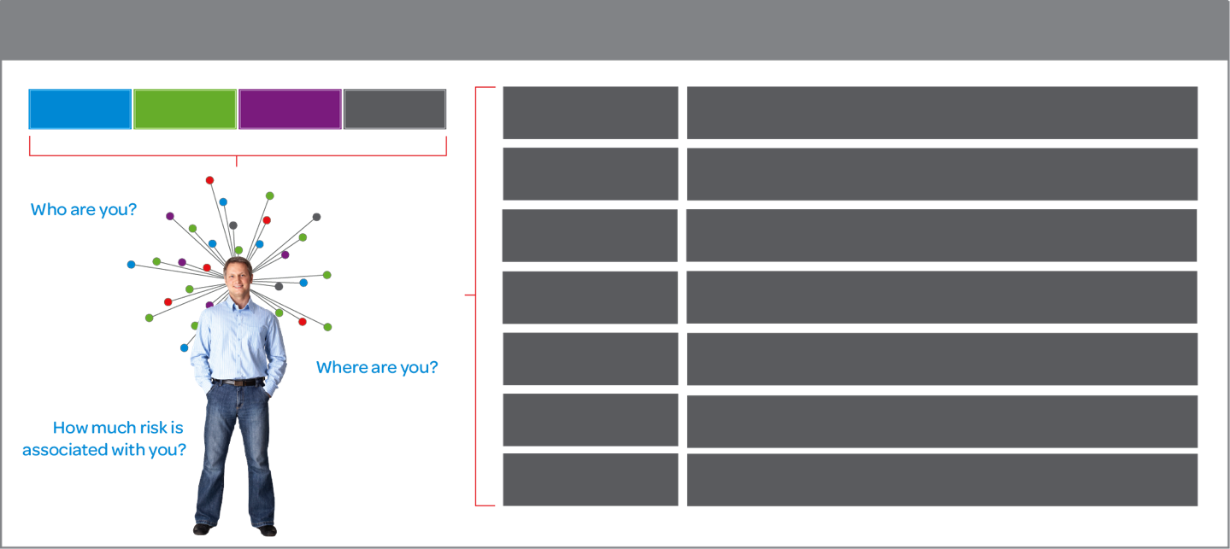
LexisNexis leverages data about people, businesses, and assets to assess risk and opportunity associated with industry-specific problems
Contributory Data
Public Records
Credit Headers
Phone Listings
Insurance
Assess underwriting risk and verify applicant data; prevent/ investigate fraudulent claims; optimize policy administration
Financial Services
Prevent/investigate money laundering and comply with laws Prevent/investigate identity fraud
HPCC Systems technology
Open Source and commercial offerings of our leading Big Data platform
Receivables Management
Assist collections by locating delinquent debtors
Assess collectability of debts and prioritize collection efforts
Legal
Locate/vet witnesses, assess assets/associations of parties in legal actions; Perform diligence on prospective clients (KYC)
Government
Locate missing children/suspects; research/document cases; reduce entitlement fraud; accelerate revenue collection
Health Care
Verify patient identity, eligibility, and ability to pay
Validate provider credentials; prevent/investigate fraud

Slide 4
LexisNexis Risk Solutions works with Fortune 1000 and mid-market clients across all industries and both federal and state governments.
Customers in over 139 countries
6 of the world’s top 10 banks
100% of the top 50 U.S. banks
80% of the Fortune 500 companies
100% of U.S. P&C insurance carriers
All 50 U.S. states
70% of local governments
80% of U.S. Federal agencies
97 of AM Law 100 firms

Slide 5
HPCC Systems

Slide 6
LexisNexis Big Data Value Chain
Collection – Structured, unstructured and semi-structured data from multiple sources
Ingestion – loading vast amounts of data onto a single data store
Discovery & Cleansing – understanding format and content; clean up and formatting
Integration – linking, entity extraction, entity resolution, indexing and data fusion
Analysis – Intelligence, statistics, predictive and text analytics, machine learning
Delivery – querying, visualization, real time delivery on enterprise-class availability
6

Slide 7
Sample Use Cases for HPCC Systems
Vertical | Example
Automate Identification | Automate Identity Identification and disambiguation for people, businesses, assets
Complex Queries | Run complex queries on transaction data (years, months, decades) to see past and present behavior
Predict Behavior | Predict behavior and patterns leveraging current and historical data from a variety of data sources
Financial Services | Analyze current and historical consumer transaction data from various sources to see fraud patterns or opportunities during a lifetime cycle of a customer.
Government | Manage and analyze the flow of people, businesses and assets from various data sources to monitor transactions and fraud rings.
Health Care/Insurance | Manage customer/patient transaction data on electronic medical records /claims including medical information, medical procedures, prescriptions, etc.
Internet | Monitor social media outlets for trends and patterns. Monitor all the data on your network to guard against cyber security attacks.
Retail | Capture and analyze information from all branches of stores, locations, departments to manage pricing, inventory, distribution.
Telecommunications | Processing customer data such as billions of call records, texts, streaming media and GPS history. Analyze customer churn, usage behavior patterns, failure.

Slide 8
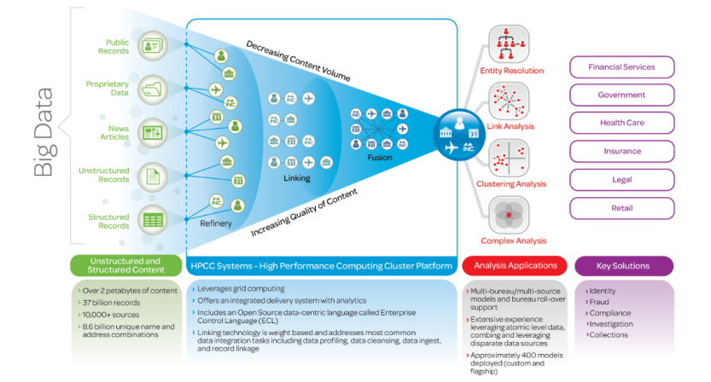
HPCC Systems is an Open Source Platform for Big Data Processing
High Performance Computing Cluster (HPCC Systems) enables data integration on a scale not previously available and real-time answers to millions of users. Built for Big Data and proven for 10 years with enterprise customers.
ECL Parallel Programming Language optimized for business differentiating data intensive applications
Single architecture offers two data platforms (query and refinery) and a consistent data-intensive programming language (ECL)
Notes:
Expanded text:
11.6 billion consumer records
• 6.5 billion unique Name & Address Combinations and 30+ years of Address History
• 2.7 billion motor vehicle registrations
• 2.7 billion property records
• 302 million unique businesses
• 227 million auto and home claim records; 99% of all U.S. auto claims
• 12 million background checks and 3 million drug screen tests per year

Slide 9
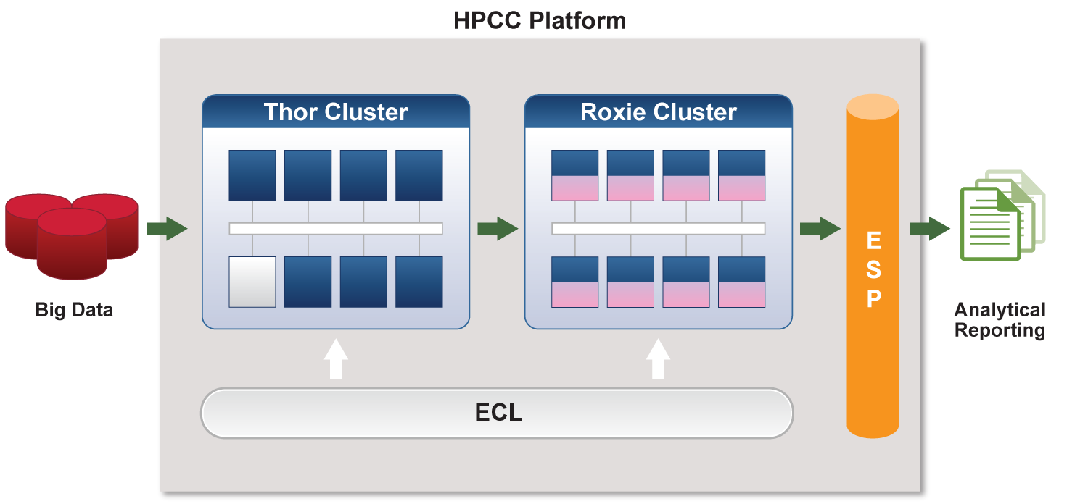
HPCC Systems Architecture

Slide 10
HPCC Systems Roadmap Solves the Talent & Work Crunch Problem
How HPCC Systems Helps Address the Talent Crunch
Types of Users:
Developers
Linkers
Modelers
Data
Scientists
BI Analysts
Business Managers
Ingest data
Write queries
Create products
Discover attributes, create models & scoring logic
Discover patterns
Write algorithms
Understand patterns
Discover anomalies
Monitor business performance and customer needs, dynamics
What
they
do
Link
datasets
Developers want a faster, better way to solve problems. Hadoop requires many developers, which is expensive for firms
Hard for companies to find and hire. They need a better, faster way to understand how to link data for analysis.
Hard for companies to find and hire. They need a better, faster way to model data so that are spending their time on analysis, not programing models
Hard and expensive for companies to find and hire. Need more time on analysis not low-level data manipulation tasks.
Hard and expensive for companies to find and hire. Need more time on analysis not low-level data manipulation tasks.
They struggle with IT and data solutions to get the data and insight they need to make business decisions. Most IT and data solutions are not connected.
Talent &
Work
Crunch
Issue
High-level tools:
HPCC Flow,
KEL
Smart View,
SALT, KEL
HPCC Flow, Circuits, RAMPS
Scored Search, Dashboard
HPCC Flow, EDA
Dashboard
Low-level tools:
ECL
N/A
N/A
KEL, SALT, ECL
N/A
N/A
10

Slide 11
Deep Dive on HPCC Systems Components

Slide 12
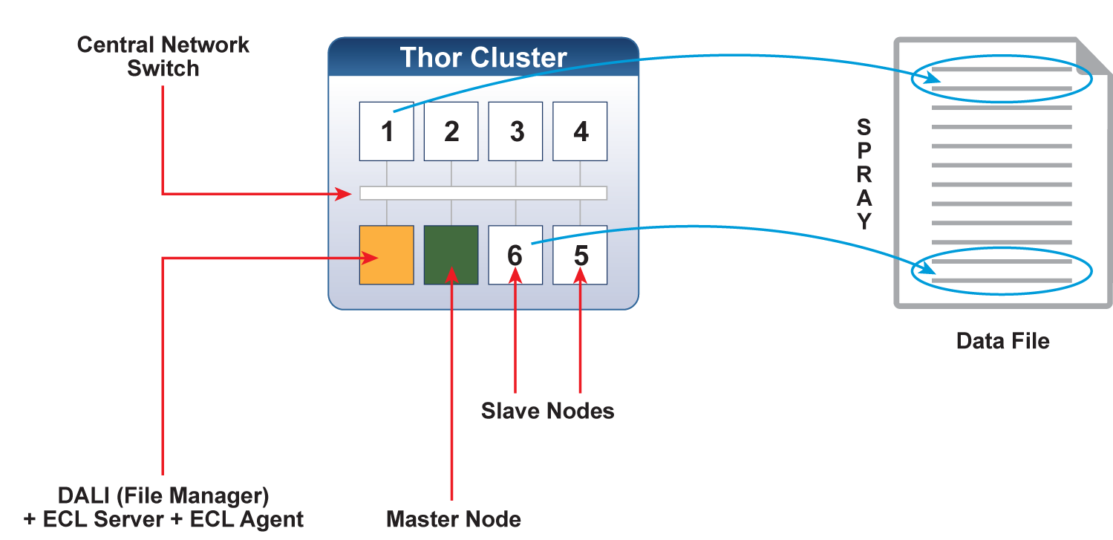
Thor Logical Architecture

Slide 13
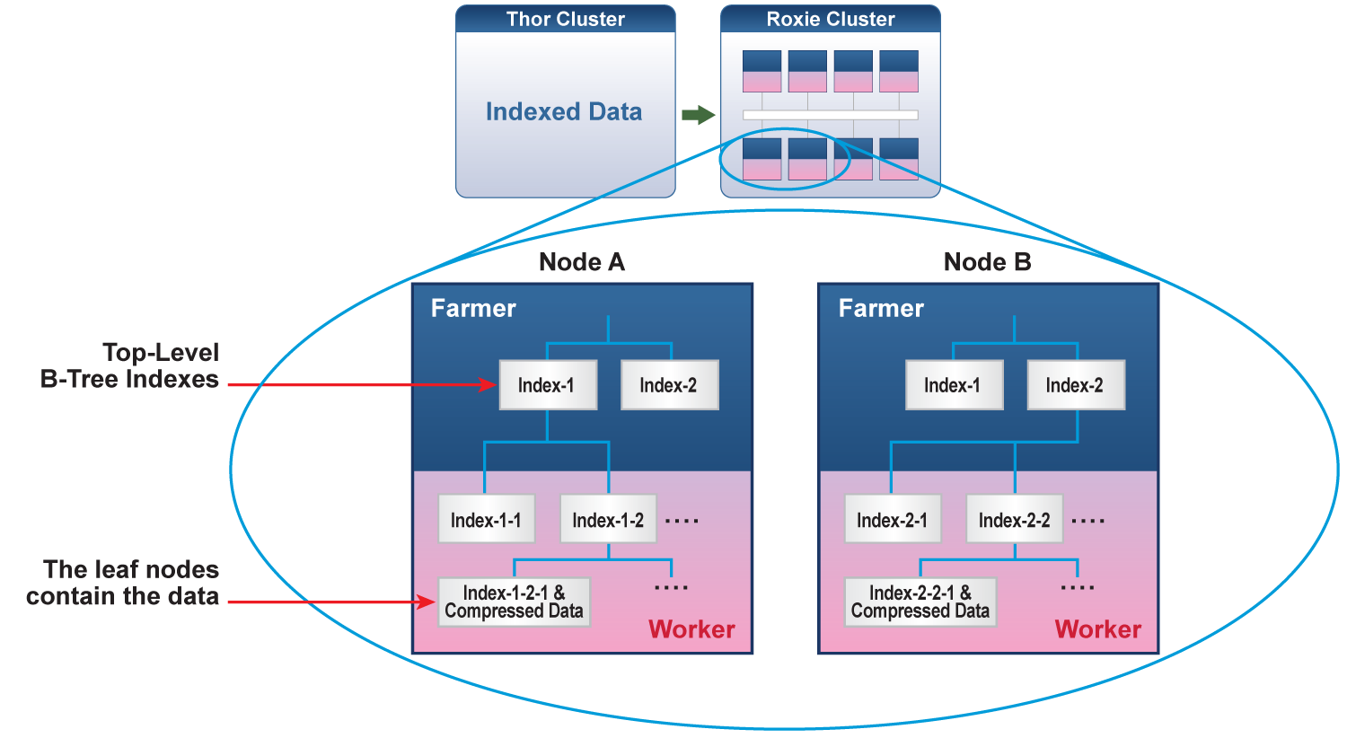
Roxie Logical Architecture

Slide 14
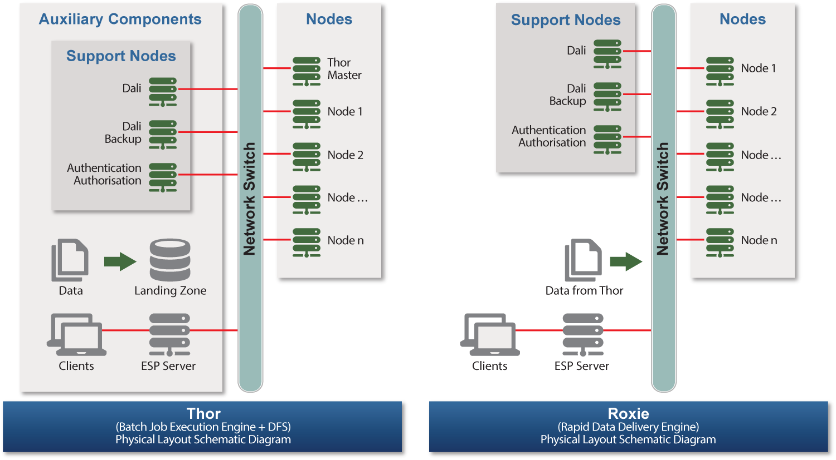
Thor Physical Architecture

Slide 15
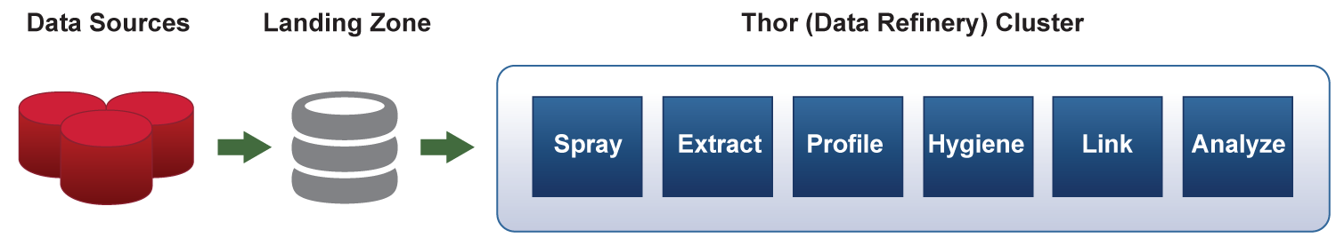
Data Refinery Process

Slide 16
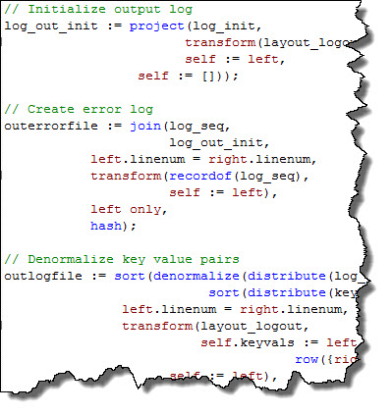
Programming Language is called Enterprise Control Language (ECL)
Declarative programming language: Describe what needs to be done and not how to do it
Powerful: Unlike Java, high level primitives as JOIN, TRANSFORM, PROJECT, SORT, DISTRIBUTE, MAP, etc. are available. Higher level code means fewer programmers & shortens time to delivery
Extensible: As new attributes are defined, they become primitives that other programmers can use
Implicitly parallel: Parallelism is built into the underlying platform. The programmer needs not be concerned with it
Maintainable: A high level programming language, no side effects and attribute encapsulation provide for more succinct, reliable and easier to troubleshoot code
Complete: ECL provides for a complete data programming paradigm
Homogeneous: One language to express data algorithms across the entire HPCC platform, including data ETL and high speed data delivery

Slide 17
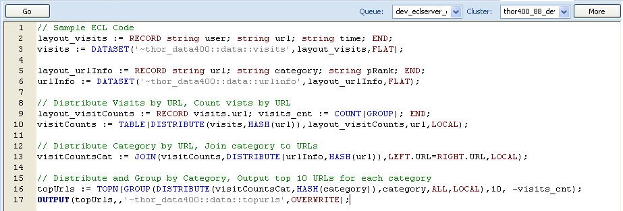
Programming Language is called Enterprise Control Language (ECL)
ECL is a declarative, data-centric, programming language which can expressed concisely, parallelizes naturally, is free from side effects, and results in highly-optimized executable code.
ECL is designed for a specific problem domain (data-intensive computing), which makes resulting programs clearer, more compact, and more expressive. ECL provides a more natural way to think about data processing problems for large distributed datasets.
Since ECL is declarative, execution is not determined by the order of the language statements, but from the sequence of dataflows and transformations represented by the language statements. The ECL compiler determines the optimum execution strategy and graph.
ECL incorporates transparent and implicit parallelism regardless of the size of the computing cluster and reduces the complexity of parallel programming increasing the productivity of application developers.
The ECL compiler generates highly optimized C++ for execution.
ECL provides a comprehensive IDE and programming tools including an Eclipse plugin.
ECL is provided with a large library of efficient modules to handle common data manipulation tasks.

Slide 18
Scalable Automated Linking Technology (SALT) and LexID

Slide 19
SALT - Algorithms for Data Analysis and Linking
Data Ingest
Data Profiling
Data Hygiene
Format fields correctly at the character level (i.e., capitals, punctuation, spelling errors, etc.)
Entity Resolution
Create 360⁰ profiles on individuals, organizations, etc. through iteratively linking data from multiple sources
Relationship Extraction
Uncover hidden patterns within massive datasets to determine how entities relate to one another
Transform a base file into a rolling historic record of incoming records.
Generate statistics for field lengths, word counts, population rate, etc.
SALT
Scalable
Automated
Linking
Technology
19

Slide 20
LexisNexis linking is statistically-based (not rules-based), using the LexisNexis master databases for reference
Two examples where linkage strictly based on rules doesn’t work:
LN Linking sufficiently explores all credible matches
LN Linking
Match, because the system has learnt that “Villanustre” is specific because the frequency of occurrence is small and there is only one present in Atlanta
INPUT
Flavio Villanustre, Atlanta
Javio Villanustre, Atlanta
Record 1
NO MATCH, because the rules determine that
“Flavio“ and “Javio” are not the same
Record 2
Error
RULES
LN Linking effectively minimizes false matches
LN Linking
NO Match, because the system has learnt that “John Smith” is not specific because the frequency of occurrence is large and there are many present in Atlanta
INPUT
John Smith, Atlanta
John Smith, Atlanta
MATCH, because the rules determine that
“John Smith“ and the city for both the records match
Error
RULES
20

Slide 21

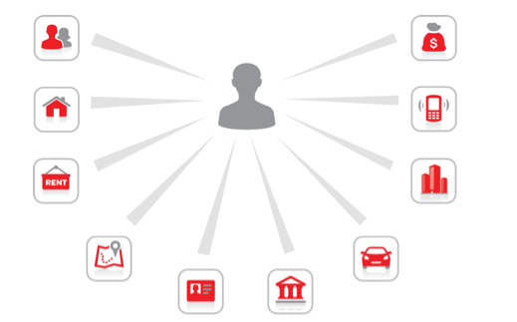
The secret sauce in our portfolio is LexIDSM
The fastest linking technology platform available with results that help you make intelligent information connections.
LexIDSM is the ingredient behind our products that turns disparate information into meaningful insights. This technology enables customers using our products to identify, link and organize information quickly with a high degree of accuracy.
Get a more complete picture
Make intelligent information connections beyond the obvious by drawing insights from both traditional and new sources of data.
Better results, faster
Use the fastest technology for processing large amounts of data to help you solve cases more quickly and confidently.
Protect private information
Keep customer SSNs and FEINs secure and enjoy peace of mind knowing you are taking steps to observe the highest levels of privacy and compliance.

Slide 22
Case Studies

Slide 23
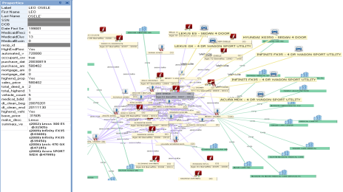
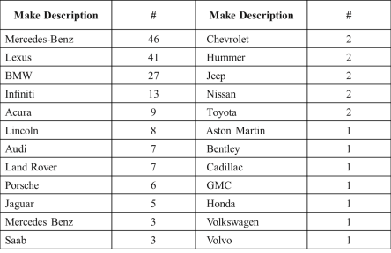
Case Study: Fraud in Medicaid
Scenario
Proof of concept for Office of the Medicaid Inspector Generation (OMIG) of large Northeastern state. Social groups game the Medicaid system which results in fraud and improper payments.
Task
Given a large list of names and addresses, identify social clusters of Medicaid recipients living in expensive houses, driving expensive cars.
Result
Interesting recipients were identified using asset
variables, revealing hundreds of high-end
automobiles and properties.
Leveraging the Public Data Social Graph, large social
groups of interesting recipients were identified
along with links to provider networks.
The analysis identified key individuals not in the data
supplied along with connections to suspicious
volumes of “property flipping” potentially indicative
of mortgage fraud and money laundering
23

Slide 24
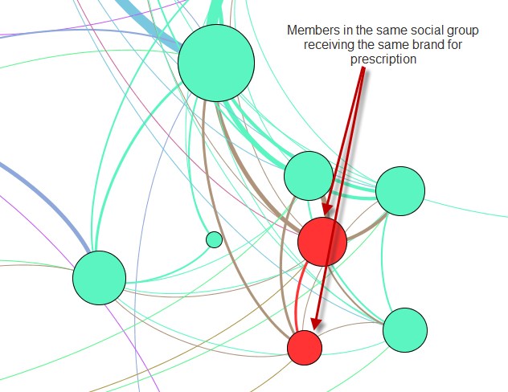
Case Study: Fraud in Prescription Drugs
Scenario
Healthcare insurers need better analytics to identify drug seeking behavior and schemes that recruit members to use their membership fraudulently.
Groups of people collude to source schedule drugs through multiple members to avoid being detected by rules based systems.
Providers recruit members to provide and escalate services that are not rendered.
Task
Given a large set of prescriptions. Calculate normal social distributions of each brand and detect where there is an unusual socialization of prescriptions and services.
Result
The analysis detected social groups that are sourcing Vicodin and other schedule drugs. Identifies prescribers and pharmacies involved to help the insurer focus investigations and intervene strategically to mitigate risk.
24

Slide 25
Case Study: Insurance Score From 100 Days To 30 Minutes
Scenario
One of the top 3 insurance providers using Oracle analytics products on multiple statistical model platforms with disparate technologies
Insurer issues request to re-run all past reports for a customer: 11.5M reports since 2004
Using their current technology infrastructure it would take 100 days to run these 11.5M reports
Task
Migration of 75 different models, 74,000 lines of code and approximately 700 definitions to the HPCC
Models were migrated in 1 man month.
Using a small development system (and only one developer), we ran 11.5 million reports in 66 minutes
Performance on a production-size system: 30 minutes
Testing demonstrated our ability to work in batch or online
Result
Reduced manual work, increases reliability, and created capability to do new scores
Decreased development time from 1 year to several weeks; decreased run time from 100 days to 30 minutes
One HPCC (one infrastructure) translates into less people maintaining systems.
25

Slide 26
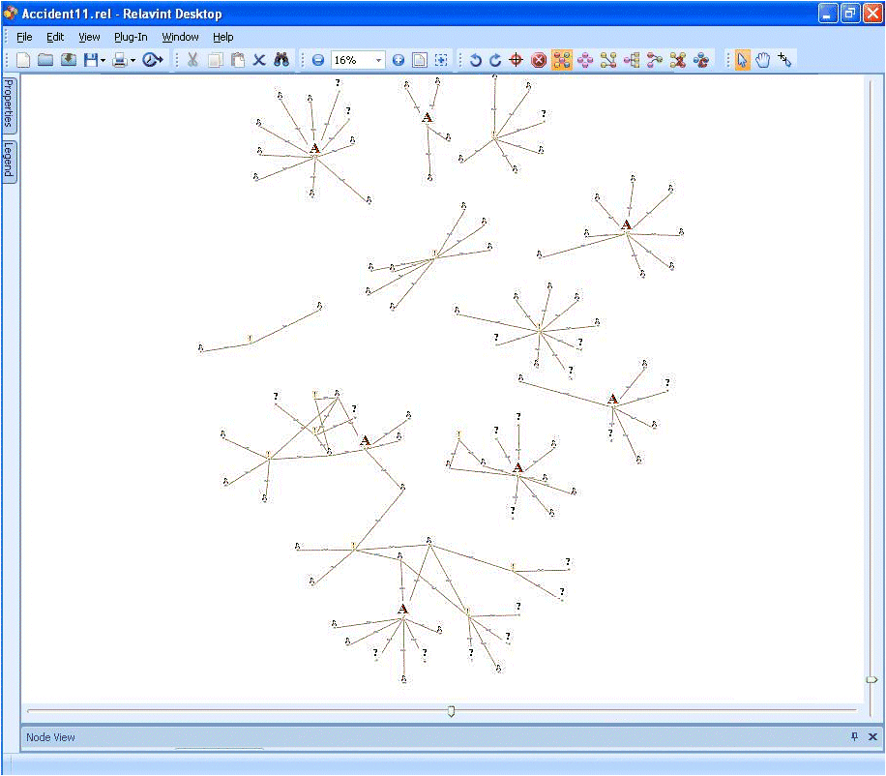
Case Study: Fraud & Collusion in Auto Insurance Claims
Scenario
This view of carrier data shows seven known fraud claims and an additional linked claim.
The Insurance company data only finds a connection between two of the seven claims, and only identified one other claim as being weakly connected.
26

Slide 27
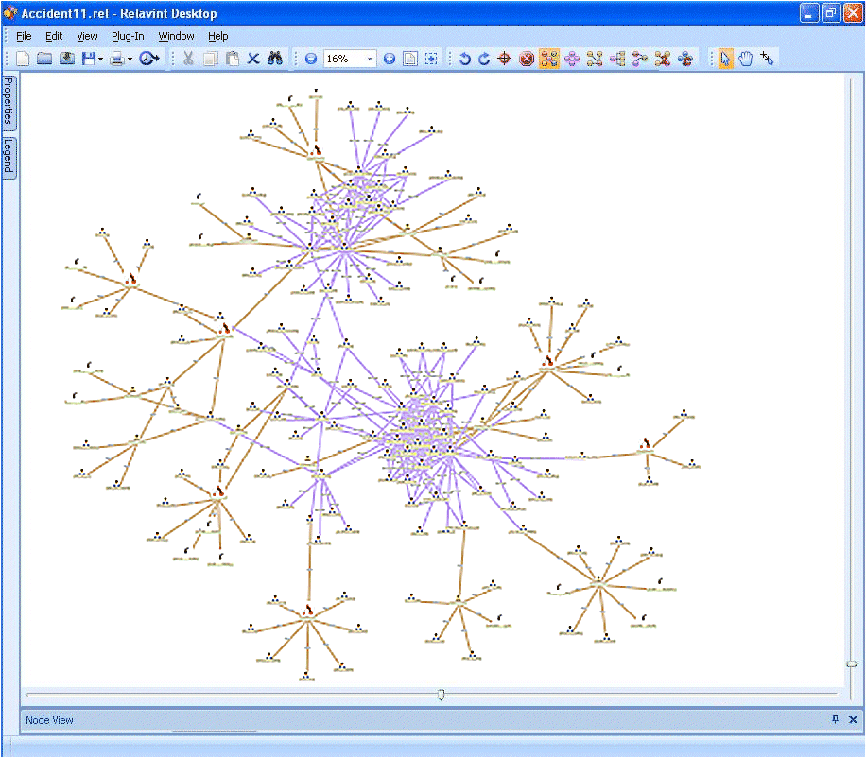
Case Study: Fraud & Collusion in Auto Insurance Claims
Task
After adding the LexID to the carrier Data, LexisNexis HPCC technology then added 2 additional degrees of associations
Result
The results showed two family groups interconnected on all of these seven claims.
The links were much stronger than the carrier data previously supported.
Family 1
Family 2
27

Slide 28
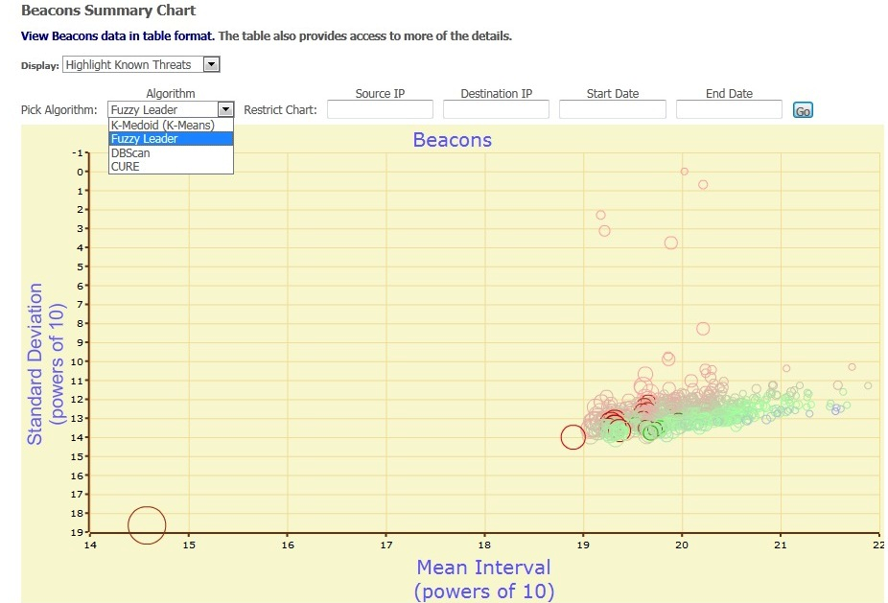
Case Study: Network Traffic Analysis in Seconds
Scenario
Conventional network sensor and monitoring solutions are constrained by inability to quickly ingest massive data volumes for analysis
- 15 minutes of network traffic can generate 4 Terabytes of data, which can take 6 hours to process
90 days of network traffic can add up to 300+ Terabytes
Task
Drill into all the data to see if any US government systems have communicated with any suspect systems of foreign organizations in the last 6 months
- In this scenario, we look specifically for traffic occurring at unusual hours of the day
Result
In seconds, HPCC Systems sorted through months of network traffic to identify patterns and suspicious behavior
28
Notes:
28

Slide 29
Contact Us
info@hpccsystems.com
US: 1.877.316.9669
Intl: 1.678.694.2200

