Slide 1
Moving to the Client – JavaFX and HTML5
Stephen Chin (@steveonjava)
Kevin Nilson (@javaclimber)

Slide 2
The following is intended to outline our general product direction. It is intended for information purposes only, and may not be incorporated into any contract. It is not a commitment to deliver any material, code, or functionality, and should not be relied upon in making purchasing decisions. The development, release, and timing of any features or functionality described for Oracle’s products remains at the sole discretion of Oracle.

Slide 3
Meet the Presenters
Stephen Chin
Kevin Nilson
@steveonjava
@javaclimber
just.me VP of Engineering
Author Web 2.0 Fundamentals
Family Man
User Groups
Silicon Valley JUG
Silicon Valley JS Meetup
Silicon Valley Google Developer Group
Motorcyclist

Slide 4
History of the Web
1991 HTML
1994 HTML 2
1996 CSS 1 + JavaScript
1997 HTML 4
1998 CSS 2
2000 XHTML 1
2002 Tableless Web Design
2005 AJAX
2009 HTML 5

Slide 5
What is HTML5
Web Hypertext Application Technology Working Group (WHATWG)
HTML5 ! = HTML + CSS + JavaScript
HTML5 = Next Generation Features for Modern Web Development
Offline Storage, Web SQL Database, IndexedDB, Application Cache, Web Workers, WebSocket, Notifications, Native Drag & Drop, File System, GeoLocation, Speech Input, Form Types, Audio, Video, Canvas, SVG

Slide 6
HTML5 Rounded Corners
http://slides.html5rocks.com/#rounded-corners
HTML5
No HTML5

Slide 7
HTML5 Canvas 3D (WebGL)
http://oos.moxiecode.com/js_webgl/fish/index.html

Slide 8
Prefixes
-webkit-text-fill-color: black;
-webkit-column-count: 2;
Before the Spec is final
Before the Browser implementation is Verified

Slide 9
Cross Browser
Browsers behave fairly differently
HTML5 Non-Ambiguous Spec
JavaScript Frameworks (jQuery, Dojo, Ember, YUI) give consistent API

Slide 10
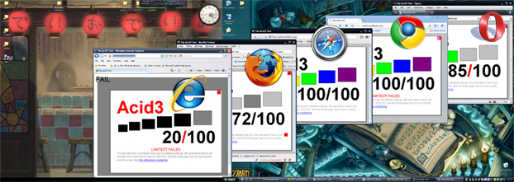
Acid Test
http://acid3.acidtests.org

Slide 11
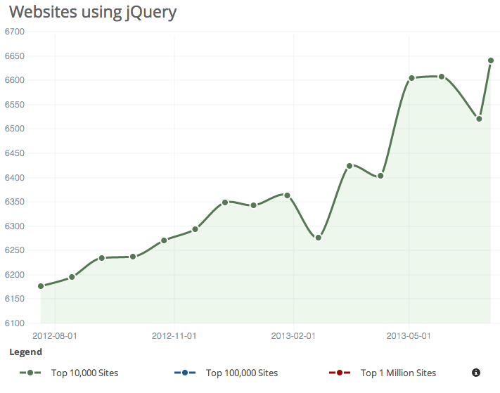
jQuery On The Rise
66.41% of Top 10,000 sites use jQuery (builtwith.com)

Slide 12
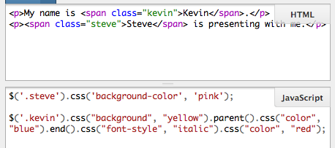
jQuery
http://jsfiddle.net/3urR9

Slide 13
Reaching Older Browsers
Chrome Frame
IE6, IE7, IE8 running Chrome
Modernizer
Feature detection rather than User Agent Sniffing

Slide 14
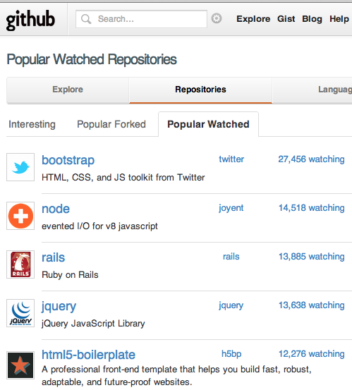
Bootstrap

Slide 15
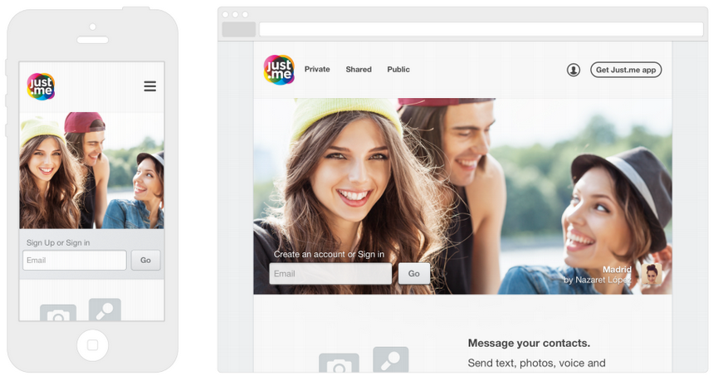
Responsive UI
http://www.just.me

Slide 16
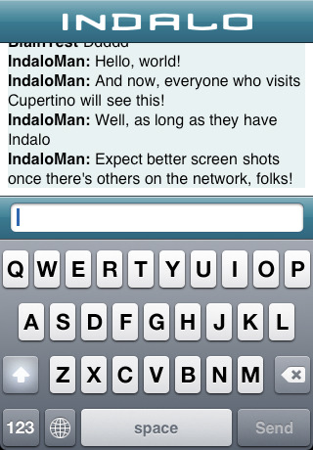
iPhone UIWebView
Formatting Text
Indalo is an iPhone App Kevin Helped Write

Slide 17
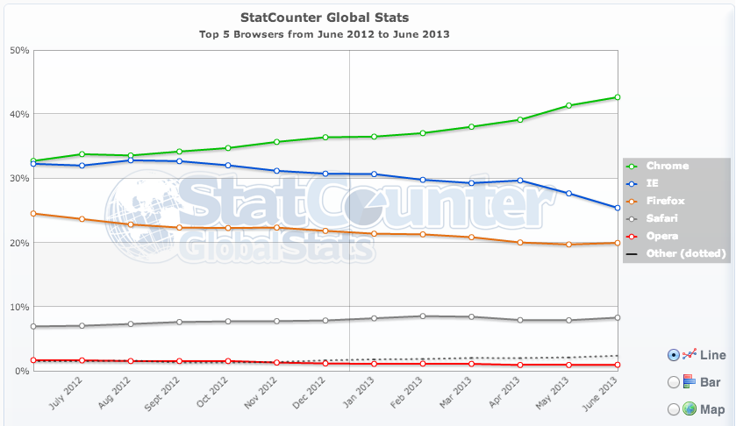
Global Browser Usage

Slide 18
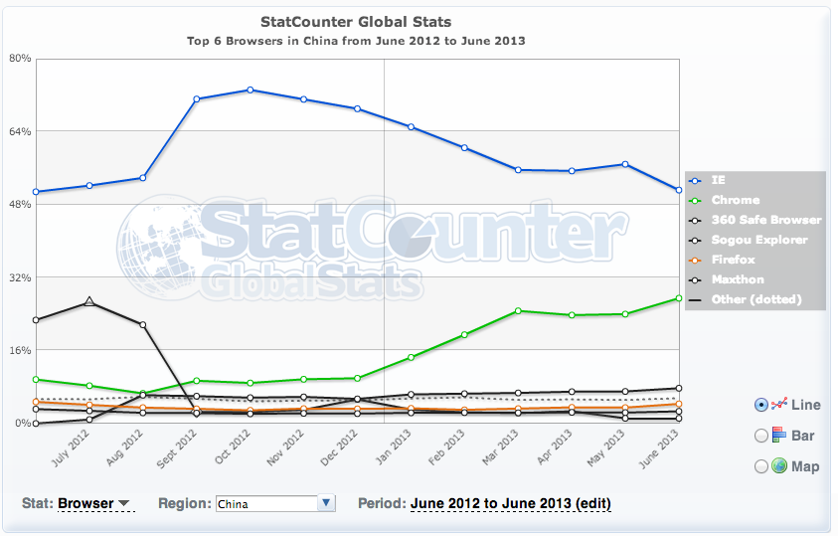
China Browser Usage

Slide 19
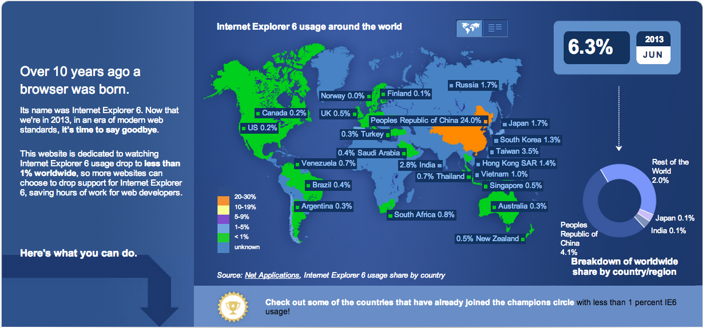
ie6countdown.com

Slide 20
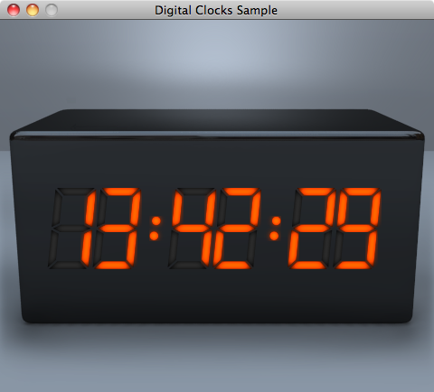
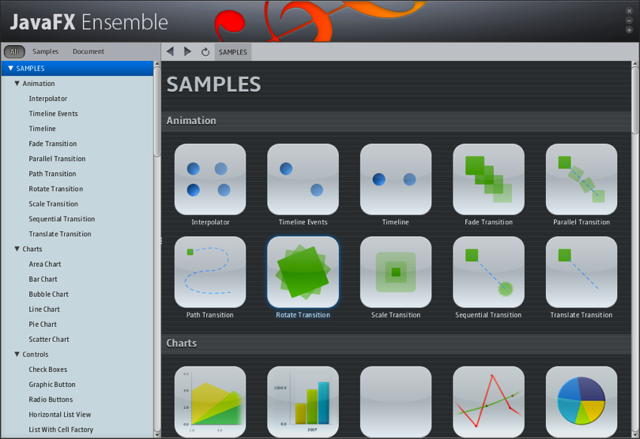
JavaFX 2.0 Platform
Immersive Application Experience
Cross-platform Animation, Video, Charting
Integrate Java, JavaScript, and HTML5 in the same application
New graphics stack takes advantage of hardware acceleration for 2D and 3D applications
Use your favorite IDE: NetBeans, Eclipse, IntelliJ

Slide 21
Displaying HTML in JavaFX
public class WebViewTest extends Application {
public static void main(String[] args) {
launch(args);
}
@Override public void start(Stage stage) {
WebView webView = new WebView();
webView.getEngine().load("http://oracle.com/javaone");
Scene scene = new Scene(webView);
stage.setScene(scene);
stage.setTitle("Web Test");
stage.show();
}}

Slide 22
Displaying HTML in JavaFX

Slide 23
Calling JavaScript from Java
String script = "alert('We have got a message, Houston!');";
eng.executeScript(script);

Slide 24
And back again…
Calling Java from JavaScript
public class JavaApplication {
public void exit() {
Platform.exit();
}}
JSObject window = (JSObject) webEngine.executeScript("window");
window.setMember("app", new JavaApplication());
<a href="" onclick="app.exit()">Click here to exit application</a>

Slide 25
JavaScript to Java Type Conversion
JavaScript | Java
null | null
undefined | “undefined”
number | java.lang.Number (Integer or Double)
string | java.lang.String
boolean | java.lang.Boolean
object | netscape.javascript.JSObject

Slide 26
Responding to Browser Events
Alert/Confirm/Prompt – Respond to JavaScript user interaction functions
Resize – Web page moves or resizes the window object
Status – Web page changes the status text
Visibility – Hide or show the window object
Popup – Spawn a second web view/engine

Slide 27
Use Case 1: The Java Conference Tour app

Slide 28
Use Case 2: Packaging Your EE Apps

Slide 29
Upcoming Local Events
Silicon Valley Code Camp
October 6 & 7
siliconvalley-codecamp.com
DevFest West
October 20 & 21
DevFestWest.com
Google Developer Group

Slide 30
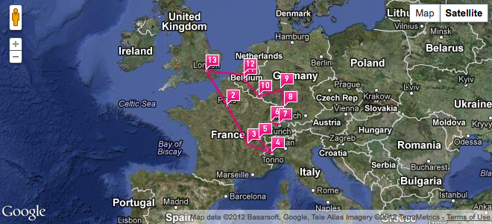
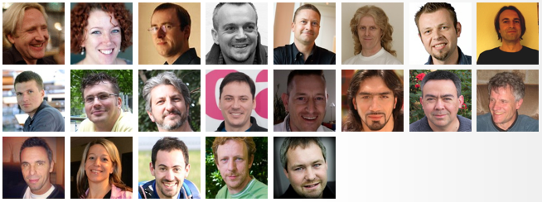
NightHacking Tour
-- The Road to Devoxx --
Oct 29 to Nov 11
nighthacking.com

Slide 31
NightHacking Tour
-- The Road to Devoxx --
Stephen Chin
tweet: @steveonjava
Kevin Nilson
tweet: @javaclimber
Oct 29 to Nov 11
nighthacking.com

