Slide 1
New Java Card Platform for Mobile Payment
– China Introduction
Hu Yan Alipay China

Slide 2
大纲
什么是支付
支付的发展进程
支付的改变-BANK
再一次改变支付- MOBILE
New Mobile Payment-Java Card

Slide 3


Overview of Payment
A payment is the transfer of money from one party (such as a person or company) to another.
A payment is usually made in exchange for the provision of goods, services or both, or to fulfill a legal obligation.

Slide 4



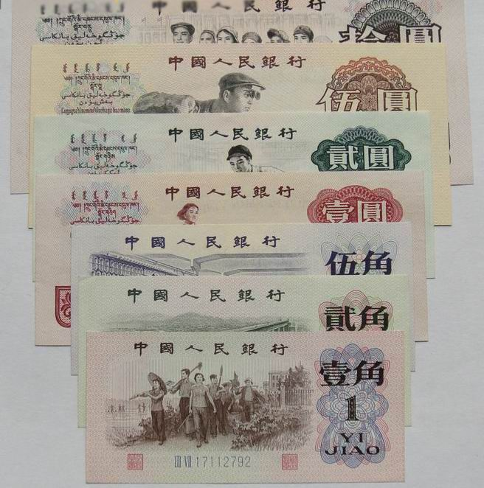

支付的发展进程...价值

Slide 5



支付的改变-Bank

Slide 6
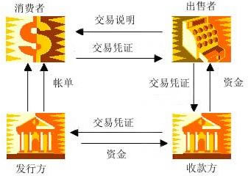
支付的改变-Bank

Slide 7
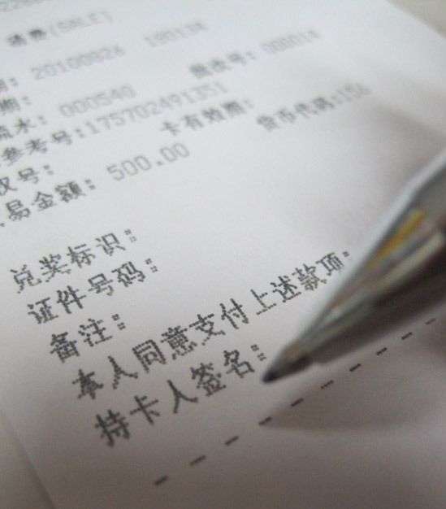
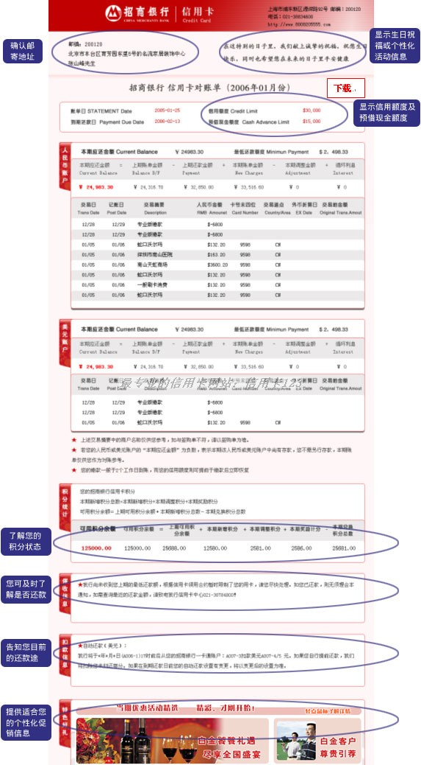

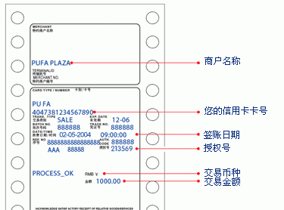
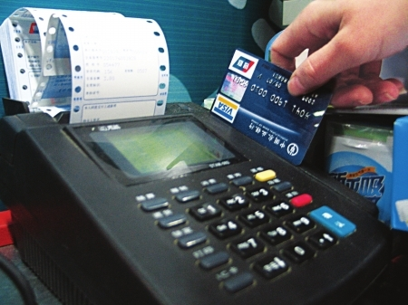
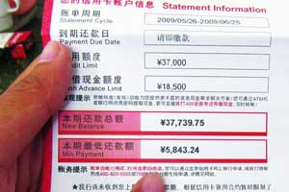
支付的改变-Bank

Slide 8
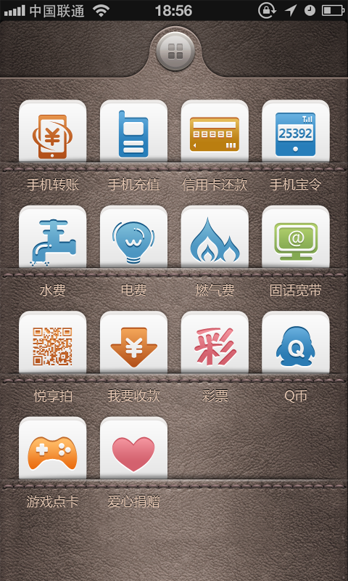


再一次改变支付- MOBILE

Slide 9
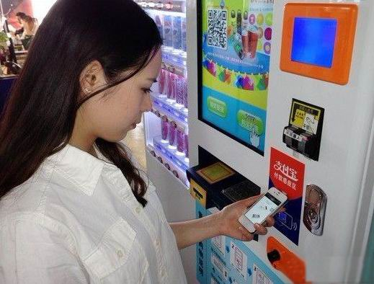
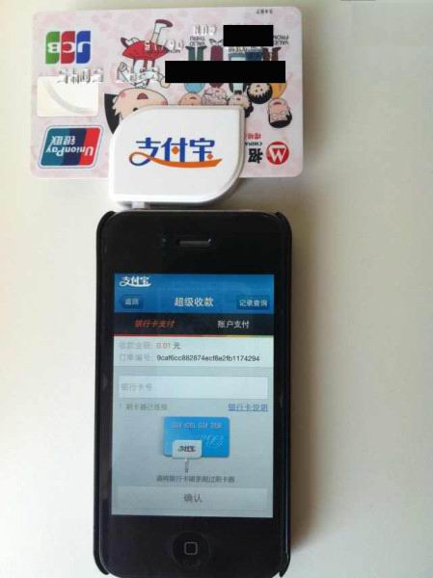
再一次改变支付- MOBILE

Slide 10
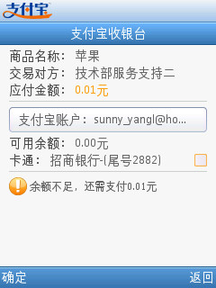
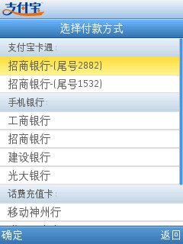


再一次改变支付- MOBILE
The cashier
Select a payment method
Successful pay
Mobile banking processes
Recharge the successful return

Slide 11
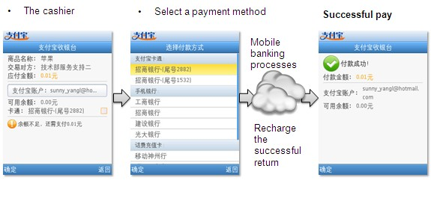
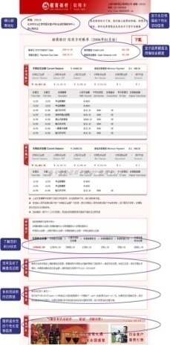


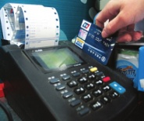
Payment

Slide 12
支付的未来
钱的本质代表的就是价值
支付的本质是一种价值交换。
未来，所有有价值的东西都是可以用来支付，“包括你所在的地点、你的时间，你各种消费与信任的积累等各种信息。”

Slide 13



Overview of payment
Payment Community

Slide 14



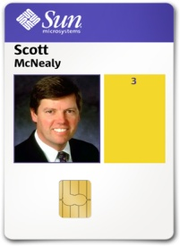
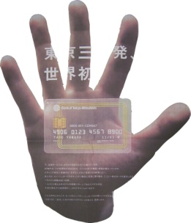
Pay Anywhere
SIM Cards
Passports
Smart Cards
Contactless

Slide 15
Using Cryptographic services
Store certificates
Use the Java Card Cryptographic API

Slide 16
Java Card Crypto API
javacard.security
  authentication classes and a set of symmetric and asymmetric cryptography key interfaces
  Random Data
    Pseudo Random and Secure Random
  Message Digest
    MD5, SHA1, RIPEMD160
  Digital Signature

Slide 17
Java Card Crypto API
javacardx.crypto
  the cipher class, which allows the use of strong encryption and decryption
  DES, DES3, RSA

Slide 18


因为信任、所以简单

Slide 19





About the architecture
As an infrastructure service
Security payment service offers the account service and payment service for upper layers applications.
The security service includes encryption, authentication, authorization, cash-in channel and transaction query.

Slide 20
Service Functional
Mobile Secure Payment Service (1)
Payment service：application can call the payment service of security service, and the payment service will finish the transaction for the application. The payment service is a black-box for all applications

Slide 21
Service Functional
Mobile Secure Payment Service (2)
Account service：Based on the features of security service , account service will supply the account solution and allows application login and logout by connecting with application servers.

Slide 22
Service API Definition
Payments in apps - Mobile
  Initialization
  Create the order
  Pay
import com.alipay.service.*;
Alixpay alixcardpay = Alixpay.getInstance();
Seller id
String orderString = "partner=2088301265823075&
seller=2088301265823075&out_trade_no=500000000006548&
subject=道具1&body=道具1&total_fee=30.0&
notify_url=http://notify.java.jpxx.org/index.jsp&
sign=kU2Fa3x6V985g8ayTo...5f1xg%3D&sign_type=RSA";
trade_no
total_fee
String result = alixcardpay.pay(orderString);

Slide 23

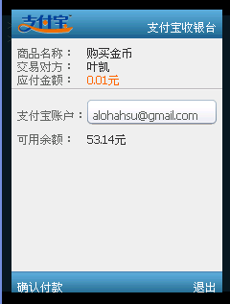

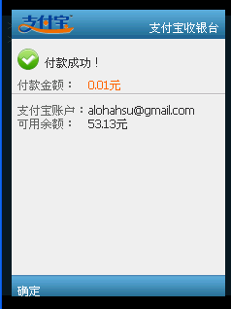
Process outlined
Alixpay.Pay (partner, seller, midlet)
Alipay
JAVACARD
API
Server
Cloud
Server
send(partner, seller, buyer, …)
wait for order confirm
confirm order
order payment result
TRADE_FINISHED
success
Sent to Cloud Payment

Slide 24

Process outlined
evokes secure payment
pay

Slide 25



Security Service in JavaCard
Facilitating New Business Models
Services co-marketing
Gaming
Music
Sports
Movies
Shopping
Feedback
Issuer / Trusted Service Manager

Slide 26


Payment Service in Cloud
Facilitating New Business Models
Service Providers
Content
Payment
Enterprise

Slide 27
Merits for Alipay
Revenue opportunity is increased by “Alipay module” embedded into mobile handset.
Trusted and qualified brand making of “Alipay”, with embedded into market-recognized manufacturers hardware and devices

Slide 28


New Mobile Payment-Java Card
New Architecture
Java Card Payment Service
Java Card 支付服务
支付服务
账户服务
安全加密
身份验证
资金管理
通知服务

