Slide 1

I’m in the Cloud, Now What?
Kevin Nilson
just.me VP of Engineering

Slide 2




About Kevin Nilson
VP of Engineering - just.me
Java Champion
3 Time JavaOne Rock Star
Co-Author of Web 2.0 Fundamentals
Leader Silicon Valley Java User Group
Leader Silicon Valley JavaScript Meetup
Leader Silicon Valley Google Developer Group
Taught 7 Course @ College of San Mateo, CIS

Slide 3
Outline
Being in the Cloud
About just.me
AWS Monitoring and Notifications
Yammer Metrics
Graphite
Nagios
Cubism
New Relic
Google Analytics
jMeter

Slide 4
About just.me
Mobile Social Startup
Funded by Khosla (co-founder of Sun), Google Ventures, True Ventures, SV Angel, Betaworks, Mike Arrington, Don Dodge, ...
Stack
  AWS
  DynamoDB, RDS / MySQL, Neo4j, Apache Solr
  SpringMVC
  Graphite, Nagios, CloudWatch, New Relic, Nagios

Slide 5
Just.me Office
TVs with monitoring visible from my desk.

Slide 6
Being in the Cloud (Advantages)
Lowers the Barrier to Entry
  More with less. AWS can do it better than me.
Pay is based on demand
More infrastructure ready when needed.

Slide 7
Being in the Cloud (Challenges)
What is my API performance?
How many servers are running?
What servers are not performing?
How do I answer the what if questions?

Slide 8
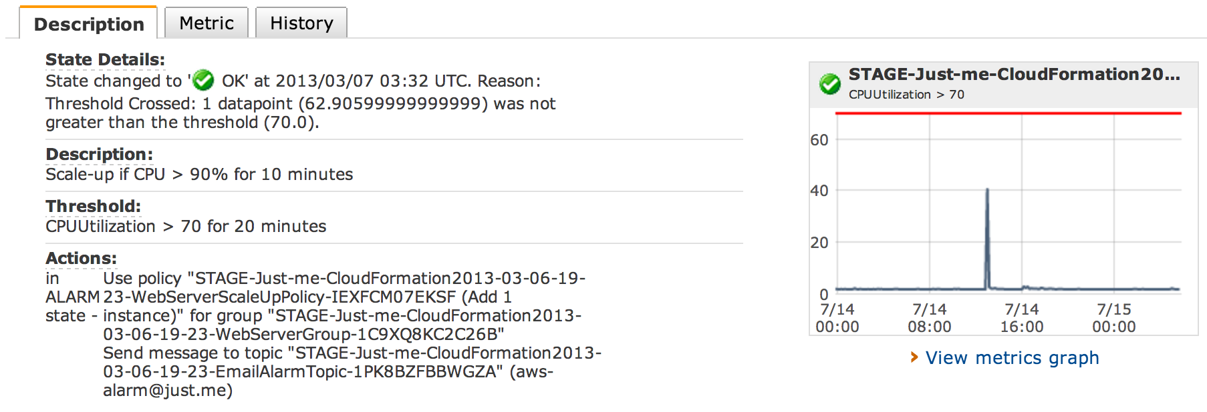
AWS Monitoring and Notifications

Slide 9
AWS Monitoring and Notifications
CloudWatch
  CPUUtilization
  DiskReadBytes
  DiskReadOps
  DiskWriteBytes
  DiskWriteOps
  NetworkIn
  NetworkOut

Slide 10
Problem
How are my APIs performing?

Slide 11

Yammer Metrics
Java
Gauges, Counters, Meters, Histograms, Timers
Timers
  Rate code is Called
  Distribution of its Duration.

Slide 12
Timer - Yammer Metrics
web.index:
count = 15029
mean rate = 4.10 calls/m
1-minute rate = 3.07 calls/m
5-minute rate = 4.02 calls/m
15-minute rate = 4.25 calls/m
min = 0.56ms
max = 1559.16ms
mean = 2.19ms
stddev = 13.42ms
median = 2.38ms
75% <= 2.62ms
95% <= 7.32ms
98% <= 8.93ms
99% <= 9.39ms
99.9% <= 163.62ms

Slide 13
Problem
What are my trends?
How can I visualize this data?
How do I see my data after my server is terminated?

Slide 14
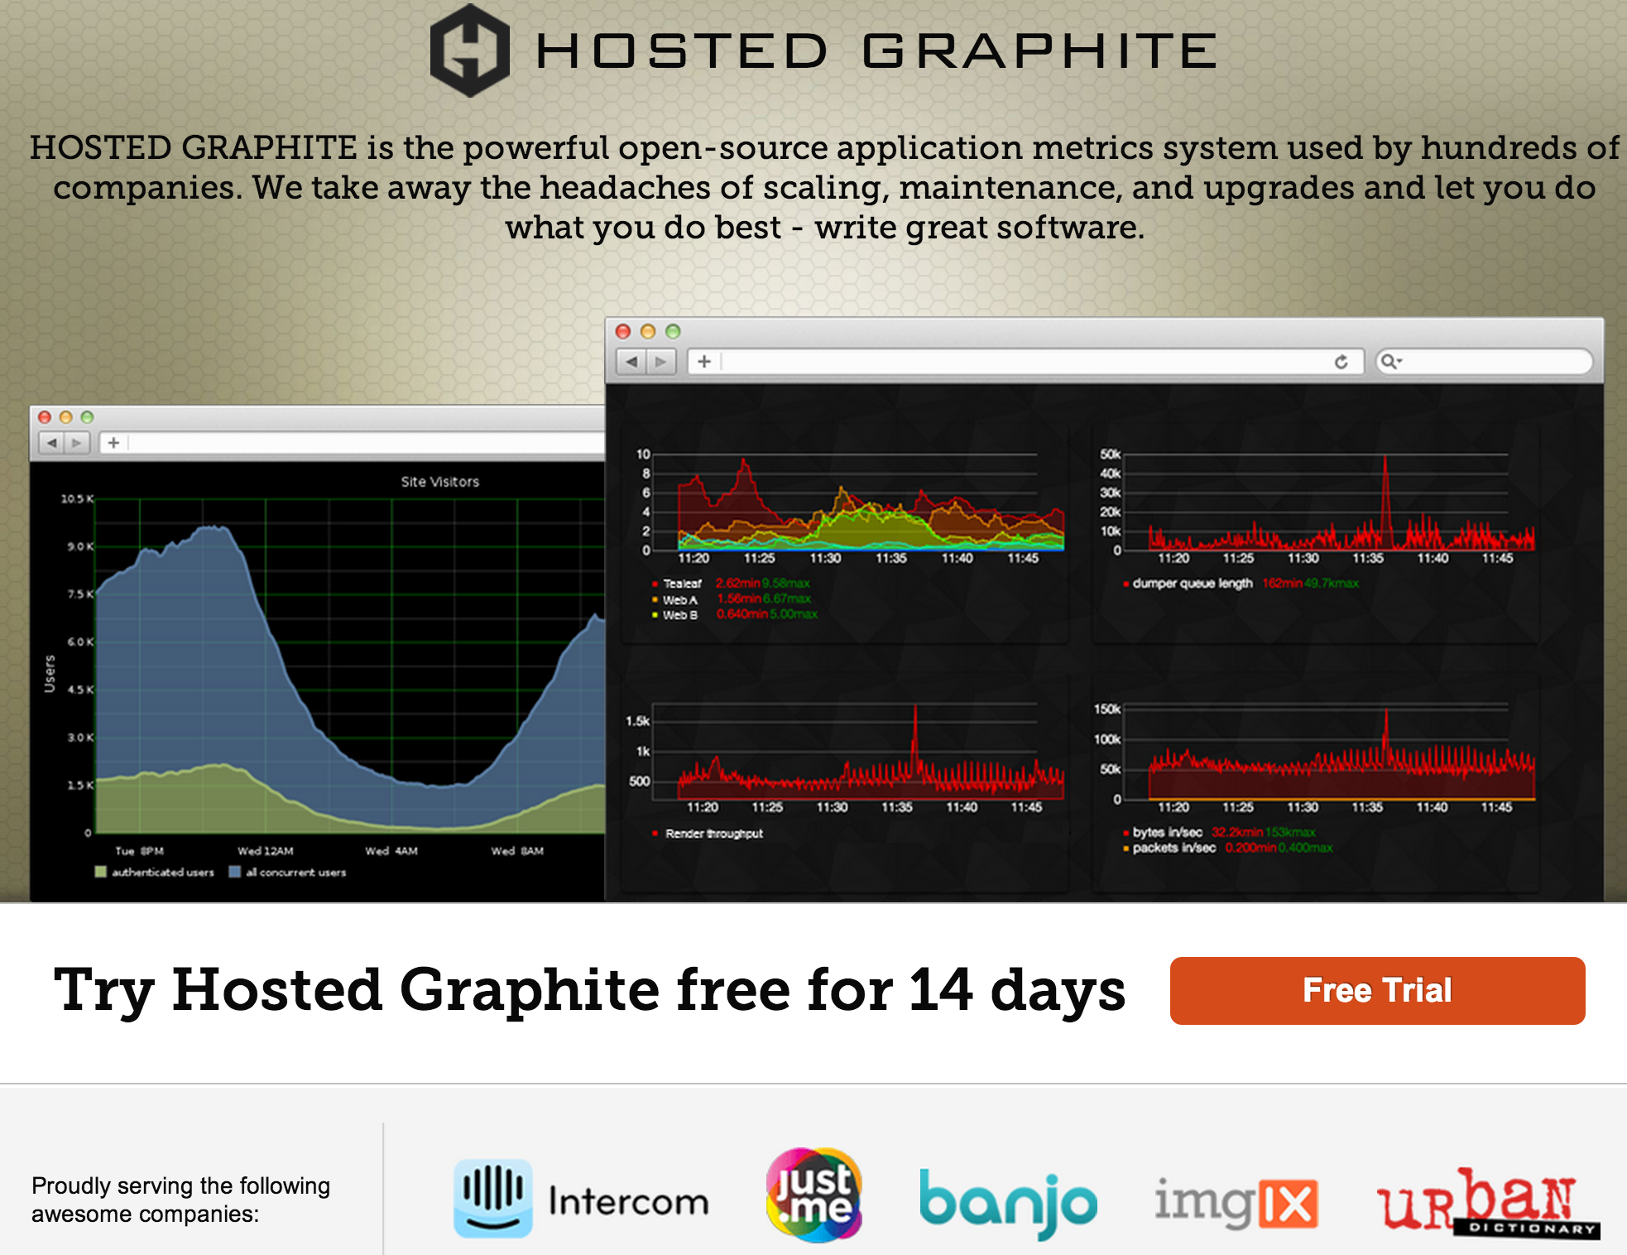

Slide 15
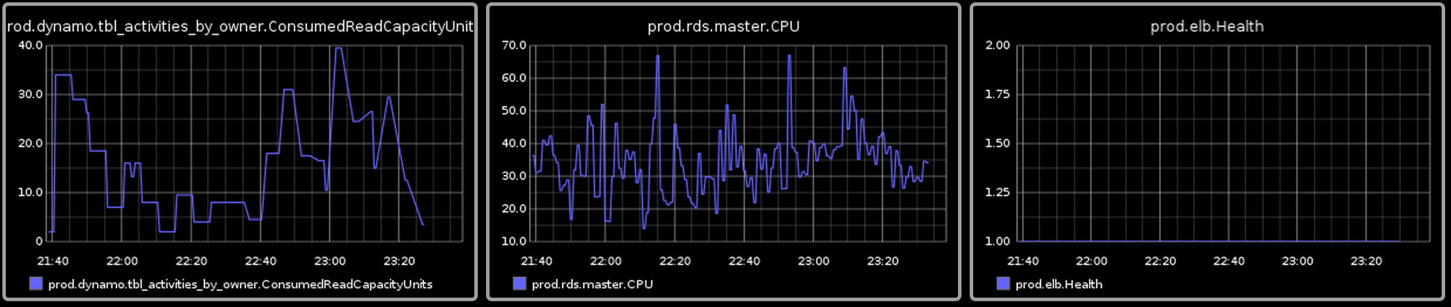
Dashbaord

Slide 16
Problem
How do I support multiple Environments?
How do I “zoom-in”?

Slide 17
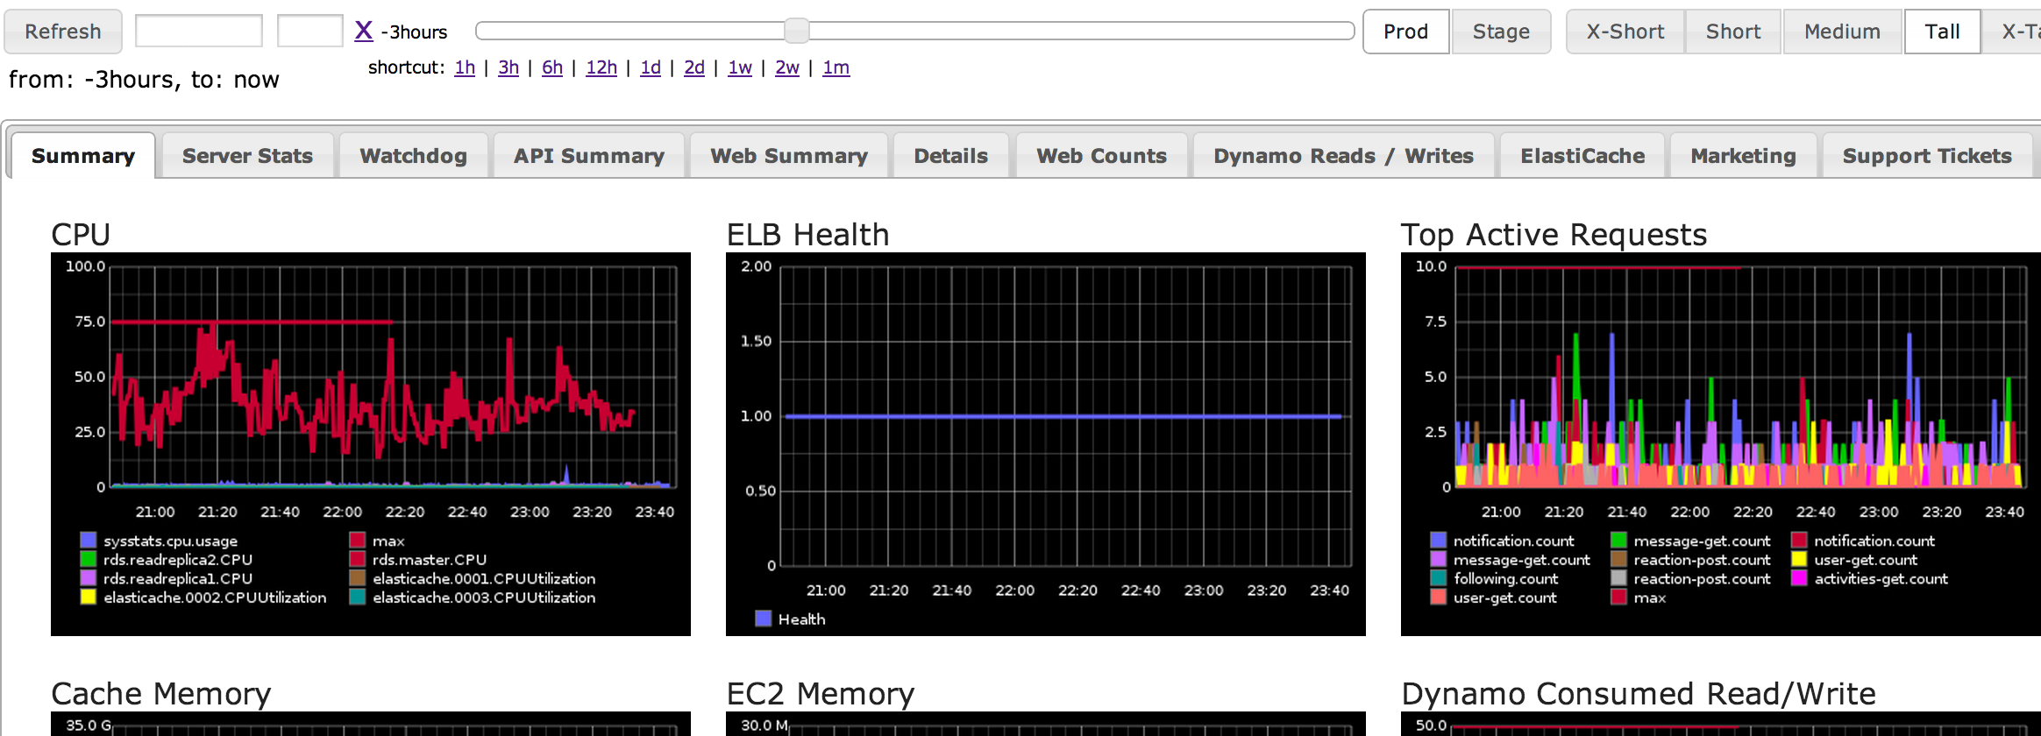
Graphite API + JSON Config +jQuery UI

Slide 18
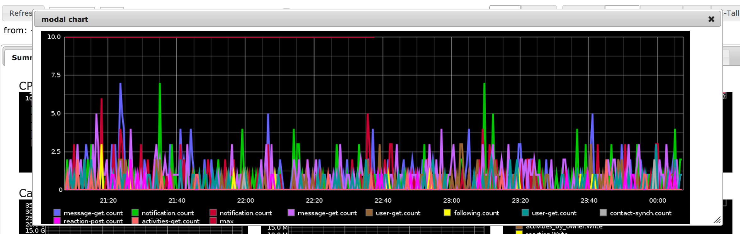
Zoom

Slide 19
Problem
How can I aggregate data from multiple servers?

Slide 20
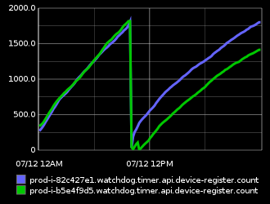
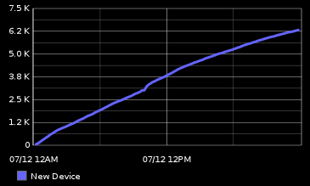
How many Devices registered?
1st server rebooted once (Blue)
2nd server rebooted twice (Green)
Raw Data
Desired Report

Slide 21
Graphite API Functions
alias(
integral(
sumSeries(
nonNegativeDerivative(device-register.count)))
,'New%20Device')

Slide 22
Problem
What if I am not watching the metrics?

Slide 23
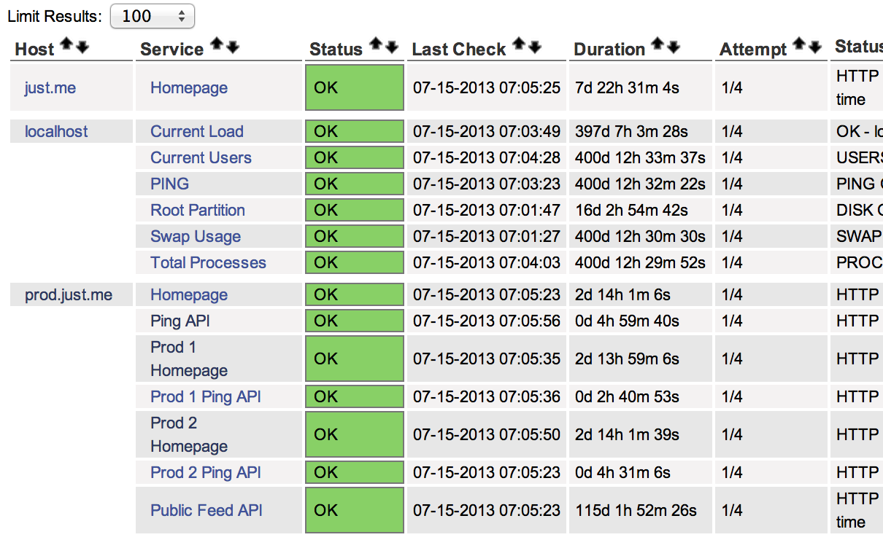
Nagios

Slide 24
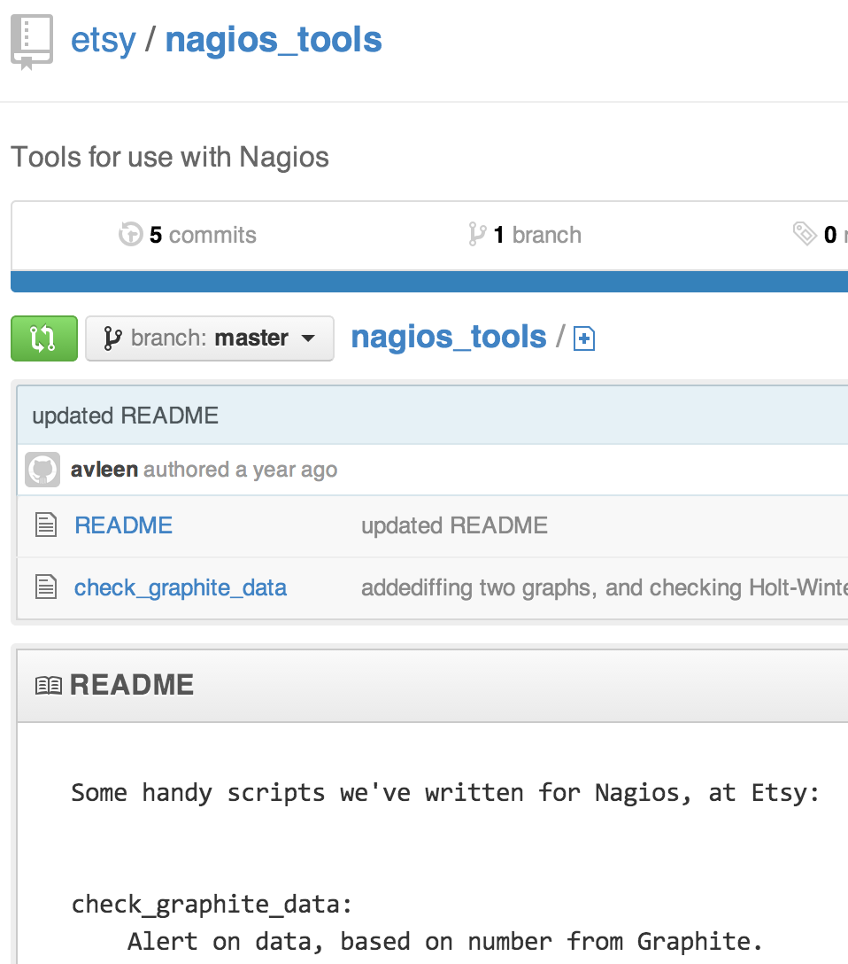
Problem
How can I Nagios know about all my servers?

Slide 25
Problem
How can I see overview and details?

Slide 26
Cubism by Square
Cubism.js is a D3 plugin for visualizing time series. Use Cubism to construct better real-time dashboards, pulling data from Graphite, Cube and other sources. Cubism is available under the Apache License on GitHub.

Slide 27
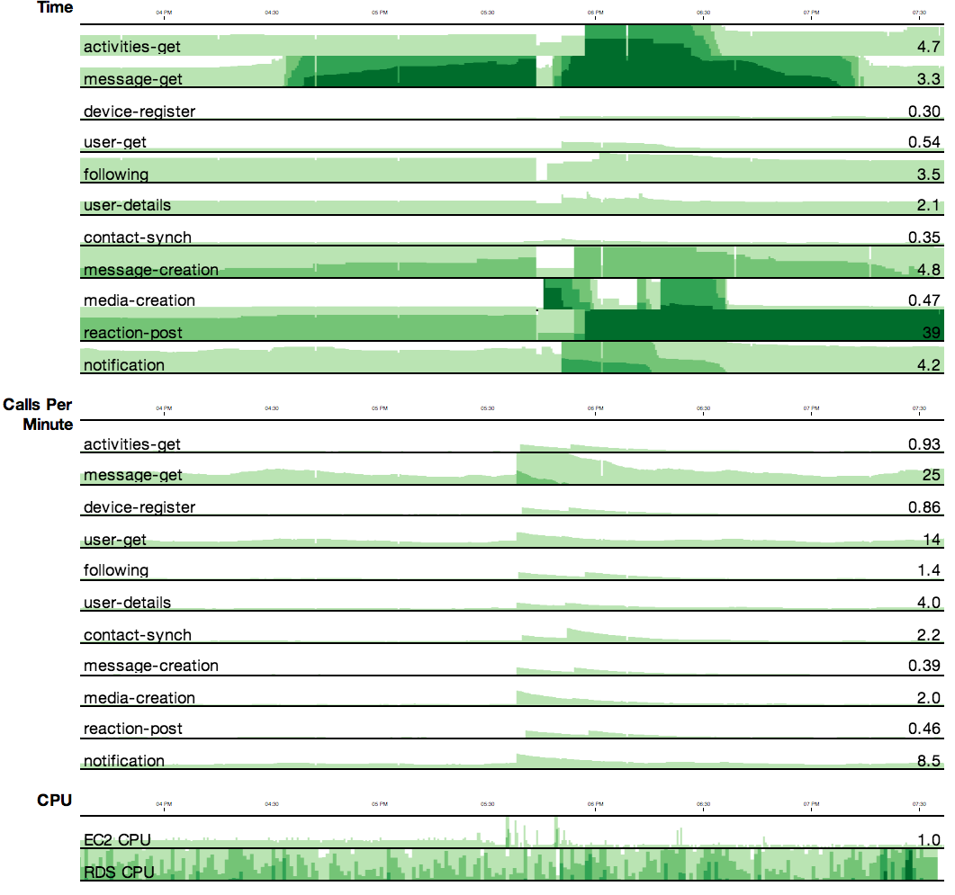
Cubism

Slide 28
Problem
Why is it slow?

Slide 29

New Relic

Slide 30
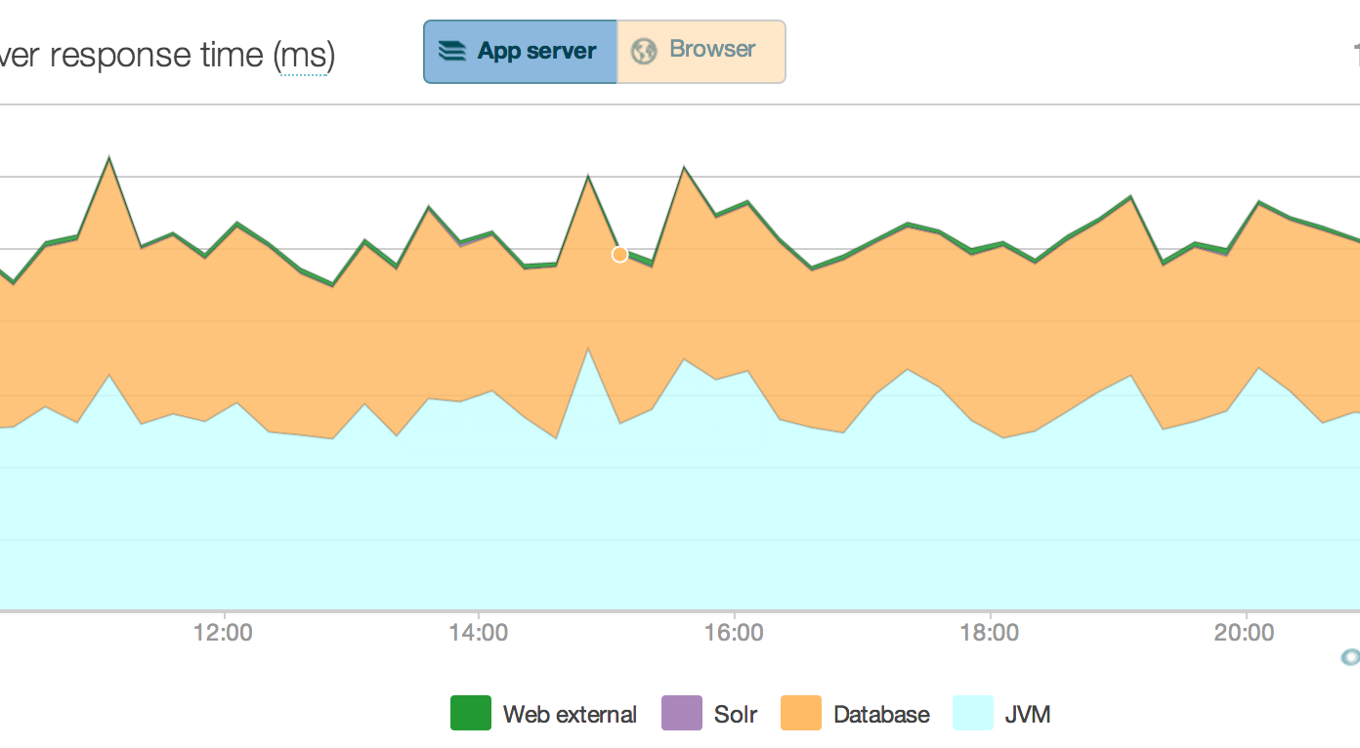

Slide 31
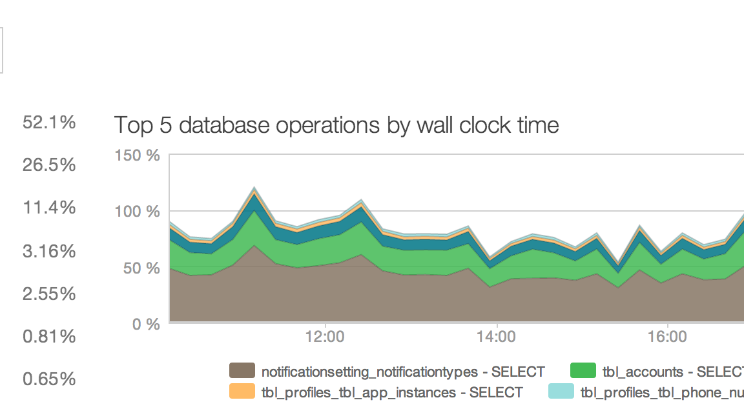

Slide 32
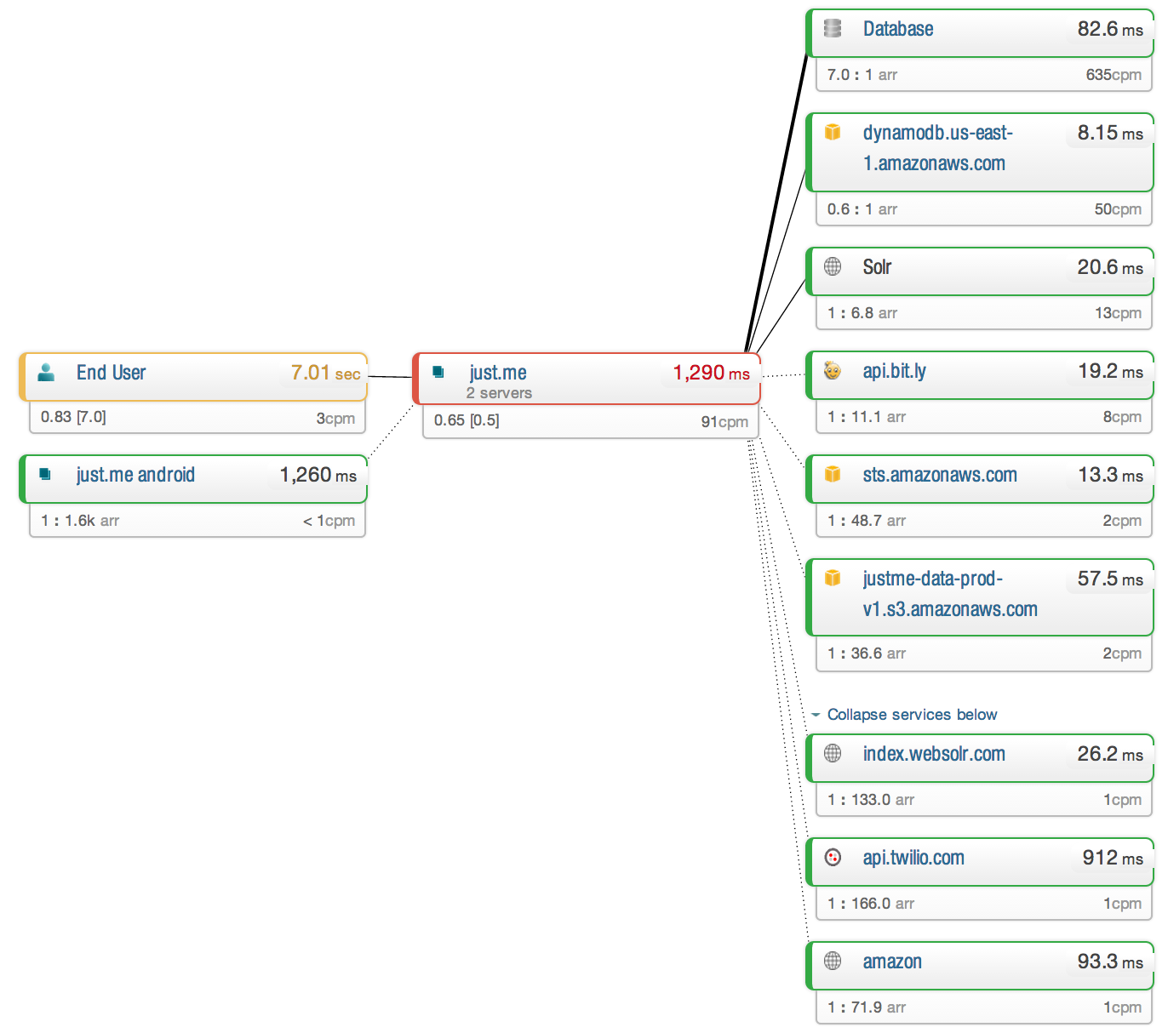

Slide 33
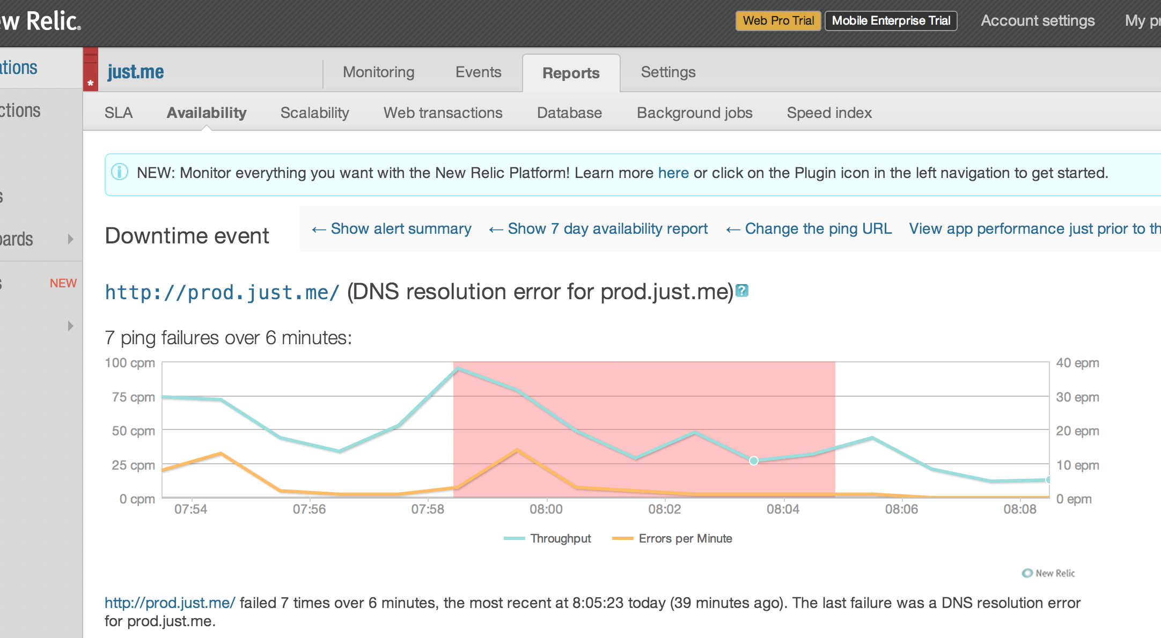

Slide 34
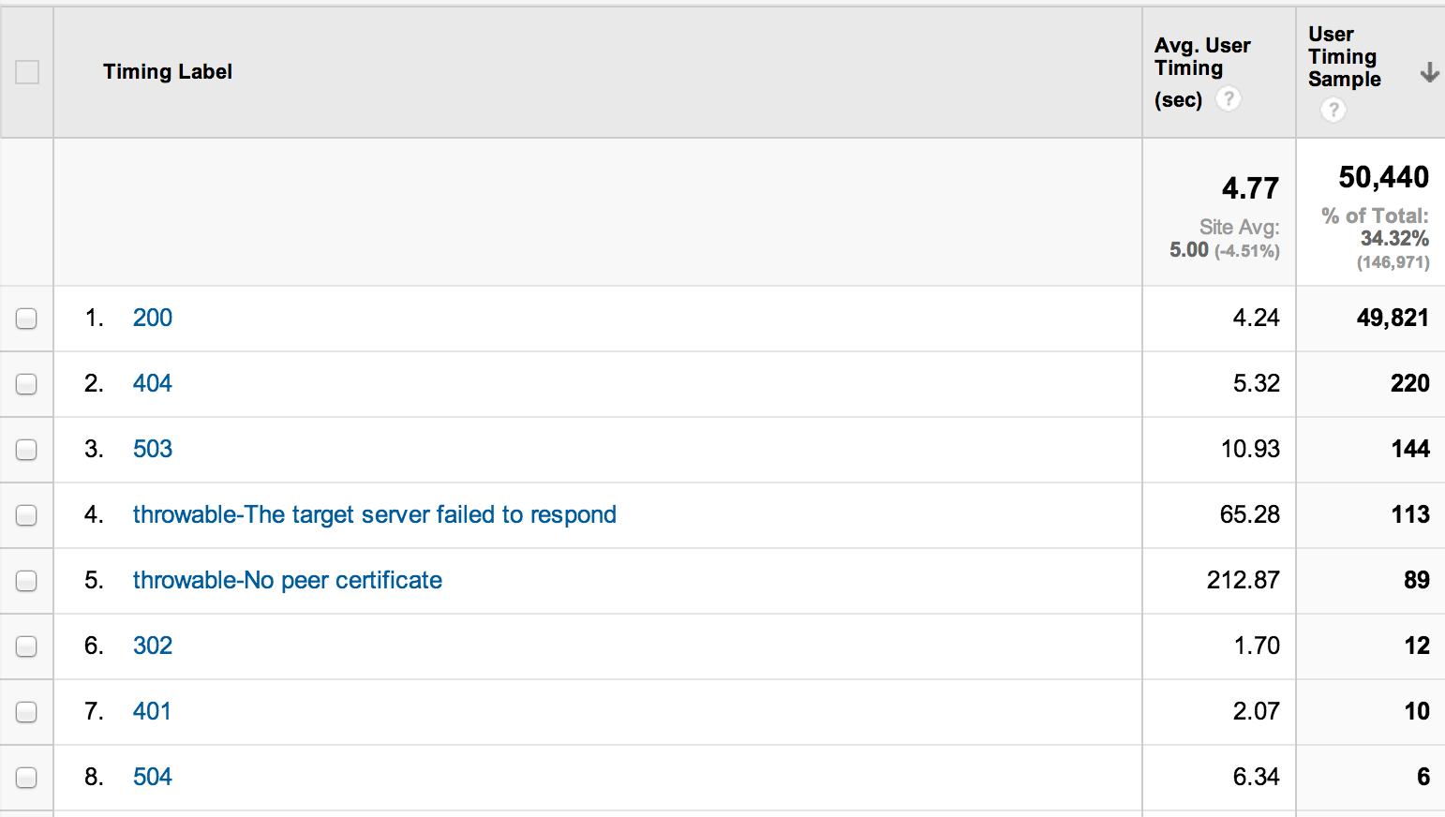
Google Analytics
App Speed

Slide 35


Problem
What if?
+

Slide 36
What’s Next for Monitoring at just.me?
We’re hiring…

Slide 37
Thanks
Kevin Nilson
  Just.me VP of Engineering
  @javaclimber

