Slide 2
Do You Like Coffee With Your Dessert? Java and The Raspberry Pi
Simon Ritter
Java Technology Evangelist
Twitter: @speakjava

Slide 3
The following is intended to outline our general product direction. It is intended for information purposes only, and may not be incorporated into any contract. It is not a commitment to deliver any material, code, or functionality, and should not be relied upon in making purchasing decisions. The development, release, and timing of any features or functionality described for Oracle’s products remains at the sole discretion of Oracle.

Slide 4
Program Agenda
The Raspberry Pi
ARM Processors
Java on ARM and the Raspberry Pi
Using Java on the Raspberry Pi
Demos

Slide 5
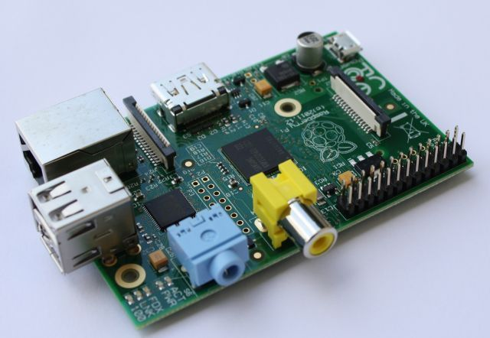
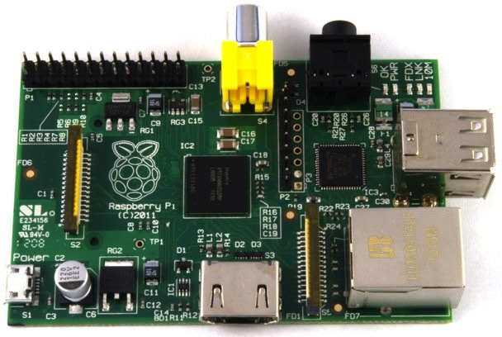
The Raspberry Pi

Slide 6
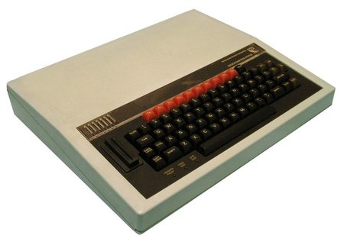
Raspberry Pi
History and Goals
Project started in 2006
Goal was to devise a computer to inspire children
Inspiration from the BBC Micro project from 1981

Slide 7
Raspberry Pi
History and Goals
Officially launched on Febuary 29th 2012
First production run was 10,000 boards
Both RS and Farnell’s servers were stalled on the day of launch
RS reported over 100,000 pre-orders in one day
Current production is about 4,000 boards per day
Originally in China, now by Sony in the UK
Current estimate is that around 1 million boards sold so far

Slide 8
Raspberry Pi
Specification
CPU: ARM 11 core running at 700MHz
Broadcom SoC package
Can now be overclocked to 1GHz (without breaking the warranty!)
Memory: 256Mb 512Mb
I/O:
HDMI and composite video
Audio out (3.5mm plug)
2 x USB ports (Model B only)
Ethernet (Model B only)
Header pins for GPIO, UART, SPI and I2C

Slide 9
ARM Architecture

Slide 10
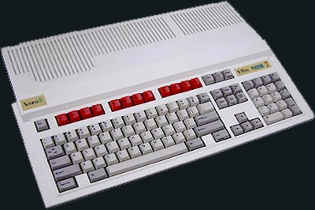
A Brief (But Interesting) History Lesson
Acorn BBC Micro (6502 based)
Not powerful enough for Acorn’s plans for a business computer
Berkeley RISC Project
UNIX kernel only used 30% of instruction set of Motorola 68000
More registers, less instructions (Register windows)
One chip architecture to come from this was… SPARC
Acorn RISC Machine (ARM)
32-bit data, 26-bit address space, 27 registers
First machine was Acorn Archimedes
Spin off from Acorn, Advanced RISC Machines

Slide 11
ARM Features
32-bit RISC Architecture
ARM accounts for 75% of embedded 32-bit CPUs today
8 billion chips sold last year, more than 30 billion in total
zero manufactured by ARM
Abstract architecture and microprocessor core designs
Raspberry Pi uses an ARM11 with the ARMv6 instruction set
Low power consumption
Good for mobile devices
Raspberry Pi can be powered from 700mA 5V only PSU
Raspberry Pi does not require heatsink or fan

Slide 12
Current ARM Technology
ARMv6
ARM 11, ARM Cortex-M
ARMv7
ARM Cortex-A, ARM Cortex-M, ARM Cortex-R
ARMv8 (Announced)
Will support 64-bit data and addressing
32-bit instructions, 30 registers

Slide 13
Java On The ARM and Raspberry Pi

Slide 14
Java Specifics For ARM
Floating Point Operations
Despite being an ARMv6 processor it does include an FPU
FPU only became standard as of ARMv7
FPU (Hard Float, or HF) is much faster than a software library
Linux distros and Oracle JVM for ARM assume no HF on ARMv6
Need special build of both
Raspbian distro build now available
Oracle JVM just released (Early Access)

Slide 15
Beyond RISC
Performance Improvements
DSP Enhancements
Jazelle
Thumb / Thumb2 / ThumbEE (Reduced instruction set RISC)
Better code density
Floating Point (VFP)
NEON
Security Enhancements (TrustZone)
2 Virtual processors (mode switch)
Hardware based access control
Notes:
Thumb – making code more condensed. Thumb =16bit, thumb 2 = 32 bit, thumb extended execution good for JIT type compilation
NEON enhanced SIMD (Single Instruction, multiple data) Media Processing Engine, optimised for media
TrustZone adds an extra bit to indicate security.

Slide 16
JDK8 Early Access
Official Java For The Raspberry Pi
Released at end of 2012
Hard floating point support compiled in
Includes JavaFX libraries
Tested specifically for the Raspberry Pi
Java SE 7 to follow at a later date

Slide 17
Java ME Embedded 3.3
Raspberry Pi Version
Intended for small footprint devices
10s of Mb RAM
Low power processor
Raspberry Pi is cheap platform to start development
Includes Device Access API
GPIO, SPI, I2C, UART support

Slide 18
Using Java on the Raspberry Pi

Slide 19
Making A Noise With Java
Sound drivers now included in distros
Java Sound API
Remember to add audio to user’s groups
modprobe snd_pcm_oss
creates /dev/dsp, needed by MIDI interface
Some bits work, others not so much
Playing (the right format) WAV file works
MIDI seems unbelievably slow
FreeTTS text-to-speech
Some bits working (limited domain voice)

Slide 20
JavaFX on the Raspberry Pi
Work involves optimal implementation of Prism graphics engine
Take advantage of Videocore 4 GPU
Configure with -Djavafx.platform
x11 (X11, software rendering) No X11 support
eglfb (OpenGL rendering to framebuffer) (JDK8 EA)
Some things not supported
Media
WebEngine, WebView
Some IO still needs work (gamepad)

Slide 21
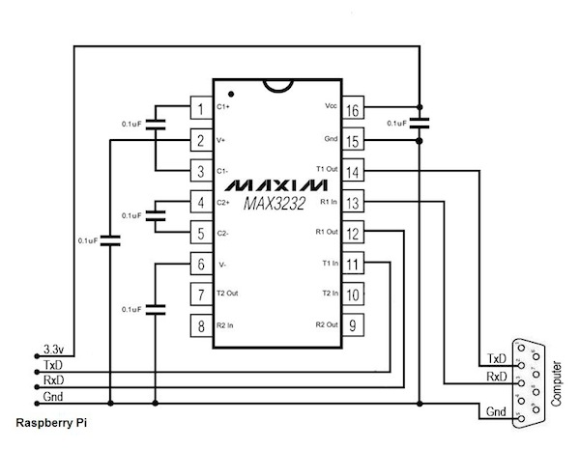
Using The Serial Port
UART provides TTL level signals (3.3V)
RS-232 uses 12V signals
Use MAX3232 chip to convert
Use this for access to serial console
Serial port connectivity
/dev/ttyAMA0

Slide 22
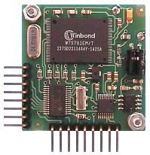
The Talking Raspberry Pi
TX
RX
GND
+5V
SP03 text to speech board
Connected to UART via RS-232
Disable console output
Edit /etc/inittab
Comment out getty /dev/ttyAMA0
Edit /boot/cmdline.txt
remove console and kgdboc references
38,400 baud, 8 Bit, 2 stop bits, no parity
Simple byte sequence to send text to the board

Slide 23
USB Peripherals
Universal Serial Bus (But not as simple as serial)
Easy devices are ones that appear as simple serial devices
/dev/ttyUSB0
More complex devices need native code and libusb
apt-get install libusb-1.0-0-dev

Slide 24
Java and Serial Port/USB Serial Device
JavaComm API
Install RXTX package
apt-get install librxtx-java
How to solve the /dev/ttyS* only problem
System.setProperty(“gnu.io.rxtx.SerialPorts”,
“/dev/ttyUSB0”);
System.setProperty(“gnu.io.rxtx.SerialPorts”,
“/dev/ttyAMA0”);

Slide 25
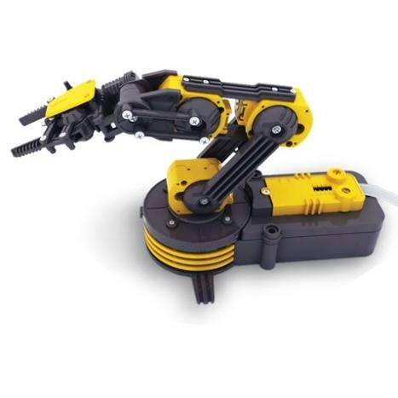
The OWI Robot Arm
Cheap and cheerful
Comes with USB interface
Windows only driver
Recognized as USB device by Linux
Use native code for control and JNI
Simple control protocol
3 bytes (1 = arm, 2 = base, 3 = light)
Combining movements requires some bit twiddling
Can only stop all motors, not individually

Slide 26
Robot Arm Control
JNI Code
Native C functions
Initialisation of arm using libusb and appropriate device
Separate function for each control element
Compile to shared library
Use JNI to generate header file appropriate to Java code usage
e.g. native int arm_usb_init()
Implement appropriate stub to call library
Compile to shared library
JNI can be fiddly

Slide 27
Robot Arm Control
Java Code
Java code is simple
Calibration required to determine time for specific movement
arm_gripper_move(OPEN);
uSleep(500);
arm_gripper_move(STOP);
uSleep(500);
arm_gripper_move(CLOSE);
uSleep(500);
arm_gripper_move(STOP);

Slide 28
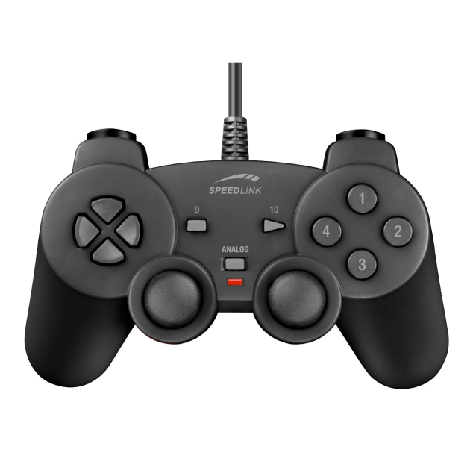
Gamepad Controller
Manual dexterity
Linux supports most of these out of the box
Drivers create entries in /dev/input
Java API through Jinput
Mature technology (not been touched since 2003)
Recompile code on RasPi
Needed to tweak build script for incomplete classpath
EVIOCGUSAGE disappeared
Rename libjinput-linux.so to libjinput-linux64.so
Devices do not have general read/write access
Possible (but frustratingly difficult) to use udev.rules to fix this

Slide 29
Gamepad Controller
Code
Wrote library on top of JInput
JInput too generic, needed code to be more specific to gamepad
GamePadController gpc = new GamePadController();
gpc.addButtonListener(GamePadController.BUTTON_1, this);
gpc.addJoystickListener(GamePadController.JOYSTICK_LEFT, this);
new Thread(gpc).start();

Slide 30
Gamepad Controller
Code
public void buttonAction(ButtonEvent be) {
if (be.getId() == GamePadController.BUTTON_1)
robotArm.setGripperLight(true);
...
}
public void joystickAction(JoystickEvent jse) {
if (jse.getId() == GamePadController.JOYSTICK_LEFT) {
if ((position & JoystickEvent.POSITION_LEFT) != 0)
robotArm.moveElbow(ArmController.UP);
}
...
}

Slide 31
Mind Controlled Raspberry Pi
Neurosky headset
Bluetooth USB dongle
Serial communications
Custom Java library to gather data

Slide 32
Using The GPIO Lines
P1 Connector Layout (REV 1)
14 (TXD)
15 (RXD)
5V
DNC
GND
18
DNC
23
24
DNC
25
8
7
P1-01
0 (SDA)
1 (SCL)
4
DNC
17
21
22
DNC
10 (MOSI)
9 (MISO)
DNC
3.3V
11 (SCLK)
P2 Connector: Pin 1 = 3.3V Pin 7,8 = GND

Slide 33
Using the GPIO Lines
P1 Connector Layout (Rev 2)
14 (TXD)
15 (RXD)
5V
5V
GND
18
GND
23
24
GND
25
8
7
P1-01
0 (SDA)
1 (SCL)
4
GND
17
27
22
GND
10 (MOSI)
9 (MISO)
GND
3.3V
11 (SCLK)

Slide 34
Using the GPIO Lines
Magic Incantations
#define BCM2708_PERI_BASE 0x20000000
#define GPIO_BASE (BCM2708_PERI_BASE + 0x200000)
#define BLOCK_SIZE (1024 * 4)
#define PAGE_SIZE (1024 * 4)
/* MMAP */
mem_fd = open(“/dev/mem”, O_RDWR | O_SYNC);
gpio_mem = malloc(BLOCK_SIZE + (PAGE_SIZE – 1));
gpio_map = (unsigned char *)mmap(
(caddr_t)gpio_mem, BLOCK_SIZE, PROT_READ | PROT_WRITE,
MAP_SHARED | MAP_FIXED, mem_fd, GPIO_BASE);
gpio = (volatile unsigned *)gpio_map;

Slide 35
Using the GPIO Lines
More Magic Incantations
/* Pin input */
*(gpio + (pin / 10)) &= ~(7 << ((pin % 10) * 3));
/* Pin output */
*(gpio + (pin / 10)) &= ~(7 << ((pin % 10) * 3));
*(gpio + (pin / 10)) |= (1 << ((pin % 10) * 3));
/* Pin high */
*(gpio + 7) = 1 << pin;
/* Pin low */
*(gpio + 10) = 1 << pin;

Slide 36
Hide The Magic Incantations With JNI
Simple Java Interface
Access to /dev/mem needs root access
Could solve this by writing our own device driver
gpio_init();
gpio_pin_output(MOTOR_PIN_CLKWISE);
gpio_pin_output(MOTOR_PIN_ACLKWISE);
/* Turn clockwise */
gpio_pin_low(MOTOR_PIN_ACLKWISE);
gpio_pin_high(MOTOR_PIN_CLKWISE);

Slide 37
Pi4J
Simpler IO
Bridge between native code and Java
GPIO
I2C
SPI
GPIO code is simple and easy to use
Still needs root access
Still in development
Current version 0.0.4

Slide 38
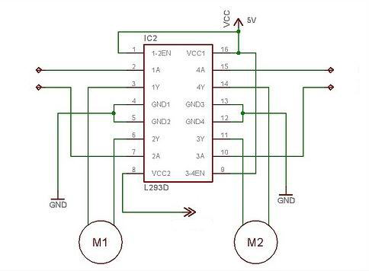
GPIO Example: LEGO Motors
Using L293D Dual H-Bridge
GPIO line
GPIO line
GPIO line
GPIO line
+9V Supply

Slide 39
How to Use SPI and I2C
Even more complex peripherals
Drivers still experimental
Check Chris Boot’s blog (www.bootc.net)
Devices for SPI
/dev/spidev-0.0 and /dev/spidev-0.1
Devices for I2C
Run i2c-dev
/dev/i2c-0
Not yet tried these with Java (Screen and JavaFX project next)

Slide 40
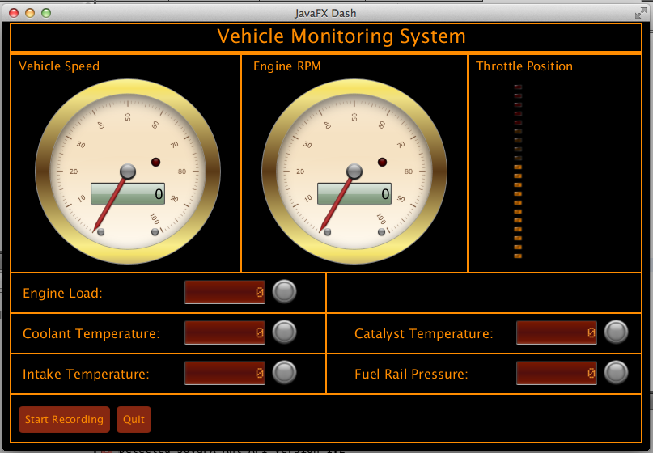
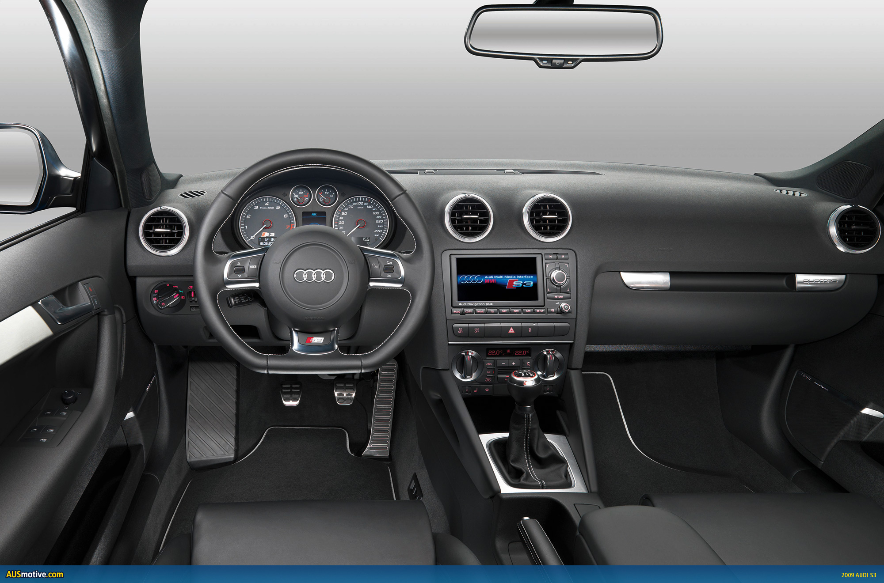
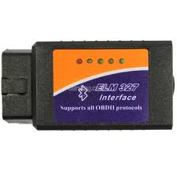
Current Project
In Car Raspberry Pi with JavaFX

Slide 41
Conclusions
Raspberry Pi is a very cool (and cheap) computer
Great for teaching
Great introduction to ARM
Java works well and will get better
Opportunities are limitless!

Slide 42
Further Information
java.oracle.com
www.oracle.com/technetwork/java/embedded
Raspberry Pi User Guide – Eben Upton, Gareth Halfacree
www.raspberrypi.org
blogs.oracle.com/speakjava

Slide 43
Demos

