Slide 2
Building WebSocket Apps in Java using JSR 356
To fill a shape with an image.
Use existing picture box, DO NOT delete and create new picture box.
Right click on the shape.
At the bottom of the submenu select “Format Shape”
Select “Fill” at the top of the “Format Shape” dialog box.
Select “Picture or Texture fill” from the options.
And select “File” under the “Insert from” option.
Navigate to the file you want to use and select “Insert”
On the “Format” tab, in the Size group, click on “Crop to Fill” in the Crop tool and drag the image bounding box to the desired size
DELETE THIS INSTRUCTION NOTE WHEN NOT IN USE
Arun Gupta
blogs.oracle.com/arungupta, @arungupta

Slide 3
The preceding is intended to outline our general product direction. It is intended for information purposes only, and may not be incorporated into any contract. It is not a commitment to deliver any material, code, or functionality, and should not be relied upon in making purchasing decisions. The development, release, and timing of any features or functionality described for Oracle’s products remains at the sole discretion of Oracle.

Slide 4
Agenda
Primer on WebSocket
JSR 356: Java API for WebSocket

Slide 5
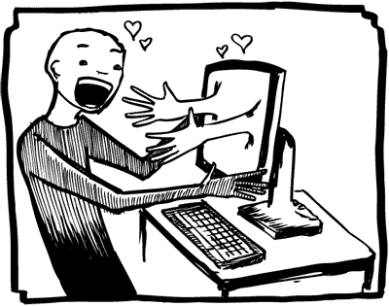
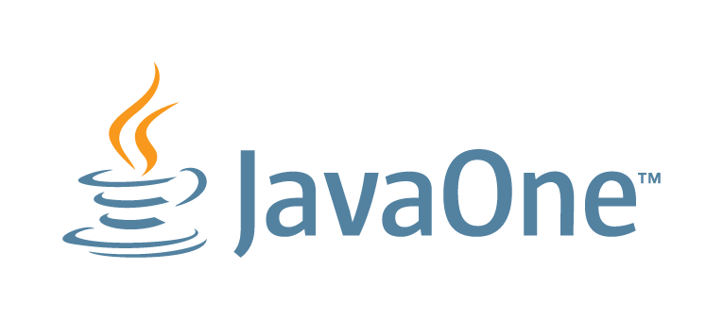
Interactive Web Sites
HTTP is half-duplex
HTTP is verbose
Hacks for Server Push
Polling
Long Polling
Comet/Ajax
Complex, Inefficient, Wasteful
Notes:
Historically, creating web applications that need bidirectional communication between a client and a server (e.g., instant messaging and gaming applications) has required an abuse of HTTP to poll the
server for updates while sending upstream notifications as distinct HTTP calls
This results in a variety of problems:
o The server is forced to use a number of different underlying TCP connections for each client: one for sending information to the client and a new one for each incoming message.
o The wire protocol has a high overhead, with each client-to-server message having an HTTP header.
o The client-side script is forced to maintain a mapping from the outgoing connections to the incoming connection to track replies.
A simpler solution would be to use a single TCP connection for traffic in both directions. This is what the WebSocket Protocol provides.
Combined with the WebSocket API [WSAPI], it provides an alternative to HTTP polling for two-way communication from a web page to a remote server.
The same technique can be used for a variety of web applications: games, stock tickers, multiuser applications with simultaneous editing, user interfaces exposing server-side services in real time, etc.
The WebSocket Protocol is designed to supersede existing bidirectional communication technologies that use HTTP as a transport
layer to benefit from existing infrastructure (proxies, filtering, authentication). Such technologies were implemented as trade-offs between efficiency and reliability because HTTP was not initially
meant to be used for bidirectional communication (see [RFC6202] for further discussion). The WebSocket Protocol attempts to address the goals of existing bidirectional HTTP technologies in the context of the existing HTTP infrastructure; as such, it is designed to work over HTTP ports 80 and 443 as well as to support HTTP proxies and intermediaries, even if this implies some complexity specific to the current environment.
The WebSocket Protocol attempts to address the goals of existing bidirectional HTTP technologies in the context of the existing HTTP infrastructure; as such, it is designed to work over HTTP ports 80 and 443 as well as to support HTTP proxies and intermediaries, even if this implies some complexity specific to the current environment. However, the design does not limit WebSocket to HTTP, and future implementations could use a simpler handshake over a dedicated port without reinventing the entire protocol. This last point is important because the traffic patterns of interactive messaging do not closely match standard HTTP traffic and can induce unusual loads on some components.

Slide 6
WebSocket to the Rescue
TCP based, bi-directional, full-duplex messaging
Originally proposed as part of HTML5
IETF-defined Protocol: RFC 6455
Handshake
Data Transfer
W3C defined JavaScript API
Candidate Recommendation
Notes:
The protocol has two parts: a handshake and the data transfer.
Combined with the WebSocket API [WSAPI], it provides an alternative to HTTP polling for two-way communication from a web page to a remote server.
Once the client and server have both sent their handshakes, and if
the handshake was successful, then the data transfer part starts.
This is a two-way communication channel where each side can,
independently from the other, send data at will.

Slide 7
What’s the basic idea ?
Upgrade HTTP to upgrade to WebSocket
Single TCP connection
Transparent to proxies, firewalls, and routers
Send data frames in both direction (Bi-directional)
No headers, cookies, authentication
No security overhead
“ping”/”pong” frames for keep-alive
Send message independent of each other (Full Duplex)
End the connection

Slide 8
Establish a connection
Client
Server
Handshake Request
Handshake Response

Slide 9
Handshake Request
GET /chat HTTP/1.1 Host: server.example.com Upgrade: websocket Connection: Upgrade Sec-WebSocket-Key: dGhlIHNhbXBsZSBub25jZQ== Origin: http://example.com Sec-WebSocket-Protocol: chat, superchat Sec-WebSocket-Version: 13
Notes:
The protocol consists of an opening handshake followed by basic message framing, layered over TCP.
In compliance with [RFC2616], header fields in the handshake may be sent by the client in any order, so the order in which different header fields are received is not significant.
The leading line from the client follows the Request-Line format. The leading line from the server follows the Status-Line format. After the leading line in both cases come an unordered set of header fields.
The "Request-URI" of the GET method [RFC2616] is used to identify the endpoint of the WebSocket connection, both to allow multiple domains to be served from one IP address and to allow multiple WebSocket endpoints to be served by a single server.
The client includes the hostname in the |Host| header field of its handshake as per [RFC2616], so that both the client and the server can verify that they agree on which host is in use.
HTTP defines an upgrade mechanism using Upgrade: header. This is typically used for to upgrade a client to a newer http protocol version or switch to a different protocol, such as HTTP over TLS. The Upgrade general-header allows the client to specify what additional communication protocols it supports and would like to use if the server finds it appropriate to switch protocols. This mechanism is used for upgrading to WebSocket.
Additional header fields are used to select options in the WebSocket Protocol.
Sec-WebSocket-Key is used in the creation of the server's handshake to indicate an acceptance of the connection. This helps ensure that the server does not accept connections from non-WebSocket clients (e.g. HTTP clients) that are being abused to send data to unsuspecting WebSocket servers. This prevents an attacker from tricking a WebSocket server by sending it carefully-crafted packets using |XMLHttpRequest| [XMLHttpRequest] or a |form| submission. To prove that the handshake was received, the server has to take two pieces of information and combine them to form a response. The first piece of information comes from the |Sec-WebSocket-Key| header field in the client handshake. For this header field, the server has to take the value (as present in the header field, e.g. the base64-encoded [RFC4648] version minus any leading and trailing whitespace), and concatenate this with the Globally Unique Identifier (GUID, [RFC4122]) "258EAFA5-E914-47DA-95CA-C5AB0DC85B11" in string form, which is unlikely to be used by network endpoints that do not understand the WebSocket protocol. A SHA-1 hash (160 bits), base64-encoded (see Section 4 of [RFC4648]), of this concatenation is then returned in the server's handshake.
The |Sec-WebSocket-Protocol| request-header field can be used to indicate what subprotocols (application-level protocols layered over the WebSocket protocol) are acceptable to the client. The server selects one or none of the acceptable protocols and echoes that value in its handshake to indicate that it has selected that protocol.
The |Sec-WebSocket-Version| header field in the client's handshake includes the version of the WebSocket protocol the client is attempting to communicate with.
The |Origin| header field is used to protect against unauthorized cross-origin use of a WebSocket server by scripts using the |WebSocket| API in a Web browser.
The |Sec-WebSocket-Extensions| header field is used in the WebSocket opening handshake. It is initially sent from the client to the server, and then subsequently sent from the server to the client, to agree on a set of protocol-level extensions to use for the duration of the connection.

Slide 10
Handshake Response
HTTP/1.1 101 Switching Protocols Upgrade: websocket Connection: Upgrade Sec-WebSocket-Accept: s3pPLMBiTxaQ9kYGzzhZRbK+xOo= Sec-WebSocket-Protocol: chat
Notes:
The handshake from the server is much simpler than the client handshake. The first line is an HTTP Status-Line, with the status code 101. Any status code other than 101 indicates that the WebSocket handshake has not completed and that the semantics of HTTP still apply. The headers follow the status code.
The |Sec-WebSocket-Accept| header field indicates whether the server is willing to accept the connection. If present, this header field must include a hash of the client's nonce sent in |Sec-WebSocket-Key| along with a predefined GUID. Any other value must not be interpreted as an acceptance of the connection by the server.
These fields are checked by the WebSocket client for scripted pages. If the |Sec-WebSocket-Accept| value does not match the expected value, if the header field is missing, or if the HTTP status code is not 101, the connection will not be established, and WebSocket frames will not be sent.
Option fields can also be included. In this version of the protocol, the main option field is |Sec-WebSocket-Protocol|, which indicates the subprotocol that the server has selected. WebSocket clients verify that the server included one of the values that was specified in the WebSocket client's handshake. A server that speaks multiple subprotocols has to make sure it selects one based on the client's handshake and specifies it in its handshake.
The WebSocket protocol specification defines Ping and Pong frames that can be used for keep-alive, heart-beats, network status probing, latency instrumentation, and so forth. These are not currently exposed in the API.
Once the client and server have both sent their handshakes, and if the handshake was successful, then the data transfer part starts. This is a two-way communication channel where each side can, independently from the other, send data at will. The header fields in the handshake may be sent by the client in any order, so the order in which different header fields are received is not significant.

Slide 11
Establishing a Connection
Client
Server
Handshake Request
Handshake Response
Connected !

Slide 12
WebSocket Lifecycle
Connected !
Peer (client)
Peer (server)
open
open
message
message
message
message
error
message
close
Disconnected
Notes:
After a successful handshake, clients and servers transfer data back and forth in conceptual units referred to in this specification as "messages". On the wire, a message is composed of one or more frames. The WebSocket message does not necessarily correspond to a particular network layer framing, as a fragmented message may be coalesced or split by an intermediary.
A frame has an associated type. Each frame belonging to the same message contains the same type of data. Broadly speaking, there are types for textual data (which is interpreted as UTF-8 [RFC3629] text), binary data (whose interpretation is left up to the application), and control frames (which are not intended to carry data for the application but instead for protocol-level signaling, such as to signal that the connection should be closed). This version of the protocol defines six frame types and leaves ten reserved for future use.
Closing Handshake:
The closing handshake is far simpler than the opening handshake.
Either peer can send a control frame with data containing a specified control sequence to begin the closing handshake (detailed in Section 5.5.1). Upon receiving such a frame, the other peer sends a Close frame in response, if it hasn't already sent one. Upon receiving _that_ control frame, the first peer then closes the connection, safe in the knowledge that no further data is forthcoming. After sending a control frame indicating the connection should be closed, a peer does not send any further data; after receiving a control frame indicating the connection should be closed, a peer discards any further data received.
It is safe for both peers to initiate this handshake simultaneously.
The closing handshake is intended to complement the TCP closing handshake (FIN/ACK), on the basis that the TCP closing handshake is not always reliable end-to-end, especially in the presence of intercepting proxies and other intermediaries.
By sending a Close frame and waiting for a Close frame in response, certain cases are avoided where data may be unnecessarily lost. For instance, on some platforms, if a socket is closed with data in the receive queue, a RST packet is sent, which will then cause recv() to fail for the party that received the RST, even if there was data waiting to be read.

Slide 13
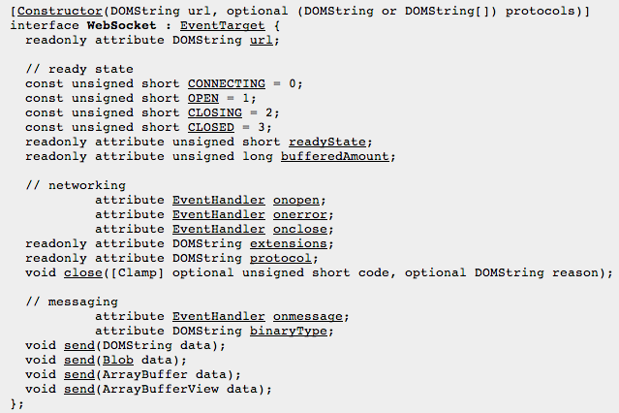
WebSocket API
www.w3.org/TR/websockets/

Slide 14
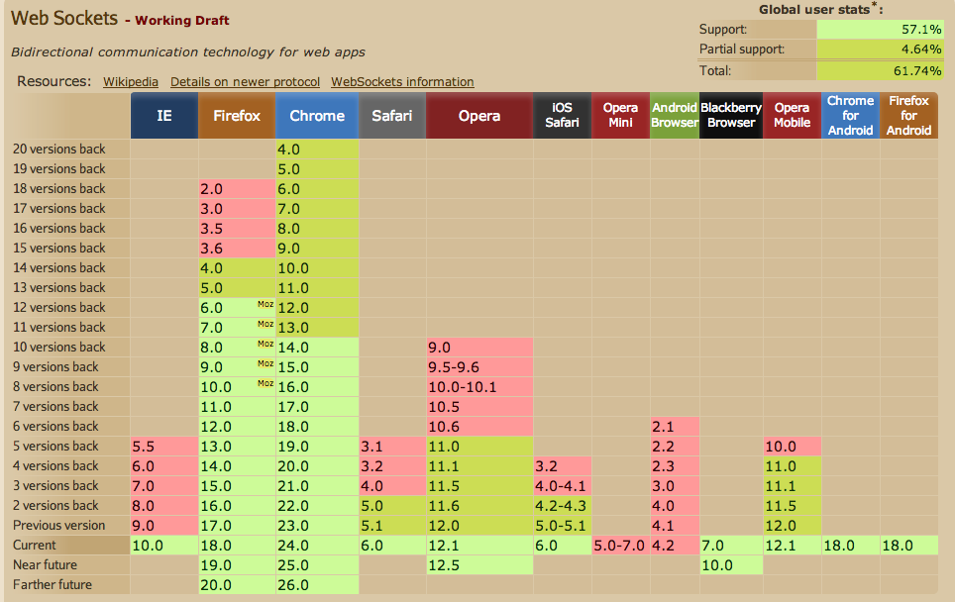
Browser Support
http://caniuse.com/websockets

Slide 15
JSR 356 Specification
Standard Java API for creating WebSocket Applications
Transparent Expert Group
jcp.org/en/jsr/detail?id=356
java.net/projects/websocket-spec
FINAL: Part of Java EE 7
Notes:
Client connects to one server, server accepts multiple connections from different clients
Client profile may be submitted as part of Java SE 9

Slide 16
JSR 356: Reference Implementation
Tyrus: java.net/projects/tyrus
Open source and transparent
Integrated in GlassFish 4

Slide 17
Java API for WebSocket Features
API for WebSocket Server and Client Endpoint
Annotated: @ServerEndpoint, @ClientEndpoint
Programmatic: Endpoint
WebSocket opening handshake negotiation
Lifecycle callback methods
Integration with Java EE technologies
Notes:
Override the algorithm or match in interesting ways then using Endpoint
Power users will use the programmatic API
ASK: What approach do the developers see them using ?

Slide 18
Hello World and Basics POJO

Slide 19
Hello World
Annotated Endpoint
import javax.websocket.*; @ServerEndpoint("/hello") public class HelloBean { @OnMessage public String sayHello(String name) { return “Hello “ + name; } }
Notes:
Earlier: 1 endpoint instance per URI, multi-threaded concurrent model
Now: 1 instance per client connection, called back only once per client. Single-threaded model and so no concurrency required in the runtime. EJB Singleton can be used but the user code need to manage concurrency in that case. Ditto with CDI Singleton.
Highlight similarities/differences with JAX-RS

Slide 20
Annotations
Annotation | Level | Purpose
@ServerEndpoint | class | Turns a POJO into a Server Endpoint
@ClientEndpoint | class | Turns a POJO into a Client Endpoint
@OnMessage | method | Intercepts WebSocket Message events
@PathParam | method parameter | Flags a matched path segment of a URI-template
@OnOpen | method | Intercepts WebSocket Open events
@OnClose | method | Intercepts WebSocket Close events
@OnError | method | Intercepts errors during a conversation
Notes:
The annotation defines that the decorated method be called whenever a new client has connected to this endpoint. The container notifies the method after the connection has been established [WSC-21]. The decorated method can only have optional Session parameter and zero to n String parameters annotated with a @WebSocketPathSegment annotation as parameters. If the Session parameter is present, the implementation must pass in the newly created Session corresponding to the new connection [WSC-22]. If the method throws an error, the implementation must pass this error to the onError method of the endpoint together with the session.
The annotation defines that the decorated method be called whenever a new client is about to be disconnected from this endpoint. The container notifies the method before the connection is brought down [WSC-25]. The decorated method can only have optional Session parameter and zero to n String parameters annotated with a @WebSocketPathSegment annotation as parameters. If the Session parameter is present, the implementation must pass in the about-to-be ended Session corresponding to the connection [WSC-26]. If the method throws an error, the implementation must pass this error to the onError method of the endpoint together with the session.
The annotation defines that the decorated method be called whenever an error is generated on any of the connections to this endpoint. The decorated method can only have optional Session parameter, mandatory Throwable parameter and zero to n String parameters annotated with a @WebSocketPathSegment annotation as parameters. If the Session parameter is present, the implementation must pass in the Session in which the error occurred to the connection [WSC-XX]. The container must pass the error as the Throwable parameter to this method.

Slide 21
@ServerEndpoint attributes
value | Relative URI or URI template e.g. “/hello” or “/chat/{subscriber-level}”
decoders | list of message decoder classnames
encoders | list of message encoder classnames
subprotocols | list of the names of the supported subprotocols

Slide 22
Custom Payloads
@ServerEndpoint( value="/hello", decoders={MyMessageDecoder.class}, encoders={MyMessageEncoder.class} ) public class MyEndpoint { . . . }
Notes:
The encoders parameter contains a (possibly empty) list of Java classes that are to act as encoder components for this endpoint. These classes must implement some form of the Encoder interface, and have public no-arg constructors and be visible within the classpath of the application that this websocket endpoint is part of. The implementation must attempt to encode application objects of matching parametrized type as the encoder when they are attempted to be sent using the RemoteEndpoint API.
The decoders parameter contains a (possibly empty) list of Java classes that are to act as decoder components for this endpoint. These classes must implement some form of the Decoder interface, and have public no-arg constructors and be visible within the classpath of the application that this websocket endpoint is part of. The implementation must attempt to decode web socket messages using the first appropriate decoder in the list and pass the message in decoded object form to the websocket endpoint [WSC-17]. The implementation uses the willDecode() method on the decoder to determine if the Decoder will match the incoming message.

Slide 23
Custom Payloads – Text Decoder
public class MyMessageDecoder implements Decoder.Text<MyMessage> {
public MyMessage decode(String s) { JsonObject jsonObject = Json.createReader(…).readObject(); return new MyMessage(jsonObject); }
public boolean willDecode(String string) { . . . return true; // Only if can process the payload }
. . . }

Slide 24
Custom Payloads – Text Encoder
public class MyMessageEncoder implements Encoder.Text<MyMessage> {
public String encode(MyMessage myMessage) { return myMessage.jsonObject.toString(); }
. . . }

Slide 25
Custom Payloads – Binary Decoder
public class MyMessageDecoder implements Decoder.Binary<MyMessage> { public MyMessage decode(byte[] bytes) { . . . return myMessage;
}
public boolean willDecode(byte[] bytes) { . . . return true; // Only if can process the payload }
. . . }

Slide 26
Which methods can be @OnMessage ?
Exactly one of the following
Text: String, Java primitive or equivalent class, String and boolean, Reader, any type for which there is a decoder
Binary: byte[], ByteBuffer, byte[] and boolean, ByteBuffer and boolean, InptuStream, any type for which there is a decoder
Pong messages: PongMessage
An optional Session parameter
0..n String parameters annotated with @PathParam
Return type: String, byte[], ByteBuffer, Java primitive or class equivalent or any type for which there is a encoder
Notes:
The allowed parameters are:
Exactly one of any of the following choices
if the method is handling text messages:
String to receive the whole message
Java primitive or class equivalent to receive the whole message converted to that type
String and boolean pair to receive the message in parts
Reader to receive the whole message as a blocking stream
any object parameter for which the endpoint has a text decoder (Decoder.Text or Decoder.TextStream).
if the method is handling binary messages:
byte[] or ByteBuffer to receive the whole message
byte[] and boolean pair, or ByteBuffer and boolean pair to receive the message in parts
InputStream to receive the whole message as a blocking stream
any object parameter for which the endpoint has a binary decoder (Decoder.Binary or Decoder.BinaryStream).
if the method is handling pong messages:
PongMessage for handling pong messages
and Zero to n String or Java primitive parameters annotated with the WebSocketPathParam annotation for server endpoints.
and an optional Session parameter
The parameters may be listed in any order.
The method may have a non-void return type, in which case the web socket runtime must interpret this as a web socket message to return to the peer. The allowed data types for this return type, other than void, are String, ByteBuffer, byte[], any Java primitive or class equivalent, and anything for which there is an encoder. If the method uses a Java primitive as a return value, the implementation must construct the text message to send using the standard Java string representation of the Java primitive. If the method uses a class equivalent of a Java primitive as a return value, the implementation must construct the text message from the Java primitive equivalent as described above.
Developers should note that if developer closes the session during the invocation of a method with a return type, the method will complete but the return value will not be delivered to the remote endpoint. The send failure will be passed back into the endpoint's error handling method.

Slide 27
Sample Messages
void m(String s);
void m(Float f, @PathParam(“id”)int id);
Product m(Reader reader, Session s);
void m(byte[] b); or void m(ByteBuffer b);
Book m(int i, Session s, @PathParam(“isbn”)String isbn, @PathParam(“store”)String store);

Slide 28
Chat Server
@ServerEndpoint("/chat")
public class ChatBean {
static Set<Session> peers = Collections.synchronizedSet(…); @OnOpen public void onOpen(Session peer) { peers.add(peer); } @OnClose public void onClose(Session peer) { peers.remove(peer); } . . .

Slide 29
Chat Server
. . . @OnMessage
public void message(String message, Session client) {
for (Session peer : peers) { peer.getBasicRemote().sendObject(message); } } }

Slide 30
URI Template Matching
Level 1 only
@ServerEndpoint(“/orders/{order-id}”) public class MyEndpoint { @OnMessage public void processOrder( @PathParam(“order-id”)String orderId) { . . . } }

Slide 31
WebSocket Client
@ClientEndpoint public class HelloClient { @OnMessage public void message(String message, Session session) { // process message from server } }
WebSocketContainer c = ContainerProvider.getWebSocketContainer(); c.connectToServer(HelloClient.class, “hello”);

Slide 32
Hello World and Basics Non-POJO

Slide 33
Programmatic Endpoint
public class MyEndpoint extends Endpoint { @Override public void onOpen(Session session) { session.addMessageHandler(new MessageHandler.Text() { public void onMessage(String name) { try { session.getBasicRemote().sendText(“Hello “ + name); } catch (IOException ex) { } } }); } }
Notes:
A logical websocket endpoint is represented in the Java WebSocket API as an instance of the Endpoint class. Developers may subclass the Endpoint class in order to intercept lifecycle events of the endpoint: those of a peer connecting, a peer disconnecting and an error being raised during the lifetime of the endpoint.
The implementation must use at least one instance of the Endpoint class to represent the logical endpoint. Each instance of the Endpoint class may therefore handle connections to the endpoint from multiple peers. Some implementations may wish to use multiple instances of Endpoint to represent a logical endpoint, perhaps one instance per VM in a distributed server setting.
The Java WebSocket API models the sequence of interactions between an endpoint and each of its peers using an instance of the Session class. The interactions between a peer and an endpoint begin with an open notification, followed by some number, possibly zero, of web socket messages between the endpoint and peer, followed by a close notification or error terminal to the connection. For each peer that is interacting with an endpoint, there is one Session instance that represents that interaction. The Session instance corresponding to the peer is passed to the Endpoint instance representing the endpoint at the key events in its lifecycle.

Slide 34
Interface-driven Endpoint
Server Packaging
ServerEndpointConfiguration config = ServerEndpointConfigurationBuilder .create(MyEndpoint.class, “/foo”) .build();

Slide 35
Server and Client Configuration
Server
URI matching algorithm
Subprotocol and extension negotiation
Message encoders and decoders
Origin check
Handshake response
Client
Requested subprotocols and extensions
Message encoders and decoders
Request URI

Slide 36
Relationship with Dependency Injection
Full Dependency Injection support required in endpoints
Field, method, constructor injection
Interceptors permitted too

Slide 37
Relationship with Servlet 3.1
Allows a portable way to upgrade HTTP request
New API
HttpServletRequest.upgrade(ProtocolHandler handler)

Slide 38
Security
Authenticates using Servlet security mechanism during opening handshake
Endpoint mapped by ws:// is protected using security model defined using the corresponding http:// URI
Authorization defined using <security-constraint>
TBD: Add/reuse security annotations
Transport Confidentiality using wss://
Access allowed over encrypted connection only

Slide 39
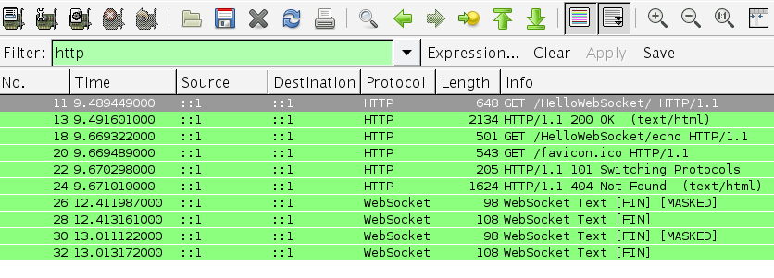
How to view WebSocket messages ?
Capture traffic on loopback
Notes:
In the WebSocket Protocol, data is transmitted using a sequence of frames. To avoid confusing network intermediaries (such as intercepting proxies) and for security reasons that are further discussed in Section 10.3, a client MUST mask all frames that it sends to the server (see Section 5.3 for further details). Note that masking is done whether or not the WebSocket Protocol is running over TLS. A server MUST NOT mask any frames that it sends to the client.
Mask all data from the client to the server, so that the remote script (attacker) does not have control over how the data being sent appears on the wire and thus cannot construct a message that could be misinterpreted by an intermediary as an HTTP request. Clients MUST choose a new masking key for each frame, using an algorithm that cannot be predicted by end applications that provide data. For example, each masking could be drawn from a cryptographically strong random number generator.

Slide 40
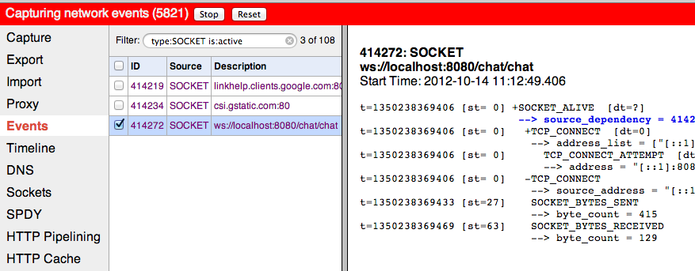
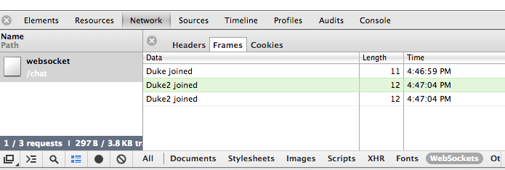
How to view WebSocket messages ?
chrome://net-internals -> Sockets -> View live sockets

Slide 41
Resources
Specification
JSR: jcp.org/en/jsr/detail?id=356
Mailing Lists, JIRA, Archive: java.net/projects/websocket-spec
FINAL: Part of Java EE 7
Reference Implementation
Tyrus: java.net/projects/tyrus
Integrated in GlassFish 4

Slide 42
Q & A

