Slide 1
JavaFX with JVM Languages Asia Version
Stephen Chin
Java Technology Ambassador
JavaOne Content Chair
stephen.chin@oracle.com
tweet: @steveonjava

Slide 2
Safe Harbor Statement
The following is intended to outline our general product direction. It is intended for information purposes only, and may not be incorporated into any contract. It is not a commitment to deliver any material, code, or functionality, and should not be relied upon in making purchasing decisions. The development, release, and timing of any features or functionality described for Oracle’s products remains at the sole discretion of Oracle.

Slide 3
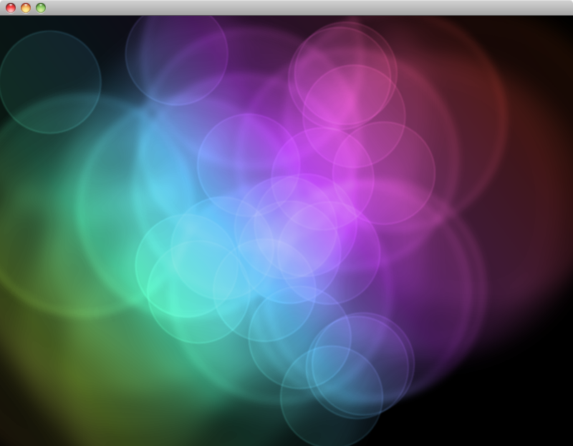
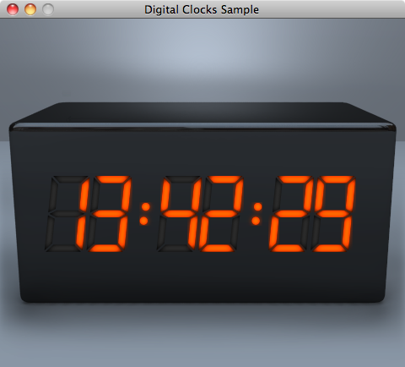
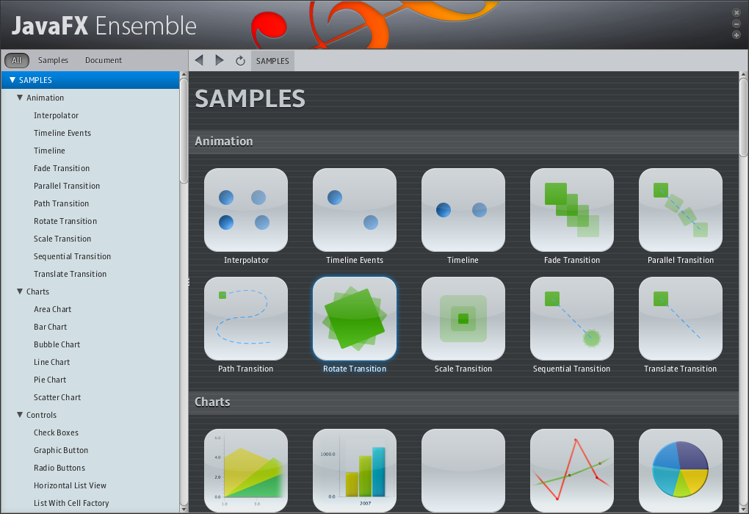
JavaFX 2.0 Platform
Immersive Application Experience
Leverage your Java skills with modern JavaFX APIs
Cross-platform Animation, Video, Charting
Integrate Java, JavaScript, and HTML5 in the same application
New graphics stack takes advantage of hardware acceleration for 2D and 3D applications
Use your favorite IDE: NetBeans, Eclipse, IntelliJ, etc.

Slide 4
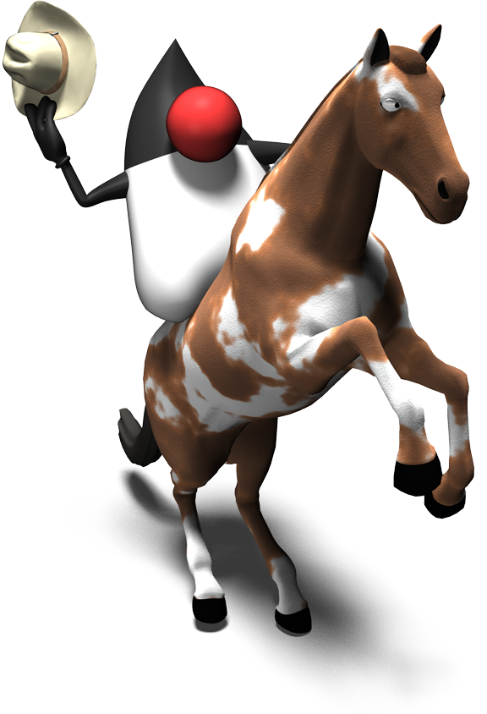
JavaFX With Java

Slide 5
Programming Languages
JavaFX 2 APIs are now in Java
Pure Java APIs for all of JavaFX
Binding and Sequences exposed as Java APIs
FXML Markup for tooling
Embrace all JVM languages
Groovy, Scala, Clojure, JRuby
Fantom, Mira, Gosu, Jython, etc.
JavaFX Script is no longer supported by Oracle
Existing JavaFX Script based applications will continue to run
Visage is the open-source successor to the JavaFX Script language

Slide 6
Vanishing Circles

Slide 7
Vanishing Circles in Java
public class VanishingCircles extends Application {
public static void main(String[] args) {
Application.launch(args);
}
@Override
public void start(Stage primaryStage) {
primaryStage.setTitle("Vanishing Circles");
Group root = new Group();
Scene scene = new Scene(root, 800, 600, Color.BLACK);
List<Circle> circles = new ArrayList<Circle>();
for (int i = 0; i < 50; i++) {
final Circle circle = new Circle(150);
circle.setCenterX(Math.random() * 800);
circle.setCenterY(Math.random() * 600);
circle.setFill(new Color(Math.random(), Math.random(), Math.random(), .2));
circle.setEffect(new BoxBlur(10, 10, 3));
circle.addEventHandler(MouseEvent.MOUSE_CLICKED, new EventHandler<MouseEvent>() {
public void handle(MouseEvent t) {
KeyValue collapse = new KeyValue(circle.radiusProperty(), 0);
new Timeline(new KeyFrame(Duration.seconds(3), collapse)).play();
}
});
circle.setStroke(Color.WHITE);
circle.strokeWidthProperty().bind(Bindings.when(circle.hoverProperty())
.then(4)
.otherwise(0));
circles.add(circle);
}
root.getChildren().addAll(circles);
primaryStage.setScene(scene);
primaryStage.show();
Timeline moveCircles = new Timeline();
for (Circle circle : circles) {
KeyValue moveX = new KeyValue(circle.centerXProperty(), Math.random() * 800);
KeyValue moveY = new KeyValue(circle.centerYProperty(), Math.random() * 600);
moveCircles.getKeyFrames().add(new KeyFrame(Duration.seconds(40), moveX, moveY));
}
moveCircles.play();
}
}
40 Lines
1299 Characters

Slide 8
Application Skeleton
public class VanishingCircles extends Application {
public static void main(String[] args) {
Application.launch(args);
}
@Override
public void start(Stage primaryStage) {
primaryStage.setTitle("Vanishing Circles");
Group root = new Group();
Scene scene = new Scene(root, 800, 600, Color.BLACK);
[create the circles…]
root.getChildren().addAll(circles);
primaryStage.setScene(scene);
primaryStage.show();
[begin the animation…]
}
}

Slide 9
Create the Circles
List<Circle> circles = new ArrayList<Circle>();
for (int i = 0; i < 50; i++) {
final Circle circle = new Circle(150);
circle.setCenterX(Math.random() * 800);
circle.setCenterY(Math.random() * 600);
circle.setFill(new Color(Math.random(), Math.random(),
Math.random(), .2));
circle.setEffect(new BoxBlur(10, 10, 3));
circle.setStroke(Color.WHITE);
[setup binding…]
[setup event listeners…]
circles.add(circle);
}

Slide 10
Setup Binding
circle.strokeWidthProperty().bind(Bindings
.when(circle.hoverProperty())
.then(4)
.otherwise(0)
);

Slide 11
Setup Event Listeners
circle.addEventHandler(MouseEvent.MOUSE_CLICKED,
new EventHandler<MouseEvent>() {
public void handle(MouseEvent t) {
KeyValue collapse = new KeyValue(circle.radiusProperty(), 0);
new Timeline(new KeyFrame(Duration.seconds(3),
collapse)).play();
}
});

Slide 12
Begin the Animation
Timeline moveCircles = new Timeline();
for (Circle circle : circles) {
KeyValue moveX = new KeyValue(circle.centerXProperty(),
Math.random() * 800);
KeyValue moveY = new KeyValue(circle.centerYProperty(),
Math.random() * 600);
moveCircles.getKeyFrames().add(new KeyFrame(Duration.seconds(40),
moveX, moveY));
}
moveCircles.play();

Slide 13
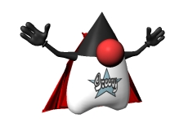
JavaFX With Groovy

Slide 14
Features of Groovy
Modern language
Closures
AST Transforms
Strongly typed dynamic language
Tight integration with Java
Very easy to port from Java to Groovy
Declarative syntax with GroovyFX Builders
Familiar to Groovy and JavaFX Script developers

Slide 15
Java vs. GroovyFX DSL
public class VanishingCircles extends Application {
public static void main(String[] args) {
Application.launch(args);
}
@Override
public void start(Stage primaryStage) {
primaryStage.setTitle("Vanishing Circles");
Group root = new Group();
Scene scene = new Scene(root, 800, 600, Color.BLACK);
List<Circle> circles = new ArrayList<Circle>();
for (int i = 0; i < 50; i++) {
final Circle circle = new Circle(150);
circle.setCenterX(Math.random() * 800);
circle.setCenterY(Math.random() * 600);
circle.setFill(new Color(Math.random(), Math.random(), Math.random(), .2));
circle.setEffect(new BoxBlur(10, 10, 3));
circle.addEventHandler(MouseEvent.MOUSE_CLICKED, new EventHandler<MouseEvent>() {
public void handle(MouseEvent t) {
KeyValue collapse = new KeyValue(circle.radiusProperty(), 0);
new Timeline(new KeyFrame(Duration.seconds(3), collapse)).play();
}
});
circle.setStroke(Color.WHITE);
circle.strokeWidthProperty().bind(Bindings.when(circle.hoverProperty())
.then(4)
.otherwise(0));
circles.add(circle);
}
root.getChildren().addAll(circles);
primaryStage.setScene(scene);
primaryStage.show();
Timeline moveCircles = new Timeline();
for (Circle circle : circles) {
KeyValue moveX = new KeyValue(circle.centerXProperty(), Math.random() * 800);
KeyValue moveY = new KeyValue(circle.centerYProperty(), Math.random() * 600);
moveCircles.getKeyFrames().add(new KeyFrame(Duration.seconds(40), moveX, moveY));
}
moveCircles.play();
}
}
GroovyFX.start { primaryStage ->
def sg = new SceneGraphBuilder()
def rand = new Random().&nextInt
def circles = []
sg.stage(title: 'Vanishing Circles', show: true) {
scene(fill: black, width: 800, height: 600) {
50.times {
circles << circle(centerX: rand(800), centerY: rand(600), radius: 150, stroke: white,
strokeWidth: bind('hover', converter: {val -> val ? 4 : 0})) {
fill rgb(rand(255), rand(255), rand(255), 0.2)
effect boxBlur(width: 10, height: 10, iterations: 3)
onMouseClicked { e ->
timeline {
at(3.s) { change e.source.radiusProperty() to 0 }
}.play()
}
}
}
}
timeline(cycleCount: Timeline.INDEFINITE, autoReverse: true) {
circles.each { circle ->
at (40.s) {
change circle.centerXProperty() to rand(800)
change circle.centerYProperty() to rand(600)
}
}
}.play()
}
}
40 Lines
1299 Characters
29 Lines
671 Characters

Slide 16
GroovyFX.start { primaryStage ->
def sg = new SceneGraphBuilder()
def rand = new Random().&nextInt
def circles = []
sg.stage(title: 'Vanishing Circles', show: true) {
scene(fill: black, width: 800, height: 600) {
50.times {
circles << circle(centerX: rand(800), centerY: rand(600),
radius: 150, stroke: white,
strokeWidth: bind('hover', converter: {val -> val ? 4 : 0})) {
fill rgb(rand(255), rand(255), rand(255), 0.2)
effect boxBlur(width: 10, height: 10, iterations: 3)
}
}
}
}
}

Slide 17
GroovyFX.start { primaryStage ->
def sg = new SceneGraphBuilder()
def rand = new Random().&nextInt
def circles = []
sg.stage(title: 'Vanishing Circles', show: true) {
scene(fill: black, width: 800, height: 600) {
50.times {
circles << circle(centerX: rand(800), centerY: rand(600),
radius: 150, stroke: white,
strokeWidth: bind('hover', converter: {val -> val ? 4 : 0})) {
fill rgb(rand(255), rand(255), rand(255), 0.2)
effect boxBlur(width: 10, height: 10, iterations: 3)
}
}
}
}
}
Builder for GroovyFX scene graphs

Slide 18
GroovyFX.start { primaryStage ->
def sg = new SceneGraphBuilder()
def rand = new Random().&nextInt
def circles = []
sg.stage(title: 'Vanishing Circles', show: true) {
scene(fill: black, width: 800, height: 600) {
50.times {
circles << circle(centerX: rand(800), centerY: rand(600),
radius: 150, stroke: white,
strokeWidth: bind('hover', converter: {val -> val ? 4 : 0})) {
fill rgb(rand(255), rand(255), rand(255), 0.2)
effect boxBlur(width: 10, height: 10, iterations: 3)
}
}
}
}
}
Declarative Stage definition

Slide 19
GroovyFX.start { primaryStage ->
def sg = new SceneGraphBuilder()
def rand = new Random().&nextInt
def circles = []
sg.stage(title: 'Vanishing Circles', show: true) {
scene(fill: black, width: 800, height: 600) {
50.times {
circles << circle(centerX: rand(800), centerY: rand(600),
radius: 150, stroke: white,
strokeWidth: bind('hover', converter: {val -> val ? 4 : 0})) {
fill rgb(rand(255), rand(255), rand(255), 0.2)
effect boxBlur(width: 10, height: 10, iterations: 3)
}
}
}
}
}
Inline property definitions

Slide 20
GroovyFX.start { primaryStage ->
def sg = new SceneGraphBuilder()
def rand = new Random().&nextInt
def circles = []
sg.stage(title: 'Vanishing Circles', show: true) {
scene(fill: black, width: 800, height: 600) {
50.times {
circles << circle(centerX: rand(800), centerY: rand(600),
radius: 150, stroke: white,
strokeWidth: bind('hover', converter: {val -> val ? 4 : 0})) {
fill rgb(rand(255), rand(255), rand(255), 0.2)
effect boxBlur(width: 10, height: 10, iterations: 3)
}
}
}
}
}
Bind to properties

Slide 21
GroovyFX.start { primaryStage ->
def sg = new SceneGraphBuilder()
def rand = new Random().&nextInt
def circles = []
sg.stage(title: 'Vanishing Circles', show: true) {
scene(fill: black, width: 800, height: 600) {
50.times {
circles << circle(centerX: rand(800), centerY: rand(600),
radius: 150, stroke: white,
strokeWidth: bind('hover', converter: {val -> val ? 4 : 0})) {
fill rgb(rand(255), rand(255), rand(255), 0.2)
effect boxBlur(width: 10, height: 10, iterations: 3)
}
}
}
}
}
Sequence Creation Via Loop

Slide 22
Animation in GroovyFX
timeline(cycleCount: Timeline.INDEFINITE, autoReverse: true) {
circles.each { circle ->
at (40.s) {
change circle.centerXProperty() to rand(800)
change circle.centerYProperty() to rand(600)
}
}
}.play()

Slide 23
Animation in GroovyFX
timeline(cycleCount: Timeline.INDEFINITE, autoReverse: true) {
circles.each { circle ->
at (40.s) {
change circle.centerXProperty() to rand(800)
change circle.centerYProperty() to rand(600)
}
}
}.play()
Easy animation syntax:
at (duration) {keyframes}

Slide 24
Animation in GroovyFX
timeline(cycleCount: Timeline.INDEFINITE, autoReverse: true) {
circles.each { circle ->
at (40.s) {
change circle.centerXProperty() to rand(800)
change circle.centerYProperty() to rand(600)
}
}
}.play()
Key frame DSL

Slide 25
Animation in GroovyFX
timeline(cycleCount: Timeline.INDEFINITE, autoReverse: true) {
circles.each { circle ->
at (40.s) {
change circle.centerXProperty() to rand(800) tween ease_both
change circle.centerYProperty() to rand(600) tween linear
}
}
}.play()
Optional easing

Slide 26
Event Listeners in GroovyFX
Supported using the built-in Closure syntax
Optional arguments for event objects
onMouseClicked { e ->
timeline {
at(3.s) { change e.source.radiusProperty() to 0 }
}.play()
}

Slide 27
Event Listeners in GroovyFX
Supported using the built-in Closure syntax
Optional arguments for event objects
onMouseClicked { MouseEvent e ->
timeline {
at(3.s) { change e.source.radiusProperty() to 0 }
}.play()
}
Compact syntax
{body}

Slide 28
Event Listeners in GroovyFX
Supported using the built-in Closure syntax
Optional arguments for event objects
Optional event parameter
{event -> body}
onMouseClicked { MouseEvent e ->
timeline {
at(3.s) { change e.source.radiusProperty() to 0 }
}.play()
}

Slide 29
But wait, there is more Grooviness…

Slide 30
Properties in Java
public class Person {
private StringProperty firstName;
public void setFirstName(String val) { firstNameProperty().set(val); }
public String getFirstName() { return firstNameProperty().get(); }
public StringProperty firstNameProperty() {
if (firstName == null)
firstName = new SimpleStringProperty(this, "firstName");
return firstName;
}
private StringProperty lastName;
public void setLastName(String value) { lastNameProperty().set(value); }
public String getLastName() { return lastNameProperty().get(); }
public StringProperty lastNameProperty() {
if (lastName == null) // etc.
}
}

Slide 31
Properties in GroovyFX
public class Person {
@FXBindable String firstName;
@FXBindable String lastName;
}

Slide 32
Properties in GroovyFX
public class Person {
@FXBindable String firstName;
@FXBindable String lastName = “Smith”;
}
Optional initializers

Slide 33
TableView in Java
ObservableList<Person> items = ...
TableView<Person> tableView = new TableView<Person>(items);
TableColumn<Person,String> firstNameCol =
new TableColumn<Person,String>("First Name");
firstNameCol.setCellValueFactory(
new Callback<CellDataFeatures<Person, String>,
ObservableValue<String>>() {
public ObservableValue<String> call(CellDataFeatures<Person, String> p)
{
return p.getValue().firstNameProperty();
}
});
tableView.getColumns().add(firstNameCol);

Slide 34
TableView in GroovyFX
def dateFormat = new SimpleDateFormat("yyyy-MM-dd");
tableView(items: persons) {
tableColumn(property: "name", text: "Name", prefWidth: 150)
tableColumn(property: "age", text: "Age", prefWidth: 50)
tableColumn(property: "gender", text: "Gender", prefWidth: 150)
tableColumn(property: "dob", text: "Birth", prefWidth: 150,
type: Date,
converter: { from -> return dateFormat.format(from) })
}

Slide 35
Layout in Java
TextField urlField = new TextField(“http://www.google.com”);
HBox.setHgrow(urlField, Priority.ALWAYS);
HBox hbox = new HBox();
hbox.getChildren().add(urlField);
WebView webView = new WebView();
VBox.setVgrow(webView, Priority.ALWAYS);
VBox vbox = new VBox();
vbox.getChildren().addAll(hbox, webView);

Slide 36
Layout in GroovyFX
sg.stage(title: "GroovyFX WebView Demo", show: true) {
scene(fill: groovyblue, width: 1024, height: 800) {
vbox {
hbox(padding: 10, spacing: 5) {
textField(“http://www.yahoo.com”, hgrow: "always")
button("Go”)
}
webView(vgrow: "always")
}
}
}

Slide 37
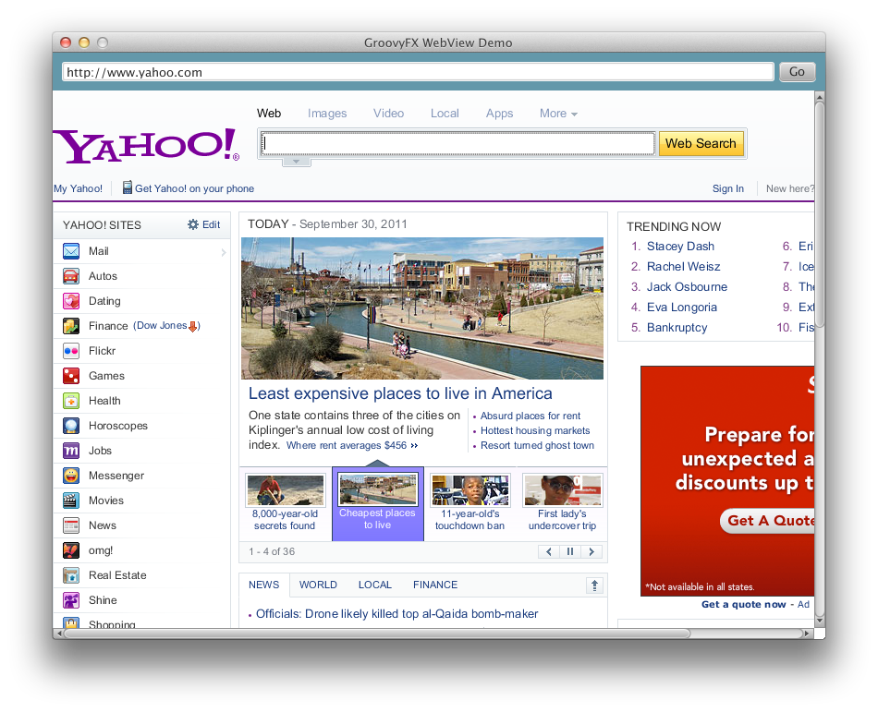
Layout in GroovyFX

Slide 38
Layout in GroovyFX
gridPane(hgap: 5, vgap: 10, padding: 25) {
columnConstraints(minWidth: 50, halignment: "right")
columnConstraints(prefWidth: 250)
label("Send Us Your Feedback", font: "24pt sanserif",
row: 0, columnSpan: GridPane.REMAINING, halignment: "center",
margin: [0, 0, 10])
label("Name: ", row: 1, column: 0)
textField(promptText: "Your name", row: 1, column: 1, hgrow: 'always')
label("Email:", row: 2, column: 0)
textField(promptText: "Your email", row: 2, column: 1, hgrow: 'always')
label("Message:", row: 3, column: 0, valignment: "baseline")
textArea(row: 3, column: 1, hgrow: "always", vgrow: "always")
button("Send Message", row: 4, column: 1, halignment: "right")
}

Slide 39
Layout in GroovyFX

Slide 40
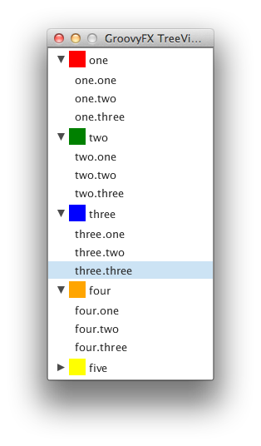
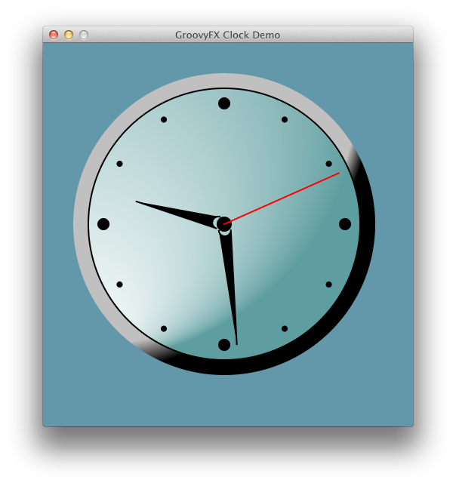
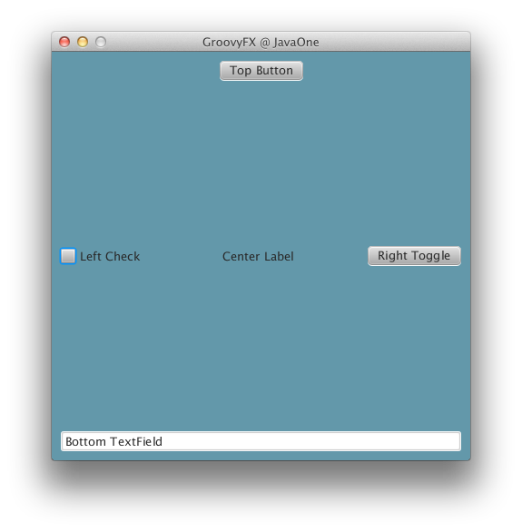
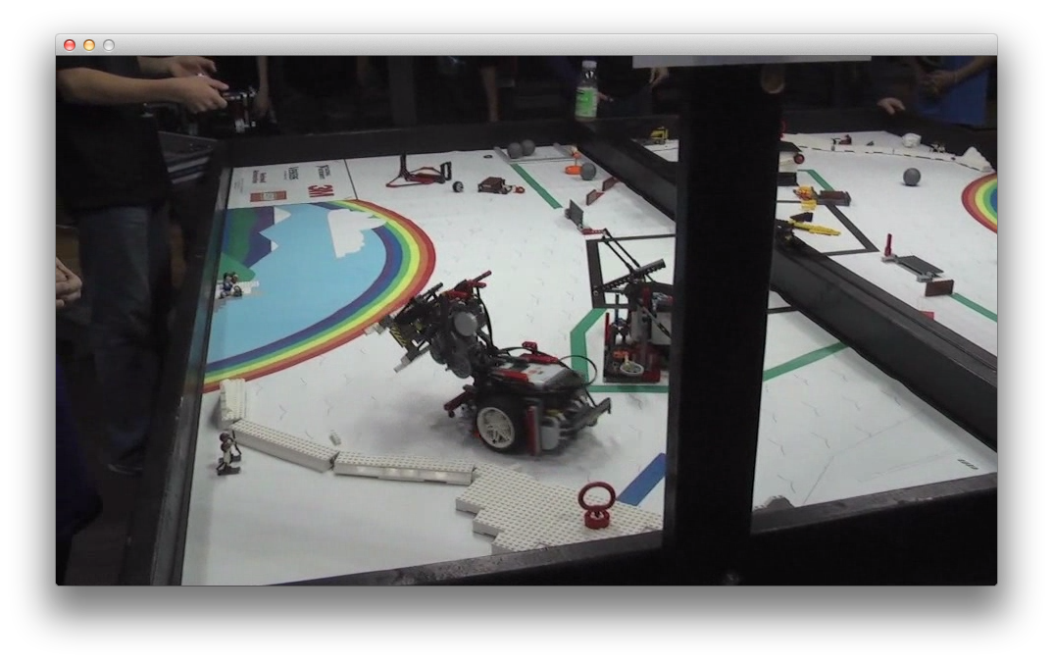
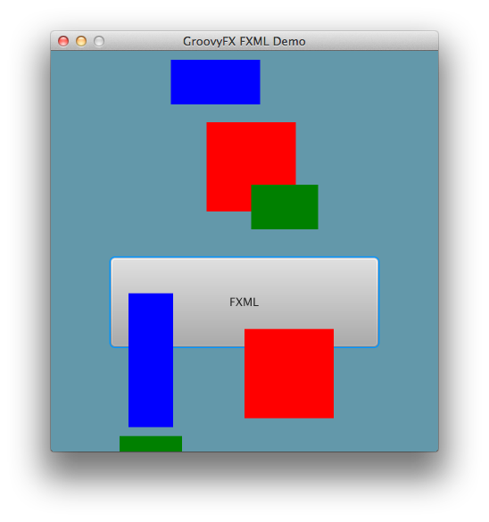
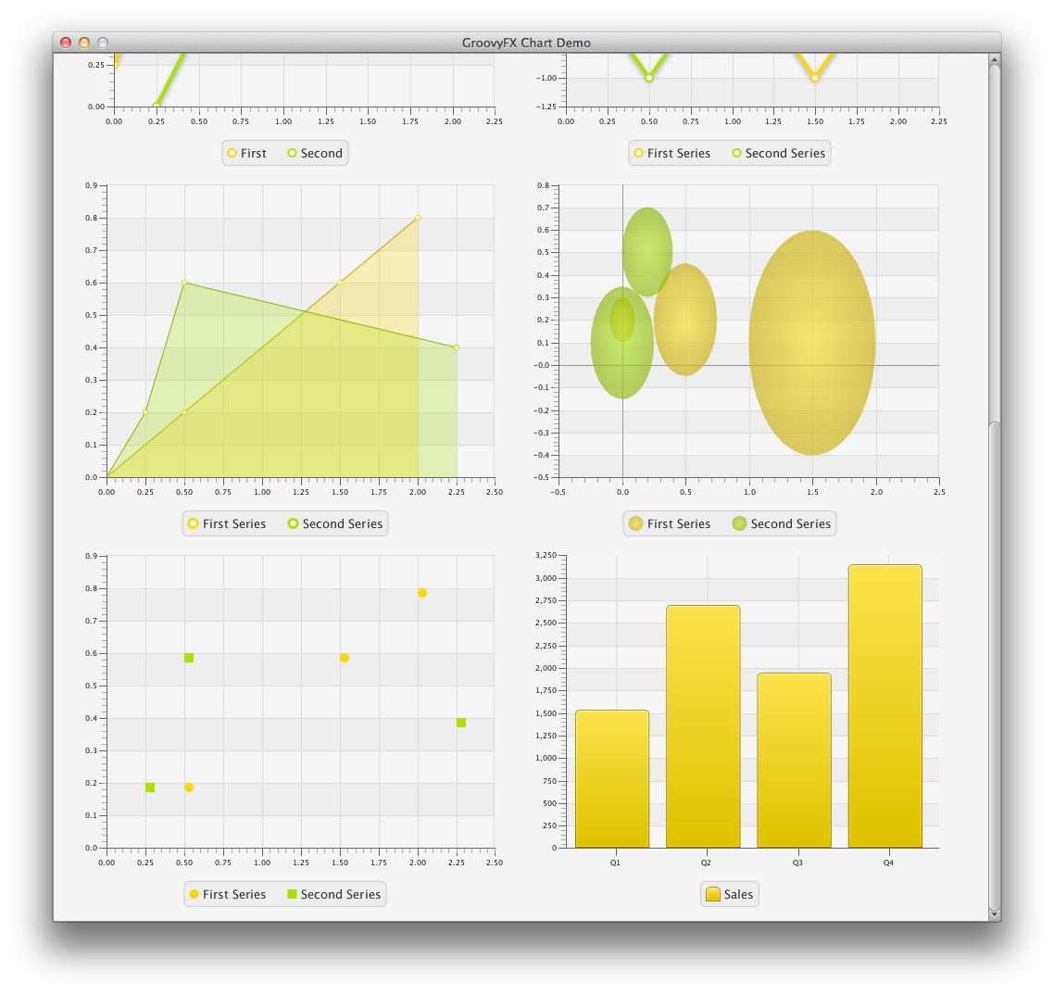
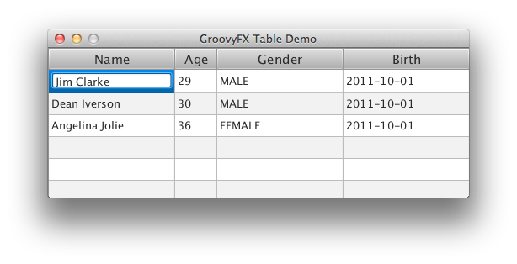
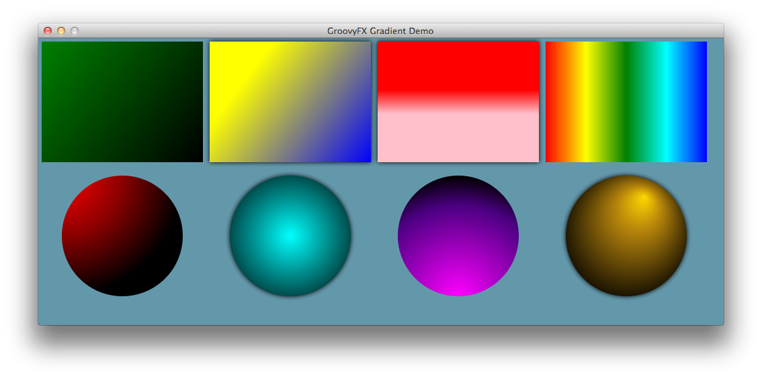
GroovyFX Supports…

Slide 41
?
And is most like
which Anime?
(or Manga)

Slide 42
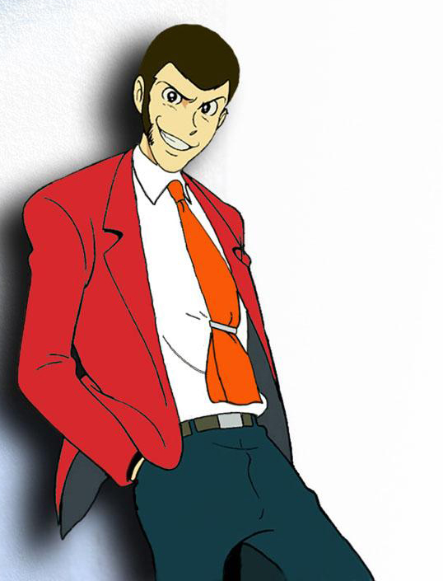
Notes:
Simple on the surface, but complicated and mischievous underneath.

Slide 43
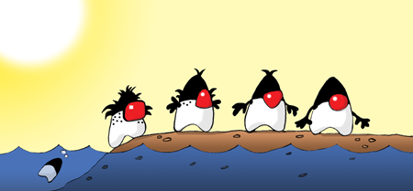
JavaFX With Clojure
Artwork by Augusto Sellhorn
http://sellmic.com/

Slide 44
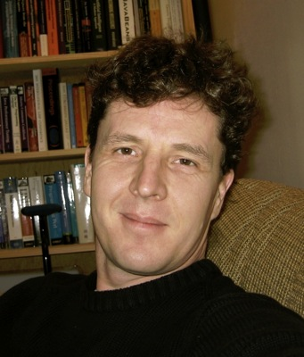
A Little About Clojure
Started in 2007 by Rich Hickey
Functional Programming Language
Derived from LISP
Optimized for High Concurrency
… and looks nothing like Java!
(def hello (fn [] "Hello world"))
(hello)

Slide 45
Clojure Syntax in One Slide
Symbols
Collections
(commas optional)
numbers – 2.178
ratios – 355/113
strings – “clojure”, “rocks”
characters – \a \b \c \d
symbols – a b c d
keywords – :alpha :beta
boolean – true, false
null - nil
Lists
(1, 2, 3, 4, 5)
Vectors
[1, 2, 3, 4, 5]
Maps
{:a 1, :b 2, :c 3, :d 4}
Sets
#{:a :b :c :d :e}
(plus macros that are syntactic sugar wrapping the above)

Slide 46
Clojure GUI Example
(defn javafxapp []
(let [stage (Stage. "JavaFX Stage")
scene (Scene.)]
(.setFill scene Color/LIGHTGREEN)
(.setWidth stage 600)
(.setHeight stage 450)
(.setScene stage scene)
(.setVisible stage true)))
(javafxapp)

Slide 47
Refined Clojure GUI Example
(defn javafxapp []
(doto (Stage. "JavaFX Stage")
(.setWidth 600)
(.setHeight 450)
(.setScene (doto (Scene.)
(.setFill Color/LIGHTGREEN)
(.setContent (list (doto (Rectangle.)
(.setX 25)
(.setY 40)
(.setWidth 100)
(.setHeight 50)
(.setFill Color/RED))))))
(.setVisible true)))
(javafxapp)

Slide 48
Refined Clojure GUI Example
(defn javafxapp []
(doto (Stage. "JavaFX Stage")
(.setWidth 600)
(.setHeight 450)
(.setScene (doto (Scene.)
(.setFill Color/LIGHTGREEN)
(.setContent (list (doto (Rectangle.)
(.setX 25)
(.setY 40)
(.setWidth 100)
(.setHeight 50)
(.setFill Color/RED))))))
(.setVisible true)))
(javafxapp)
Doto allows nested data structures

Slide 49
Closures in Clojure
Inner classes can be created using proxy
(.addListener hoverProperty
(proxy [ChangeListener] []
(handle [p, o, v]
(.setFill rect
(if (.isHover rect) Color/GREEN Color/RED)))))

Slide 50
Closures in Clojure
Inner classes can be created using proxy
Proxy form:
(proxy [class] [args] fs+)
f => (name [params*] body)
(.addListener hoverProperty
(proxy [ChangeListener] []
(handle [p, o, v]
(.setFill rect
(if (.isHover rect) Color/GREEN Color/RED)))))

Slide 51
?
And is most like
which Anime?
(or Manga)

Slide 52
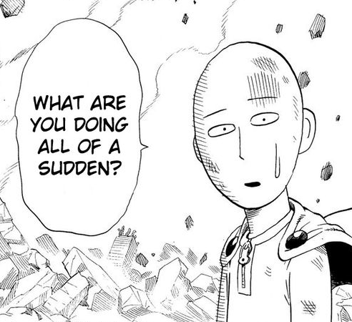
Using
Clojure
with
JavaFX
is that
easy?
Notes:
Using Clojure with JavaFX is that easy?

Slide 53
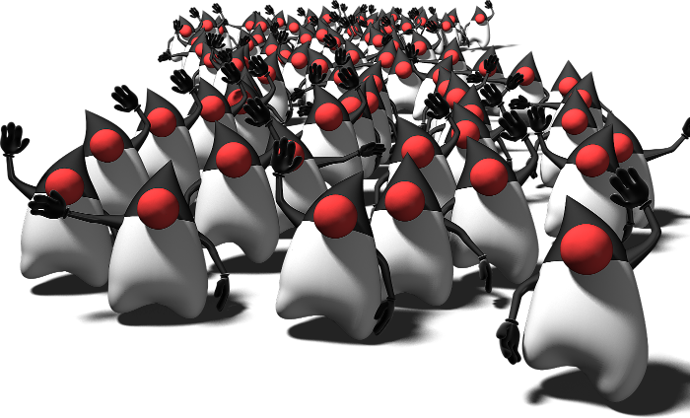
JavaFX With Scala

Slide 54
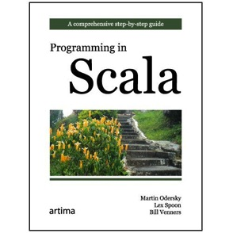
What is Scala
2001
2006
2011
2003/2004
Scala Started
Scala v1.0
Scala v2.0
Scala 2.9.2 (latest)
Started in 2001 by Martin Odersky
Compiles to Java bytecodes
Pure object-oriented language
Also a functional programming language

Slide 55
Java vs. Scala DSL
public class VanishingCircles extends Application {
public static void main(String[] args) {
Application.launch(args);
}
@Override
public void start(Stage primaryStage) {
primaryStage.setTitle("Vanishing Circles");
Group root = new Group();
Scene scene = new Scene(root, 800, 600, Color.BLACK);
List<Circle> circles = new ArrayList<Circle>();
for (int i = 0; i < 50; i++) {
final Circle circle = new Circle(150);
circle.setCenterX(Math.random() * 800);
circle.setCenterY(Math.random() * 600);
circle.setFill(new Color(Math.random(), Math.random(), Math.random(), .2));
circle.setEffect(new BoxBlur(10, 10, 3));
circle.addEventHandler(MouseEvent.MOUSE_CLICKED, new EventHandler<MouseEvent>() {
public void handle(MouseEvent t) {
KeyValue collapse = new KeyValue(circle.radiusProperty(), 0);
new Timeline(new KeyFrame(Duration.seconds(3), collapse)).play();
}
});
circle.setStroke(Color.WHITE);
circle.strokeWidthProperty().bind(Bindings.when(circle.hoverProperty())
.then(4)
.otherwise(0));
circles.add(circle);
}
root.getChildren().addAll(circles);
primaryStage.setScene(scene);
primaryStage.show();
Timeline moveCircles = new Timeline();
for (Circle circle : circles) {
KeyValue moveX = new KeyValue(circle.centerXProperty(), Math.random() * 800);
KeyValue moveY = new KeyValue(circle.centerYProperty(), Math.random() * 600);
moveCircles.getKeyFrames().add(new KeyFrame(Duration.seconds(40), moveX, moveY));
}
moveCircles.play();
}
}
object VanishingCircles extends JFXApp {
var circles: Seq[Circle] = null
stage = new Stage {
title = "Vanishing Circles"
width = 800
height = 600
scene = new Scene {
fill = BLACK
circles = for (i <- 0 until 50) yield new Circle {
centerX = random * 800
centerY = random * 600
radius = 150
fill = color(random, random, random, .2)
effect = new BoxBlur(10, 10, 3)
strokeWidth <== when (hover) then 4 otherwise 0
stroke = WHITE
onMouseClicked = {
Timeline(at (3 s) {radius -> 0}).play()
}
}
content = circles
}
}
new Timeline {
cycleCount = INDEFINITE
autoReverse = true
keyFrames = for (circle <- circles) yield at (40 s) {
Set(
circle.centerX -> random * stage.width,
circle.centerY -> random * stage.height
)
}
}.play();
}
40 Lines
1299 Characters
33 Lines
591 Characters
Notes:
Stage.add??

Slide 56
object VanishingCircles extends JFXApp {
stage = new Stage {
title = "Disappearing Circles"
width = 800
height = 600
scene = new Scene {
fill = BLACK
children = for (i <- 0 until 50) yield new Circle {
centerX = random * 800
centerY = random * 600
radius = 150
fill = color(random, random, random, 0.2)
effect = new BoxBlur(10, 10, 3)
}
}
}
}

Slide 57
object VanishingCircles extends JFXApp {
stage = new Stage {
title = "Disappearing Circles"
width = 800
height = 600
scene = new Scene {
fill = BLACK
children = for (i <- 0 until 50) yield new Circle {
centerX = random * 800
centerY = random * 600
radius = 150
fill = color(random, random, random, 0.2)
effect = new BoxBlur(10, 10, 3)
}
}
}
}
Base class for JavaFX applications

Slide 58
object VanishingCircles extends JFXApp {
stage = new Stage {
title = "Disappearing Circles"
width = 800
height = 600
scene = new Scene {
fill = BLACK
children = for (i <- 0 until 50) yield new Circle {
centerX = random * 800
centerY = random * 600
radius = 150
fill = color(random, random, random, 0.2)
effect = new BoxBlur(10, 10, 3)
}
}
}
}
Declarative Stage definition

Slide 59
object VanishingCircles extends JFXApp {
stage = new Stage {
title = "Disappearing Circles"
width = 800
height = 600
scene = new Scene {
fill = BLACK
children = for (i <- 0 until 50) yield new Circle {
centerX = random * 800
centerY = random * 600
radius = 150
fill = color(random, random, random, 0.2)
effect = new BoxBlur(10, 10, 3)
}
}
}
}
Inline property definitions

Slide 60
object VanishingCircles extends JFXApp {
stage = new Stage {
title = "Disappearing Circles"
width = 800
height = 600
scene = new Scene {
fill = BLACK
children = for (i <- 0 until 50) yield new Circle {
centerX = random * 800
centerY = random * 600
radius = 150
fill = color(random, random, random, 0.2)
effect = new BoxBlur(10, 10, 3)
}
}
}
}
Sequence Creation Via Loop

Slide 61
Binding in Scala
Infix Addition/Subtraction/Multiplication/Division:
height <== rect1.height + rect2.height
Aggregate Operators:
width <== max(rect1.width, rect2.width, rect3.width)
Conditional Expressions:
strokeWidth <== when (hover) then 4 otherwise 0
Compound Expressions:
text <== when (rect.hover || circle.hover && !disabled) then textField.text + " is enabled" otherwise "disabled"

Slide 62
Animation in Scala
val timeline = new Timeline {
cycleCount = INDEFINITE
autoReverse = true
keyFrames = for (circle <- circles) yield at (40 s) {
Set(
circle.centerX -> random * stage.width,
circle.centerY -> random * stage.height
)
}
}
timeline.play();

Slide 63
Animation in Scala
JavaFX Script-like animation syntax: at (duration) {keyframes}
val timeline = new Timeline {
cycleCount = INDEFINITE
autoReverse = true
keyFrames = for (circle <- circles) yield at (40 s) {
Set(
circle.centerX -> random * stage.width,
circle.centerY -> random * stage.height
)
}
}
timeline.play();

Slide 64
Animation in Scala
val timeline = new Timeline {
cycleCount = INDEFINITE
autoReverse = true
keyFrames = for (circle <- circles) yield at (40 s) {
Set(
circle.centerX -> random * stage.width,
circle.centerY -> random * stage.height
)
}
}
timeline.play();
Operator overloading for animation syntax

Slide 65
Animation in Scala
val timeline = new Timeline {
cycleCount = INDEFINITE
autoReverse = true
keyFrames = for (circle <- circles) yield at (40 s) {
Set(
circle.centerX -> random * stage.width tween EASE_BOTH,
circle.centerY -> random * stage.height tween EASE_IN
)
}
}
timeline.play();
Optional tween syntax

Slide 66
Event Listeners in Scala
Supported using the built-in Closure syntax
Arguments for event objects
100% type-safe
onMouseClicked = { (e: MouseEvent) =>
Timeline(at(3 s){radius->0}).play()
}

Slide 67
Event Listeners in Scala
Supported using the built-in Closure syntax
Arguments for event objects
100% type-safe
onMouseClicked = { (e: MouseEvent) =>
Timeline(at(3 s){radius->0}).play()
}
Compact syntax
{body}

Slide 68
Event Listeners in Scala
Supported using the built-in Closure syntax
Arguments for event objects
100% type-safe
Event parameter
{(event) => body}
onMouseClicked = { (e: MouseEvent) =>
Timeline(at(3 s){radius->0}).play()
}

Slide 69
TableView in ScalaFX
def dateFormat = new SimpleDateFormat("yyyy-MM-dd")
new TableView[Speaker](persons) {
columns = Seq(
new TableColumn[Speaker, String] {
text: "Name"
converter = {_.firstName}
} new TableColumn[Speaker, String] {
text: "Age"
converter = {_.age}
} new TableColumn[Speaker, String] {
text: "Gender"
converter = {_.gender}
} new TableColumn[Speaker, String] {
text: "Birth"
converter = {dateFormat.format(_.dob)},
}
)}

Slide 70
Using Giter8 to bootstrap ScalaFX
Project site:
https://github.com/jugchennai/scalafx.g8
Created by JUGChennai

Slide 71
?
And is most like
which Anime?
(or Manga)

Slide 72
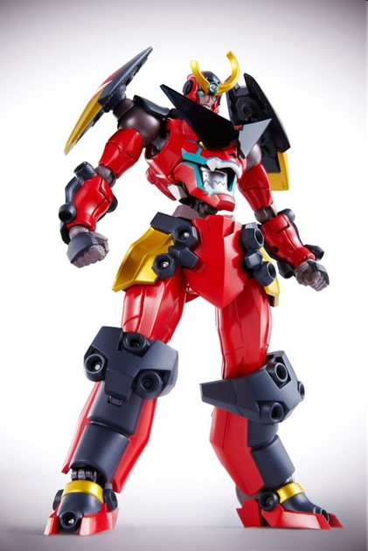
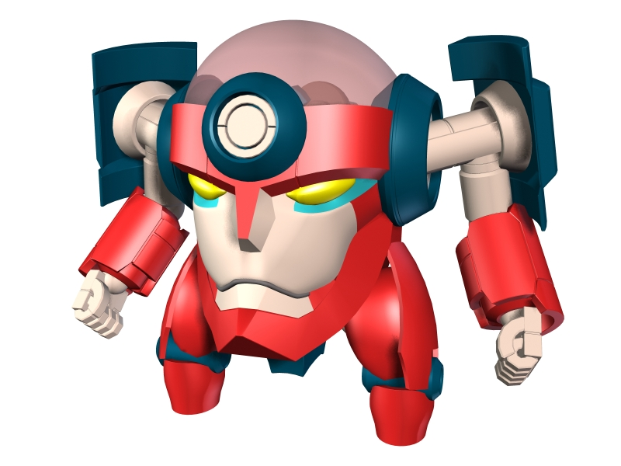
Notes:
When you keep adding new features, you get…

Slide 73
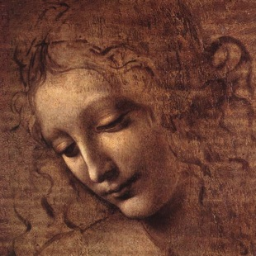
JavaFX With Visage

Slide 74
About Project Visage
“Visage is a domain specific language (DSL) designed for the express purpose of writing user interfaces.”
Visage project goals:
Compile to JavaFX Java APIs
Evolve the Language (Annotations, Maps, etc.)
Support Other Toolkits
Come join the team!
For more info: http://visage-lang.org/

Slide 75
Java vs. Visage DSL
public class VanishingCircles extends Application {
public static void main(String[] args) {
Application.launch(args);
}
@Override
public void start(Stage primaryStage) {
primaryStage.setTitle("Vanishing Circles");
Group root = new Group();
Scene scene = new Scene(root, 800, 600, Color.BLACK);
List<Circle> circles = new ArrayList<Circle>();
for (int i = 0; i < 50; i++) {
final Circle circle = new Circle(150);
circle.setCenterX(Math.random() * 800);
circle.setCenterY(Math.random() * 600);
circle.setFill(new Color(Math.random(), Math.random(), Math.random(), .2));
circle.setEffect(new BoxBlur(10, 10, 3));
circle.addEventHandler(MouseEvent.MOUSE_CLICKED, new EventHandler<MouseEvent>() {
public void handle(MouseEvent t) {
KeyValue collapse = new KeyValue(circle.radiusProperty(), 0);
new Timeline(new KeyFrame(Duration.seconds(3), collapse)).play();
}
});
circle.setStroke(Color.WHITE);
circle.strokeWidthProperty().bind(Bindings.when(circle.hoverProperty())
.then(4)
.otherwise(0));
circles.add(circle);
}
root.getChildren().addAll(circles);
primaryStage.setScene(scene);
primaryStage.show();
Timeline moveCircles = new Timeline();
for (Circle circle : circles) {
KeyValue moveX = new KeyValue(circle.centerXProperty(), Math.random() * 800);
KeyValue moveY = new KeyValue(circle.centerYProperty(), Math.random() * 600);
moveCircles.getKeyFrames().add(new KeyFrame(Duration.seconds(40), moveX, moveY));
}
moveCircles.play();
}
}
var circles:Circle[];
Stage {
title: "Vanishing Circles"
Scene {
width: 800
height: 600
fill: BLACK
Group {
circles = for (i in [1..50]) {
def c:Circle = Circle {
centerX: random() * 800
centerY: random() * 600
radius: 150
fill: color(random(), random(), random(), .2)
effect: BoxBlur {
height: 10
width: 10
iterations: 3
}
stroke: WHITE
strokeWidth: bind if (c.hover) 5 else 0
onMouseClicked: function(e) {
Timeline {at (3s) {c.radius => 0}}.play()
}
}
}
}
}
}
Timeline {
for (circle in circles) at (40s) {
circle.centerX => random() * 800;
circle.centerY => random() * 600
}
}.play()
40 Lines
1299 Characters
35 Lines
487 Characters
Notes:
Stage.add??

Slide 76
How about JavaFX on… Visage
Stage {
title: "Vanishing Circles"
scene: Scene {
width: 800
height: 600
fill: BLACK
content: Group {
circles = for (i in [1..50]) {
Circle {
centerX: random() * 800
centerY: random() * 600
}
}
}
}
}

Slide 77
How about JavaFX on… Visage
Stage {
title: "Vanishing Circles"
scene: Scene {
width: 800
height: 600
fill: BLACK
content: Group {
circles = for (i in [1..50]) {
Circle {
centerX: random() * 800
centerY: random() * 600
}
}
}
}
}

Slide 78
How about JavaFX on… Visage
Stage {
title: "Vanishing Circles"
Scene {
width: 800
height: 600
fill: BLACK
Group {
circles = for (i in [1..50]) {
Circle {
centerX: random() * 800
centerY: random() * 600
}
}
}
}
}

Slide 79
Visage is JavaFX Script++
Default Parameters
New Literal Syntax For:
Angles – 35deg, 4rad, 1turn
Colors – #DDCCBB, #AA33AA|CC
Lengths – 5px, 2pt, 3in, 4sp
Null-check Dereference
var width = rect.!width
Built-in Bindable Maps (coming soon!)
var fruitMap = ["red" : apple, "yellow" : banana]
var fruit = bind fruitMap["red"]

Slide 80
Visage and JavaFX 2.0 are made for each other…
Enhanced Binding
Retains lazy evaluation properties with additional expressive power
Integrated Collections
Sequences and Maps automatically convert between JavaFX Observable Lists/Maps
Built-in Animation Syntax
Ties into JavaFX animation subsystem
Provides consistent, clean APIs

Slide 81
?
And is most like
which Anime?
(or Manga)

Slide 82
Notes:
An Anime that cares about UI design!

Slide 83
Other JVM Languages to Try
Gosu
Up and coming language created at GuideWire
Easy to enhance libraries and create DSLs
Mirah
Invented by Charles Nutter
Local Type Inference, Static and Dynamic Typing
Fantom
Created by Brian and Andy Frank
Portable to Java and .NET
Local Type Inference, Static and Dynamic Typing
Did We Forget Something?

Slide 84
JavaFX With JRuby

Slide 85
Why JRuby?
Full implementation of Ruby
Direct access to Java APIs
Dynamic Typing
Closures
‘Closure conversion’ for interfaces
Ruby is made in Japan!
Yukihiro Matsumoto
松本行弘 (まつもとゆきひろ)

Slide 86
Java vs. JRubyFX DSL
public class VanishingCircles extends Application {
public static void main(String[] args) {
Application.launch(args);
}
@Override
public void start(Stage primaryStage) {
primaryStage.setTitle("Vanishing Circles");
Group root = new Group();
Scene scene = new Scene(root, 800, 600, Color.BLACK);
List<Circle> circles = new ArrayList<Circle>();
for (int i = 0; i < 50; i++) {
final Circle circle = new Circle(150);
circle.setCenterX(Math.random() * 800);
circle.setCenterY(Math.random() * 600);
circle.setFill(new Color(Math.random(), Math.random(), Math.random(), .2));
circle.setEffect(new BoxBlur(10, 10, 3));
circle.addEventHandler(MouseEvent.MOUSE_CLICKED, new EventHandler<MouseEvent>() {
public void handle(MouseEvent t) {
KeyValue collapse = new KeyValue(circle.radiusProperty(), 0);
new Timeline(new KeyFrame(Duration.seconds(3), collapse)).play();
}
});
circle.setStroke(Color.WHITE);
circle.strokeWidthProperty().bind(Bindings.when(circle.hoverProperty())
.then(4)
.otherwise(0));
circles.add(circle);
}
root.getChildren().addAll(circles);
primaryStage.setScene(scene);
primaryStage.show();
Timeline moveCircles = new Timeline();
for (Circle circle : circles) {
KeyValue moveX = new KeyValue(circle.centerXProperty(), Math.random() * 800);
KeyValue moveY = new KeyValue(circle.centerYProperty(), Math.random() * 600);
moveCircles.getKeyFrames().add(new KeyFrame(Duration.seconds(40), moveX, moveY));
}
moveCircles.play();
}
}
class VanishingCircles < JRubyFX::Application
def start(stage)
with(stage, title: "Vanishing Circles", x: 105, y: 140) do
layout_scene(800, 600, :black) do
group() do
50.times() do
circle(centerX: Random.rand(800), centerY: Random.rand(600), radius: 150, stroke: :white, strokeWidth: 0, fill: Color.rgb(Random.rand(255), Random.rand(255), Random.rand(255), 0.2)) do
center_x = centerXProperty
center_y = centerYProperty
radius = radiusProperty
stroke_width = strokeWidthProperty
hoverProperty.add_change_listener do
stroke_width.set(hoverProperty.get() ? 4 : 0)
end
set_on_mouse_clicked do
timeline() do
animate radius, 0.sec => 3.sec, 150 => 0
end.play
end
effect box_blur(width: 10, height: 10, iterations: 3)
timeline(cycle_count: :indefinite, auto_reverse: true) do
animate center_x, 0.sec => 40.sec, center_x.get() => Random.rand(800)
animate center_y, 0.sec => 40.sec, center_y.get() => Random.rand(600)
end.play
end
end
end
end
show
end
end
end
40 Lines
1299 Characters
33 Lines
842 Characters
Notes:
Stage.add??

Slide 87
How about JavaFX on… JRubyFX
class VanishingCircles < JRubyFX::Application
def start(stage)
with(stage, title: "Vanishing Circles", x: 105, y: 140) do
layout_scene(800, 600, :black) do
group() do
50.times() do
circle(centerX: Random.rand(800), centerY: Random.rand(600),
radius: 150, stroke: :white, strokeWidth: 0,
fill: Color.rgb(Random.rand(255), Random.rand(255),
Random.rand(255), 0.2)) do
effect box_blur(width: 10, height: 10, iterations: 3)
end
end
end
end
show
end
end
end

Slide 88
?
And is most like
which Anime?
(or Manga)

Slide 89
Notes:
So which Ichigo is Ruby and JRuby? You guess. ☺

Slide 90
Conclusion
You can write JavaFX applications in pure Java
JavaFX is also usable in alternate languages
You can get improved support using DSL libraries
GroovyFX
ScalaFX
JRubyFX!!!
Or a dedicated UI JVM Language
Visage

Slide 91
Contribute!
GroovyFX:
http://groovyfx.org
ScalaFX:
http://scalafx.org
Visage:
http://visage-lang.org
JRubyFX:
https://github.com/jruby/jrubyfx

Slide 92
Stephen Chin
stephen.chin@oracle.com
tweet: @steveonjava
Thanks to Dean Iverson, Jonathan Giles, and Angela Caicedo for help preparing this talk

