Slide 1
使用 JVM 语言的 JavaFX 亚洲版
Stephen Chin
Java 技术大使
JavaOne 内容主席stephen.chin@oracle.com
tweet: @steveonjava

Slide 2
免责声明
以下内容旨在概述产品的总体发展方向。该内容仅供参考，不可纳入任何合同。其内容不构成提供任何材料、代码或功能的承诺，并且不应该作为制定购买决策的依据。此处所述有关 Oracle 产品的任何特性或功能的开发、发布以及相应的日程安排均由 Oracle 自行决定。

Slide 3
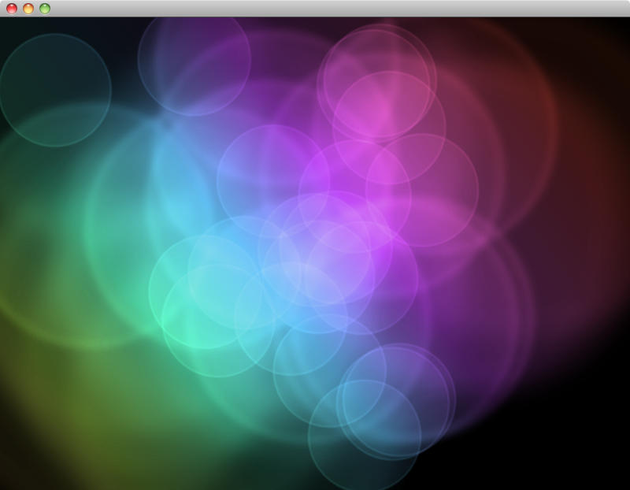
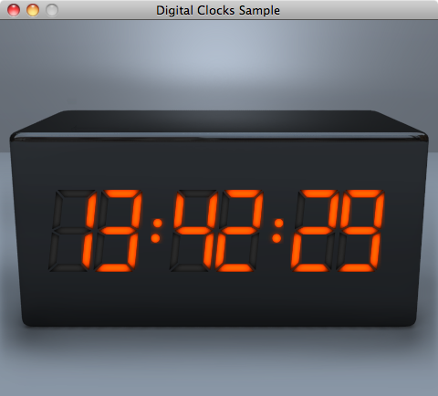
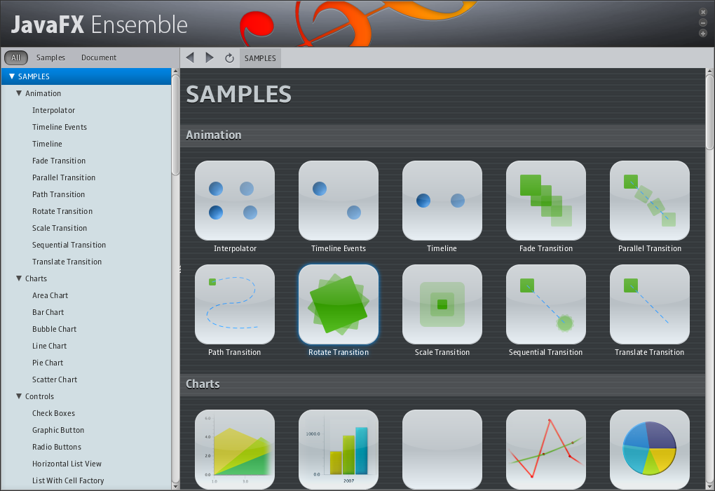
JavaFX 2.0 平台
身临其境的应用程序体验
通过现代化的 JavaFX API 利用您的 Java 技能
跨平台动画、视频、制图
在同一个应用程序中集成 Java、JavaScript 和 HTML5
新的图形体系能够让 2D 和 3D 应用程序利用硬件加速
使用您最喜爱的 IDE：NetBeans, Eclipse, IntelliJ 等等。

Slide 4
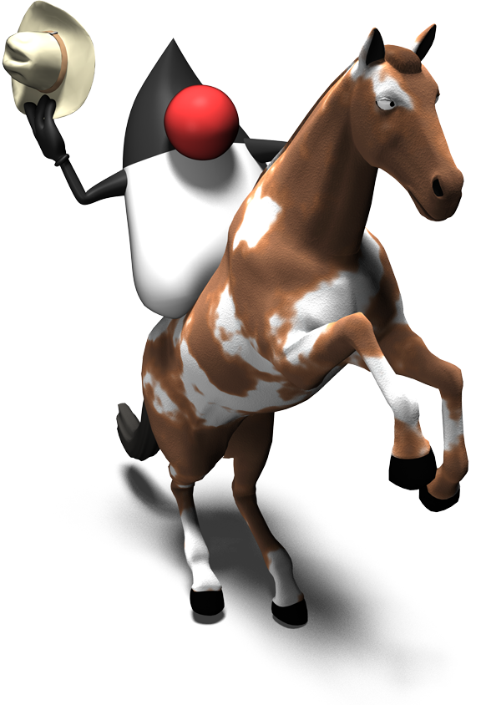

使用 Java 的 JavaFX

Slide 5
编程语言
现在，JavaFX 2 API 使用 Java 语言
适用于所有 JavaFX 的纯 Java API
绑定和序列作为 Java API 公开
使用 FXML 标记语言作为工具
接受所有 JVM 语言
Groovy, Scala, Clojure, JRuby
Fantom, Mira, Gosu 和 Jython 等。
Oracle 不再支持 JavaFX Script
现有的基于 JavaFX Script 的应用程序将能继续运行
Visage 是 JavaFX Script 语言的开源接替者

Slide 6
逐渐消失的圆圈
6

Slide 7
使用 Java 编写的逐渐消失的圆圈
public class VanishingCircles extends Application {
public static void main(String[] args) {
Application.launch(args);
}
@Override
public void start(Stage primaryStage) {
primaryStage.setTitle("Vanishing Circles");
Group root = new Group();
Scene scene = new Scene(root, 800, 600, Color.BLACK);
List<Circle> circles = new ArrayList<Circle>();
for (int i = 0; i < 50; i++) {
final Circle circle = new Circle(150);
circle.setCenterX(Math.random() * 800);
circle.setCenterY(Math.random() * 600);
circle.setFill(new Color(Math.random(), Math.random(), Math.random(), .2));
circle.setEffect(new BoxBlur(10, 10, 3));
circle.addEventHandler(MouseEvent.MOUSE_CLICKED, new EventHandler<MouseEvent>() {
public void handle(MouseEvent t) {
KeyValue collapse = new KeyValue(circle.radiusProperty(), 0);
new Timeline(new KeyFrame(Duration.seconds(3), collapse)).play();
}
});
circle.setStroke(Color.WHITE);
circle.strokeWidthProperty().bind(Bindings.when(circle.hoverProperty())
.then(4)
.otherwise(0));
circles.add(circle);
}
root.getChildren().addAll(circles);
primaryStage.setScene(scene);
primaryStage.show();
Timeline moveCircles = new Timeline();
for (Circle circle : circles) {
KeyValue moveX = new KeyValue(circle.centerXProperty(), Math.random() * 800);
KeyValue moveY = new KeyValue(circle.centerYProperty(), Math.random() * 600);
moveCircles.getKeyFrames().add(new KeyFrame(Duration.seconds(40), moveX, moveY));
}
moveCircles.play();
}
}
40 行
1299 个字符

Slide 8
应用程序框架
public class VanishingCircles extends Application {
public static void main(String[] args) {
Application.launch(args);
}
@Override
public void start(Stage primaryStage) {
primaryStage.setTitle("Vanishing Circles");
Group root = new Group();
Scene scene = new Scene(root, 800, 600, Color.BLACK);
[create the circles…]
root.getChildren().addAll(circles);
primaryStage.setScene(scene);
primaryStage.show();
[begin the animation…]
}
}

Slide 9
创建圆圈
List<Circle> circles = new ArrayList<Circle>();
for (int i = 0; i < 50; i++) {
final Circle circle = new Circle(150);
circle.setCenterX(Math.random() * 800);
circle.setCenterY(Math.random() * 600);
circle.setFill(new Color(Math.random(), Math.random(),
Math.random(), .2));
circle.setEffect(new BoxBlur(10, 10, 3));
circle.setStroke(Color.WHITE);
[setup binding…]
[setup event listeners…]
circles.add(circle);
}

Slide 10
设置绑定
circle.strokeWidthProperty().bind(Bindings
.when(circle.hoverProperty())
.then(4)
.otherwise(0)
);

Slide 11
设置事件监听器
circle.addEventHandler(MouseEvent.MOUSE_CLICKED,
new EventHandler<MouseEvent>() {
public void handle(MouseEvent t) {
KeyValue collapse = new KeyValue(circle.radiusProperty(), 0);
new Timeline(new KeyFrame(Duration.seconds(3),
collapse)).play();
}
});

Slide 12
开始播放动画
Timeline moveCircles = new Timeline();
for (Circle circle : circles) {
KeyValue moveX = new KeyValue(circle.centerXProperty(),
Math.random() * 800);
KeyValue moveY = new KeyValue(circle.centerYProperty(),
Math.random() * 600);
moveCircles.getKeyFrames().add(new KeyFrame(Duration.seconds(40),
moveX, moveY));
}
moveCircles.play();

Slide 13
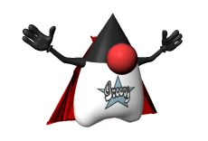
使用 Groovy 的 JavaFX

Slide 14
Groovy 的特性
现代语言
闭包
AST 转换
强类型的动态语言
与 Java 紧密集成
能够非常轻松地从 Java 移植到 Groovy
使用 GroovyFX 构建器的声明式语法
为 Groovy 和 JavaFX Script 开发人员所熟悉

Slide 15
Java vs. GroovyFX DSL
public class VanishingCircles extends Application {
public static void main(String[] args) {
Application.launch(args);
}
@Override
public void start(Stage primaryStage) {
primaryStage.setTitle("Vanishing Circles");
Group root = new Group();
Scene scene = new Scene(root, 800, 600, Color.BLACK);
List<Circle> circles = new ArrayList<Circle>();
for (int i = 0; i < 50; i++) {
final Circle circle = new Circle(150);
circle.setCenterX(Math.random() * 800);
circle.setCenterY(Math.random() * 600);
circle.setFill(new Color(Math.random(), Math.random(), Math.random(), .2));
circle.setEffect(new BoxBlur(10, 10, 3));
circle.addEventHandler(MouseEvent.MOUSE_CLICKED, new EventHandler<MouseEvent>() {
public void handle(MouseEvent t) {
KeyValue collapse = new KeyValue(circle.radiusProperty(), 0);
new Timeline(new KeyFrame(Duration.seconds(3), collapse)).play();
}
});
circle.setStroke(Color.WHITE);
circle.strokeWidthProperty().bind(Bindings.when(circle.hoverProperty())
.then(4)
.otherwise(0));
circles.add(circle);
}
root.getChildren().addAll(circles);
primaryStage.setScene(scene);
primaryStage.show();
Timeline moveCircles = new Timeline();
for (Circle circle : circles) {
KeyValue moveX = new KeyValue(circle.centerXProperty(), Math.random() * 800);
KeyValue moveY = new KeyValue(circle.centerYProperty(), Math.random() * 600);
moveCircles.getKeyFrames().add(new KeyFrame(Duration.seconds(40), moveX, moveY));
}
moveCircles.play();
}
}
GroovyFX.start { primaryStage ->
def sg = new SceneGraphBuilder()
def rand = new Random().&nextInt
def circles = []
sg.stage(title: 'Vanishing Circles', show: true) {
scene(fill: black, width: 800, height: 600) {
50.times {
circles << circle(centerX: rand(800), centerY: rand(600), radius: 150, stroke: white,
strokeWidth: bind('hover', converter: {val -> val ? 4 : 0})) {
fill rgb(rand(255), rand(255), rand(255), 0.2)
effect boxBlur(width: 10, height: 10, iterations: 3)
onMouseClicked { e ->
timeline {
at(3.s) { change e.source.radiusProperty() to 0 }
}.play()
}
}
}
}
timeline(cycleCount: Timeline.INDEFINITE, autoReverse: true) {
circles.each { circle ->
at (40.s) {
change circle.centerXProperty() to rand(800)
change circle.centerYProperty() to rand(600)
}
}
}.play()
}
}
40 行
1299 个字符
29 行
671 个字符

Slide 16
GroovyFX.start { primaryStage ->
def sg = new SceneGraphBuilder()
def rand = new Random().&nextInt
def circles = []
sg.stage(title: 'Vanishing Circles', show: true) {
scene(fill: black, width: 800, height: 600) {
50.times {
circles << circle(centerX: rand(800), centerY: rand(600),
radius: 150, stroke: white,
strokeWidth: bind('hover', converter: {val -> val ? 4 : 0})) {
fill rgb(rand(255), rand(255), rand(255), 0.2)
effect boxBlur(width: 10, height: 10, iterations: 3)
}
}
}
}
}

Slide 17
GroovyFX.start { primaryStage ->
def sg = new SceneGraphBuilder()
def rand = new Random().&nextInt
def circles = []
sg.stage(title: 'Vanishing Circles', show: true) {
scene(fill: black, width: 800, height: 600) {
50.times {
circles << circle(centerX: rand(800), centerY: rand(600),
radius: 150, stroke: white,
strokeWidth: bind('hover', converter: {val -> val ? 4 : 0})) {
fill rgb(rand(255), rand(255), rand(255), 0.2)
effect boxBlur(width: 10, height: 10, iterations: 3)
}
}
}
}
}
GroovyFX 场景图构建器

Slide 18
GroovyFX.start { primaryStage ->
def sg = new SceneGraphBuilder()
def rand = new Random().&nextInt
def circles = []
sg.stage(title: 'Vanishing Circles', show: true) {
scene(fill: black, width: 800, height: 600) {
50.times {
circles << circle(centerX: rand(800), centerY: rand(600),
radius: 150, stroke: white,
strokeWidth: bind('hover', converter: {val -> val ? 4 : 0})) {
fill rgb(rand(255), rand(255), rand(255), 0.2)
effect boxBlur(width: 10, height: 10, iterations: 3)
}
}
}
}
}
声明式 Stage 定义

Slide 19
GroovyFX.start { primaryStage ->
def sg = new SceneGraphBuilder()
def rand = new Random().&nextInt
def circles = []
sg.stage(title: 'Vanishing Circles', show: true) {
scene(fill: black, width: 800, height: 600) {
50.times {
circles << circle(centerX: rand(800), centerY: rand(600),
radius: 150, stroke: white,
strokeWidth: bind('hover', converter: {val -> val ? 4 : 0})) {
fill rgb(rand(255), rand(255), rand(255), 0.2)
effect boxBlur(width: 10, height: 10, iterations: 3)
}
}
}
}
}
内联属性定义

Slide 20
GroovyFX.start { primaryStage ->
def sg = new SceneGraphBuilder()
def rand = new Random().&nextInt
def circles = []
sg.stage(title: 'Vanishing Circles', show: true) {
scene(fill: black, width: 800, height: 600) {
50.times {
circles << circle(centerX: rand(800), centerY: rand(600),
radius: 150, stroke: white,
strokeWidth: bind('hover', converter: {val -> val ? 4 : 0})) {
fill rgb(rand(255), rand(255), rand(255), 0.2)
effect boxBlur(width: 10, height: 10, iterations: 3)
}
}
}
}
}
绑定到属性

Slide 21
GroovyFX.start { primaryStage ->
def sg = new SceneGraphBuilder()
def rand = new Random().&nextInt
def circles = []
sg.stage(title: 'Vanishing Circles', show: true) {
scene(fill: black, width: 800, height: 600) {
50.times {
circles << circle(centerX: rand(800), centerY: rand(600),
radius: 150, stroke: white,
strokeWidth: bind('hover', converter: {val -> val ? 4 : 0})) {
fill rgb(rand(255), rand(255), rand(255), 0.2)
effect boxBlur(width: 10, height: 10, iterations: 3)
}
}
}
}
}
通过循环创建序列

Slide 22
使用 GroovyFX 编写的动画
timeline(cycleCount: Timeline.INDEFINITE, autoReverse: true) {
circles.each { circle ->
at (40.s) {
change circle.centerXProperty() to rand(800)
change circle.centerYProperty() to rand(600)
}
}
}.play()

Slide 23
使用 GroovyFX 编写的动画
timeline(cycleCount: Timeline.INDEFINITE, autoReverse: true) {
circles.each { circle ->
at (40.s) {
change circle.centerXProperty() to rand(800)
change circle.centerYProperty() to rand(600)
}
}
}.play()
简单的动画语法：
at (duration) {keyframes}

Slide 24
使用 GroovyFX 编写的动画
timeline(cycleCount: Timeline.INDEFINITE, autoReverse: true) {
circles.each { circle ->
at (40.s) {
change circle.centerXProperty() to rand(800)
change circle.centerYProperty() to rand(600)
}
}
}.play()
关键帧 DSL

Slide 25
使用 GroovyFX 编写的动画
timeline(cycleCount: Timeline.INDEFINITE, autoReverse: true) {
circles.each { circle ->
at (40.s) {
change circle.centerXProperty() to rand(800) tween ease_both
change circle.centerYProperty() to rand(600) tween linear
}
}
}.play()
可选的缓动

Slide 26
GroovyFX 中的事件监听器
通过使用内置的闭包语法来支持
用于事件对象的可选参数
onMouseClicked { e ->
timeline {
at(3.s) { change e.source.radiusProperty() to 0 }
}.play()
}

Slide 27
GroovyFX 中的事件监听器
通过使用内置的闭包语法来支持
用于事件对象的可选参数
onMouseClicked { MouseEvent e ->
timeline {
at(3.s) { change e.source.radiusProperty() to 0 }
}.play()
}
紧凑的语法
{主体}

Slide 28
GroovyFX 中的事件监听器
通过使用内置的闭包语法来支持
用于事件对象的可选参数
可选的事件参数
{事件 -> 主体}
onMouseClicked { MouseEvent e ->
timeline {
at(3.s) { change e.source.radiusProperty() to 0 }
}.play()
}

Slide 29

请稍候，Groovy 还有更多出色之处……

Slide 30
Java 中的属性
public class Person {
private StringProperty firstName;
public void setFirstName(String val) { firstNameProperty().set(val); }
public String getFirstName() { return firstNameProperty().get(); }
public StringProperty firstNameProperty() {
if (firstName == null)
firstName = new SimpleStringProperty(this, "firstName");
return firstName;
}
private StringProperty lastName;
public void setLastName(String value) { lastNameProperty().set(value); }
public String getLastName() { return lastNameProperty().get(); }
public StringProperty lastNameProperty() {
if (lastName == null) // etc.
}
}

Slide 31
GroovyFX 中的属性
public class Person {
@FXBindable String firstName;
@FXBindable String lastName;
}

Slide 32
GroovyFX 中的属性
public class Person {
@FXBindable String firstName;
@FXBindable String lastName = “Smith”;
}
可选的初始化器

Slide 33
Java 中的 TableView
ObservableList<Person> items = ...
TableView<Person> tableView = new TableView<Person>(items);
TableColumn<Person,String> firstNameCol =
new TableColumn<Person,String>("First Name");
firstNameCol.setCellValueFactory(
new Callback<CellDataFeatures<Person, String>,
ObservableValue<String>>() {
public ObservableValue<String> call(CellDataFeatures<Person, String> p)
{
return p.getValue().firstNameProperty();
}
});
tableView.getColumns().add(firstNameCol);

Slide 34
GroovyFX 中的 TableView
def dateFormat = new SimpleDateFormat("yyyy-MM-dd");
tableView(items: persons) {
tableColumn(property: "name", text: "Name", prefWidth: 150)
tableColumn(property: "age", text: "Age", prefWidth: 50)
tableColumn(property: "gender", text: "Gender", prefWidth: 150)
tableColumn(property: "dob", text: "Birth", prefWidth: 150,
type: Date,
converter: { from -> return dateFormat.format(from) })
}

Slide 35
Java 中的布局
TextField urlField = new TextField(“http://www.google.com”);
HBox.setHgrow(urlField, Priority.ALWAYS);
HBox hbox = new HBox();
hbox.getChildren().add(urlField);
WebView webView = new WebView();
VBox.setVgrow(webView, Priority.ALWAYS);
VBox vbox = new VBox();
vbox.getChildren().addAll(hbox, webView);

Slide 36
GroovyFX 中的布局
sg.stage(title: "GroovyFX WebView Demo", show: true) {
scene(fill: groovyblue, width: 1024, height: 800) {
vbox {
hbox(padding: 10, spacing: 5) {
textField(“http://www.yahoo.com”, hgrow: "always")
button("Go”)
}
webView(vgrow: "always")
}
}
}

Slide 37

GroovyFX 中的布局

Slide 38
GroovyFX 中的布局
gridPane(hgap: 5, vgap: 10, padding: 25) {
columnConstraints(minWidth: 50, halignment: "right")
columnConstraints(prefWidth: 250)
label("Send Us Your Feedback", font: "24pt sanserif",
row: 0, columnSpan: GridPane.REMAINING, halignment: "center",
margin: [0, 0, 10])
label("Name: ", row: 1, column: 0)
textField(promptText: "Your name", row: 1, column: 1, hgrow: 'always')
label("Email:", row: 2, column: 0)
textField(promptText: "Your email", row: 2, column: 1, hgrow: 'always')
label("Message:", row: 3, column: 0, valignment: "baseline")
textArea(row: 3, column: 1, hgrow: "always", vgrow: "always")
button("Send Message", row: 4, column: 1, halignment: "right")
}

Slide 39


GroovyFX 中的布局

Slide 40
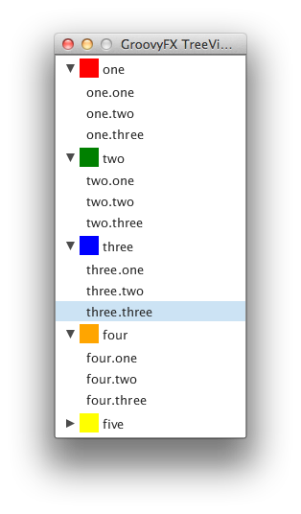
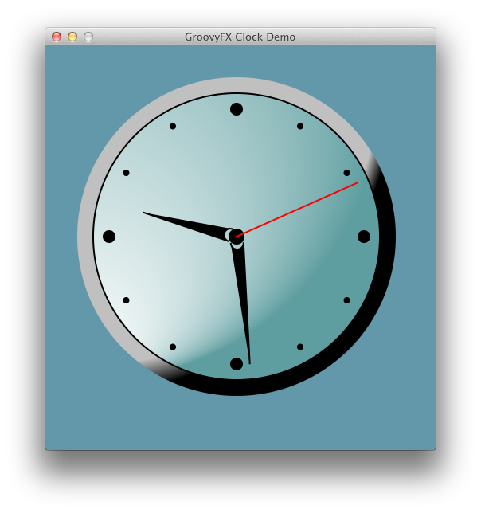
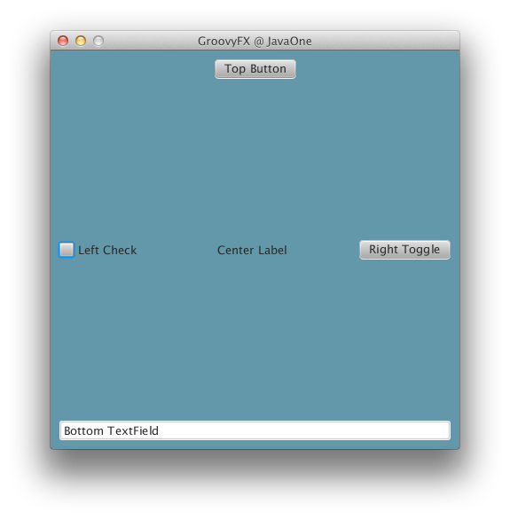
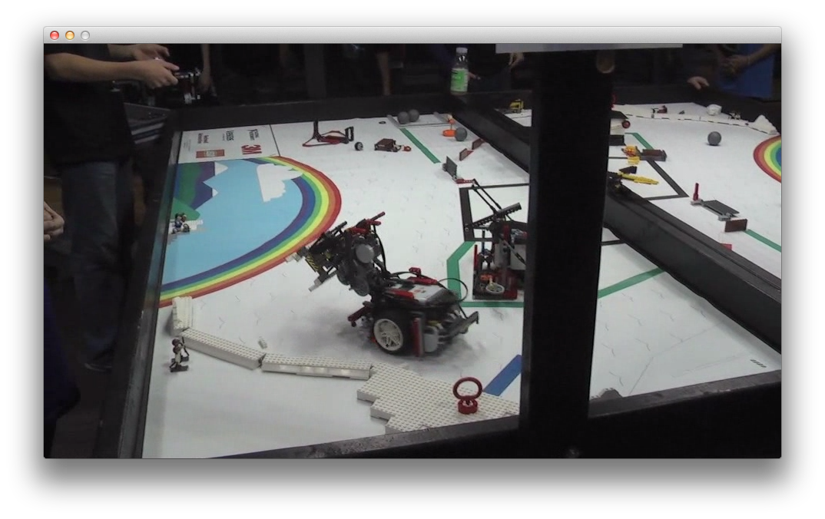
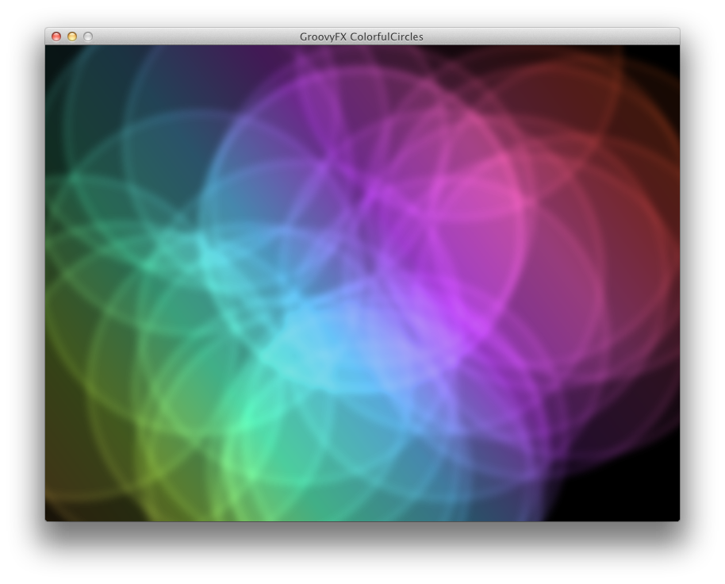
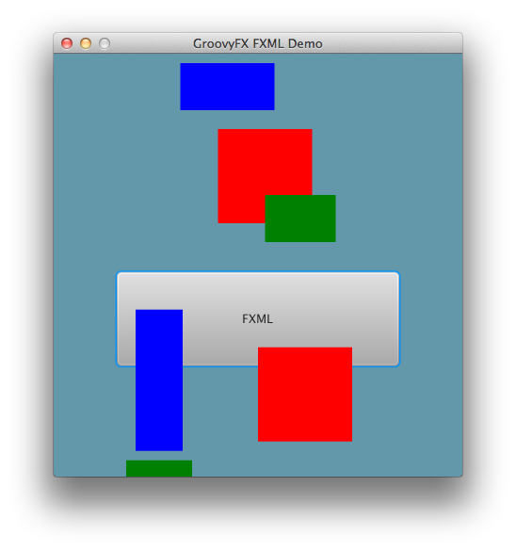
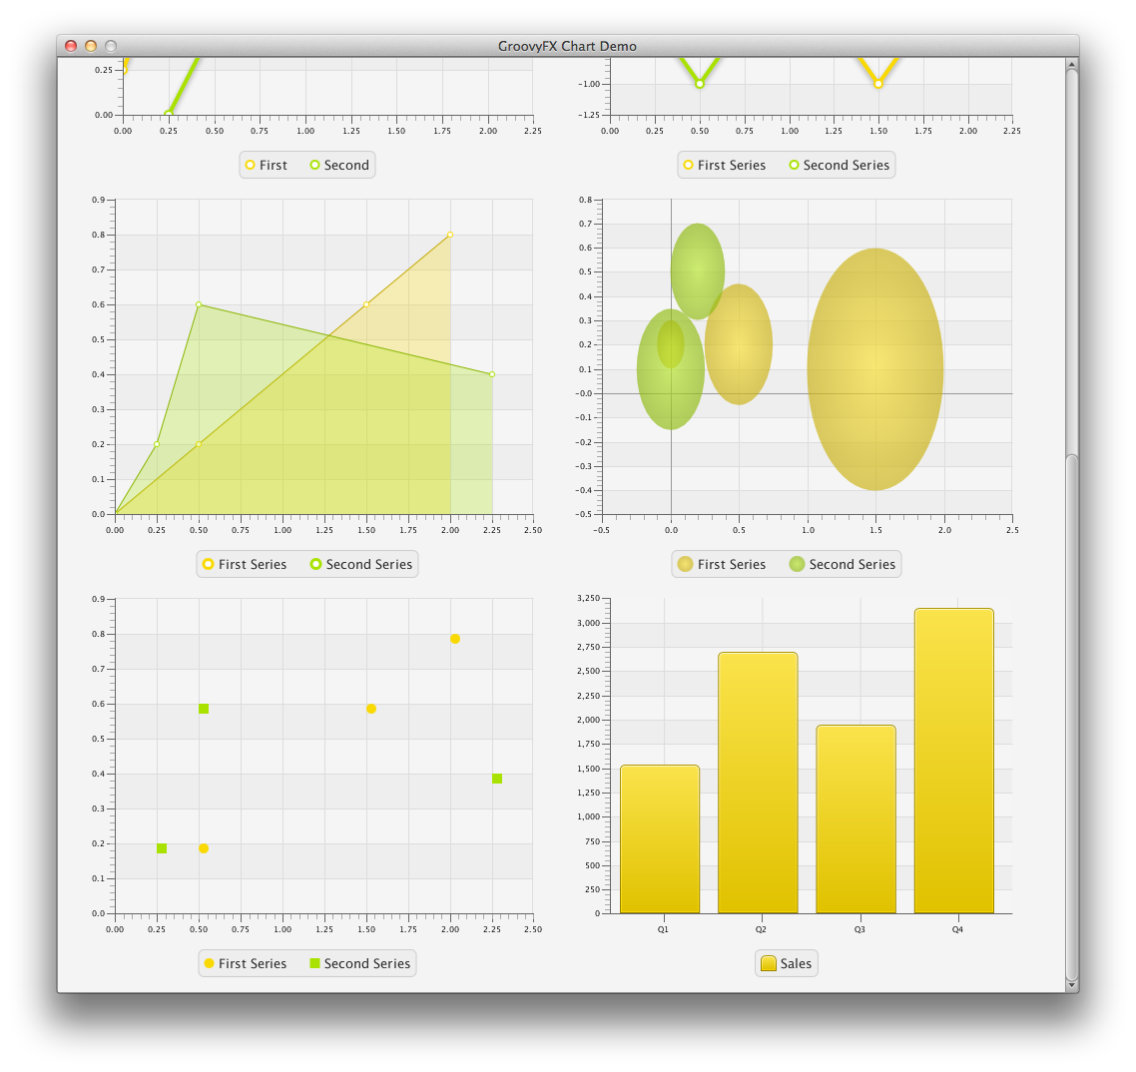
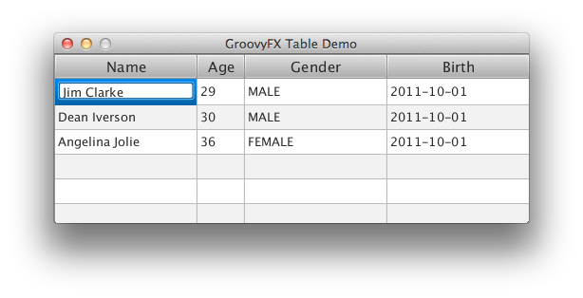
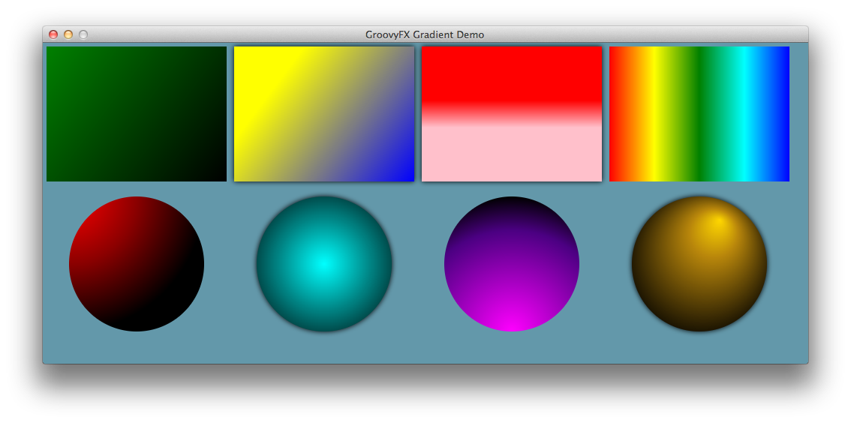
GroovyFX 支持……

Slide 41
?
最像哪部日本
动画片呢？
（或漫画）

Slide 42
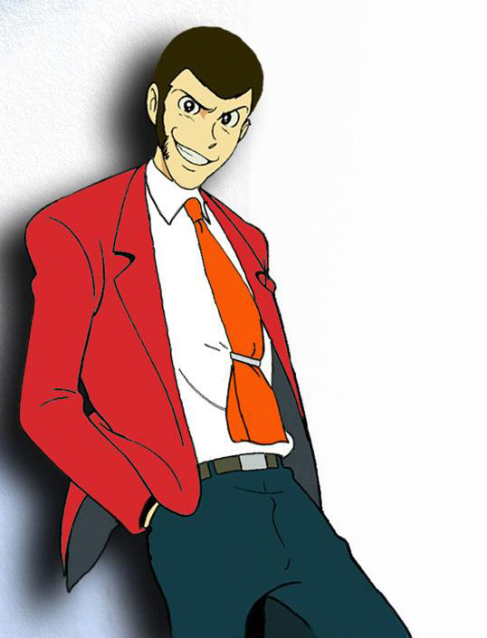

Notes:
Simple on the surface, but complicated and mischievous underneath.

Slide 43
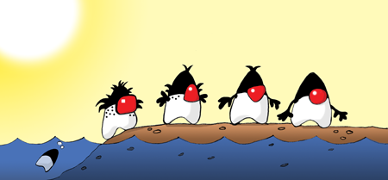

使用 Clojure 的 JavaFX
插图作者：Augusto Sellhorn
http://sellmic.com/

Slide 44

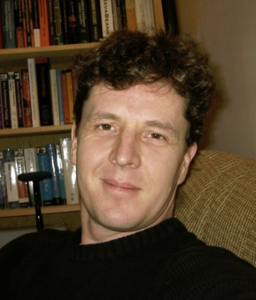
Clojure 简介
由 Rich Hickey 于 2007 年创建
函数式编程语言
从 LISP 衍生而来
针对高并发性进行了优化
…并且看上去和 Java 有天壤之别！
(def hello (fn [] "Hello world"))
(hello)

Slide 45
Clojure 语法示例
符号
集合
（逗号为可选）
数字 — 2.178
比例 — 355/113
字符串 — “clojure”, “rocks”
字符 — \a \b \c \d
符号 — a b c d
关键词 — :alpha :beta
布尔值 — true, false
空值 — nil
列表
(1, 2, 3, 4, 5)
向量
[1, 2, 3, 4, 5]
映射
{:a 1, :b 2, :c 3, :d 4}
集合
#{:a :b :c :d :e}
（除此以外还有各种宏，它们是封装以上各种元素的语法糖）

Slide 46
Clojure GUI 示例
(defn javafxapp []
(let [stage (Stage. "JavaFX Stage")
scene (Scene.)]
(.setFill scene Color/LIGHTGREEN)
(.setWidth stage 600)
(.setHeight stage 450)
(.setScene stage scene)
(.setVisible stage true)))
(javafxapp)

Slide 47
简化的 Clojure GUI 示例
(defn javafxapp []
(doto (Stage. "JavaFX Stage")
(.setWidth 600)
(.setHeight 450)
(.setScene (doto (Scene.)
(.setFill Color/LIGHTGREEN)
(.setContent (list (doto (Rectangle.)
(.setX 25)
(.setY 40)
(.setWidth 100)
(.setHeight 50)
(.setFill Color/RED))))))
(.setVisible true)))
(javafxapp)

Slide 48
简化的 Clojure GUI 示例
(defn javafxapp []
(doto (Stage. "JavaFX Stage")
(.setWidth 600)
(.setHeight 450)
(.setScene (doto (Scene.)
(.setFill Color/LIGHTGREEN)
(.setContent (list (doto (Rectangle.)
(.setX 25)
(.setY 40)
(.setWidth 100)
(.setHeight 50)
(.setFill Color/RED))))))
(.setVisible true)))
(javafxapp)
Doto 允许使用嵌套数据结构

Slide 49
Clojure 中的闭包
内部类可以使用代理创建
(.addListener hoverProperty
(proxy [ChangeListener] []
(handle [p, o, v]
(.setFill rect
(if (.isHover rect) Color/GREEN Color/RED)))))

Slide 50
Clojure 中的闭包
内部类可以使用代理创建
Proxy form：
(proxy [class] [args] fs+)
f => (name [params*] body)
(.addListener hoverProperty
(proxy [ChangeListener] []
(handle [p, o, v]
(.setFill rect
(if (.isHover rect) Color/GREEN Color/RED)))))

Slide 51
?
最像哪部日本
动画片呢？
（或漫画）

Slide 52
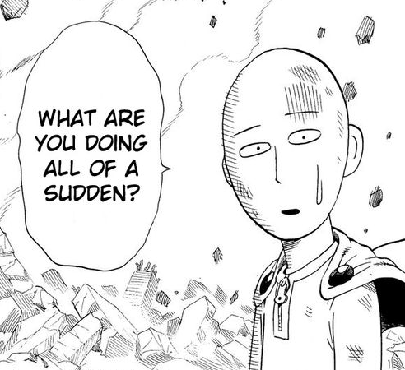

配合
JavaFX
使用
Clojure
真的那么
容易吗？
Notes:
Using Clojure with JavaFX is that easy?

Slide 53
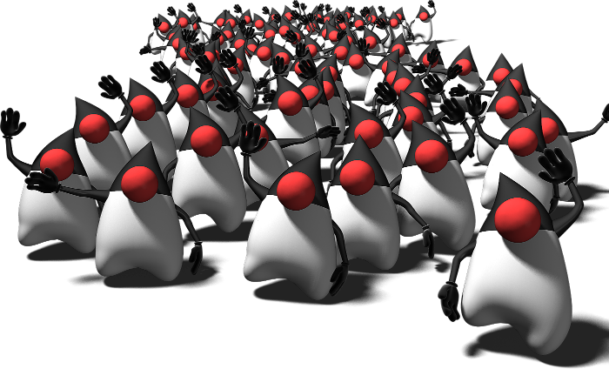












使用 Scala 的 JavaFX

Slide 54
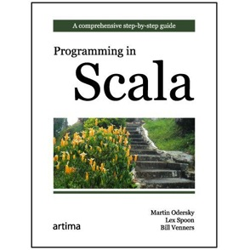
Scala 是什么
2001
2006
2011
2003/2004
Scala 面世
Scala v1.0
Scala v2.0
Scala 2.9.2（最新版本）
由 Martin Odersky 于 2001 年开始设计
编译为 Java 字节码
完全面向对象的语言
同时也是一种函数式编程语言

Slide 55
Java 与 Scala DSL
public class VanishingCircles extends Application {
public static void main(String[] args) {
Application.launch(args);
}
@Override
public void start(Stage primaryStage) {
primaryStage.setTitle("Vanishing Circles");
Group root = new Group();
Scene scene = new Scene(root, 800, 600, Color.BLACK);
List<Circle> circles = new ArrayList<Circle>();
for (int i = 0; i < 50; i++) {
final Circle circle = new Circle(150);
circle.setCenterX(Math.random() * 800);
circle.setCenterY(Math.random() * 600);
circle.setFill(new Color(Math.random(), Math.random(), Math.random(), .2));
circle.setEffect(new BoxBlur(10, 10, 3));
circle.addEventHandler(MouseEvent.MOUSE_CLICKED, new EventHandler<MouseEvent>() {
public void handle(MouseEvent t) {
KeyValue collapse = new KeyValue(circle.radiusProperty(), 0);
new Timeline(new KeyFrame(Duration.seconds(3), collapse)).play();
}
});
circle.setStroke(Color.WHITE);
circle.strokeWidthProperty().bind(Bindings.when(circle.hoverProperty())
.then(4)
.otherwise(0));
circles.add(circle);
}
root.getChildren().addAll(circles);
primaryStage.setScene(scene);
primaryStage.show();
Timeline moveCircles = new Timeline();
for (Circle circle : circles) {
KeyValue moveX = new KeyValue(circle.centerXProperty(), Math.random() * 800);
KeyValue moveY = new KeyValue(circle.centerYProperty(), Math.random() * 600);
moveCircles.getKeyFrames().add(new KeyFrame(Duration.seconds(40), moveX, moveY));
}
moveCircles.play();
}
}
object VanishingCircles extends JFXApp {
var circles: Seq[Circle] = null
stage = new Stage {
title = "Vanishing Circles"
width = 800
height = 600
scene = new Scene {
fill = BLACK
circles = for (i <- 0 until 50) yield new Circle {
centerX = random * 800
centerY = random * 600
radius = 150
fill = color(random, random, random, .2)
effect = new BoxBlur(10, 10, 3)
strokeWidth <== when (hover) then 4 otherwise 0
stroke = WHITE
onMouseClicked = {
Timeline(at (3 s) {radius -> 0}).play()
}
}
content = circles
}
}
new Timeline {
cycleCount = INDEFINITE
autoReverse = true
keyFrames = for (circle <- circles) yield at (40 s) {
Set(
circle.centerX -> random * stage.width,
circle.centerY -> random * stage.height
)
}
}.play();
}
40 行
1299 个字符
33 行
591 个字符
Notes:
Stage.add??

Slide 56
object VanishingCircles extends JFXApp {
stage = new Stage {
title = "Disappearing Circles"
width = 800
height = 600
scene = new Scene {
fill = BLACK
children = for (i <- 0 until 50) yield new Circle {
centerX = random * 800
centerY = random * 600
radius = 150
fill = color(random, random, random, 0.2)
effect = new BoxBlur(10, 10, 3)
}
}
}
}

Slide 57
object VanishingCircles extends JFXApp {
stage = new Stage {
title = "Disappearing Circles"
width = 800
height = 600
scene = new Scene {
fill = BLACK
children = for (i <- 0 until 50) yield new Circle {
centerX = random * 800
centerY = random * 600
radius = 150
fill = color(random, random, random, 0.2)
effect = new BoxBlur(10, 10, 3)
}
}
}
}
JavaFX 应用程序的基类

Slide 58
object VanishingCircles extends JFXApp {
stage = new Stage {
title = "Disappearing Circles"
width = 800
height = 600
scene = new Scene {
fill = BLACK
children = for (i <- 0 until 50) yield new Circle {
centerX = random * 800
centerY = random * 600
radius = 150
fill = color(random, random, random, 0.2)
effect = new BoxBlur(10, 10, 3)
}
}
}
}
声明式 Stage 定义

Slide 59
object VanishingCircles extends JFXApp {
stage = new Stage {
title = "Disappearing Circles"
width = 800
height = 600
scene = new Scene {
fill = BLACK
children = for (i <- 0 until 50) yield new Circle {
centerX = random * 800
centerY = random * 600
radius = 150
fill = color(random, random, random, 0.2)
effect = new BoxBlur(10, 10, 3)
}
}
}
}
内联属性定义

Slide 60
object VanishingCircles extends JFXApp {
stage = new Stage {
title = "Disappearing Circles"
width = 800
height = 600
scene = new Scene {
fill = BLACK
children = for (i <- 0 until 50) yield new Circle {
centerX = random * 800
centerY = random * 600
radius = 150
fill = color(random, random, random, 0.2)
effect = new BoxBlur(10, 10, 3)
}
}
}
}
通过循环创建序列

Slide 61
Scala 中的绑定
中缀加/减/乘/除：
height <== rect1.height + rect2.height
聚合运算符：
width <== max(rect1.width, rect2.width, rect3.width)
条件表达式：
strokeWidth <== when (hover) then 4 otherwise 0
复合表达式：
text <== when (rect.hover || circle.hover && !disabled) then textField.text + " is enabled" otherwise "disabled"

Slide 62
使用 Scala 编写的动画
val timeline = new Timeline {
cycleCount = INDEFINITE
autoReverse = true
keyFrames = for (circle <- circles) yield at (40 s) {
Set(
circle.centerX -> random * stage.width,
circle.centerY -> random * stage.height
)
}
}
timeline.play();

Slide 63
使用 Scala 编写的动画
类似于 JavaFX Script 的动画语法：at (duration) {keyframes}
val timeline = new Timeline {
cycleCount = INDEFINITE
autoReverse = true
keyFrames = for (circle <- circles) yield at (40 s) {
Set(
circle.centerX -> random * stage.width,
circle.centerY -> random * stage.height
)
}
}
timeline.play();

Slide 64
使用 Scala 编写的动画
val timeline = new Timeline {
cycleCount = INDEFINITE
autoReverse = true
keyFrames = for (circle <- circles) yield at (40 s) {
Set(
circle.centerX -> random * stage.width,
circle.centerY -> random * stage.height
)
}
}
timeline.play();
用于动画语法的运算符重载

Slide 65
使用 Scala 编写的动画
val timeline = new Timeline {
cycleCount = INDEFINITE
autoReverse = true
keyFrames = for (circle <- circles) yield at (40 s) {
Set(
circle.centerX -> random * stage.width tween EASE_BOTH,
circle.centerY -> random * stage.height tween EASE_IN
)
}
}
timeline.play();
可选的 tween 语法

Slide 66
Scala 中的事件监听器
通过使用内置的闭包语法来支持
用于事件对象的参数
100% 类型安全
onMouseClicked = { (e: MouseEvent) =>
Timeline(at(3 s){radius->0}).play()
}

Slide 67
Scala 中的事件监听器
通过使用内置的闭包语法来支持
用于事件对象的参数
100% 类型安全
onMouseClicked = { (e: MouseEvent) =>
Timeline(at(3 s){radius->0}).play()
}
紧凑的语法
{主体}

Slide 68
Scala 中的事件监听器
通过使用内置的闭包语法来支持
用于事件对象的参数
100% 类型安全
事件参数
{(事件) => 主体}
onMouseClicked = { (e: MouseEvent) =>
Timeline(at(3 s){radius->0}).play()
}

Slide 69
ScalaFX 中的 TableView
def dateFormat = new SimpleDateFormat("yyyy-MM-dd")
new TableView[Speaker](persons) {
columns = Seq(
new TableColumn[Speaker, String] {
text: "Name"
converter = {_.firstName}
} new TableColumn[Speaker, String] {
text: "Age"
converter = {_.age}
} new TableColumn[Speaker, String] {
text: "Gender"
converter = {_.gender}
} new TableColumn[Speaker, String] {
text: "Birth"
converter = {dateFormat.format(_.dob)},
}
)}

Slide 70

使用 Giter8 引导 ScalaFX
项目网站：
https://github.com/jugchennai/scalafx.g8
由 JUGChennai 创建

Slide 71
?
最像哪部日本
动画片呢？
（或漫画）

Slide 72
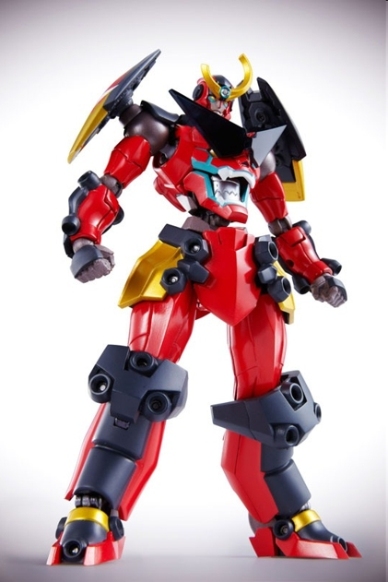
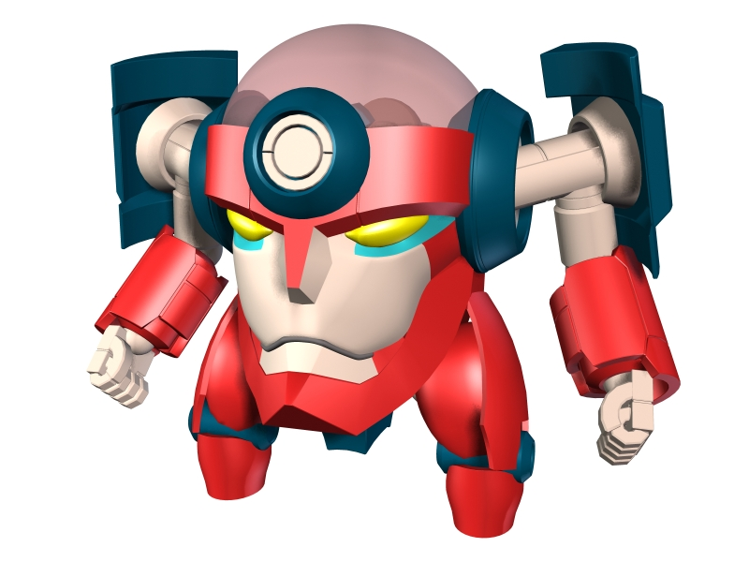

Notes:
When you keep adding new features, you get…

Slide 73
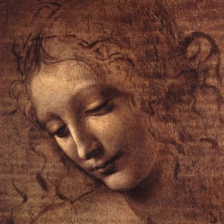
使用 Visage 的 JavaFX

Slide 74
关于 Visage 项目
“Visage 是一种领域专用语言 (DSL)，专门设计用于编写用户界面。”
Visage 项目的目标：
编译为 JavaFX Java API
发展语言（批注和映射等）
支持其他工具包
快来加入这个团队吧！
有关更多信息，请访问：http://visage-lang.org/

Slide 75
Java 与 Visage DSL
public class VanishingCircles extends Application {
public static void main(String[] args) {
Application.launch(args);
}
@Override
public void start(Stage primaryStage) {
primaryStage.setTitle("Vanishing Circles");
Group root = new Group();
Scene scene = new Scene(root, 800, 600, Color.BLACK);
List<Circle> circles = new ArrayList<Circle>();
for (int i = 0; i < 50; i++) {
final Circle circle = new Circle(150);
circle.setCenterX(Math.random() * 800);
circle.setCenterY(Math.random() * 600);
circle.setFill(new Color(Math.random(), Math.random(), Math.random(), .2));
circle.setEffect(new BoxBlur(10, 10, 3));
circle.addEventHandler(MouseEvent.MOUSE_CLICKED, new EventHandler<MouseEvent>() {
public void handle(MouseEvent t) {
KeyValue collapse = new KeyValue(circle.radiusProperty(), 0);
new Timeline(new KeyFrame(Duration.seconds(3), collapse)).play();
}
});
circle.setStroke(Color.WHITE);
circle.strokeWidthProperty().bind(Bindings.when(circle.hoverProperty())
.then(4)
.otherwise(0));
circles.add(circle);
}
root.getChildren().addAll(circles);
primaryStage.setScene(scene);
primaryStage.show();
Timeline moveCircles = new Timeline();
for (Circle circle : circles) {
KeyValue moveX = new KeyValue(circle.centerXProperty(), Math.random() * 800);
KeyValue moveY = new KeyValue(circle.centerYProperty(), Math.random() * 600);
moveCircles.getKeyFrames().add(new KeyFrame(Duration.seconds(40), moveX, moveY));
}
moveCircles.play();
}
}
var circles:Circle[];
Stage {
title: "Vanishing Circles"
Scene {
width: 800
height: 600
fill: BLACK
Group {
circles = for (i in [1..50]) {
def c:Circle = Circle {
centerX: random() * 800
centerY: random() * 600
radius: 150
fill: color(random(), random(), random(), .2)
effect: BoxBlur {
height: 10
width: 10
iterations: 3
}
stroke: WHITE
strokeWidth: bind if (c.hover) 5 else 0
onMouseClicked: function(e) {
Timeline {at (3s) {c.radius => 0}}.play()
}
}
}
}
}
}
Timeline {
for (circle in circles) at (40s) {
circle.centerX => random() * 800;
circle.centerY => random() * 600
}
}.play()
40 行
1299 个字符
35 行
487 个字符
Notes:
Stage.add??

Slide 76
JavaFX 的发展方向……Visage
Stage {
title: "Vanishing Circles"
scene: Scene {
width: 800
height: 600
fill: BLACK
content: Group {
circles = for (i in [1..50]) {
Circle {
centerX: random() * 800
centerY: random() * 600
}
}
}
}
}

Slide 77
JavaFX 的发展方向……Visage
Stage {
title: "Vanishing Circles"
scene: Scene {
width: 800
height: 600
fill: BLACK
content: Group {
circles = for (i in [1..50]) {
Circle {
centerX: random() * 800
centerY: random() * 600
}
}
}
}
}

Slide 78
JavaFX 的发展方向……Visage
Stage {
title: "Vanishing Circles"
Scene {
width: 800
height: 600
fill: BLACK
Group {
circles = for (i in [1..50]) {
Circle {
centerX: random() * 800
centerY: random() * 600
}
}
}
}
}

Slide 79
Visage 堪称 JavaFX Script++
默认参数
对以下内容使用了新的字面语法：
角度 — 35deg, 4rad, 1turn
颜色 — #DDCCBB, #AA33AA|CC
长度 — 5px, 2pt, 3in, 4sp
空值检查取消引用
var width = rect.!width
内置可绑定的 Map（即将推出）
var fruitMap = ["red" : apple, "yellow" : banana]
var fruit = bind fruitMap["red"]

Slide 80
Visage 与 JavaFX 2.0 相辅相成……
增强的绑定
继续使用惰性求值属性，提高表达能力
集成的集合
序列和图自动在 JavaFX 可观察的列表或映射之间转换
内置的动画语法
绑定到 JavaFX 动画子系统
提供简洁一致的 API

Slide 81
?
最像哪部日本
动画片呢？
（或漫画）

Slide 82
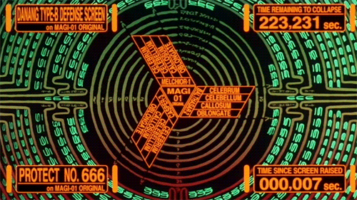
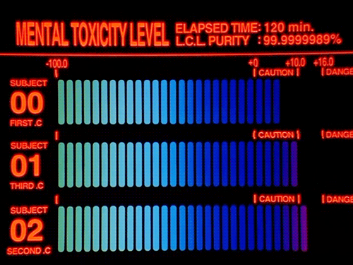

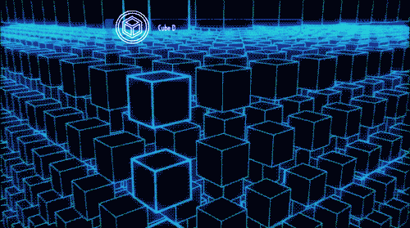
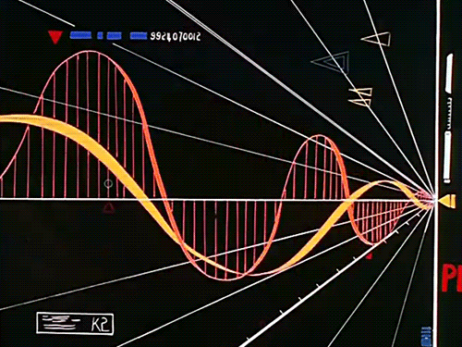
Notes:
An Anime that cares about UI design!

Slide 83
值得一试的其他 JVM 语言
Gosu
这种语言由 GuideWire 创造，前途光明
易于增强库以及创建 DSL
Mirah
由 Charles Nutter 发明
局部类型推断、静态类型和动态类型
Fantom
由 Brian 和 Andy Frank 联合创造
可移植到 Java 和 .NET
局部类型推断、静态类型和动态类型
是不是还落下了什么？

Slide 84

使用 JRuby 的 JavaFX

Slide 85
为什么要使用 JRuby？
Ruby 的全面实施
直接访问 Java API
动态类型
闭包
适用于接口的“闭包转换”
Ruby 是在日本创造的！
Yukihiro Matsumoto
松本行弘 (まつもとゆきひろ)

Slide 86
Java 与 JRubyFX DSL
public class VanishingCircles extends Application {
public static void main(String[] args) {
Application.launch(args);
}
@Override
public void start(Stage primaryStage) {
primaryStage.setTitle("Vanishing Circles");
Group root = new Group();
Scene scene = new Scene(root, 800, 600, Color.BLACK);
List<Circle> circles = new ArrayList<Circle>();
for (int i = 0; i < 50; i++) {
final Circle circle = new Circle(150);
circle.setCenterX(Math.random() * 800);
circle.setCenterY(Math.random() * 600);
circle.setFill(new Color(Math.random(), Math.random(), Math.random(), .2));
circle.setEffect(new BoxBlur(10, 10, 3));
circle.addEventHandler(MouseEvent.MOUSE_CLICKED, new EventHandler<MouseEvent>() {
public void handle(MouseEvent t) {
KeyValue collapse = new KeyValue(circle.radiusProperty(), 0);
new Timeline(new KeyFrame(Duration.seconds(3), collapse)).play();
}
});
circle.setStroke(Color.WHITE);
circle.strokeWidthProperty().bind(Bindings.when(circle.hoverProperty())
.then(4)
.otherwise(0));
circles.add(circle);
}
root.getChildren().addAll(circles);
primaryStage.setScene(scene);
primaryStage.show();
Timeline moveCircles = new Timeline();
for (Circle circle : circles) {
KeyValue moveX = new KeyValue(circle.centerXProperty(), Math.random() * 800);
KeyValue moveY = new KeyValue(circle.centerYProperty(), Math.random() * 600);
moveCircles.getKeyFrames().add(new KeyFrame(Duration.seconds(40), moveX, moveY));
}
moveCircles.play();
}
}
class VanishingCircles < JRubyFX::Application
def start(stage)
with(stage, title: "Vanishing Circles", x: 105, y: 140) do
layout_scene(800, 600, :black) do
group() do
50.times() do
circle(centerX: Random.rand(800), centerY: Random.rand(600), radius: 150, stroke: :white, strokeWidth: 0, fill: Color.rgb(Random.rand(255), Random.rand(255), Random.rand(255), 0.2)) do
center_x = centerXProperty
center_y = centerYProperty
radius = radiusProperty
stroke_width = strokeWidthProperty
hoverProperty.add_change_listener do
stroke_width.set(hoverProperty.get() ? 4 : 0)
end
set_on_mouse_clicked do
timeline() do
animate radius, 0.sec => 3.sec, 150 => 0
end.play
end
effect box_blur(width: 10, height: 10, iterations: 3)
timeline(cycle_count: :indefinite, auto_reverse: true) do
animate center_x, 0.sec => 40.sec, center_x.get() => Random.rand(800)
animate center_y, 0.sec => 40.sec, center_y.get() => Random.rand(600)
end.play
end
end
end
end
show
end
end
end
40 行
1299 个字符
33 行
842 个字符
Notes:
Stage.add??

Slide 87
JavaFX 的发展方向……JRubyFX
class VanishingCircles < JRubyFX::Application
def start(stage)
with(stage, title: "Vanishing Circles", x: 105, y: 140) do
layout_scene(800, 600, :black) do
group() do
50.times() do
circle(centerX: Random.rand(800), centerY: Random.rand(600),
radius: 150, stroke: :white, strokeWidth: 0,
fill: Color.rgb(Random.rand(255), Random.rand(255),
Random.rand(255), 0.2)) do
effect box_blur(width: 10, height: 10, iterations: 3)
end
end
end
end
show
end
end
end

Slide 88
?
最像哪部日本
动画片呢？
（或漫画）

Slide 89


Notes:
So which Ichigo is Ruby and JRuby? You guess. ☺

Slide 90
总结
您可以编写单纯使用 Java 的 JavaFX 应用程序
JavaFX 也可以使用替代语言
您可以使用 DSL 库获得改善的支持
GroovyFX
ScalaFX
JRubyFX！！！
或者使用专用的 UI JVM 语言
Visage

Slide 91
参与贡献！
GroovyFX：
http://groovyfx.org
ScalaFX：
http://scalafx.org
Visage：
http://visage-lang.org
JRubyFX：
https://github.com/jruby/jrubyfx

Slide 92

Stephen Chin
stephen.chin@oracle.com
Tweeter：@steveonjava
感谢 Dean Iverson、Jonathan Giles 和 Angela Caicedo 为准备本次演讲提供帮助

