Slide 2
The preceding is intended to outline our general product direction. It is intended for information purposes only, and may not be incorporated into any contract. It is not a commitment to deliver any material, code, or functionality, and should not be relied upon in making purchasing decisions. The development, release, and timing of any features or functionality described for Oracle’s products remains at the sole discretion of Oracle.

Slide 3


Easy Middleware for Embedded Devices
Stephen Chin (@steveonjava)
Java Technology Ambassador
JavaOne Content Chair

Slide 4
Program Agenda
Components of Oracle Java Embedded Suite
Developing applications for Java Embedded Suite
Code examples
Demo

Slide 5
Oracle Java Embedded Suite
Bringing Java EE technology to embedded gateway devices
Easy creation and hosting of web applications and services
Java runtime and middleware
Java SE Embedded
GlassFish for Embedded Suite
Java DB
Jersey
Integrated, tested and supported together
ARM Linux & x86 Linux

Slide 6
Sample Deployment Architecture
Notes:
This diagram illustrates a sample deployment scenario for Java Embedded Suite.
In this case, JES is acting as a concentrator for multitude of edge devices.
It is collecting and forwarding the data and messages to/from embedded devices and communicates the backend through the cloud. JES is also capable of performing a local analytics with ability to store data and host web services/applications.
So from the backend enterprise perspective, you can have access to aggregated/pre-processed data tailed to the required backend services. Much of the business logics runs in the backend can be localized to sub-segments or sub-system through JES without having to create something from scratch on individual embedded devices.

Slide 7
Insert M2M architecture slide here to position JES for gateway devices and define what a gateway device is

Slide 8
Java SE Embedded
Headless configuration of Java SE
With optimizations for embedded use
Familiar Java SE 7 API set
Use your favorite IDE and libraries
Initial release contains 7u6 JRE
Client JIT
Optimized for x86 and ARM V6/V7
Notes:
Not going to go into “Why Java” in this presentation…

Slide 9
GlassFish for Embedded Suite
Application server
Size-reduced for use on embedded devices
Runs in embedded mode i.e. in process
Controlled using Embedded GlassFish API
HTTP server
Servlet 3.0 container
Java DB and Jersey integration
Notes:
Lots of example Glassfish code coming later in the presentation

Slide 10
Java DB
Full-featured, multi-user RDBMS including crash recovery
Easy to use – no DBA needed
Standards based (ANSI/ISO SQL & JDBC)
Apache Project Derby
Active community of developers and users
Mature codebase (15+ years in the wild)

Slide 11
Java DB – Easy to Use
Single jar
Familiar, extensive SQL support
Self tuning
Optimizer stats, page size, lock defaults
Many features are pluggable
Encryption, authentication, functions, procedures, datatypes, …
Use the embedded JDBC DataSource

Slide 12
Java DB Session
Session ID: CON6684 Session Title: Data Storage for Embedded Middleware Venue / Room: Hotel Nikko - Monterey I/II Date and Time: Thursday 2pm

Slide 13
Jersey
RESTful web service framework
JSR-311 (JAX-RS) reference implementation
Annotation based
Makes implementing RESTful web services easy
Includes JSON support
Also provides REST client API

Slide 14
JES Application
Main
Application
Static
Content
Web Applications/Services
GlassFish
JavaDB
Jersey
Java SE Embedded

Slide 15
Hello Jersey
// The Java class will be hosted at the URI path "/helloworld"
@Path("/helloworld")
public class HelloWorldResource {
// The method will process HTTP GET requests
@GET
// The method will produce content encoded as MIME type "text/plain"
@Produces("text/plain")
public String getClichedMessage() {
return "Hello World";
}
}

Slide 16
Embedded GlassFish API
Lifecycle operations – start & stop the application server
Deploy and undeploy applications
Runtime configuration
Access services

Slide 17
Embedded GlassFish API Example
﻿GlassFishRuntime gfRuntime = GlassFishRuntime.bootstrap();
GlassFishProperties gfProps = new GlassFishProperties();
gfProps.setPort("http-listener", port);
gfProps.setPort("https-listener", port + 1);
GlassFish glassfish = gfRuntime.newGlassFish(gfProps);
glassfish.start();
Deployer deployer = glassfish.getDeployer();

Slide 18
Securing the Device
Disclaimer: this is not a complete security tutorial
You should understand how to secure your Linux installation
Remove services that are not required
Open only the ports you need
Audit file permissions
…
Let’s talk about securing access to web applications

Slide 19
GlassFish Security
Configured in conceptually the same way as “Big GlassFish”
No admin console
So no open port
Use the Embedded API to do configuration
No HTTP & HTTPS listeners until you configure them
Use properties when starting the embedded GlassFish instance
Notes:
Default admin port is 4848

Slide 20
Configuring a Secure Transport
Can require the use of HTTPS
HTTP will then redirect to HTTPS
Add <transport-guarantee> to web.xml
Or use
@ServletSecurity for servlets
@Context annotation and SecurityContext.isSecure() for Jersey
Notes:
Default admin port is 4848

Slide 21
Configuring a Secure Transport (2)
<security-constraint>
<web-resource-collection>
<web-resource-name>Admin Pages</web-resource-name>
<url-pattern>/admin/*</url-pattern>
</web-resource-collection>
<user-data-constraint>
<description/>
<transport-guarantee>CONFIDENTIAL</transport-guarantee>
</user-data-constraint>
</security-constraint>
Notes:
Default admin port is 4848

Slide 22
Limiting Access to Web Applications
GlassFish can authenticate users by
User name & password
Certificates
A combination of both
Authentication realms – file, certificate, JDBC, LDAP
Can create custom realm and LoginModule for
Other authentication mechanisms
Additional security measures e.g. per-user password salt
Notes:
A realm is a security policy domain defined for a web or application server. A realm contains a collection of users, who may or may not be assigned to a group.

Slide 23
Using a JDBC Realm
Create the JDBC realm
Specify the use of the JDBC realm
Link roles to groups and specify the role constraints
Define the user database schema
Populate the user database
Specify the access constraints
Write a custom LoginModule?

Slide 24
Create a JDBC Resource
Would usually do this from the GlassFish admin console
Or using the asadmin command
The CommandRunner API lets us run asadmin commands
CommandRunner runner = glassfish.getCommandRunner();
CommandResult result;
result = runner.run("create-jdbc-resource”,
"--connectionpoolid=DerbyPool”, "jdbc/derby");

Slide 25
Create the JDBC Realm
result = runner.run("create-auth-realm”,
”--classname=com.sun.enterprise.security.auth.realm.jdbc.JDBCRealm",
"--property=jaas-context=jdbcRealm:
encoding=Hex:
password-column=PASSWORD:
datasource-jndi=jdbc/__default:
group-table=users_groups:
user-table=users:
group-name-column=GROUPID:
digest-algorithm=MD5:
user-name-column=USERID”,
"MyJDBCRealm");
Notes:
This is where we tell Glassfish which database tables and columns to use

Slide 26
Specify the use of the JDBC Realm
In web.xml, add
<login-config>
<auth-method>BASIC</auth-method>
<realm-name>MyJDBCRealm</realm-name>
</login-config>

Slide 27
Link Roles to Groups
In sun-web.xml, add
<security-role-mapping>
<role-name>admin</role-name>
<group-name>admin</group-name>
</security-role-mapping>

Slide 28
Specify the Roles Constraints
In web.xml, add
<security-role>
<role-name>admin</role-name>
</security-role>

Slide 29
Specify the Role Constraints (2)
In web.xml, add
<security-constraint>
…
<auth-constraint>
<role-name> admin </role-name>
</auth-constraint>
</security-constraint>

Slide 30
Configuring Role Constraints
<security-constraint>
<web-resource-collection>
<web-resource-name>Admin Pages</web-resource-name>
<url-pattern>/admin/*</url-pattern>
</web-resource-collection>
<auth-constraint>
<role-name>admin</role-name>
</auth-constraint>
</security-constraint>
Notes:
Default admin port is 4848

Slide 31
Define the User Database Schema
Statement s = connection.createStatement();
s.execute("CREATE TABLE users" +
”(USERID varchar(50) NOT NULL, PASSWORD varchar(128) NOT NULL)”);
s.execute("CREATE TABLE groups" +
”(GROUPID varchar(20) NOT NULL)");
s.execute("CREATE TABLE users_groups" +
”(GROUPID varchar(20) NOT NULL, USERID varchar(50) NOT NULL”)");

Slide 32
Populate the User Database
s.execute(“INSERT INTO users(USERID,PASSWORD) VALUES(‘user’,’…’)”);
s.execute("INSERT INTO users(USERID,PASSWORD) VALUES ('user', ‘…’)”);
s.execute("INSERT INTO groups(GROUPID) VALUES ('admin')");
s.execute("INSERT INTO groups(GROUPID) VALUES ('users')");
s.execute("INSERT INTO users_groups(USERID,GROUPID)
VALUES ('adminuser', 'users')");
s.execute("INSERT INTO users_groups(USERID,GROUPID)
VALUES ('adminuser', 'admin')");
s.execute("INSERT INTO users_groups(USERID,GROUPID)
VALUES ('user', 'users')");

Slide 33
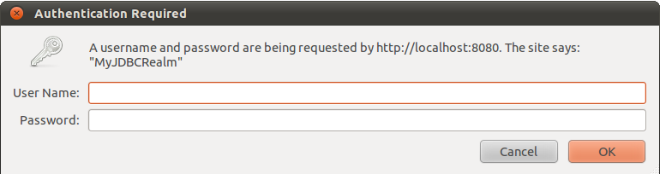
The Result

Slide 34
Including JES in a Device
Just put the JES directory wherever you want it on the device
No installation procedure required
Embedded GlassFish will create a skeleton working tree
In /tmp by default
Your application may need a “cold start”
Initialize credential store
Copy pre-initialized databases into place
…

Slide 35
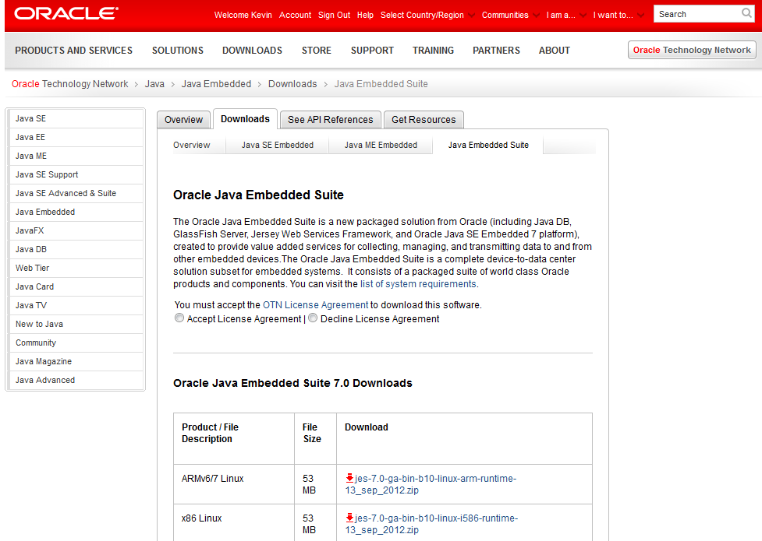
Ready to Get Started?
Access downloads directly at:
http://www.oracle.com/technetwork/java/embedded/downloads/java-embedded-suite/index.html

Slide 36
More Information
“Java Embedded Suite” | http://www.oracle.com/technetwork/java/embedded/resources/java-embedded-suite/index.html
“Java Embedded” | http://www.oracle.com/goto/javaembedded
”Java for Developers” | http://www.oracle.com/technetwork/java/index.htm
Notes:
These sites offer additional resources for your prospect to learn about Java.

Slide 37

Graphic Section Divider

Slide 39
Application packaging
Web applications and services packaged as war files
Jar files with additional application descriptors
WEB-INF/web.xml
WEB-INF/sun-web.xml

Slide 40
Accessing Protected Resources
GlassFish container
Request resource
Web
Browser
Request credentials
Check
credentials
Send credentials
Web
Application
Return resource
User
Information

Slide 41
Web Service Security
javax.ws.rs.core.SecurityContext
Get info about the connection and the user
Inject this with the @Context annotation
@Context SecurityContext security;
String username = security.getUserPrincipal().getName();
if (security.userInRole(“admin”)) {
…
}
Notes:
Use web.xml and sun-web.xml in the same way for JAX-RS. There are also some additional annotations to know about

Slide 42
Developing using Netbeans
Automatic download and execution of your application
Use the <scp> and <sshexec> Ant rules provided by Netbeans
Update the <run> target in build.xml

