Slide 2

Beyond Beauty: JavaFX, Parallax, Touch, Gyroscopes and Much More
Angela Caicedo
Java Evangelist, Oracle
Notes:
In the past few years I've been fascinated with the beauty and immersion that a 3D environment can provide in a user interface. Unfortunately, it can be really heavy-weight for small devices or even the web. However, there are simple techniques that can make your UI unbelievably realistic without the need for 3D hardware. A technique often used in video games is to use independent layers that are scrolled at different speeds in a simulated parallax motion effect. When the player/cursor is moved, this effect provides the illusion of depth and distance between layers, resulting in a rich and engaging user experience. If you include touch functionality and user positioning (or screen orientation) by incorporating a gyroscope on top of this rich user environment, the result is a unique and very realistic interface. JavaFX is a perfect fit for implementing these kind of interfaces. Join this session and explore the design and implementation of this unique UI pattern. Raspberry Pi demo will delight you

Slide 3
What Is this Talk About?
Looking for a better UIs
Current UI are so static, too flat, but the use of 3D will be too much.
Specially for Embedded
UIs should react to user positioning, we have the tools
JavaFX sounds great for more dynamic UIs
How do we put all this together?
This is what this talk is about!!!
Notes:
In Cambridge university started
ICT in UK, what they teach childrens interms of technology. School. We are teaching how to use applications, how to use a browser, how to do email, which is not computer cience. If we want people to be engineers, if we want them to have great ideas, we need to train them properly.
BBC micro project
32 kbytes of mem, and color graphics
Ship production away from china and bring it back to UK

Slide 4
Agenda
The Hardware:
Raspberry Pi
The protocol: I2C
Enabling I2C on the Pi
Used Hardware, MPU-9150
Chalkboard Electronics LCD Screen
The software
I2C Native and Java libraries
UI Principles used: Parallax
JavaFX for the implementation

Slide 5

The Hardware

Slide 6
The Raspberry Pi

Slide 7
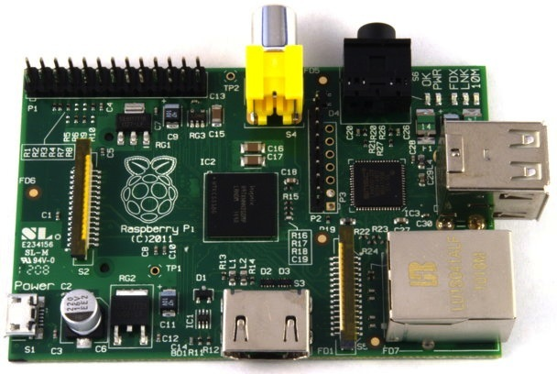
The Raspberry Pi

Slide 8
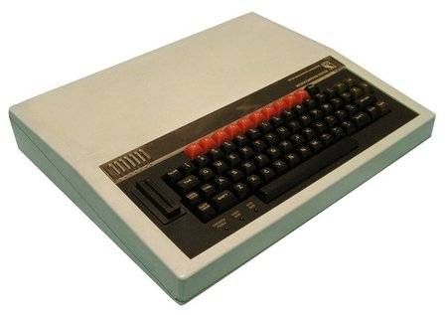
Rapberry Pi
History and Goals
Project started in 2006
Goal to devise a computer to inspire children
Inspiration from the BBC Micro project from 1981
Officially launched on Febuary 29th 2012
First production run was 10,000 boards
Both RS and Farnell’s servers were stalled on the day of launch
RS reported over 100,000 pre-orders in one day
Current production is about 4,000 boards per day
Notes:
In Cambridge university started
ICT in UK, what they teach childrens interms of technology. School. We are teaching how to use applications, how to use a browser, how to do email, which is not computer cience. If we want people to be engineers, if we want them to have great ideas, we need to train them properly.
BBC micro project
32 kbytes of mem, and color graphics
Ship production away from china and bring it back to UK

Slide 9
Raspberry Pi
Specification
CPU: ARM 11 core running at 700MHz
Broadcom SoC package
Can now be overclocked to 1GHz (without breaking the warranty!)
Memory: 512Mb
I/O:
HDMI and composite video
2 x USB ports (Model B only)
Ethernet (Model B only)
Header pins for GPIO, UART, SPI and I2C
Notes:
Broadcom System on a chip package. Most of the components are in a single package. So on the board you see a chip, that is not the procesor, it’s actyally the memory, the processor is underneath the memory, clever design for the board
Overclocking is the act of increasing the speed of certain components in a computer other than that specified by the manufacturer. It mainly refers to making your CPU run at a faster rate although it could also refer to making your graphics card or other peripherals run faster. For example if you have a 300MHz PII CPU, you could probably overclock it easily to 350 or even 400MHz. The latest P4 processors also appear to be overclockable through the FSB (front side bus) even though they are advertised as being clock-locked.
So, now that you now what overclocking is, let's see how you can actually overclock your CPU. You can do this using any of the following 3 methods: 1. Through your BIOS, 2. By changing the multiplier settings, 3. By changing the Bus speed!
256 megabites, compare with 16kbytes that started model A of BBC micro
Some GPIO lines, UART for serial communication, SPI and
I square C (I2c)
I²C ("eye-squared cee" or "eye-two-cee" Inter-Integrated Circuit; generically referred to as "two-wire interface") is a multi-master serial single-ended computer bus invented by Philips that is used to attach low-speed peripherals to a motherboard, embedded system, cellphone, or other electronic device.

Slide 10
Java On The ARM and Raspberry Pi

Slide 11
Java Specifics For ARM
Floating Point Operations
Despite being an ARMv6 processor it does include an FPU
FPU only became standard as of ARMv7
FPU (Hard Float, or HF) is much faster than a software library
Linux distros and Oracle JVM for ARM assume no HF on ARMv6
Need special build of both
Raspbian distro build now available (Based on Debian)
Oracle JVM released on Dec 2012!!! (Early access)
Notes:
In Oracle we have had embedded java for a while, we have different version to address different types of processors,because we are not dealing only with intel processors, we need to adress specific type of processors. We have a version of java that runs on ARMv6 processor, but the specification for ARMv6 doesn’t mandate the inclussion of floating point unit, so we don’t expect to have there a fpu, so we have library that emulate the ilusion of floating point, and do the mathematics on software
In the case of Rpi, there is a FPU,so there is hardware acceleration floating point matematic. The thing is if you use a library and you do it in software its slower thatn doing it on HW
It’s suppose to be very simple, from the technical point of view, set few compiler flags and run make, and then we have a version of the hard float copy of the jvm, tricky bit is to test it… :-( just to make sure there are not big bugs

Slide 12
Extending the Raspberry Pi

Slide 13


Using Java on the Raspberry Pi
Projects I’ve been work on:
Serial (TTL UART) DONE
USB DONE
GPIO DONE
I2C
Lots of great ideas!!!

Slide 14
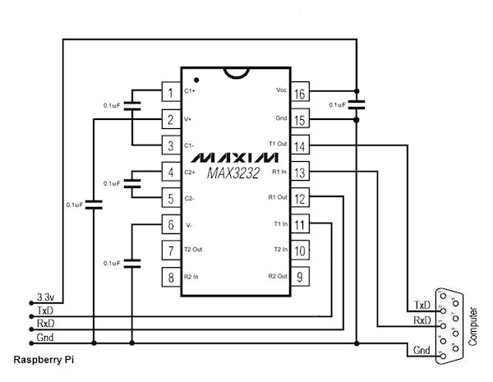
Using The Serial Port
UART provides TTL level signals (3.3V)
RS-232 uses 12V signals
Use MAX3232 chip to convert
Use this for access to serial console
Notes:
Another thing you can do with raspberry pi is to use the serial port.
UART: Universal Asynchronous Receiver/Transmitter,
If you look at the IO pins,there are some transmit and receive UART lines, and use Putty for the communication

Slide 15

USB & The OWI Robot Arm
Cheap and cheerful
Comes with USB interface
Windows only driver
Recognized as USB device by Linux
(dev/bus/usb)
Use native code for control and JNI
Simple control protocol
3 bytes (1 = arm, 2 = base, 3 = light)
Combining movements requires some bit twiddling
Can only stop all motors, not individually
Notes:
USB interface, but it’s not serial, so it’s a bit more complicated.
Recognized as a device, so under /dev/bus/usb, there is a device you can talk to. Then write some native code, talk to the device and have it do what you want to do.
There is only one stop command, you need to remember the once that are running and start them again inmediatelly after

Slide 16
Robot Arm Control
JNI Code
Native C functions
Initialization of arm using libusb and appropriate device
Separate function for each control element
Compile to shared library
Use JNI to generate header file appropriate to Java code usage
e.g. native int arm_usb_init()
Implement appropriate stub to call library
Compile to shared library
JNI is not easy to reuse
Notes:
In jni, create a native method, then create the necessary stub header files using javah, compile into a shared library
Seriusly thinking in JDK 9 or so to re-write to make it easier to use

Slide 17
Robot Arm Control
Java Code
Java code is simple
Calibration required to determine time for specific movement
arm_gripper_move(OPEN);
uSleep(500);
arm_gripper_move(STOP);
uSleep(500);
arm_gripper_move(CLOSE);
uSleep(500);
arm_gripper_move(STOP);

Slide 18
Using The GPIO Lines
P1 Connector Layout
14 (TXD)
15 (RXD)
5V
GND
18
23
24
25
8
7
P1-01
0 (SDA)
1 (SCL)
4
17
21
22
10 (MOSI)
9 (MISO)
3.3V
11 (SCLK)
P2 Connector: Pin 1 = 3.3V Pin 7,8 = GND
Notes:
14, 15 UART lines so you can get the serial console

Slide 19
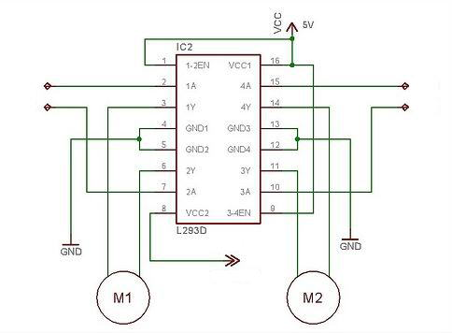
GPIO Example: LEGO Motors
Using L293D Dual H-Bridge
GPIO line
GPIO line
GPIO line
GPIO line
+9V Supply
Notes:
Need 9v, you you need a little circuit like the one here. , the lines that you get out of the Rpi are very low, so you can’t drive the motor

Slide 20
Hide The Magic Incantations With JNI
Simple Java Interface
Access to /dev/mem needs root access
Could solve this by writing our own device driver
gpio_init();
gpio_pin_output(MOTOR_PIN_CLKWISE);
gpio_pin_output(MOTOR_PIN_ACLKWISE);
/* Turn clockwise */
gpio_pin_low(MOTOR_PIN_ACLKWISE);
gpio_pin_high(MOTOR_PIN_CLKWISE);
Notes:
Anything using /dev/mem need root access. So anyone usign the GPIO lines need to be root
You end up with some JNI code, simple like this

Slide 21
I2C in the Raspberry Pi

Slide 22
I2C Overview
Used for moving data simply and quickly from one device to another
Serial Interface
Synchronous:
The data is clocked along with a clock signal (SCL)
The clock signal controls when data is changed and when it should be read
Clock rate can vary, unlike asynchronous (RS-232 style) communications
Bidirectional
Notes:
with a slave device. Data is exchanged between these devices.
Since I2C is synchronous, it has a clock pulse along with the data. RS232 and other
asynchronous protocols do not use a clock pulse, but the data must be timed very
accurately.
Since I2C has a clock signal, the clock can vary without disrupting the data. The
data rate will simply change along with the changes in the clock rate. This makes
I2C ideal when the micro is being clocked imprecisely, such as by a RC oscillator.

Slide 23
I2C In Few Words…
Inter-Integrated Circuit, ("two-wire interface")
Multi-master serial single-ended computer bus
Invented by Philips for attaching low-speed peripherals to a motherboard, embedded system, cellphone, or other electronic device.
Uses two bidirectional open-drain lines
Serial Data Line (SDA) and
Serial Clock (SCL),
pulled up with resistors.
Typical voltages used are +5 V or +3.3 V
Notes:
IÇC uses only two bidirectional open-drain
lines, Serial Data Line (SDA) and Serial
Clock (SCL), pulled up with resistors.
Typical voltages used are +5 V or +3.3 V
although systems with other voltages are
permitted.
The IÇC reference design has a 7-bit or a
10-bit (depending on the device used)
address space. [5] Common IÇC bus speeds
are the 100 kbit/s standard mode and the 10
kbit/s low-speed mode, but arbitrarily low
clock frequencies are also allowed. Recent revisions of IÇC can host more nodes and run at faster speeds
(400 kbit/s Fast mode, 1 Mbit/s Fast mode plus or Fm+, and 3.4 Mbit/s High Speed mode). These speeds
are more widely used on embedded systems than on PCs. There are also other features, such as 16-bit
addressing.

Slide 24
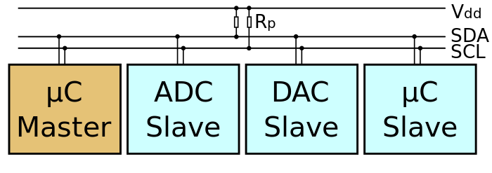
I2C Design
A bus with a clock (SCL) and data (SDA) lines
7-bit addressing.
Roles:
Master: generates the clock and initiates communication with slaves
Slave: receives the clock and responds when addressed by the master
Multi-Master bus
Switch between master and slave allowed
Notes:
The aforementioned reference design is a bus with a clock (SCL) and data (SDA) lines with 7-bit
addressing. The bus has two roles for nodes: master and slave:
Master node — node that generates the clock and initiates communication with slaves
Slave node — node that receives the clock and responds when addressed by the master
The bus is a multi-master bus which means any number of master nodes can be present. Additionally,
master and slave roles may be changed between messages (after a STOP is sent).
There are four potential modes of operation for a given bus device, although most devices only use a
single role and its two modes:
master transmit — master 1. node is sending data to a slave
2. master receive — master node is receiving data from a slave
3. slave transmit — slave node is sending data to the master
4. slave receive — slave node is receiving data from the master

Slide 25
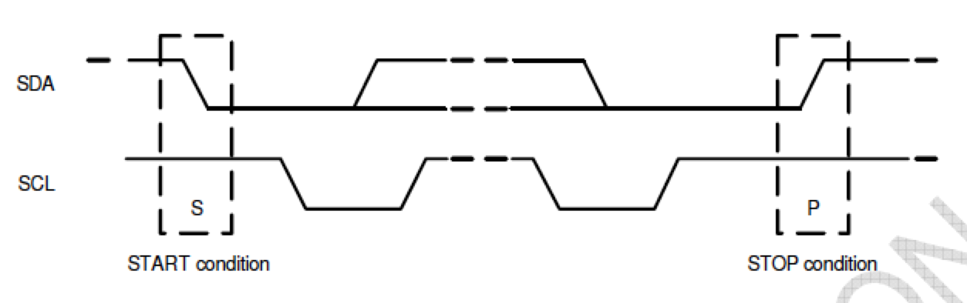
I2C Communication Protocol
START (S) and STOP (P) Conditions
Communication starts when master puts START condition (S) on the bus: HIGH-to-LOW transition of the SDA line while SCL line is HIGH
Bus is busy until master puts a STOP condition (P) on the bus: LOW to HIGH transition on the SDA line while SCL is HIGH
Notes:
START (S) and STOP (P) Conditions
Communication on the I2C bus starts when the master puts the START condition (S) on the bus, which is
defined as a HIGH-to-LOW transition of the SDA line while SCL line is HIGH (see figure below). The bus is
considered to be busy until the master puts a STOP condition (P) on the bus, which is defined as a LOW to
HIGH transition on the SDA line while SCL is HIGH (see figure below).
Additionally, the bus remains busy if a repeated START (Sr) is generated instead of a STOP condition.

Slide 26
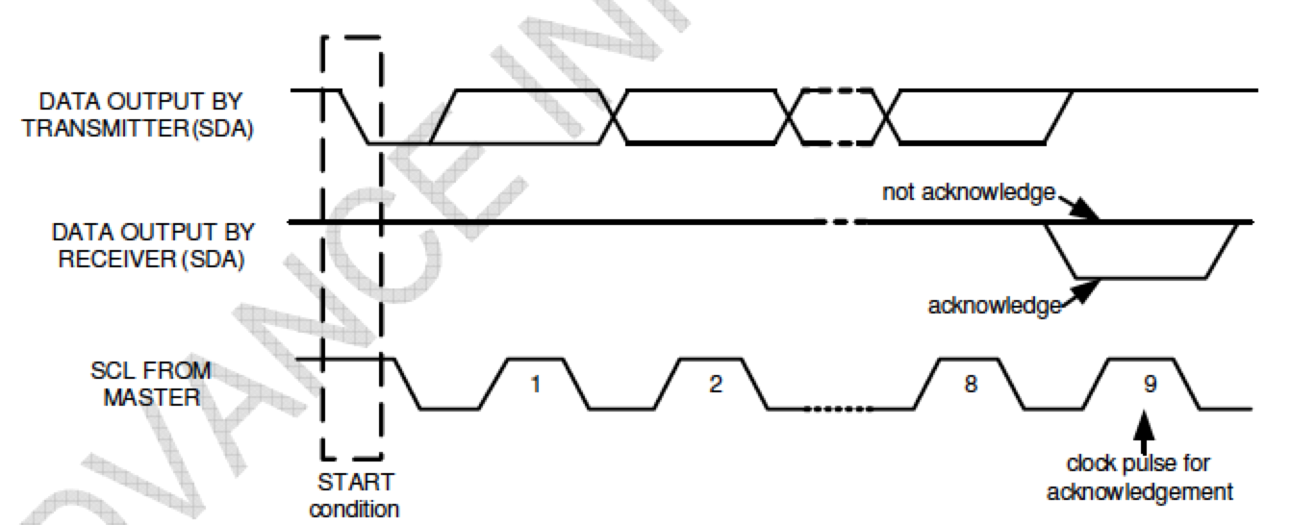
I2C Communication Protocol
Data Format / Acknowledge
I2 C data bytes are 8-bits long
Each byte transferred must be followed by acknowledge ACK signal
Notes:
Data Format / Acknowledge
I2C data bytes are defined to be 8-bits long. There is no restriction to the number of bytes transmitted per
data transfer. Each byte transferred must be followed by an acknowledge (ACK) signal. The clock for the
acknowledge signal is generated by the master, while the receiver generates the actual acknowledge signal
by pulling down SDA and holding it low during the HIGH portion of the acknowledge clock pulse.
If a slave is busy and cannot transmit or receive another byte of data until some other task has been
performed, it can hold SCL LOW, thus forcing the master into a wait state. Normal data transfer resumes
when the slave is ready, and releases the clock line (refer to the following figure).

Slide 27
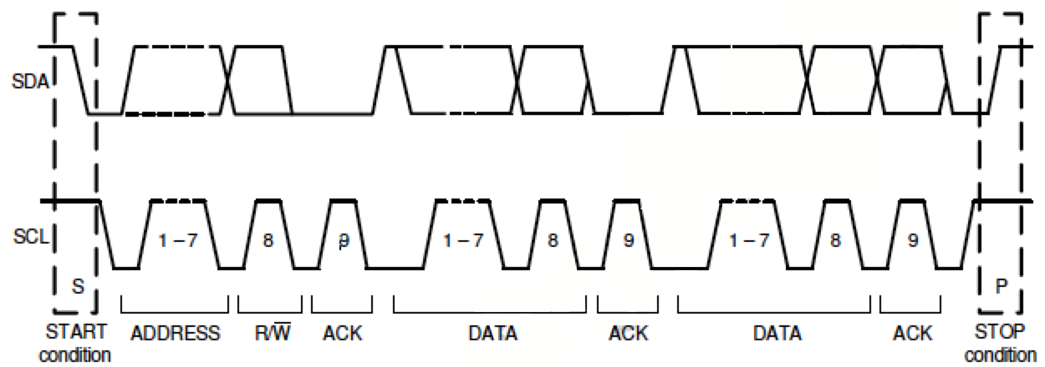
I2C Communication Protocol
Communications
Notes:
After beginning communications with the START condition (S), the master sends a 7-bit slave address
followed by an 8th bit, the read/write bit. The read/write bit indicates whether the master is receiving data from
or is writing to the slave device. Then, the master releases the SDA line and waits for the acknowledge
signal (ACK) from the slave device. Each byte transferred must be followed by an acknowledge bit. To
acknowledge, the slave device pulls the SDA line LOW and keeps it LOW for the high period of the SCL line.
Data transmission is always terminated by the master with a STOP condition (P), thus freeing the
communications line. However, the master can generate a repeated START condition (Sr), and address
another slave without first generating a STOP condition (P). A LOW to HIGH transition on the SDA line while
SCL is HIGH defines the stop condition. All SDA changes should take place when SCL is low, with the
exception of start and stop conditions.

Slide 28
Enabling I2C on the Raspberry Pi

Slide 29
I2C Not enabled!!!!
/etc/modules
Add lines: i2c-bcm2708
i2c-dev
Install i2c-tools. Handy for detecting devices
sudo apt-get install python-smbus
sudo apt-get install i2c-tools
/etc/modprobe.d/raspi-blacklist.conf comment out the lines
blacklist spi-bcm2708
blacklist i2c-bcm2708

Slide 30
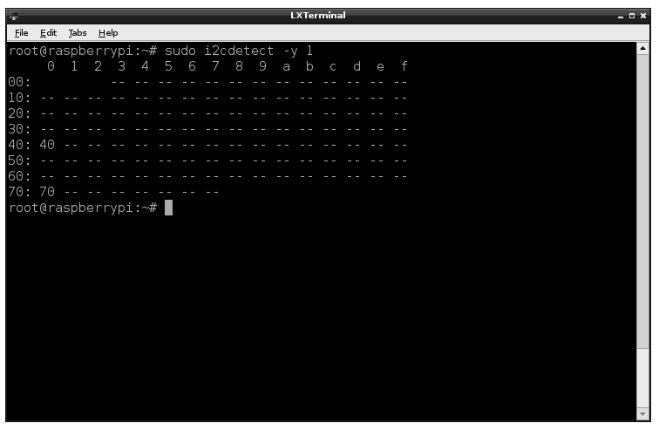
I2C Not enabled!!!!
Can you see your device?
sudo i2cdetect -y 1
Or
Sudo i2cdetect –y 0
(for 256 Pi Model B)

Slide 31
I2C Verify…
You should have under /dev
spidev0.0
Spidev0.1
I2c-0
I2c-1
If you don’t see anything run
sudo modprobe i2c-dev

Slide 32
I2C Hardware

Slide 33
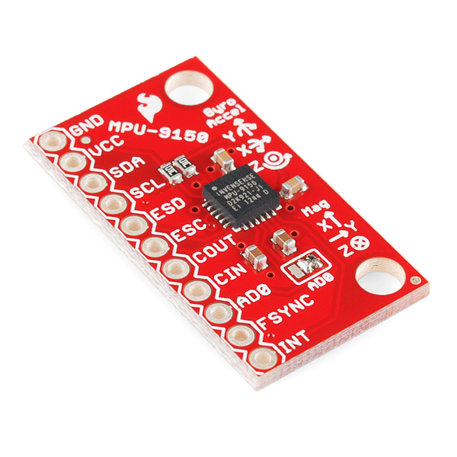
MPU-9150 Breakout Board
9-axis MotionTracking device
I²C serial host interface
Solder jumper for switching LSB of the I2C address
Allow you to connect 2 of them
Tri-Axis angular rate sensor (gyro)
Tri-Axis accelerometer
Tri-axis compass with a full scale range of ±1200µT
VDD Supply voltage range of 2.4V–3.46V

Slide 34
Connecting things

Slide 35
Using I2C Lines
P1 Connector Layout
14 (TXD)
15 (RXD)
5V
GND
18
23
24
25
8
7
P1-01
0 (SDA)
1 (SCL)
4
17
21
22
10 (MOSI)
9 (MISO)
3.3V
11 (SCLK)
P2 Connector: Pin 1 = 3.3V Pin 7,8 = GND
Notes:
14, 15 UART lines so you can get the serial console

Slide 36
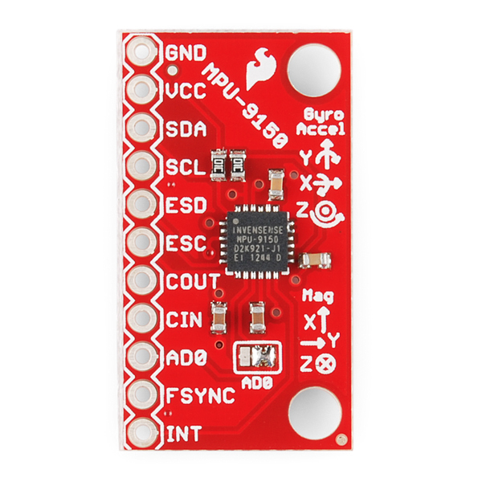
Pi Connector Layout
(SDA)
3.3V
(SCL)
3.3V/GND
P2 Connector: Pin 1 = 3.3V Pin 7,8 = GND
Notes:
14, 15 UART lines so you can get the serial console

Slide 37
The Screen

Slide 38
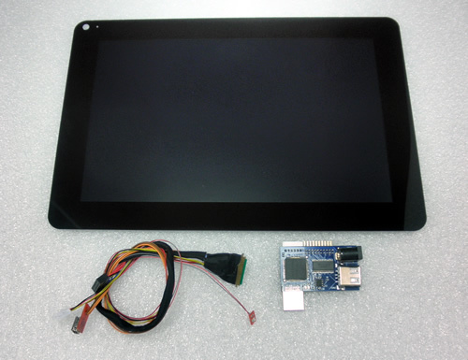
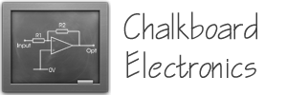


Chalkboard Electronics Touchscreen
10" or 7" Form Factor
Connects via HDMI/USB
Tested with JavaFX 8
10% Exclusive Discount:
G1F0U796Z083

Slide 39
The Wood Work…

Slide 40
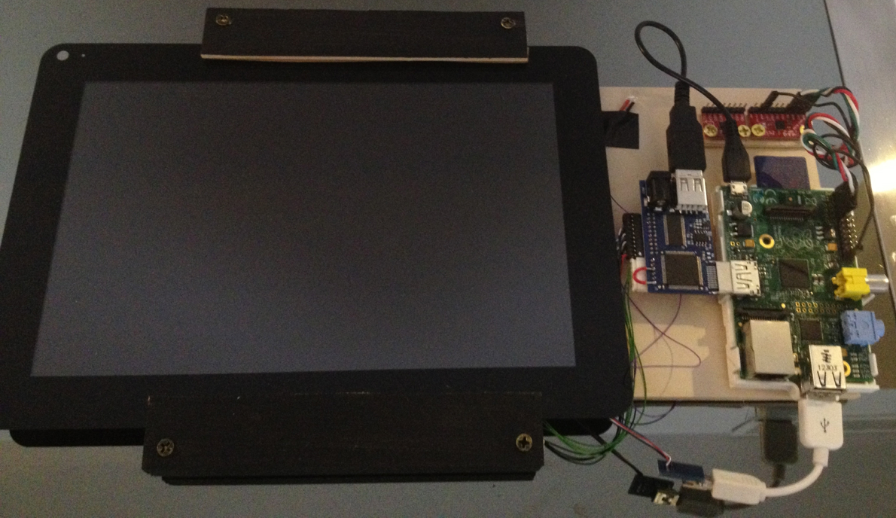
Demo Setup
Brightness sensor
ADXL345
MPU-9150
Breakout
LCD
Screen
The
Raspberry Pi
Touch Screen
sensor

Slide 41
The Software

Slide 42
Java – I2C and the Raspberry Pi

Slide 43
WiringPi Native Library
Library written in C
Inspired on Arduino’s Wiring package
Core of the input and output for the Raspberry Pi
Provides access to:
GPIOs pin, I2C and SPI interface, UART lines
Includes a command-line utility gpio:
Allow to program and setup the GPIO pins
Read and write the pins and even use it to control them from shell scripts.
Notes:
WiringPi
WiringPi is an Arduino wiring-like library written in C and released under the GNU LGPLv3 license which is usable from C and C++ and many other languages with suitable wrappers (See below)
You may be familiar with the Arduino… Briefly; Arduino is really two things; one is a hardware platform, the other software, and part of the software is a package called Wiring. Wiring is the core of the input and output for the Arduino, so I thought it would be good to replicate that functionality (or a good usable subset) on the Raspberry Pi.
The Raspberry Pi has a 26-pin General Purpose Input/Output (GPIO) connector and this carries a set of signals and buses. There are 8 general purpose digital I/O pins – these can be programmed as either digital outputs or inputs. One of these pins can be designated for PWM output too. Additionally there is a 2-wire I2C interface and a 4-wire SPI interface (with a 2nd select line, making it 5 pins in total) and the serial UART with a further 2 pins.
The Revision 2 Raspberry Pi has an additional 4 GPIO lines on a separate connector which you have to solder onto the board.
The I2C and SPI interfaces can also be used a general purpose I/O pins when not being used in their bus modes, and the UART pins can also be used if you reboot with the serial console disabled, giving a grand total of 8 + 2 + 5 + 2 = 17 I/O pins.
WiringPi includes a command-line utility gpio which can be used to program and setup the GPIO pins. You can use this to read and write the pins and even use it to control them from shell scripts.

Slide 44
Pi4J
Provide a bridge between the native libraries (WiringPi) and Java for full access to the Raspberry Pi.
The Team:
Robert Savage
Chris Walzl
Raspberry Pi Community Forums
Pi4J Google Groups Discussion Forum
https://groups.google.com/forum/#!forum/pi4j
@Pi4J on Twitter
Pi4J Issue Tracking
https://github.com/Pi4J/pi4j/issues

Slide 45
Pi4J: Features (1/2)
Wrapper classes for direct access to WiringPi Library from Java
Export & unexport GPIO pins
Configure GPIO pin direction
Configure GPIO pin edge detection
Control/write GPIO pin states
Pulse GPIO pin state
Read GPIO pin states
Listen for GPIO pin state changes (interrupt-based; not polling)
Automatically set GPIO states on program termination (GPIO shutdown)

Slide 46
Pi4J: Features (2/2)
Triggers for automation based on pin state changes
Send & receive data via RS232 serial communication
I2C Communication
SPI Communication
Extensible GPIO Provider interface to add GPIO capacity via expansion boards
Access system information and network information from the Raspberry Pi
Wrapper classes for direct access to WiringPi Library from Java

Slide 47
Installing and Using Pi4J (1/2)
Get the APIs
wget http://pi4j.googlecode.com/files/pi4j-0.0.5.deb
Install
sudo dpkg -i pi4j-0.0.5.deb
Check the source files at: /opt/pi4j/lib /opt/pi4j/examples
Include the Pi4J lib folder in the classpath: javac -classpath .:classes:/opt/pi4j/lib/'*' ...

Slide 48
Installing and Using Pi4J (2/2)
Include Pi4J lib folder in the classpath: sudo java -classpath .:classes:/opt/pi4j/lib/'*' ...
Build all demos: cd /opt/pi4j/examples ./build
Uninstall Pi4J
sudo dpkg -r pi4j

Slide 49
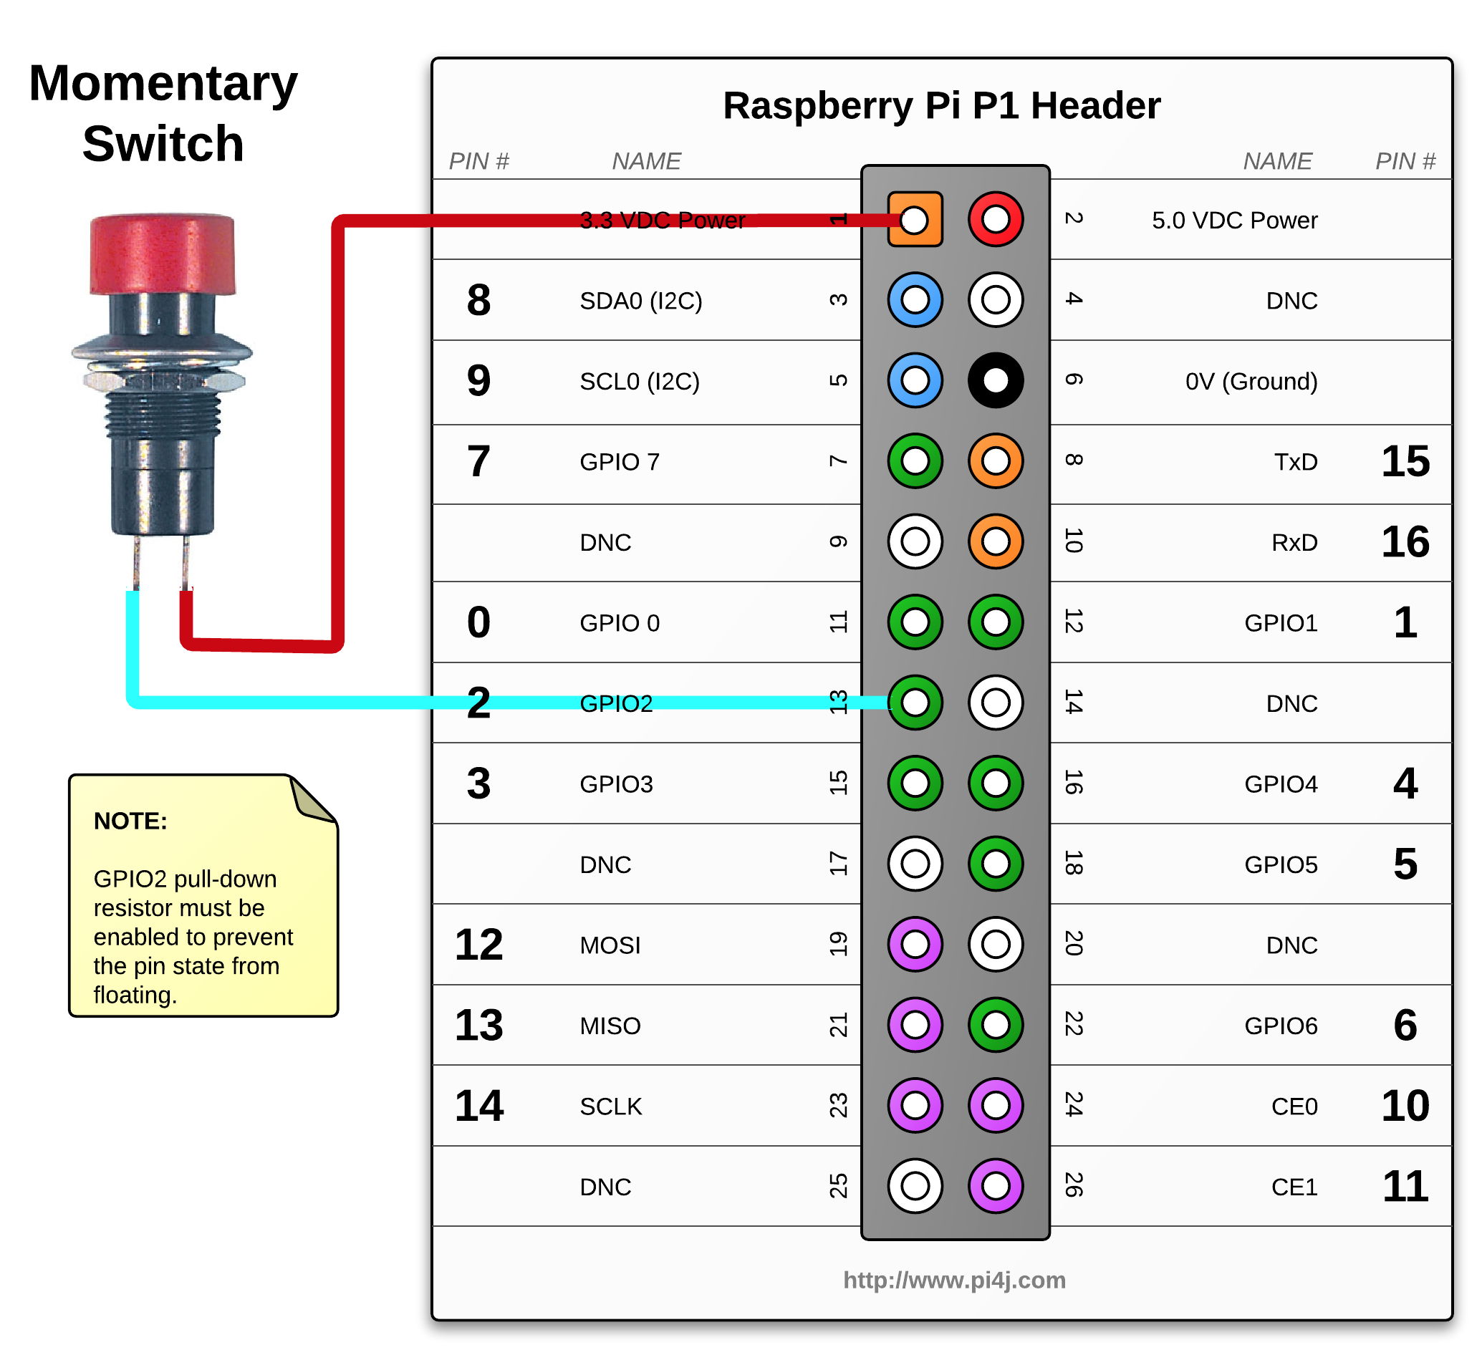
GPIO State Listener Example using Pi4J

Slide 50
GPIO State Listener Example using Pi4J
public class ListenGpioExample {
public static void main(String args[]) throws InterruptedException {
final GpioController gpio = GpioFactory.getInstance();
final GpioPinDigitalInput myButton =
gpio.provisionDigitalInputPin(RaspiPin.GPIO_02,
PinPullResistance.PULL_DOWN);
myButton.addListener(new GpioPinListenerDigital() {
@Override
public void handleGpioPinDigitalStateChangeEvent(
GpioPinDigitalStateChangeEvent event) {
System.out.println(”PIN STATE: " + event.getPin() + " = " +
event.getState());
}
});
for (;;) {Thread.sleep(500);}
// stop all GPIO activity/threads
// gpio.shutdown(); <--- implement this method call if you wish to
//terminate the Pi4J GPIO controller
}
}

Slide 51
I2C with Pi4J (1/2)
public Sensors() {
try {
//get i2c bus
bus = I2CFactory.getInstance(I2CBus.BUS_1);
//get device itself
device = bus.getDevice(0x68);
//start sensing, using config registries 6B and 6C
device.write(0x6B, (byte) 0b00000000);
device.write(0x6C, (byte) 0b00000000);
//config gyro
device.write(0x1B, (byte) 0b11100000);
//config accel
device.write(0x1C, (byte) 0b00011001);
startReading();
catch (IOException e) {System.out.println(e.getMessage()); }
}

Slide 52
I2C with Pi4J (2/2)
private void readingSensors() throws IOException {
while (true) {
accelData = new byte[6];
gyroData = new byte[6];
int r = device.read(0x3B, accelData, 0, 6);
if (r != 6) {
System.out.println("Error reading accel data, < 6 bytes");
}
int accelX = asInt(accelData[0]) * 256 + asInt(accelData[1]);
int accelY = asInt(accelData[2]) * 256 + asInt(accelData[3]);
int accelZ = asInt(accelData[4]) * 256 + asInt(accelData[5]);
System.out.println("accelX: " + accelX + ", accelY: " + accelY + ", accelZ: " + accelZ);
...

Slide 53
I2C with Pi4J (2/2)
r = device.read(0x43, gyroData, 0, 6);
if (r != 6) {
System.out.println("Error reading gyro data, < 6 bytes");
}
gyroX = (asInt(gyroData[0]) * 256 + asInt(gyroData[1]));
gyroY = (asInt(gyroData[2]) * 256 + asInt(gyroData[3]));
gyroZ = asInt(gyroData[4]) * 256 + asInt(gyroData[5]);
...
}

Slide 54
The User Interface: Parallax Effect

Slide 55
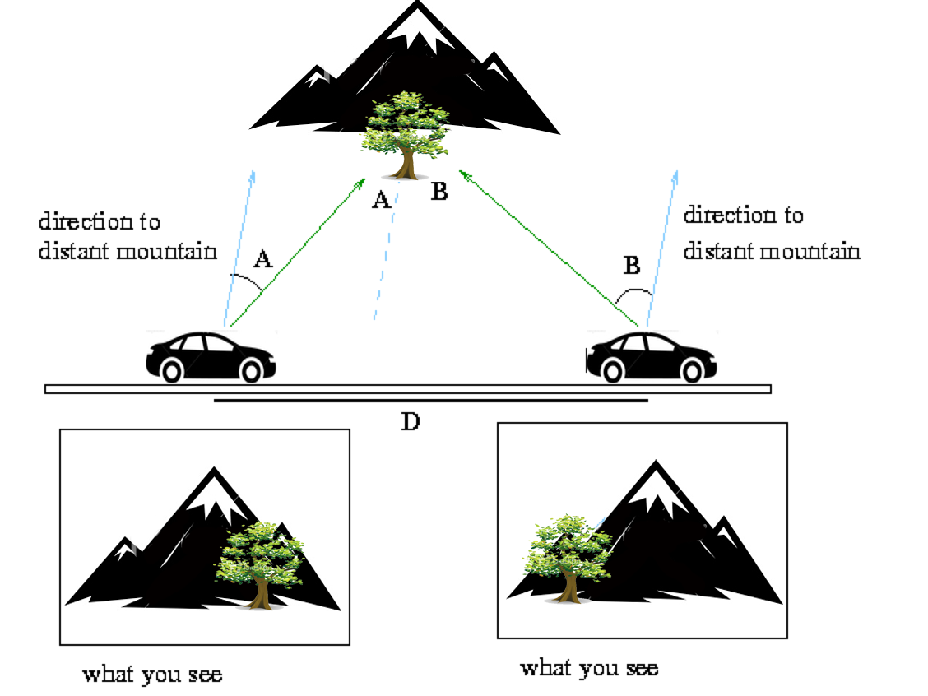
The Parallax Principle
Scrolling technique in computer graphics, wherein background images move by the camera slower than foreground images, creating an illusion of depth in a 2D video game and adding to the immersion.
We see it everyday!
Notes:
To used the GPIO lines you need to do some byte twidling
So if you want to set a pin for output there is this obscure line, bit twigtling of different things
For output, need to set it first for input and then output: for output you can set pin low or high

Slide 56

Finding the Vanishing Point
Roman Cortes
Trace 2 lines following the 3d parallel lines ( right wall )
The crossing is the vanishing point.
Trace two lines following the right and bottom corners of the back wall
A line crossing the vanishing point and the intersection of the two red lines defines the corner of the ground with the right wall.

Slide 57

Layer’s Movement Speed

Slide 58

The more layers… the better!
Thanks Photoshop
Notes:
To used the GPIO lines you need to do some byte twidling
So if you want to set a pin for output there is this obscure line, bit twigtling of different things
For output, need to set it first for input and then output: for output you can set pin low or high

Slide 59










The Sprite and Layers
Thanks Photoshop
Notes:
To used the GPIO lines you need to do some byte twidling
So if you want to set a pin for output there is this obscure line, bit twigtling of different things
For output, need to set it first for input and then output: for output you can set pin low or high

Slide 60

The Final Screen

Slide 61
JavaFX on the Raspberry Pi

Slide 62
JavaFX and the Pi
JavaFX is part of the JDK distribution
Great for creating UI
Great for doing animations
Great binding capabilities
Multi-threading support
Mature and easy to use
PERFECT CHOICE!!!

Slide 63
JavaFX Multi-Threading and Binding

Slide 64
Tasks
Implement the logic of work that needs to be done on a background thread
Inherits from java.utils.concurrent.FutureTask class, which implements the Runnable interface
Task<Integer> task = new Task<Integer>() {
@Override protected Integer call() throws Exception {
int iterations;
for (iterations = 0; iterations < 100000; iterations++) {
if (isCancelled()) {break;}
System.out.println("Iteration " + iterations);
}
return iterations;
}
};
Notes:
The Task Class
Tasks are used to implement the logic of work that needs to be done on a background thread. First, you need to extend the Task class. Your implementation of the Task class must override the call method to do the background work and return the result.
The call method is invoked on the background thread, therefore this method can only manipulate states that are safe to read and write from a background thread. For example, manipulating an active scene graph from the call method throws runtime exceptions. On the other hand, the Task class is designed to be used with JavaFX GUI applications, and it ensures that any changes to public properties, change notifications for errors or cancellation, event handlers, and states occur on the JavaFX Application thread. Inside the call method, you can use the updateProgress, updateMessage, updateTitle methods, which update the values of the corresponding properties on the JavaFX Application thread. However, if the task was canceled, a return value from the call method is ignored.
Note that the Task class fits into the Java concurrency libraries because it inherits from the java.utils.concurrent.FutureTask class, which implements the Runnable interface. For this reason, a Task object can be used within the Java concurrency Executor API and also can be passed to a thread as a parameter. You can call the Task object directly by using the FutureTask.run() method, which enables calling this task from another background thread. Having a good understanding of the Java concurrency API will help you understand concurrency in JavaFX.

Slide 65

Binding
Both high-level and low-level binding APIs
High-level APIs are clean and easy to use
Low-level APIs are faster and useful when speed matters
Binding is Lazy
New values are only computed on demand
Binding is made of:
Dependency tracking
Recomputing a value on read
Type specific bindings (no auto-boxing required)
65

Slide 66
Property Binding
Rectangle r1 = new Rectangle();
Rectangle r2 = new Rectangle();
// Ensures that r2.x = r1.x
r2.xModel().bind(r1.xModel());
// Models can also be used to get/set
r1.xModel().set(10);
// Or do it the normal way
r1.setX(20);
66

Slide 67
Binding
clowdsPar.xCoord.bind(sensor.coordX);
farmPar.xCoord.bind(sensors.coordX);
backtreesPar.xCoord.bind(sensors.coordX);
…
clowdsPar.yCoord.bind(sensor.coordY);
farmPar.yCoord.bind(sensors.coordY);
backtreesPar.yCoord.bind(sensors.coordY);
…
67

Slide 68
Demo

Slide 69
Conclusions
Raspberry Pi is a very cool (and cheap) computer
Great for teaching
Great introduction to ARM
Java works well and will get better
Opportunities are limitless!
HAVE FUN!

Slide 70
Further Information
java.oracle.com
www.oracle.com/technetwork/java/embedded
Raspberry Pi User Guide – Eben Upton, Gareth Halfacree
www.raspberrypi.org
pi4j.com
blogs.oracle.com/acaicedo

Slide 71
THANK YOU!

Slide 72



