Slide 2

Openning the hidden door: JavaFX deployment everywhere
Angela Caicedo
Java Evangelist
Oracle

Slide 3
Program Agenda
Getting started
Application execution modes
Application startup and preloaders
Packaging basics
Self-contained packages
Deployment to the App Store
Demos

Slide 4

Getting Started

Slide 5
JavaFX Packager Should….
Ensure the required Java and JavaFX Runtimes are installed
Autodownload missing dependencies or offer to install them as needed
Provide visual feedback to the user while the application is being loaded
Show descriptive error messages
Packages should work out of the box in multiple OS
Launch from the command line, jars and self-contained application launcher
Embed the application into a web page

Slide 6
Application Execution Modes

Slide 7
Application Execution Modes
Execution Mode | Description
Standalone | App package is available on a local drive
Web Start | Click a link in a web page to start app from remote web server. App downloaded Later execution available from desktop shortcut.
Embedded on web page | JavaFX content embedded in the web page Page hosted on a remote web server.
Self-contained app | App installed on the local drive and runs as a standalone program Uses a private copy of Java and JavaFX runtimes. Launched as native applications for that OS
Times
Arial
Notes:
One of the main features of the JavaFX application model is that you can write one application
and easily deploy it several different ways. The user can experience the same application
running on the desktop, in a browser, or starting from a link in a web page.
However, different execution modes are not completely equivalent. There are some important
differences to keep in mind while developing the application.

Slide 8
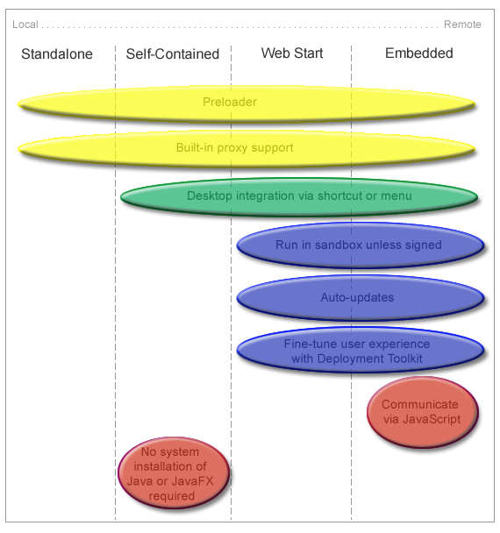
Understanding Feature Differences
Notes:
The preloader is a small JavaFX application that receives notifications about application
loading and initialization progress. The preloader is used with all execution modes, but
depending on the execution mode, the preloader implementation receives a different set of
events and optimal behavior may be different.
For example, in self-contained application or standalone execution mode or when launched
from a shortcut, the preloader will not get any loading progress events, because there is nothing
to load. See Chapter 9, "Preloaders" for information about preloader implementation and
differences in behavior.
Desktop Integration via Shortcut
Most of the operating systems allow applications to simplify subsequent launch and integrate
with the user’s desktop by creating a desktop shortcut or adding a link to the programs menu or
dock.
Built-in support for desktop shortcuts is available for self-contained and web-deployed
applications. There is no built-in support for standalone applications.
3.2.3 Built-In Proxy Support
Properly packaged JavaFX application have proxy settings initialized according to Java
Runtime configuration settings. By default, this means proxy settings will be taken from the
current browser if the application is embedded into a web page, or system proxy settings will be
used. Proxy settings are initialized by default in all execution modes.
3.2.4 Run in Sandbox Unless Signed
WebStart and embedded applications are, by default, run in a restricted environment, known as
a sandbox. In this sandbox, Java Runtime does the following:
n Protects users against malicious code that could affect local files.
n Protects enterprises against code that could attempt to access or destroy data on networks.
Applications that are not signed with a security certificate are considered to be untrusted and
are referred to as unsigned applications. When running on a client (unless launched as a
standalone application), unsigned applications operate within a security sandbox that allows
only a set of safe operations.
Unsigned applications cannot perform the following operations:
n They cannot access client resources such as the local filesystem, executable files, system
clipboard, and printers.
n They cannot connect to or retrieve resources from any third-party server (in other words,
any server other than the server it originated from).
n They cannot load native libraries.
n They cannot change the SecurityManager.
n They cannot create a ClassLoader.
n They cannot read certain system properties. See System Properties for a list of forbidden
system properties.
3.2.5 Auto-Updates
JavaFX applications that run from a web page or were earlier installed from the web
automatically check for availability of updates to the application at the original location where
the application is loaded. This happens every time an application starts, and, by default, the
update runs in the background. The application is automatically updated if updates are detected.
For standalone and self-contained applications, you are responsible for handling updates.
3.2.6 Deployment Toolkit
The Deployment Toolkit performs two important functions:
n It helps to simplify web deployment of JavaFX applications by managing updates.
n It improves the end user experience while waiting for applications to start.

Slide 9
Coding Tips
Detecting Embedded Applications
Accessing Application Parameters
Consider the Use of Host Services
Loading Resources
Resize-Friendly Applications

Slide 10
Coding Tips
Detecting Embedded Applications
public void start(Stage stage) {
boolean isEmbedded = (stage.getWidth() > 0);
…}
Application.getHostServices();
Accessing Application Parameters
Consider the Use of Host Services
Loading Resources
Resize-Friendly Applications
Notes:
When an application is run in embedded mode, it gets staged with predefined dimensions and
cannot update them directly. Example 3–1 shows a very simple code snippet to detect if the
Coding Tips
Application Execution Modes 3-5
application is embedded in the browser. The code can be used in either the main application or
the preloader start method.
Example 3–1 Detect if the Application is Embedded in the Browser
public void start(Stage stage) {
boolean isEmbedded = (stage.getWidth() > 0);
...
}
As an alternative, you can try to get a reference to the web context from the
Application.getHostServices() method. It will be null unless the applications is
embedded

Slide 11
Coding Tips
Detecting Embedded Applications
Accessing Application Parameters
Map m = getParameters().getNamed();
int cnt = 0;
String labelText = "List of application parameters: \n";
for(String st: (Set<String>) m.keySet()) {
labelText += " ["+st+"] : ["+m.get(st)+"]\n";
cnt++;
}
Consider the Use of Host Services
Loading Resources
Notes:
JavaFX applications support both named and unnamed parameters that can be passed in a
variety of ways:
n They can be specified on the command line for a standalone launch.
n They can be hardcoded in the application package (jar and deployment descriptor).
n They can be passed from the HTML page in which the application is embedded.
To access parameters from a preloader or main application, use the getParameters() method.

Slide 12
Resize-Friendly Application
public class ResizeFriendlyApp extends Application
implements ChangeListener<Number> {
private Stage stage;
public void start(Stage stage) {
//be resize friendly
this.stage = stage;
stage.widthProperty().addListener(this);
stage.heightProperty().addListener(this);
...
//resize content
resize(stage.getWidth(), stage.getHeight());
...

Slide 13
Resize-Friendly Application
stage.show();
}
private void resize(double width, double height) {
//relayout the application to match given size
}
public void changed(ObservableValue<? extends Number> ov,
Number t, Number t1) {
resize(stage.getWidth(), stage.getHeight());
}
}

Slide 14
Consider the Use of Host Services
Access to execution-mode-specific services
final HostServices services = getHostServices();
Button jsButton = new Button("Test Javascript");
jsButton.setOnAction(new EventHandler<ActionEvent>() {
public void handle(ActionEvent t) {
JSObject js = services.getWebContext();
js.eval("window.alert('Hello from JavaFX')");
}
});
Button openButton = new Button("Test openDocument()");
openButton.setOnAction(new EventHandler<ActionEvent>() {
public void handle(ActionEvent t) {
services.showDocument("http://javafx.com/");
}
});

Slide 15
Coding Tips
Detecting Embedded Applications
Accessing Application Parameters
Consider the Use of Host Services
Loading Resources
scene.getStylesheets().
add(this.getClass().getResource("my.css").toExternalForm());
Resize-Friendly Applications
Notes:
Loading Resources
Using the File API and explicit relative references to external data files or resources may not
work when the application is loaded from the web.
The best way to refer to resources relative to your application is to use the getResource()
method on one of the application classes, as shown in Example 3–4.
Example 3–4 Use the getResource() Method to Load Resources
scene.getStylesheets().
add(this.getClass().getResource("my.css").toExternalForm());
As an alternative, consider using getCodeBase() or getDocumentBase() from the
HostServices class to refer to resources relative to the application or the location where the
application is used.
3.3.5 Resize-Friendly Applications
When an application is embedded into a web page, it cannot control stage dimensions.
Dimensions you specify at packaging time are preferences only and can be overridden by the
user, for example if the user has custom browser zoom settings. Moreover, the stage can be
resized at runtime any time by the user.
To provide a good user experience, it is necessary to be prepared for arbitrary stage size.
Otherwise, the application might be cropped, or there could be garbage painted in the unused
area of the stage.
If your application uses layouts, then you do not need to do anything. Layouts take care of
resizing for you. Otherwise, implement resizing logic and listen to stage dimension changes to
update the application, as shown in the simplified code in Example 3–5.
Example 3–5 Using Listeners to Resize an Embedded Application
public class ResizeFriendlyApp extends Application implements

Slide 16
Application Startup and Pre-loaders
Notes:
The user experience (UE) is an extremely important factor for success of the application. The
way the application is deployed creates a first impression on the user and has a crucial impact
on user satisfaction, even before the application itself is ready.
Users are easily annoyed if they fail to launch the application, if they do not understand what
the next steps are, if they perceive the application to be slow or it hangs, or for other reasons.
A properly packaged and deployed JavaFX application includes tweaks for many typical user
experience problems, and with JavaFX, developers have a wide range of options to customize
the user experience for their application and its audience.

Slide 17
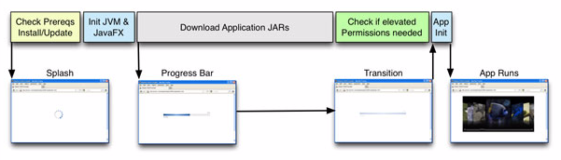
Startup Process
Initialization:
Not much can be done (Java platform not initialized yet)
Feedback by other means: JavaScript, or HTML
Notes:
There are four phases in the application startup process:
n Phase 1: Initialization
Initialization of Java Runtime and an initial examination identifies components that must
be loaded and executed before starting the application. The initialization phase is depicted
in the first two boxes in the upper row

Slide 18
Startup Process
Loading and preparation:
Resources are loaded (network or a disk)
Validation
Preloader is displayed
Notes:
There are four phases in the application startup process:
n Phase 1: Initialization
Initialization of Java Runtime and an initial examination identifies components that must
be loaded and executed before starting the application. The initialization phase is depicted
in the first two boxes in the upper row
To provide visual feedback after the initialization phase, JavaFX provides a preloader, which
gets notifications about the loading progress and can also get application-specific notifications.
By default, a default preloader with a progress bar is displayed during this phase,

Slide 19
Startup Process
Application specific initialization
Application technically started
Load additional resources
Check elevated permissions
Notes:
Phase 3: Application-specific initialization
The application is started, but it may need to load additional resources or perform other
lengthy preparations before it becomes fully functional. An example of this is checking
whether elevated permissions are needed and displaying the appropriate request for
permission to the user.

Slide 20
Startup Process
Application execution
Application displayed and ready to use
Notes:
Phase 4: Application execution
The application is displayed and is ready to use. This occurs after the background
operations shown in Figure 4–1 are finished.

Slide 21
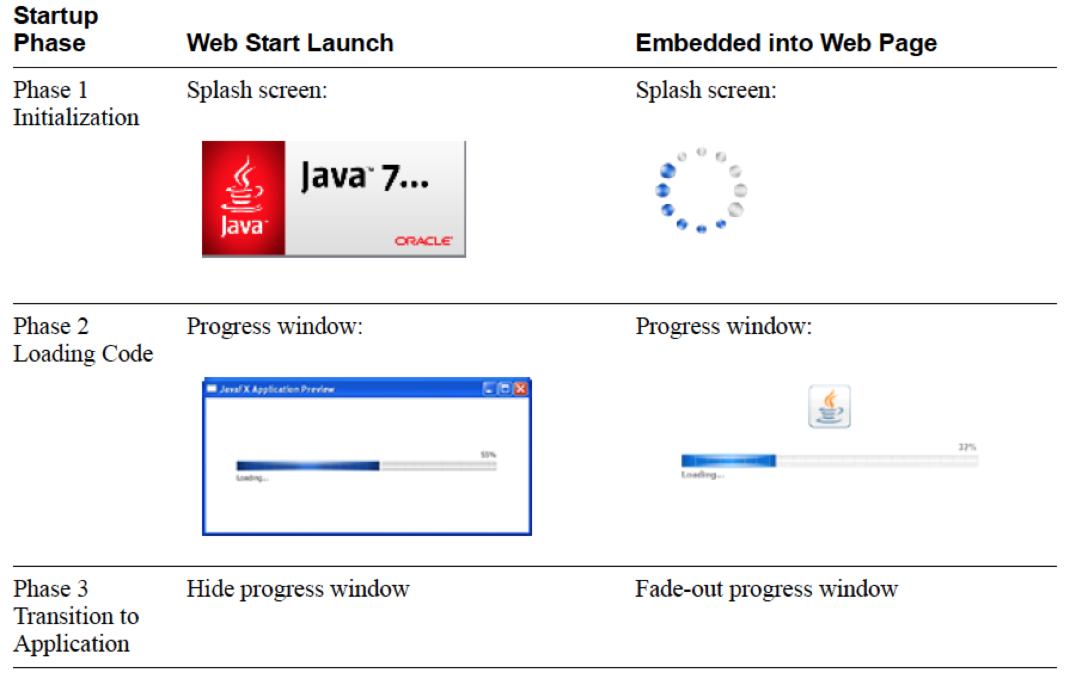
Default User Experience

Slide 22
Customization Options
Customize the preloader using CSS
My.css
.default-preloader {
-fx-background-color: yellow;
-fx-text-fill: red;
-fx-preloader-graphic: url("http://host.domain/ duke.gif");
-fx-preloader-text: "Loading, loading, LOADING!";
}
Notes:
Customization Options
The splash screen for embedded applications is displayed in the web page and can be easily
customized by using an onGetSplash callback, as shown in Section 7.2.3, "onGetSplash."
The default preloader can be customized by using a CSS stylesheet, similar to other JavaFX
components. Pass the customized style data using the
javafx.default.preloader.stylesheet parameter for your application. The value of the
parameter can be any of following:
n Absolute or relative URI of the CSS stylesheet, either as a text file with a .css extension or
in binary form with a .bss extension. For more information about binary conversion, see
Section 5.4, "Stylesheet Conversion."
n Actual CSS code.
To customize the preloader, use the .default-preloader class. In addition to standard CSS
keys, the preloader has two special keys:
n -fx-preloader-status-text
Status text to be shown in the preloader
n -fx-preloader-graphic
Absolute or relative URI of the image to be used by the preloader

Slide 23
Customization Options
Customize the preloader using CSS
Modify ant task
<fx:deploy ...>
<fx:application ...>
<fx:htmlParam name="javafx.default.preloader.stylesheet”
value="my.css"/>
<fx:application>
</fx:deploy>
Notes:
Example 4–1 Example CSS Class to Customize the Preloader
.default-preloader {
-fx-background-color: yellow;
-fx-text-fill: red;
-fx-preloader-graphic: url("http://host.domain/duke.gif");
-fx-preloader-text: "Loading, loading, LOADING!";
}
Add the stylesheet to the <fx:deploy> Ant task as shown in Example 4–2:
Example 4–2 Adding a Preloader Stylesheet to the <fx:deploy> Ant Task
<fx:deploy ...>
<fx:application ...>
<fx:htmlParam name="javafx.default.preloader.stylesheet"
value="my.css"/>
<fx:application>
</fx:deploy>
If your customizations are small, then it is more efficient to pass CSS code instead of a file
name, because there is no need to

Slide 24
Customization Options
Customize the preloader using CSS
For small changes, consider including the code directly
<fx:deploy ...>
<fx:application ...>
<!-- Using fx:param here, so it will be applicable to all web
execution environemnts -->
<fx:param name="javafx.default.preloader.stylesheet”
value=".default-preloader {
-fx-background-color: yellow; }"/>
<fx:application>
</fx:deploy>
Notes:
Example 4–1 Example CSS Class to Customize the Preloader
.default-preloader {
-fx-background-color: yellow;
-fx-text-fill: red;
-fx-preloader-graphic: url("http://host.domain/duke.gif");
-fx-preloader-text: "Loading, loading, LOADING!";
}
Add the stylesheet to the <fx:deploy> Ant task as shown in Example 4–2:
Example 4–2 Adding a Preloader Stylesheet to the <fx:deploy> Ant Task
<fx:deploy ...>
<fx:application ...>
<fx:htmlParam name="javafx.default.preloader.stylesheet"
value="my.css"/>
<fx:application>
</fx:deploy>
If your customizations are small, then it is more efficient to pass CSS code instead of a file
name, because there is no need to download the file. Example 4–3 shows to change the
background color to yellow.

Slide 25
Implementing A Custom Preloader (1/2)
public class FirstPreloader extends Preloader {
ProgressBar bar;
Stage stage;
private Scene createPreloaderScene() {
bar = new ProgressBar();
BorderPane p = new BorderPane();
p.setCenter(bar);
return new Scene(p, 300, 150);}
public void start(Stage stage) throws Exception {
this.stage = stage;
stage.setScene(createPreloaderScene());
stage.show();}
…

Slide 26
Implementing A Custom Preloader (2/2)
…
@Override
public void handleProgressNotification(ProgressNotification pn) {
bar.setProgress(pn.getProgress());
}
@Override
public void handleStateChangeNotification
(StateChangeNotification evt) {
if (evt.getType() == StateChangeNotification.Type.BEFORE_START) {
stage.hide();
}
}
}

Slide 27
Deployment Descriptor with a Preloader
...
<resources>
<j2se version="1.6+"
href="http://java.sun.com/products/autodl/j2se"/>
<jar href="lib/FirstPreloader.jar" size="2801"
download="progress" />
<jar href="AnimatedCircles.jar" size="13729" download="always" />
</resources>
<jfx:javafx-desc width="800" height="600"
main-class="animatedcircles.AnimatedCircles"
name="AnimatedCircles”
preloader-class="firstpreloader.FirstPreloader"/>
<update check="background"/>
</jnlp>

Slide 28
Packaging Basics

Slide 29
Base Application Package
An executable JAR file:
Application code and resources
Double-click for launching
Additional JAR and resource files
A deployment descriptor for web deployment (kept in the JNLP file)
HTML file:
Sample JavaScript to embed and launch the app from a web page
web-files folder for support files (NetBeans IDE only)

Slide 30
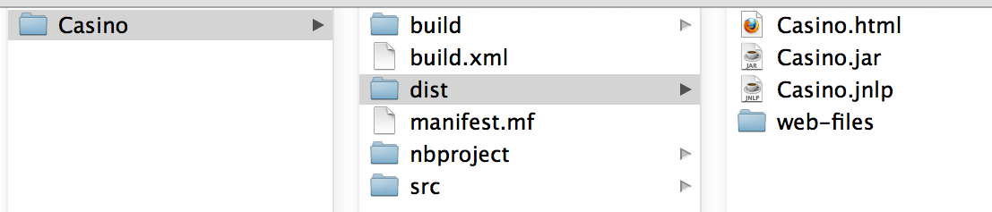
Base Application Package

Slide 31
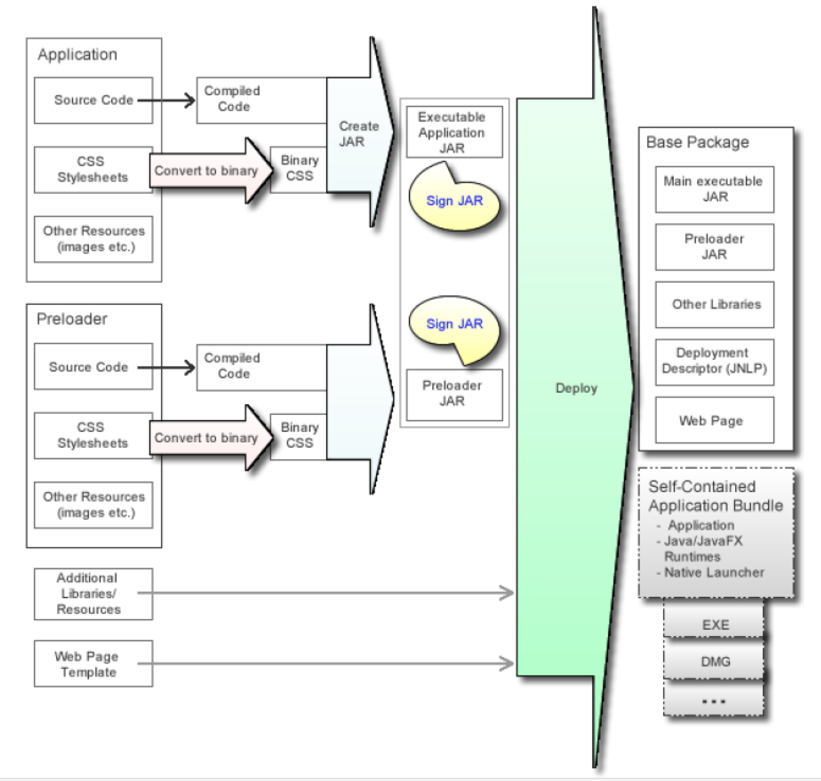
Build Process for JavaFX Applications
Notes:
New or modified steps are marked with colored arrows and described as follows:
n (Optional) Convert stylesheets to binary form
Converts CSS files to binary form to reduce parsing overhead at application runtime.
n Create JAR
Packages code and resources needed for the JavaFX application into a JAR file and
embeds the utility classes to support autodetection of JavaFX Runtime, launch on
double-click, and integration with the preloader JAR, if needed.
See Section 5.5, "Create the Main Application JAR File."
n (Optional) Sign the JAR files
Signing JAR files is needed only when the application requires elevated privileges, such as
accessing files on the local file system or accessing nonsecure system properties. Signing is
not a new concept, and you can sign the JAR files for your JavaFX application in the same
way as you would for Swing/AWT applications.
JavaFX Runtime supports a new method to sign JAR files that reduces the JAR size
overhead for signing, thereby improving the download time.
Run the Deploy task
Assembles the application package for redistribution. By default, the deploy task will
generate the base application package, but it can also generate self-contained application
packages if requested. See Section 5.7, "Run the Deploy Task or Command" and
Chapter 6, "Self-Contained Application Packaging."

Slide 32
JavaFX Packaging Tools (1 of 2)
Task | JavaFX Packager Ant Task | JavaFX Packager Tool Command | NetBeans IDE
Convert any CSS files to binary format | <fx:csstobin> | javafxpackager -createbss | Binary Encode JavaFX CSS files check box.
Create a JAR | <fx:jar> | javafxpackager -createjar | Default Build command
Note: scene.getStylesheets().add(this.getClass().getResource
("mystyles.bss").toExternalForm());
Notes:
JavaFX Packaging Tools
The recommended way to package JavaFX applications is to use a collection of Ant tasks
(ant-javafx.jar), provided with the JavaFX SDK and also with JDK 7 Update 6 or later.
NetBeans IDE uses these Ant tasks to package JavaFX projects. Embedded packaging support
in NetBeans IDE covers most of the typical use cases. However, if you need something special,
you can always tune packaging by adding custom packaging hooks to the build.xml file (for
example, as a -post-jar target).
Most of the other popular IDEs can easily use custom Ant build scripts. Other popular build
frameworks, for example Maven or Gradle, support integration with Ant also.
The JavaFX SDK and JDK 7 Update 6 or later include a command-line packaging utility,
javafxpackager, which can be used for simple packaging tasks. Note that javafxpackager
is a convenience utility and does not provide as much flexibility or as many options as Ant
tasks.
Table 5–1 summarizes how to accomplish the build steps using the various packaging tools
available. Note that javafxpackager also provides a -makeall macro command to create a
complete application package for simple applications

Slide 33
JavaFX Packaging Tools (2 of 2)
Task | JavaFX Packager Ant Task | JavaFX Packager Tool Command | NetBeans IDE
Sign a JAR archive | <fx:signjar> | javafxpackager -signJar | -Request unres-tricted access -Attach certificate
Assemble application package for deployment | <fx:deploy> | javafxpackager -deploy | Based app package created by default Self-contained apps explained later
Notes:
JavaFX Packaging Tools
The recommended way to package JavaFX applications is to use a collection of Ant tasks
(ant-javafx.jar), provided with the JavaFX SDK and also with JDK 7 Update 6 or later.
NetBeans IDE uses these Ant tasks to package JavaFX projects. Embedded packaging support
in NetBeans IDE covers most of the typical use cases. However, if you need something special,
you can always tune packaging by adding custom packaging hooks to the build.xml file (for
example, as a -post-jar target).
Most of the other popular IDEs can easily use custom Ant build scripts. Other popular build
frameworks, for example Maven or Gradle, support integration with Ant also.
The JavaFX SDK and JDK 7 Update 6 or later include a command-line packaging utility,
javafxpackager, which can be used for simple packaging tasks. Note that javafxpackager
is a convenience utility and does not provide as much flexibility or as many options as Ant
tasks.
Table 5–1 summarizes how to accomplish the build steps using the various packaging tools
available. Note that javafxpackager also provides a -makeall macro command to create a
complete application package for simple applications

Slide 34
Configure the Deployment Descriptor
Specify entry points: the main app, preloader
<fx:application>
<fx:param> and <fx:htmlParam>: app’s parameters.
Preferred application stage size (important for embedded)
<fx:info> App description
<fx:platform> Platform requirements, and JVM settings
<fx:preferences> Desktop integration preferences (adding a shortcut to the desktop)
<fx:permissions> Permissions needed to run the app
Notes:
Configure the Deployment Descriptor
The key part of this task is providing information to fill the deployment descriptor for web
deployment. This information includes:
n Entry points: the main application class, preloader class, and other details
Defined as attributes of the <fx:application> tag.
n Parameters to be passed to the application
Defined using <fx:param> and <fx:htmlParam> tags under <fx:application>.
n The preferred application stage size
It is crucial to reserve the display area for embedded content.
Width and height are defined using width and height attributes in the <fx:deploy> tag for
Ant tasks, the javafxpackager -deploy command in the javafxpackager tool, or in the Run
category of NetBeans project properties.
n A description of application to be used in any dialog boxes that the user sees during
application startup
Defined using the <fx:info> tag.
n Platform requirements, including required versions of Java and JavaFX Runtimes and
JVM settings
Note: All JAR files must be signed or unsigned in the context of a single
deployment descriptor file. If you need to mix signed and unsigned JAR files,
use an additional <fx:deploy> Ant task to generate an additional deployment
descriptor for each JAR file. These additional deployment descriptors are
called extension descriptors. Use <fx:resources> to refer to the extension
descriptors when the main descriptor is generated. For an example of how to
do this, see Using <fx:resources> for Extension Descriptors.
Run the Deploy Task or Command
5-8 Oracle JavaFX Deploying JavaFX Applications
Defined using the <fx:platform> tag. For an example, see <fx:platform> Parameter to
Specify JVM Options.
n Desktop integration preferences of the application, such as adding a shortcut to the desktop
or a reference to the Start menu.
Defined using the optional <fx:preferences> tag. See <fx:preferences> Usage Examples.
n Permissions needed to run the application.
By default web applications run in the sandbox. To request elevated permissions, use the
<fx:permissions> tag. Note that in order for permissions to be granted, application JAR
files must be signed, and the user must trust the security certificate used for signing. If the
application requests elevated permissions but requirements for the user granting
permissions are not met, then the application will fail to launch.

Slide 35
Deployment Descriptor Sample
<fx:deploy width="600" height="400"
outdir="web-dist" outfile="App">
<fx:info title="Sample application"/>
<fx:platform javafx="2.1+">
<fx:jvmarg value="-Xmx400m"/>
<fx:jvmarg value="-verbose:jni"/>
<property name="purpose" value="sample value"/>
</fx:platform>
<fx:application name="Sample app"
mainClass="test.MyApplication”
preloaderClass="testpreloader.Preloader">>
<param name="simpleParam" value="something"/>
<param name="complexParam" value="Compiled ${java.version}"/>
<param name="novalueParam"/>
</fx:application>
</fx:deploy>

Slide 36
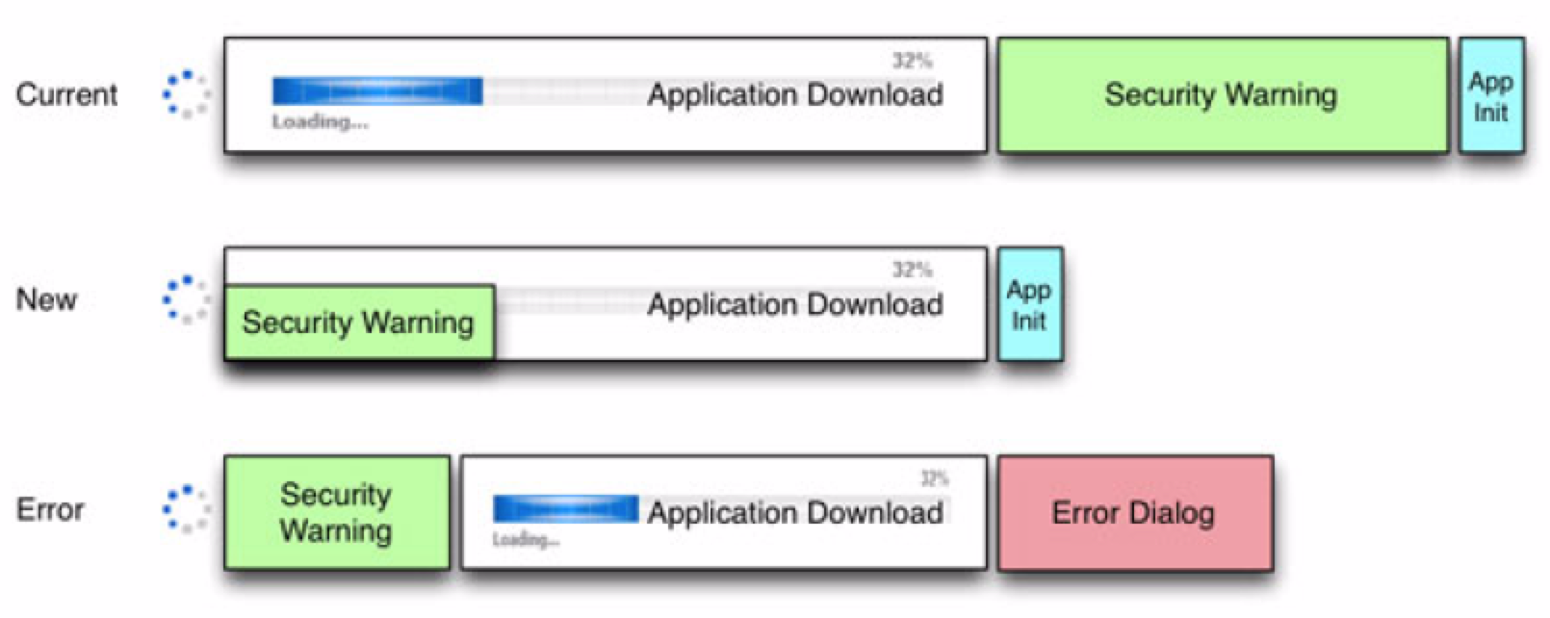
Embed Signing Certificate into Deployment Descriptor
Ant task: cachecertificates attribute of <fx:permissions>
JavaFX Packager tool: -embedCertificates
Notes:
Embed Signing Certificate into Deployment Descriptor
If the application is signed, then this option embeds into the JNLP file a copy of the details of
the certificate used to sign the JAR files. If the user needs to approve permissions, this
certificate, followed by a security prompt, is shown while the application JAR files are being
loaded,

Slide 37
Self-contained packages

Slide 38
Self-Contained Application Packaging
Basic package is simply a single folder:
Includes apps jar, Java Runtime, native launcher app, and metadata (icons)
Redistributed as is, or
Build an installable package (EXE or DMG format).
Process similar to produce a basic JavaFX app, but:
Can only be built with JDK 7 Update 6 or later
Explicitly requested in <fx:deploy>
Operating system and must be met to build a package in a specific format.
Notes:
Introduction
JavaFX packaging tools provide built-in support for several formats of self-contained
application packages. The basic package is simply a single folder on your hard drive that
includes all application resources as well as Java Runtime. It can be redistributed as is, or you
can build an installable package (for example, EXE or DMG format).
From the standpoint of process, producing a self-contained application package is very similar
to producing a basic JavaFX application package as discussed in Chapter 5, "Packaging
Basics," with the following differences:
n Self-contained application packages can only be built using JDK 7 Update 6 or later. (The
standalone JavaFX SDK does not support self-contained applications.)
n Self-contained application packages must be explicitly requested by passing additional
arguments to the <fx:deploy> Ant task or javafxpackager tool.
n Operating system and tool requirements must be met to be able to build a package in a
specific format.
While it is easy to create a basic self-contained application package, tailoring it to achieve the
best user experience for a particular distribution method usually requires some effort and a
deeper understanding of the topic.

Slide 39
Self-Contained Packages Benefits
Resemble native applications for the target platform:
Familiar installation process for user
Familiar launch process
No-hassle compatibility .
Version of JRE used by the app controlled by the app developer.
App easily deployed on fresh systems:
No requirement for installed Java runtime
Deployment occurs with no need for admin permissions when using ZIP or user-level installers
Notes:
Deciding whether the uses of self-contained application packages is the best way to deploy
your application depends on your requirements.
Self-contained application packages have several benefits:
n They resemble native applications for the target platform , in that users install the
application with an installer that is familiar to them and launch it in the usual way.
n They offer no-hassle compatibility . The version of Java Runtime used by the application
is fully controlled by the application developer.
n Your application is easily deployed on fresh systems with no requirement for Java
Runtime to be installed .
n Deployment occurs with no need for admin permissions when using ZIP or user-level
installers.

Slide 40
Self-Contained Packages Caveats
"Download and run" user experience
May need additional steps (browser security dialog…)
Larger download size
Private copy of Java Runtime is included.
Package per target platform
Platform specific
Produced for the same system that you build on.
Developer responsible for application updates
Notes:
On the other hand, there are a few caveats:
n "Download and run" user experience
Unlike web deployment, the user experience is not about "launch the application from the
web." It is more one of "download, install, and run" process, in which the user might need
to go through additional steps to get the application launched. For example, the user might
have to accept a browser security dialog, or find and launch the application installer from
the download folder.
n Larger download size
In general, the size of self-contained application packages will be noticeably larger than the
size of a standalone application, because a private copy of Java Runtime is included.
n Package per target platform
Self-contained application packages are platform specific and can only be produced for the
same system that you build on. If you want to deliver self-contained application packages
on Windows, Linux and Mac you will have to build your project on all three platforms.
n Application updates are the responsibility of developer
Web-deployed Java applications automatically download application updates from the web
as soon as they are available. The Java Autoupdate mechanism takes care of updating the
Java and JavaFX Runtimes to the latest secure version several times every year. There is no
built-in support for this in self-contained applications.

Slide 41
Basic Build
Ant Task
<fx:deploy width="${javafx.run.width}"
height="${javafx.run.height}"
nativeBundles="all"
outdir="${basedir}/${dist.dir}"
outfile="${application.title}">
<fx:application name="${application.title}"
mainClass="${javafx.main.class}"/>
<fx:resources>
<fx:fileset dir="${basedir}/${dist.dir}" includes="*.jar"/>
</fx:resources>
<fx:info title="${application.title}"
vendor="${application.vendor}"/>
</fx:deploy>

Slide 42
Basic Build
On NetBeans
Add previous code as a post-build step overriding the "-post-jfx-deploy" target
JavaFX Packager command
javafxpackager -deploy -native -outdir packages
-outfile BrickBreaker -srcdir dist -srcfiles BrickBreaker.jar
-appclass brickbreaker.Main -name "BrickBreaker"
-title "BrickBreaker demo"

Slide 43
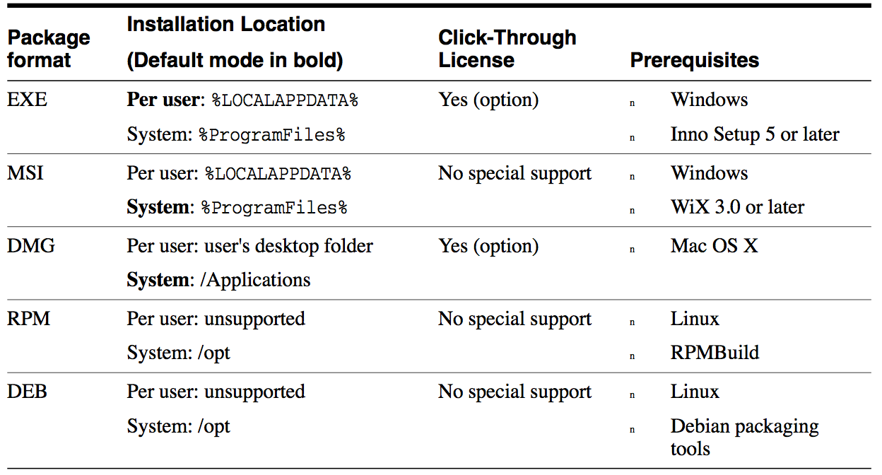
Installable Package Formats

Slide 44
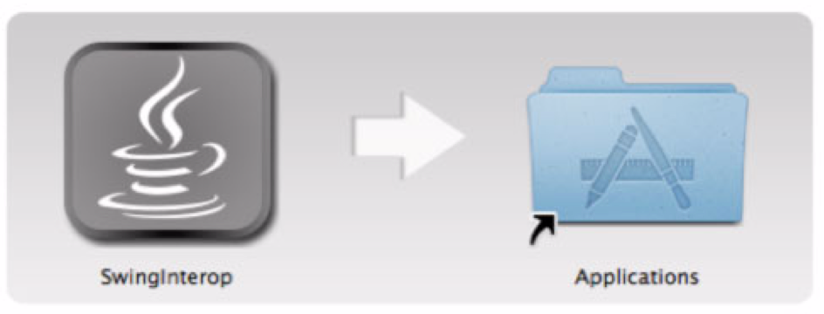
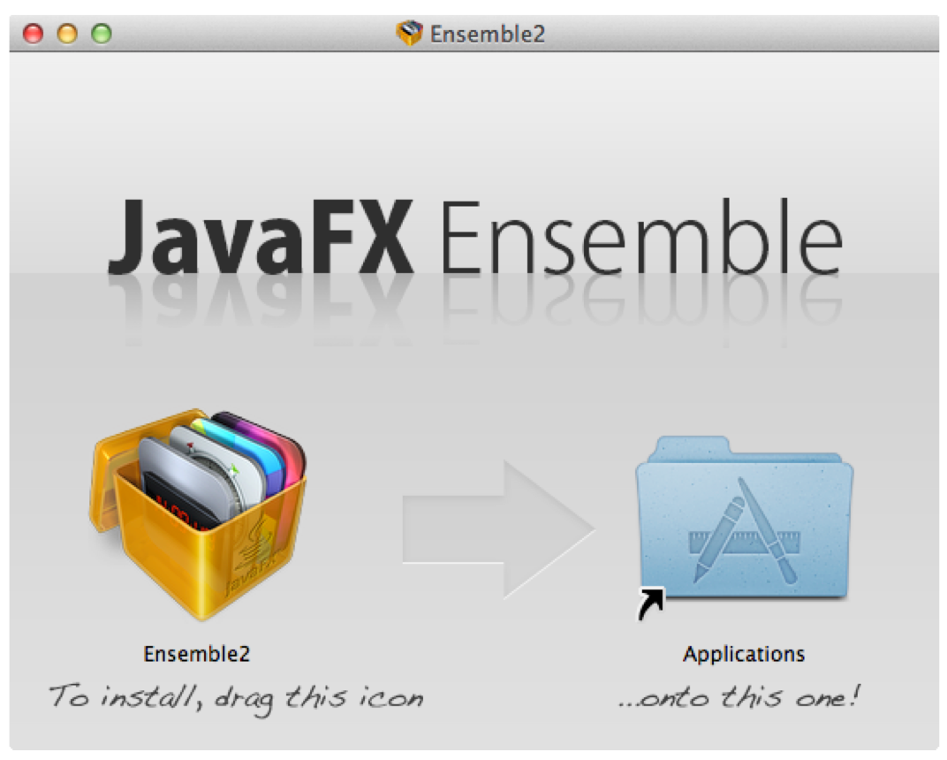
Customize your Installers

Slide 45
Deployment in the Browser
Using Deployment Toolkit Library
JavaScript API to simplify web deployment of JavaFX
Provide HTML tags to insert JavaFX content into the web page
Detects if the user environment is supported
Offers to install JavaFX Runtime if needed
Provides visual feedback while the application is loaded
Reports unexpected errors
Provides helper APIs
Import it from http://java.com/js/dtjava.js or
Have it local and use includeDT option in <fx:deploy> Ant task
Notes:
This page explains how to deploy JavaFX applications in the browser using the Deployment
Toolkit. The chapter includes an API overview, information about the callback methods, and
typical examples of use.
The recommended way to embed a JavaFX application into a web page or launch it from inside
a web browser is to use the Deployment Toolkit library.
The Deployment Toolkit provides a JavaScript API to simplify web deployment of JavaFX
applications and improve the end user experience with getting the application to start.
In addition to providing functionality to add HTML tags needed to insert JavaFX content into
the web page, the Deployment Toolkit also does the following:
n Detects whether the user environment is supported
n Offers to install the JavaFX Runtime if needed
n Provides visual feedback to the user while the application is loaded
n Reports to the user in case of unexpected error
n Provides other helper APIs to the developer, which can be used to simplify deployment and
integration with the web page

Slide 46
API Overview
dtjava.embed(app, platform, callbacks)
Embeds the app into the browser
Runtime required? User will be guided
dtjava.launch(app, platform, callbacks)
Launches applications that are deployed outside the browser
If Java installation is required:
It attempts to start the Java installer.
If not possible, popup request to install it manually.
Notes:
The Deployment Toolkit API provides several important methods:
n dtjava.embed(app, platform, callbacks)
Embeds the application into the browser based on a given application descriptor. If Java
Runtime or JavaFX Runtime installation is required, by default it will guide the user to
click to install it or click to redirect to the page to download the installer.
n dtjava.launch(app, platform, callbacks)
Launches applications that are deployed outside the browser, based on a given application
descriptor. If Java or JavaFX Runtime installation is required, then by default it performs
the following actions:
– It attempts to start the Java or JavaFX Runtime installer.
– If automated installation of the Runtime is not possible, it presents a popup request
for the user to install manually.
n dtjava.install(platform, callbacks)
Initiates installation of required components according to platform requirements.
n dtjava.validate(platform)
Validates that the user environment satisfies platform requirements (for example, if a
required version of JavaFX is available). Returns PlatformMismatchEvent describing
problems, if any.
n dtjava.hideSplash(id)
Hides the HTML splash panel for an application with a given id. If the splash panel does
not exist, this method has no effect. For JavaFX applications, this method is called
automatically after the application is ready

Slide 47
API Overview
dtjava.install(platform, callbacks)
Initiates installation of required components
dtjava.validate(platform)
Validates user environment satisfies platform requirements
Returns PlatformMismatchEvent if problems
dtjava.hideSplash(id)
Hides the HTML splash panel with a given id.
Called automatically after the application is ready
Notes:
The Deployment Toolkit API provides several important methods:
n dtjava.embed(app, platform, callbacks)
API Overview
7-2 Oracle JavaFX Deploying JavaFX Applications
Embeds the application into the browser based on a given application descriptor. If Java
Runtime or JavaFX Runtime installation is required, by default it will guide the user to
click to install it or click to redirect to the page to download the installer.
n dtjava.launch(app, platform, callbacks)
Launches applications that are deployed outside the browser, based on a given application
descriptor. If Java or JavaFX Runtime installation is required, then by default it performs
the following actions:
– It attempts to start the Java or JavaFX Runtime installer.
– If automated installation of the Runtime is not possible, it presents a popup request
for the user to install manually.
n dtjava.install(platform, callbacks)
Initiates installation of required components according to platform requirements.
n dtjava.validate(platform)
Validates that the user environment satisfies platform requirements (for example, if a
required version of JavaFX is available). Returns PlatformMismatchEvent describing
problems, if any.
n dtjava.hideSplash(id)
Hides the HTML splash panel for an application with a given id. If the splash panel does
not exist, this method has no effect. For JavaFX applications, this method is called
automatically after the application is ready

Slide 48
Application Descriptor
The application launch descriptor is an instance of the dtjava.App object.
Contains all of the details describing what needs to be launched.
dtjava.App constructor
dtjava.App(url, {attribute_map});
Attributes: id, jnlp_content, params, width, height, placeholder

Slide 49
Creating a dtjava.App Object
var app = new dtjava.App(
'ssh.jnlp',
{
id: 'SSH',
width: 100,
height: 25,
placeholder: 'SSH_application_container',
params: {
config: 'ssh_application.conf',
}
}
);

Slide 50
Callbacks
onDeployError : function(app, mismatchEvent)
onInstallFinished : function(placeholder, component, status,
relaunchNeeded)
onInstallNeeded : function(app, platform, cb, isAutoinstall,
needRelaunch, launchFunc)
onInstallStarted - function(placeholder, component, isAuto,
restartNeeded)
onGetNoPluginMessage function(app)
onGetSplash : function(app)
onJavascriptReady : function(id)
onRuntimeError : function(id)

Slide 51
JavaFX Application into the HTML Body
<head>
<script type="text/javascript"
src="http://java.com/js/dtjava.js"></script>
<script>
function deployIt() {
dtjava.embed(
{id: "myApp”,url: "Fish.jnlp”, width: 300, height: 200
placeholder: "place”},
{javafx: "2.1+" },
);
}
dtjava.addOnloadCallback(deployIt);
</script>
</head>
<body> <div id="place"></div> </body>
Notes:
Provides the java web start jnlp file (Java network launcing protocol)

Slide 52
Launch a Web Start App from a web page
<a href="my.jnlp"
onclick="dtjava.launch(new dtjava.App('my.jnlp'));
return false;">Launch me!</a>
<a href="my.jnlp"
onclick="dtjava.launch({url: 'my.jnlp'});
return false;">Launch me!</a>

Slide 53
Passing Parameters
dtjava.embed(
{ id: "myApp",
url: "Map.jnlp",
width: 300,
height: 200,
placeholder: "place",
params: {
mode: "streetview",
zip: zipcode
}
},
{ javafx: "2.1+" },
);
}

Slide 54
Specify Platform Requirements
dtjava.embed(
{ id: "myApp”, url: "Map.jnlp”, width: 300,
height: 200, placeholder: "place",
params: {
mode: "streetview”, zip: zipcode
}
},
{
jvm: "1.6.0+",
javafx: "2.1+",
jvmargs: "-Dapp.property=somevalue -Xmx1024m"
}
);
}

Slide 55
Deployment to the App Store

Slide 56
Packaging a Java App for Distribution on a Mac
Create a JAR File
Bundle the JAR File into an App Package
Bundle the JRE with the App Package
Sign the App
Submitting an App to the Mac App Store

Slide 57

Create a JAR File
Lets create a ButtonDemo.jar file.
Previous slides

Slide 58
Bundle the JAR File into an App Package (1/2)
Modify the build.xml file
<?xml version="1.0" encoding="UTF-8"?>
<project name="ButtonDemo" default="default" basedir=".">
<import file="nbproject/build-impl.xml"/>
<taskdef name="bundleapp"
classname="com.oracle.appbundler.AppBundlerTask"
classpath="lib/appbundler-1.0.jar" />
<target name="bundle-buttonDemo">
<bundleapp outputdirectory="dist"
name="ButtonDemo" displayname="Button Demo"
identifier="components.ButtonDemo"
mainclassname="components.ButtonDemo">
<classpath file="dist/ButtonDemo.jar" />
</bundleapp>
</target>
</project>

Slide 59
Bundle the JAR File into an App Package (2/2)
Install the appbundler-1.0.jar file
http://java.net/projects/appbundler
Packages a Java application as Mac app bundle
From the high-level project dir invoke the appbundler:
ant bundle-buttonDemo
This creates the ButtonDemo.app package in the dist directory.
Try to launch the app:
Double click on ButtonDemo.app
open ButtonDemo.app at command line

Slide 60
Bundle the JRE with the App Package (1/2)
Modify build.xml
<?xml version="1.0" encoding="UTF-8"?>
<project name="ButtonDemo" default="default" basedir=".">
<import file="nbproject/build-impl.xml"/>
<property environment="env" />
<taskdef name="bundleapp"
classname="com.oracle.appbundler.AppBundlerTask"
classpath="lib/appbundler-1.0ea.jar" />
<target name="bundle-buttonDemo">
<bundleapp outputdirectory="dist"
name="ButtonDemo" displayname="Button Demo"
identifier="components.ButtonDemo”
mainclassname="components.ButtonDemo">
<runtime dir="${env.JAVA_HOME}" />
<classpath file="dist/ButtonDemo.jar" />
</bundleapp>
</target> </project>
Notes:
Specify an environment property, named env: <property environment="env" />
In the target that creates the bundle, specify the location of the JRE on your system, using the env property: <runtime dir="${env.JAVA_HOME}" />

Slide 61
Bundle the JRE with the App Package (2/2)
Create a fresh version of ButtonDemo.app,
Using the ant bundle-buttonDemo command.
The resulting version includes the JRE in the app package.
Confirm this by examining the Contents/PlugIns directory inside of the app package.

Slide 62
Sign the App
Gatekeeper only allows: (see Code Signing Task from developer.apple.com)
OS X App Store apps
Developer ID signed apps
From Mountain Lion (OS X 10.8)
The signing certificate contains a field called Common Name.
Use the string from the Common Name field to sign your application.
Sign your application using codesign tool
Create and manipulate code signatures
Check with spctl tool
Manage the security assessment policy subsystem
Notes:
Sign the App
The Gatekeeper feature, introduced in Mountain Lion (OS X 10.8), allows users to set the level of security for downloaded applications. By default, Gatekeeper is set to allow only OS X App Store and Developer ID signed applications. Unless your app is signed with a Developer ID certificate provided by Apple, your application will not launch on a system with Gatekeeper's default settings.
For information on the signing certificates available, see Code Signing Tasks on developer.apple.com.
The signing certificate contains a field called Common Name. Use the string from the Common Name field to sign your application.
Sign your app using the codesign(1) tool, as shown in the following example:
% codesign -s "Developer ID Application: CommonNameFromCertificate" ExampleApp.app To verify that the app is signed, the following command provides information about the signing status of the app:
% codesign -d --verbose=4 ExampleApp.app To check whether an application can be launched when Gatekeeper is enabled, use the spctl command:
% spctl --assess --verbose=4 --type execute ExampleApp.app If you leave off the --verbose tag, and it does not print any output, indicates 'success'.
For more information, see Distributing Outside the Mac App Store on developer.apple.com.

Slide 63
Sign the App
Sign your app using the codesign(1) tool
% codesign -s "Developer ID Application:
CommonNameFromCertificate" ExampleApp.app
Verify the app is signed:
% codesign -d --verbose=4 ExampleApp.app
To check whether an application can be launched when Gatekeeper is enabled:
% spctl --assess --verbose=4 --type execute ExampleApp.app
Notes:
Sign the App
The Gatekeeper feature, introduced in Mountain Lion (OS X 10.8), allows users to set the level of security for downloaded applications. By default, Gatekeeper is set to allow only OS X App Store and Developer ID signed applications. Unless your app is signed with a Developer ID certificate provided by Apple, your application will not launch on a system with Gatekeeper's default settings.
For information on the signing certificates available, see Code Signing Tasks on developer.apple.com.
The signing certificate contains a field called Common Name. Use the string from the Common Name field to sign your application.
Sign your app using the codesign(1) tool, as shown in the following example:
% codesign -s "Developer ID Application: CommonNameFromCertificate" ExampleApp.app To verify that the app is signed, the following command provides information about the signing status of the app:
% codesign -d --verbose=4 ExampleApp.app To check whether an application can be launched when Gatekeeper is enabled, use the spctl command:
% spctl --assess --verbose=4 --type execute ExampleApp.app If you leave off the --verbose tag, and it does not print any output, indicates 'success'.
For more information, see Distributing Outside the Mac App Store on developer.apple.com.

Slide 64
Submitting an App to the Mac App Store
https://developer.apple.com/library/mac/#releasenotes/General/SubmittingToMacAppStore/_index.html#//apple_ref/doc/uid/TP40010572
And WAIT!!!!....

Slide 65
Conclussion
We are aware Deployment is a key feature in JavaFX and also Java SE
Working hard on this
Want to hear from your experience
Stay tuned for JavaOne San Francisco

Slide 66
Resources
FX Deployment docs are here: http://docs.oracle.com/javafx/2/deployment/jfxpub-deployment.htm
http://docs.oracle.com/javase/7/docs/technotes/guides/jweb/packagingAppsForMac.html
Marco Dinacci blog
http://intransitione.com/blog/take-java-to-app-store/
JavaOne 2012:
CON8224 - Deploy Your Application with OpenJDK 7 on Mac OS X CON7488 - Java Deployment on Mac OS X

Slide 67

Thank you!

