Slide 2

开启隐藏之门：无处不在的 JavaFX 部署
Angela Caicedo
Java 宣讲师
Oracle

Slide 3
演讲议题
快速入门
应用程序执行模式
应用程序启动和预加载器
打包基本知识
完备的程序包
部署到应用商店
演示

Slide 4

快速入门

Slide 5
JavaFX Packager 应当……
确保所需的 Java 和 JavaFX 运行时已安装
自动下载缺少的依赖项或者根据需要提供以安装它们
加载应用程序时向用户提供可视化反馈
显示说明性错误消息
让程序包可以在多个操作系统中随取随用
从命令行、JAR 和完备应用程序的启动器中启动
将应用程序嵌入到 Web 页面

Slide 6
应用程序执行模式

Slide 7
应用程序执行模式
执行模式 | 说明
独立 | 应用程序包在本地驱动器中可用
Web 启动 | 单击 Web 页面中的链接以从远程 Web 服务器启动应用程序。 下载应用程序 以后可从桌面快捷方式执行。
嵌入到 Web 页面中 | JavaFX 内容嵌入到 Web 页面中 页面托管于远程 Web 服务器上。
完备的应用程序 | 应用程序安装于本地驱动器上并作为独立程序而运行 使用 Java 和 JavaFX 运行时的私有副本。 作为该操作系统的原生应用程序启动
Times
Arial
Notes:
One of the main features of the JavaFX application model is that you can write one application
and easily deploy it several different ways. The user can experience the same application
running on the desktop, in a browser, or starting from a link in a web page.
However, different execution modes are not completely equivalent. There are some important
differences to keep in mind while developing the application.

Slide 8
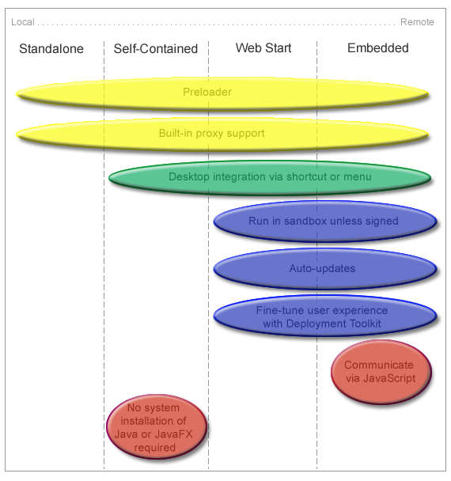
了解特性差异
Notes:
The preloader is a small JavaFX application that receives notifications about application
loading and initialization progress. The preloader is used with all execution modes, but
depending on the execution mode, the preloader implementation receives a different set of
events and optimal behavior may be different.
For example, in self-contained application or standalone execution mode or when launched
from a shortcut, the preloader will not get any loading progress events, because there is nothing
to load. See Chapter 9, "Preloaders" for information about preloader implementation and
differences in behavior.
Desktop Integration via Shortcut
Most of the operating systems allow applications to simplify subsequent launch and integrate
with the user’s desktop by creating a desktop shortcut or adding a link to the programs menu or
dock.
Built-in support for desktop shortcuts is available for self-contained and web-deployed
applications. There is no built-in support for standalone applications.
3.2.3 Built-In Proxy Support
Properly packaged JavaFX application have proxy settings initialized according to Java
Runtime configuration settings. By default, this means proxy settings will be taken from the
current browser if the application is embedded into a web page, or system proxy settings will be
used. Proxy settings are initialized by default in all execution modes.
3.2.4 Run in Sandbox Unless Signed
WebStart and embedded applications are, by default, run in a restricted environment, known as
a sandbox. In this sandbox, Java Runtime does the following:
n Protects users against malicious code that could affect local files.
n Protects enterprises against code that could attempt to access or destroy data on networks.
Applications that are not signed with a security certificate are considered to be untrusted and
are referred to as unsigned applications. When running on a client (unless launched as a
standalone application), unsigned applications operate within a security sandbox that allows
only a set of safe operations.
Unsigned applications cannot perform the following operations:
n They cannot access client resources such as the local filesystem, executable files, system
clipboard, and printers.
n They cannot connect to or retrieve resources from any third-party server (in other words,
any server other than the server it originated from).
n They cannot load native libraries.
n They cannot change the SecurityManager.
n They cannot create a ClassLoader.
n They cannot read certain system properties. See System Properties for a list of forbidden
system properties.
3.2.5 Auto-Updates
JavaFX applications that run from a web page or were earlier installed from the web
automatically check for availability of updates to the application at the original location where
the application is loaded. This happens every time an application starts, and, by default, the
update runs in the background. The application is automatically updated if updates are detected.
For standalone and self-contained applications, you are responsible for handling updates.
3.2.6 Deployment Toolkit
The Deployment Toolkit performs two important functions:
n It helps to simplify web deployment of JavaFX applications by managing updates.
n It improves the end user experience while waiting for applications to start.

Slide 9
编码技巧
检测嵌入式应用程序
访问应用程序参数
考虑使用托管服务
加载资源
便于调整大小的应用程序

Slide 10
编码技巧
检测嵌入式应用程序
public void start(Stage stage) {
boolean isEmbedded = (stage.getWidth() > 0);
…}
Application.getHostServices();
访问应用程序参数
考虑使用托管服务
加载资源
便于调整大小的应用程序
Notes:
When an application is run in embedded mode, it gets staged with predefined dimensions and
cannot update them directly. Example 3–1 shows a very simple code snippet to detect if the
Coding Tips
Application Execution Modes 3-5
application is embedded in the browser. The code can be used in either the main application or
the preloader start method.
Example 3–1 Detect if the Application is Embedded in the Browser
public void start(Stage stage) {
boolean isEmbedded = (stage.getWidth() > 0);
...
}
As an alternative, you can try to get a reference to the web context from the
Application.getHostServices() method. It will be null unless the applications is
embedded

Slide 11
编码技巧
检测嵌入式应用程序
访问应用程序参数
Map m = getParameters().getNamed();
int cnt = 0;
String labelText = "List of application parameters: \n";
for(String st: (Set<String>) m.keySet()) {
labelText += " ["+st+"] : ["+m.get(st)+"]\n";
cnt++;
}
考虑使用托管服务
加载资源
Notes:
JavaFX applications support both named and unnamed parameters that can be passed in a
variety of ways:
n They can be specified on the command line for a standalone launch.
n They can be hardcoded in the application package (jar and deployment descriptor).
n They can be passed from the HTML page in which the application is embedded.
To access parameters from a preloader or main application, use the getParameters() method.

Slide 12
便于调整大小的应用程序
public class ResizeFriendlyApp extends Application
implements ChangeListener<Number> {
private Stage stage;
public void start(Stage stage) {
//be resize friendly
this.stage = stage;
stage.widthProperty().addListener(this);
stage.heightProperty().addListener(this);
...
//resize content
resize(stage.getWidth(), stage.getHeight());
...

Slide 13
便于调整大小的应用程序
stage.show();
}
private void resize(double width, double height) {
//relayout the application to match given size
}
public void changed(ObservableValue<? extends Number> ov,
Number t, Number t1) {
resize(stage.getWidth(), stage.getHeight());
}
}

Slide 14
考虑使用托管服务
访问特定于执行模式的服务
final HostServices services = getHostServices();
Button jsButton = new Button("Test Javascript");
jsButton.setOnAction(new EventHandler<ActionEvent>() {
public void handle(ActionEvent t) {
JSObject js = services.getWebContext();
js.eval("window.alert('Hello from JavaFX')");
}
});
Button openButton = new Button("Test openDocument()");
openButton.setOnAction(new EventHandler<ActionEvent>() {
public void handle(ActionEvent t) {
services.showDocument("http://javafx.com/");
}
});

Slide 15
编码技巧
检测嵌入式应用程序
访问应用程序参数
考虑使用托管服务
加载资源
scene.getStylesheets().
add(this.getClass().getResource("my.css").toExternalForm());
便于调整大小的应用程序
Notes:
Loading Resources
Using the File API and explicit relative references to external data files or resources may not
work when the application is loaded from the web.
The best way to refer to resources relative to your application is to use the getResource()
method on one of the application classes, as shown in Example 3–4.
Example 3–4 Use the getResource() Method to Load Resources
scene.getStylesheets().
add(this.getClass().getResource("my.css").toExternalForm());
As an alternative, consider using getCodeBase() or getDocumentBase() from the
HostServices class to refer to resources relative to the application or the location where the
application is used.
3.3.5 Resize-Friendly Applications
When an application is embedded into a web page, it cannot control stage dimensions.
Dimensions you specify at packaging time are preferences only and can be overridden by the
user, for example if the user has custom browser zoom settings. Moreover, the stage can be
resized at runtime any time by the user.
To provide a good user experience, it is necessary to be prepared for arbitrary stage size.
Otherwise, the application might be cropped, or there could be garbage painted in the unused
area of the stage.
If your application uses layouts, then you do not need to do anything. Layouts take care of
resizing for you. Otherwise, implement resizing logic and listen to stage dimension changes to
update the application, as shown in the simplified code in Example 3–5.
Example 3–5 Using Listeners to Resize an Embedded Application
public class ResizeFriendlyApp extends Application implements

Slide 16
应用程序启动和预加载器
Notes:
The user experience (UE) is an extremely important factor for success of the application. The
way the application is deployed creates a first impression on the user and has a crucial impact
on user satisfaction, even before the application itself is ready.
Users are easily annoyed if they fail to launch the application, if they do not understand what
the next steps are, if they perceive the application to be slow or it hangs, or for other reasons.
A properly packaged and deployed JavaFX application includes tweaks for many typical user
experience problems, and with JavaFX, developers have a wide range of options to customize
the user experience for their application and its audience.

Slide 17
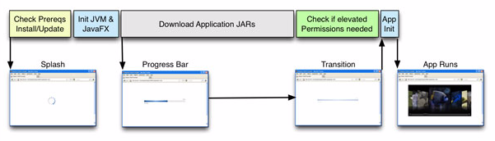
启动过程
初始化：
  没有多少可以进行的操作（Java 平台还未初始化）
  通过其他方式进行反馈：JavaScript 或 HTML
Notes:
There are four phases in the application startup process:
n Phase 1: Initialization
Initialization of Java Runtime and an initial examination identifies components that must
be loaded and executed before starting the application. The initialization phase is depicted
in the first two boxes in the upper row

Slide 18
启动过程
加载和准备：
  加载资源（网络或磁盘）
  验证
  显示预加载器
Notes:
There are four phases in the application startup process:
n Phase 1: Initialization
Initialization of Java Runtime and an initial examination identifies components that must
be loaded and executed before starting the application. The initialization phase is depicted
in the first two boxes in the upper row
To provide visual feedback after the initialization phase, JavaFX provides a preloader, which
gets notifications about the loading progress and can also get application-specific notifications.
By default, a default preloader with a progress bar is displayed during this phase,

Slide 19
启动过程
特定于应用程序的初始化
  从技术方面而言，应用程序已启动
  加载附加资源
  检查提升的权限
Notes:
Phase 3: Application-specific initialization
The application is started, but it may need to load additional resources or perform other
lengthy preparations before it becomes fully functional. An example of this is checking
whether elevated permissions are needed and displaying the appropriate request for
permission to the user.

Slide 20
启动过程
应用程序执行
  应用程序显示出来并且可以使用
Notes:
Phase 4: Application execution
The application is displayed and is ready to use. This occurs after the background
operations shown in Figure 4–1 are finished.

Slide 21
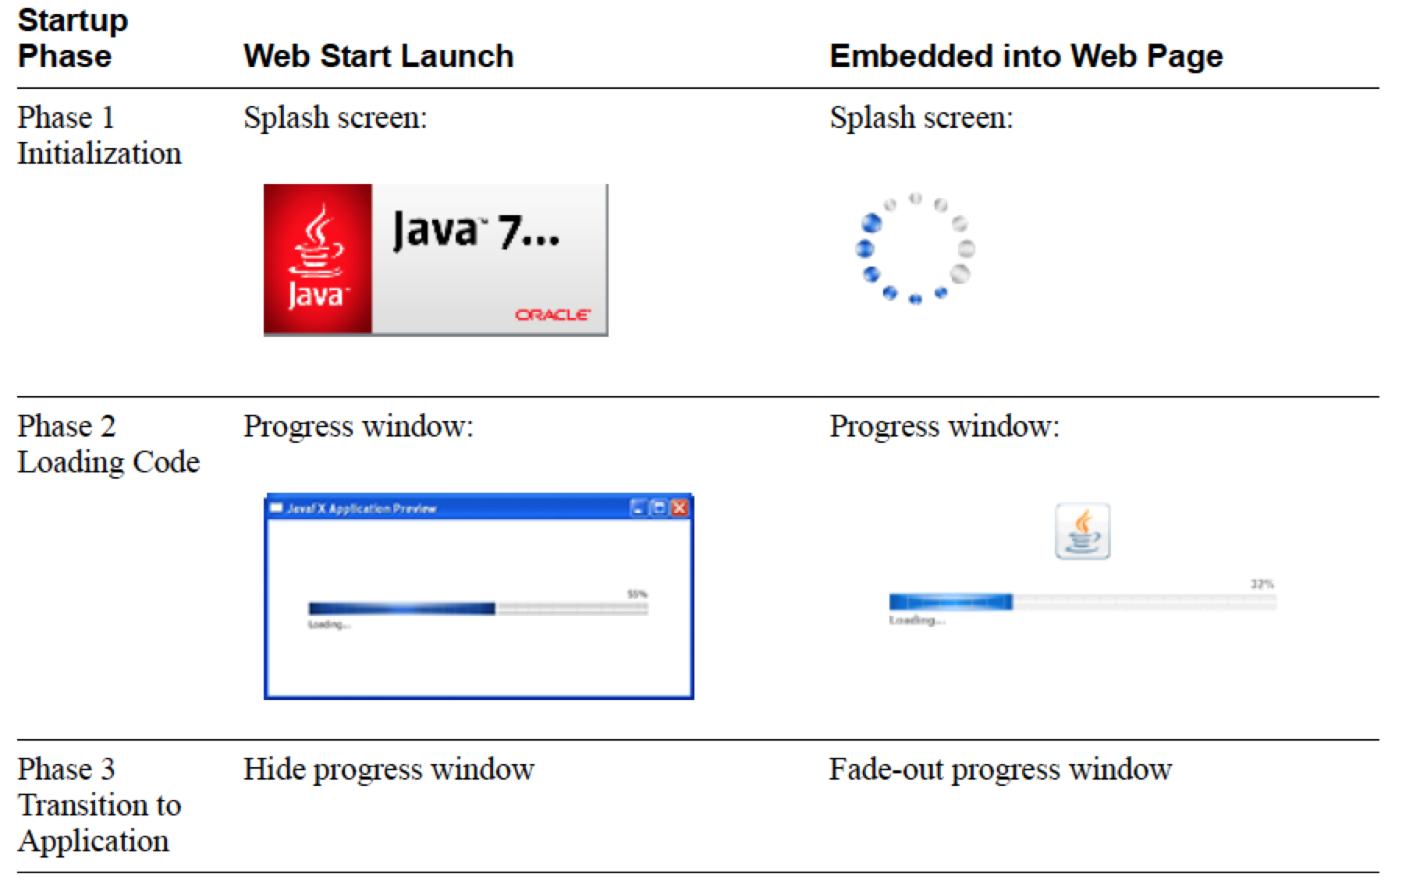
默认用户体验

Slide 22
自定义选项
使用 CSS 自定义预加载器
My.css
.default-preloader {
-fx-background-color: yellow;
-fx-text-fill: red;
-fx-preloader-graphic: url("http://host.domain/ duke.gif");
-fx-preloader-text: "Loading, loading, LOADING!";
}
Notes:
Customization Options
The splash screen for embedded applications is displayed in the web page and can be easily
customized by using an onGetSplash callback, as shown in Section 7.2.3, "onGetSplash."
The default preloader can be customized by using a CSS stylesheet, similar to other JavaFX
components. Pass the customized style data using the
javafx.default.preloader.stylesheet parameter for your application. The value of the
parameter can be any of following:
n Absolute or relative URI of the CSS stylesheet, either as a text file with a .css extension or
in binary form with a .bss extension. For more information about binary conversion, see
Section 5.4, "Stylesheet Conversion."
n Actual CSS code.
To customize the preloader, use the .default-preloader class. In addition to standard CSS
keys, the preloader has two special keys:
n -fx-preloader-status-text
Status text to be shown in the preloader
n -fx-preloader-graphic
Absolute or relative URI of the image to be used by the preloader

Slide 23
自定义选项
使用 CSS 自定义预加载器
修改 ant 任务
<fx:deploy ...>
<fx:application ...>
<fx:htmlParam name="javafx.default.preloader.stylesheet”
value="my.css"/>
<fx:application>
</fx:deploy>
Notes:
Example 4–1 Example CSS Class to Customize the Preloader
.default-preloader {
-fx-background-color: yellow;
-fx-text-fill: red;
-fx-preloader-graphic: url("http://host.domain/duke.gif");
-fx-preloader-text: "Loading, loading, LOADING!";
}
Add the stylesheet to the <fx:deploy> Ant task as shown in Example 4–2:
Example 4–2 Adding a Preloader Stylesheet to the <fx:deploy> Ant Task
<fx:deploy ...>
<fx:application ...>
<fx:htmlParam name="javafx.default.preloader.stylesheet"
value="my.css"/>
<fx:application>
</fx:deploy>
If your customizations are small, then it is more efficient to pass CSS code instead of a file
name, because there is no need to

Slide 24
自定义选项
使用 CSS 自定义预加载器
对于小的更改，考虑直接包括代码
<fx:deploy ...>
<fx:application ...>
<!-- Using fx:param here, so it will be applicable to all web
execution environemnts -->
<fx:param name="javafx.default.preloader.stylesheet”
value=".default-preloader {
-fx-background-color: yellow; }"/>
<fx:application>
</fx:deploy>
Notes:
Example 4–1 Example CSS Class to Customize the Preloader
.default-preloader {
-fx-background-color: yellow;
-fx-text-fill: red;
-fx-preloader-graphic: url("http://host.domain/duke.gif");
-fx-preloader-text: "Loading, loading, LOADING!";
}
Add the stylesheet to the <fx:deploy> Ant task as shown in Example 4–2:
Example 4–2 Adding a Preloader Stylesheet to the <fx:deploy> Ant Task
<fx:deploy ...>
<fx:application ...>
<fx:htmlParam name="javafx.default.preloader.stylesheet"
value="my.css"/>
<fx:application>
</fx:deploy>
If your customizations are small, then it is more efficient to pass CSS code instead of a file
name, because there is no need to download the file. Example 4–3 shows to change the
background color to yellow.

Slide 25
实施自定义预加载器 (1/2)
public class FirstPreloader extends Preloader {
ProgressBar bar;
Stage stage;
private Scene createPreloaderScene() {
bar = new ProgressBar();
BorderPane p = new BorderPane();
p.setCenter(bar);
return new Scene(p, 300, 150);}
public void start(Stage stage) throws Exception {
this.stage = stage;
stage.setScene(createPreloaderScene());
stage.show();}
…

Slide 26
实施自定义预加载器 (2/2)
…
@Override
public void handleProgressNotification(ProgressNotification pn) {
bar.setProgress(pn.getProgress());
}
@Override
public void handleStateChangeNotification
(StateChangeNotification evt) {
if (evt.getType() == StateChangeNotification.Type.BEFORE_START) {
stage.hide();
}
}
}

Slide 27
包含预加载器的部署描述文件
...
<resources>
<j2se version="1.6+"
href="http://java.sun.com/products/autodl/j2se"/>
<jar href="lib/FirstPreloader.jar" size="2801"
download="progress" />
<jar href="AnimatedCircles.jar" size="13729" download="always" />
</resources>
<jfx:javafx-desc width="800" height="600"
main-class="animatedcircles.AnimatedCircles"
name="AnimatedCircles”
preloader-class="firstpreloader.FirstPreloader"/>
<update check="background"/>
</jnlp>

Slide 28
打包基本知识

Slide 29
基础应用程序包
可执行的 JAR 文件；
  应用程序代码和资源
  双击可启动
附加的 JAR 和资源文件
用于 Web 部署的部署描述文件（保存在 JNLP 文件中）
HTML 文件：
  用于在 Web 页面中嵌入应用程序并从 Web 页面中启动应用程序的示例 JavaScript
web-files 文件夹，包含支持文件（仅限 NetBeans IDE）

Slide 30
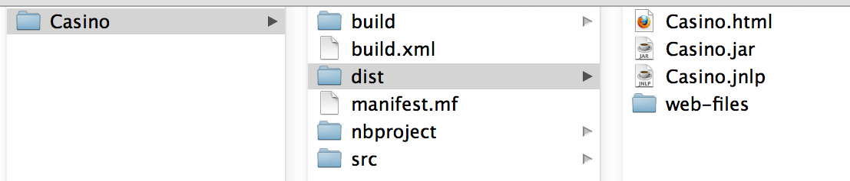
基础应用程序包

Slide 31
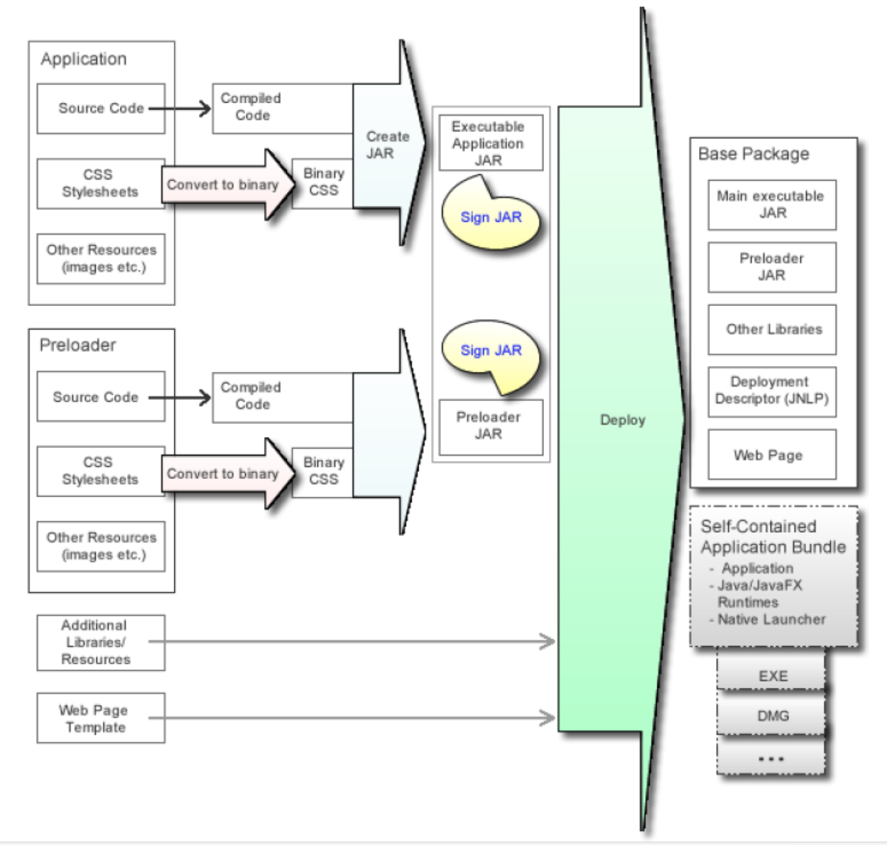
JavaFX 应用程序的生成过程
Notes:
New or modified steps are marked with colored arrows and described as follows:
n (Optional) Convert stylesheets to binary form
Converts CSS files to binary form to reduce parsing overhead at application runtime.
n Create JAR
Packages code and resources needed for the JavaFX application into a JAR file and
embeds the utility classes to support autodetection of JavaFX Runtime, launch on
double-click, and integration with the preloader JAR, if needed.
See Section 5.5, "Create the Main Application JAR File."
n (Optional) Sign the JAR files
Signing JAR files is needed only when the application requires elevated privileges, such as
accessing files on the local file system or accessing nonsecure system properties. Signing is
not a new concept, and you can sign the JAR files for your JavaFX application in the same
way as you would for Swing/AWT applications.
JavaFX Runtime supports a new method to sign JAR files that reduces the JAR size
overhead for signing, thereby improving the download time.
Run the Deploy task
Assembles the application package for redistribution. By default, the deploy task will
generate the base application package, but it can also generate self-contained application
packages if requested. See Section 5.7, "Run the Deploy Task or Command" and
Chapter 6, "Self-Contained Application Packaging."

Slide 32
JavaFX 打包工具 (1/2)
任务 | JavaFX Packager Ant 任务 | JavaFX Packager 工具命令 | NetBeans IDE
将任何 CSS 文件转换为二进制格式 | <fx:csstobin> | javafxpackager -createbss | 二进制编码 JavaFX CSS 文件复选框。
创建 JAR | <fx:jar> | javafxpackager -createjar | 默认生成命令
注意： scene.getStylesheets().add(this.getClass().getResource
("mystyles.bss").toExternalForm());
Notes:
JavaFX Packaging Tools
The recommended way to package JavaFX applications is to use a collection of Ant tasks
(ant-javafx.jar), provided with the JavaFX SDK and also with JDK 7 Update 6 or later.
NetBeans IDE uses these Ant tasks to package JavaFX projects. Embedded packaging support
in NetBeans IDE covers most of the typical use cases. However, if you need something special,
you can always tune packaging by adding custom packaging hooks to the build.xml file (for
example, as a -post-jar target).
Most of the other popular IDEs can easily use custom Ant build scripts. Other popular build
frameworks, for example Maven or Gradle, support integration with Ant also.
The JavaFX SDK and JDK 7 Update 6 or later include a command-line packaging utility,
javafxpackager, which can be used for simple packaging tasks. Note that javafxpackager
is a convenience utility and does not provide as much flexibility or as many options as Ant
tasks.
Table 5–1 summarizes how to accomplish the build steps using the various packaging tools
available. Note that javafxpackager also provides a -makeall macro command to create a
complete application package for simple applications

Slide 33
JavaFX 打包工具 (2/2)
任务 | JavaFX Packager Ant 任务 | JavaFX Packager 工具命令 | NetBeans IDE
将 JAR 存档签名 | <fx:signjar> | javafxpackager -signJar | -请求无限制访问 -附加证书
组装 用于部署的 应用程序 包 | <fx:deploy> | javafxpackager -deploy | 默认情况下创建的基本应用程序包 稍后说明完备的应用程序
Notes:
JavaFX Packaging Tools
The recommended way to package JavaFX applications is to use a collection of Ant tasks
(ant-javafx.jar), provided with the JavaFX SDK and also with JDK 7 Update 6 or later.
NetBeans IDE uses these Ant tasks to package JavaFX projects. Embedded packaging support
in NetBeans IDE covers most of the typical use cases. However, if you need something special,
you can always tune packaging by adding custom packaging hooks to the build.xml file (for
example, as a -post-jar target).
Most of the other popular IDEs can easily use custom Ant build scripts. Other popular build
frameworks, for example Maven or Gradle, support integration with Ant also.
The JavaFX SDK and JDK 7 Update 6 or later include a command-line packaging utility,
javafxpackager, which can be used for simple packaging tasks. Note that javafxpackager
is a convenience utility and does not provide as much flexibility or as many options as Ant
tasks.
Table 5–1 summarizes how to accomplish the build steps using the various packaging tools
available. Note that javafxpackager also provides a -makeall macro command to create a
complete application package for simple applications

Slide 34
配置部署描述文件
指定入口点： 主要应用程序和预加载器
<fx:application>
<fx:param> 和 <fx:htmlParam>： 应用程序的参数。
首选的应用程序舞台大小（对嵌入至关重要）
<fx:info> 应用程序说明
<fx:platform> 平台要求和 JVM 设置
<fx:preferences> 桌面集成首选项（向桌面添加快捷方式）
<fx:permissions> 运行应用程序所需的权限
Notes:
Configure the Deployment Descriptor
The key part of this task is providing information to fill the deployment descriptor for web
deployment. This information includes:
n Entry points: the main application class, preloader class, and other details
Defined as attributes of the <fx:application> tag.
n Parameters to be passed to the application
Defined using <fx:param> and <fx:htmlParam> tags under <fx:application>.
n The preferred application stage size
It is crucial to reserve the display area for embedded content.
Width and height are defined using width and height attributes in the <fx:deploy> tag for
Ant tasks, the javafxpackager -deploy command in the javafxpackager tool, or in the Run
category of NetBeans project properties.
n A description of application to be used in any dialog boxes that the user sees during
application startup
Defined using the <fx:info> tag.
n Platform requirements, including required versions of Java and JavaFX Runtimes and
JVM settings
Note: All JAR files must be signed or unsigned in the context of a single
deployment descriptor file. If you need to mix signed and unsigned JAR files,
use an additional <fx:deploy> Ant task to generate an additional deployment
descriptor for each JAR file. These additional deployment descriptors are
called extension descriptors. Use <fx:resources> to refer to the extension
descriptors when the main descriptor is generated. For an example of how to
do this, see Using <fx:resources> for Extension Descriptors.
Run the Deploy Task or Command
5-8 Oracle JavaFX Deploying JavaFX Applications
Defined using the <fx:platform> tag. For an example, see <fx:platform> Parameter to
Specify JVM Options.
n Desktop integration preferences of the application, such as adding a shortcut to the desktop
or a reference to the Start menu.
Defined using the optional <fx:preferences> tag. See <fx:preferences> Usage Examples.
n Permissions needed to run the application.
By default web applications run in the sandbox. To request elevated permissions, use the
<fx:permissions> tag. Note that in order for permissions to be granted, application JAR
files must be signed, and the user must trust the security certificate used for signing. If the
application requests elevated permissions but requirements for the user granting
permissions are not met, then the application will fail to launch.

Slide 35
部署描述文件示例
<fx:deploy width="600" height="400"
outdir="web-dist" outfile="App">
<fx:info title="Sample application"/>
<fx:platform javafx="2.1+">
<fx:jvmarg value="-Xmx400m"/>
<fx:jvmarg value="-verbose:jni"/>
<property name="purpose" value="sample value"/>
</fx:platform>
<fx:application name="Sample app"
mainClass="test.MyApplication”
preloaderClass="testpreloader.Preloader">>
<param name="simpleParam" value="something"/>
<param name="complexParam" value="Compiled ${java.version}"/>
<param name="novalueParam"/>
</fx:application>
</fx:deploy>

Slide 36
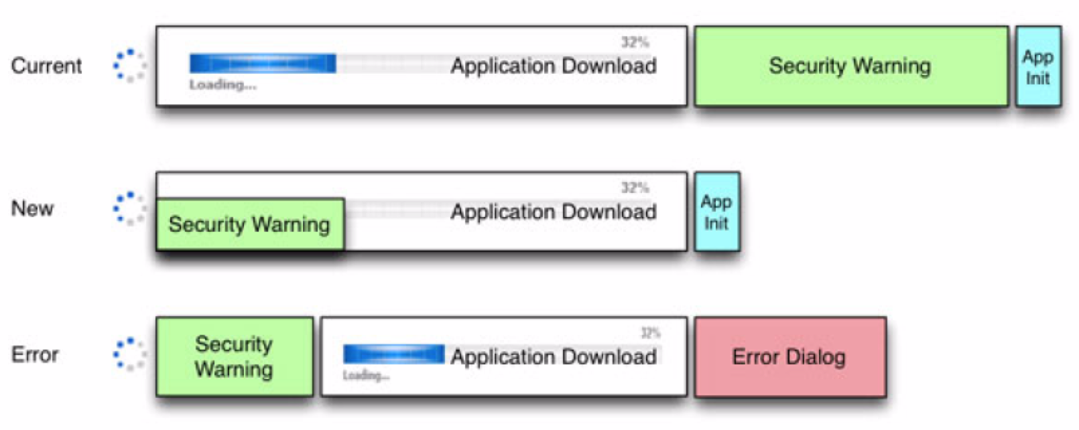
将签名证书嵌入到部署描述文件中
Ant 任务：<fx:permissions> 的 cachecertificates 属性
JavaFX Packager 工具：-embedCertificates
Notes:
Embed Signing Certificate into Deployment Descriptor
If the application is signed, then this option embeds into the JNLP file a copy of the details of
the certificate used to sign the JAR files. If the user needs to approve permissions, this
certificate, followed by a security prompt, is shown while the application JAR files are being
loaded,

Slide 37
完备的程序包

Slide 38
完备的程序包
基本程序包仅是一个文件夹：
  包括应用程序 JAR、Java 运行时、原生启动器应用程序和元数据（图标）
  按现状重新分布或
  生成可安装程序包（EXE 或 DMG 格式）。
过程类似于生成基本 JavaFX 应用程序，但是：
  仅可使用 JDK 7 Update 6 或更高版本编译生成
  在 <fx:deploy> 中明确请求
  必须满足操作系统要求才能以特定格式生成程序包。
Notes:
Introduction
JavaFX packaging tools provide built-in support for several formats of self-contained
application packages. The basic package is simply a single folder on your hard drive that
includes all application resources as well as Java Runtime. It can be redistributed as is, or you
can build an installable package (for example, EXE or DMG format).
From the standpoint of process, producing a self-contained application package is very similar
to producing a basic JavaFX application package as discussed in Chapter 5, "Packaging
Basics," with the following differences:
n Self-contained application packages can only be built using JDK 7 Update 6 or later. (The
standalone JavaFX SDK does not support self-contained applications.)
n Self-contained application packages must be explicitly requested by passing additional
arguments to the <fx:deploy> Ant task or javafxpackager tool.
n Operating system and tool requirements must be met to be able to build a package in a
specific format.
While it is easy to create a basic self-contained application package, tailoring it to achieve the
best user experience for a particular distribution method usually requires some effort and a
deeper understanding of the topic.

Slide 39
完备程序包的优点
类似于目标平台的原生应用程序：
  用户熟悉的安装过程
  熟悉的启动过程
无争议兼容。
  应用程序所使用的 JRE 版本由应用程序开发人员控制。
可在新系统上轻松部署应用程序：
  对安装的 Java 运行时无要求
使用 ZIP 或用户级安装程序时，不需要管理员权限即可进行部署
Notes:
Deciding whether the uses of self-contained application packages is the best way to deploy
your application depends on your requirements.
Self-contained application packages have several benefits:
n They resemble native applications for the target platform , in that users install the
application with an installer that is familiar to them and launch it in the usual way.
n They offer no-hassle compatibility . The version of Java Runtime used by the application
is fully controlled by the application developer.
n Your application is easily deployed on fresh systems with no requirement for Java
Runtime to be installed .
n Deployment occurs with no need for admin permissions when using ZIP or user-level
installers.

Slide 40
完备程序包的注意事项
“下载和运行”用户体验
  可能需要附加步骤（浏览器安全性对话……）
较大的下载大小
  包括 Java 运行时的私有副本。
每个目标平台的程序包
  特定于平台
  为生成时所使用的同一个系统而生成。
开发人员负责应用程序更新
Notes:
On the other hand, there are a few caveats:
n "Download and run" user experience
Unlike web deployment, the user experience is not about "launch the application from the
web." It is more one of "download, install, and run" process, in which the user might need
to go through additional steps to get the application launched. For example, the user might
have to accept a browser security dialog, or find and launch the application installer from
the download folder.
n Larger download size
In general, the size of self-contained application packages will be noticeably larger than the
size of a standalone application, because a private copy of Java Runtime is included.
n Package per target platform
Self-contained application packages are platform specific and can only be produced for the
same system that you build on. If you want to deliver self-contained application packages
on Windows, Linux and Mac you will have to build your project on all three platforms.
n Application updates are the responsibility of developer
Web-deployed Java applications automatically download application updates from the web
as soon as they are available. The Java Autoupdate mechanism takes care of updating the
Java and JavaFX Runtimes to the latest secure version several times every year. There is no
built-in support for this in self-contained applications.

Slide 41
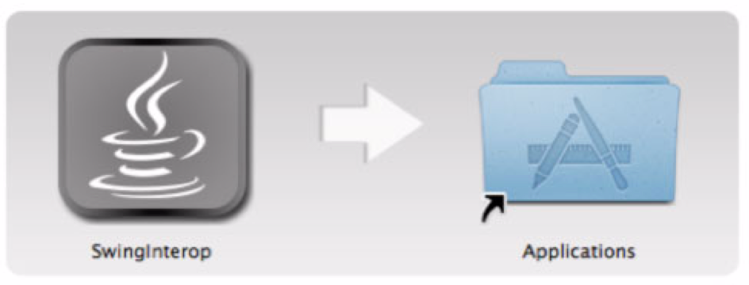
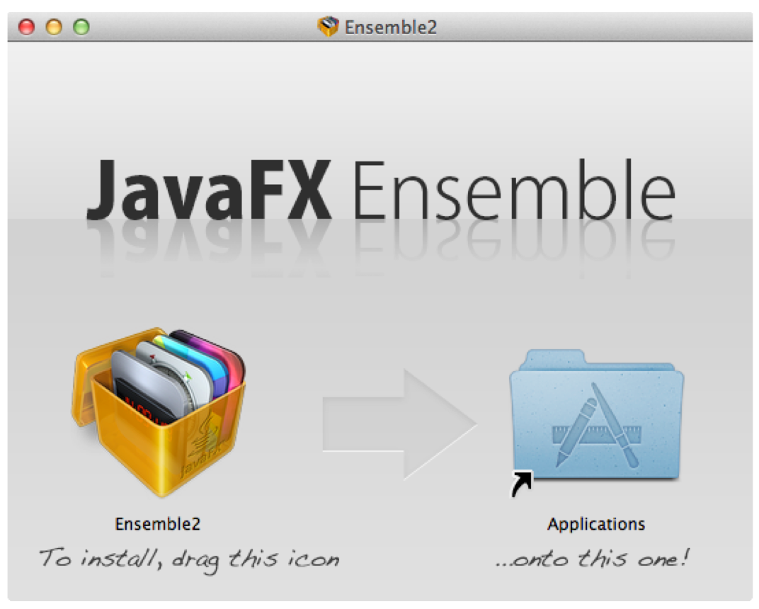
自定义安装程序

Slide 42
基础构建
Ant 任务
<fx:deploy width="${javafx.run.width}"
height="${javafx.run.height}"
nativeBundles="all"
outdir="${basedir}/${dist.dir}"
outfile="${application.title}">
<fx:application name="${application.title}"
mainClass="${javafx.main.class}"/>
<fx:resources>
<fx:fileset dir="${basedir}/${dist.dir}" includes="*.jar"/>
</fx:resources>
<fx:info title="${application.title}"
vendor="${application.vendor}"/>
</fx:deploy>

Slide 43
基础构建
在 NetBeans 上
  将先前代码作为生成后步骤添加，以覆盖 ”-post-jfx-deploy” 目标
JavaFX Packager 命令
javafxpackager -deploy -native -outdir packages
-outfile BrickBreaker -srcdir dist -srcfiles BrickBreaker.jar
-appclass brickbreaker.Main -name "BrickBreaker"
-title "BrickBreaker demo"

Slide 44
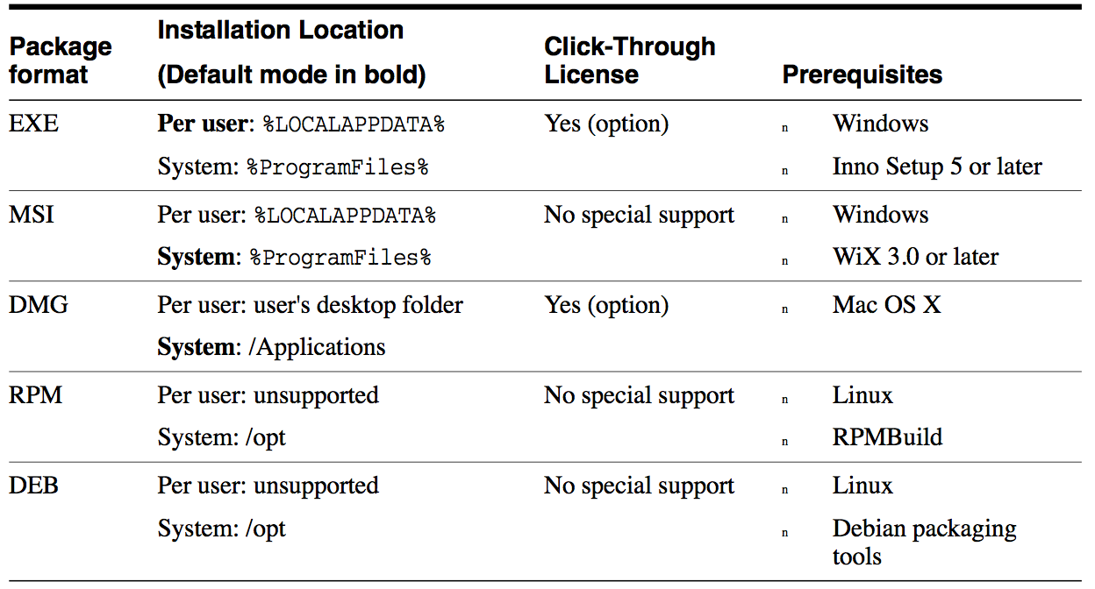
可安装程序包的格式

Slide 45
在浏览器中部署
使用部署工具包库
JavaScript API 可简化 JavaFX 的 Web 部署
提供 HTML 标签以将 JavaFX 内容插入到 Web 页面
检测用户环境是否受支持
在需要时主动安装 JavaFX 运行时
加载应用程序时提供可视化反馈
报告意外错误
提供帮助程序 API
从 http://java.com/js/dtjava.js 将其导入，或者
将其下载到本地并使用 <fx:deploy> Ant 任务中的 includeDT 选项
Notes:
This page explains how to deploy JavaFX applications in the browser using the Deployment
Toolkit. The chapter includes an API overview, information about the callback methods, and
typical examples of use.
The recommended way to embed a JavaFX application into a web page or launch it from inside
a web browser is to use the Deployment Toolkit library.
The Deployment Toolkit provides a JavaScript API to simplify web deployment of JavaFX
applications and improve the end user experience with getting the application to start.
In addition to providing functionality to add HTML tags needed to insert JavaFX content into
the web page, the Deployment Toolkit also does the following:
n Detects whether the user environment is supported
n Offers to install the JavaFX Runtime if needed
n Provides visual feedback to the user while the application is loaded
n Reports to the user in case of unexpected error
n Provides other helper APIs to the developer, which can be used to simplify deployment and
integration with the web page

Slide 46
API 概述
dtjava.embed(app, platform, callbacks)
  将应用程序嵌入到浏览器
  如果需要安装 Java/JavaFX 运行时，用户将受到指引
dtjava.launch(app, platform, callbacks)
  启动在浏览器以外部署的应用程序
  如果要求 Java 安装：
    将尝试启动 Java 安装程序。
    如果无法启动安装程序，则会弹出一条消息，要求手动安装。
Notes:
The Deployment Toolkit API provides several important methods:
n dtjava.embed(app, platform, callbacks)
Embeds the application into the browser based on a given application descriptor. If Java
Runtime or JavaFX Runtime installation is required, by default it will guide the user to
click to install it or click to redirect to the page to download the installer.
n dtjava.launch(app, platform, callbacks)
Launches applications that are deployed outside the browser, based on a given application
descriptor. If Java or JavaFX Runtime installation is required, then by default it performs
the following actions:
– It attempts to start the Java or JavaFX Runtime installer.
– If automated installation of the Runtime is not possible, it presents a popup request
for the user to install manually.
n dtjava.install(platform, callbacks)
Initiates installation of required components according to platform requirements.
n dtjava.validate(platform)
Validates that the user environment satisfies platform requirements (for example, if a
required version of JavaFX is available). Returns PlatformMismatchEvent describing
problems, if any.
n dtjava.hideSplash(id)
Hides the HTML splash panel for an application with a given id. If the splash panel does
not exist, this method has no effect. For JavaFX applications, this method is called
automatically after the application is ready

Slide 47
API 概述
dtjava.launch(app, platform, callbacks)
  初始化所需组件的安装
dtjava.validate(platform)
  验证用户环境是否满足平台要求
  如果不满足，则返回 PlatformMismatchEvent
dtjava.hideSplash(id)
  使用给定的 ID 隐藏 HTML 闪面板。
  应用程序就绪后自动调用
Notes:
The Deployment Toolkit API provides several important methods:
n dtjava.embed(app, platform, callbacks)
API Overview
7-2 Oracle JavaFX Deploying JavaFX Applications
Embeds the application into the browser based on a given application descriptor. If Java
Runtime or JavaFX Runtime installation is required, by default it will guide the user to
click to install it or click to redirect to the page to download the installer.
n dtjava.launch(app, platform, callbacks)
Launches applications that are deployed outside the browser, based on a given application
descriptor. If Java or JavaFX Runtime installation is required, then by default it performs
the following actions:
– It attempts to start the Java or JavaFX Runtime installer.
– If automated installation of the Runtime is not possible, it presents a popup request
for the user to install manually.
n dtjava.install(platform, callbacks)
Initiates installation of required components according to platform requirements.
n dtjava.validate(platform)
Validates that the user environment satisfies platform requirements (for example, if a
required version of JavaFX is available). Returns PlatformMismatchEvent describing
problems, if any.
n dtjava.hideSplash(id)
Hides the HTML splash panel for an application with a given id. If the splash panel does
not exist, this method has no effect. For JavaFX applications, this method is called
automatically after the application is ready

Slide 48
应用程序描述文件
应用程序启动描述文件是 dtjava.App 对象的实例。
包含对需要启动的所有对象的详细说明。
dtjava.App constructor
  dtjava.App(url, {attribute_map});
  Attributes: id, jnlp_content, params, width, height, placeholder

Slide 49
创建 dtjava.App 对象
var app = new dtjava.App(
'ssh.jnlp',
{
id: 'SSH',
width: 100,
height: 25,
placeholder: 'SSH_application_container',
params: {
config: 'ssh_application.conf',
}
}
);

Slide 50
回调
onDeployError : function(app, mismatchEvent)
onInstallFinished : function(placeholder, component, status,
relaunchNeeded)
onInstallNeeded : function(app, platform, cb, isAutoinstall,
needRelaunch, launchFunc)
onInstallStarted - function(placeholder, component, isAuto,
restartNeeded)
onGetNoPluginMessage function(app)
onGetSplash : function(app)
onJavascriptReady : function(id)
onRuntimeError : function(id)

Slide 51
将 JavaFX 应用程序嵌入到 HTML 正文
<head>
<script type="text/javascript"
src="http://java.com/js/dtjava.js"></script>
<script>
function deployIt() {
dtjava.embed(
{id: "myApp”, url: "Fish.jnlp”, width: 300, height: 200
placeholder: "place”},
{javafx: "2.1+" },
);
}
dtjava.addOnloadCallback(deployIt);
</script>
</head>
<body> <div id="place"></div> </body>
Notes:
Provides the java web start jnlp file (Java network launcing protocol)

Slide 52
从 Web 页面启动 Web Start 应用程序
<a href="my.jnlp"
onclick="dtjava.launch(new dtjava.App('my.jnlp'));
return false;">Launch me!</a>
<a href="my.jnlp"
onclick="dtjava.launch({url: 'my.jnlp'});
return false;">Launch me!</a>

Slide 53
传递参数
dtjava.embed(
{ id: "myApp",
url: "Map.jnlp",
width: 300,
height: 200,
placeholder: "place",
params: {
mode: "streetview",
zip: zipcode
}
},
{ javafx: "2.1+" },
);
}

Slide 54
指定平台要求
dtjava.embed(
{ id: "myApp”, url: "Map.jnlp”, width: 300,
height: 200, placeholder: "place",
params: {
mode: "streetview”, zip: zipcode
}
},
{
jvm: "1.6.0+",
javafx: "2.1+",
jvmargs: "-Dapp.property=somevalue -Xmx1024m"
}
);
}

Slide 55
部署到应用商店

Slide 56
打包 Java 应用程序以在 Mac 上分发
创建 JAR 文件
将 JAR 文件捆绑到应用程序包中
将 JRE 与应用程序包捆绑
为应用程序签名
将应用程序提交到 Mac App Store

Slide 57

创建 JAR 文件
我们来创建一个 ButtonDemo.jar 文件。
先前的幻灯片

Slide 58
将 JAR 文件捆绑到应用程序包中 (1/2)
修改 build.xml 文件
<?xml version="1.0" encoding="UTF-8"?>
<project name="ButtonDemo" default="default" basedir=".">
<import file="nbproject/build-impl.xml"/>
<taskdef name="bundleapp"
classname="com.oracle.appbundler.AppBundlerTask"
classpath="lib/appbundler-1.0.jar" />
<target name="bundle-buttonDemo">
<bundleapp outputdirectory="dist"
name="ButtonDemo" displayname="Button Demo"
identifier="components.ButtonDemo"
mainclassname="components.ButtonDemo">
<classpath file="dist/ButtonDemo.jar" />
</bundleapp>
</target>
</project>

Slide 59
将 JAR 文件捆绑到应用程序包中 (2/2)
安装 appbundler-1.0.jar 文件
  http://java.net/projects/appbundler
  将 Java 应用程序作为 Mac 应用程序捆绑进行打包
从高级项目目录调用 appbundler：
  ant bundle-buttonDemo
  这将在 dist 目录中创建 ButtonDemo.app 程序包。
尝试启动应用程序：
  双击 ButtonDemo.app
  将在命令行中打开 ButtonDemo.app

Slide 60
将 JRE 与应用程序包捆绑 (1/2)
修改 build.xml
<?xml version="1.0" encoding="UTF-8"?>
<project name="ButtonDemo" default="default" basedir=".">
<import file="nbproject/build-impl.xml"/>
<property environment="env" />
<taskdef name="bundleapp"
classname="com.oracle.appbundler.AppBundlerTask"
classpath="lib/appbundler-1.0ea.jar" />
<target name="bundle-buttonDemo">
<bundleapp outputdirectory="dist"
name="ButtonDemo" displayname="Button Demo"
identifier="components.ButtonDemo”
mainclassname="components.ButtonDemo">
<runtime dir="${env.JAVA_HOME}" />
<classpath file="dist/ButtonDemo.jar" />
</bundleapp>
</target> </project>
Notes:
Specify an environment property, named env: <property environment="env" />
In the target that creates the bundle, specify the location of the JRE on your system, using the env property: <runtime dir="${env.JAVA_HOME}" />

Slide 61
将 JRE 与应用程序包捆绑 (2/2)
创建 ButtonDemo.app 的新版本
  使用 ant bundle-buttonDemo 命令。
生成的版本在应用程序包中包括 JRE。
  通过检查应用程序包中的 Contents/PlugIns 目录进行确认。

Slide 62
为应用程序签名
网关守卫仅允许：（从 developer.apple.com 查看代码签名任务）
  OS X App Store 应用程序
  开发人员 ID 签名的应用程序
  从 Mountain Lion（OS X 10.8）
签名证书包含名为 Common Name 的字段。
  使用 Common Name 字段中的字符串为应用程序签名。
使用 codesign 工具为应用程序签名
  创建并处理代码签名
使用 spctl 工具检查
  管理安全评估策略子系统
Notes:
Sign the App
The Gatekeeper feature, introduced in Mountain Lion (OS X 10.8), allows users to set the level of security for downloaded applications. By default, Gatekeeper is set to allow only OS X App Store and Developer ID signed applications. Unless your app is signed with a Developer ID certificate provided by Apple, your application will not launch on a system with Gatekeeper's default settings.
For information on the signing certificates available, see Code Signing Tasks on developer.apple.com.
The signing certificate contains a field called Common Name. Use the string from the Common Name field to sign your application.
Sign your app using the codesign(1) tool, as shown in the following example:
% codesign -s "Developer ID Application: CommonNameFromCertificate" ExampleApp.app To verify that the app is signed, the following command provides information about the signing status of the app:
% codesign -d --verbose=4 ExampleApp.app To check whether an application can be launched when Gatekeeper is enabled, use the spctl command:
% spctl --assess --verbose=4 --type execute ExampleApp.app If you leave off the --verbose tag, and it does not print any output, indicates 'success'.
For more information, see Distributing Outside the Mac App Store on developer.apple.com.

Slide 63
为应用程序签名
使用 codesign(1) 工具为应用程序签名
% codesign -s "Developer ID Application:
CommonNameFromCertificate" ExampleApp.app
验证应用程序是否签署：
% codesign -d --verbose=4 ExampleApp.app
启用网管守卫时检查应用程序是否可以启动：
% spctl --assess --verbose=4 --type execute ExampleApp.app
Notes:
Sign the App
The Gatekeeper feature, introduced in Mountain Lion (OS X 10.8), allows users to set the level of security for downloaded applications. By default, Gatekeeper is set to allow only OS X App Store and Developer ID signed applications. Unless your app is signed with a Developer ID certificate provided by Apple, your application will not launch on a system with Gatekeeper's default settings.
For information on the signing certificates available, see Code Signing Tasks on developer.apple.com.
The signing certificate contains a field called Common Name. Use the string from the Common Name field to sign your application.
Sign your app using the codesign(1) tool, as shown in the following example:
% codesign -s "Developer ID Application: CommonNameFromCertificate" ExampleApp.app To verify that the app is signed, the following command provides information about the signing status of the app:
% codesign -d --verbose=4 ExampleApp.app To check whether an application can be launched when Gatekeeper is enabled, use the spctl command:
% spctl --assess --verbose=4 --type execute ExampleApp.app If you leave off the --verbose tag, and it does not print any output, indicates 'success'.
For more information, see Distributing Outside the Mac App Store on developer.apple.com.

Slide 64
将应用程序提交到 Mac App Store
https://developer.apple.com/library/mac/#releasenotes/General/SubmittingToMacAppStore/_index.html#//apple_ref/doc/uid/TP40010572
更多精彩，敬请期待……

Slide 65
总结
我们意识到，部署是 JavaFX 以及 Java SE 的关键特性
致力于此
希望倾听您的体验
敬请关注 JavaOne San Francisco

Slide 66
资源
FX 部署文档位于： http://docs.oracle.com/javafx/2/deployment/jfxpub-deployment.htm
http://docs.oracle.com/javase/7/docs/technotes/guides/jweb/packagingAppsForMac.html
Marco Dinacci 博客
  http://intransitione.com/blog/take-java-to-app-store/
JavaOne 2012：
    CON8224 — 在 Mac OS X 上使用 OpenJDK 7 部署应用程序 CON7488 — 在 Mac OS X 上进行 Java 部署

Slide 67

谢谢！

