Slide 2

From Invokedynamic to Project Nashorn
Simon Ritter
Java Technology Evangelist
Twitter: @speakjava

Slide 3

Program
Agenda
The invokedynamic bytecode
Dynamically typed languages on the JVM – Implementation
Project Nashorn
Future Directions

Slide 4
Invokedynamic
First time a new bytecode was introduced in the history of the JVM specification
A new type of call
  Previously: invokestatic, invokevirtual, invokeinterface and invokespecial
Notes:
Bytecodes are 8-bit, so only 256 slots available (250 used so far – check)

Slide 5
Invokedynamic
Basic idea: It’s a function pointer
  Make a method call without standard JVM checks
  Enables completely custom linkage
  Essential for hotswap method call targets
Not used by javac currently
  JDK8 will use it for Lambda expressions
Used by compilers for dynamically typed languages

Slide 6
invokedynamic bytecode
calls
Bootstrap Method
Bootstrap Method
returns
java.lang.invoke.CallSite
contains
Target
(java.lang.invoke.MethodHandle)
6
Notes:
Bootstrap method is a Java method
CallSite contains a method handle

Slide 7
Invokedynamic
20: invokedynamic #97,0
// InvokeDynamic #0:”func”:(Ljava/lang/Object;
Ljava/lang/Object;)V
public static CallSite bootstrap(
final MethodHandles.Lookup lookup,
final String name,
final MethodType type,
Object… callsiteSpecificArgs) {
MethodHandle target = f(
name,
callSiteSpecificArgs);
// do stuff
CallSite cs = new MutableCallSite(target);
// do stuff
return cs;
}
java.lang.invoke.CallSite
One invokedynamic for each callsite
Returned by the bootstrap call
Holder for a MethodHandle
  MethodHandle is the target
  Target may/may not be mutable
  getTarget / setTarget
Notes:
If the target is immutable the JVM knows that it can optimise it through things like inlining

Slide 8
Invokedynamic
java.lang.invoke.MethodHandle
Concept: “This is your function pointer”
MethodType mt =
MethodType.methodType(String.class,
char.class, char.class);
MethodHandle mh =
lookup.findVirtual(String.class, "replace", mt);
String s = (String)mh.invokeExact("daddy", 'd', 'n');
assert "nanny".equals(s) : s;
Notes:
Combination of class name and method type is used to generate a method handle
Reflection based technique

Slide 9
Invokedynamic
java.lang.invoke.MethodHandle
Concept: “This is your function pointer”
Logic may be woven into:
  Guards
  c = if (guard) a(); else b();
  Parameter transforms/binding
MethodHandle add =
MethodHandles.guardWithTest(
isInteger,
addInt
addDouble);
Notes:
The idea here is to combine methodHandles to give you new functionality.
The ‘guard’ is a function that determines which MethodHandle is used to when calling the method.
This can all be done without generating bytecodes directly, as it is done in Java

Slide 10
Invokedynamic
java.lang.invoke.MethodHandle
MethodHandle add =
MethodHandles.guardWithTest(
isInteger,
addInt
addDouble);
Concept: “This is your function pointer”
Logic may be woven into:
  Guards
  c = if (guard) a(); else b();
  Parameter transforms/binding
Switchpoints
  Function of two MethodHandles, a and b
  Invalidation: rewrite a to b
SwitchPoint sp = new SwitchPoint();
MethodHandle add = sp.guardWithTest(
addInt,
addDouble);
// do stuff
if (notInts())
sp.invalidate();
}
Notes:
switchpoints allow the pointer being used to be changed asynchronously

Slide 11
Invokedynamic
Performance in the JVM
JVM knows a CallSite target and can in-line it
  No strange workaround machinery involved
  Standard adaptive runtime assumptions, e.g. guard taken
Superior performance
  At least, in theory
  Rapid changing of CallSite targets will result in de-optimised code from the JVM
Notes:
Rapid changing = megamorphic call sites

Slide 12




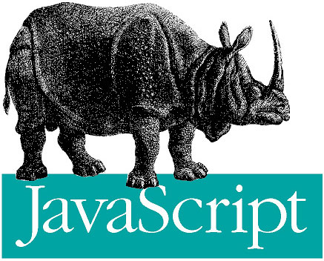

Implementing Dynamic Languages on the JVM
12

Slide 13
Dynamic Languages on the JVM
Hows and Whys
I want to implement a dynamically typed language on the JVM
Bytecodes are already platform neutral
So, what’s the problem?
Although the JVM knows nothing about Java syntax
  It was designed with Java in mind
  Rewriting CallSites
  The real problem is types

Slide 14
The Problem With Changing Assumptions
Runtime assumptions typically change a lot more than with Java
Let’s say dynamic code deletes a field
  We need to change where the getter method goes
  All places that make assumptions about this object’s layout must be updated
Let’s say you redefine Math.sin to always return 17
Let’s say you set func.constructor to always return 3
Valid, but pretty stupid…

Slide 15
The Problem With Weak Types
Consider this Java method
In Java, int types are known at compile time
If you want to add doubles, go somewhere else
int sum(int a, int b) {
return a + b;
}
iload_1
iload_2
iadd
ireturn
Notes:
The method has the word int in it three times. Strongly typed.
Note that the bytecdes are prefixed with an i to indicate integer.

Slide 16
The Problem With Weak Types
Consider instead this JavaScript function
Not sure…
  a and b are something…
  that can be added
The + operator can do a large number of horrible things
  The horror that is operator overloading, e.g. String concatenation
function sum(a, b) {
return a + b;
}
???
???
???
Notes:
In the function we do not see the word in anywhere

Slide 17
The Problem With Weak Types
More Details
In JavaScript, a and b mights start out as ints that fit into 32-bits
  But addition may overflow and change the result to a long
  …or a double
  A JavaScript “number” is a rather fuzzy concept to the JVM
  True for other languages, like Ruby, as well
Type inference at compile time is just too weak
Notes:
In Java adding two very large integers that give overflow will probably give you a negative numbe.

Slide 18
How To Solve The Weak Type Problem
For The JVM
Gamble
Remember the axiom of adaptive runtime behaviour
  Worst cases probably don’t happen
  If and when they do, take the penalty then, not now
function sum(a, b) {
try {
int sum = (Integer)a + (Integer)b;
checkIntOverflow(a, b, sum);
return sum;
} catch (OverFlowException | ClassCastException e) {
return sumDoubles(a, b);
}
}

Slide 19
How To Solve The Weak Type Problem
For The JVM
Type specialisation is the key
Previous example does not use Java SE 7+ features
Let’s make it more generic
final MethodHandle sumHandle = MethodHandles.guardWithTest(
intsAndNotOverflow,
sumInts,
sumDoubles);
function sum(a, b) {
return sumHandle(a, b);
}

Slide 20
Alternative Approach
Use mechanism rather than guards
  Rewrite the MethodHandle on a ClassCastException
  switchPoints
Approach can be extended to Strings and other objects
Compile-time types should be used if they are available
Ignore integer overflows for now
  Primitive to object representation is another common scenario
  Combine runtime analysis and invalidation with static types from JavaScript compiler

Slide 21
Specialise The sum Function For This CallSite
Using doubles will run faster than semantically equivalent objects
  That’s why Java has primitives
Nice and short, just 4 bytecodes and no calls into runtime
// specialized double sum
sum(DD)D:
dload_1
dload_2
dadd
dreturn

Slide 22
What If It Gets Overwritten?
Dynamic means things change
What if the program does this between callsites?
Use a switchPoint, generate a revert stub
  Doesn’t need to be explicit bytecode
CallSite now points to the revert stub, not the double specialisation
sum = function(a, b) {
return a + ‘string’ + b;
}
)

Slide 23
Revert Stubs
None of the revert stub needs to be generated as explicit bytecodes
  MethodHandle combinators suffice
sum(DD)D:
dload_1
dload_2
dadd
dreturn
sum_revert(DD)D: //hope this doesn’t happen
dload_1
invokestatic JSRuntime.toObject(D)
dload_2
invokestatic JSRuntime.toObject(D)
invokedynamic sum(OO)O
invokestatic JSRuntime.toNumber(O)
dreturn

Slide 24
Field Representation
Assume field types do not change
  If they do they converge on a final type quickly
Internal type representation can be a field, several fields or a “tagged value”
  Reduce data badwidth
  Reduce boxing
Remember undefined
  Representation problems
var x;
print(x); // getX()O
x = 17; // setX(I)
print(x); // getX()O
x *= 4711.17; // setX(D)
print(x); // getX()O
x += “string”; // setX(O)
print(x); // getX()OO
// naïve impl
// don’t do this
class XObject {
int xi;
double xd;
Object xo;
}

Slide 25
Field Representation
Getters On The Fly – Use switchPoints
No actual code – generated by MethodHandle
int getXWhenUndefined()I {
return 0;
}
double getXWhenUndefined()D {
return NaN;
}
Object getXWhenUndefined()O {
return Undefined.UNDEFINED;
}
}
int getXWhenInt()I {
return xi;
}
double getXWhenInt()D {
return JSRuntime.toNumber(xi);
}
Object getXWhenInt()O {
return JSRuntime.toObject(xi)
};
}
int getXWhenDouble()I {
return JSRuntime.toInt32(xd);
}
double getXWhenDouble()D {
return xd;
}
Object getXWhenDouble()O {
return JSRuntime.toObj(xd);
}
int getXWhenObject()I {
return JSRuntime.toInt32(xo);
}
double getXWhenObject()D {
return JSRuntime.toNumber(xo);
}
Object getXWhenObject()O {
return xo;
}

Slide 26
Field Representation
Setters
Setters to a wider type, T, trigger all switchPoints up to that point
void setXWhenInt(int i) {
this.xi = i; //we remain an int, woohoo!
}
void setXWhenInt(double d) {
this.xd = d;
SwitchPoint.invalidate(xToDouble);
//invalidate next switchpoint, now a double;
}
void setXWhenInt(Object o) {
this.xo = o;
SwitchPoint.invalidate(xToDouble, xToObject)
//invalidate all remaining switchpoints, now an Object forevermore.
}

Slide 27
Tagged Values
One of the worst problems for dynamic languages on the JVM is primitive boxing
A primitive value should not have an object overhead
  Allocation / boxing / unboxing
  The JVM cannot remove all of these
Need a way to interleave primitives with object references
Doing it for the whole JVM would be very disruptive
Tagged arrays – a work in progress

Slide 28
The Nashorn Project
JavaScript using
invokedynamic
28

Slide 29
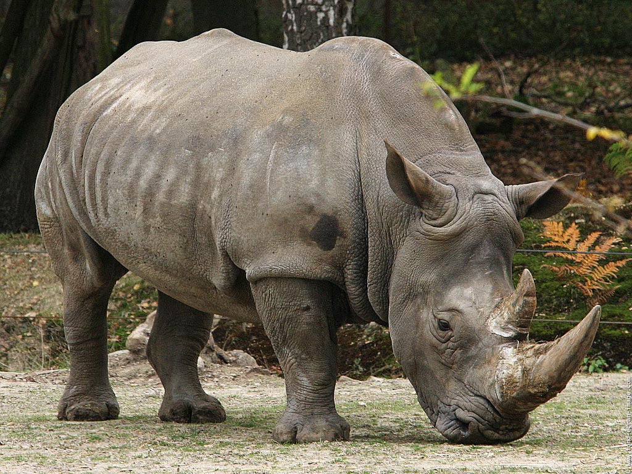
The Nashorn Project
A Rhino for 2013 (aiming for open source release in the Java 8 timeframe)
Nashorn is German for Rhino (also sounds cool)
29

Slide 30
Project Nashorn
Rationale
Create an invokedynamic sample implementation on top of the JVM
Should be faster than previous non-invokedynamic implementations
Proof that invokedynamic works (and works well)
Any performance bottlenecks should be communicated between teams

Slide 31
Project Nashorn
Rationale for JavaScript
Rhino is a non-invokedynamic implementation
Rhino is slow
Rhino contains challenging deprecated backwards compatability things
Ripe for replacement
JSR 223: Java to JavaScript, JavaScript to Java
  Automatic support. Very powerful
The JRuby team are already doing great things with JRuby

Slide 32
The real reason – Keep up with Atwood’s law:
Atwood’s law: “Any application that can be written in JavaScript, will eventually be written in JavaScript”
- James Atwood (founder, stackoverflow.com)
32

Slide 33
Project Nashorn
Goals
Create a node.js implementation that works with Nashorn
  node.jar (asynchronous I/O implemented in project Grizzly)
4-5 people working fulltime in the languages/tools group
Nashorn scheduled for open source release in JDK8 timeframe
  Source available earlier
  node.jar has no official schedule yet
Other things that will go into the JDK
  Dynalink
  ASM

Slide 34
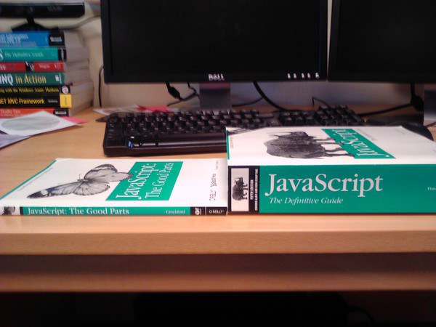
Project Nashorn
Challenge: JavaScript is a nasty, nasty, nasty language

Slide 35
Project Nashorn
JavaScript is a nasty, nasty, nasty language
  ‘4’ - 2 === 2, but ‘4’ + 2 === ’42’
  You can declare variables after you use them
  The with keyword
  Number(“0xffgarbage”) === 255
  Math.min() > Math.max() === true
  Take a floating point number and right shift it…
  a.x looks like field a access
    Could just as easily be a getter (with side effects), a could be as well
  There’s plenty more where that came from…

Slide 36
Project Nashorn Compliance
Currently we have full ECMAScript compliance
This is better than ANY existing JavaScript runtime
Rhino only at about ~94%
Our focus is now shifting to performance

Slide 37
Project Nashorn Performance

Slide 38
Project Nashorn Advantages
node.jar file is small
  Equally useful in Java EE and embedded environments
  Tested and running on a Raspberry Pi
JVM tools work just as well
  Mission control and flight recorder

Slide 39
Future Improvements
Performance, performance, performance
Investigate parallel APIs
Library improvements
  RegExp
  Possible integration with existing 3rd party solutions
TaggedArrays – using some of the low level JVM internals

Slide 40
Conclusions and Further Information
Invokedynamic makes the JVM much more powerful
  Especially for dynamically typed languages
Project Nashorn is a great demonstration
  Full ECMAScript compliance
  Great performance
  Open source
openjdk.java.net/projects/nashorn

