Slide 2


Java : Device to DataCenter
Charles Shih & Naveen Asrani
Oracle
Notes:
The Internet of Things and the rise of a machine-to-machine (M2M)
ecosystem has been long anticipated. As this ecosystem converges
with cloud computing and big data, you need a seamless platform that
runs from the device to the data center with Java. Only Oracle provides it.
In the next 40-50 minutes we talk about this Oracle D2D offering based on Java

Slide 3
The following is intended to outline our general product direction. It is intended
for information purposes only, and may not be incorporated into any contract.
It is not a commitment to deliver any material, code, or functionality, and should not be relied upon in making purchasing decisions. The development, release, and timing of any features or functionality described for Oracle’s products remains at the sole discretion of Oracle.

Slide 4
Need Integration
Need Fast Data
Inflexible
Niche
Security
Devices
#COMPLEXITY
Platforms
No SQL
CLOUD
Agility
Sensors
Analytics
Slow
Lifecycle Mgt
Rigid
Testing
Events
Proprietary
Scale
BIGDATA

Slide 5
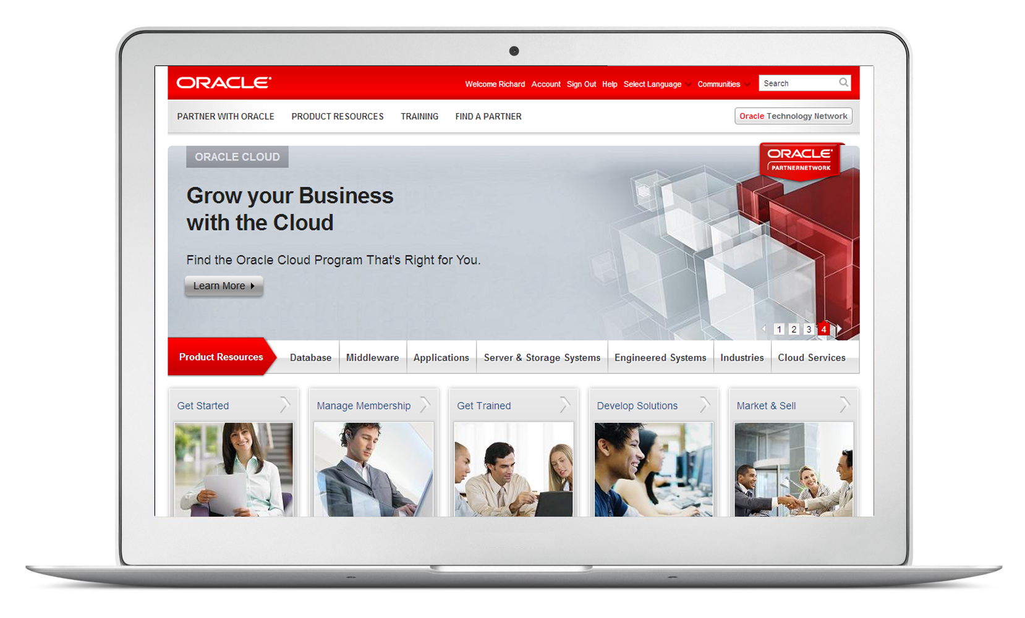
2.3B
Internet
Users
Source: IDC

Slide 6

1.1B Global
3G MOBILE SUBSCRIBERS
Source: Mobithink

Slide 7
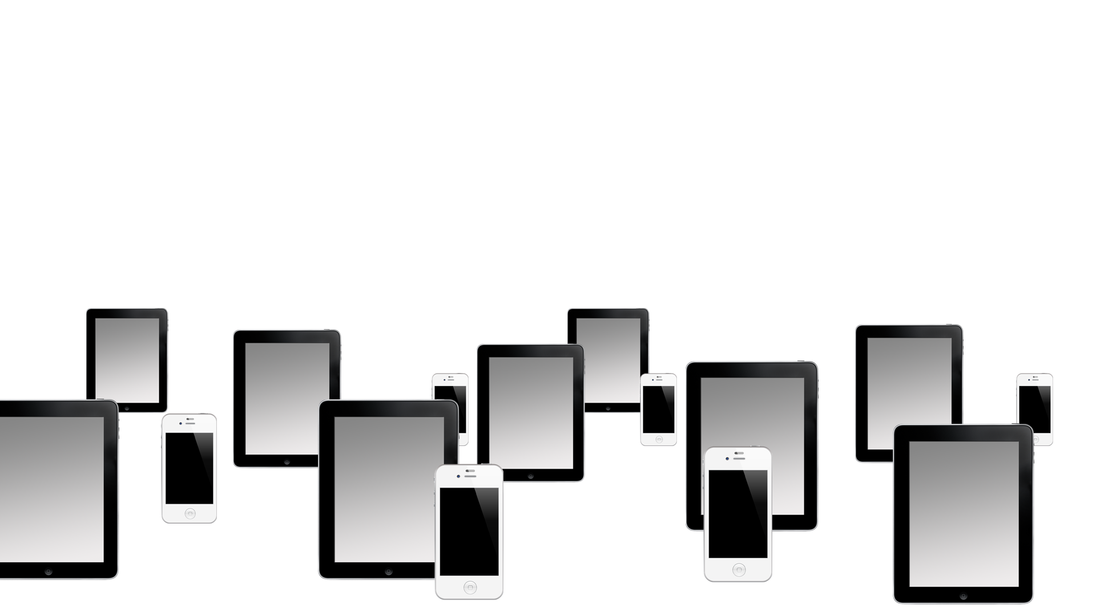
Today - 3Bn Devices
Source: Ericsson

Slide 8
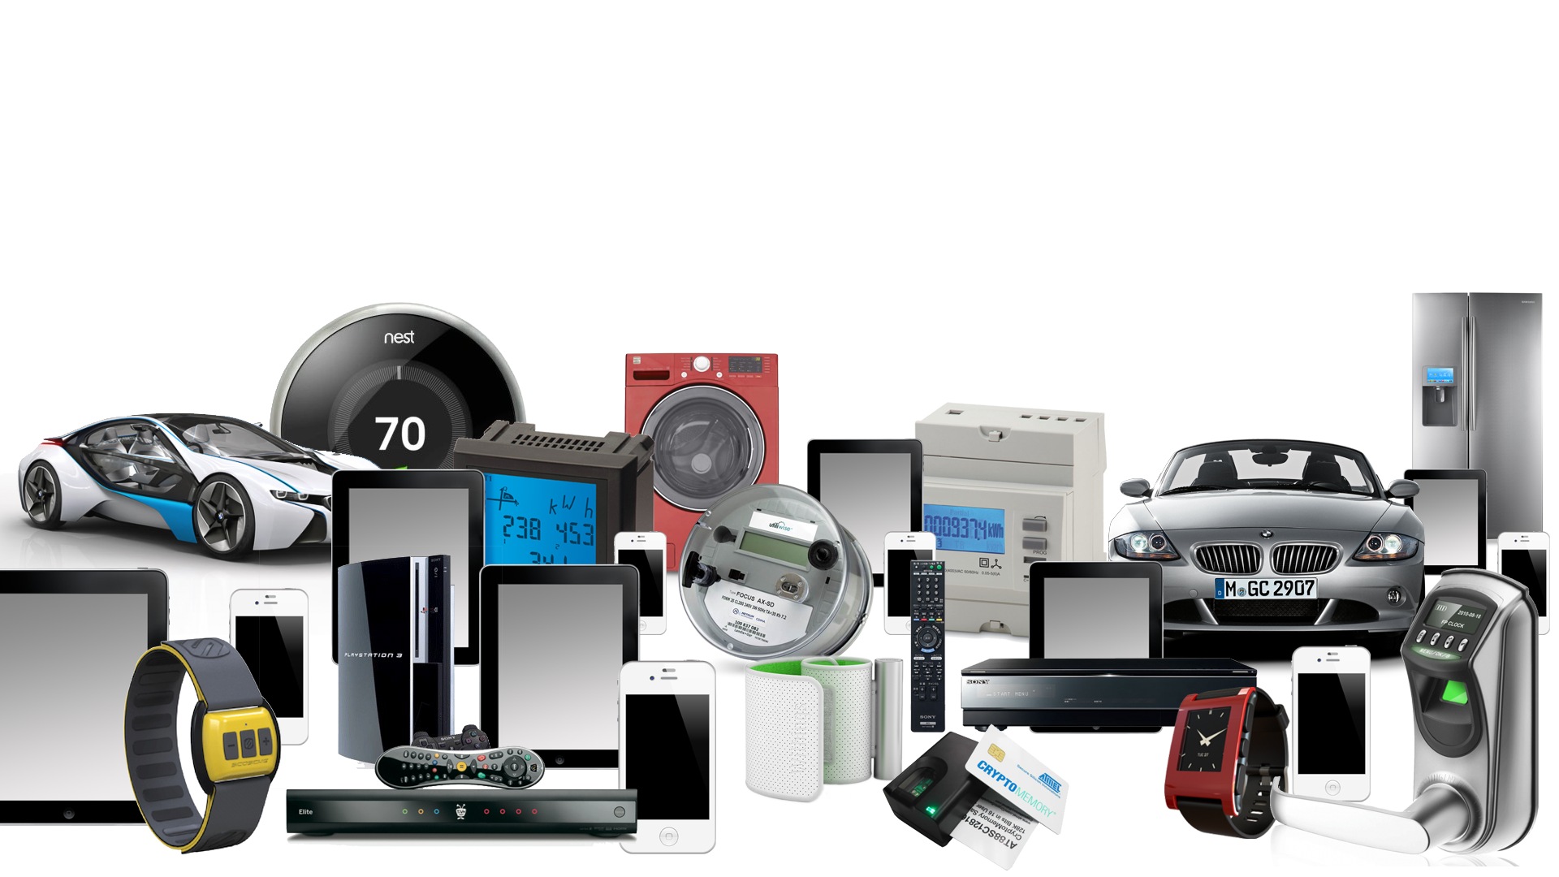
In the Next 5 Years - 50Bn Devices
Source: Ericsson

Slide 9
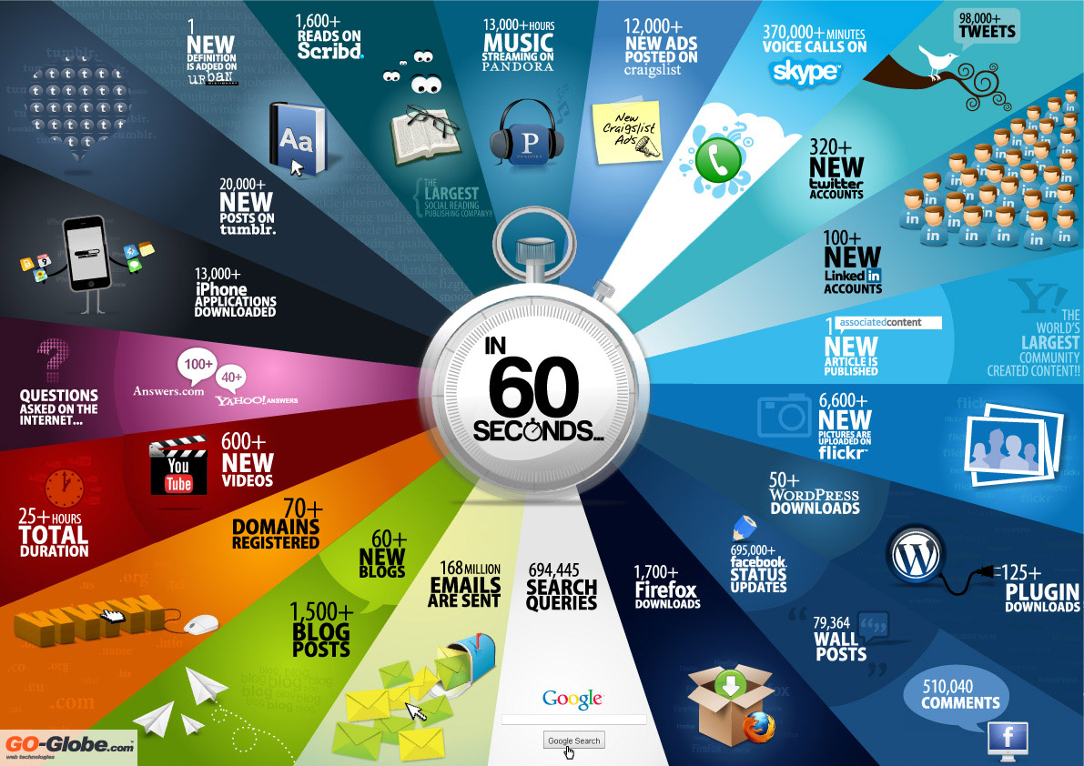
Data Explosion
Web & social networks experienced it first…
Infographic by Go-gulf.com

Slide 10

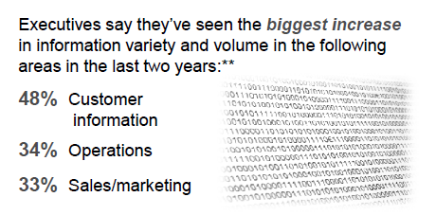
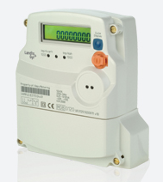
… but enterprises are now facing it too
… but enterprises are also facing it now
Utilities deploying smart meters?
→ 200x information flowing to data center!
Source: http://www.oracle.com/us/corporate/press/1704764

Slide 11
















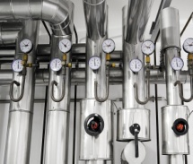

Imroving operational efficiency
Minimize Downtime – High Availability
Challenges in the M2M Era
Real-time Data Data Analysis & Management
Common Development Environment across M2M solutions
Extracting value from large amounts of data
Enabling New Services and faster time to market
Support for a wide variety
of devices
Cloud based Services key to reduce cost & complexity
Devices in-market for longer
duration
Intermittent connectivity
Integration and Automation with existing systems
Portability, security with scalability
Risk of opportunity lost or non compliance
Faster local decision
making

Slide 12
Challenges in the M2M Era
Always-on devices connected to variety of sensors and running multiple software applications
High-frequency data analysis for instant decision making and automation of information flows
Customer service differentiation from automated real-time responsiveness
Intelligent Devices
Fast Data
Responsiveness

Slide 13




Obstacles to Faster Data
Ensuring Real-Time Accuracy, Efficiency, and Scale
Business event
Data captured
Business Value
Analysis completed
Action taken
Action Time
Source: Richard Hackethorn’s Component’s of Action Time

Slide 14
Oracle’s Device to Data Center Platform
Complete, Best in Class & Engineered Together
Bring data from connected products and assets to existing applications
Optimize & Innovate
Achieve standardization, portability and speed for building applications
Develop & Deploy
Reduce costs & deliver new solutions and services to the
market faster
Integrate & Automate
Manage & Analyze
Protect & Comply
Manage data through entire lifecycle from collection, storage, processing and analysis
Protect data & achieve security, privacy and regulatory requirements
14

Slide 15

Oracle Device to Data Center Platform
Complete, Best in Class & Engineered Together
M2M APPLICATION
MIDDLEWARE
NETWORK
CLOUD
NETWORK CLOUD
GATEWAY
NETWORK
CLOUD
DEVICE
GATEWAY
DEVICE
DATABASE
OS & VIRTUAL MACHINE
ENGINEERED SYSTEMS,
SERVERS & STORAGE

Slide 16
Oracle Device to Data Center Platform
Complete, Best in Class & Engineered Together
Java on ANY Device or Gateway
Faster, portable and more reliable development
M2M APPLICATION
MIDDLEWARE
NETWORK
CLOUD
NETWORK CLOUD
GATEWAY
NETWORK
CLOUD
DEVICE
GATEWAY
DEVICE
DATABASE
OS & VIRTUAL MACHINE
ENGINEERED SYSTEMS,
SERVERS & STORAGE

Slide 17
Oracle Device to Data Center Platform
Complete, Best in Class & Engineered Together
Java on ANY Device or Gateway
Faster, portable and more reliable development
M2M APPLICATION
Middleware & Database
Performance, scalability, security, integration
MIDDLEWARE
NETWORK
CLOUD
NETWORK CLOUD
GATEWAY
NETWORK
CLOUD
DEVICE
GATEWAY
DEVICE
DATABASE
OS & VIRTUAL MACHINE
ENGINEERED SYSTEMS,
SERVERS & STORAGE

Slide 18
Oracle Device to Data Center Platform
Complete, Best in Class & Engineered Together
Java on ANY Device or Gateway
Faster, portable and more reliable development
M2M APPLICATION
Middleware & Database
Performance, scalability, security, integration
MIDDLEWARE
NETWORK
CLOUD
NETWORK CLOUD
GATEWAY
NETWORK
CLOUD
DEVICE
GATEWAY
DEVICE
DATABASE
Engineered Systems
delivering cloud services and manage Big Data
OS & VIRTUAL MACHINE
ENGINEERED SYSTEMS,
SERVERS & STORAGE

Slide 19














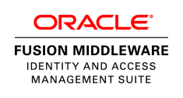










Oracle’s Device to Data Center Offerings
Built on Top of state of the art Java VMs
M2M APPLICATION
As on Device
M2M APPLICATION
Delivery of Applications and Dashboards through a Portal, with support for
Java on ANY Device for Faster, More Reliable Development using same commodity skills as used in the Data Center
Use Oracle Middleware and Database software to build your IP on for Better Security, Better Support, Better Quality of Service
Use Oracle Engineered Systems to deliver the Cloud Services and manage Big Data
MIDDLEWARE
Embedded Event Processing
MIDDLEWARE
MIDDLEWARE
Java Card
on remote devices.
As on Device, with additional event processing and storage
Java Embedded Suite
XML, Security, Web Services, File i/o, Messaging, Location,
CONCENTRATOR
OR
GATEWAY
NETWORK
CLOUD
DEVICE
DEVICE
Data Encryption, user and device identity provisioning as well as access
DATABASE
DATABASE
Java ME Embedded
DATABASE
Embeddable, transactional storage engine written entirely in Java. With Data Synchronization.
OS & VIRTUAL MACHINE
OS & VIRTUAL MACHINE
Integrated storage, networking and processing, in HA configuration, supporting control.
OS & VIRTUAL MACHINE
ENGINEERED SYSTEMS, SERVERS & STORAGE
ENGINEEDED SYSTEMS,
SERVERS & STORAGE
NETWORK
CLOUD
DATA CENTER PLATFORM
DEVICE
GATEWAY

Slide 20


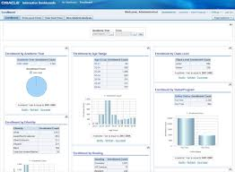
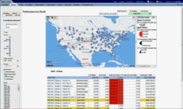

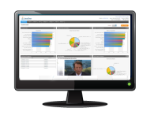








Device to Data Centre
Java VM: Virtualizing the Connected D2D World
Location Sensor
Falling Over Sensor
Speed sensor
Vibration Sensor
Pulse Sensor
Sleep Sensor
Location Sensor
Pulse Sensor
Dashboard
Fault Sensor
Consumer Fitness
Remote Patient / Clinical
Data Sync, Control, Feedback and Updates
Controlling App
mHealthcare
Device
Event Processing
Automotive Telematics
Device
Bluetooth, Zigbee, WLAN, DASH7
Data Management
Vibration Sensor
2G, 3G, LTE, Satellite
Gateway
Network Abstraction
Protocol Gateway
Scalable
Resilient
Secure
Standards Based
Managed
Integrated
Fuel Sensor
Network
Big Data Analytics
Temprature Sensor
Industrial Automation Device
Fleet/Asset Management
Fixed Internet
Fixed Internet
Integration
Service Bus
External Systems
Energy
Home Automation
Device
Industry Specific core solutions and external/customer systems
Wear Sensor
Spatial/GIS
Industry Solutions
Fault Sensor
Temperature Sensor
Other Data Generating Sources such as Social Media
MES
Elec Meter
Data Encryption, Device and Application Identity and Access Management
Gas Meter
Intruder
Temperature Sensor
Video
Police Warning
Energy
Security & Access Control

Slide 21
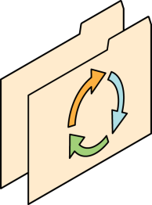
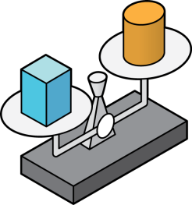
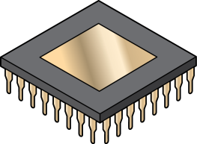
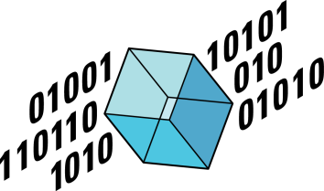


The Embedded Ecosystem Today
Setting the Context
Highly diverse and rapidly changing use cases & technologies
Hardware capabilities & connectivity evolving rapidly
Value is in software, but embedded software development is difficult
Expensive to reinvent and reintegrate must-have features (management, security, etc.)
The value of data gaining importance as a business driver
Time-to-market and flexibility are key to success

Slide 22

Common Pain Points
How do I tell my boss we cannot find good developers?
What if this vendor locks us in for years to come?
Who will support this solution 10 years from now?
There is no way we can cut BOM costs a penny more!
New devices need to be deployed in 30 days!
We just cannot afford to replace modules in the field every time application changes!
Notes:
Subtitle:ODM/OEMs are under pressure to drive costs down AND enable new revenue

Slide 23
Java the enabler
Extended Product Lifecycle: In-market update and refresh
Competitive Advantage: Focus on business value, reuse commodities from ecosystem
Innovation: Fueled by largest pool of developer talent
Increased Market Reach: Wider applicability of modules
Grow
Revenue
Portability: Increase flexibility to manage BOM and roadmap
Shorter Time-to-Market: Reduce QA cycles and remove reinvention
Reduced Support: Remote update
  Reduced Risk: Most widely deployed, secure, reliable development
  platform developed in the open and backed by Oracle
Reduce Cost
Notes:
CxO’s care about their return on investment (ROI) and reducing costs. Java delivers significant benefits in these two areas.
For ROI, Java provides a robust, mature, proven platform which meets the requirements of almost any type of embedded device. Support for remote downloads and updates ensures devices deliver greater value to the end-user. Widespread industry support ensures easy availability of partner technologies, ongoing innovation, and prevents proprietary lock-in.
For cost reduction, Java’s independence from the underlying hardware/software platform provides flexibility in CPU vendor selection and easy migration across dissimilar hardware. Java’s leading developer ecosystem ensures a vast worldwide pool of programming talent and training.
Java Embedded can address many of the issues raised and help ensure successful product development. With the largest base of developers, backed by an Oracle and third-party ecosystem of tools, support, and training, management can be assured that educated, experienced developers will be readily available for staffing and maintaining a project
And how does this fit together into a larger view for the Internet of Things? (next slide)

Slide 24
Key Value Propositions of Java Embedded
1
Software development decoupled from hardware
Write once, run anywhere
Virtualized embedded platform
Simple, inexpensive development model
Worldwide prevalence
2
3
4
5
Notes:
Here’s a quick view of why Java for Embedded
Software development decoupled from hardware: Decoupling the software development cycle from the hardware development cycle cuts development costs and promotes maximum reusability
Write once, run anywhere: Create high-performance, portable, secure, robust cross-platform applications that run on a large range of embedded platforms without any changes
Virtualized embedded platform: Java isolates applications from underlying language, operating system and hardware variations (e.g. OS, kernel, libc differences, CPU, graphics)
Simple, inexpensive development model: Development and testing can be done using free development tools on desktop systems, reducing amount of testing on embedded hardware
Worldwide prevalence: Most popular application platform on the planet with a vibrant developer ecosystem fueled by powerful tools, books, libraries, code samples, and more

Slide 25
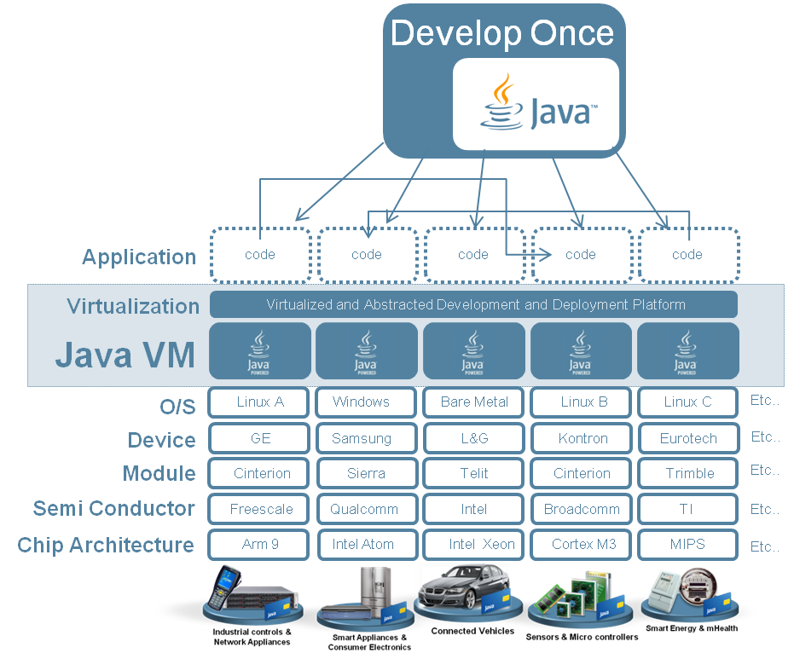
Java VM – What it is
Virtualizing the Connected D2D World
Java VM (JVM) runs on all connected devices
Hides the specifics of the device and the embedded O/S
Deploy/Move Code to any platform with a JVM implementation
Applications are compiled in Java Virtual Machine (JVM) bytecode.
Can be run on any platform with a JVM implementation.
Portable, Secure, Dynamic, Productive, Robust, Multi-Threaded Applications
Notes:
We Provide Embedded Building
Blocks so that don’t have to build and
maintain them themselves
• Get faster with more value to market
with Java than without Java
• We will help continue to deliver value
to help you to build m2m based
services

Slide 26


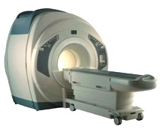




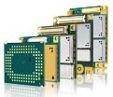



Java Embedded
Product Portfolio
10MB-100MB
Footprint
Java SE Embedded
Java Embedded Suite
OEP for Oracle Java Embedded
1MB-10MB
Java ME Embedded
50KB-1MB
Device
CPU/
GPU/I-O
Java Card
SECURITY SMALL MEDIUM LARGE

Slide 27



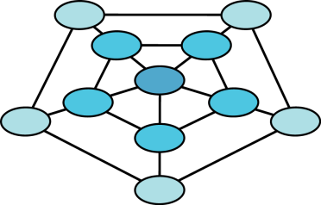
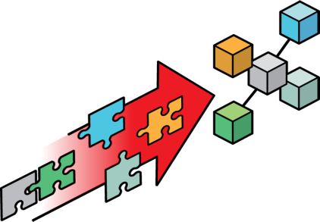

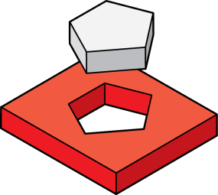

Java ME Embedded
Features at a Glance
Proven Java embedded platform (15 yrs maturity) based Java ME standards
Highly optimized multitasking CLDC-HI Java Virtual Machine
Fully headless operation with wired & wireless connectivity
Support for connectivity to various peripherals and devices
Ideal for granular in field upgrades – Full Firmware, JVM or Applications
Configurable remote application deployment and management
Multiple RTOS or bare metal supported
Ideal for microcontroller-class systems with low-memory requirements
27

Slide 28

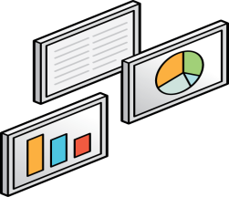

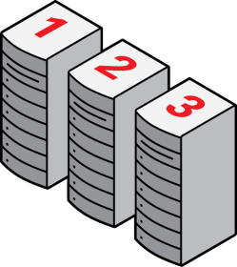


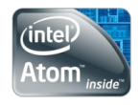
Java SE Embedded
Features at a Glance
Full featured Java SE platform with Java 7 language support
Industry standard, high-performance HotSpot Just-In-Time compiler
Headless and Headful (JavaFX or AWT/Swing) configurations
Proven, mature Java SE 7 APIs for connectivity and integration
Production ready binaries optimized for multiple embedded platforms
Three new optimized Java runtimes a.k.a. Compact profiles*
Simple migration of legacy headless CDC applications*
Reduced static footprint & memory requirements on embedded systems
* Feature planned for Java SE Embedded 8
28

Slide 29


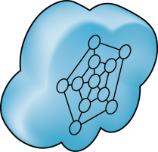

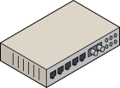



Java Embedded Suite
Features at a Glance
Enterprise middleware capabilities on embedded devices
Integrated Java application server for development & deployment of applications
High-performance, lightweight RDBMS for local data storage
RESTful Web Services development & deployment
Pre-integrated, production ready binaries optimized for embedded platforms
OSGi-based modular, managed application container for extensibility*
RESTful remote management of services & applications*
Optimized static footprint & memory requirements than DIY solutions
* Feature planned for Java Embedded Suite 7.1
29

Slide 30

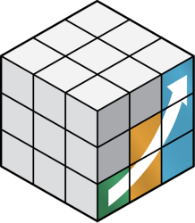
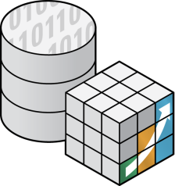

Oracle Event Processing for Java Embedded
Features at a Glance
Industry leading event processing engine
Continuous Query Language (ANSI standard)
Operates on multiple streams of disparate data
Join incoming streaming data with persisted data
Pluggable framework for I/O adapters
Dynamic remote provisioning of OEP applications
Event processing network simplifies D2D integration
Optimized for ARM and x86 embedded systems
30
Notes:
Industry-leading complex event processing engine that provides low-latency pattern matching and user-defined windows for event evaluation
Event processing engine uses extensions to the SQL language, called Oracle Continuous Query Language or CQL, to enable anyone with standard SQL skills to quickly develop OEP applications
Ability to join incoming streaming events with persisted data, thereby delivering contextually aware filtering, correlation, aggregation and pattern matching
Lightweight, Java-based container customized for embedded environments with optimized application thread and memory management
Pluggable framework to easily develop input and output adapters with SSL support for a variety of event sources like sockets, RMI, Web services, and JDBC
Easy integration of OEP Embedded on edge devices with server-side OEP deployments allows creating event processing networks that enable seamless device to data center integration. In an end-to-end event processing network,
OEP Embedded nodes perform contextual filtering and aggregation of real-time data from sensors and edge devices
OEP servers upstream perform complex combining of multiple streams of data and correlation across the various data streams
Declarative environment allows dynamic remote provisioning and updates of OEP applications running on embedded devices
Optimized for ARM v7 and x86 systems running Java Embedded Suite 1.0 and Linux (minimum 256 MB RAM recommended)

Slide 31
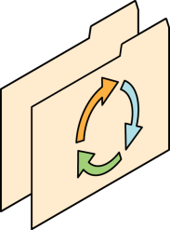





Java Card
Features at a Glance
Java platform for smart
cards and secure elements
Post-issuance application management based on industry standards
Application interoperability across hardware vendors
Multiple field-of-use and form factors
High-level security certifications and reduced certification times
Standards alignment (ETSI, 3GPP, GlobalPlatform)
Open development process and strong community
31

Slide 32
Platform Choices
 | Java ME Embedded | Java SE for Embedded
Java APIs | CLDC 1.1.1 | Full featured Java SE 7 API support
Min RAM | Total: 1MB | Total: 32MB (Headless)
Min MHz | 30MHz | 200MHz
Min Storage | ROMized 2MB | 32MB (min recommended RAM) / 40MB
Target Segments | Small embedded (resource-constrained) devices | Mid to High embedded devices
Sample Devices/Use Cases | Mobile/Feature Handsets, Digital Pen, Sensors | Industrial automation/equipments, High-end Network Appliances/Printing Devices, Medial, Aerospace and Defence, Smart Grid/ Kiosks
Available Ports | ARM Cortex-M3/M4 on KEIL MCBSTM32F200 ARM11 on Raspberry Pi Qualcomm M2M product family (based on ARM9) Custom ports available through Java Engineering Services | OS: Linux, Windows Processors: ARM v5/6/7, PowerPC, X86
Notes:
We have 3 major configurations for Java Embedded:
Small, Medium, Large
Java ME based on CLDC provides small configuration – i.e. about 1mb static foot print.
Java ME based on CDC provide medium config – i.e. about anywhere from 3.5mb to 8 mb
And Java SE for large with full SE APIs and libraries
This slide summarize major characteristics of each platforms to help you determine which platform would be a better choice.

Slide 33
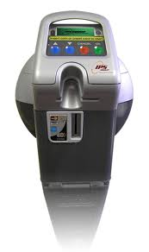
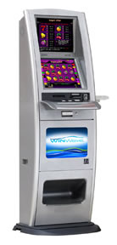
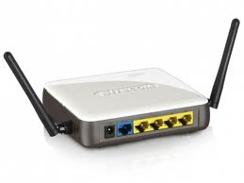
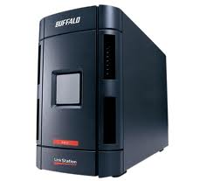
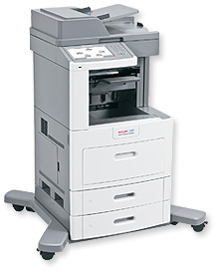
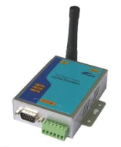














Java Embedded
History of devices powered by Oracle Java Embedded
RFID Readers
Parking Meters
Intelligent Power Module
Routers & Switches
Storage Appliances
Network Management Systems
Factory Automation Systems
Security Systems
Smart Meters
Multi Function Printers
ATMs
POS Systems
In-Flight Entertainment Systems
Electronic Voting Systems
Medical Imaging Systems
Notes:
Java embedded technologies are used in a wide variety of embedded devices. This list is just a small sampling of devices that are currently using Java Embedded/Java SE Embedded ( highlighted – TBC) and in industry segments that we have always connected with. Lets explore some of the opportunities we see for Java SE Embedded in the coming slides

Slide 34
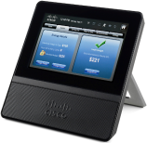





Industry Solutions
Java Embedded enables new opportunities in a number of industries
Home Gateway/Automation
Industrial Automation & Building Control
Healthcare
Smart City/Smart Grid
Automotive & Telematics
Communications

Slide 35

Use Case: Home Automation
Real-time pricing with adaptive intelligence for carbon footprint reduction
Automatic water usage metering enables conservation
Home security

Slide 36
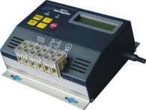
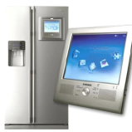
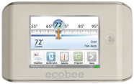

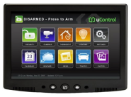
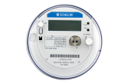
Complex network of smart devices communicating with business applications
Solar panel micro-grid controller
IP
Utilities Company
Billing & Demand/Response
IP
Meter Data Management
Smart Appliance
Home Gateway
IP
IP
Smart Thermostat
Appliance Company
Applications Provisioning
IP
Plug-in car charging station controller
Z-Wave
IP
ZigBee
Security Company
Events Processing System
Security Controller
Smart Meter

Slide 37

Use Case: Transportation & Telemetry
Location tracking
Container contents monitoring
Intrusion detection
Temperature and pressure monitoring
Source: http://www.flickr.com/photos/9979792@N04/2984873350/

Slide 38

Use Case: City Automation & Traffic Management
Automatic number plate recognition
Red-light violation detection
Traffic jam detection
Vehicle location system
Geo-fences
Source: http://www.flickr.com/photos/epsos/5591761716/

Slide 39

Summary
The Opportunity is here -Now
Your ability to take action closer to the event is key to harnessing business value
  Java enables greater intelligence on devices
  Java enables more portable, more connected, flexible solutions for M2M

Slide 40

Deep Dive Sessions ( this slide will be updated with actual time of slots)
CON1160 - Java in the Internet of Things: Small, Smart, Connected
CON1156 - Easy Middleware for Your Embedded Device
CON1147 - Do You Like Coffee with Your Dessert? Java and the Raspberry Pi
HOL Raspberry Pi NightHacking
CON1314 - Java Practice On The Raspberry Pi
CON1406 - Java与乐高机器人
Getting Started with Java in M2M

Slide 41




Where next?
Java Embedded
Twitter twitter.com/@JavaEmbedded
Facebook facebook.com/ILoveJava
Oracle Java blog blogs.oracle.com/java
Oracle Java Web site oracle.com/goto/javaembedded
Oracle Device to Data Center oracle.com/m2m

Slide 42


Graphic Section Divider

Slide 43
The preceding is intended to outline our general product direction. It is intended for information purposes only, and may not be incorporated into any contract.
It is not a commitment to deliver any material, code, or functionality, and should not be relied upon in making purchasing decisions. The development, release, and timing of any features or functionality described for Oracle’s products remains at the sole discretion of Oracle.

