Slide 2
Java 战略主题演讲
Peter Utzschneider
Java 产品管理
副总裁

Slide 3
以下内容旨在概述产品的总体发展方向。该内容仅供参考，不可纳入任何合同。该内容不构成提供任何材料、代码或功能的承诺，并且不应该作为制定购买决策的依据。此处所述有关 Oracle 产品的任何特性或功能的开发、发布以及相应的日程安排均由 Oracle 自行决定。

Slide 4
打造未来的 Java
平台完整性
现代化与创新
开发人员工作效率
开放和透明的发展
积极参与社区活动
质量和安全性
Notes:
When we say Make the Future Java, this really means the Platform and the Process.
In terms of creating the next generation Java platform,
From a high level, there are three areas we want to address here.
We want to fill in any and all gaps to make the platform complete. This is really about making sure Java works everywhere and for everyone. This is a broad topic that incorporates everything from adherence to standards to accessibility technologies.
We are driving innovation into the platform. As the largest software platform, the industry depends on Java to extend important innovations to its broad development community.
At the same time, developer productivity is a constant theme that permeates everything. For employers and managers, this is about lowering the cost of developing and maintaining products and services. For developers, it’s about being able to express themselves with as little unnecessary overhead as possible.
From a process perspective, it’s not only what to do with Java but how to get there. In many ways, Java pioneered the concept of open, collaborative evolution and this was a key to its initial success. Companies have bet their future on Java, and developers their careers. We owe all these constituents a transparent roadmap so that they can plan ahead, and a chance to help Java evolve in directions that are important to them, knowing that the Java skills they’re investing in are transferable across the platform so they can take advantage of the many different platforms without having to learn new skills. That means you can do more with Java than you ever thought possible.
Finally, quality and security are top priorities that permeates everything we do. Oracle takes these two very seriously because they are critical to our business, and because they are critical to the entire Java community.
Recently, vulnerabilities affecting Java SE have received a lot of public attention. A vast majority of these issues impact one specific Java use case – Java running in web browsers. A large number of Java programs run on the servers in data centers and as applications on the PC and desktop computers. These Java programs are not affected by most of the vulnerabilities identified recently.

Slide 5
Java 系列 Java 社区设立的标准
Java SE
Java Embedded
Java EE
Java FX
行业标准，针对服务器端 Java 计算的集成平台。
用于跨异构服务器环境开发和部署高性能和安全的应用程序。
支持针对智能 M2M 系统和设备至数据中心解决方案的跨平台产品。
用于创建富企业客户端应用程序的首选平台。
Notes:
Java is the foundation for virtually every type of networked application and is the global standard for developing and delivering embedded and mobile applications, Web-based content and enterprise software. The breadth of the platform, its rich features, low cost, maturity, and application portability maximize developer opportunity.

Slide 6
最新发布
Oracle Java Platform Integrator 程序
扩大 Java 在物联网 (IoT) 中的应用范围
轻松定制 Java Embedded 以应用于广泛的设备
提高开发和部署的灵活性
跨可选硬件和操作系统实现一致的平台可移植性
降低工程复杂性，缩短上市时间，减少成本
了解更多信息
oracle.com/technetwork/java/embedded
Notes:
We are very excited to announce Java Enterprise Edition 7.
We're committed to Java EE, not just by leading Java EE 7, but also in the products that Oracle delivers.
This platform is a culmination of work by all of us, Oracle, our Java Partners and of course you, the Java community
So without further ado, I’d like to invite Cameron Purdy, VP of Development, to tell us more about the platform.
Congratulations Cameron (hand shake)

Slide 7
积极参与。
机会正在
向您招手。
您的参与
就是 Java 的未来

Slide 8
阅读：Java Magazine
60% 的内容产生自社区
80% 的读者认为该杂志不可不读
立即订阅！
oracle.com/javamagazine
2013 Maggie 奖得主
最佳纯数字行业出版物
Notes:
Launched less than a couple of years ago, this magazine has already won prestigious awards
That’s because 60%... 85%...
Subscribe today and add your contribution
So hopefully you are excited as I am to be part of this community. Let me turn it back over to Cameron to share some more exciting news

Slide 9
加入：Java 用户群
200 多个遍布全球的 Java 用户群
10 多万名成员
立即加入！
java.net/jugs
Notes:
Launched less than a couple of years ago, this magazine has already won prestigious awards
That’s because 60%... 85%...
Subscribe today and add your contribution
So hopefully you are excited as I am to be part of this community. Let me turn it back over to Cameron to share some more exciting news

Slide 10
学习：继续旅程
向 21 世纪的计算机科学学生敞开大门
帮助 97 个国家/地区的超过 190 万名学生
师从经验丰富的 Java 讲师
享受 Oracle 认证准备和考试的折扣
academy.oracle.com
Notes:
Need even more?
Get training and expert help to accelerate your adoption

Slide 11
歡迎JavaOne大會
Welcome to JavaOne!
Huānyíng JavaOne dàhuì

Slide 12
Java SE 最新进展
Nandini Ramani
Java 客户端和嵌入式平台
副总裁
@eyeseewaters

Slide 13
Java SE 更新
JDK 7：得到 ISV、托管提供商和开发人员的广泛采用
JDK 8/9：JDK 8 支持 Lambda、JavaScript 互操作性和 JVM 整合；JDK 9 支持 Jigsaw
JDK 9 及更高版本：通用语言互操作性、GPU 编程、云计算增强
100%
90%
80%
70%
60%
50%
40%
30%
20%
10%
Java 6
0%
Java 7
十月
十一月
十二月
一月
二月
三月
四月
五月
六月
七月
八月
信息来源：来自 Jelastic.com 的托管统计信息
Notes:
Just over a year ago we delivered Java SE 7 – the first major version of Java SE released
under Oracle’s stewardship. Since then we have delivered regular updates every couple
of months, with hundreds of bug fixes, performance improvements, and new features.
We are pleased with the speed of adoption of this new version. We are seeing strong
uptake among developers, ISVs, and hosting companies. Java SE 7 is rapidly making
its way into the enterprise as well.
In fact, Oracle (traditionally careful about upgrades) supports its entire FMW stack on
Java 7 because we know it has great quality and performance.
Even as of last August we were seeing massive adoption of Java SE 7, and you can see how rapidly releases become standards.

Slide 14
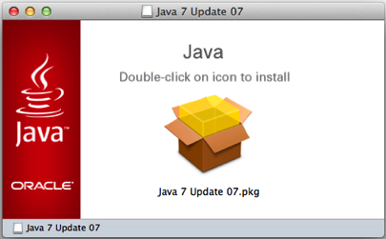
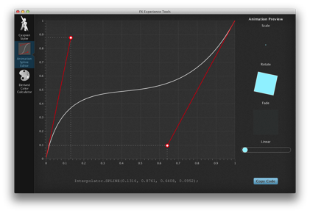
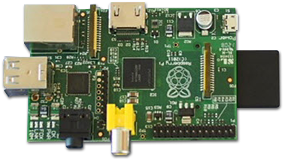
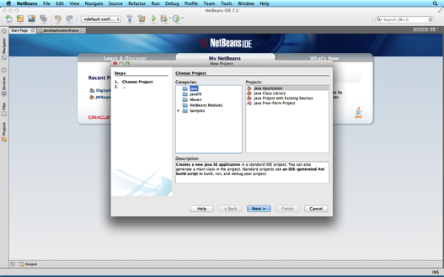
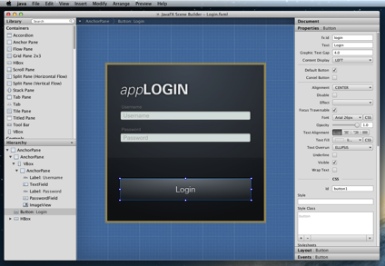
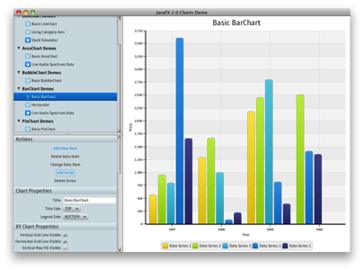
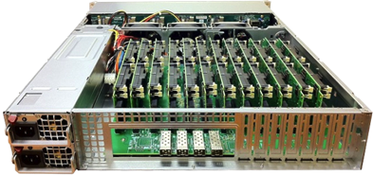
Java 7 支持 OS X 和 Linux/ARM
以太网
HDMI
电源
USB
SD 卡
RCA 视频
通用 I/O
音频
图片来源：Boston Ltd.，英国
Notes:
In addition to the incremental improvements to Java 7, we have also increased the set of platforms supported by Oracle from Linux, Windows, and Solaris to now also include Mac OS X (“ten”) and Linux/ARM for ARM based PCs such as the Raspberry Pi and emerging ARM based microservers.
These are the first new ports of Java since 64 bit Windows in 2007 and 64 bit Linux in 2003.
So Oracle has released as many new ports In the last year for desktops and servers as were done in the preceding decade of Java SE’s history.
And new for JavaOne Brasil, I am pleased to relate that we will be making EA builds of the Linux ARM binary which supports the Hard Float ABI
for ARM v6/7 on platforms like the raspberry Pi available by the end of this calendar year.

Slide 15
JDK 8
创新
Lambda（即闭包）
语言互操作性
Nashorn
Java 普及
针对资源受限设备的配置文件
JSR 310 — 日期和时间 API
非罗马日历
Unicode 6.2
ResourceBundle
BCP47 区域匹配
全球化和易访问性
客户端
部署增强
JavaFX 8
Java SE Embedded 支持
增强的 HTML5 支持
3D 形状和属性
显示
核心库
核心集合 API 支持并行操作
功能增强
改进的类型推断
工具
编译器控制和日志记录
JSR 308 — Java 类型批注
本机应用捆绑
应用商店捆绑工具
安全性
受限的 doPrivilege
NSA Suite B 算法支持
SNI 服务器端支持
DSA 更新至 FIPS186-3
AEAD JSSE CipherSuites
一般改进
JVM 增强
无 PermGen 限制
性能增强
Notes:
While Java 7 updates and ports have been progressing, we have also been hard at work on Java 8.
Most people are aware that Project Lambda, adding closures to the Java language, is a key feature.
But there are lots of other features in the works. Some of my favorites are Bulk data operations on core collections APIs, and JVM improvements like removing the PermGen and new date and time APIs.
And as always, there are general improvements and updates to standards support around security, internationalization and accessibility
Of course we'll have more detail in the technical keynote and many sessions throughout the conference.
And remember that you can go to OpenJDK to see this development being done in real-time
change-set by change-set, and that there are weekly early access builds of OracleJDK 8 that you can download and try already today.

Slide 16
Java SE 规划
JDK 8（2014 年 1 季度）
Lambda
JVM 整合
JavaScript 互操作性
JavaFX 8
3D API
Java SE Embedded 支持
增强的 HTML5 支持
JDK 9
模块化 — Jigsaw
互操作性
云
易于使用
JavaFX JSR
优化
7u40
Java Flight Recorder
Java Mission Control 5.2
Java 发现协议
本机内存跟踪
本地安全策略
7u21
Java 客户端安全增强
应用商店打包工具
JDK 8u40
2013
2014
2015
2016
NetBeans IDE 7.3
新的提示和重构
Scene Builder 支持
NetBeans IDE 8
JDK 8 支持
Scene Builder 2.0 支持
Scene Builder 2.0
JavaFX 8 支持
增强的 Java IDE 支持
JDK 8u20
Deterministic G1
Java Mission Control 6.0
改进的 JRE 安装程序
应用捆绑增强
NetBeans IDE 9
JDK 9 支持
Scene Builder 3.0 支持
Scene Builder 3.0
JavaFX 9 支持
Scene Builder 1.1
Linux 支持
Notes:
Just to summarize the releases we have been taking about, this is the roadmap, Not going to go through it in detail.
CHANGED: JDK 8, from “Complete JVM convergence to just JVM Convergence”
Added the features for 7u10

Slide 17
下载
Java SE 7
oracle.com/java
测试预览版
Java SE 8
openjdk.java.net

Slide 18
JavaFX 最新进展

Slide 19
如今的 JavaFX
本机部署
Linux
图表
FXML
OpenJFX
多点触控
1080p
可写映像
Mac
分页
HTML5
Web 历史记录
Scene Builder
图表
组合框
PixelWriter
Swing 集成
h.264
针对 Windows 和 Mac OS X
HTTP 实时流媒体
GroovyFX
Windows
ScalaFX
画布
硬件加速的图形
UI 控件
E(fx)clipse
WebView
i18n
ColorPicker
JavaScript 到 Java
SWT 集成
Notes:
Over the last year, signficiant progress
Ports to Linux, Mac, early access on Linux/ARM
SceneBuilder tooling, with NB integration
HTML 5, including canvas
Media including H.264
Lots of new controls
Interop with Swing and SWT
Also numerous community projects like E(fx)clipse, DataFX, language additions such ScalaFX, Ruby FX and much more

Slide 20
JavaFX 部署
Notes:
Intended as swing replacement in Rich interactive desktop applications
We’ve seen a lot of positive adoption of JavaFX, both in the developer community as well as with established enterprises.
Here are some examples
Quantcell - data analytics
Healthcon - Healthcare
Celer - Trading app in just 6 months
Navis – Shipping container management
Belgian Railways - Train management
CaptainCasa - Enterpriise application framework
Mint Software Systems- Training Management System for air navigation
DooApp – Visual diagnosis of building energy consumption

Slide 21
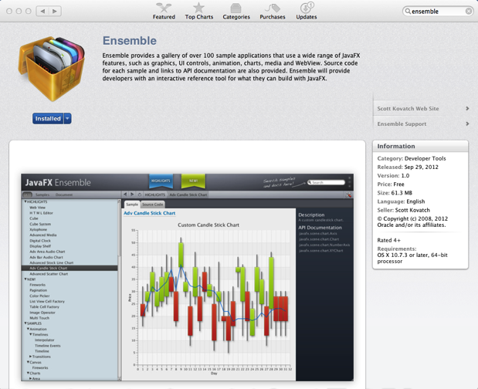
享受 Mac App Store 和 OpenJFX 的乐趣！
http://openjdk.java.net/projects/openjfx
http://javafx-jira.kenai.com/secure/Dashboard.jspa
JavaFX 技术拥有光明的前景，而开源的开发方式更是为其锦上添花。我们希望为这个项目做出自己的贡献，就如同我们为 OpenJDK 做的那样。
— Deepak Bhole，Red Hat
Notes:
App Store
Future for client deployment
Already possible, Ensemble is in app store
Download it, let’s get it to number #1!
Will improve tools and docs to make this really easy
OpenJFX
Continue to release more parts of JavaFX to OpenJFX
Start seeing 3rd parties joining, including Red Hat who recently announced on the OpenJFX mailing lists
Would like to see contributors from Shanghai, come talk to us during this conference!

Slide 22
JavaFX 8 和更高版本
嵌入式
显示
Maven
多点触控
UI 控件公共 API
SwingNode
Scene Builder
高级单元
针对 Linux
富文本
TreeTableView
3D
复杂字符
快照
ARM
性能
易访问性
IntelliJ
Notes:
Some key future features
Multi Touch
Improved integration with Swing
Support for ARM and other embedded systems

Slide 23
JavaFX 规划
JDK 8（2014 年 1 季度）
Lambda
JVM 整合
JavaScript 互操作性
JavaFX 8
3D API
Java SE Embedded 支持
增强的 HTML5 支持
JDK 9
模块化 — Jigsaw
互操作性
云
易于使用
JavaFX JSR
优化
7u40
Java Flight Recorder
Java Mission Control 5.2
Java 发现协议
本机内存跟踪
本地安全策略
7u21
Java 客户端安全增强
应用商店打包工具
JDK 8u40
2013
2014
2015
2016
NetBeans IDE 7.3
新的提示和重构
Scene Builder 支持
NetBeans IDE 8
JDK 8 支持
Scene Builder 2.0 支持
Scene Builder 2.0
JavaFX 8 支持
增强的 Java IDE 支持
JDK 8u20
Deterministic G1
Java Mission Control 6.0
改进的 JRE 安装程序
应用捆绑增强
NetBeans IDE 9
JDK 9 支持
Scene Builder 3.0 支持
Scene Builder 3.0
JavaFX 9 支持
Scene Builder 1.1
Linux 支持
Notes:
Just to summarize the releases we have been taking about, this is the roadmap, Not going to go through it in detail.
CHANGED: JDK 8, from “Complete JVM convergence to just JVM Convergence”
Added the features for 7u10

Slide 24
下载
JavaFX
oracle.com/javafx
JavaFX 2
针对富企业客户端应用程序的
完整首选平台

Slide 25
Java Embedded 最新进展

Slide 26
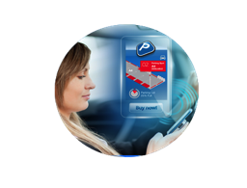
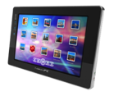
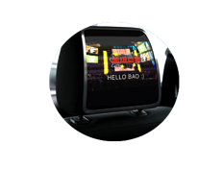
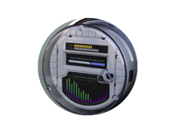
第 3次 IT 革命
基于标准的硬件和软件
专用的硬件 和软件
x86 架构/ Windows 操作系统
主机时代
PC 时代
物联网
1960 - 1985
1985-2006
2006 - 2025
Notes:
For context, Given the trends in M2M and Internet of things, We believe the Java embedded space is exciting
1990s - internet of computers, connected PCs, and the Web
2000s - proliferation in people becoming connected.
3rd wave is the internet of things. Devices all around us - On 24x7, connected all the time
Explosion of devices is the next IT revolution Java is the right solution for this space.
Java embedded solutions provide a framework to provision, manage, and secure devices
Also ability to aggregate, process and analyze multitude of data.
One platform to program them all.

Slide 27
世界人口
63 亿
68 亿
72 亿
76 亿
连接的设备
5 亿
125 亿
250 亿
500 亿
平均每人拥有的
连接的设备
0.08
1.84
3 倍
3.47
5 倍
6.58
2003
2010
2015
2020
连接的设备超过人口
来源：Cisco，2013 年 4 月
Notes:
We’ve already reached a tipping point where the number of connected devices outnumber people on earth.
All of these devices, from remote sensors to autonomous machines offer newfound value to businesses and developers alike.
And Java can help driving greater value and provide an easier runway for you to be creative in creating the next set of applications that operate the embedded device world that surrounds us.

Slide 28
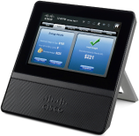
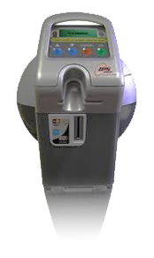
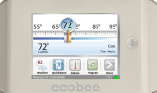
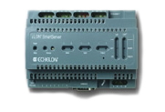
Java Embedded — 连接的设备
“物联网”的基础
针对 M2M 的设备到数据中心平台
中间件
企业数据和应用程序
设备
网关
数据中心
Notes:
Java Embedded: Driving "Device to Datacenter" strategy aimed at providing a standard development platform for the Internet of Things. Introduced a broad range of products spanning from Java ME for sensors and other microcontroller-based devices, through Java SE Embedded for gateways and concentrators to Java Embedded Suite which is a complete middleware stack for high-end IoT gateways. Formed key partnerships with companies like Qualcomm and Freescale, and with significant market interest.
Java ME will move to a generic small footprint platform, with Oracle investing towards enabling edge devices in the Internet of Things.
Java Card will continue in its role as a secure OS for smart cards, but also expand to be a security layer for any type of client including embedded.

Slide 29
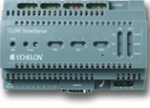
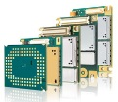
最新的 Java Embedded 版本
Java ME Embedded 3.3
适用于小型嵌入式设备的运行时：微控制器级平台
Java Embedded Suite 7.0
预先集成的功能完备的 Java 嵌入式平台
企业数据和应用程序
3.1.1
DB
Embedded
OEP Embedded
实时过滤、关联和处理流事件
边缘设备
网关/集线器
Notes:
(2 new Java embedded products ito address the internet of things)
3 categories of compute devices:
1st – Small edge devices like thermostats and sensors, directly connected to the backend through an operator network with a gateway as the hub.
2nd - Gateway i- coordinates a local network and as the name implies, acts as a gateway to the backend.
3rd - Backend, which could be the data center or cloud.
Oracle enables Java everywhere in the internet of things.
Java ME compliant platform optimized for micro controller and other low powered devices. new functionality to interact with peripherals such as SD cards.
JES, integrated middleware stack based on SE 7 embedded, Java DB, and versions of GlassFish and the Jersey Web Services stack optimized for small footprint devices.
enables remote management and interoperability with a Java-based backend.

Slide 30
Oracle 的 Java Embedded 战略和展望
推动 Java 成为首屈一指的嵌入式平台
打造统一的开发体验
提供完整的嵌入式解决方案
发展 Java Embedded 生态系统
Notes:
Outline of overall vision for Oracle’s investment. (Bullets speak for themselves, but some color here):
Java can provide enormous value to developers and enterprises, and that value is greatly magnified the more Java there is.
At Oracle, we intend to make Java #1. A key aspect of this is enabling the same ease of development (as you have for web or mobile applications), for embedded devices and end-to-end applications including end-to-end devices.
You should only need ONE unified development experience across all the application and devices you create and Java can be that technology for you
Oracle will seed the market by providing a very competitive Java platform and products based on it, with a complete feature set. We do the plumbing, you the business logic.
But as with Java elsewhere, we believe that the path to success is through a rich ecosystem of developers, partners, SIs, standards, etc

Slide 31
实现更加智能、时刻连通的世界
GEMALTO M2M
Axel HANSMANN
2013-07-23

Slide 32
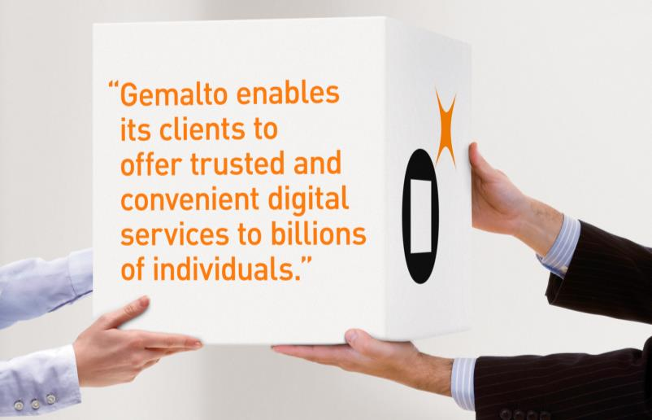
Gemalto：公司概览
我们的客户
190
个国家/地区，我们的客户遍布全球
3000+
家金融机构
450+
家移动运营商
80
个电子政务计划
Notes:
Gemalto helps people to trust one another in an increasingly connected digital World
We develop secure software that runs on trusted devices
We manage the devices and the confidential information that they contain

Slide 33
Gemalto M2M 解决方案帮助实现连通的世界
GEMALTO M2M
我们帮助全球各地的客户连接其设备
于 1994 年发明蜂窝 M2M
我们将 Java 带入 M2M
现场支持超过 5000 万台设备
我们的解决方案：
开辟新的业务模式
自动化工业流程
降低支持成本
资源的优化使用
长期可靠地工作

Slide 34
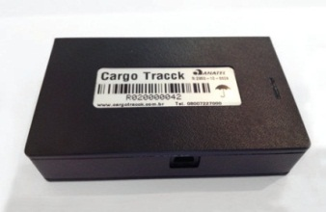
Gemalto M2M 连通您身边的世界……
RMC
智能
量表
智能
能源
家用
警报
运输
跟踪
……无处不在
安全
连接的路灯
ITS
物流
汽车
数字广告牌
移动
医疗
电动汽车

Slide 35
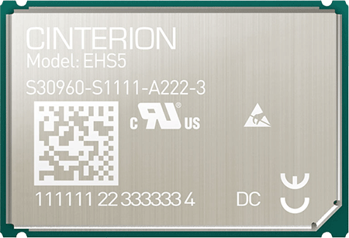
Gemalto 将 Java 的优势带给 M2M
Cinterion EHS5 Java 模块
Java 在 M2M 中的优势
缩减物料清单 (BOM)
提高开发效率
支持下一代架构
提高设计和开发的灵活性
改进应用程序的管理
Java ME Embedded 3.2
HSPA 7.2M/5.7M 连接
针对工业应用而强化
广泛的接口
全球覆盖
你将如何开始？

Slide 36
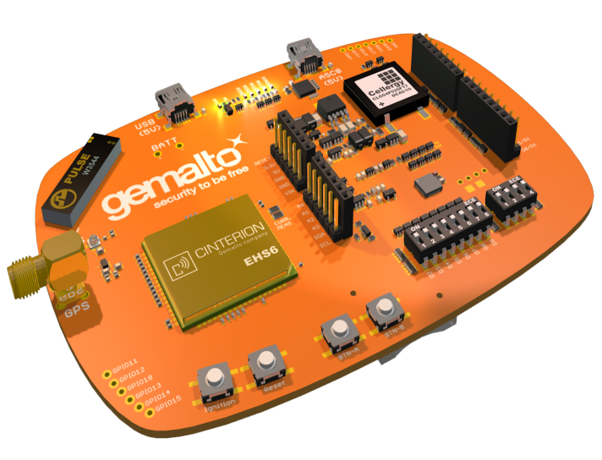
抢先体验 BubbleBoard!
可扩展的 Java 开发工具包
具有 Arduino 风格连接器的 HW 扩展
RS232 / USB 接口
通过 USB 或电池供电
用户按钮和 LED
板载 SIM 支架和集成式天线
所有接口均可访问
立即预订： www.gemalto.com/bubbleboard
扩展板
适用于传感器等
如需了解更多详情，请于 24 日周三
10:15 点前往430 室
M2M 和物联网入门

Slide 37
Java Embedded 规划
Java SE Embedded 8
全面的 JVM 整合
新增更多小型设备配置文件
JavaFX for Embedded
Java Embedded Suite 8
集成更多企业中间件
Flight Recorder/Mission Control
NetBeans IDE 8
Java ME/SE 8 Embedded 支持
Java ME Embedded 3.4
快速跟进
仅 QSC 平台
增强的设备上调试、监视
Java Embedded Suite 7
SE Embedded 7
Web 容器
嵌入式 SQL 数据库
2012
2013
2014
2015
2016
Java ME Embedded 3.3
设备 I/O 版本 B
增加 QSC、RPI 平台
空间占用优化和配置工具
Java ME SDK 3.3
改进开发人员工具和体验
针对 Java Embedded 11.1.1.7.1 的 Oracle Event Processing
针对嵌入式设备的实时数据捕获和分析
Java ME Embedded 3.2
Java for MCUs
STMF32 平台
设备 I/O 版本 A
Java ME SDK 3.2
嵌入式模拟器
Eclipse 集成
Java ME Embedded 8
Java ME 8
标准化的嵌入式 API
新的可移植架构
小型和完整配置文件
增加 FSC 平台
Java ME SDK 8
改进开发人员工具和体验
Java Embedded 9
Java ME 和 SE 9
基于 Jigsaw 的模块化
Notes:
We are leading the charge in embedded
In parallel, bringing the specs forward to enable the ecosystem.
Next year, updating specs in SE8 & ME8, enables alignment between the 2 platforms; ME will be a proper subset of SE.
JavaME releases will be synchronized with SE release.
Update release for JES and ME Embedded * ME SDK
Integrating enterprise middleware technology such as identity management & event processing capabilities into Java embedded platforms.
Java 9., developers will have even more flexibility with modularity with Jigsaw.

Slide 38
下载
Java Embedded
oracle.com/java
Oracle Java SE Embedded
Oracle Java ME Embedded
Oracle Java Embedded Suite
针对 Oracle Java Embedded 的 Oracle Event Processing

Slide 39
Java EE 战略
Cameron Purdy
云应用程序基础和 Java EE
副总裁
@cpurdy

Slide 40
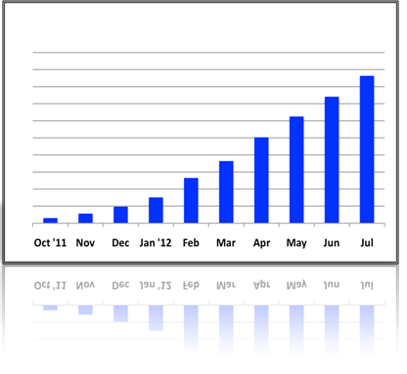
Java EE 的重点和方向
标准：专注于企业应用程序开发
工作效率：针对企业 Java 开发人员
可移植性： 跨供应商、跨云
可扩展性：采纳创新
模块化：支持模块化设计

Slide 41
Java EE 发展历程
Java EE 7
开发人员工作效率和 HTML5
易于开发
企业 Java 平台
轻型
强健性
EE 5、EE 6
28 个规范
J2EE
20 个规范
Web 服务
32 个规范
1998-2004
2005-2012
2013 － 未来
Notes:
Important to know where we came from
We heard from developers that we needed to focus more on them, and not just on new features. Beginning with Java EE 5, Java has focused on driving ease of use and consistency into the platform, and today we have a rich set of features designed to work together, which are expressed primarily as annotated Java Objects.
What’s beyond Java EE 7? Well, I’m not telling… You’ll have to stick around for the technical keynote for more details.

Slide 42
现已推出！
Java Platform, Enterprise Edition 7
社区驱动企业软件的标准

Slide 43
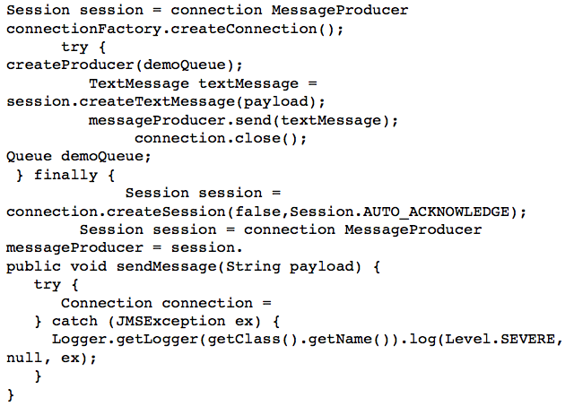
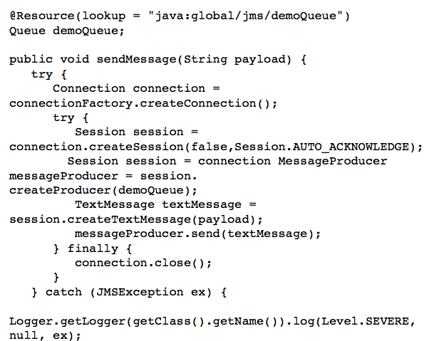
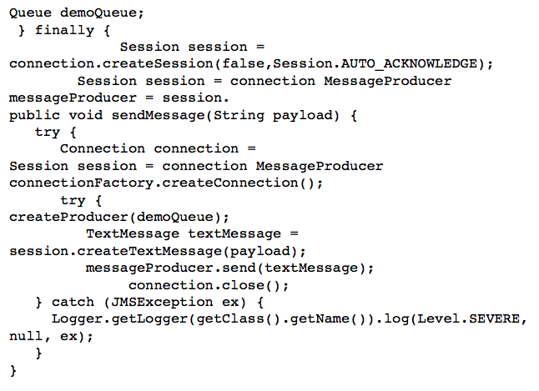
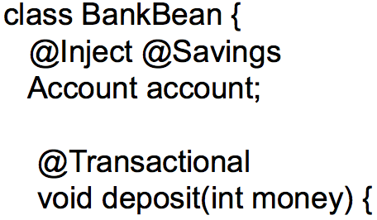
Java EE 7 主题
ENTERPRISE EDITION
开发人员
工作效率
满足 企业需求
Java EE 7
更多带批注的 POJO
更少的样板代码
内聚式集成平台
批处理
并发性
简化的 JMS
WebSocket
JSON
Servlet 3.1 NIO
REST
Notes:
Thanks to Infosys for their Java EE support, so what will Java EE 7 entail?
Need speaker notes here
Productivity
Html 5
Enterprise demands

Slide 44
Java EE 7 之于下一代应用程序
WebSocket
提供 HTML5 动态可伸缩应用
借助 WebSockets 通过低延迟数据交换缩短响应时间
借助标准 JSON 支持简化可移植应用程序的数据解析
提供异步、可伸缩、高性能的 REST 式服务
Notes:
Need speaker notes here

Slide 45
Java EE 7 之于开发人员
提高开发人员工作效率
借助内聚式集成平台，简化应用程序架构
通过减少样板代码和拓宽批注用途提高效率
通过标准 REST 式 Web 服务客户端支持增强应用程序可移植性
Java EE 7
Notes:
Need speaker notes here

Slide 46
Java EE 7 之于企业
可伸缩以满足最严苛的要求
将批量作业细分为可管理的块，以实现不中断的 OLTP 性能
轻松定义多线程并发任务以改进可伸缩性
简化通通过通过标准 Java 消息传递服务互操作性简化应用程序集成
Notes:
TRANS TO IBM VIDEO AFTER THIS SLIDE
To hear more about the Batch JSR and their overall contribution to Java, let’s tune in for a message from IBM.

Slide 47
Java EE 7 社区发展势头
您
187
Adopt a JSR
GlassFish
32
位专家
26
19
89
家公司
16
JUG
个发布的 Build 版本
14
个活跃项目
位规范领导者
14
活跃和透明的邮件列表
个采用的 JSR
个活跃 JSR
Notes:
ARUN: Thanks to IBM and thanks Cameron, but we all know that with just Oracle and our partners, Java EE would not be the mega power that it is.
You, our community, is what makes this all possible.
Overview of huge community
Reiteration that community makes or breaks the JCP, EE and Java as a whole

Slide 48
令人惊叹的 JSR 采用者
共同努力 我们将推动 JAVA EE
向前发展
这里是您的
JUG

Slide 49
Java：行业采用最为广泛
9,000,000 名 JAVA 开发人员
部署到 18 种符合 JAVA 标准的应用服务器
Notes:
TRANS TO INFOSYS VIDEO AFTER THIS SLIDE
But why does this matter?
18 EE 6-compliant app servers
Strategic to almost every major technology vendor, including Oracle
EE 6 adopted quickly, anticipate EE 7 standard to continue trend
EE affects the way the world does business, and that’s why we’re so excited
But it’s not just software vendors that bet their business on EE, there is an entire ecosystem around it.
To hear more from one of our important Ecosystem members, let’s turn over to InfoSys

Slide 50
还有更多 — Java EE 的后续发展
云、瘦服务器架构、NoSQL 等等！
多租户
NoSQL
JSON-B
并发
Java EE 的后续发展
状态 管理
存储
PaaS
支持
瘦服务器 架构
Notes:
Plans for EE 8

Slide 51
下载
Java EE 7 SDK
oracle.com/javaee
GlassFish 4.0
完整平台或 Web Profile
glassfish.org

