Slide 2
Java Strategy Keynote
Peter Utzschneider
Vice President
Java Product Management

Slide 3
The preceding is intended to outline our general product direction. It is intended for information purposes only, and may not be incorporated into any contract. It is not a commitment to deliver any material, code, or functionality, and should not be relied upon in making purchasing decisions. The development, release, and timing of any features or functionality described for Oracle’s products remains at the sole discretion of Oracle.

Slide 4
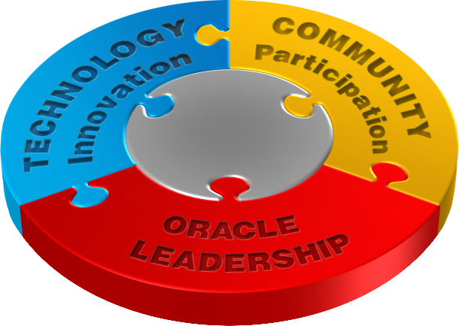
Make the Future Java
Platform Completeness
Modernization and Innovation
Developer Productivity
Open and Transparent Evolution
Active Community Involvement
Quality and Security
Notes:
When we say Make the Future Java, this really means the Platform and the Process.
In terms of creating the next generation Java platform,
From a high level, there are three areas we want to address here.
We want to fill in any and all gaps to make the platform complete. This is really about making sure Java works everywhere and for everyone. This is a broad topic that incorporates everything from adherence to standards to accessibility technologies.
We are driving innovation into the platform. As the largest software platform, the industry depends on Java to extend important innovations to its broad development community.
At the same time, developer productivity is a constant theme that permeates everything. For employers and managers, this is about lowering the cost of developing and maintaining products and services. For developers, it’s about being able to express themselves with as little unnecessary overhead as possible.
From a process perspective, it’s not only what to do with Java but how to get there. In many ways, Java pioneered the concept of open, collaborative evolution and this was a key to its initial success. Companies have bet their future on Java, and developers their careers. We owe all these constituents a transparent roadmap so that they can plan ahead, and a chance to help Java evolve in directions that are important to them, knowing that the Java skills they’re investing in are transferable across the platform so they can take advantage of the many different platforms without having to learn new skills. That means you can do more with Java than you ever thought possible.
Finally, quality and security are top priorities that permeates everything we do. Oracle takes these two very seriously because they are critical to our business, and because they are critical to the entire Java community.
Recently, vulnerabilities affecting Java SE have received a lot of public attention. A vast majority of these issues impact one specific Java use case – Java running in web browsers. A large number of Java programs run on the servers in data centers and as applications on the PC and desktop computers. These Java programs are not affected by most of the vulnerabilities identified recently.

Slide 5
The Java Family Where community sets the standards
Java SE
Java Embedded
Java EE
Java FX
Develop and deploy performant and secure applications across heterogeneous server environments.
Industry standard, integrated platform for server-side Java computing.
Enables cross-platform products for intelligent M2M systems and device-to-data-center solutions.
Premier platform for creating rich enterprise client applications.
Notes:
Java is the foundation for virtually every type of networked application and is the global standard for developing and delivering embedded and mobile applications, Web-based content and enterprise software. The breadth of the platform, its rich features, low cost, maturity, and application portability maximize developer opportunity.
Java SE: Release Java SE 7
Java EE: Released Java EE 7
JavaFX: Released JavaFX 2
Java Embedded: Released Java SE-E 3.3

Slide 6
Announcement
Oracle Java Platform Integrator Program
Extends Reach of Java in the Internet of Things (IoT)
Easily customize Java Embedded to reach breadth of devices
Greater development and deployment flexibility
Consistent platform portable across choice of hardware and OS
Reduce engineering complexity, time-to-market and cost
Learn More!
oracle.com/technetwork/java/embedded
Notes:
We are very excited to announce Java Enterprise Edition 7.
We're committed to Java EE, not just by leading Java EE 7, but also in the products that Oracle delivers.
This platform is a culmination of work by all of us, Oracle, our Java Partners and of course you, the Java community
So without further ado, I’d like to invite Cameron Purdy, VP of Development, to tell us more about the platform.
Congratulations Cameron (hand shake)

Slide 7
Be involved.
There’s
opportunities
for you.
YOUR PARTICIPATION
is the future of Java

Slide 8
Read: Java Magazine
60% Community-generated Content
80% Consider it a MUST READ
Subscribe Now!
oracle.com/javamagazine
2013 Maggie Award Winner
BEST DIGITAL-ONLY TRADE PUBLICATION
Notes:
Launched less than a couple of years ago, this magazine has already won prestigious awards
That’s because 60%... 85%...
Subscribe today and add your contribution
So hopefully you are excited as I am to be part of this community. Let me turn it back over to Cameron to share some more exciting news

Slide 9
Join: Java User Group
200+ Java User Groups Worldwide
100K+ Members
Join Now!
java.net/jugs
Notes:
Launched less than a couple of years ago, this magazine has already won prestigious awards
That’s because 60%... 85%...
Subscribe today and add your contribution
So hopefully you are excited as I am to be part of this community. Let me turn it back over to Cameron to share some more exciting news

Slide 10
Learn: Continue the Journey
Opening doors for computer science students in the 21st century
Helping over 1.9 million students in 97 countries
Learn from experienced Java instructors
Discounts on Oracle certification preparation and exams
academy.oracle.com
Notes:
Need even more?
Get training and expert help to accelerate your adoption

Slide 11
歡迎JavaOne大會
Welcome to JavaOne!
Huānyíng JavaOne dàhuì

Slide 12
Java SE Update
Nandini Ramani
Vice President
Java Platform
@eyeseewaters

Slide 13
Java SE Uptake
JDK 7: Adoption strong among ISVs, hosting providers, developers
JDK 8/9: Lambda, JavaScript interop and JVM convergence in 8, Jigsaw in 9
JDK 9 and beyond: Generic language interop, GPU programming, enhancements for cloud
100%
90%
80%
70%
60%
50%
40%
30%
20%
10%
Java 6
0%
Java 7
Oct
Nov
Dec
Jan
Feb
Mar
Apr
May
June
July
Aug
Source: Hosting statistics from Jelastic.com
Notes:
Just over a year ago we delivered Java SE 7 – the first major version of Java SE released
under Oracle’s stewardship. Since then we have delivered regular updates every couple
of months, with hundreds of bug fixes, performance improvements, and new features.
We are pleased with the speed of adoption of this new version. We are seeing strong
uptake among developers, ISVs, and hosting companies. Java SE 7 is rapidly making
its way into the enterprise as well.
In fact, Oracle (traditionally careful about upgrades) supports its entire FMW stack on
Java 7 because we know it has great quality and performance.
Even as of last August we were seeing massive adoption of Java SE 7, and you can see how rapidly releases become standards.

Slide 14
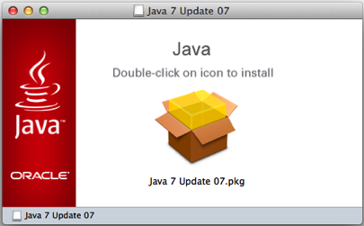
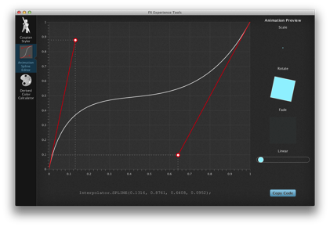
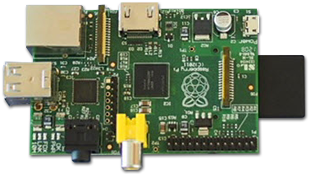
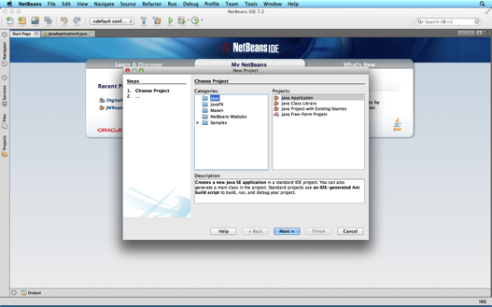
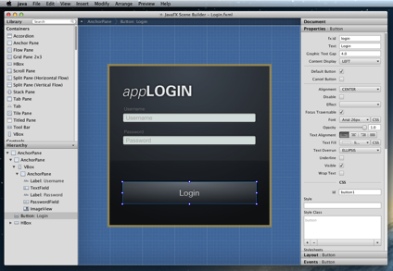
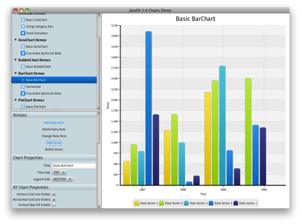
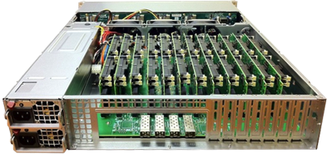
Java 7 on OS X and Linux/ARM
Ethernet
HDMI
Power
USB
SD Card
RCA Video
General Purpose I/O
Audio
Image source: Boston Ltd., UK
Notes:
In addition to the incremental improvements to Java 7, we have also increased the set of platforms supported by Oracle from Linux, Windows, and Solaris to now also include Mac OS X (“ten”) and Linux/ARM for ARM based PCs such as the Raspberry Pi and emerging ARM based microservers.
These are the first new ports of Java since 64 bit Windows in 2007 and 64 bit Linux in 2003.
So Oracle has released as many new ports In the last year for desktops and servers as were done in the preceding decade of Java SE’s history.
And new for JavaOne Brasil, I am pleased to relate that we will be making EA builds of the Linux ARM binary which supports the Hard Float ABI
for ARM v6/7 on platforms like the raspberry Pi available by the end of this calendar year.

Slide 15
JDK 8
Innovation
Lambda aka Closures
Language Interop
Nashorn
Java for Everyone
Profiles for constrained devices
JSR 310 - Date & Time APIs
Non-Gregorian calendars
Unicode 6.2
ResourceBundle.
BCP47 locale matching
Globalization & Accessibility
Client
Deployment enhancements
JavaFX 8
Java SE Embedded support
Enhanced HTML5 support
3D shapes and attributes
Printing
Core Libraries
Parallel operations for core collections APIs
Improvements in functionality
Improved type inference
Tools
Compiler control & logging
JSR 308 - Annotations on Java Type
Native app bundling
App Store Bundling tools
Security
Limited doPrivilege
NSA Suite B algorithm support
SNI Server Side support
DSA updated to FIPS186-3
AEAD JSSE CipherSuites
General Goodness
JVM enhancements
No PermGen limitations
Performance lmprovements
Notes:
While Java 7 updates and ports have been progressing, we have also been hard at work on Java 8.
Most people are aware that Project Lambda, adding closures to the Java language, is a key feature.
But there are lots of other features in the works. Some of my favorites are Bulk data operations on core collections APIs, and JVM improvements like removing the PermGen and new date and time APIs.
And as always, there are general improvements and updates to standards support around security, internationalization and accessibility
Of course we'll have more detail in the technical keynote and many sessions throughout the conference.
And remember that you can go to OpenJDK to see this development being done in real-time
change-set by change-set, and that there are weekly early access builds of OracleJDK 8 that you can download and try already today.

Slide 16
Java SE Roadmap
JDK 8 (Q1 2014)
Lambda
JVM Convergence
JavaScript Interop
JavaFX 8
3D API
Java SE Embedded support
Enhanced HTML5 support
JDK 9
Modularity – Jigsaw
Interoperability
Cloud
Ease of Use
JavaFX JSR
Optimizations
7u40
Java Flight Recorder
Java Mission Control 5.2
Java Discovery Protocol
Native memory tracking
Local Security Policy
7u21
Java Client Security Enhancements
App Store Packaging tools
JDK 8u40
2013
2014
2015
2016
NetBeans IDE 7.3
New hints and refactoring
Scene Builder Support
NetBeans IDE 8
JDK 8 support
Scene Builder 2.0 support
Scene Builder 2.0
JavaFX 8 support
Enhanced Java IDE support
JDK 8u20
Deterministic G1
Java Mission Control 6.0
Improved JRE installer
App bundling enhancements
NetBeans IDE 9
JDK 9 support
Scene Builder 3.0 support
Scene Builder 3.0
JavaFX 9 support
Scene Builder 1.1
Linux support
Notes:
Just to summarize the releases we have been taking about, this is the roadmap, Not going to go through it in detail.
CHANGED: JDK 8, from “Complete JVM convergence to just JVM Convergence”
Added the features for 7u10

Slide 17
DOWNLOAD
Java SE 7
oracle.com/java
TEST PREVIEW
Java SE 8 EA
openjdk.java.net

Slide 18
JavaFX Update

Slide 19
JavaFX Today
Native Deployment
Linux
Charts
FXML
OpenJFX
Multi-Touch
1080p
Writeable Image
Mac
Pagination
HTML5
Web history
Scene Builder
Charts
ComboBox
PixelWriter
Swing integration
h.264
for Windows and Mac OS X
HTTP Live Streaming
GroovyFX
Windows
ScalaFX
Canvas
Hardware Accelerated Graphics
UI Controls
e(fx)clipse
WebView
i18n
ColorPicker
JavaScript-to-Java
SWT integration
Notes:
Over the last year, signficiant progress
Ports to Linux, Mac, early access on Linux/ARM
SceneBuilder tooling, with NB integration
HTML 5, including canvas
Media including H.264
Lots of new controls
Interop with Swing and SWT
Also numerous community projects like E(fx)clipse, DataFX, language additions such ScalaFX, Ruby FX and much more

Slide 20
JavaFX Deployments
Notes:
Intended as swing replacement in Rich interactive desktop applications
We’ve seen a lot of positive adoption of JavaFX, both in the developer community as well as with established enterprises.
Here are some examples
Quantcell - data analytics
Healthcon - Healthcare
Celer - Trading app in just 6 months
Navis – Shipping container management
Belgian Railways - Train management
CaptainCasa - Enterpriise application framework
Mint Software Systems- Training Management System for air navigation
DooApp – Visual diagnosis of building energy consumption

Slide 21
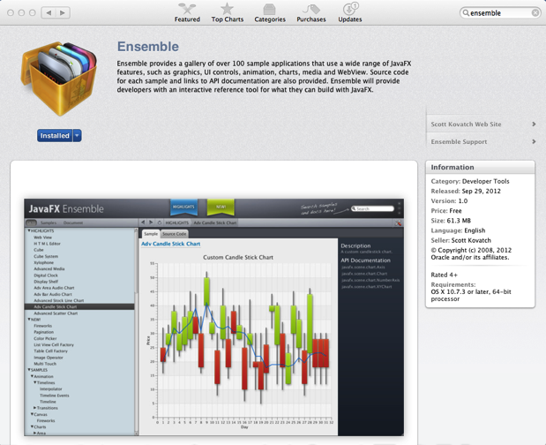
Fun with Mac App Store and OpenJFX!
http://openjdk.java.net/projects/openjfx
http://javafx-jira.kenai.com/secure/Dashboard.jspa
JavaFX technology holds a lot of promise and developing it in an open-source manner only makes it more so. We would like to contribute to this project just like we contribute to OpenJDK.
-- Deepak Bhole, Red Hat
Notes:
App Store
Future for client deployment
Already possible, Ensemble is in app store
Download it, let’s get it to number #1!
Will improve tools and docs to make this really easy
And we have now fully open-sourced JavaFX as we committed to
OpenJFX
Continue to release more parts of JavaFX to OpenJFX
Start seeing 3rd parties joining, including Red Hat who recently announced on the OpenJFX mailing lists
Would like to see contributors from Shanghai, come talk to us during this conference!

Slide 22
JavaFX 8 and Beyond
Embedded
Printing
Maven
Multi-Touch
UI Controls Public API
SwingNode
Scene Builder
Advanced Cells
for Linux
Rich Text
TreeTableView
3D
Complex characters
Snapshot
ARM
Performance
Accessibility
IntelliJ
Notes:
Some key future features
Multi Touch
Improved integration with Swing
Support for ARM and other embedded systems

Slide 23
JavaFX Roadmap
JDK 8 (Q1 2014)
Lambda
JVM Convergence
JavaScript Interop
JavaFX 8
3D API
Java SE Embedded support
Enhanced HTML5 support
JDK 9
Modularity – Jigsaw
Interoperability
Cloud
Ease of Use
JavaFX JSR
Optimizations
7u40
Java Flight Recorder
Java Mission Control 5.2
Java Discovery Protocol
Native memory tracking
Local Security Policy
7u21
Java Client Security Enhancements
App Store Packaging tools
JDK 8u40
2013
2014
2015
2016
NetBeans IDE 7.3
New hints and refactoring
Scene Builder Support
NetBeans IDE 8
JDK 8 support
Scene Builder 2.0 support
Scene Builder 2.0
JavaFX 8 support
Enhanced Java IDE support
JDK 8u20
Deterministic G1
Java Mission Control 6.0
Improved JRE installer
App bundling enhancements
NetBeans IDE 9
JDK 9 support
Scene Builder 3.0 support
Scene Builder 3.0
JavaFX 9 support
Scene Builder 1.1
Linux support
Notes:
Just to summarize the releases we have been taking about, this is the roadmap, Not going to go through it in detail.
CHANGED: JDK 8, from “Complete JVM convergence to just JVM Convergence”
Added the features for 7u10

Slide 24
DOWNLOAD
JavaFX
oracle.com/javafx
JavaFX 2
Full Premier Platform for
Rich Enterprise Client Applications
Notes:
* Be sure to download JDK 8 EA (now offering JavaFX integration)

Slide 25
Java Embedded Update

Slide 26
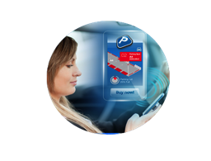
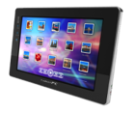
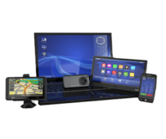
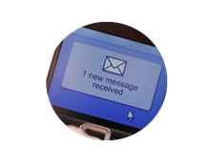
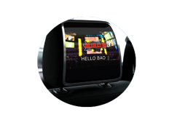
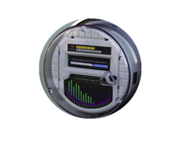
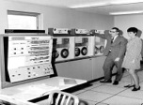
The 3rd IT Revolution
Standards Based Hardware & Software
Proprietary Hardware & Software
x86 Architecture/ Windows OS
Host Era
PC Era
Internet of Things
1960 - 1985
1985-2006
2006 - 2025
Notes:
For context, Given the trends in M2M and Internet of things, We believe the Java embedded space is exciting
1990s - internet of computers, connected PCs, and the Web
2000s - proliferation in people becoming connected.
3rd wave is the internet of things. Devices all around us - On 24x7, connected all the time
Explosion of devices is the next IT revolution Java is the right solution for this space.
Java embedded solutions provide a framework to provision, manage, and secure devices
Also ability to aggregate, process and analyze multitude of data.
One platform to program them all.

Slide 27
World Population
6.3 Billion
6.8 Billion
7.2 Billion
7.6 Billion
Connected Devices
500 Million
12.5 Billion
25 Billion
50 Billion
Connected Devices
Per Person
0.08
1.84
3x
3.47
5x
6.58
2003
2010
2015
2020
More connected devices than people
Source: Cisco, April 2013
Notes:
We’ve already reached a tipping point where the number of connected devices outnumber people on earth.
All of these devices, from remote sensors to autonomous machines offer newfound value to businesses and developers alike.
And Java can help driving greater value and provide an easier runway for you to be creative in creating the next set of applications that operate the embedded device world that surrounds us.

Slide 28
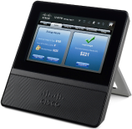
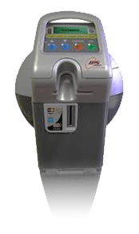
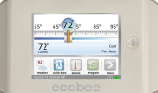
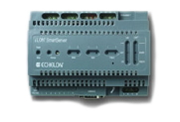
Java Embedded – Connected Devices
Foundation for the ‘Internet of Things’
Device to Data Center Platform for M2M
Middleware
Enterprise Data & Applications
DEVICES
GATEWAYS
DATA CENTER
Notes:
Java Embedded: Driving "Device to Datacenter" strategy aimed at providing a standard development platform for the Internet of Things. Introduced a broad range of products spanning from Java ME for sensors and other microcontroller-based devices, through Java SE Embedded for gateways and concentrators to Java Embedded Suite which is a complete middleware stack for high-end IoT gateways. Formed key partnerships with companies like Qualcomm and Freescale, and with significant market interest.
Java ME will move to a generic small footprint platform, with Oracle investing towards enabling edge devices in the Internet of Things.
Java Card will continue in its role as a secure OS for smart cards, but also expand to be a security layer for any type of client including embedded.

Slide 29
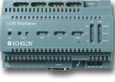
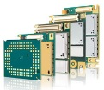
Current Embedded Releases
Java ME Embedded 3.3
Runtime for small embedded devices: Microcontroller class platforms
Java Embedded Suite 7.0
Pre-integrated full featured Java Embedded Platform
Enterprise Data & Applications
3.1.1
DB
Embedded
OEP Embedded
Filter, correlate and process streaming events in real-time
EDGE DEVICES
GATEWAYS/CONCENTRATORS
Notes:
(2 new Java embedded products ito address the internet of things)
3 categories of compute devices:
1st – Small edge devices like thermostats and sensors, directly connected to the backend through an operator network with a gateway as the hub.
2nd - Gateway i- coordinates a local network and as the name implies, acts as a gateway to the backend.
3rd - Backend, which could be the data center or cloud.
Oracle enables Java everywhere in the internet of things.
Java ME compliant platform optimized for micro controller and other low powered devices. new functionality to interact with peripherals such as SD cards.
JES, integrated middleware stack based on SE 7 embedded, Java DB, and versions of GlassFish and the Jersey Web Services stack optimized for small footprint devices.
enables remote management and interoperability with a Java-based backend.
“To demonstrate how Oracle’s Java Embedded technology investments are making a real-world difference, I’d like to invite Chris Baker (enter title here at Oracle) and Axel Hansmann (VP Strategy & MarCom M2M at Gemalto) to the stage.”

Slide 30
Oracle’s Java Embedded Strategy and Vision
NOTE FOR NANDINI: Evaluate if this slide is needed
Make Java the #1 Platform for embedded
Create a unified development experience
Provide a complete embedded solution
Grow the Java embedded ecosystem
Notes:
Outline of overall vision for Oracle’s investment. (Bullets speak for themselves, but some color here):
Java can provide enormous value to developers and enterprises, and that value is greatly magnified the more Java there is.
At Oracle, we intend to make Java #1. A key aspect of this is enabling the same ease of development (as you have for web or mobile applications), for embedded devices and end-to-end applications including end-to-end devices.
You should only need ONE unified development experience across all the application and devices you create and Java can be that technology for you
Oracle will seed the market by providing a very competitive Java platform and products based on it, with a complete feature set. We do the plumbing, you the business logic.
But as with Java elsewhere, we believe that the path to success is through a rich ecosystem of developers, partners, SIs, standards, etc

Slide 31
Enabling a Smarter Connected World
GEMALTO M2M
Axel HANSMANN
2013-07-23

Slide 32
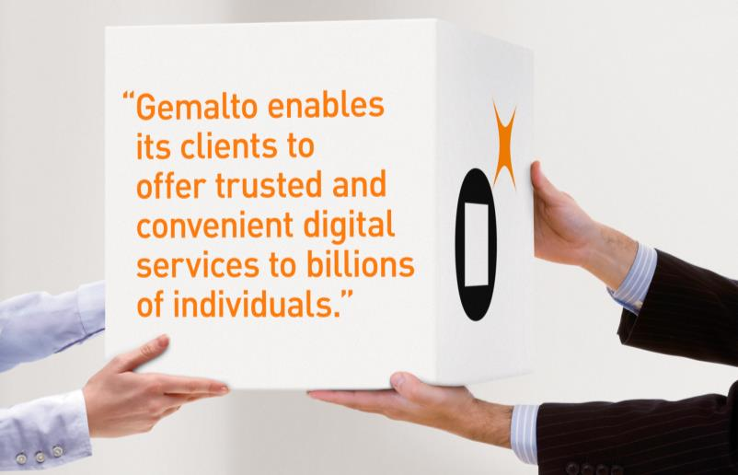
Gemalto: Our Company at-a-Glance
OUR CUSTOMERS
190
Countries where we have customers
3000+
Financial institutions
450+
Mobile operators
80
eGovernment programs
Notes:
Gemalto helps people to trust one another in an increasingly connected digital World
We develop secure software that runs on trusted devices
We manage the devices and the confidential information that they contain

Slide 33
Gemalto M2M Solutions Enable a Connected World
GEMALTO M2M
We help customers around the world connect their machines
Invented cellular M2M in 1994
We brought Java to M2M
Supporting more than 50 million devices in the field
Our solutions:
Enable new business models
Automate industrial processes
Reduce support costs
Optimize use of resources
Work reliably for a long time

Slide 34
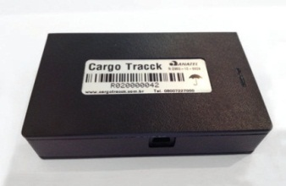
Gemalto M2M Connects the World Around You ...
RMC
Smart meters
Smart Energy
Home Alarm
Transport
Tracking
... and Everywhere
Security
Connected street lights
ITS
Logistics
Automotive
Digital Signage
mHealth
eMobility

Slide 35
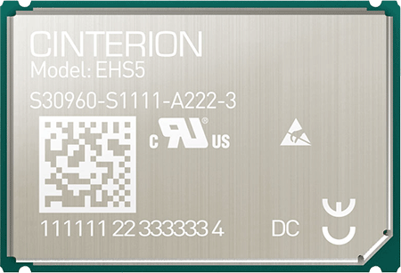
Gemalto Delivers Benefits of Java to M2M
Cinterion EHS5 Java Module
Benefits of Java in M2M
Lower Bill of Materials (BOM)
More efficient development
Enables next generation architectures
Higher flexibility in design and development
Improved management of the application
Java ME embedded 3.2
HSPA 7.2M/5.7M connectivity
Ruggedized for industrial applications
Wide range of interfaces
Global coverage
So how do you get started?

Slide 36
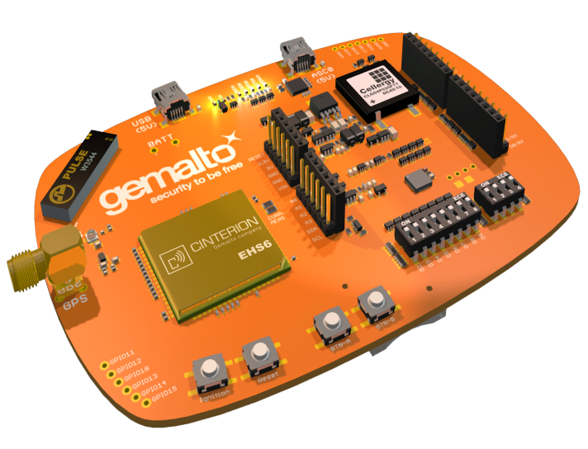
Say Hello to BubbleBoard!
Coming this Fall
Extendable Java Development Kit
HW-extensions with Arduino-style Connector
RS232 / USB Interface
Power via USB or battery
User buttons and LEDs
On board SIM holder and integrated antenna
All interfaces accessible
Pre-order now: www.gemalto.com/bubbleboard
ExtensionBoard
for Sensors, etc.
Find out more Wednesday at 10:15 in ROOM 430
Getting started with M2M and the Internet of Things

Slide 37
Java Embedded Roadmap
Java SE Embedded 8
Complete JVM convergence
Additional compact profiles
JavaFX for Embedded
Java Embedded Suite 8
Additional enterprise middleware integrations
Flight Recorder/Mission Control
NetBeans IDE 8
Java ME/SE 8 Embedded support
Java ME Embedded 3.4
Fast follow-on
QSC platform only
Enhanced on-device debugging, monitoring
Java Embedded Suite 7
SE Embedded 7
Web Container
Embedded SQL DB
2012
2013
2014
2015
2016
Java ME Embedded 3.3
Device I/O ver B
Adds QSC, RPI platforms
Footprint optimization & configuration tools
Java ME SDK 3.3
Improved developer tooling & experience
Oracle Event Processing for Java Embedded 11.1.1.7.1
Real-time data capture and analysis for embedded devices
Java ME Embedded 3.2
Java for MCUs
STMF32 platform
Device I/O ver A
Java ME SDK 3.2
Embedded emulator
Eclipse integration
Java ME Embedded 8
Java ME 8
Standardized Embedded API
New portable architecture
Small and full profiles
Adds FSC platform
Java ME SDK 8
Improved developer tooling & experience
Java Embedded 9
Java ME and SE 9
Modularity based on Jigsaw
Notes:
We are leading the charge in embedded
In parallel, bringing the specs forward to enable the ecosystem.
Next year, updating specs in SE8 & ME8, enables alignment between the 2 platforms; ME will be a proper subset of SE.
JavaME releases will be synchronized with SE release.
Update release for JES and ME Embedded * ME SDK
Integrating enterprise middleware technology such as identity management & event processing capabilities into Java embedded platforms.
Java 9., developers will have even more flexibility with modularity with Jigsaw.

Slide 38
DOWNLOAD
Java Embedded
oracle.com/java
Oracle Java SE Embedded
Oracle Java ME Embedded
Oracle Java Embedded Suite
Oracle Event Processing for Oracle Java Embedded

Slide 39
Java EE Strategy
Cameron Purdy
Vice President
Cloud Application Foundation and Java EE
@cpurdy

Slide 40
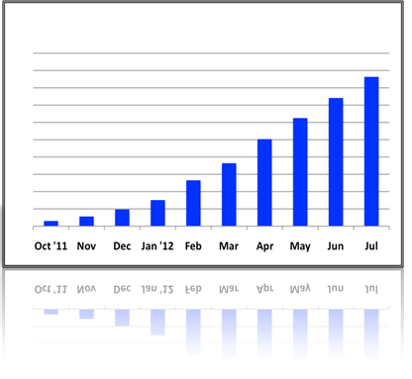
Java EE Focus and Direction
Standard: For Developing Enterprise Applications
Productivity: For Enterprise Java Developers
Portability: Across vendors, across clouds
Extensibility: Embracing innovation
Modularity: Supporting modular design

Slide 41
Java EE Journey
Java EE 7
Developer Productivity & HTML5
Ease of Development
Enterprise Java Platform
Lightweight
Robustness
EE 5, EE 6
28 specs
J2EE
20 specs
Web Services
32 specs
1998-2004
2005-2012
2013 - Future
Notes:
Important to know where we came from
We heard from developers that we needed to focus more on them, and not just on new features. Beginning with Java EE 5, Java has focused on driving ease of use and consistency into the platform, and today we have a rich set of features designed to work together, which are expressed primarily as annotated Java Objects.
What’s beyond Java EE 7? Well, I’m not telling… You’ll have to stick around for the technical keynote for more details.

Slide 42
Now Available!
Java Platform, Enterprise Edition 7
The standard in community-driven enterprise software
Notes:
We are very excited to announce Java Enterprise Edition 7.
We're committed to Java EE, not just by leading Java EE 7, but also in the products that Oracle delivers.
This platform is a culmination of work by all of us, Oracle, our Java Partners and of course you, the Java community
So without further ado, I’d like to invite Cameron Purdy, VP of Development, to tell us more about the platform.
Congratulations Cameron (hand shake)

Slide 43
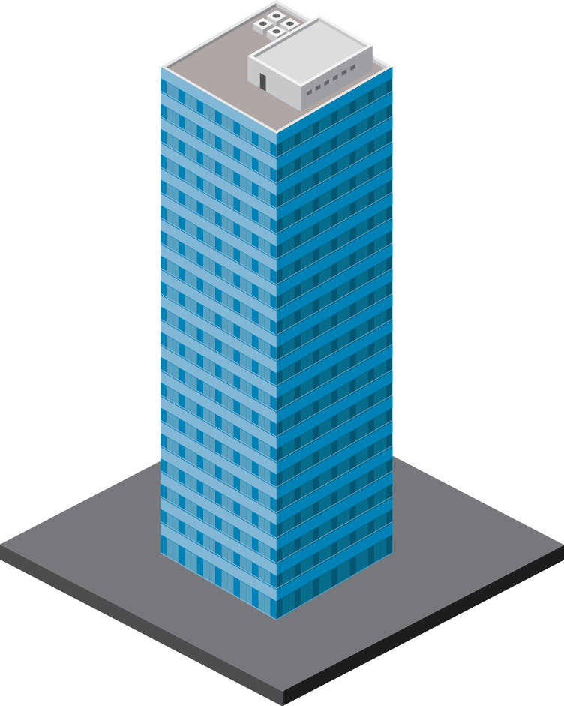
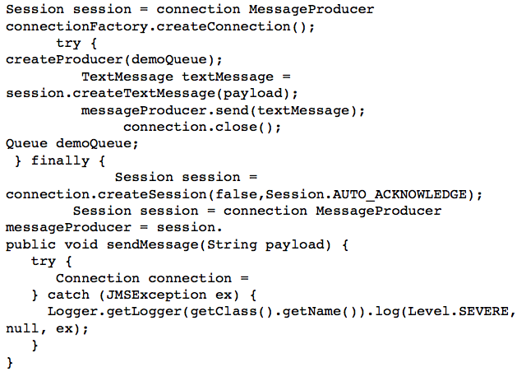
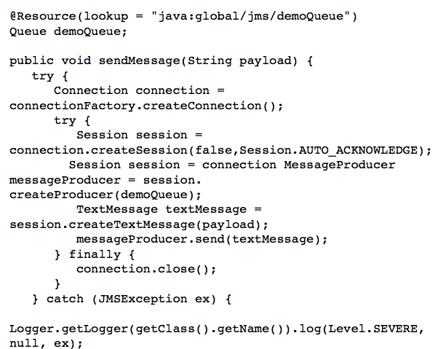
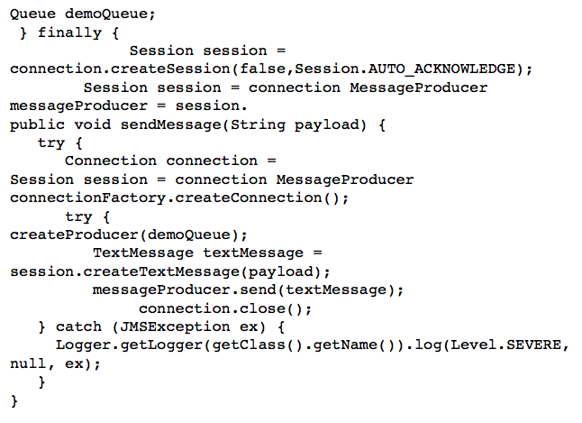
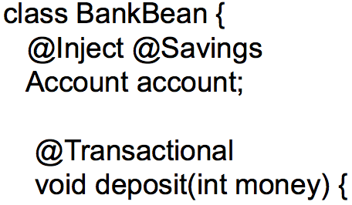
Java EE 7 Themes
ENTERPRISE EDITION
DEVELOPER
PRODUCTIVITY
MEETING ENTERPRISE DEMANDS
Java EE 7
More annotated POJOs
Less boilerplate code
Cohesive integrated platform
Batch
Concurrency
Simplified JMS
WebSockets
JSON
Servlet 3.1 NIO
REST
Notes:
Thanks to Infosys for their Java EE support, so what will Java EE 7 entail?
Need speaker notes here
Productivity
Html 5
Enterprise demands

Slide 44
Java EE 7 for Next Generation Applications
WebSockets
Deliver HTML5 Dynamic Scalable Apps
Reduce response time with low latency data exchange using WebSockets
Simplify data parsing for portable applications with standard JSON support
Deliver asynchronous, scalable, high performance RESTful Services
Notes:
Need speaker notes here

Slide 45
Java EE 7 for the Developer
Increased Developer Productivity
Simplify application architecture with a cohesive integrated platform
Increase efficiency with reduced boiler-plate code and broader use of annotations
Enhance application portability with standard RESTful web service client support
Java EE 7
Notes:
Need speaker notes here

Slide 46
Java EE 7 for the Enterprise
Scaling to the Most Demanding Requirements
Break down batch jobs into manageable chunks for uninterrupted OLTP performance
Easily define multithreaded concurrent tasks for improved scalability
Simplify application integration with standard Java Messaging Service interoperability
Notes:
TRANS TO IBM VIDEO AFTER THIS SLIDE
To hear more about the Batch JSR and their overall contribution to Java, let’s tune in for a message from IBM.

Slide 47
Java EE 7 Community Momentum
YOU
187
Adopt a JSR
GlassFish
32
EXPERTS
26
19
89
COMPANIES
16
JUGs
PROMOTED BUILDS
14
ACTIVE PROJECTS
SPEC LEADS
14
Active and transparent mailing lists
JSRs ADOPTED
ACTIVE JSRs
Notes:
ARUN: Thanks to IBM and thanks Cameron, but we all know that with just Oracle and our partners, Java EE would not be the mega power that it is.
You, our community, is what makes this all possible.
Overview of huge community
Reiteration that community makes or breaks the JCP, EE and Java as a whole

Slide 48
Amazing JSR Adopters
TOGETHER WE CAN MOVE JAVA EE
FORWARD
Your JUG
here

Slide 49
Java: Broadest Industry Adoption
9,000,000 JAVA DEVELOPERS
DEPLOYING TO 18 JAVA EE COMPLIANT APPLICATION SERVERS
Notes:
TRANS TO INFOSYS VIDEO AFTER THIS SLIDE
But why does this matter?
18 EE 6-compliant app servers
Strategic to almost every major technology vendor, including Oracle
EE 6 adopted quickly, anticipate EE 7 standard to continue trend
EE affects the way the world does business, and that’s why we’re so excited
But it’s not just software vendors that bet their business on EE, there is an entire ecosystem around it.
To hear more from one of our important Ecosystem members, let’s turn over to InfoSys

Slide 50
And There Is More – Java EE Next Steps
Cloud, Thin Server Architecture, NoSQL and More!
Multi-
Tenancy
NoSQL
JSON-B
Concurrency
Java EE Next Steps
State Management
Storage
PaaS
Enablement
Thin Server Architecture
Notes:
Plans for EE 8

Slide 51
DOWNLOAD
Java EE 7 SDK
oracle.com/javaee
GlassFish 4.0
Full Platform or Web Profile
glassfish.org

