Slide 1
Java EE
Arun Gupta
Java Technology Ambassador
@arungupta

Slide 2
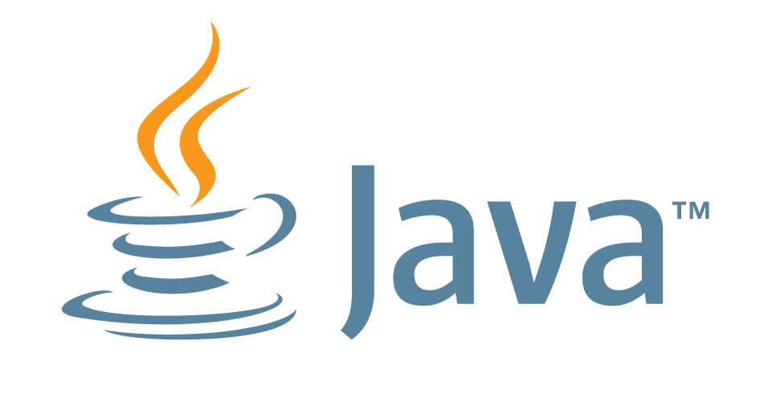
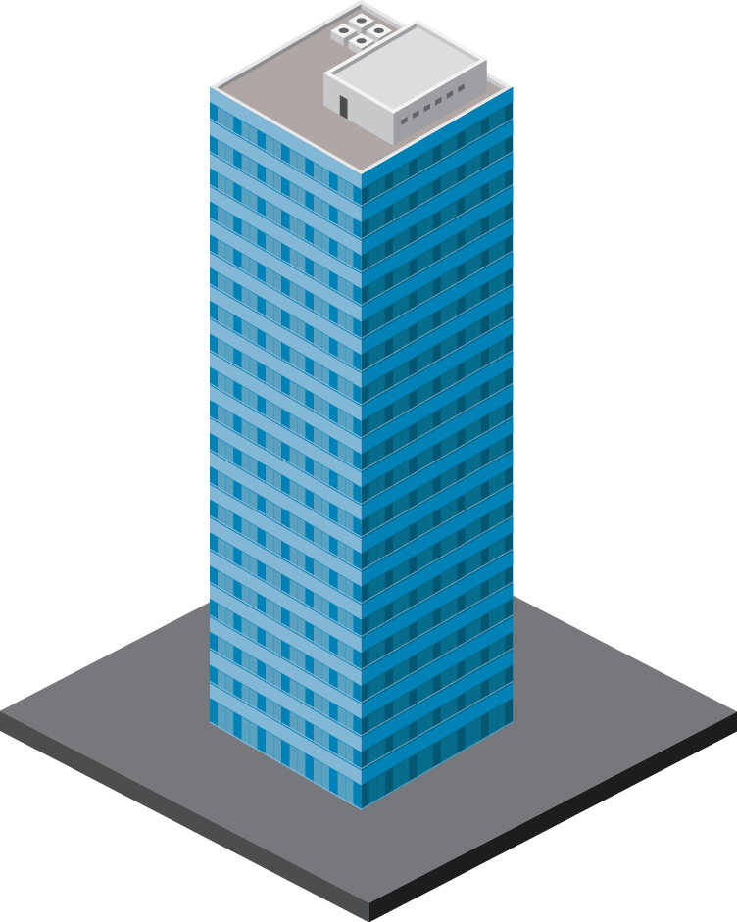
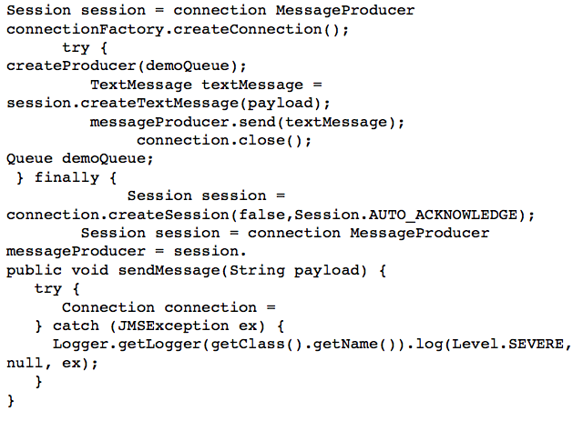
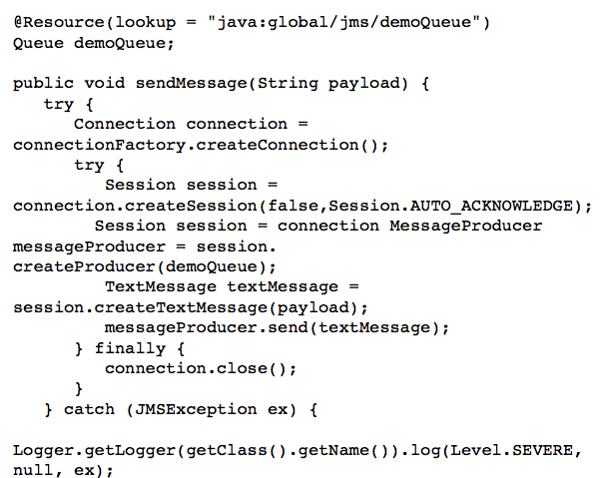
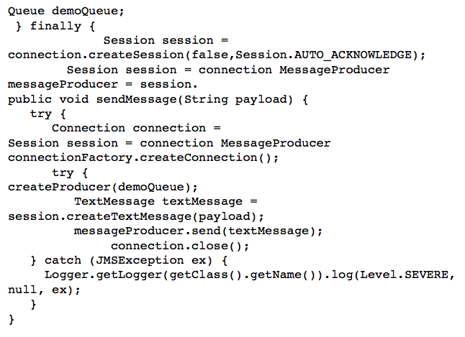
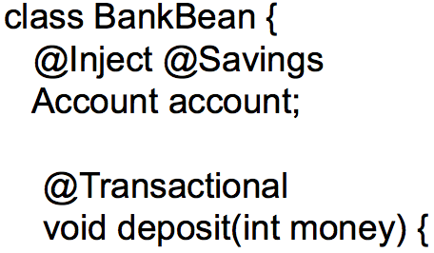
Java EE 7 Themes
ENTERPRISE EDITION
DEVELOPER
PRODUCTIVITY
MEETING ENTERPRISE DEMANDS
Java EE 7
More annotated POJOs
Less boilerplate code
Cohesive integrated platform
Batch
Concurrency
Simplified JMS
WebSockets
JSON
Servlet 3.1 NIO
REST
Notes:
Thanks to Infosys for their Java EE support, so what will Java EE 7 entail?
Need speaker notes here
Productivity
Html 5
Enterprise demands

Slide 3
JSON Processing 1.0
API to parse and generate JSON
Streaming API
Low-level, efficient way to parse/generate JSON
Similar to StAX API in XML world
Object Model API
Simple, easy to use high-level API
Similar to DOM API in XML world
Notes:
JSON is lingua franca for HTML5
Analogous to JAXP and JAXB in the XML world, JSON-P is aligned with JAXP
Low-level Streaming API, generates events such as START_OBJECT, START_ARRAY, KEY_NAME, VALUE_STRING, etc. Use Streaming API for more control over parsing.
High-level Object Model API, built on top of Streaming API. Allows to read JSON data structure as JsonObject and JsonArray. Use this API if you only care about reading the entire structure, it reads the entire structure in the memory as opposed to Streaming which only reads the relevant parts of the structure.
When do I use what ? – If you need to cross-reference objects, then use Object Model API. If you just want to parse specific parts of object then use Streaming API.
In both cases, read JSON data structure from a Reader/InputStream. Write to a Writer/OutputStream.

Slide 4
Java API for WebSocket 1.0
Server and Client WebSocket Endpoint
Annotated: @ServerEndpoint, @ClientEndpoint
Programmatic: Endpoint
Lifecycle methods
Packaging and Deployment
@ServerEndpoint(“/chat”) public class ChatServer { @OnMessage public void chat(String m) {
. . . }
}
Notes:
WebSocket provides a bi-directional and full-duplex communication channel over a single TCP connection. Bi-directional allows a client to send a message to server and vice versa. Full-duplex allows client and server to communicate with each other without waiting for the other party. An HTTP connection is upgraded using a standard mechanism to a WebSocket connection and then all messages exchanged over that connection are framed using the WebSocket protocol. The best part is that all messages are exchanged over a single TCP connection. This allows a more efficient usage of the connection and, unlike HTTP, avoids setting up and tearing down of connection with every message exchange.
Java API for WebSocket 1.0 allows to setup a client and server endpoint using annotations and programmatically. Annotated endpoint allows to convert a POJO into an endpoint by using @ServerEndpoint and @ClientEndpoint annotations and specifying the URI where the endpoints are hosted. Programmatic endpoints are defined by extending Endpoint class.
There are also annotations defined for callback handlers that allow a business method to be called when the WebSocket connection is opened, closed, or an error is received. Of course, there is an annotation that allows a method to be invoked when a message is received at the endpoint. The payload of the incoming message is tied to the method parameter and optionally can also provide more information about the other end of the connection.
The spec also defines how endpoints can be packaged in a WAR file and how a client-side endpoints can be packaged in a JAR file.
Lets look at a video from Johan Vos/Belgium JUG where they conducted a hackathon using JSR 356 as part of Adopt-a-JSR.

Slide 5
HTML5-Friendly Markup in JavaServer Faces 2.2
Pass-through attributes and elements
No need for a priori knowledge of set of allowable attributes
Enables HTML5 type and data-* attributes
<h:inputText value="#{userBean.color}” p:type="color"/>
Notes:
The set of available attributes supported by a JSF component is determined by the combination of the UIComponent and Renderer for that tag. In some cases the value of the attribute is interpreted by the UIComponent or Renderer (for example, the columns attribute of h:panelGrid) and in others the value is passed straight through to the user agent (for example, the lang attribute of h:input Text). In both cases, the UIComponent/Renderer has a priori knowledge of the set of allowable attributes. Other attributes are ignored.
HTML5 adds a series of new attributes for existing elements. Those attributes includes things like the type attribute for input elements, supporting values such as email, url, tel, number, range, and date.
<input type="email" name="myEmail"/>
This code fragment allows the browser to check the entered text is in email format.
JSF 2.2 supports these attributes by introducing Pass Through Attributes and Elements. They allow to list arbitrary name value pairs in a component that are passed straight through to the user agent without interpretation by the UIComponent or Renderer.

Slide 6
Get More from Less: Simplified JMS
Java EE 7
New JMSContext interface
AutoCloseable JMSContext, Connection, Session, …
Use of runtime exceptions
Method chaining on JMSProducer
Simplified message sending
Notes:
Sending and Receiving a JMS message using JMS 1.1 requires lot of boilerplate code, primarily because the API was designed 10+ years ago. Leveraging improvements in the Java EE platform over the past few years, JMS 2.0 introduces a “new simplified API” that requires much less boilerplate code. For example, JMSContext is the main interface in this new API. It combines in a single object the functionality of two separate objects from the JMS 1.1 classic API: a Connection and a Session. In Java EE 7, a container-managed JMSContext can be simply injected using @Inject annotation. createProducer creates a JMS producer and createConsumer creates a JMS consumer.
Another area where we have made huge improvement is how to invoke a REST endpoint from a Java client. Up until now you need to establish a connection using HttpUrlConnection, setup all the metadata, do all the data binding, error checking, etc. With newly introduced JAX-RS 2 Client API, we can now use a fluent builder-style API to invoke a REST endpoint. This APIs builds on existing concepts in the specification and reduces the amount of boilerplate code.
We have also added more annotations that can be placed on POJOs to simplify development and deployment process for resources that need to be explicitly created otherwise. For example, @JMSDestinationDefinition can create a JMS destination and register with JNDI instead of relying upon manual creation in an application-server specific way. Similarly @MailSessionDefinition defines a MailSession to be registered with JNDI and @ConnectionFactoryDefinition defines a Connector Connection Factory to be registered with JNDI.

Slide 7
Cohesive Integrated Platform
Java EE 7
CDI is core component model
New CDI scopes: @TransactionScoped, @FlowScoped
JSF 2.2 now strongly aligned with CDI
@Transactional: Interceptor Binding
@Priority: Interceptor Ordering
Bean Validation on POJOs
Notes:
CDI is making the platform lot more cohesive and is becoming a core component model.
- Up until now, only EJBs had the ability to declare container-managed transactions. Starting with Java EE 7, JTA 1.2 introduces @javax.transaction.Transactional annotation. It provides an application the ability to declaratively control transaction boundaries on CDI managed beans, as well as classes defined as managed beans such as servlets, JAX-RS resource classes, and JAX-WS service endpoints.
A new CDI scope, @TransactionScoped, is defined that ties a bean lifecycle to the currently active JTA transaction. Similarly JSF introduces Faces Flow that provides an encapsulation of related pages and corresponding backing beans as a module. This module has well-defined defined entry and exit points assigned by the application developer. A new CDI scope is introduced that allows automatic activation/passivation of the bean as the scope is entered/exited.
JSF 2.2 spec says “The annotations in the package javax.faces.bean will be deprecated in a version of the JSF specification after 2.2.” Planned for deprecation now, and actual deprecation in 2.2+. Highly recommended to use @Named for backing beans.
Interceptors can be more generically applied to all CDI beans ???
First release of Bean Validation provided integration with JPA and JSF. Now not only it provides integration with JAX-RS, it also allows constraints to be specified on POJOs making it much more widely usable.

Slide 8
Default Resources
Java EE 7
JMS: java:comp/DefaultJMSConnectionFactory
JDBC/JPA: java:comp/DefaultDataSource
Concurrency
java:comp/DefaultManagedExecutorService
java:comp/DefaultManagedScheduledExecutorService
java:comp/DefaultManagedThreadFactory
java:comp/DefaultContextService
Notes:
A typical Java EE application requires a database and possibly a JMS service. In order to use these components, a container managed PersistenceContext needs to be injected using a DataSource. Similarly a JMSContext needs to be injected using JMSConnectionFactory. Developers have to manually create these objects in an application-server specific way before getting started. With the newly added Concurrency Utilities for Java EE, ManagedExecutorService and other managed objects need to be registered in the JNDI namespace before they can be used. Even though this might be a simple operation but each application server has their own way to create these resources.
Java EE 7 now provides

Slide 9
Concurrency Utilities for Java EE 1.0
Extension of Java SE Concurrency Utilities API
Provide asynchronous capabilities to Java EE application components
Provides 4 types of managed objects
ManagedExecutorService
ManagedScheduledExecutorService
ManagedThreadFactory
ContextService

Slide 10
Batch Applications for Java Platform 1.0
Suited for non-interactive, bulk-oriented, and long-running tasks
Batch execution: sequential, parallel, decision-based
Processing Styles
Item-oriented: Chunked (primary)
Task-oriented: Batchlet

Slide 11
DOWNLOAD
JAVA EE 7 SDK
oracle.com/javaee
GlassFish 4.0
Full Platform or Web Profile
glassfish.org

