Slide 1



JavaFX 3D in 10 Minutes
Jim Weaver
Java Technology Ambassador
james.weaver@oracle.com
weibo.com/JavaFXpert 请关注我
@javafxpert

Slide 2

JavaFX 3D in 10 Minutes

Slide 3
JavaFX 3D Use Cases
Inventory and Process Visualization
Scientific and Engineering Visualization
3D Charting
Mechanical CAD and CAE
Medical Imaging
Product Marketing
Architectural Design and Walkthroughs
Advanced User Experience
Mission Planning
Training
Entertainment
3

Slide 4
JavaFX 3D Use Cases
Inventory and Process Visualization
Scientific and Engineering Visualization
3D Charting
Mechanical CAD and CAE
Medical Imaging
Product Marketing
Architectural Design and Walkthroughs
Advanced User Experience
Mission Planning
Training
Entertainment
4

Slide 5
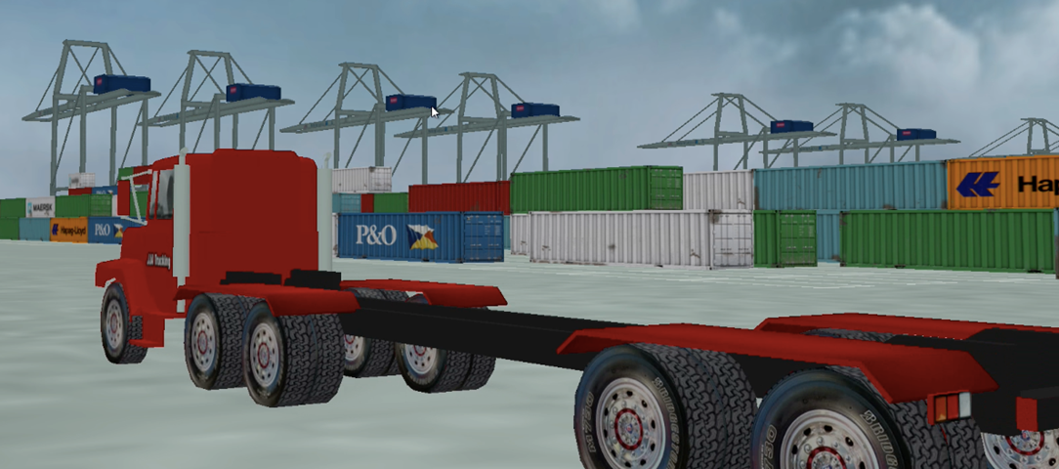
Inventory and Process
Visualization Example
5

Slide 6
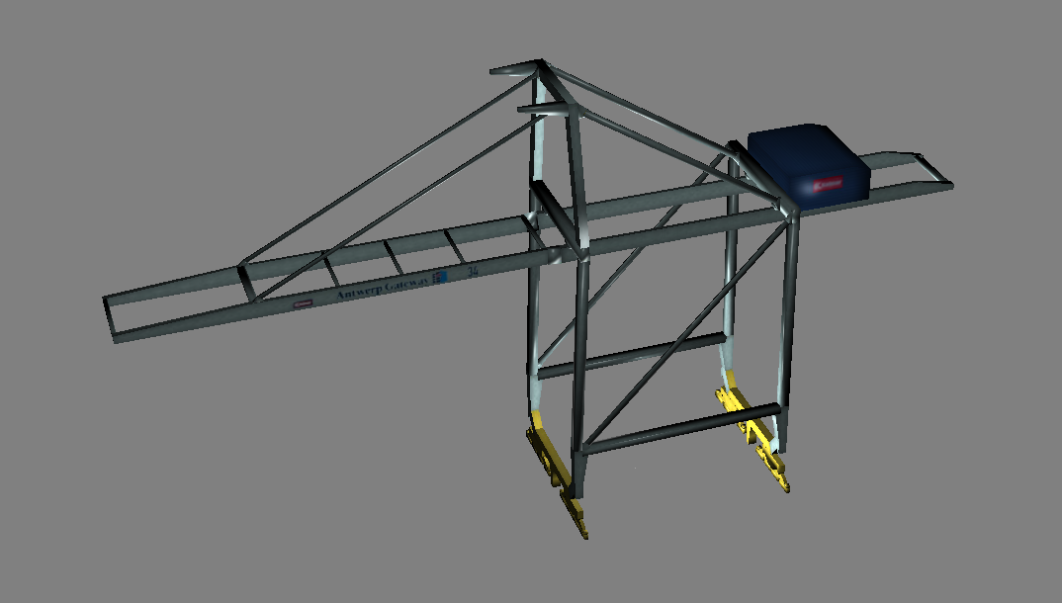
3D Model of the Cranes
6

Slide 7
“JavaFX 3D gives you the ability to use 3D geometry, cameras, and lights in JavaFX.”
Jasper Potts
JavaFX Engineer,
Oracle Corporation

Slide 8
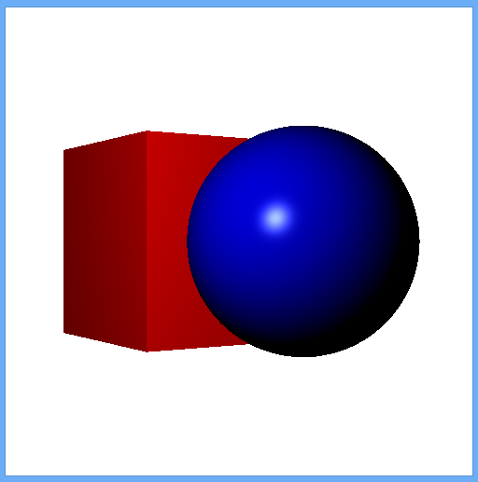
Mesh Geometry (3D Shapes)
Predefined shapes
  Box
  Cylinder
  Sphere
User-defined shapes
  Using TriangleMesh / MeshView
8

Slide 9
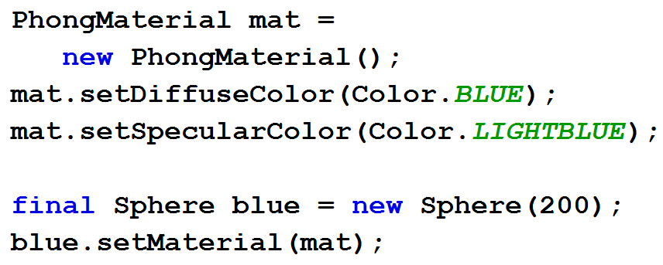
Creating Primitive Shapes and Materials
9

Slide 10
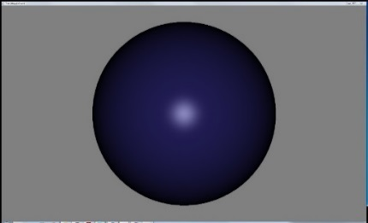
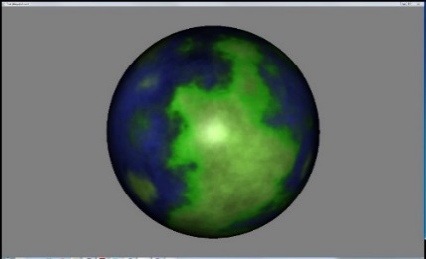
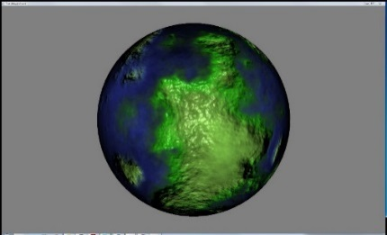
3D Materials and Textures
https://wikis.oracle.com/display/OpenJDK/3D+Features
PhongMaterial has these properties
  Ambient color
  Diffuse color, diffuse map
  Specular color, specular map
  Specular power
  Bump map
  Self-illumination map
10

Slide 11
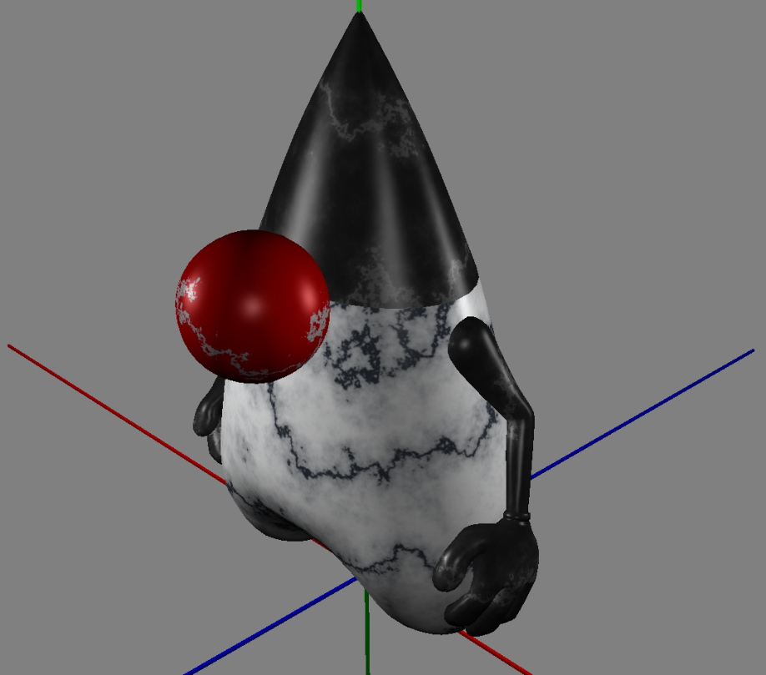
Duke’s nose has a Diffuse Map texture
11

Slide 12
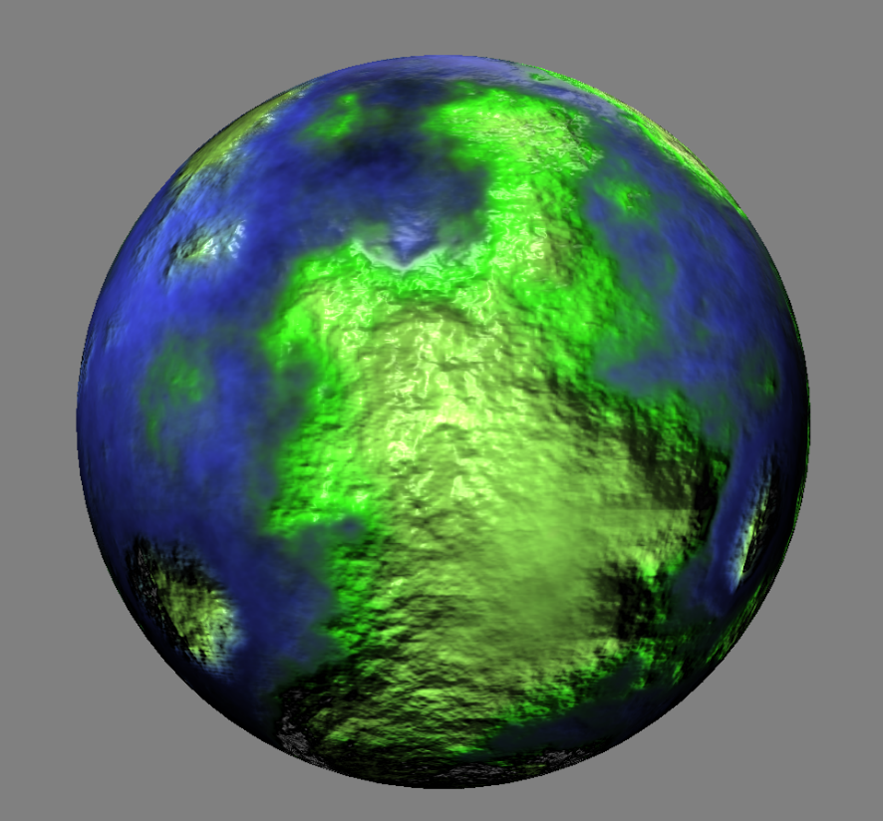
This planet has a Bump Map texture
12

Slide 13
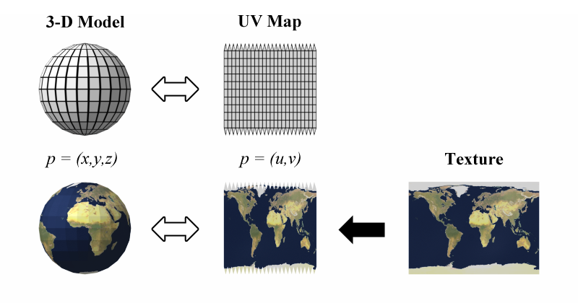
UV Mapping Textures to Shapes
Tip: A texture is a 2D image to be mapped on a 3D surface
Source: http://en.wikipedia.org/wiki/File:UVMapping.png
13

Slide 14
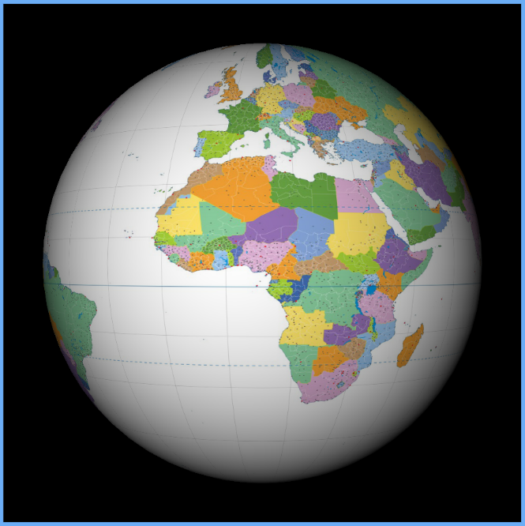
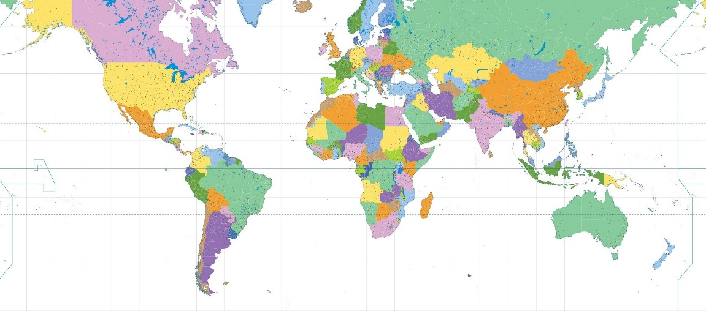
Placing a Texture on a Sphere
14

Slide 15
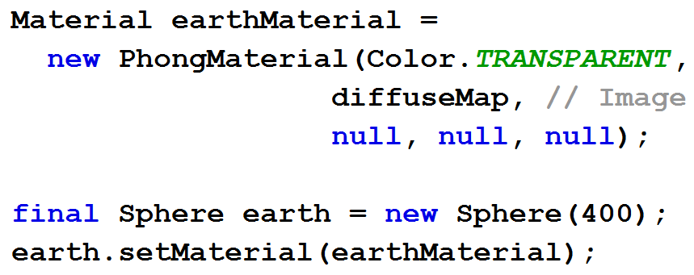
Placing a Texture on a Sphere
15

Slide 16
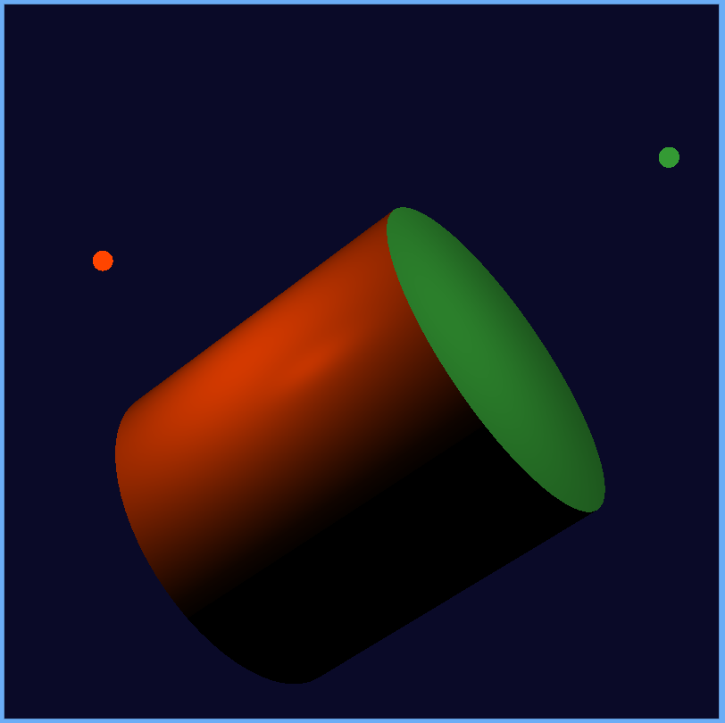
3D Lights
Lights are nodes in the scene graph
  PointLight
  AmbientLight
Default light provided if no active lights
16

Slide 17
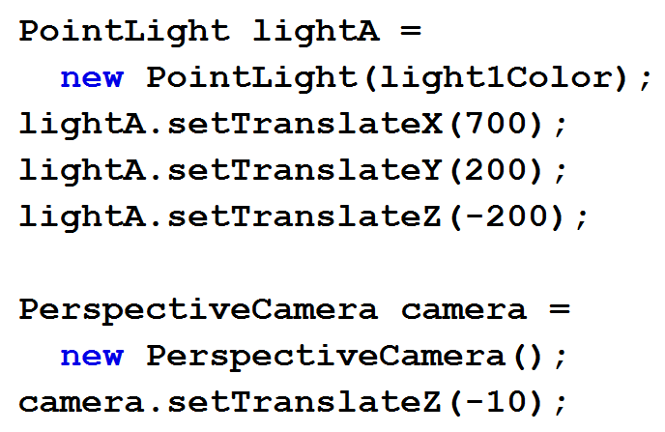
Lights, Camera, Action!
17

Slide 18
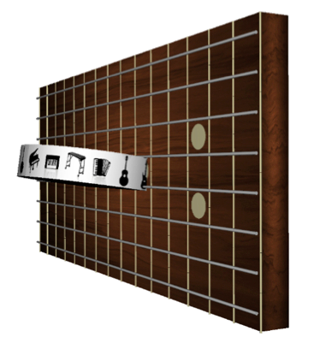
Example 3D Multi-touch App: ZenGuitar3D

Slide 19

I’ll play music...Will you push your button?
19

Slide 20
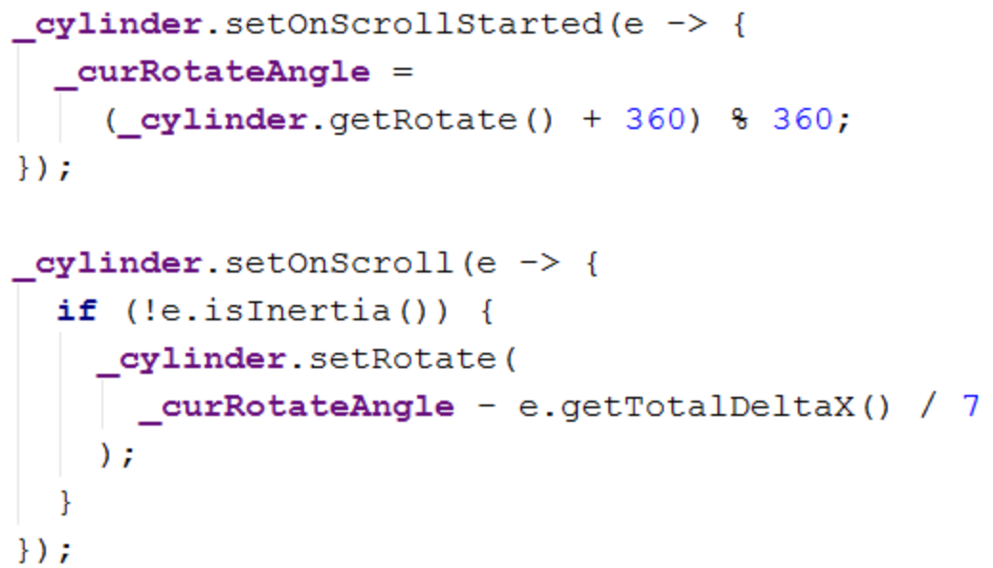
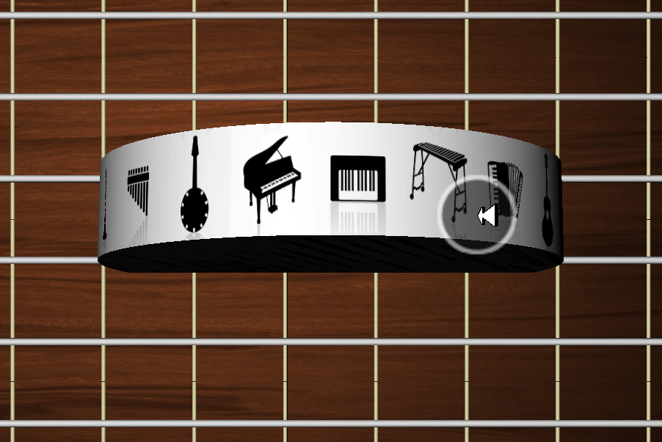
Rotating Instrument Picker with Scroll Gesture
20

Slide 21
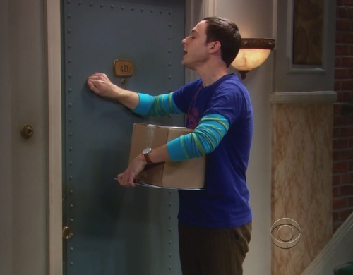
Knock, Knock, Knock, Penny... ☺
21

Slide 22
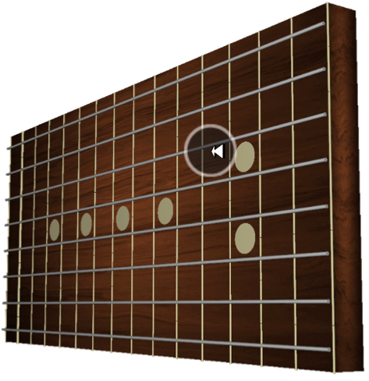
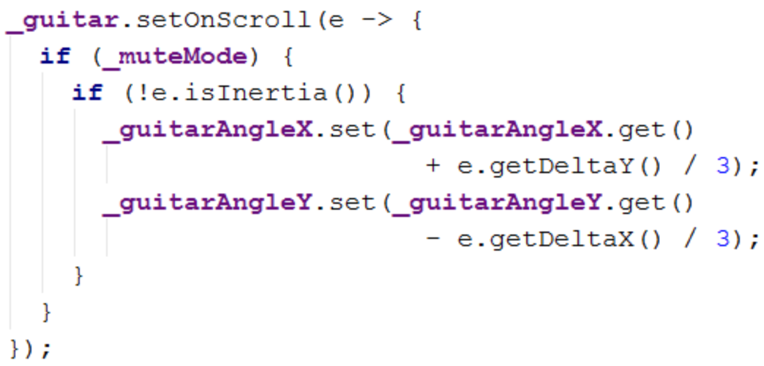
Using Scroll Gesture for X/Y Rotate
22

Slide 23
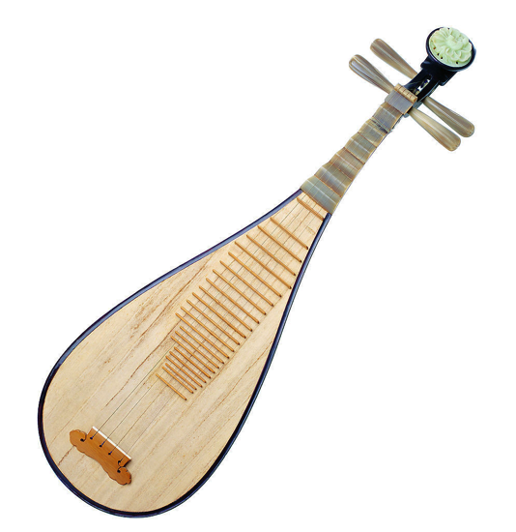
Gardenia Open on the Chinese Guitar
23

Slide 24
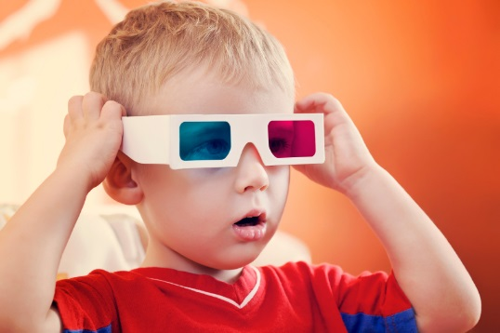
Playing with
JavaFX 3D

Slide 25

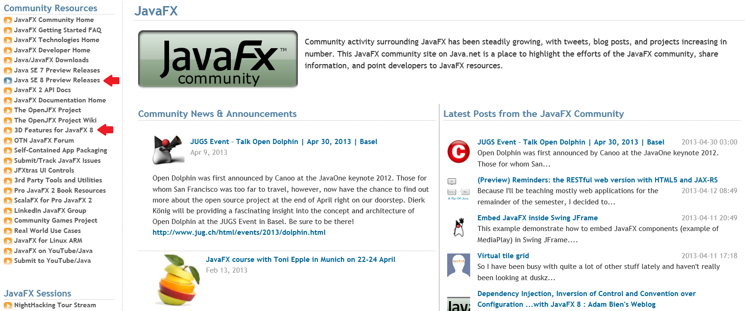
Start Here: http://javafxcommunity.com
25

Slide 26
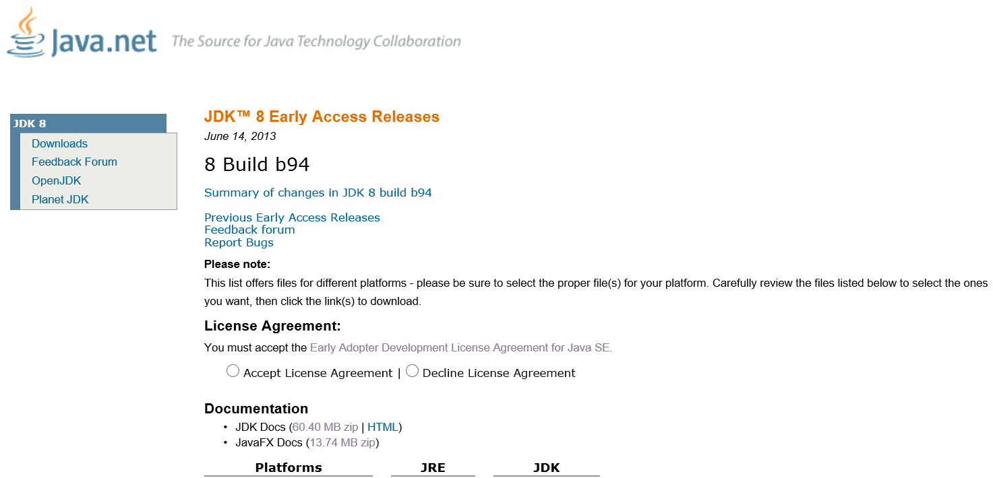
Download JDK 8 Early Access Release
26

Slide 27
Thank You!
Jim Weaver
Java Technology Ambassador
james.weaver@oracle.com
weibo.com/JavaFXpert 请关注我
@javafxpert

