Slide 1
JavaFX 3D in 7 Minutes
Jim Weaver
Java Technology Ambassador
Oracle Corporation
@JavaFXpert
james.weaver@oracle.com

Slide 2
JavaFX 3D in 7 Minutes

Slide 3
JavaFX 3D Use Cases
Inventory and Process Visualization
Scientific and Engineering Visualization
3D Charting
Mechanical CAD and CAE
Medical Imaging
Product Marketing
Architectural Design and Walkthroughs
Advanced User Experience
Mission Planning
Training
Entertainment
3

Slide 4
JavaFX 3D Use Cases
Inventory and Process Visualization
Scientific and Engineering Visualization
3D Charting
Mechanical CAD and CAE
Medical Imaging
Product Marketing
Architectural Design and Walkthroughs
Advanced User Experience
Mission Planning
Training
Entertainment
4

Slide 5
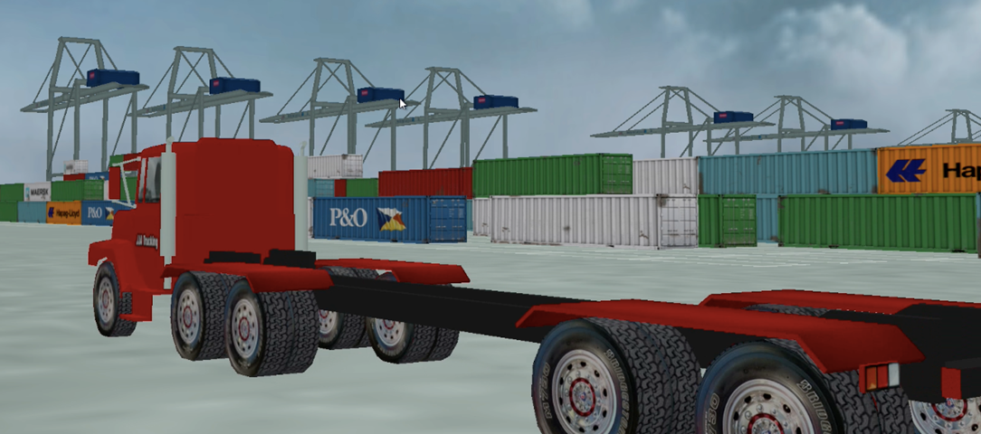
Inventory and Process Visualization Example
5

Slide 6
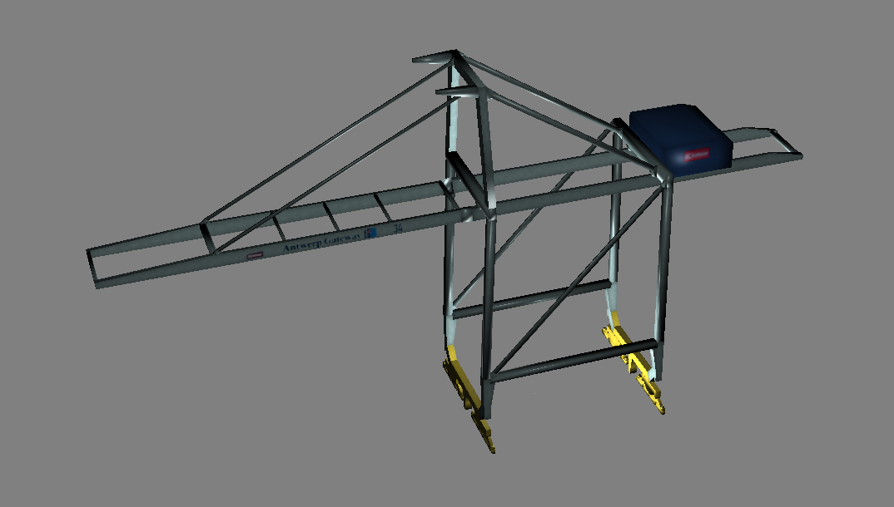
3D Model of the Cranes
6

Slide 7
“JavaFX 3D gives you the ability to use 3D geometry, cameras, and lights in JavaFX.”
Jasper Potts
JavaFX Engineer, Oracle Corporation

Slide 8
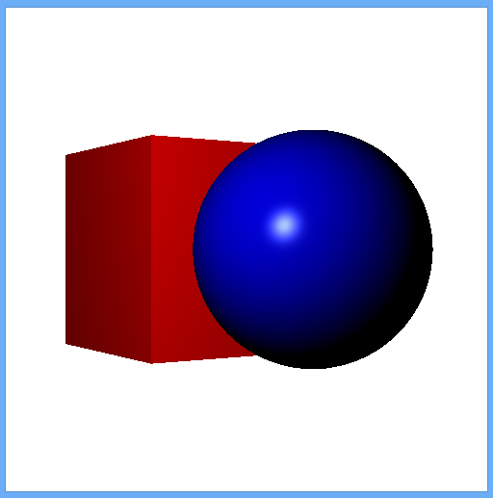
Mesh Geometry (3D Shapes)
Predefined shapes
Box
Cylinder
Sphere
User-defined shapes
Using TriangleMesh / MeshView
8

Slide 9
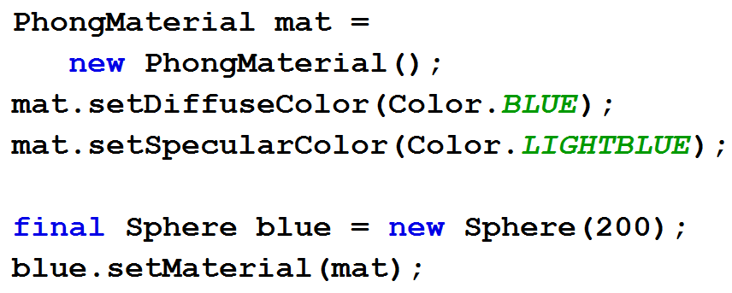
Creating Primitive Shapes and Materials
9

Slide 10
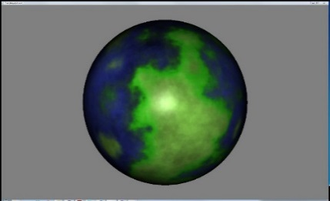
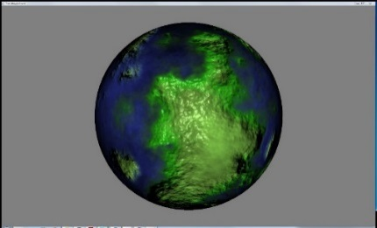
3D Materials and Textures
https://wikis.oracle.com/display/OpenJDK/3D+Features
PhongMaterial has these properties
Ambient color
Diffuse color, diffuse map
Specular color, specular map
Specular power
Bump map
Self-illumination map
10

Slide 11
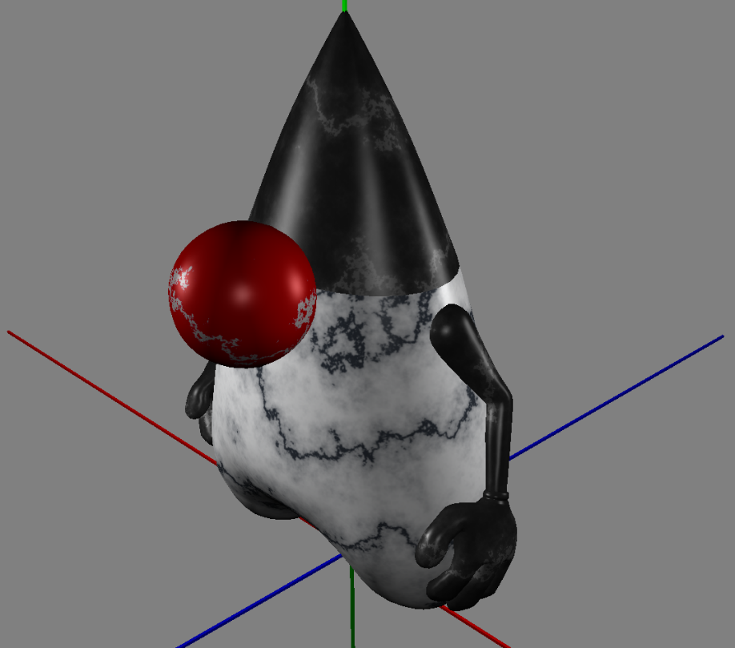
Duke’s nose has a Diffuse Map texture
11

Slide 12
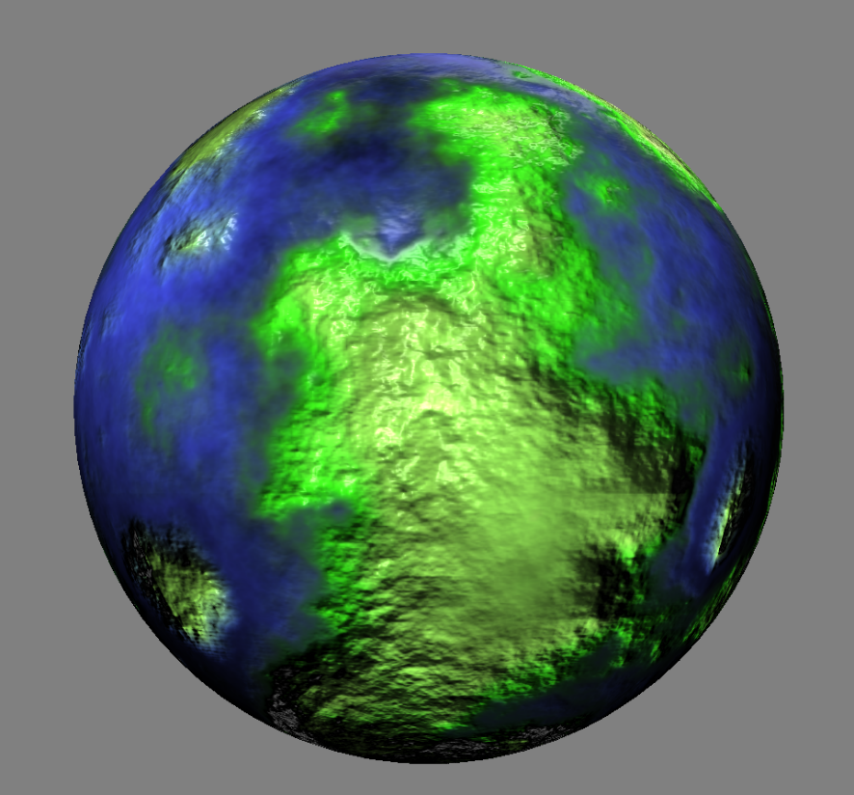
This planet has a Bump Map texture
12

Slide 13
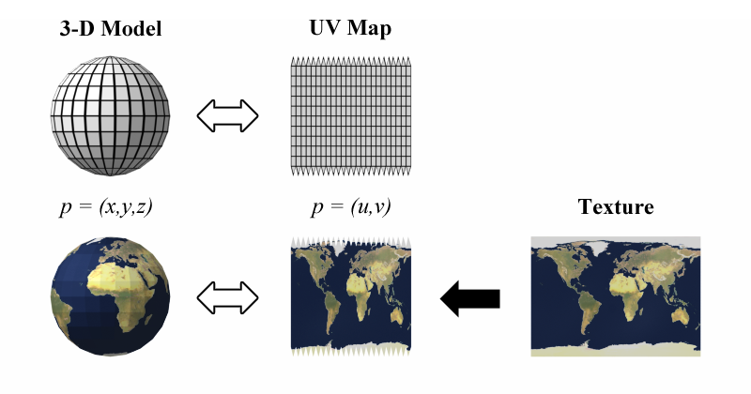
UV Mapping Textures to Shapes
Tip: A texture is a 2D image to be mapped on a 3D surface
Source: http://en.wikipedia.org/wiki/File:UVMapping.png
13

Slide 14
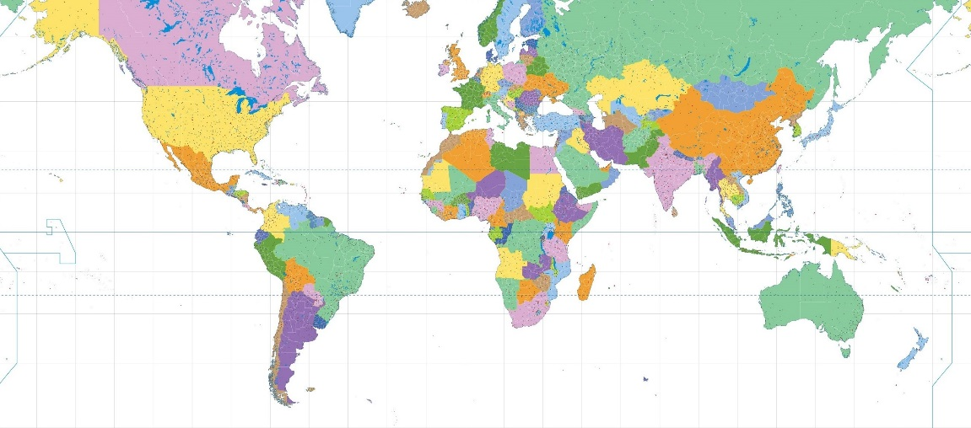
Placing a Texture on a Sphere
14

Slide 15
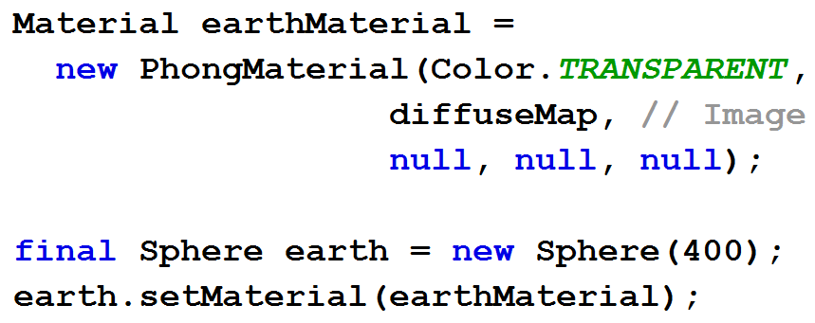
Placing a Texture on a Sphere
15

Slide 16
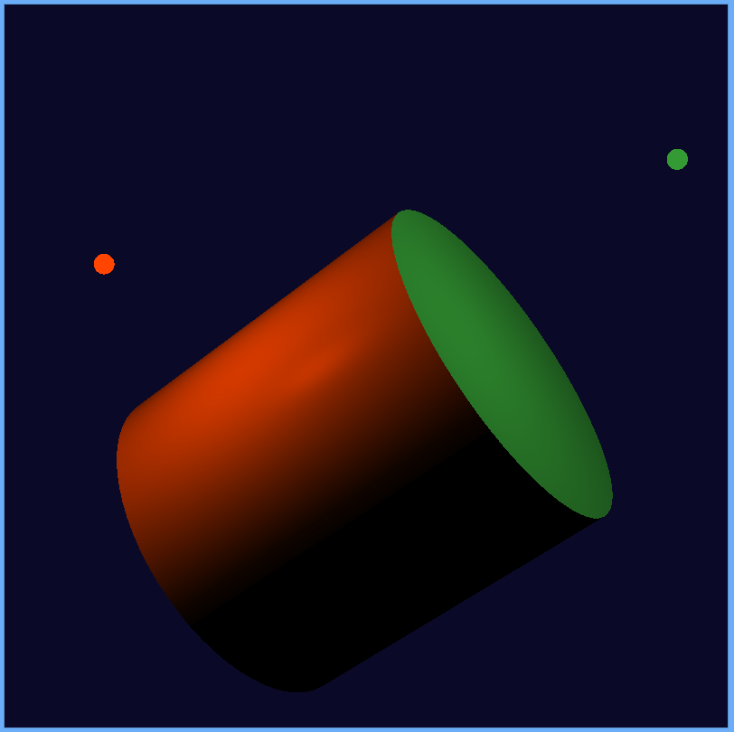
3D Lights
Lights are nodes in the scene graph
PointLight
AmbientLight
Default light provided if no active lights
16

Slide 17
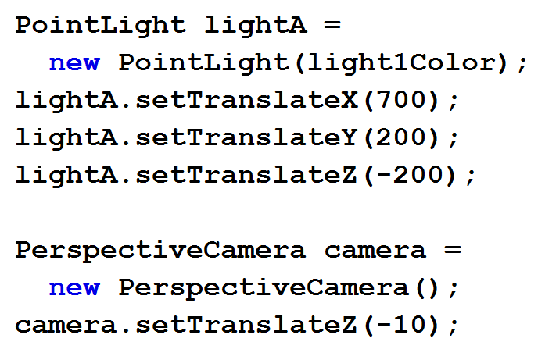
Lights, Camera, Action!
17

Slide 18
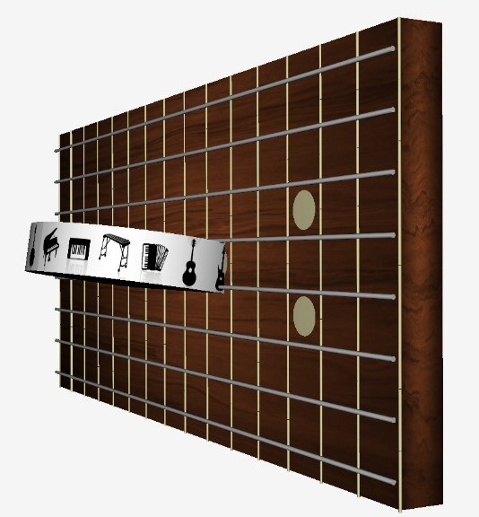
Example 3D / multi-touch app: ZenGuitar3D

Slide 19
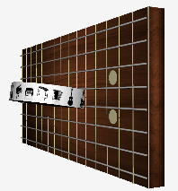
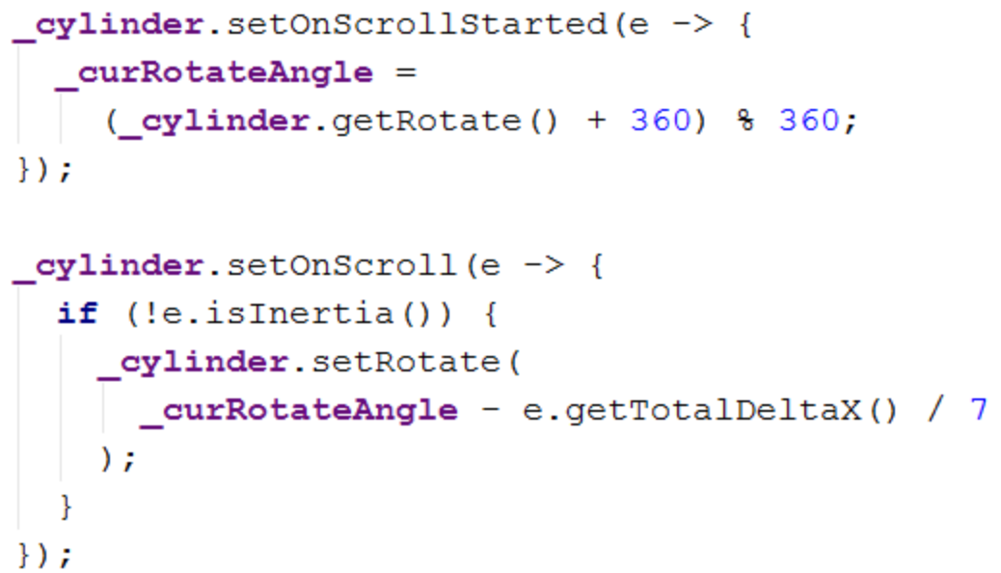
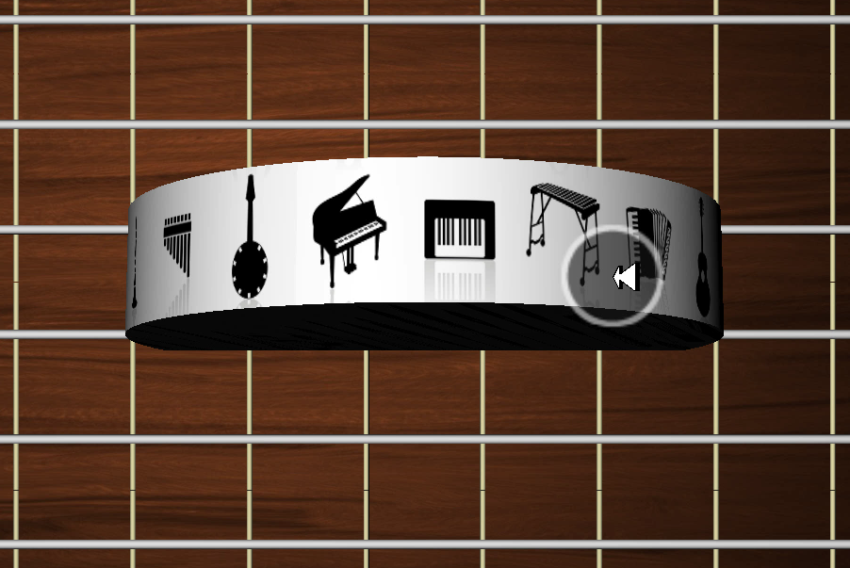
Rotating Instrument Picker with Scroll Gesture
19

Slide 20
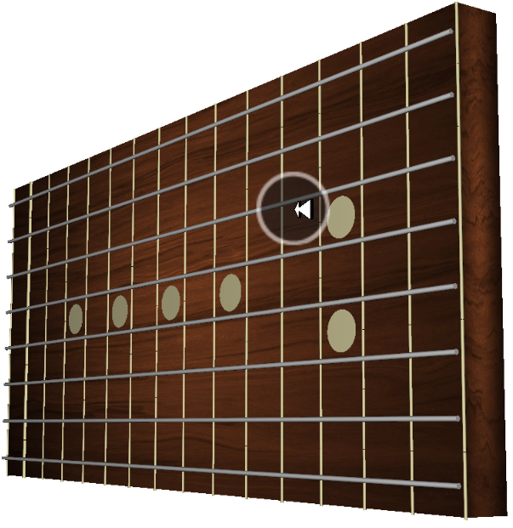
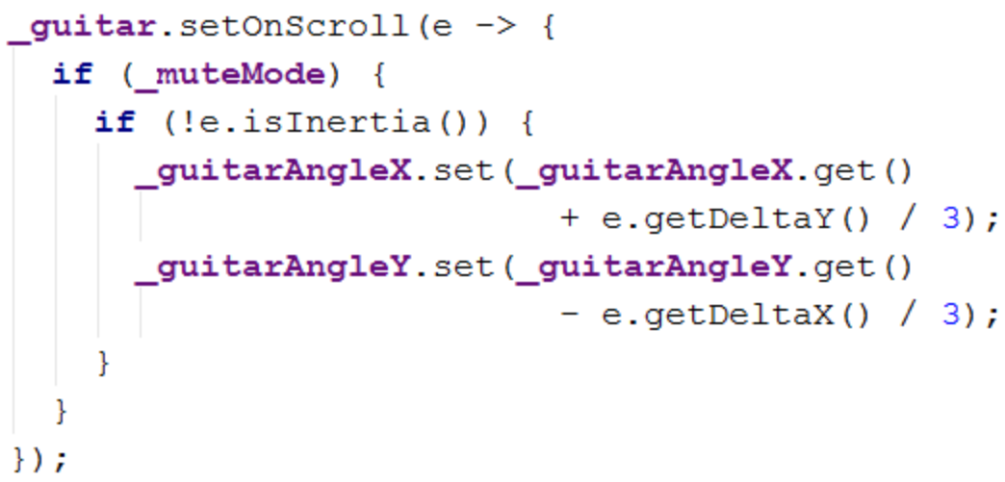
Using Scroll Gesture for X/Y Rotate
20

Slide 21
Playing with JavaFX 3D

Slide 22
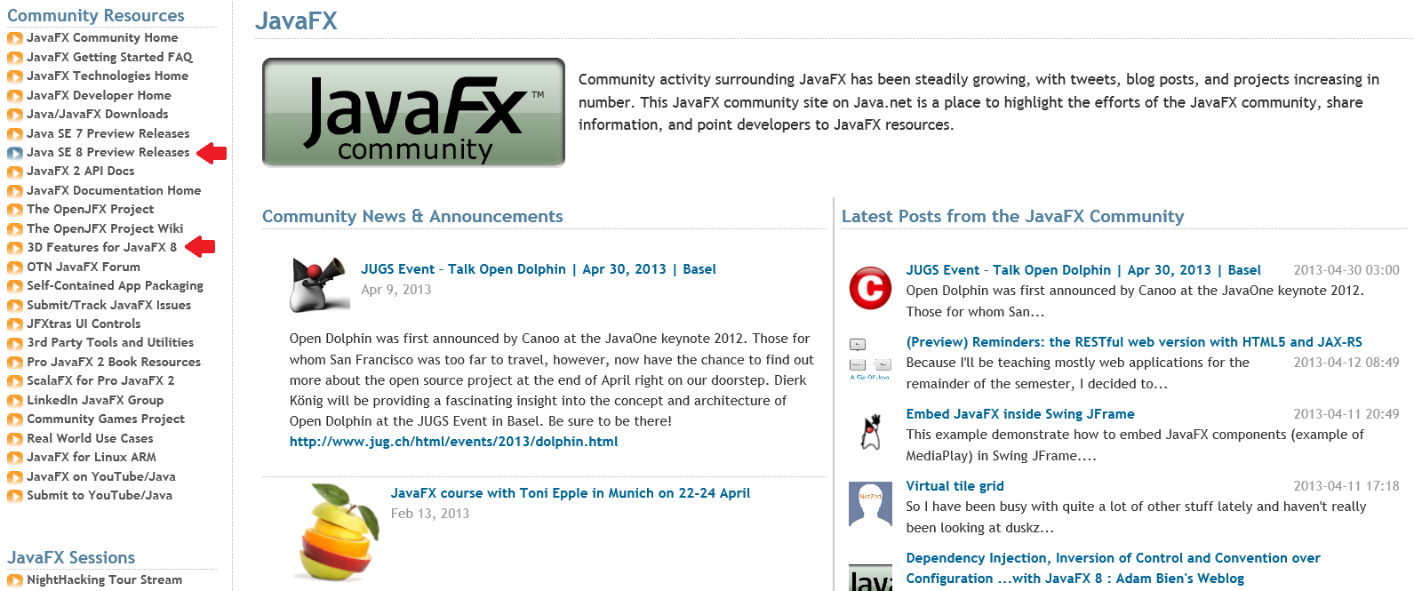
Start Here: http://javafxcommunity.com
22

Slide 23
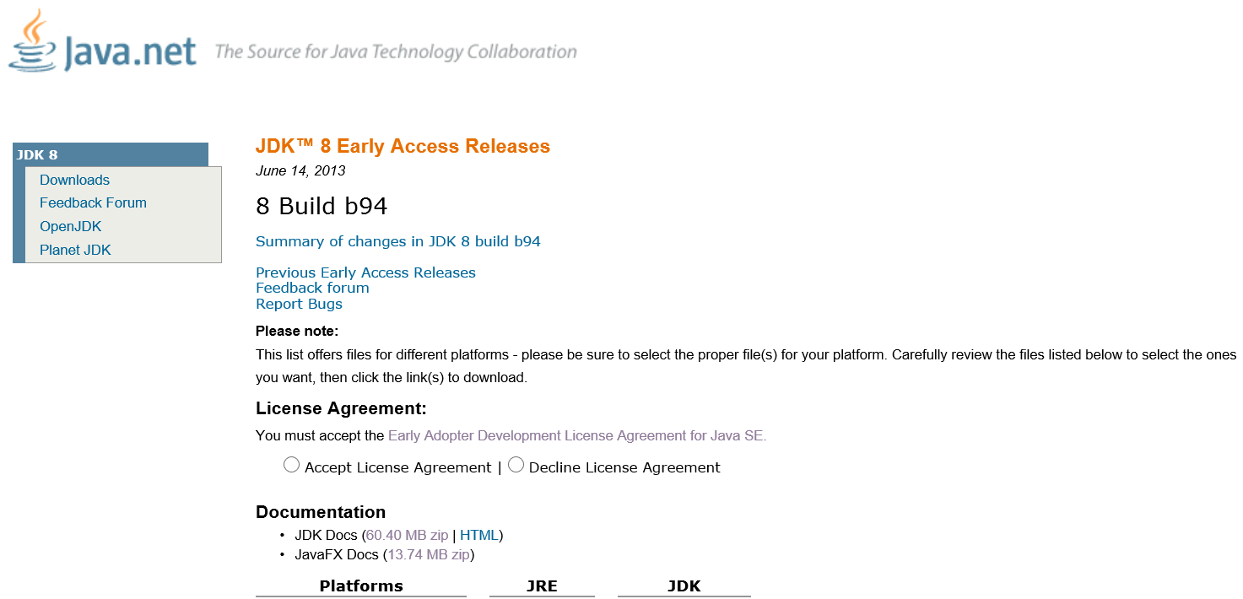
Download JDK 8 Early Access Release
23

Slide 24
JavaFX 3D in 7 Minutes
Jim Weaver
Java Technology Ambassador
Oracle Corporation
@JavaFXpert
james.weaver@oracle.com

