Slide 3
MVC in JavaEE 8
Manfred Riem
Principal Member of Technical Staff
September, 2014
Copyright © 2014, Oracle and/or its affiliates. All rights reserved.

Slide 5
Program Agenda
MVC
What is MVC?
Different styles of MVC
MVC 1.0 JSR
A rough JSP example
A rough Facelets example

Slide 6
What is MVC?
MVC is a pattern used to implement a user interface (UI).
It consists of 3 major components
Model (M)
View (V)
Controller (C)
Each of the components has a distinct responsibility which is covered in the next slides

Slide 7
The M in MVC
The Model
The model is the interim state you want to keep when you are building an application that shows a user interface
Examples
Who is logged in
What are they trying to buy
What page are they on in a multi page flow

Slide 8
The V in MVC
The View
The view is what your user interacts with
In a web application that would be the web page or web pages
your JSP page
your CSS styles
your JavaScript
In a thick client scenario it would be the entire UI
In an embedded scenario it could be the touch screen, hardware buttons etc

Slide 9
The C in MVC
The Controller
The controller is the work horse of the pattern, as it:
Executes the business logic
Run a credit card transaction
Send out the order for fulfilling
Updates the model
Mark the transaction as successful in the model object
Set the fulfillment date in the model object
Ask the view to render itself
Shows the transaction was successful
Shows when to expect the order to be fulfilled

Slide 10
Different styles of MVC
Component-based MVC
Action-based MVC
Other styles

Slide 11
Component-based MVC
A specific style of MVC made popular by component frameworks
Controller provided by the framework
Some examples
Java Server Faces (in the JavaEE platform)
Seam (discontinued)
Wicket
Tapestry
Apache Click (retired)

Slide 12
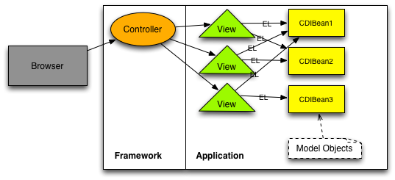

Slide 13
Action-based MVC
Controller(s) defined by the application
Currently no JavaEE implementation
Good news there is one!
Some examples
Struts 1 (end of life)
Struts 2
Spring MVC

Slide 14
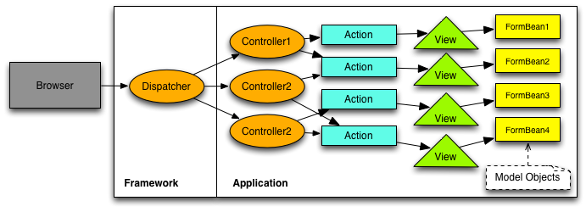

Slide 15
Compare and contrast
High level overview
Action-based MVC
Manual request parameter processing
No view kept around
Limited support for re-usable behavior
Developer responsible for all HTML / JavaScript
No automatic input conversion
No automatic input validation
Request centric
Component-based MVC
Automatic request parameter procession
View kept around (component tree)
Component libraries that implement re-usable behavior
Components render HTML / JavaScript
Automatic input conversion
Automatic input validation
Page centric

Slide 16
The MVC JSR

Slide 17
The MVC JSR
Version 1.0
It really is the “Action-based MVC 1.0” JSR
Where it this coming from?
JavaEE 8 survey
Talking to our customers
UI landscape is not one size fits all
Who is supporting it?

Slide 18
The MVC JSR
List of supporters (see JCP page)
Joshua Wilson (Red Hat)
Woong-ki Lee (TmaxSoft)
Josh Juneau
Fabio Velloso (SouJava)
Yara Senger (SouJava)
Bruno Souza (SouJava)
Markus Karg
Antonio Goncalves
Rajmahendra (JUGChennai)
Francisco Sokol
Werner Keil
Martijn Verburg (London Java Community)
And of course Oracle

Slide 19
The MVC JSR
Where, how and where?
Where are we at?
The JSR has just been approved
We are in the process of forming the EG
How can I help?
Consider joining the EG
Participate in the Adopt-a-JSR program (JUGs)
Where can I get more information?
See the end of the presentation
Talk / contact to the spec leads

Slide 21
The MVC JSR
A rough JSP example
Initial HTML page
Managed Bean
Result HTML page

Slide 22
Rough JSP example
Initial HTML page
<!DOCTYPE html PUBLIC "-//W3C//DTD XHTML 1.0 Transitional//EN" "http://www.w3.org/TR/xhtml1/DTD/xhtml1-transitional.dtd">
<html> <head> <title>Rough example</title> </head> <body> <form action=”/rough-example/form1a.jsp”> <input id="input1" value="#{roughExampleBean.value}"/> <input id="submit" type="submit" value="Submit"/> </form> </body> </html>

Slide 23
Rough JSP example
Managed Bean
@Named("roughExampleBean”) @RequestScoped public class RoughExampleBean implements Serializable { private String value; @Path(value = "/form1a.jsp”) public String form1(@Inject HttpServletRequest request) { String input1 = request.getParameter("inputText1"); setValue("We set input1 manually to - " + input1); return "/form1b.jsp”; } … omitted getter/setter methods … }

Slide 24
Rough JSP example
Result HTML page
<!DOCTYPE html PUBLIC "-//W3C//DTD XHTML 1.0 Transitional//EN” "http://www.w3.org/TR/xhtml1/DTD/xhtml1-transitional.dtd">
<html> <head> <title>Rough example result page</title> </head> <body> We did a POST to an action based URL and the result is: #{roughExampleBean.value} </body> </html>

Slide 25
The MVC JSR
A rough Facelets example
Initial HTML page
Managed Bean
Result HTML page

Slide 26
Rough Facelets example
Initial HTML page
<!DOCTYPE html PUBLIC "-//W3C//DTD XHTML 1.0 Transitional//EN" "http://www.w3.org/TR/xhtml1/DTD/xhtml1-transitional.dtd">
<html> <head> <title>Rough example</title> </head> <body> <form action=”/rough-example/form1a.xhtml”> <input id="input1" jsf:value="#{roughExampleBean.value}"/> <input id="submit" type="submit" value="Submit"/> </form> </body> </html>

Slide 27
Rough Facelets example
Managed Bean
@Named("roughExampleBean”) @RequestScoped public class RoughExampleBean implements Serializable { private String value; @Path(value = "/form1a.xhtml”) public String form1(@Inject HttpServletRequest request) { String input1 = request.getParameter("inputText1"); setValue("We set input1 manually to - " + input1); return "/form1b.xhtml”; } … omitted getter/setter methods … }

Slide 28
Rough Facelets example
Result HTML page
<!DOCTYPE html PUBLIC "-//W3C//DTD XHTML 1.0 Transitional//EN” "http://www.w3.org/TR/xhtml1/DTD/xhtml1-transitional.dtd">
<html> <head> <title>Rough example result page</title> </head> <body> We did a POST to an action based URL and the result is: #{roughExampleBean.value} </body> </html>

Slide 29
Questions & Answers

