Slide 2
How to work from home, effectively!
Masoud Kalali
Software engineer
ORACLE
twitter: @MasoudKalali

Slide 3
Notes:
This is a Safe Harbor Front slide, one of two Safe Harbor Statement slides included in this template.
One of the Safe Harbor slides must be used if your presentation covers material affected by Oracle’s Revenue Recognition Policy
To learn more about this policy, e-mail: Revrec-americasiebc_us@oracle.com
For internal communication, Safe Harbor Statements are not required. However, there is an applicable disclaimer (Exhibit E) that should be used, found in the Oracle Revenue Recognition Policy for Future Product Communications. Copy and paste this link into a web browser, to find out more information.
http://my.oracle.com/site/fin/gfo/GlobalProcesses/cnt452504.pdf
For all external communications such as press release, roadmaps, PowerPoint presentations, Safe Harbor Statements are required. You can refer to the link mentioned above to find out additional information/disclaimers required depending on your audience.

Slide 4
Program Agenda
1
Software engineering job, what we do?
Workspace
Setting routines
Setting limits and drawing red lines
Timing
Communication
2
3
4
5
6

Slide 5
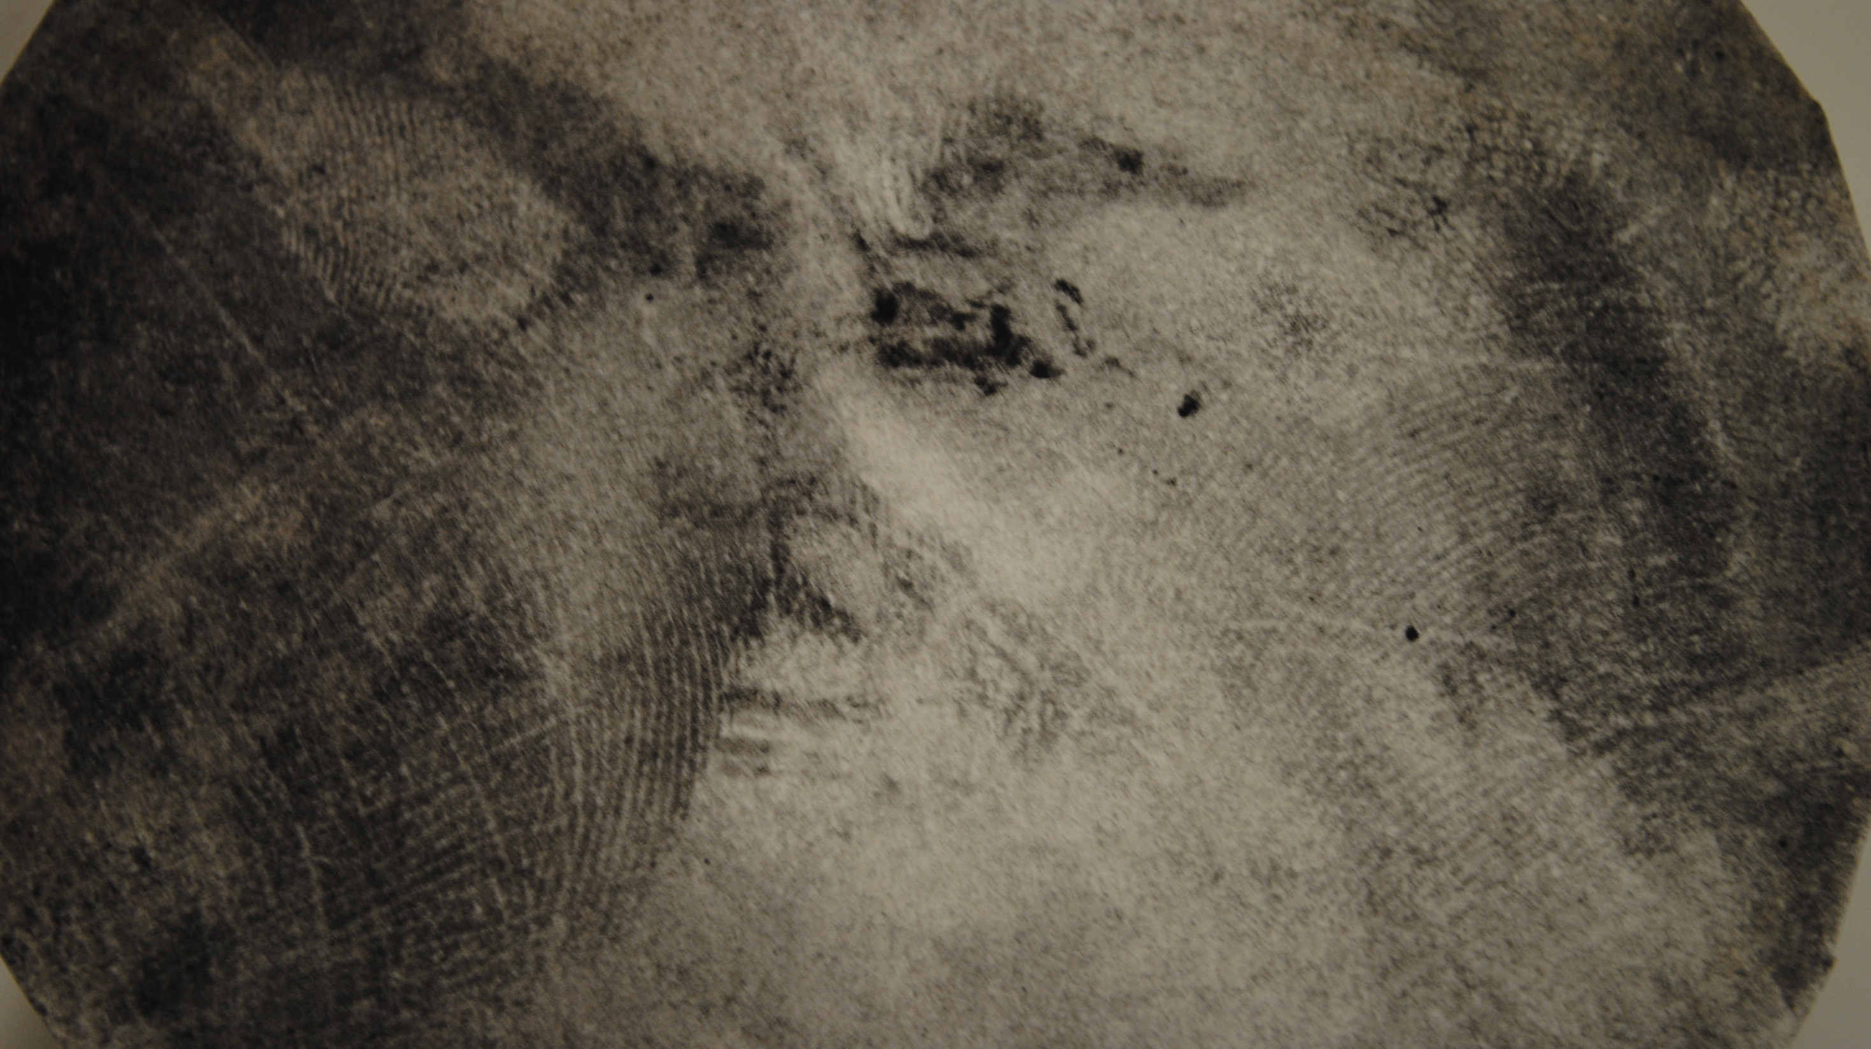
A little about me
Software engineer, author, blogger…
Working from home since 2009
  For ORACLE since 2012 as lead engineer
Tweet at @MasoudKalali
Listens to high definition Audio (you got what I mean)

Slide 6

Software engineering job, what we do?
Notes:
This slide can also be used as a Q and A slide

Slide 7
Home-office curses
One does not simply work from home!
Being left out
Not being seen
Distractions
Over working
Sometime underworking?

Slide 8
Home-office rewards
One does not simply commute to office!
Saving in time! Lots of time
  Around 2 hours per day
Flexibility when/if needed
Being close to home/family for emergencies

Slide 9

Workspace
Dedicated workspace
Office furniture
Lighting
Personal emblems
Notes:
This slide can also be used as a Q and A slide

Slide 10
Dedicated workspace
One does not simply work on the couch
A dedicated office space
  Separate room
  Dedicated square meters in the hall
Somewhere more isolated when/if needed
  To think
  To have the conference calls

Slide 11
Office furniture
Home office is an office
Proper office desk
Comfortable office chair
Drawers and shelves, they are always needed!
Printer, scanner, etc.

Slide 12
Lighting
Proper lighting as is in the HQ
Good lighting reduce eye strains
Good lighting let you be seen properly over the video calls

Slide 13
Personal emblems
Make the office personal
Keep it casual
Eyes need candies
Add personal emblems here and there

Slide 14
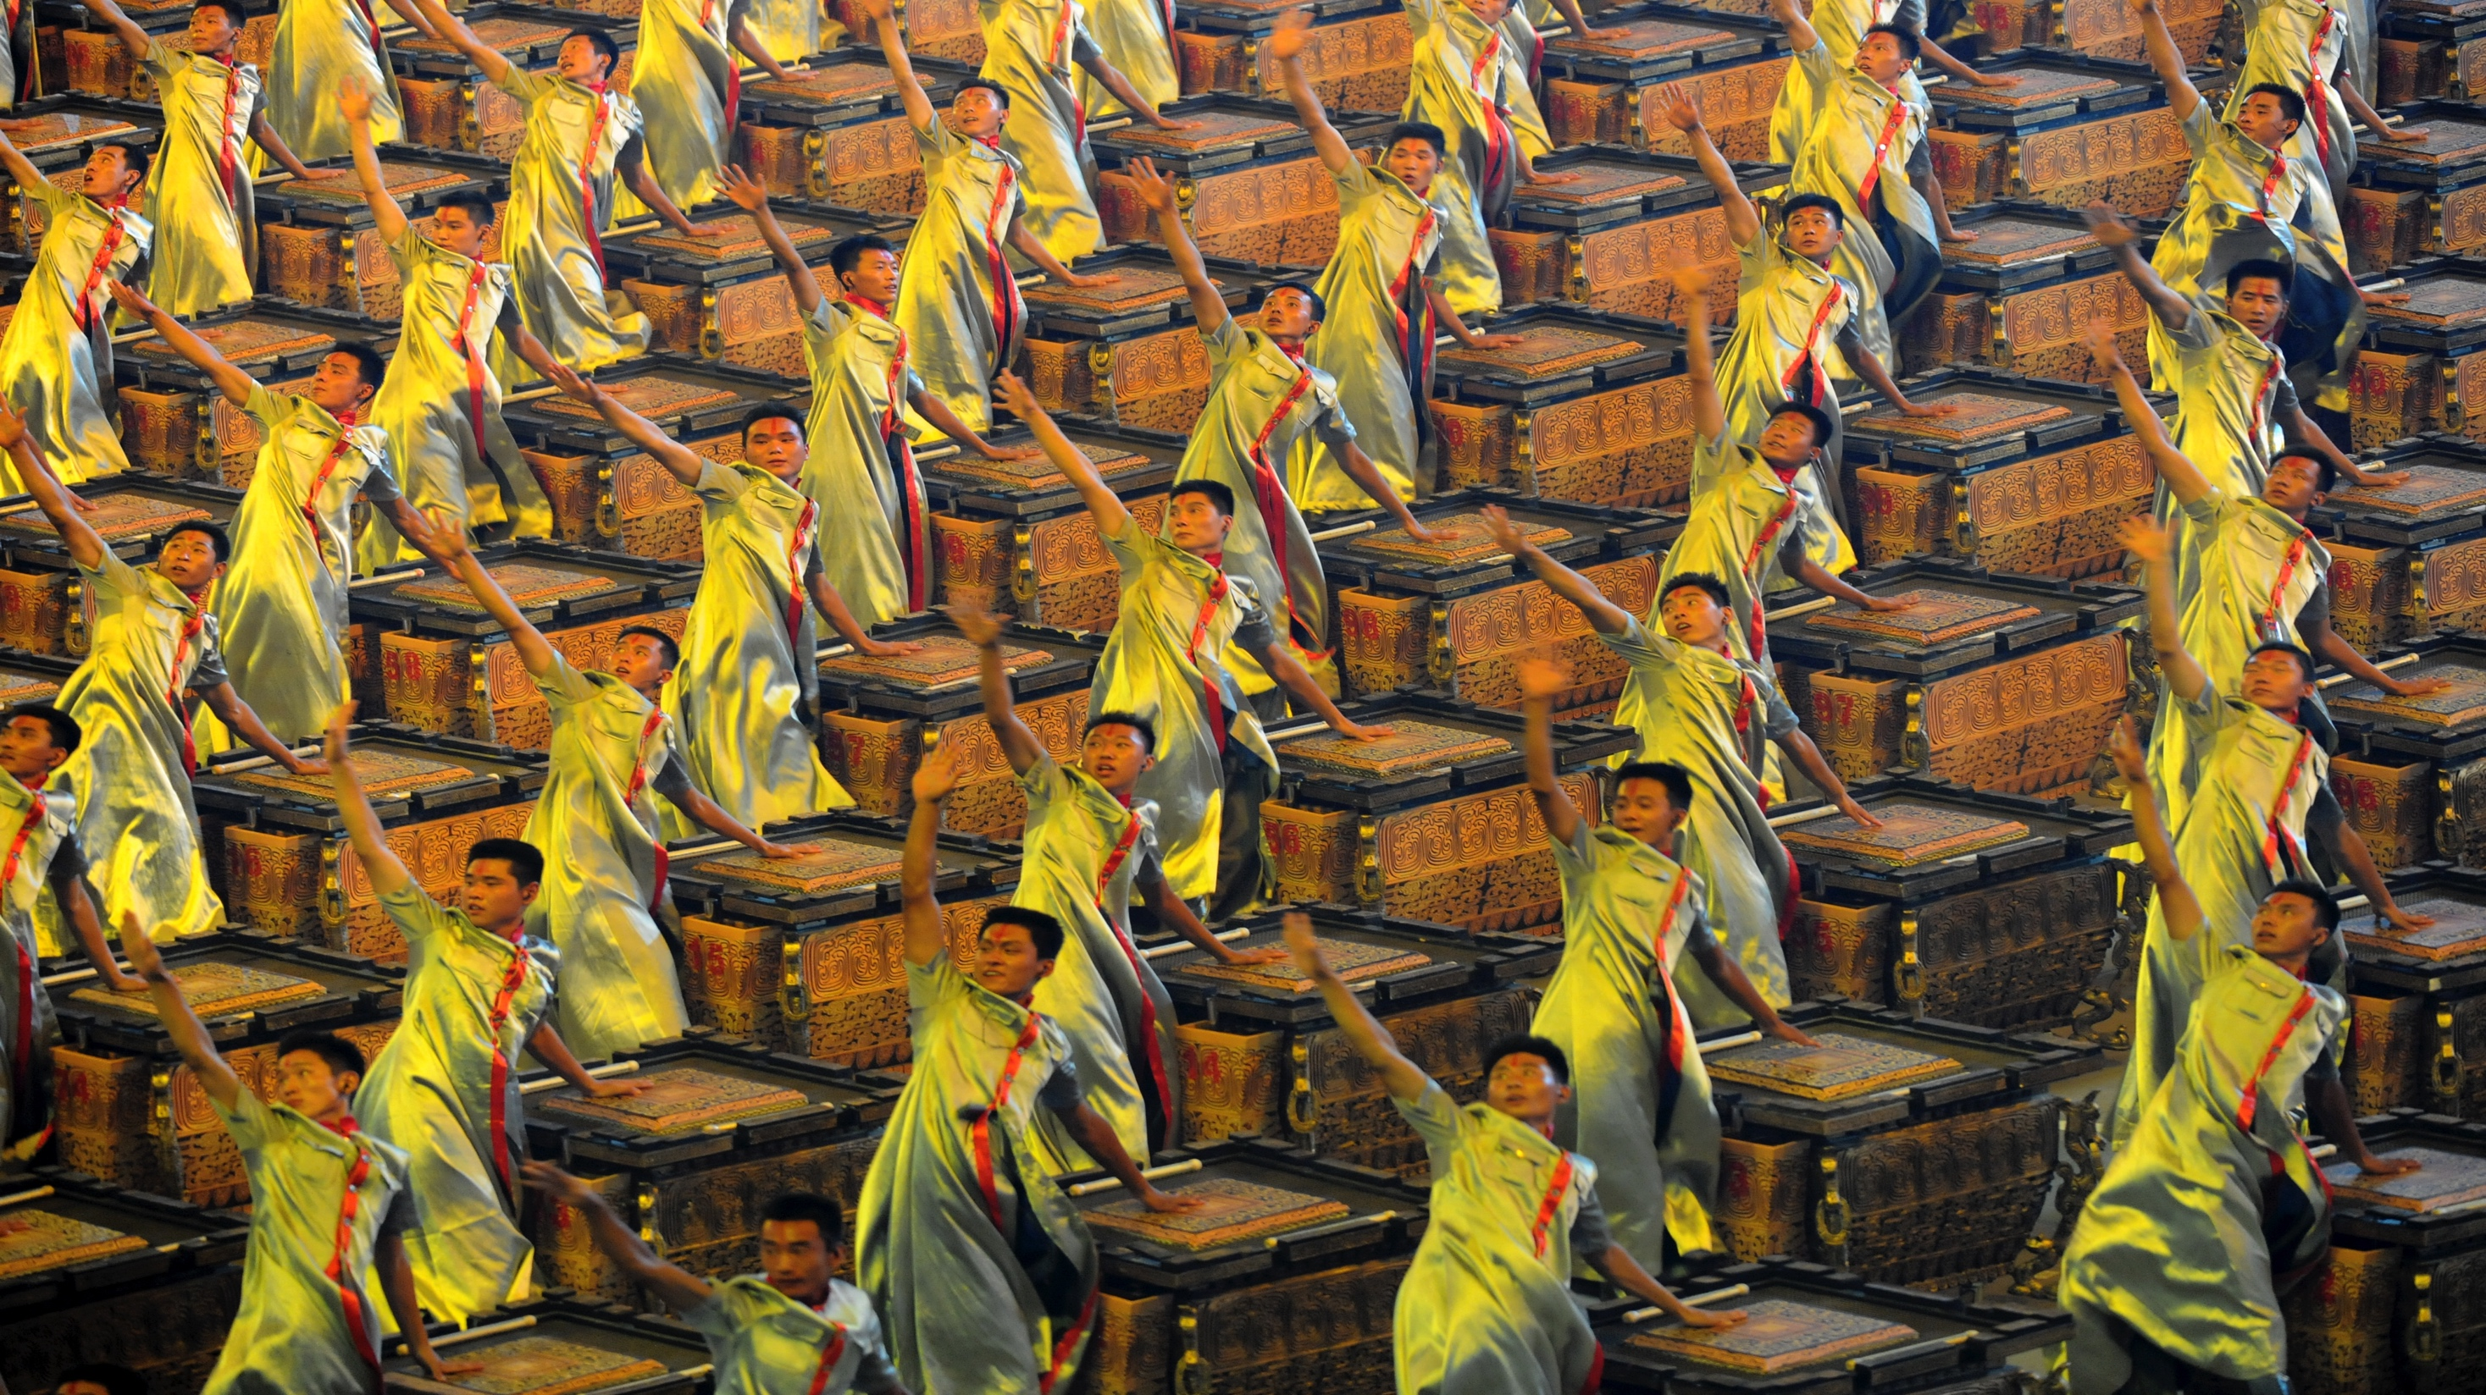
Setting routines
Start time
Rest intervals
End time
Notes:
This slide can also be used as a Q and A slide

Slide 15
Start time
Start as would people in HQ do
Start the day as you would be going to office
  Breakfast
  Coffee
  Water bottle
Start at routine start hour
Don’t push it too far or too early
Specify your start/end time in your profile (for other timezone benefits)

Slide 16
Resting intervals
Rest and take a walk every now and then
We are bio-machine!
Get out on a short walk for lunch time
Do a walk around when frustrated
Chat with a colleague every now and then! not just the technicals!

Slide 17
End time
Have a predefined end time
Set up a routine end time
  As you would end it at office
Have specific day/time for other timezones
  Handy when you work from home
  Specify the timings in your profile for other to know
  Let others know your timezone (if different)

Slide 18
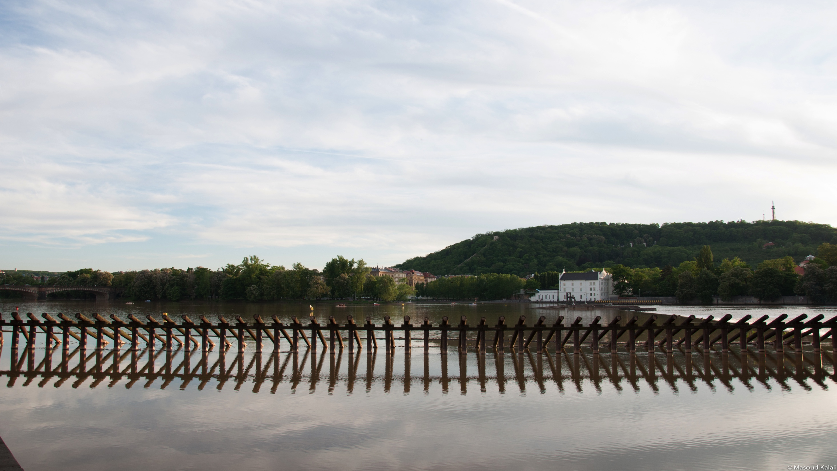
Drawing red lines and setting limits
We are not living to work
Family comes first
Notes:
This slide can also be used as a Q and A slide

Slide 19
We are not living to work
Don’t overwork!
Enough to say we are not living to work but rater the other way around!
~8 hours per day and that is the top of usual days
More than 8 hours maybe couple of days per months

Slide 20
Family comes first
Work can always wait!
As you would be in the office
No one will remember the bug you didn’t fix
Your family will remember when you where not there

Slide 21

Timing
Time box everything
Notes:
This slide can also be used as a Q and A slide

Slide 22
Yet again, have fixed work hours
Box the timing
Let colleagues on other time zones access you
  Clearly specify which days of week you are available for other timezone meetings
I am CET but stay at work 2 extra hours on Monday and Thursdays for meetings and extra coverage
  Do shopping, and exercising, etc. during mid day instead
Stay half an hour extra (17.30-18.00) everyday to meet with my team, depending on daylight saving

Slide 23
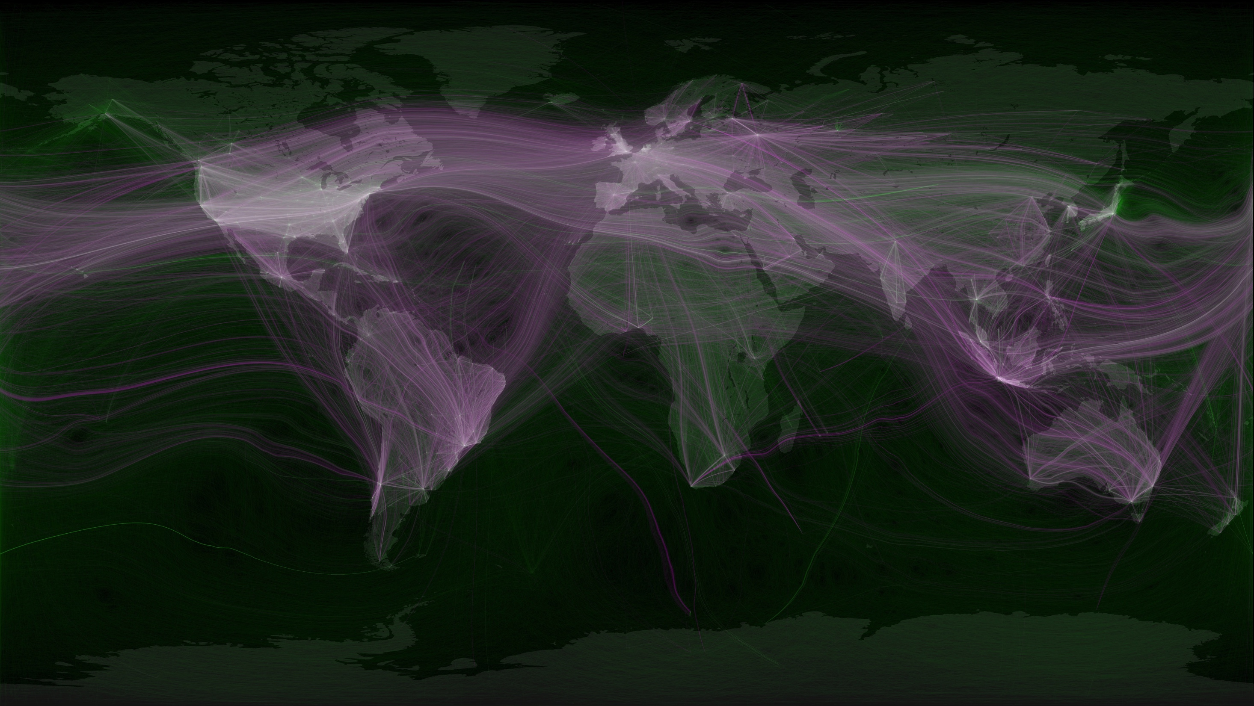
Communication
Make all channels available
Notes:
This slide can also be used as a Q and A slide

Slide 24
Communication
Keep it casual and be available
Setup a reliable and good network connection
Have your availability and contact numbers in your profile
  Phone numbers
  Chatting Ids
  video/audio conferencing details
Have your conference calling details simple and handy
  e.g. Beehive conferencing, Webex, …
Have Skype as backup to corporate VoIP
Setup a good quality headphone, webcam system
  Set a wireless headphone if you can

Slide 25
Feeling left out?
Feel free to contact people as you would do in the corridors!
Introduce yourself to anyone you are working with
  People you didn’t meet yet
  Try and know the people you are working at personal level
Make sure all communication channels are open
Don’t feel ashamed to ping people
Setup a proper phone system
  soft phones
  mobile
  IP phone, etc.

Slide 26
Feeling left out?
Let your voice be heard in the conference calls
No one think less of a home office worker
Announce your join in
Speak loudly and clearly
You are not there for eye-contact
  If someone didn’t know, let them know!
  Be polite but firm

Slide 27

Comments, Questions?

Slide 28
Resources
All photos are Creative Commons (CC) license:
  https://www.flickr.com/photos/mediterraneaaan/5476611597
  https://www.flickr.com/photos/mugfaker/5702680145/
  https://www.flickr.com/photos/joeyparsons/3178503206
  https://www.flickr.com/photos/cdnphoto/3463109752
  https://www.flickr.com/photos/familymwr/4928460718/
  https://www.flickr.com/photos/familymwr/4928481644
  https://www.flickr.com/photos/ferran-jorda/1464915106
  https://www.flickr.com/photos/randihausken/3005431254
  https://www.flickr.com/photos/randihausken/3005431254
  https://www.flickr.com/photos/clf/6870171733
  https://www.flickr.com/photos/stuart-dootson/4568976192
  https://www.flickr.com/photos/erin_m/3336215915
  https://www.flickr.com/photos/bhollar/1872985270
  https://www.flickr.com/photos/walkingsf/6635655755
  https://www.flickr.com/photos/longo/2684733921

