Slide 1

JavaServer Faces Antipatterns and Best Practices
Kito D. Mann
Principal Consultant

Slide 2

Kito D. Mann www.twitter.com/kito99
Principal Consultant at Virtua
http://www.virtua.com
Training, consulting, architecture, mentoring,
JSF product development
Author, JavaServer Faces in Action
Founder, JSF Central
http://www.jsfcentral.com
Internationally recognized speaker
JavaOne, JavaZone, Devoxx, NFJS, TSSJS, etc.

Slide 3
Kito D. Mann www.twitter.com/kito99
JCP Member
JSF, WebBeans, JSF Portlet Bridge, Portlets

Slide 4


Slide 5
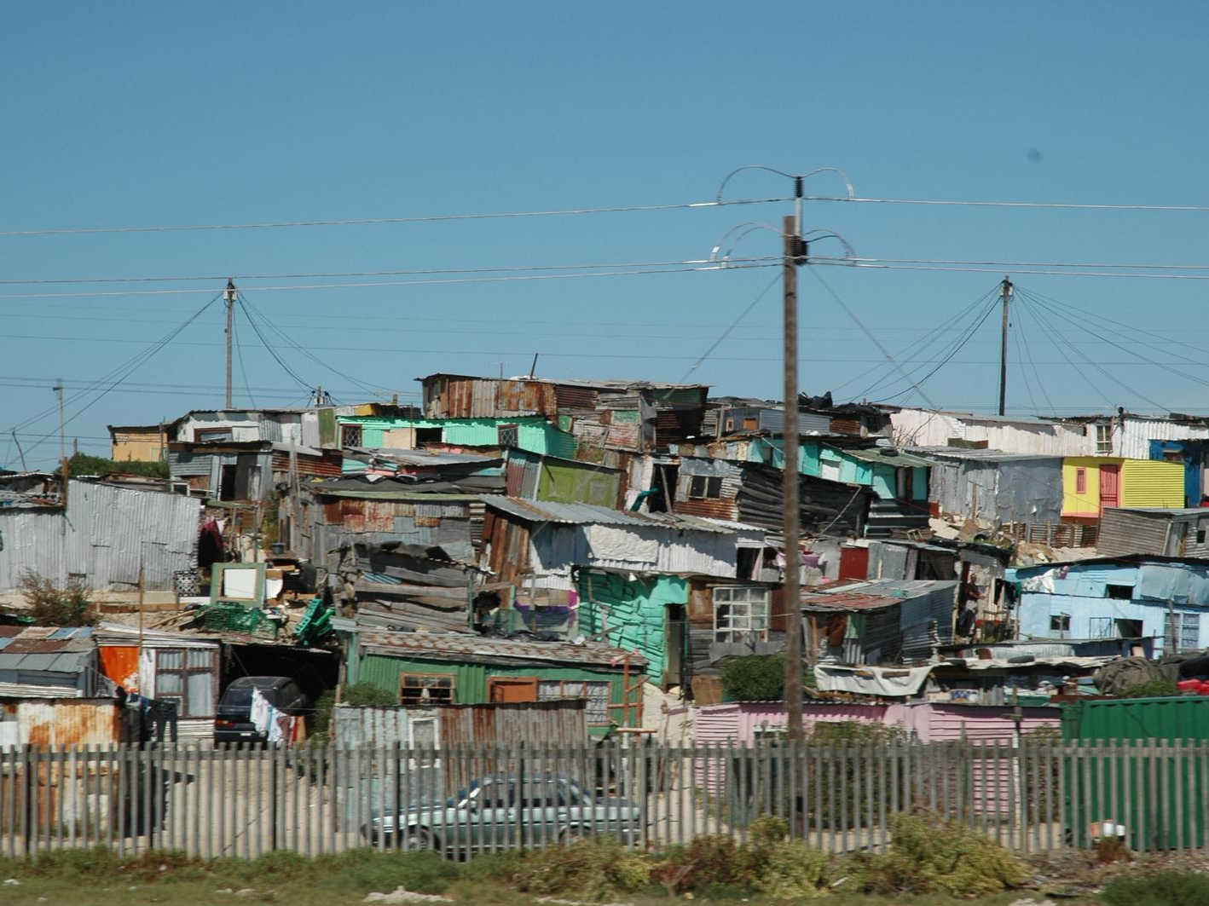

Slide 6
Avoid the Big Ball of Mud
http://www.laputan.org/mud/
Notes:
Even if all of these antipatterns are obvious to you, they may not be for all members of the team.
It's important that everyone understands how to avoid these pitfalls.

Slide 7
Antipatterns

Slide 8
Giant backing bean

Slide 9
Giant backing bean
Several hundred or thousand lines

Slide 10
Giant backing bean
Several hundred or thousand lines
Unnecessary comments

Slide 11
Giant backing bean
Several hundred or thousand lines
Unnecessary comments
Very complicated view that uses Ajax

Slide 12
Giant backing bean
Several hundred or thousand lines
Unnecessary comments
Very complicated view that uses Ajax
Business logic in backing beans

Slide 13
Giant backing bean
Several hundred or thousand lines
Unnecessary comments
Very complicated view that uses Ajax
Business logic in backing beans
Data access logic in backing beans

Slide 14
Giant backing bean
Refactor
Multiple backing beans
Move code
Other layers
Utility classes
Other scoped objects

Slide 15
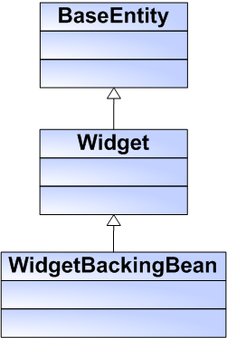

Slide 16
Backing bean subclasses domain object

Slide 17
Backing bean subclasses domain object
Violates separation of concerns and OO principles

Slide 18
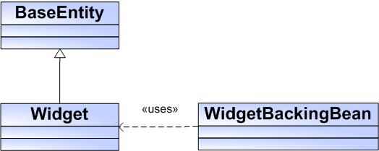
Backing bean subclasses domain object
Violates separation of concerns and OO principles

Slide 19
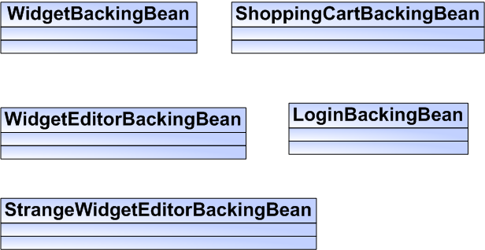

Slide 20
Flat backing bean hierarchy

Slide 21
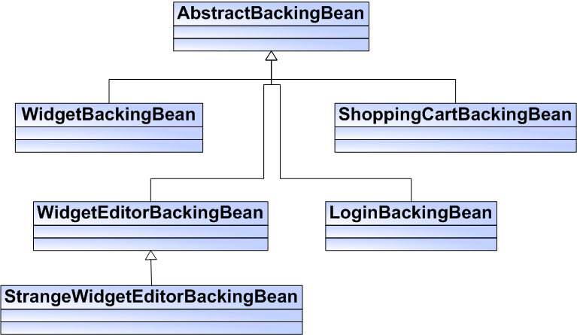
Flat backing bean hierarchy

Slide 22
public void validateName (FacesContext facesContext,
UIComponent sender, Object newValue) throws ValidatorException {
if (!nameExists((String) newValue)) {
facesContext.addMessage("newWidgetForm:name", new FacesMessage("Duplicate widget name"));
}
}

Slide 23
public void validateName (FacesContext facesContext,
UIComponent sender, Object newValue) throws ValidatorException {
if (!nameExists((String) newValue)) {
facesContext.addMessage("newWidgetForm:name", new FacesMessage("Duplicate widget name"));
}
}

Slide 24
Magic string dependencies
public void validateName (FacesContext facesContext,
UIComponent sender, Object newValue) throws ValidatorException {
if (!nameExists((String) newValue)) {
facesContext.addMessage("newWidgetForm:name", new FacesMessage("Duplicate widget name"));
}
}

Slide 25
Magic string dependencies
public void validateName(FacesContext facesContext, UIComponent sender,
Object newValue) throws ValidatorException {
if (!nameExists((String) newValue)) {
throw new ValidatorException(new FacesMessage(
"Duplicate widget name."));
}
}

Slide 26
Magic string dependencies
public void deleteWidget (ActionEvent event) {
FacesContext facesContext =
FacesContext.getCurrentInstance();
String id = event.getComponent().getClientId(facesContext);
int beginIndex = id.indexOf(":", 0);
beginIndex = id.indexOf(":", beginIndex + 1);
int endIndex = id.indexOf(":", beginIndex + 1);
String rowIndex = id.substring(beginIndex + 1, endIndex);
deleteWidget(Integer.parseInt(rowIndex));
}

Slide 27
Magic string dependencies
public void deleteWidget (ActionEvent event) {
FacesContext facesContext =
FacesContext.getCurrentInstance();
String id = event.getComponent().getClientId(facesContext);
int beginIndex = id.indexOf(":", 0);
beginIndex = id.indexOf(":", beginIndex + 1);
int endIndex = id.indexOf(":", beginIndex + 1);
String rowIndex = id.substring(beginIndex + 1, endIndex);
deleteWidget(Integer.parseInt(rowIndex));
}

Slide 28
Magic string dependencies
<h:dataTable id="widgetTable" value="#{widgetEditorController.widgets}" var="widget">
<h:column>
<f:facet name="header">Name</f:facet>
<h:outputText value="#{widget.name}" />
</h:column>
<h:column>
<f:facet name="header">Size</f:facet>
<h:outputText value="#{widget.size}" />
</h:column>
<h:column>
<h:commandLink value="#{widgetEditorController.delete}">
<f:setPropertyActionListener value="widget" target="#{widgetEditorController.currentWidget}"/>
</h:commandLink>
</h:column>
</h:dataTable>

Slide 29
Magic string dependencies
<h:dataTable id="widgetTable" value="#{widgetEditorController.widgets}" var="widget">
<h:column>
<f:facet name="header">Name</f:facet>
<h:outputText value="#{widget.name}" />
</h:column>
<h:column>
<f:facet name="header">Size</f:facet>
<h:outputText value="#{widget.size}" />
</h:column>
<h:column>
<h:commandLink value="#{widgetEditorController.delete(widget)}"/>
</h:column>
</h:dataTable>

Slide 30
Magic string dependencies
Use value or component bindings

Slide 31
Magic string dependencies
Use value or component bindings
Retrieve the sending UI component in event listener methods

Slide 32
Unnecessary FacesContext lookups

Slide 33
Unnecessary FacesContext lookups
Calling FacesContext.getCurrentInstance() multiple times in the same method

Slide 34
Unnecessary FacesContext lookups
Use a variable

Slide 35
Interdependent backing beans

Slide 36
Interdependent backing beans
Factor out behavior to other layers or helper objects
Inject the dependency

Slide 37
Interdependent backing beans

Slide 38
Giant view

Slide 39
Giant view
Similar markup repeated in every page

Slide 40
Giant view
Similar markup repeated in every page
No templating or reuse

Slide 41
Giant view
Use templating or includes for any common markup

Slide 42
Giant view
Use templating or includes for any common markup
Break up pages into smaller fragments

Slide 43
Giant view
Use templating or includes for any common markup
Break up pages into smaller fragments
Use composite components

Slide 45
Bloated component tree

Slide 46
Bloated component tree
Consume lots of memory
Render large pages
Slower

Slide 47
Bloated component tree
The rendered attribute does not affect the size of the component tree

Slide 48
Bloated component tree
Is Ajax really required?
Consider transient markup (<div>, <span>, text output, etc.)
Consider stateless views (JSF 2.2)
Investigate dynamic loading features

Slide 49
Bloated component tree
Use a scope other than session
Use <c:if> (sparingly)
Split into separate views

Slide 50
public List<Widget> getWidgets () {
WidgetProvider widgetProvider = new WidgetProvider();
return widgetProvider.getWidgets();
}

Slide 51
public List<User> getUsers () {
ELContext elContext = FacesContext. getCurrentInstance().getELContext();
UserProvider userProvider =
(UserProvider) elContext.getELResolver()
.getValue(elContext, null, "userProvider");
return userProvider.getUsers();
}

Slide 52
Lack of dependency injection
public List<User> getUsers () {
ELContext elContext = FacesContext. getCurrentInstance().getELContext();
UserProvider userProvider =
(UserProvider) elContext.getELResolver()
.getValue(elContext, null, "userProvider");
return userProvider.getUsers();
}

Slide 53
Lack of dependency injection
Don't create singletons or scoped objects with new operator
Use dependency injection to wire up backing beans to other objects

Slide 54
Lack of dependency injection
@Inject
private UserProvider userProvider;
public UserProvider getUserProvider() {
return userProvider;
}
public void setUserProvider(UserProvider userProvider) {
this.userProvider = userProvider;
}
public List<User> getUsers() {
return userProvider.getUsers();
}
Notes:
Mention differences between CDI injection and Managed Beans (scopes)

Slide 55
public void getData() {
return service.getData();
}
Notes:
Mention differences between CDI injection and Managed Beans (scopes)

Slide 56
Getter grabber
public void getData() {
return service.getData();
}
Notes:
Mention differences between CDI injection and Managed Beans (scopes)

Slide 57
Getter grabber
Do not perform any expensive operations in getters
Retrieve data when view is loaded

Slide 58
widgetViewer.xhtml
WidgetEditorPage.xhtml
wiget_search.xtml

Slide 59
Inconsistent artifact names
widgetViewer.xhtml
WidgetEditorPage.xhtml
wiget_search.xtml

Slide 60
Inconsistent artifact names
Define and enforce naming conventions

Slide 61
Initializing backing beans in constructor
Dependency injection has not taken place

Slide 62
Initializing backing beans in constructor
Lazy initialization
Use @PostConstruct annotation
Initialize before the view is displayed
JSF 1.2: PhaseListener
<f:view beforePhase="#{myBean.init}">
JSF 2: BeforeRender event
<f:event type="beforeRender" listener="#{myBean.init}">

Slide 63
Eager view initialization

Slide 64
Eager view initialization
Lazy initialization

Slide 65
Lazy library initialization

Slide 66
Lazy library initialization
Causes unnecessary delays for the first user

Slide 67
Lazy library initialization
Initialize expensive objects at startup
Spring ContextLoader
JSF 1.x: ServletContextListener
JSF 2: Load managed bean at startup (eager) with @PostConstruct

Slide 68
Static variables in scoped objects

Slide 69
Static variables in scoped objects
Breaks the semantics of scoped state
Can cause synchronization issues
Does not work in a clustered environment

Slide 70
Static variables in scoped objects
Use an application-scoped object or a constant

Slide 71
Non-serializable session-scoped objects
Make all session, view and conversation-scoped objects serializable

Slide 72
Overcomplicated expressions

Slide 73
Overcomplicated expressions
Hard to read
Mixes business logic with display logic

Slide 74
Overcomplicated expressions
Move logic into backing bean properties

Slide 75
Exception eating
public List<User> getUsers () {
try {
return userProvider.getUsers();
} catch (DataAccessException e) {
e.printStackTrace();
}
return null;
}

Slide 76
Exception eating
If you cannot properly handle the exception, don't
Let exceptions bubble up to the container
Make sure you use a Logger instead of System.out.println()
Use the JSF2 ExceptionHandler to centralize exception handling

Slide 77
Unnecessary UI Component Bindings

Slide 78
Unnecessary UI Component Bindings
Component bindings can be problematic for non-request scoped beans
http://leadingyouastray.blogspot.com/2010/02/references-to-uicomponents-in-session.html
Component bindings in view-scoped backing beans break partial state saving (fixed in JSF 2.2)

Slide 79
Unnecessary UI Component Bindings
Use value bindings
<f:setPropertyActionListener>
Retrieve components from event objects in event listeners
Use request-scoped holder pattern
Notes:
Re: "Unnecessary UI Component Bindings" you may want to mention a gotcha with setPropertyActionListener: since it is a child of the command component, it is called after the action="" or actionListener="" method is called (that's why we used <f:param> in eServices)

Slide 80
Backing bean messages

Slide 81
Backing bean messages
Use ordinary JSF messages

Slide 82
Backing bean messages
Use ordinary JSF messages
Create convenience methods in your base backing bean class

Slide 83
Backing bean messages
Use ordinary JSF messages
Create convenience methods in your base backing bean class
Issue: scope
Will redisplay for request scoped beans unless you do a redirect (fixed in JSF 2.0)

Slide 84
Immediate overuse

Slide 85
Immediate overuse
Avoid using immediate for non-Command components

Slide 86
Immediate overuse
Avoid using immediate for non-Command components
Consider putting input controls in a separate form

Slide 87
Immediate overuse
Avoid using immediate for non-Command components
Consider putting input controls in a separate form
Use Ajax features
RichFaces: <a4j:ajaxOnly>
JSF 2: <f:ajax ... execute="@this"/>

Slide 88
Nameless UI components
<h:form>
<h:inputText value="#{widgetEditor.currentWidget}" />
<h:commandButton value="Submit”
action="#{widgetEditor.save}" />
</h:form>

Slide 89
Nameless UI components
Makes testing difficult
Hard to integrate with custom JavaScript or Ajax features
Increases rendered page size

Slide 90
<h:form id="frm">
<h:inputText id="name" value="#{widgetEditor.currentWidget}" />
<h:commandButton id="submit" value="Submit”
action="#{widgetEditor.save}" />
</h:form>

Slide 91
Nameless UI components
Assign short, meaningful ids
All input controls
Components with Ajax behavior
Naming containers

Slide 92
Nameless UI components
Develop naming conventions
frm
dtb
widgetFrm
widgetDtb

Slide 93
CSS style soup
Hardcoded styles in JSF views

Slide 94
CSS style soup
Use CSS selectors instead of inline styles
Most suites let you override default selectors
Develop custom theme if possible

Slide 95
Session overload

Slide 96
Session overload
Put beans in request scope when possible
For Ajax, use view scope
JSF 1.x: not supported
Seam Page scope
Tomahawk <t:saveState>
RichFaces <a4j:keepAlive>

Slide 97
Session overload
Conversation scope
Not implemented natively
JSF 1.x
Seam, MyFaces Orchestra
MyFaces Trinidad PageFlowScope
Spring Web Flow
Spring 3.1
JSF 2: CDI

Slide 98
Gotchas

Slide 99
Null input values
JSF 1.2: Null values are converted to a 0 or false
https://jsp-spec-public.dev.java.net/issues/show_bug.cgi?id=183
Tomcat and JBoss
"-Dorg.apache.el.parser.COERCE_TO_ZERO=false" as a VM parameter.
JSF 2: javax.faces.INTERPRET_EMPTY_STRING_SUBMITTED_VALUES_AS_NULL context parameter

Slide 100
Null input values
JSF 2: javax.faces.INTERPRET_EMPTY_STRING_SUBMITTED_VALUES_AS_NULL context parameter

Slide 101
Validating empty fields
JSF 1.x: Validators not called for empty values
JSF 2: javax.faces.VALIDATE_EMPTY_FIELDS context parameter
Notes:
javax.faces.VALIDATE_EMPTY_FIELDS: auto is default

Slide 102
Best practices

Slide 103
Use constants or enums for action method outcomes
public enum Outcome {
SUCCESS, FAILURE, PREVIOUS, NEXT, ERROR;
@Override
public String toString()
{
return super.toString().toLowerCase();
}
}

Slide 104
Use constants or enums for action method outcomes
public Outcome updateWidget() {
....
return Outcome.SUCCESS;
}

Slide 105
Build a library of composite components
Standardize behavior and look and feel

Slide 106
Build a library of composite components
Standardize behavior and look and feel
Examples
Input control layout
Panels
Buttons
Icons
Forms

Slide 107
Build a library of composite components
<html xmlns="http://www.w3.org/1999/xhtml"
xmlns:h="http://java.sun.com/jsf/html"
xmlns:composite="http://java.sun.com/jsf/composite">
<composite:interface>
<composite:attribute name="label" />
<composite:attribute name="value" required="true" />
</composite:interface>
<composite:implementation>
<h:outputLabel for="input" value="#{cc.attrs.label}" />
<h:inputText id="input" value="#{cc.attrs.value}" />
</composite:implementation>
</html>

Slide 108
Development team best practices
Documentation
Coding guidelines
Code review
Static analysis
Build process
Continuous integration
Unit testing
Notes:
JSFUnit, Sonar, and JTest do static analysis

Slide 109
More Best Practices
Externalize all messages to resource bundles
Use another object for state in PhaseListeners

Slide 110
R

Slide 111
RT

Slide 112
RTF

Slide 113
RTFM

Slide 114
Resources
http://www.javaserverfaces.org
http://www.jsfcentral.com
Books
Core JSF
JSF: The Complete Reference

