Slide 1
JavaFX Coding Playground BoF 2730

Slide 2
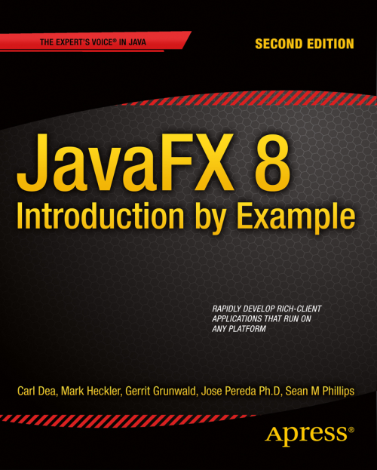
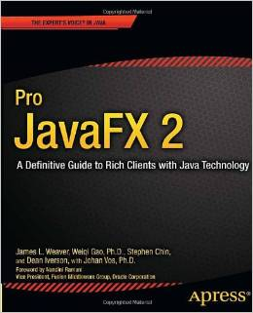
Carl Dea
Mr. Dea works for Objective Solutions, Inc. as a senior software engineer. On his off time he is a JavaFX enthusiast, blogger and book author. He is a Co-Author of the book JavaFX 8 Introduction by Example, Co-Author of Java 7 Recipes and technical reviewer of the Pro JavaFX 2 book by Apress publishing.
Twitter: @carldea Website: carlfx.wordpress.com
LinkedIn: https://www.linkedin.com/in/carldea

Slide 3
Gerrit Grunwald
Mr. Grunwald works for Oracle corp. as a Java Technology Evangelist. Mr. Grunwald is also a JUG Leader, JavaFX Community Co-Lead, Co-Author of the book JavaFX 8 Intro by Example by Apress, IoT Community Co-Lead, Java Champion, and JavaONE Rockstar. He participates in many open source projects like JFXtras.org as well as his own projects (Enzo, SteelSeries Swing, SteelSeries Canvas). He is an internationally renowned speaker at many conferences and user groups.
Twitter: @hansolo_ Website: harmonic-code.org
LinkedIn: de.linkedin.com/in/harmoniccode

Slide 4
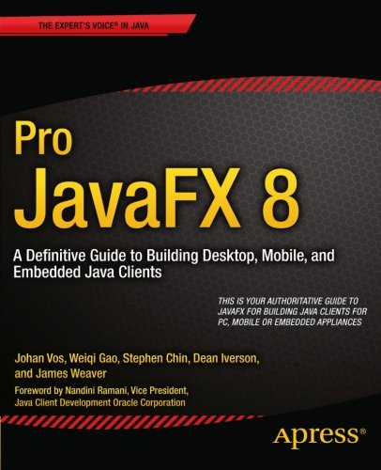
Notes:
Hendrik Ebbers
Johan Vos
Weiqi Gao
Stephin Chin
Dean Iverson
James Weaver

Slide 5
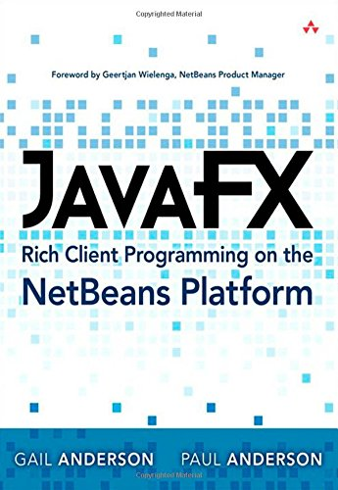

Slide 6
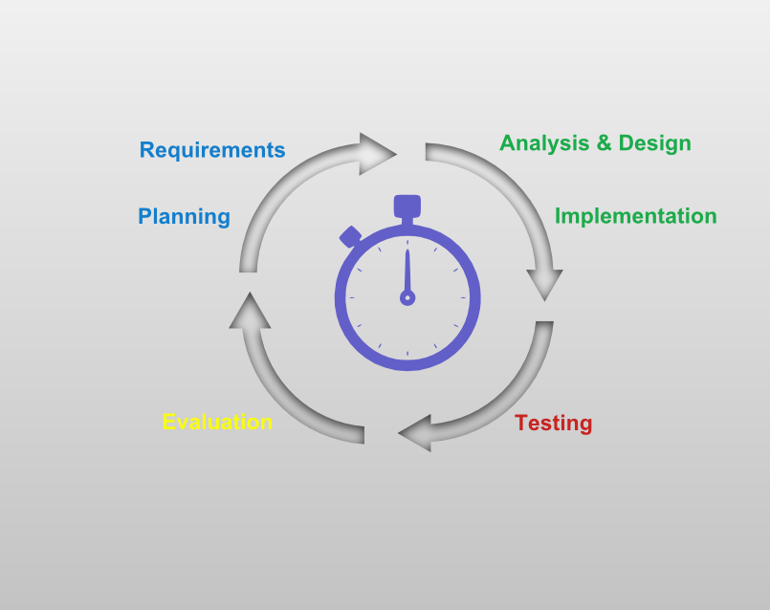
Have you ever shipped prototype code into production?
Notes:
Technical debt…
Technical debt (also known as design debt^{[citation needed]} or code debt) is a neologistic metaphor referring to the eventual consequences of poor system design, software architecture or software development within acodebase. The debt can be thought of as work that needs to be done before a particular job can be considered complete or proper. If the debt is not repaid, then it will keep on accumulating interest, making it hard to implement changes later on. Unaddressed technical debt increases software entropy.

Slide 7
Technical Debt \ˈtek-ni-kəl ˈdet\ -
“Shipping first time code is like going into debt. A little debt speeds development so long as it is paid back promptly with a rewrite… The danger occurs when the debt is not repaid. Every minute spent on not-quite-right code counts as interest on that debt. Entire engineering organizations can be brought to a stand-still under the debt load of an unconsolidated implementation.
-- Ward Cunningham,
OOPSLA 1992
Inventor of Wiki
Notes:
The technical debt metaphor was coined by Ward Cunningham in his 1992 OOPSLA experience report in defense of relentless refactoring as a means of managing debt: Shipping first time code is like going into debt. A little debt speeds development so long as it is paid back promptly with a rewrite
Shipping first time code is like going into debt. A little debt speeds development so long as it is paid back promptly with a rewrite.... The danger occurs when the debt is not repaid. Every minute spent on not-quite-right code counts as interest on that debt. Entire engineering organizations can be brought to a stand-still under the debt load of an unconsolidated implementation.
Technical Debt: Don't Go Bankrupt
By Philippe Kruchten
https://www.youtube.com/watch?v=ZUYIFLfyxoI (loss of productivity)
Technical debt = Invisible feature with negative value.
Value… of repaying technical debt, interests loss of productivity, etc.
Will decrease value over time.
Code level 33:53
32:18 Tools and methods to deal with code smells, etc. Code debt.
Technical Debt by Ward Cunningham
https://www.youtube.com/watch?v=pqeJFYwnkjE

Slide 8
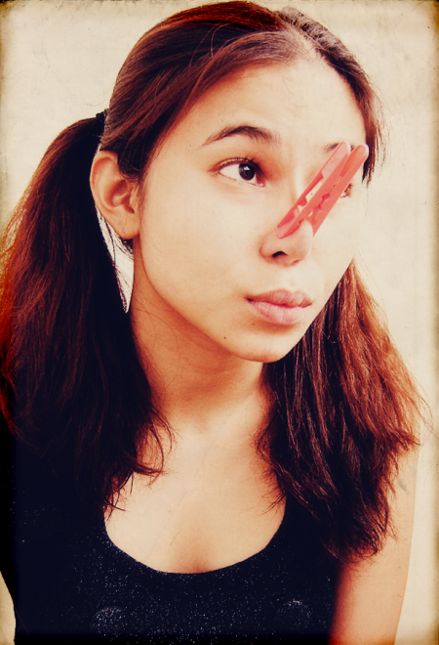
In other words, Shipping first time code is the same as prototype code (smelly, hacky) ending up in production code.

Slide 9
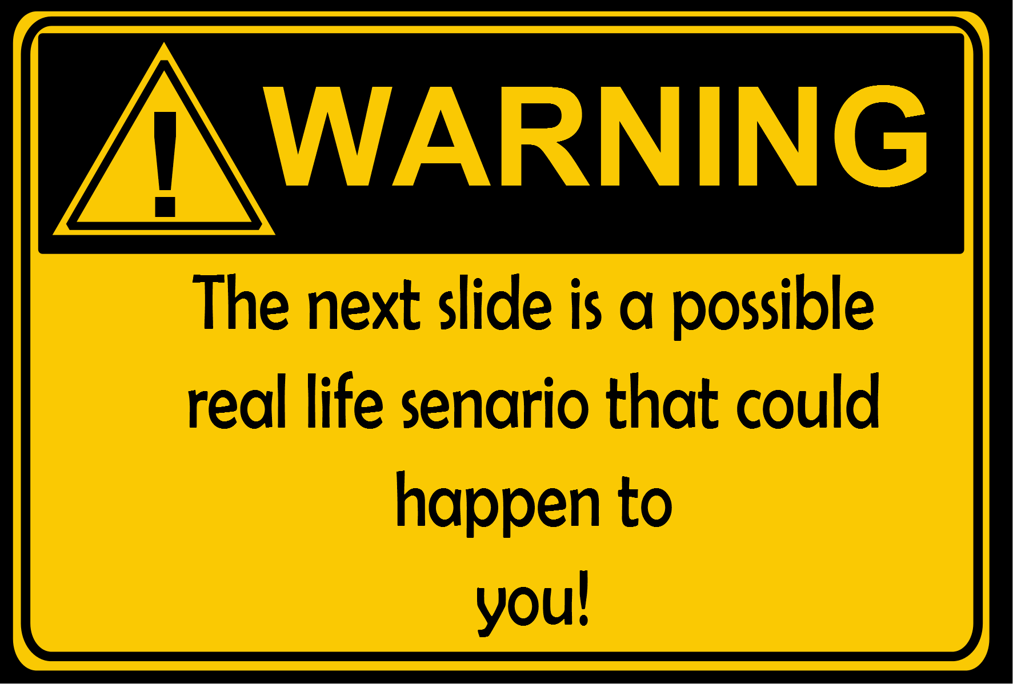

Slide 10
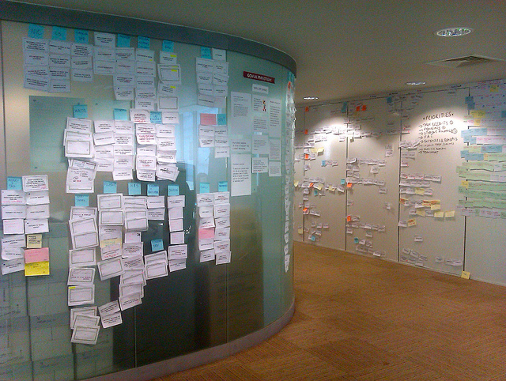
When you create smelly code you will have implementation issues.
When you have implementation issues you will need to extend your project schedule. And
when you extend your project schedule you will miss your deadline and
when you miss your deadline the customer gets unhappy and
Notes:
A parody similar to the Direct TV’s funny commercials when technical debts aren’t paid.

Slide 11
when the customer gets unhappy your boss goes super nova!
Don't let your boss go super nova, Get rid of smelly code! And Use coding playgrounds to prototype code!

Slide 12
What is a Coding Playground?
Short answer:
A live editor tool for quick prototyping.
Long answer:
A live editor tool to execute code on the fly without compiling code, thus providing immediate feedback.

Slide 13
Key Benefits to Using Playgrounds
Reduce Technical Debt
Rapid Application Development
Immediate Feedback
Evaluate, Learn and Explore APIs (R&D)

Slide 14
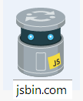
Coding Playgrounds
JSFiddle
Code Pen
JSbin
Dabblet
Apple's Swift Playground
SnapCode
FX Playground
Notes:
JavaFX Coding Playground
BOF 2730
Outline
Who we are?
Carl Dea
Objective Solutions Inc.
Co-Author of Java7 Recipes
Author of JavaFX 2 (by Apress) Introduction by Example
Co-author of JavaFX 8 Intro by Example.
What kinds of coding playgrounds exist?
HTML5/JavaScript/CSS
jsFiddle http://jsfiddle.net/, Code Pen http://codepen.io/
Why/When would you need a coding playground?
Experimentation
Exploring
Prototyping Ideas
What are some examples of coding playgrounds?
http://www.reportmill.com/snap/

Slide 15
FX Playground’s Capabilities
Execute HTML5 Code
Access JavaFX Graphics APIs
Load third party libraries
Supports the following languages:
JavaScript (Nashorn & Webkit)
Groovy & GroovyFX
Python (Jython)
Ruby (JRuby)
Scala
Clojure

Slide 16
Markup Window
FXML/HTML
CSS Window
Coding Window
Output Window

Slide 17
FX Playground’s Capabilities
Execute HTML5 Code
Access JavaFX Graphics APIs
Load third party libraries
Supports the following languages:
JavaScript (Nashorn & Webkit)
Groovy & GroovyFX
Python (Jython)
Ruby (JRuby)
Scala
Clojure

Slide 18
Demo
Notes:
HTML5 symbol from W3C
http://commons.wikimedia.org/wiki/File:HTML5_logo_and_wordmark.svg
http://commons.wikimedia.org/wiki/File%3AHTML5_logo_and_wordmark.svg
http://upload.wikimedia.org/wikipedia/commons/6/61/HTML5_logo_and_wordmark.svg
W3C [CC-BY-3.0 (http://creativecommons.org/licenses/by/3.0)], via Wikimedia Commons
This is basically all JavaFX related demos.
http://docs.oracle.com/javase/8/docs/technotes/guides/scripting/nashorn/javafx.html
https://wiki.openjdk.java.net/display/Nashorn/Main
Show off HTML
Style CSS
Show off FXML

Slide 19
FX Playground’s Capabilities
Execute HTML5 Code
Access JavaFX Graphics APIs
Load third party libraries
Supports the following languages:
JavaScript (Nashorn & Webkit)
Groovy & GroovyFX
Python (Jython)
Ruby (JRuby)
Scala
Clojure

Slide 20
Notes:
FXML Markup Window

Slide 21
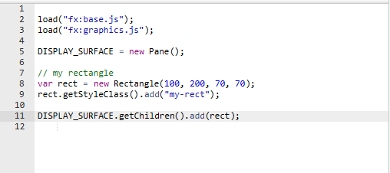
Nashorn / JavaScript
http://docs.oracle.com/javase/8/docs/technotes/guides/scripting/nashorn/javafx.html

Slide 22
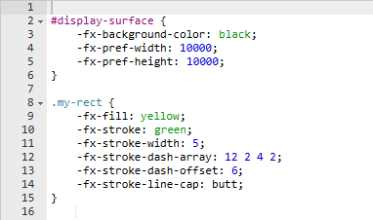
JavaFX CSS
http://docs.oracle.com/javase/8/javafx/api/javafx/scene/doc-files/cssref.html

Slide 23
FX Playground’s Predefined Variables:
FXML_NODE (javafx.scene.Node)
The FXML markup as a JavaFX Node (Pane)
DISPLAY_SURFACE (javafx.scene.layout.Pane)
A Pane Node instantiated by the user
Otherwise the system creates a Pane to
output JavaFX nodes.
Notes:
javafx.scene.layout.Pane

Slide 24
Demo
Nashorn
Notes:
Simple demo to show case a hello world. This is basically all JavaFX related demos.
http://docs.oracle.com/javase/8/docs/technotes/guides/scripting/nashorn/javafx.html
https://wiki.openjdk.java.net/display/Nashorn/Main
Show off HTML
Style CSS
Show off FXML

Slide 25
FX Playground’s Capabilities
Execute HTML5 Code
Access JavaFX Graphics APIs
Load third party libraries
Supports the following languages:
JavaScript (Nashorn & Webkit)
Groovy & GroovyFX
Python (Jython)
Ruby (JRuby)
Scala
Clojure

Slide 26
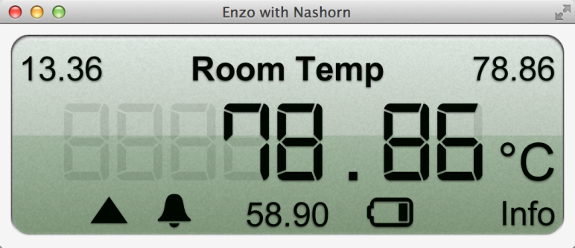
Demo
Orson Charts
by
Notes:
These demos are related to 3rd party libraries.

Slide 27
FX Playground’s Capabilities
Execute HTML5 Code
Access JavaFX Graphics APIs
Load third party libraries
Supports the following languages:
JavaScript (Nashorn & Webkit)
Groovy & GroovyFX
Python (Jython)
Ruby (JRuby)
Scala
Clojure

Slide 28
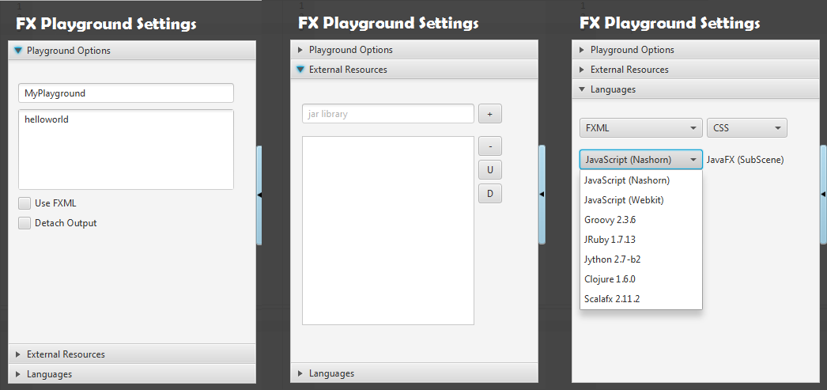

Slide 29
Languages & JavaFX
Demo
Notes:
These demos are related to JSR 223 (languages)

Slide 30
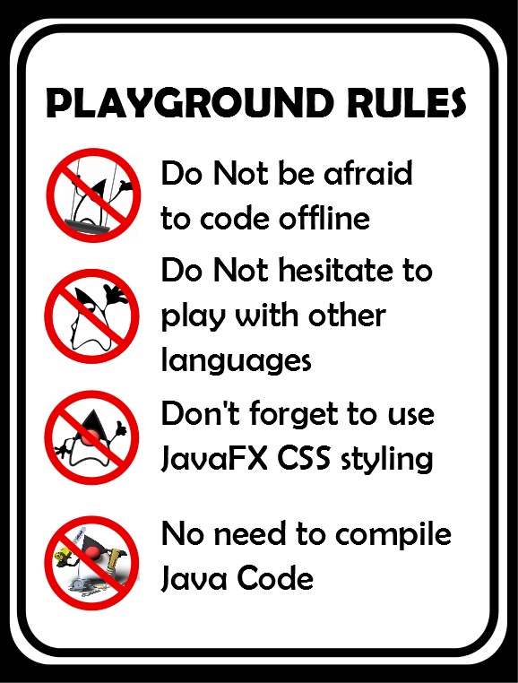
Notes:
Typically, when you enter a playground you get rules, however this sign is a reminder to the user(developer) when using the FX Playground Application.

Slide 31
Thank you for attending this session! Have a great time at JavaOne

Slide 33
Pictures and Attributions (Creative Commons)
"Secret #1: What.The.Huh." https://www.flickr.com/photos/helga/3264983583 by Helga Weber https://www.flickr.com/photos/helga "CC BY 2.0" https://creativecommons.org/licenses/by-nd/2.0
"and all at once, a host of pivotal-cards" https://www.flickr.com/photos/psd/7645555148 by Paul Downey https://www.flickr.com/photos/psd/ "CC BY 2.0“ https://creativecommons.org/licenses/by/2.0/
"Sad Reese" https://www.flickr.com/photos/donnieray/10584676434 by Donnie Ray Jones https://www.flickr.com/photos/donnieray/ "CC BY 2.0" https://creativecommons.org/licenses/by/2.0
"Pure Inspiration" by Marines https://www.flickr.com/photos/marine_corps/ "CC BY 2.0" https://creativecommons.org/licenses/by-nc/2.0/
Duke, the Java Mascot, in the waving pose.by sbmehta converted to SVG from Sun Microsystems AI version. http://commons.wikimedia.org/wiki/File:Wave.svg
Html5 logo http://www.w3.org/html/logo/index.html by Alex Muller http://commons.wikimedia.org/wiki/File%3AHTML5_logo_and_wordmark.svg http://commons.wikimedia.org/wiki/File:HTML5_logo_and_wordmark.svg http://upload.wikimedia.org/wikipedia/commons/6/61/HTML5_logo_and_wordmark.svg W3C [CC-BY-3.0 (http://creativecommons.org/licenses/by/3.0)], via Wikimedia Commons
Java Mascot introducing Netbeans.Wikimedia Commons . https://duke.dev.java.net/ http://commons.wikimedia.org/wiki/File:Netbeans-Duke.png
Notes:
[tek-ni-kuh l]\ˈdet\
Ward Cunningham
Title "Creative Commons 10th Birthday Celebration San Francisco"
Author? "tvol" - linked to his profile page
Source? "Creative Commons 10th Birthday Celebration San Francisco" - linked to original Flickr page
License? "CC BY 2.0" - linked to license deed
"Secret #1: What.The.Huh." https://www.flickr.com/photos/helga/3264983583 by Helga Weber https://www.flickr.com/photos/helga "CC BY 2.0" https://creativecommons.org/licenses/by-nd/2.0
"and all at once, a host of pivotal-cards" https://www.flickr.com/photos/psd/7645555148 by Paul Downey https://www.flickr.com/photos/psd/ "CC BY 2.0" https://creativecommons.org/licenses/by/2.0/
"Sad Reese" https://www.flickr.com/photos/donnieray/10584676434 by Donnie Ray Jones https://www.flickr.com/photos/donnieray/ "CC BY 2.0" https://creativecommons.org/licenses/by/2.0
"Pure Inspiration" https://www.flickr.com/photos/marine_corps/8654792719 by Marines https://www.flickr.com/photos/marine_corps/ "CC BY 2.0" https://creativecommons.org/licenses/by-nc/2.0/
creative commons:
Html5 logo:
http://www.w3.org/html/logo/index.html
by Alex Muller
http://commons.wikimedia.org/wiki/File%3AHTML5_logo_and_wordmark.svg
http://commons.wikimedia.org/wiki/File:HTML5_logo_and_wordmark.svg
http://upload.wikimedia.org/wikipedia/commons/6/61/HTML5_logo_and_wordmark.svg
W3C [CC-BY-3.0 (http://creativecommons.org/licenses/by/3.0)], via Wikimedia Commons
https://wiki.openjdk.java.net/display/Nashorn/Main
http://docs.oracle.com/javase/8/docs/technotes/guides/scripting/nashorn/javafx.html
http://docs.oracle.com/javase/8/javafx/api/javafx/scene/doc-files/cssref.html
https://bitbucket.org/hansolo/enzo/wiki/Home
http://fxexperience.com/controlsfx/
http://www.object-refinery.com/orsoncharts/index.html
http://www.jroller.com/dgilbert/entry/creating_3d_charts_in_java

Slide 34
References:
Books
JavaFX 8 Intro by Example by Apress Publishing http://www.amazon.com/JavaFX-Introduction-Example-Carl-Dea/dp/1430264608
Mastering JavaFX 8 Controls (Oracle (McGraw-Hill)) http://www.amazon.com/Mastering-JavaFX-Controls-Oracle-McGraw-Hill/dp/0071833773
Pro JavaFX 8 by Apress Publishing http://www.amazon.com/Pro-JavaFX-Definitive-Building-Embedded/dp/1430265744
Java 8 Recipes by Apress Publising http://www.amazon.com/Java-8-Recipes-Josh-Juneau/dp/1430268271
JavaFX Rich Client Programming on the NetBeans Platform JavaFX http://www.amazon.com/JavaFX-Client-Programming-NetBeans-Platform/dp/0321927710
GUI Playgrounds
JSFiddle http://jsfiddle.net/
Code Pen http://codepen.io/
JS Bin http://jsbin.com/
Dabblet http://dabblet.com/
Apple’s Swift Language https://developer.apple.com/swift/
SnapCode by Report Mill http://www.reportmill.com/snap/
FX Playground https://bitbucket.org/cdea/fxplayground

Slide 35
References (cont):
Languages Supported
Groovy http://groovy.codehaus.org/
GroovyFX http://groovyfx.org/
Jython http://www.jython.org/
JRuby http://jruby.org/
Scala http://www.scala-lang.org/
Clojure http://clojure.org/
Technical Debt by Ward Cunningham https://www.youtube.com/watch?v=pqeJFYwnkjE
Technical Debt: Don't Go Bankrupt By Philippe Kruchten https://www.youtube.com/watch?v=ZUYIFLfyxoI
Ace IDE http://ace.c9.io/
Notes:
creative commons:
Html5 logo:
http://www.w3.org/html/logo/index.html
by Alex Muller
http://commons.wikimedia.org/wiki/File%3AHTML5_logo_and_wordmark.svg
http://commons.wikimedia.org/wiki/File:HTML5_logo_and_wordmark.svg
http://upload.wikimedia.org/wikipedia/commons/6/61/HTML5_logo_and_wordmark.svg
W3C [CC-BY-3.0 (http://creativecommons.org/licenses/by/3.0)], via Wikimedia Commons
http://www.amazon.com/JavaFX-Introduction-Example-Carl-Dea/dp/1430264608
Mastering JavaFX 8 Controls (Oracle (McGraw-Hill)) http://www.amazon.com/Mastering-JavaFX-Controls-Oracle-McGraw-Hill/dp/0071833773
http://www.amazon.com/Pro-JavaFX-Definitive-Building-Embedded/dp/1430265744
http://www.amazon.com/Java-8-Recipes-Josh-Juneau/dp/1430268271
JavaFX Rich Client Programming on the NetBeans Platform
http://www.amazon.com/JavaFX-Client-Programming-NetBeans-Platform/dp/0321927710
Technical Debt by Ward Cunningham
https://www.youtube.com/watch?v=pqeJFYwnkjE
Technical Debt: Don't Go Bankrupt
By Philippe Kruchten
https://www.youtube.com/watch?v=ZUYIFLfyxoI (loss of productivity)
"Secret #1: What.The.Huh." https://www.flickr.com/photos/helga/3264983583 by Helga Weber https://www.flickr.com/photos/helga "CC BY 2.0" https://creativecommons.org/licenses/by-nd/2.0
"and all at once, a host of pivotal-cards" https://www.flickr.com/photos/psd/7645555148 by Paul Downey https://www.flickr.com/photos/psd/ "CC BY 2.0" https://creativecommons.org/licenses/by/2.0/
"Sad Reese" https://www.flickr.com/photos/donnieray/10584676434 by Donnie Ray Jones https://www.flickr.com/photos/donnieray/ "CC BY 2.0" https://creativecommons.org/licenses/by/2.0
"Pure Inspiration" by Marines https://www.flickr.com/photos/marine_corps/ "CC BY 2.0" https://creativecommons.org/licenses/by-nc/2.0/
http://jsfiddle.net/
http://codepen.io/
http://jsbin.com/
http://dabblet.com/
https://developer.apple.com/swift/
http://www.reportmill.com/snap/
Java Mascot introducing Netbeans.
Duke, the Java Mascot, in the waving pose.by sbmehta converted to SVG from Sun Microsystems AI version.
http://commons.wikimedia.org/wiki/File:Wave.svg
Java Mascot introducing Netbeans.
Wikimedia Commons
https://duke.dev.java.net/
http://commons.wikimedia.org/wiki/File:Netbeans-Duke.png
JavaFX and Nashorn:
https://wiki.openjdk.java.net/display/Nashorn/Main
http://docs.oracle.com/javase/8/docs/technotes/guides/scripting/nashorn/javafx.html
http://docs.oracle.com/javase/8/javafx/api/javafx/scene/doc-files/cssref.html
3rd Party libraries
http://fxexperience.com/controlsfx/
https://bitbucket.org/hansolo/enzo/wiki/Home
http://jfxtras.org/
http://www.object-refinery.com/orsoncharts/index.html
http://www.jroller.com/dgilbert/entry/creating_3d_charts_in_java
Languages supported:
Groovy http://groovy.codehaus.org/
GroovyFX http://groovyfx.org/
Jython http://www.jython.org/
JRuby http://jruby.org/
Scala http://www.scala-lang.org/
Clojure http://clojure.org/
Misc
http://ace.c9.io/

