Slide 1
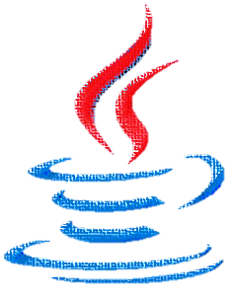
Making All Client Side Java Secure
Bill Gardner
Sr. Director Products
September 2014

Slide 2
Agenda
The Security Landscape
Let’s Talk Java
Demonstration
Q&A

Slide 3
The IT Security Paradox
Are breaches going down?
Up 294%
$30B
No! Up 390%
Security Spending — ’05–’14
Malware/Breaches — ’05–’14
Source: Gartner, Idtheftcenter, $30B is a Gartner figure for 2014
Notes:
Let me start by saying that security is broken. And we are living in the great IT security paradox. What do I mean by that? Let’s begin by taking look at the larger picture, the security industry as a whole. The spend on security each year is over $30 billion dollars ($20B on network, $10B on endpoint). This is an increase of almost 300% over the last decade, a staggering amount. One would think that with this significant level of spend breaches would be going down as organizations would have figured out the optimal defense in depth strategy to counter cyber-attacks. Remember, we have added layers on top of layers over the years. In fact, this is not case. Breaches have actually gone up dramatically and most of this growth is in the last 3 years. Why is that?
Deeper look (optional) – Further, if you look at the spend buckets according to IDC, most organizations have not fundamentally changed the allocation of spend. They are spending roughly the same amount in each security segment, such as firewalls or IPS or AV, as they spent almost 10 years ago. How is this possible when the cybercriminals have completely ratcheted up their game. This is another major contributing factor. But let’s take a deeper look at the real issue.

Slide 4
The Problem
Polymorphic
Targeted
Zero Day
Pattern-Matching
Only known
Many false positives
Costly remediation
71% of all breaches start on the endpoint!
Advanced Threats
Ineffective Detection
The Endpoint Problem
Source: Verizon Data Breach Report
Notes:
The predominant issue the industry is facing and the reason for the dramatic growth in breaches is the sophistication of the cyber underground and cybercriminals themselves. The types of attacks have fundamentally changed the last few years from routine viruses and broad-based spray attacks targeting many users, which can be caught by AV, to very stealthy, targeted attacks, such as zero-day or APT attacks or spear-phishing attacks. Cybercriminals have migrated from basic ‘known’ attacks to unique, highly customized ‘unknown’ attacks. And traditional detection methods, whether on the network or host, simply aren’t effective. They were built to stop only ‘known’ attacks, where they have seen the threat prior. This is the essence of the legacy pattern-matching model. There must be a pattern to match. Further, given the tuning that is required to try and ensure the legacy defenses even capture the known attacks, every system has to overcompensate, thereby creating a flurry of false positives that require security professionals to chase down and validate. Last, cleaning all the machines that got infected is an enormous cost for every organization.
The challenge we face today is that end users are under attack. Every time a user clicks on a link or opens a document from an email he is potentially getting compromised. Attackers are using things such as Java, flash, browser exploits, pdf and office vulnerabilities to compromise the endpoint and steal enterprise data. In fact, the Verizon Data Breach Report highlights that 71% of all attacks resulted from an attack on an endpoint. A huge number. So the challenge is how do we protect the ‘weakest link in the security chain’, the endpoint.

Slide 5
The Problem
“Anti-virus is dead. It catches only 45% of cyber-attacks.
Polymorphic
Targeted
Zero Day
Pattern-Matching
Only known
Many false positives
Costly remediation
Brian Dye SVP, Symantec
”
71% of all breaches start on the endpoint!
Advanced Threats
Ineffective Detection
The Endpoint Problem
Source: Verizon Data Breach Report
Notes:
You may have read just a few months ago that even Symantec came out and said that AV is dead and cannot stop today’s modern attacks. This is backed up by all of the Gartner and Forrester analysts, who all recommend augmenting your traditional defenses.

Slide 6
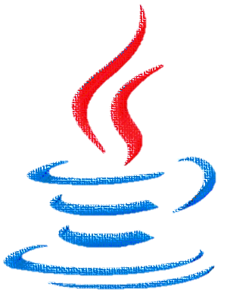
If JAVA didn’t exist…
It would have to be invented

Slide 7
Let’s Talk About Java
97%
of enterprise browsers ran Java in 2013
Source: Cisco 2014 Annual Threat Report
91%
of successful enterprises attacks exploited Java in 2013
Source: Cisco 2014 Annual Threat Report
19%
of enterprise Windows PCs ran the latest version of Java between August 1-29, 2013
Source: CIOL Bureau
~50%
of enterprise traffic uses a Java version that’s more than two years out of date
Source: CIOL Bureau

Slide 8
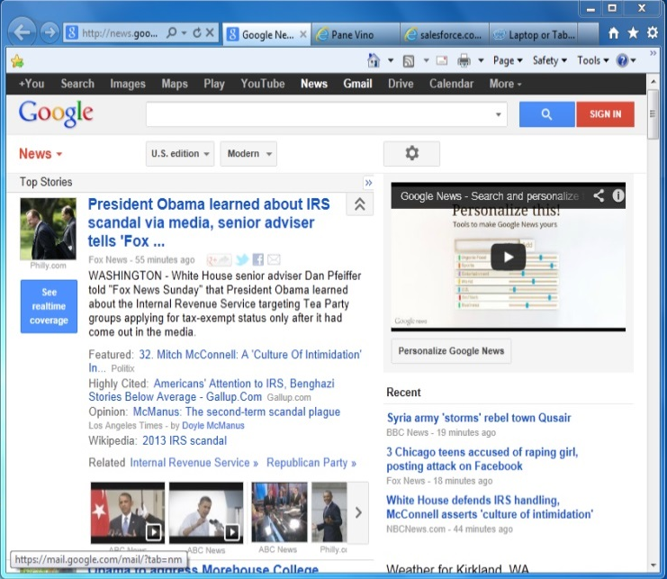
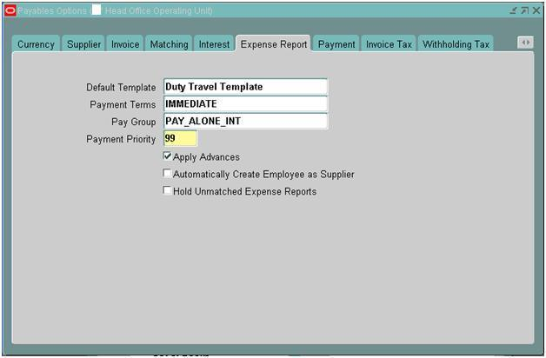
Java Is Not the Problem
NTDLL.DLL
ntoskrnl.exe
win32k.sys
HAL

Slide 9
And All Software Is Vulnerable
NTDLL.DLL
ntoskrnl.exe
win32k.sys
HAL

Slide 10
A Better Idea
Isolate the threat!

Slide 11
Bromium vSentry: Hardware-isolation for Untrusted Tasks
Hardware isolates each untrusted Windows task
Lightweight, fast, hidden, with an unchanged native UX
Based on Xen with a small, secure code base
Fully integrated into the desktop user experience
Microvisor
Hardware virtualization
Hardware security features
Notes:
Bromiums’ breakthrough technology, micro-virtualization uses hardware security features of the CPU to enforce isolation. We are essentially ‘lighting up’ functionality that already exists in a CPU.
It reduces a systems attack surface by using a very small amount of code in the micro visor.
It isolates individual tasks like opening a document or a viewing a web page in it’s own micro-VM.
It allows dozens or hundreds of microVMs to run at the same time on a standard notebook or desktop system.
vSentry creates micro-VMs for each user task in just a fraction of a second and is invisible to the user.

Slide 12
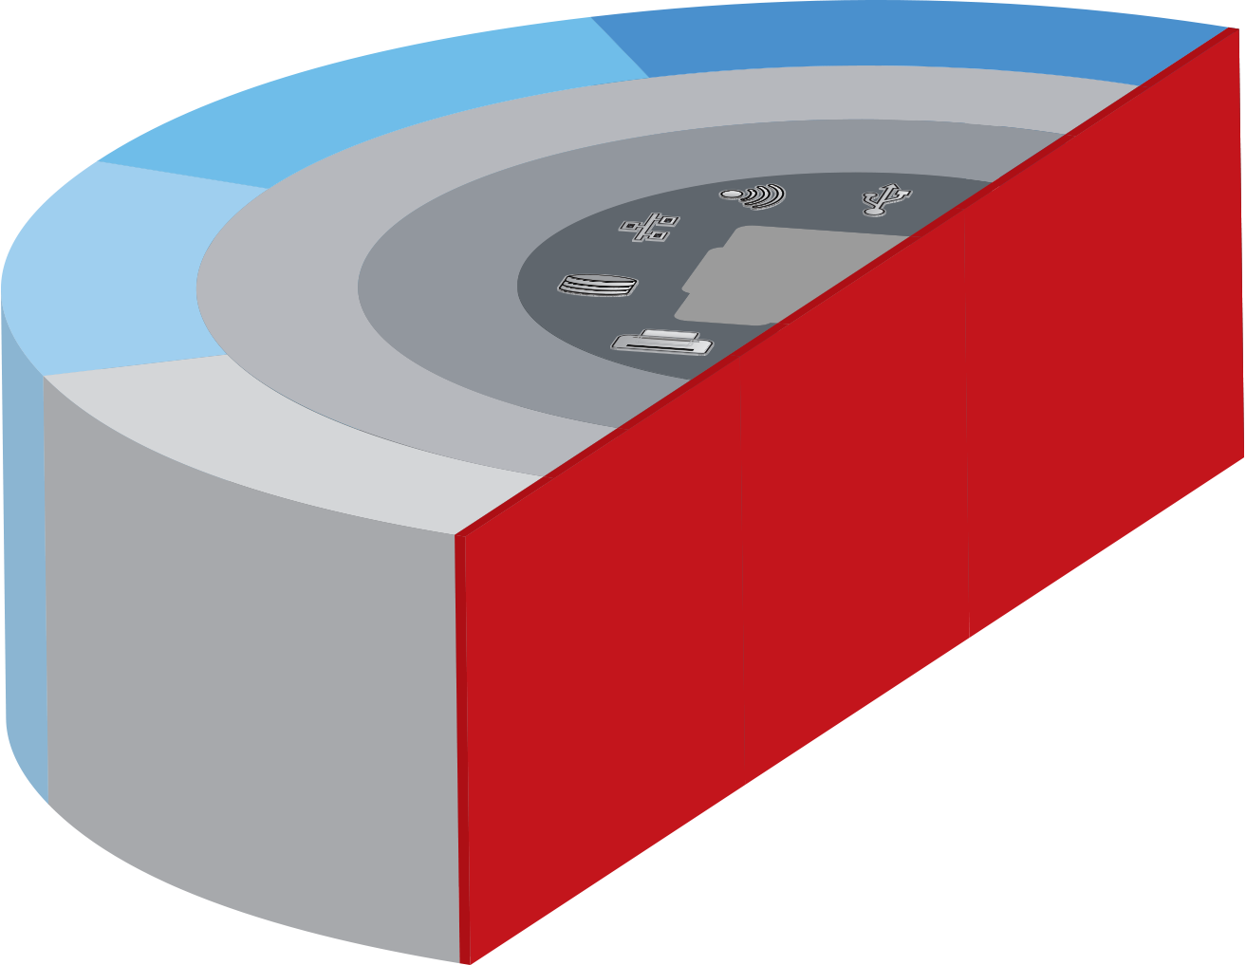
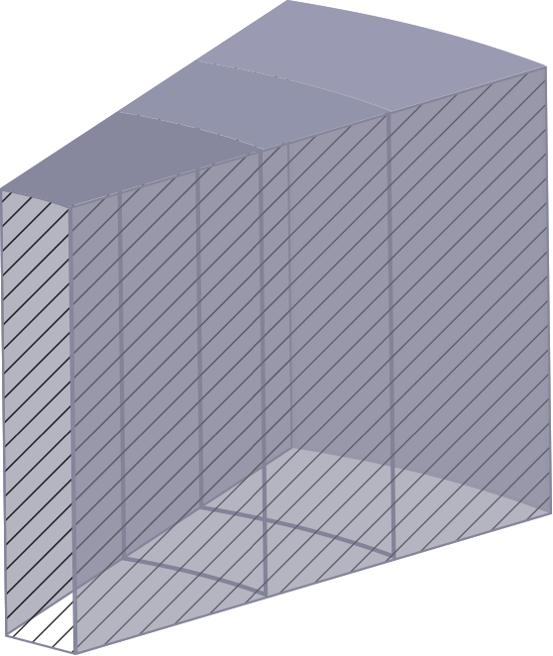
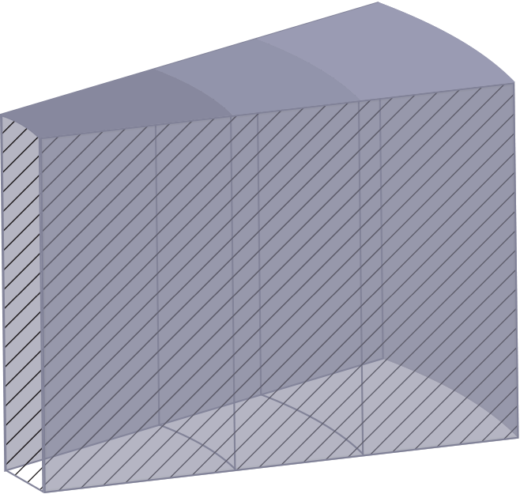
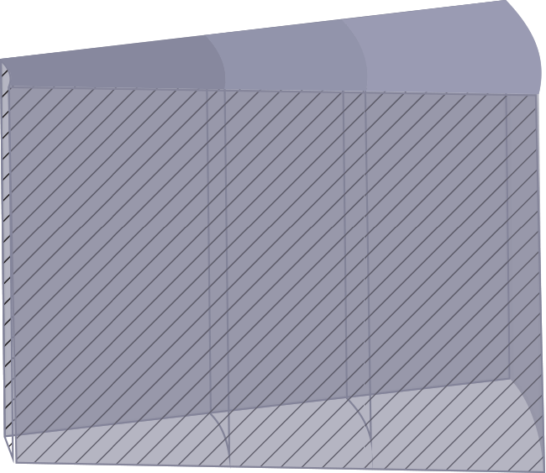
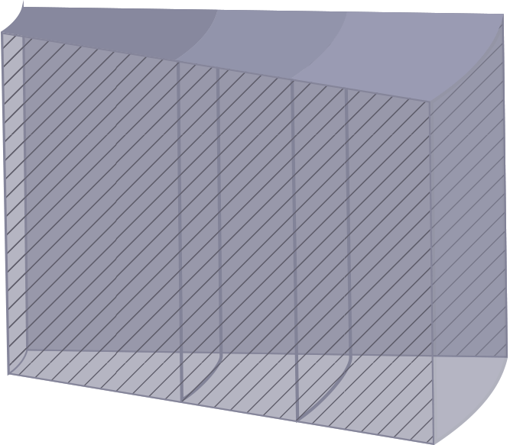
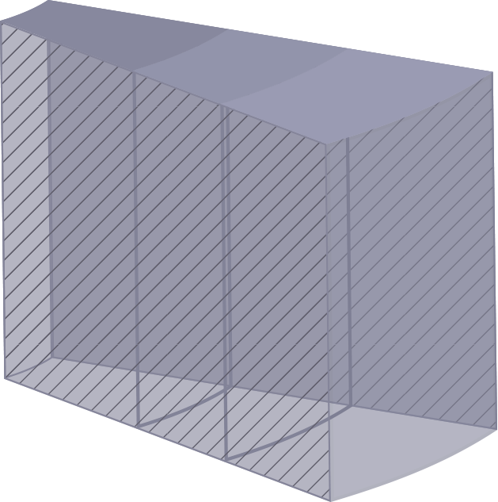
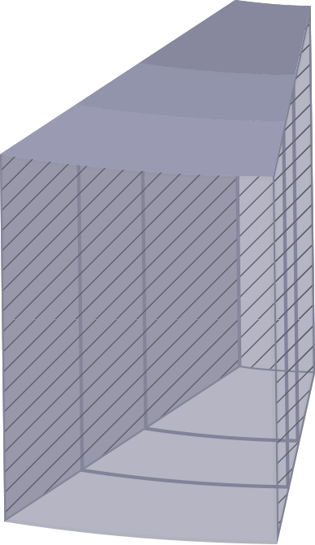
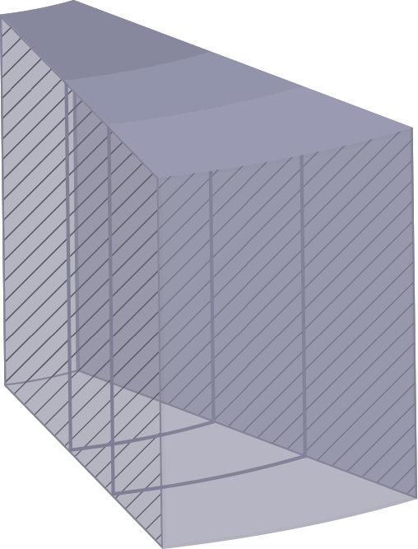
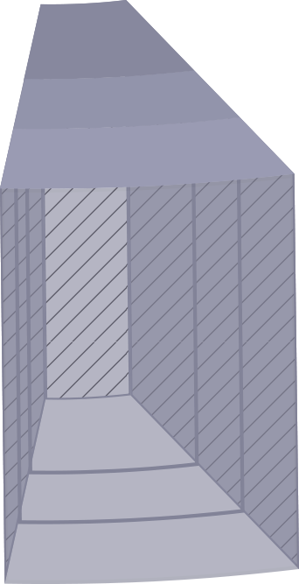
Desktop
Untrusted Tasks
Micro-visor mutually isolates untrustworthy tasks from the OS and each other

Slide 13
Untrusted Tasks
Each untrusted task is instantly isolated in a micro-VM, invisible to the user

Slide 14
Micro-VMs execute “Copy on Write”

Slide 15
Malware is automatically discarded when the task is complete

Slide 16
4
Live Attack Visualization & Analysis (LAVA)
2
One task per micro-VM
3
Full attack execution
1
Micro-VM introspection

Slide 17
Benefits
Empower users: “click on anything”
Real-time insight into actual attacks
Protect un-patched desktops
Eliminate remediation
SaaS/Cloud & VDI
Patching & Remediation
Data is secure at runtime
Malware has no access to your network
Defeat Advanced Persistent Threats
Robust to human mistakes
Consumerization
End Point Security

Slide 18
Benefits
Empower users: “click on anything”
Real-time insight into actual attacks
Protect un-patched desktops
Eliminate remediation
SaaS/Cloud & VDI
Patching & Remediation
Data is secure at runtime
Malware has no access to your network
Defeat Advanced Persistent Threats
Robust to human mistakes
Consumerization
End Point Security

Slide 19
Summary
The attack landscape has fundamentally changed; perimeter evaporating in the cloud and mobile era
Current ‘detection’ defenses are ineffective; endpoint is the weakest link
Bromium is redefining endpoint security with micro-virtualization
Enormous benefits in defeating attacks, streamlining IT and empowering users

Slide 20
Demo

Slide 21
Find Out How You Can Make Java Safe…
Email info@bromium.com
Explore www.bromium.com

