Slide 1
Internet of Things Security Architecture
Noel Poore
Architect
Java Platform Group
September 29, 2014
Copyright © 2014, Oracle and/or its affiliates. All rights reserved.
Notes:
This is a Title Slide with Java FY15 Theme slide ideal for including the Java Theme with a brief title, subtitle and presenter information.
To customize this slide with your own picture:
Right-click the slide area and choose Format Background from the pop-up menu. From the Fill menu, click Picture and texture fill. Under Insert from: click File. Locate your new picture and click Insert.
To copy the Customized Background from Another Presentation on PC
Click New Slide from the Home tab's Slides group and select Reuse Slides.
Click Browse in the Reuse Slides panel and select Browse Files. Double-click the PowerPoint presentation that contains the background you wish to copy.
Check Keep Source Formatting and click the slide that contains the background you want.
Click the left-hand slide preview to which you wish to apply the new master layout.
Apply New Layout (Important): Right-click any selected slide, point to Layout, and click the slide containing the desired layout from the layout gallery.
Delete any unwanted slides or duplicates.
To copy the Customized Background from Another Presentation on Mac
Click New Slide from the Home tab's Slides group and select Insert Slides from Other Presentation…
Navigate to the PowerPoint presentation file that contains the background you wish to copy. Double-click or press Insert. This prompts the Slide Finder dialogue box.
Make sure Keep design of original slides is unchecked and click the slide(s) that contains the background you want. Hold Shift key to select multiple slides.
Click the left-hand slide preview to which you wish to apply the new master layout.
Apply New Layout (Important): Click Layout from the Home tab's Slides group, and click the slide containing the desired layout from the layout gallery.
Delete any unwanted slides or duplicates.

Slide 2
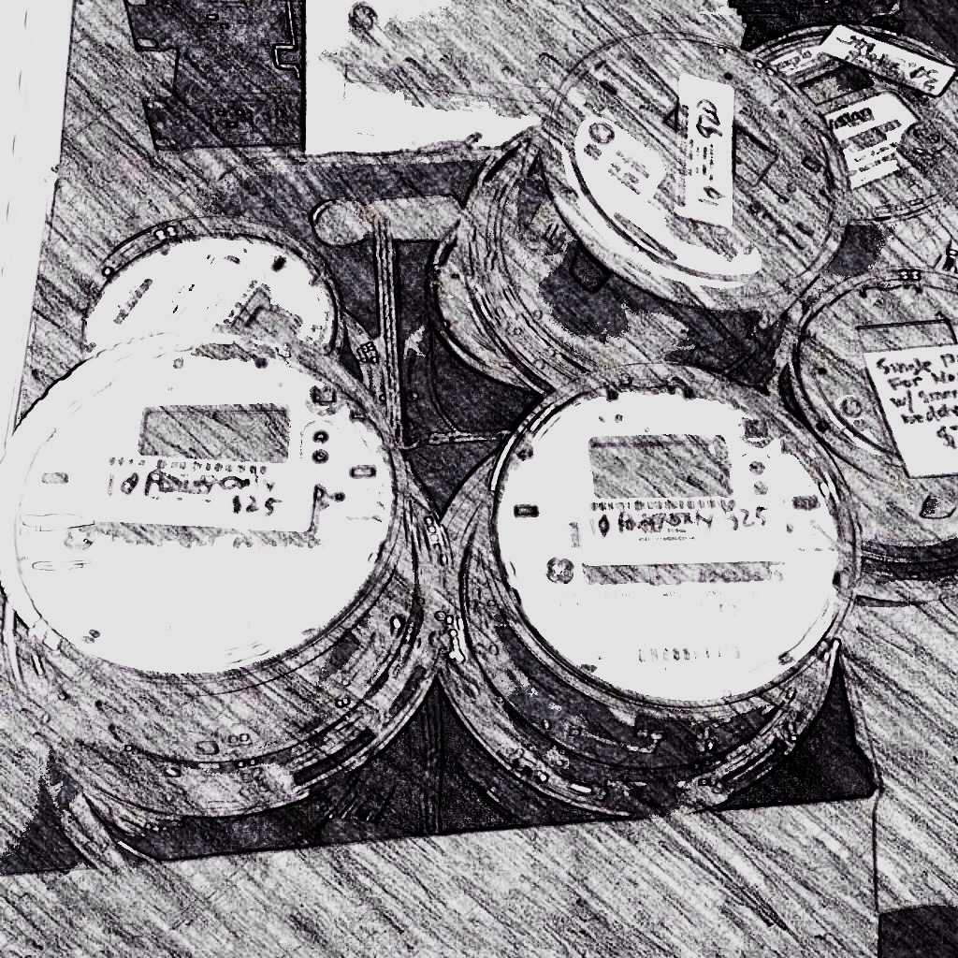
Oracle IoT Architecture
A quick overview…

Slide 3
Oracle IoT Architecture
IoT Cloud Service
Non-Java Device
3rd Party Device Cloud
Endpoint Management
Oracle Database (12c)
Business Intelligence Cloud Service
IoT Cloud Service Gateway
Non-Java Device
Java Device
WWAN
3G Network
Firewall
Messaging Proxy
Oracle Event Processing
Custom
App
Non-Java Device
Device Management
Dispatcher
REST/JMS
Integration Cloud Service
Users

Slide 4
Oracle IoT Architecture
IoT Cloud Service
Non-Java Device
3rd Party Device Cloud
Endpoint Management
Oracle Database (12c)
Business Intelligence Cloud Service
Data
IoT Cloud Service Gateway
Non-Java Device
Java Device
WWAN
3G Network
Firewall
Messaging Proxy
Oracle Event Processing
Custom
App
Non-Java Device
Device Management
Dispatcher
REST/JMS
Integration Cloud Service
Users

Slide 5
Oracle IoT Architecture
IoT Cloud Service
Non-Java Device
3rd Party Device Cloud
Endpoint Management
Oracle Database (12c)
Business Intelligence Cloud Service
Data
IoT Cloud Service Gateway
Non-Java Device
Control
Java Device
WWAN
3G Network
Firewall
Messaging Proxy
Oracle Event Processing
Custom
App
Non-Java Device
Device Management
Dispatcher
REST/JMS
Integration Cloud Service
Users

Slide 6
What do we need to secure?
Access to devices and applications
From anywhere in the IoT network
And to the data they generate
Whether that data is in motion or at rest
A body temperature sensor and a thermostat both measure temperature
But you must be able to secure them differently
Especially on e.g. a multi-tenant home gateway

Slide 7
IoT Security Threats
Defending the device cloud…

Slide 8
Threat Modeling for IoT
Large, complex systems
Unattended devices
Connected via the public internet
Many different threats to consider
Correspondingly broad spectrum of countermeasures

Slide 9
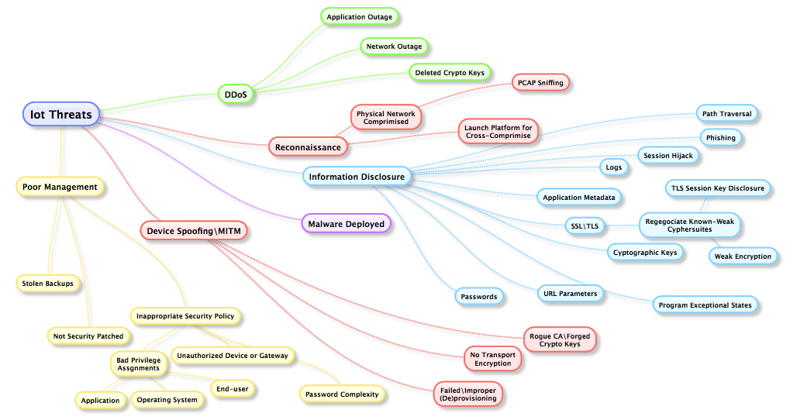
IoT Threats
An overview…
DDoS
Deny business operations
Loss of revenue
Compliance and safety concerns
Notes:
Before we can secure something we need to understand some of the threat

Slide 10
IoT Threats
An overview…
Reconnaissance
Physical network, PCAPs
Devices, cameras
Servers, applications
Surveillance for cross-compromise

Slide 11
IoT Threats
An overview…
Info Disclosure
Exfiltrate logs, app metadata, crypto keys, URL parameters
SSL/TLS attacks
Session hijacking

Slide 12
IoT Threats
An overview…
Device Spoof/MITM
Rogue CA, forged keys
No Transport Encryption
Failed/Improper (De)provisioning

Slide 13
IoT Threats
An overview…
Poor Management
Inappropriate security policy
Unauthorized access
Bad privilege assigments
Lack of security patching

Slide 14
IoT Security Model
High level overview…

Slide 15
Scalability
Down to very small devices
Can’t be too resource intensive
To large numbers of devices
Performance
Comprehensibility & manageability
To different risk profiles
One size doesn’t fit all

Slide 16
Basic Principles
Use standards wherever possible
Defense in depth
All IoT applications run in a secure container
All code is signed and only trusted code will be executed
All communications are encrypted and authenticated
All access to resources (devices, REST APIs, …) must be authenticated and authorized

Slide 17
Endpoint Identity Management
All endpoints (devices and applications) must be enrolled before they may participate in the IoT system
The endpoint must either authenticate itself directly, or be vouched for by a previously enrolled gateway
Configurable delegation of trust for different use cases
Enrollment creates a unique endpoint identity and a trust relationship
Safe end-of-life process

Slide 18
Security Policies
Enrollment policy
Do you want this endpoint in your system?
Compliance policy
Do you still want this endpoint in your system?
Endpoint policy
What actions is this endpoint authorized to perform

Slide 19
Enrollment Policies
Direct enrollment
How many enrollment attempts are allowed?
Time period before onboarding expires?
Time period when enrollment allowed?
Indirect enrollment
Configurable delegation of trust to gateways
E.g. is a gateway allowed to onboard and enroll new devices?
How many devices of what types?
Which/how many application endpoints are allowed?

Slide 20
Endpoint Policies
Specify the allowable interactions between endpoints
And with the data/messages they originate
Specified via rules
In plain English, the rules allow the following kinds of relationships
“Enterprise app x is allowed read access to all pulse oximeter devices”
“IoT app y can access all thermostats on the same gateway”
“IoT app z can send messages to dispatcher A”
Enforced on device gateways as well as in the cloud service

Slide 21
Java for Trusted Execution Environment
Brings the benefits of Java to secure hardware
Separates credentials and critical cryptographic activities from the rich OS
Part of the solution for hardening devices and device gateways
The IoT client platform is architected to integrate with TEE or a secure element
Storage of sensitive information such as credentials and keys
Performing sensitive crypto operations
Several TEE sessions this week in the IoT track

Slide 22
Another Security Session
Security and the Internet of Things: Preparing for the Internet of Stings [CON5948]
Wednesday 11:30am Hilton Golden Gate 6/7/8

Slide 23
Notes:
This is a Safe Harbor Front slide, one of two Safe Harbor Statement slides included in this template.
One of the Safe Harbor slides must be used if your presentation covers material affected by Oracle’s Revenue Recognition Policy
To learn more about this policy, e-mail: Revrec-americasiebc_us@oracle.com
For internal communication, Safe Harbor Statements are not required. However, there is an applicable disclaimer (Exhibit E) that should be used, found in the Oracle Revenue Recognition Policy for Future Product Communications. Copy and paste this link into a web browser, to find out more information.
http://my.oracle.com/site/fin/gfo/GlobalProcesses/cnt452504.pdf
For all external communications such as press release, roadmaps, PowerPoint presentations, Safe Harbor Statements are required. You can refer to the link mentioned above to find out additional information/disclaimers required depending on your audience.

