Slide 3


Introduction To
JavaFX Scenic View
Jonathan Giles
Software Engineer, JavaFX Team
Oracle Corp
Copyright © 2014, Oracle and/or its affiliates. All rights reserved.

Slide 5
Scenic View in a Nutshell
  Scenic View is to JavaFX what
  Firebug is to websites
5

Slide 6
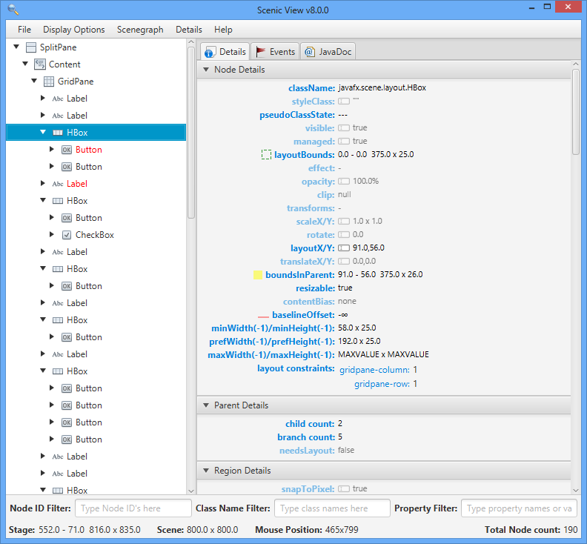
Scenic View in a Nutshell
6

Slide 7
Scenic View in a Nutshell
Scenic View is a free JavaFX scenegraph analyser.
I develop Scenic View,
  when time permits,
  it is not my job!
Download and find out more about Scenic View here:
http://www.scenic-view.org
7

Slide 8

Scenic View
What is Scenic View?
  Originally built by Amy Fowler for diagnosing runtime issues with UI layout
  It was really simple to use:
  just add ScenicView.show(scene) in your code
I took Amy’s code and polished the UI considerably before the first public release of Scenic View on May 6, 2012
It looked a little like this:
8

Slide 9
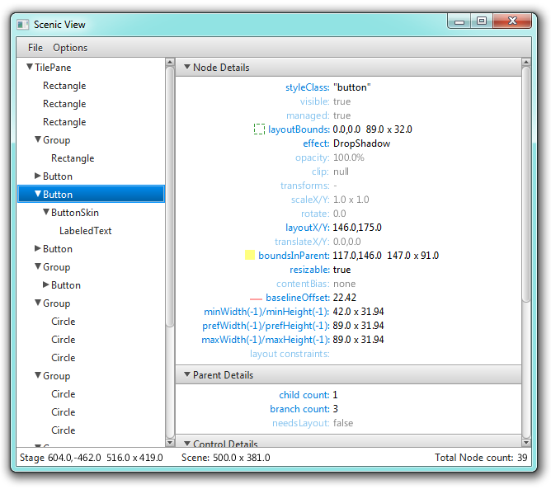
Scenic View Pre-1.0.0
Tree showing scenegraph structure of running application
The most important properties for the selected node
Application overview
9

Slide 10
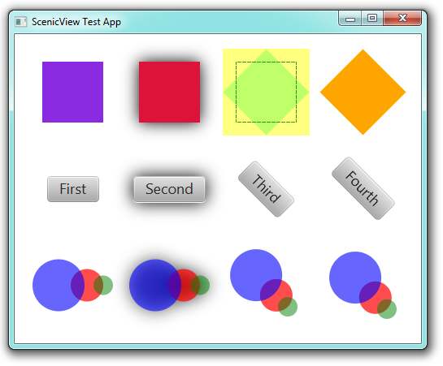
Scenic View
Scenic View can also draw overlays in the application it is observing.
The green dashed rectangle shows the layoutBounds, and the yellow filled rectangle shows the boundsInParent.
This can be very useful for debugging.

Slide 11

Scenic View
The response to the public release of Scenic View was extremely positive.
Most feedback was of the form: “I love it, but it needs to do X”
X included:
  Live editing
  Filtering
  Selecting nodes by clicking in the UI
  Event tracing
11

Slide 12

Scenic View 1.0.0
Ander Ruiz contacted me after the first release, and had a number of ideas.
Even better, he was keen to help program them!
Together we made available Scenic View 1.0.0 on June 4, 2012
The first versioned release of Scenic View
It looked a little like this:
12

Slide 13
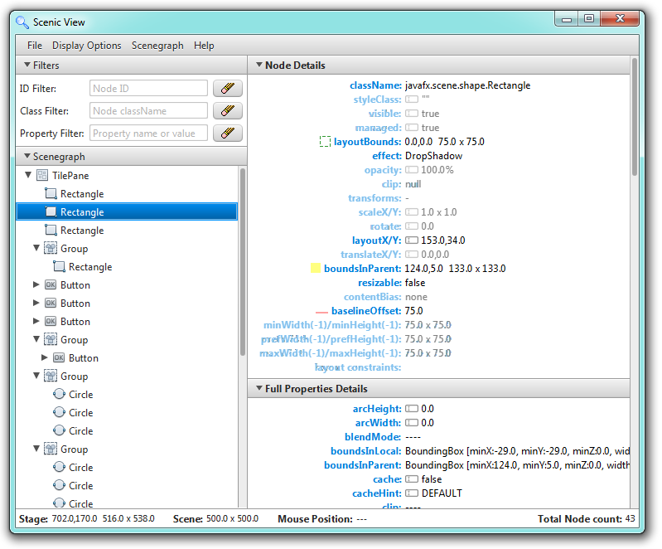
Scenic View 1.0.0
Ability to filter the tree area by typing in an ID or class name.
Ability to filter the details area by typing in a property name
13

Slide 14
The Problem with Scenic View 1.0.0
The major complaint Ander and I heard from users:
  People did not want to have to modify their code by adding ScenicView.show(scene).
This proved an interesting (and complex) problem to resolve!
We needed a way to connect to applications at runtime without any modification of their code.
We settled on two solutions
14

Slide 15
Solution 1: Java Agents
The Java agent API allows for an external library to be called when an application starts.
Simply add the following when starting your application:
-javaagent:ScenicView.jar
Scenic View will start when your application starts
It will automatically discover all stages in your application
Best approach: in your IDE have two ‘run’ profiles, one with Scenic View enabled and the other without
15

Slide 16
Solution 2: Java Attach API
Java provides the Attach API to discover running Java applications
We use this to install a small socket server into your application at runtime, through which Scenic View can communicate
This means that Scenic View can discover all running JavaFX applications and you don’t need to do anything!
To use this solution, simply start Scenic View directly and it’ll start in this mode
16

Slide 17
Scenic View 1.1.0
Scenic View 1.1.0 was released on August 14th, 2012 after much testing and user feedback
This release required a massive amount of reworking and foundation building.
We were incredibly relieved to get this working on Windows, Mac OS and Linux!
However, things are never perfect, and Scenic View 1.1.1 was released on August 16th, 2012
This improved our ability to debug peoples issues.
17

Slide 18
Scenic View 1.2.0
Still, we knew there was more to do, so we carried on and released Scenic View 1.2.0 on September 25th, 2012.
This release included:
  Event tracing support
  JavaDoc browsing support
  Streamlined menus (context menus)
  Bug fixes!
18

Slide 19
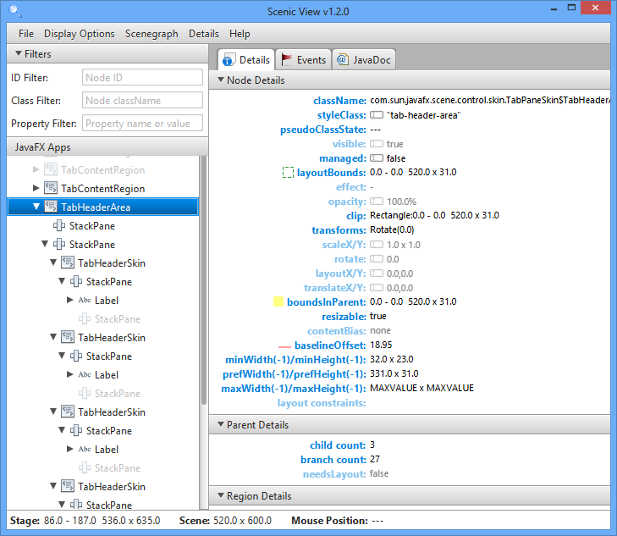
Scenic View 1.2.0
Tabbed area for new functionality
19

Slide 20
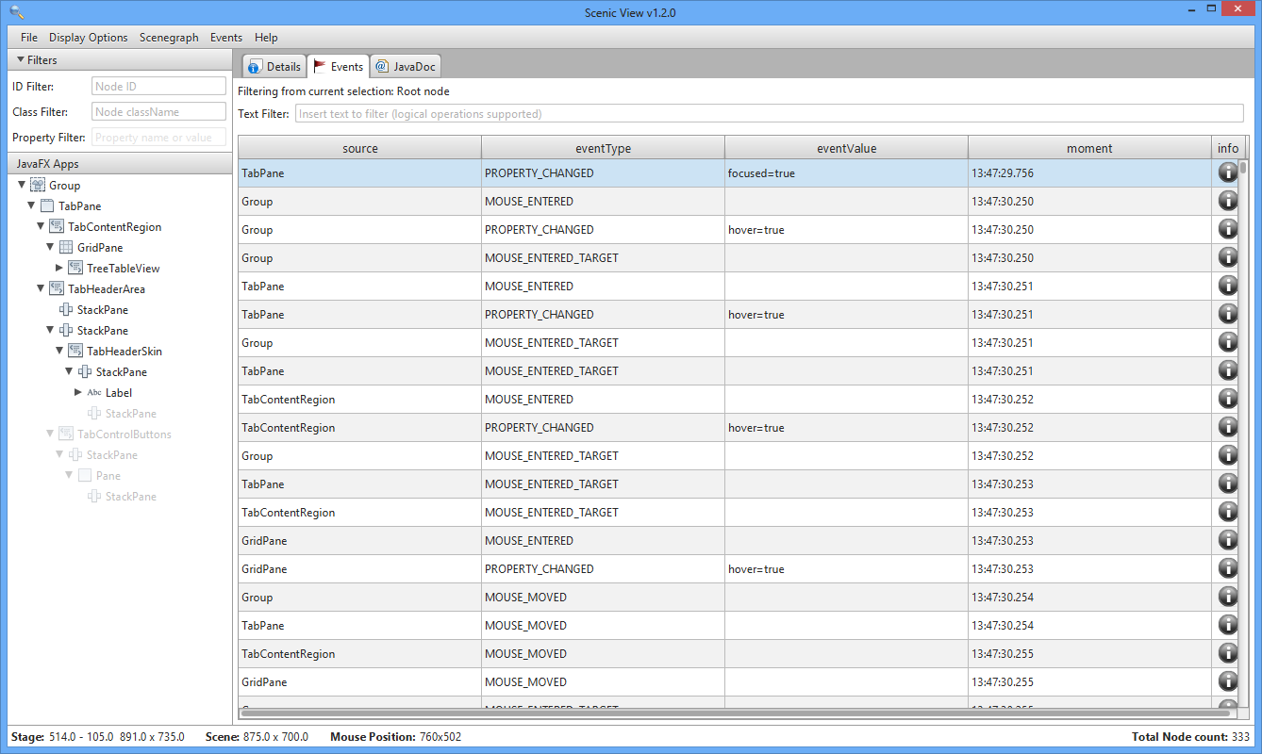
Scenic View 1.2.0: Event Tracing
Event tracing is enabled from the Events menu
Events are recorded only from selected node down
Table shows all matching events
Events can be searched using boolean statements
Click the info button for the entire stacktrace
20

Slide 21
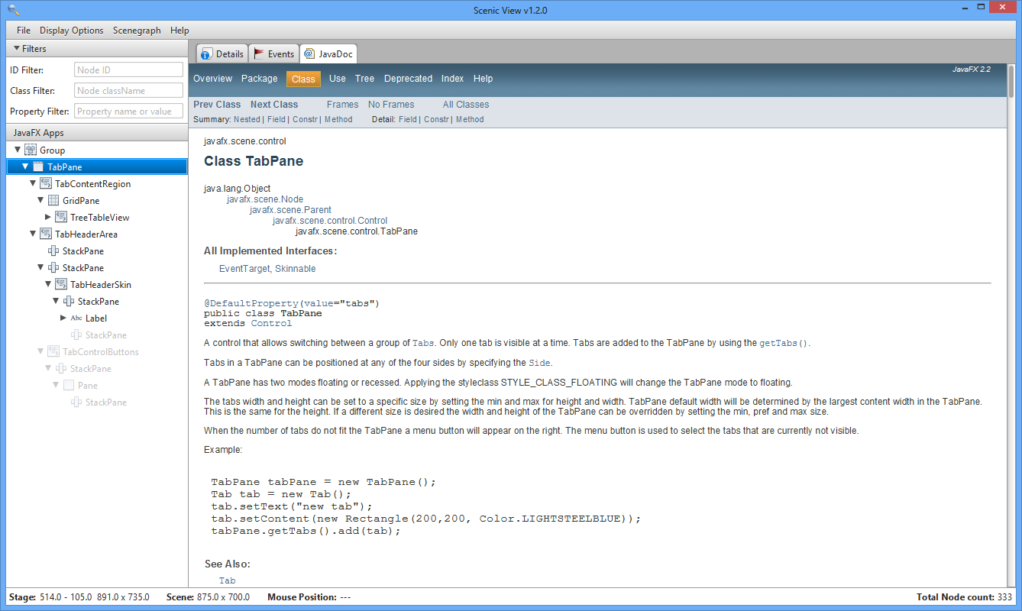
Scenic View 1.2.0: JavaDoc Browser
Browser shows JavaDoc for currently selected node
21

Slide 22
Scenic View 1.3.0
Scenic View 1.3.0 was released on November 12, 2012
What was new?
  Massive performance gains
  Animation tracer
  Improved CSS support
  Version update checking
  Mac native menubar integration
  Bug fixes and miscellaneous improvements
22

Slide 23
Beyond Scenic View 1.3.0
Scenic View 1.3.0 was the last release for JavaFX 2.x.
Since then, work has been underway to release Scenic View 8.0.0
Unfortunately at this stage Ander had to drop out due to work commitments
23

Slide 24
Downloads
I track downloads of Scenic View.
The results are pleasing (as of September 8th, 2014):
Version | Release Date | Downloads
1.0.0 | 4th June, 2012 | 208
1.0.1 | 7th June, 2012 | 859
1.1.0 | 14th August, 2012 | 575
1.1.1 | 16th August, 2012 | 539
1.2.0 | 25th August, 2012 | 932
1.3.0 | 9th November, 2012 | 7164
24

Slide 25
Downloads
I track downloads of Scenic View.
The results are pleasing (as of September 8th, 2014):
Version | Release Date | Downloads
8.0.0 (Developer Preview 1) | 3rd February, 2013 | 177
8.0.0 (Developer Preview 2) | 26th February, 2013 | 378
8.0.0 (Developer Preview 3) | 21st April, 2013 | 436
8.0.0 (Developer Preview 4) | 8th August, 2013 | 3769
8.0.0 (Developer Preview 5) | 14th August, 2014 | 136
8.0.0 (Developer Preview 6) | 17th August, 2014 | 583
25

Slide 26
Working Towards Scenic View 8.0.0
Irregular developer preview releases:
  Developer Preview 1: February 3, 2013
  Developer Preview 2: February 26, 2013
  Developer Preview 3: May 20, 2013
  Developer Preview 4: August 8, 2013
  Developer Preview 5: August 14, 2014
  Developer Preview 6: August 17, 2014
26

Slide 27
Scenic View 8.0.0
Today I am pleased to announce the final release of Scenic View 8.0.0.
There is still a lot more to do, but we need to get a release out sometime!
27

Slide 28
Scenic View 8.0.0
Today also marks another important milestone:
Scenic View is now open source
GPL licensed
Code repository is open here:
https://bitbucket.org/scenicview/scenic-view
28

Slide 29
Scenic View Demo

Slide 30




Getting Started
- In Six Simple Steps!
The following software is required:
  Mercurial
  Gradle
  JDK 8
You’ll need a Bitbucket account
  Accounts are free from http://bitbucket.org
1
2

Slide 31
Getting Started
- In Six Simple Steps!
Fork the repo.
Go here to create your own fork
  https://bitbucket.org/scenicview/scenic-view/fork
Clone your fork:
  hg clone https://<username>@bitbucket.org/<username>/<forkname>
  e.g.
    hg clone https://jonathangiles@bitbucket.org/jonathangiles/scenic-view
3
4

Slide 32
Getting Started
- In Six Simple Steps!
Build your clone. From clone root directory, run:
  gradle clean assemble
Run your clone:
  gradle run
5
6

Slide 33
The Future of Scenic View
What else is there left to do?
Should I pack my bags and stop developing Scenic View now?
Is there a feature you’d love to have?
  Tell me!
  Email me and let me know at jonathan.giles@oracle.com
Some ideas:
  Pulse logger support (pulse duration, time since last pulse, etc)
  Less bugs, faster, better UI, etc
33

Slide 34
The Future of Scenic View
Even better – please join in and help me to develop it!
Fork the project on bitbucket and do pull requests
34

Slide 35
One more thing
35

Slide 36
3D!
36

Slide 37
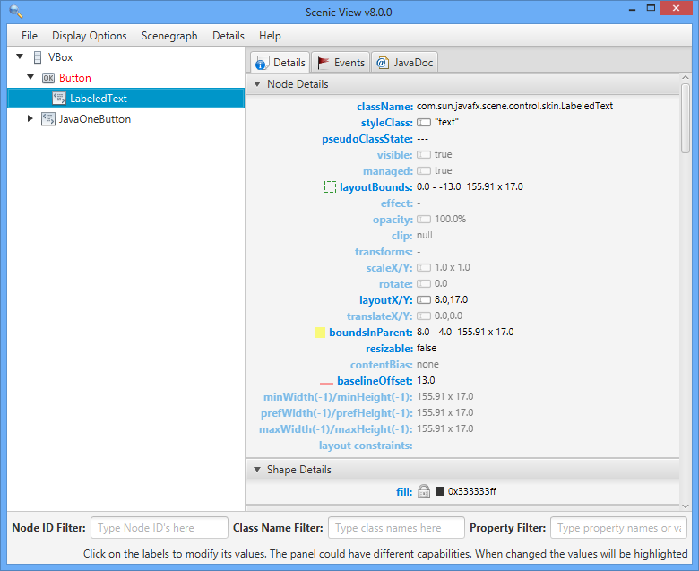
3D!
37

Slide 38
No – actual 3D
38

Slide 39
Thanks for Attending!
It’s Discussion Time!
How to contact me:
jonathan@jonathangiles.net
@JonathanGiles

