Slide 1
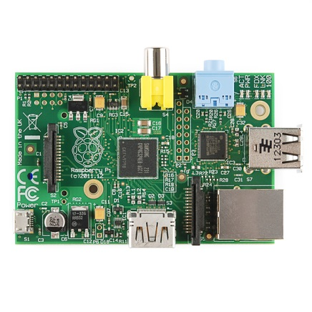
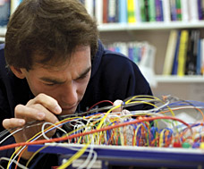
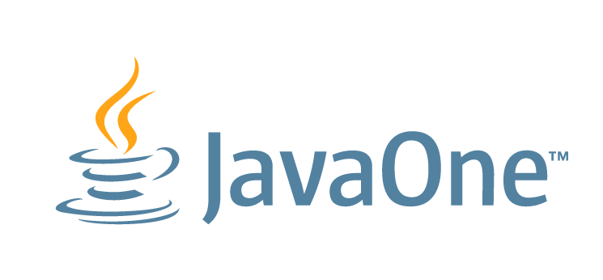
Teaching Kids to Program Things with Java and the Raspberry Pi
Ian Utting & Fabio Hedayioglu

Slide 2
Overview
What is the Pi?
What is the Pi for?
Developing for/on the Pi
Java for the Pi
BlueJ for the Pi
Challenges
Demo

Slide 3
What is the Raspberry Pi?
A small, cheap, self-contained, Linux machine
Based on a Broadcom SoC:
700MHz ARM11 processor, 512MB SDRAM
VideoCore IV GPU (OpenGL, 1080p, H264)
HDMI out
8 GPIO pins, I2C etc.
Ethernet and 2xUSB 2.0 (e.g. for WiFi)
Raspbian Linux boots from SD

Slide 4
What is the Raspberry Pi for?
To support/encourage/revive programming in schools
Conceived as a sensor/actuator hardware platform:
Many daughter boards available
and a desktop replacement:
Needs a keyboard/mouse and screen (TV or monitor)
In schools, it doesn’t need “permission”
Notes:
Outsourcing of schools’ IT support
C.f. the Apple 2/spreadsheets story.

Slide 5
Developing for the Pi: 2 approaches
Develop on a separate machine, treat the Pi as a slave
Allows use of standard tools (but their generality adds configuration complexity)
Requires a second machine (and significantly complicates the execution model for beginners)
Develop on the Pi itself
Simplifies deploy/debug cycle
Standard tools (NetBeans/Eclipse) are too heavy, so use vi/emacs and the command line (☹)
Notes:
Mention IDLE -- Python lightweight REPL/IDE

Slide 6
Java on the Pi: 2 approaches
Java ME Embedded
Wants to be headless – no GUI APIs
Unfamiliar i/o mechanisms (GCF etc.)
Sees the Pi as a gateway platform for embedded systems
Java SE 8
Includes Swing and JavaFX
Pi4J library provides good access to GPIO etc.
Sees the Pi as a desktop device with hardware extensions

Slide 7
BlueJ on the Pi
BlueJ is a lightweight Java IDE designed for beginners. Used by ~2M students/year
It includes basic IDE functionality: edit, compile, execute, debug, and version control
It also includes direct object manipulation through the GUI – great for exploring APIs and behaviours

Slide 8
Challenges
BlueJ is a Swing app, and so doesn’t use the Pi GPU
Remove gradients, drop shadows, transparencies
But BlueJ runs user-code in a separate JVM
JavaFX performance gains are available
WiringPi (which backs Pi4J) needs to be run as root (for read/write access to /dev/mem!)
We’ve had to slightly change the semantics of Pi4J to match BlueJ’s workflows.

Slide 9
Demo

Slide 10
Take Homes
The Pi is a great platform for beginners to explore IoT
Self-hosted development is much easier for beginners than using remote Pro Tools
An IDE helps them focus on the task-in-hand
Java ME may be better for really small devices, but, for beginners, all the support is around SE
More details and downloads: bluej.org/raspberrypi

