Slide 1
Starting a JUG on Uncle Sam’s Turf
Mike Kelly &
Andy Niepraschk

Slide 2
Agenda
Welcome and introduction
A little background
Mission statement and values
Why a JUG?
What happens at our meetings?
JUG success
JUG plans
Discussion and comments

Slide 3
Welcome and Introduction
Who are the presenters?
Mike Kelly – Software developer
Andy Niepraschk – Software developer
Goals for this briefing
Communicate the unique challenges associated with starting a JUG in a military or other large organization
Identify a few tools for overcoming challenges
Discuss any suggestions that you might have

Slide 4
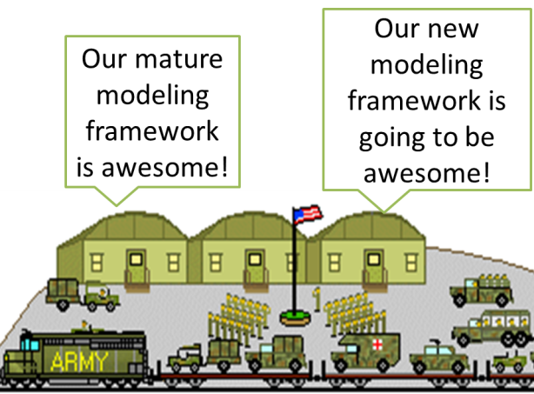
But First, A Little Background
Culture of withholding information – “Need to Know”
Silos of technical knowledge and/or software frameworks even on the same base
Duplication of effort and inevitable waste of resources
Shrinking budgets, “do more with less,” requires improvements in collaboration

Slide 5
Sharing is Hard
Information sharing especially difficult for software developers
We’re not exactly known for our social networking skills
Not talking facebook here but actual face to face interactions
Increased collaboration, sharing, and reuse is required to avoid/minimize
Steep learning curves
Reinvention of tools and frameworks that have already been previously built and matured
Another application of the DRY principle
Building the same functionality twice within the same organization makes no sense
Ԓ All by myself Ԓ

Slide 6
So What’s the Answer?
42?
Not 42 I’m afraid
Our idea was to start a Java User Group targeted towards other developers within our organization
Objective is to bring together developers across the organization to achieve
Cross pollination of ideas
Better understanding of what technologies are being utilized
Reuse of any software frameworks that can be leveraged towards new domains

Slide 7
Technical JUG Motivations
There is a lot of work being done in Java both on our base and in the Dahlgren community
Java is still a top tier programming language
Java has moved into a period where it changes rapidly and we had no easy way of keeping up with it
Java programmers were making friendships in classes and using that as a means to get Java help

Slide 8
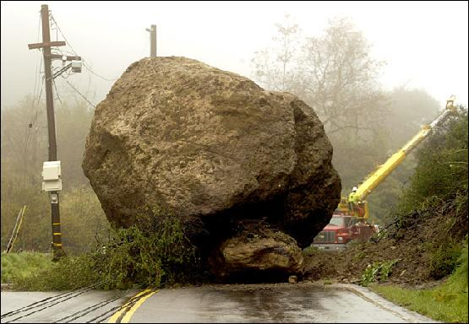
A Few Roadblocks
Culture of secrecy
Can’t raise funds
Every move has to be approved by someone
Traveling is not easy, for example to go to Oracle JUG leader meetings.

Slide 9
Art of Persuasion
So like, Java is cool and stuff
Needed to convince leadership that JUG meetings were “working” meetings in which attendees
Remain on the clock
Earn training credits for attending
Unfortunately the argument of “Java is cool and it helps us do stuff” wasn’t going to fly
Needed to come up with an argument that made sense to non technical people

Slide 10
What Do Non-Technical Managers Understand?
That’s not what I read on Wikipedia
Mission statements, goals, and objectives
Money, money, money
At the end of the day, it all comes down to cost savings in either procurement or man hours
The JUG justification needed to cast a vision that clearly stated the benefits of have a JUG

Slide 11
Our JUG Mission Statement & Values
Mission Statement
Providing a Java software developer community that
Improves developer productivity
Reduces duplication of effort through reuse,
Fosters innovation through constructive dialogue
Values
Mastering Java Fundamentals
Software development best practices
Exchange of ideas
Fostering innovation

Slide 12
Why is this important?
Mission statement and values provide a focus for the group that allows people to quickly understand why the JUG exists
Because we had a clear vision for the group, we had very little push back from leadership regarding on the clock meetings and training points
Also helps us as JUG leadership to stay focused on what is important

Slide 13
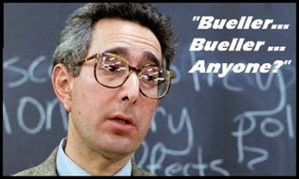
JUG Leadership Challenges
Planning far enough ahead
Procuring good venues for JUG meetings
Determining engaging content for meeting presentations
Finding JUG members to present topics of interest

Slide 14
So What happens in a meeting?
Welcome and introduction
Mission statement and values (same as seen)
Meeting schedule
Java News
Java Lesson
Discussion and comments

Slide 15
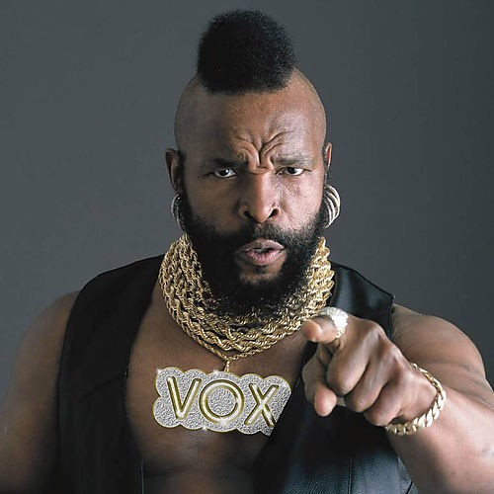
A Few Topics of Discussion
I pity the fool that use Eclipse
Netbeans Platform and its advantages
JavaFX
What's new in Java 8
Intro to Lambdas
Interview with Paul Anderson
The JUG is a great place to disseminate new ideas/approaches that can potentially change the way people work
Since one of our goals is improving best practices, we’ve frequently spoke on how Netbeans Platform can drastically reduce development costs

Slide 16
JUG Success
Between 20 and 70 people at every meeting, average is about 35
More than 150 on our mailing list
A year and still going
New connections have been made
Questions have been fielded and answered at meetings
Starting to get more volunteers willing to teach lessons
Invited to JavaOne

Slide 17
Some Unique Benefits
We manage the Jug on the clock
Speakers develop their lessons on the clock
Attendees get to attend the meetings on the clock, and they get continuous learning points
We are guaranteed a meeting spot, for free, it just may not be one we like

Slide 18
Jug Plans
Continue to grow
Include students – Recruitment Potential
Get Java Celebrities to visit
Continue to spread the word about the JUG
Entitle others to speak at Conferences

Slide 19
Summary
Military culture is not conducive to information sharing (i.e. Need to Know)
Shrinking budgets requires culture to change
Information sharing leads to less duplication and more cost savings
Starting a JUG on a Naval base requires a good justification
Mission statement and values is a good tool to convince non technical leadership of why JUG is value added
Already seeing promising results, but typical challenges remain

Slide 20
Discussion

