Slide 1
BOF6297 - September 30, 2014
Java and Digital Currencies, Friend or FOE?

Slide 2
Speakers
Michael Gronager Michael (@gronager) is a COO of Payward Inc. Technologist, developer, public speaker, founder at Ceptacle and primary author of the libcoin Bitcoin library. Board member at National Super Computer Center, Sweden.
Werner Keil Werner (@wernerkeil) is Agile Coach, Principal Consultant and Distinct Architect for Embedded and Real-time solutions after working as Build Manager at Maersk. He is co-founder of the Agorava Social Framework, Apache DeviceMap, EG Member of JSR-354 (Money & Currency), Spec Lead of JSR-363 (Units of Measurement) and currently only Individual JCP EC Member.
Anatole Tresch After his studies at the University of Zurich, Anatole (@atsticks) worked several years as a Managing Partner and consultant within both, small and large scaled enterprise contexts. As of today Anatole works as a technical coordinator and architect within Credit Suisse and acts as Specification Lead for JSR 354 (Money & Currency).

Slide 3
Digital CURRENCIES

Slide 4
What is Local Money?
Thousands of projects worldwide use their own, local currencies
Can only be used within certain area: neighbourhood, city, region
No replacement of national currency, but complementary
Some local currencies: no exchange for a national currency

Slide 5
Social Trade Organisation
The Social Trade Organization (STRO) was founded in 1970 based in Utrecht, The Netherlands
Mission:
“to research, experiment and implement innovative
sustainable economic structures made to suit local economies.”

Slide 6
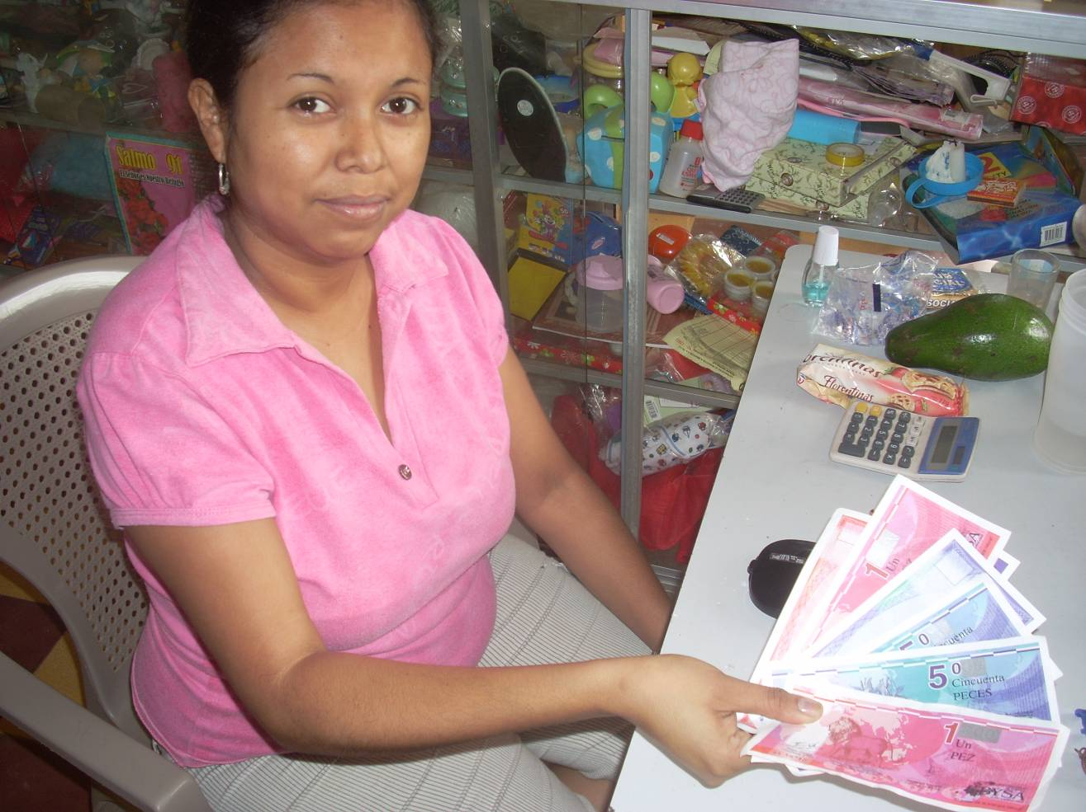
Local Money – Paper
Other local currencies: exchange for national currency or goods

Slide 7
Local Money – Digital
STRO's open source software for administration and operation of Transaction Networks
For users it works like online banking software, allowing transfers between accounts through Web, cards and SMS
Provides functions of social networks and online market places
Built with Java
Website: http://www.cyclos.org/

Slide 8
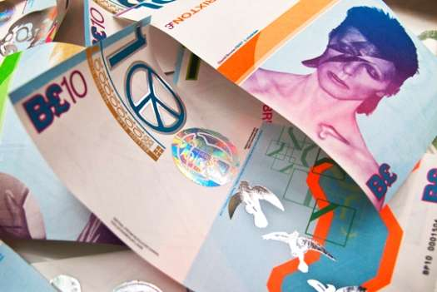
Local Money – Brixton to Bristol
Objective is to encourage people to spend more money with local businesses

Slide 9
Facebook Credits
Facebook Credits are a virtual currency you can use to buy virtual goods in any games or apps of the Facebook platform that accept payments. You can purchase Facebook Credits directly from within an app using your credit card, PayPal, mobile phone and many other local payment methods. ► Hence any purchase is practically a conversion, similar to travelling abroad

Slide 10
Facebook Credits (2)
Facebook’s launch of Facebook Credits, “the safe and easy way to buy things on Facebook” has grown into a major source of revenue for Facebook and it’s system of credits is expanding to other companies such as Warner Brothers.
Facebook Credits work by if you spend $5 you obtain 50 credits, you then can take these credits and purchase things such as a virtual bouquet of flowers for birthday postings on someone’s Facebook wall.

Slide 11
Facebook Credits (3)
In sum, Facebook’s new credit based economy is basically a new way of purchasing digital goods.
What Companies are involved?
1. Facebook
2. Warner Bros, Miramax, Paramount, other companies offering digital movies or music.
3. PayPal, Visa, other credit card companies

Slide 12
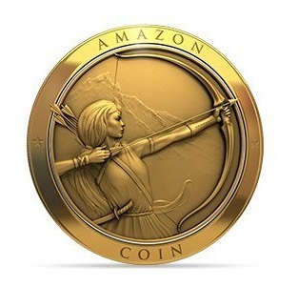
Amazon Coins
Since May 2013, Amazon Coins is a new virtual currency for purchasing apps, games, and in-app items on Kindle, etc.
Amazon Coins is an easy way for Kindle customers to spend money on developers’ apps in the Amazon Appstore, offering app and game developers another chance to drive traffic, downloads and increase monetization even further

Slide 13
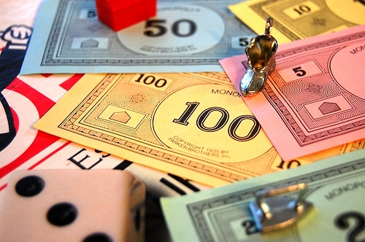
Game Currencies
Many popular games use virtual currencies: Gold, Gems or similar game money, just like good old Monopoly money

Slide 14
Top 11 Game Currencies
Gold
Gil
Rupees (not Indian;-)
Credits
Gold Rings
Hearts
Zenny
Potch
Munny
Nuyen
(Linden) Dollars

Slide 15
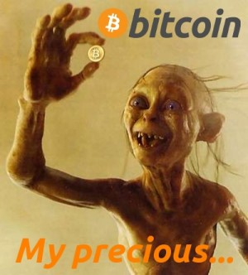
Bitcoin
Images © 2001 - New Line Productions, Inc.

Slide 16
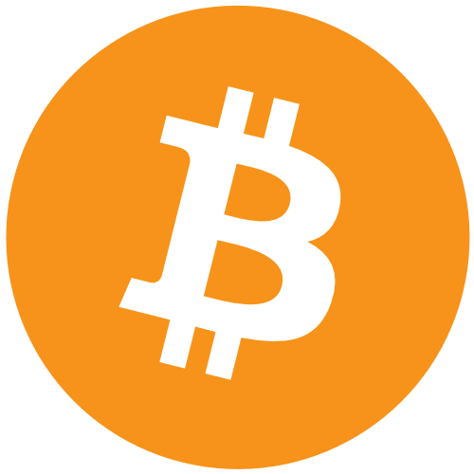
What is Bitcoin?
Bitcoin is a peer-to-peer payment system and digital currency introduced as open source software in 2009 by pseudonymous developer Satoshi Nakamoto. It is a cryptocurrency, so-called because it uses cryptography to control the creation and transfer of money.

Slide 17
What is Bitcoin? (2)
Bitcoins are created by a process called mining, in which participants verify and record payments in exchange for transaction fees and newly minted bitcoins. Users send / receive bitcoins using wallet software on PC, mobile device, or web application. Bitcoins can be obtained by mining or in exchange for products, services, or other currencies

Slide 18
Bitcoin
Hungry Trolls…
Images © 2013 - New Line Productions, Inc.

Slide 19
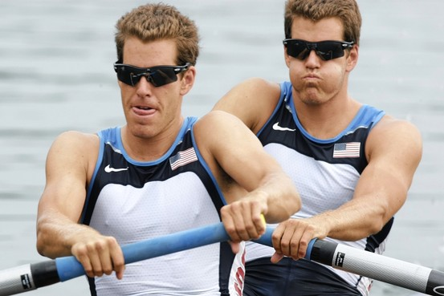
Bitcoin
Hungry Trolls…

Slide 20
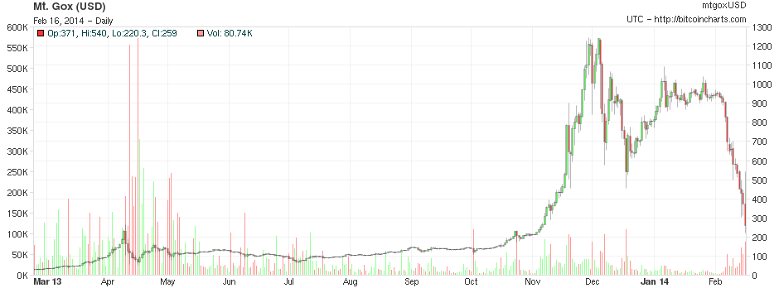
Bitcoin
… and their trail of destruction

Slide 21
Coinbase – Crowd Funded
Brian Armstrong (Previously AirBnB) founded the first YC backed Bitcoin company. Now, he’s reached an even bigger milestone. Coinbase (YC S12) is now officially the first traditionally crowd funded Bitcoin company (we say traditionally because some Bitcoin companies have raised funds in Bitcoin via the GLBSE stock market)..
This shows that a lot of people believe in Coinbase and, by proxy, Bitcoin. Some all stars like Y Combinator, Alexis Ohanian (reddit co-founder), Trevor Blackwell (Anybots, YC co-founder) and IDG Ventures have invested in Coinbase.

Slide 22
Alternatives
Ripple
Litecoin
Peercoin
Namecoin
Dogecoin
Primecoin
Mastercoin

Slide 23
Java Currency so far
Monetary values are a key feature to many applications.
The existing java.util.Currency class is restricted to representing ISO-4217 standard currencies. Extending is very cumbersome and poorly documented, even in Java 7 or 8.
No standard value type to represent a monetary amount.
No support for currency arithmetic or conversion

Slide 24
JSR 354 – Money & Currency
Standard providing money and currency API for Java™, targeting users of currencies and monetary amounts.
The API provides support for standard ISO-4217 and Custom (e.g. Digital) currencies, as well as representation of a monetary amount.
It supports arithmetic operations, formatting, rounding and currency conversion

Slide 25
JSR 354 – Bitcoin Provider
CurrencyUnit BTC = CurrencyUnitBuilder.of(„BTC", CurrencyContextBuilder.of(BitcoinDeRateProvider.class.getSimpleName()).build()).setDefaultFractionDigits(8).build(true);
public class BitcoinDeRateProvider extends AbstractRateProvider implements LoaderListener {
private static final String BASE_CURR_CODE = "BTC";
private static final RateType RATE_TYPE = DEFERRED;
private static final String PROVIDER_URL = "https://bitcoinapi.de/v1/${YOUR_API_KEY}/rate.json";
private static final ProviderContext CONTEXT = ProviderContextBuilder.of("Bitcoin.de", RATE_TYPE)
.set("providerDescription", “Bitcoin.de").set("days", 1).build();
[…]

Slide 26
JSR 354 – Exchange Rate
public ExchangeRate getExchangeRate(ConversionQuery query){
CurrencyUnit base = query.getBaseCurrency();
CurrencyUnit term = query.getCurrency();
Long timestamp = query.getTimestampMillis();
// Get Conversion base as derived rate: base -> BTC -> term
ExchangeRate rate1 = getExchangeRateInternal(base, MonetaryCurrencies.getCurrency(BASE_CURR_CODE));
ExchangeRate rate2 = getExchangeRateInternal(MonetaryCurrencies.getCurrency(BASE_CURR_CODE), term);
if(Objects.nonNull(rate1) && Objects.nonNull(rate2)){
builder.setFactor(multiply(rate1.getFactor(), rate2.getFactor()));
builder.setRateChain(rate1, rate2);
return builder.build();
}
[…]
}

Slide 27
Discussion
Let’s Talk...

Slide 28
Links
Bitcoin:
http://www.bitcoin.org
JavaMoney – JSR-354
http://javamoney.org
Bitcoin Wiki: https://en.bitcoin.it/wiki/Main_Page
Payward:
http://payward.com/
Notes:
New Page

