Slide 1
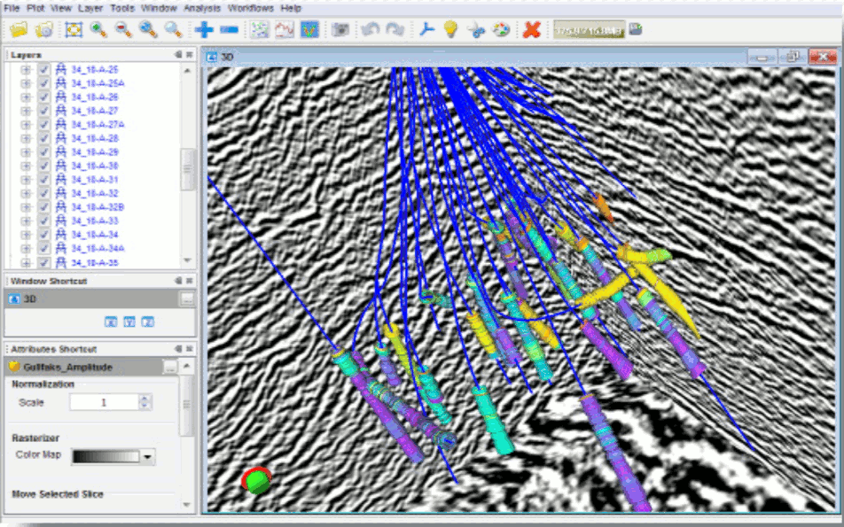
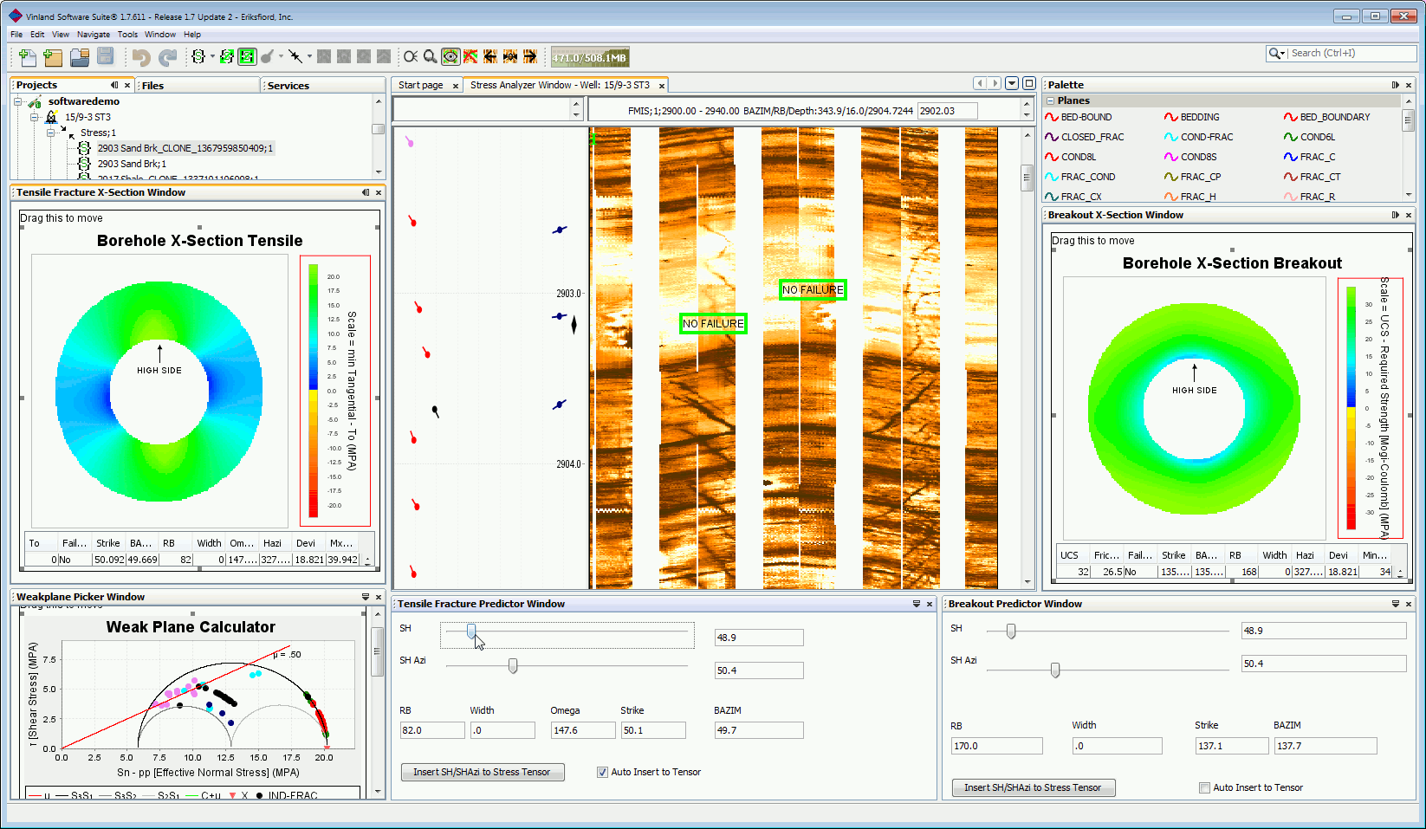
The Relevance of Java in the Oil&Gas sector
INTViewer
Thierry Danard
BOF7063 JavaOne, 2014
Vinland
Bernd Ruehlicke

Slide 2
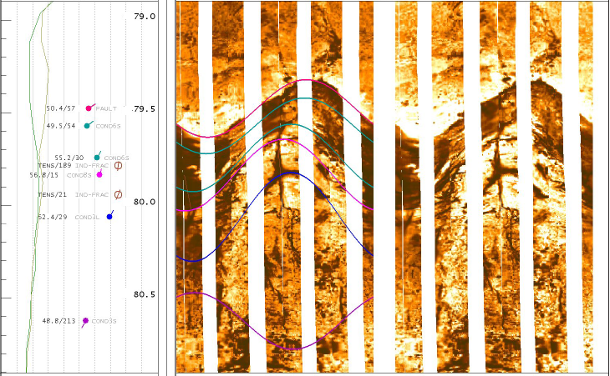
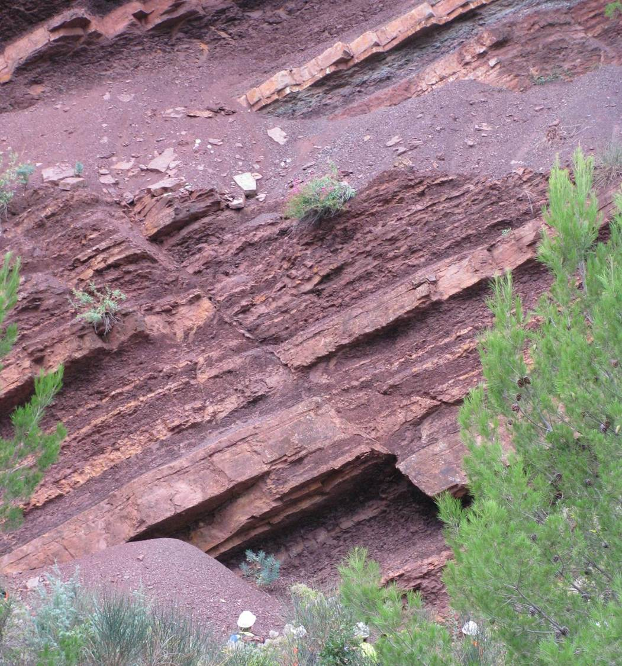
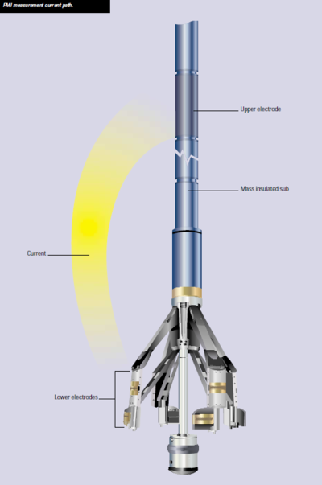
Why Oil&Gas industry ?
Big capital expenditure budgets
High-tech, Cool Science
Lots of niche domain knowledge
Human

Slide 3
Why is Java a perfect fit ?
Java as a language widely known by our clients
→ Making client-customization very accessible
Rich Client Platform available : Modularity
→ Enables quickly to code up an application
→ Focus on domain knowledge not plumbing
https://platform.netbeans.org/screenshots.html
Multiplatform [Linux, Windows, Mac OS]
→ Linux is heavily used in the industry
→ Write once run anywhere [Swing/FX]

Slide 4
Demo

