Slide 2
Coding in the Cloud
For Java Developers
John Ceccarelli
NetBeans Director
Brian Fry
Tools Product Management
Sept, 2014
Copyright © 2014, Oracle and/or its affiliates. All rights reserved. |
Notes:
This is a Title Slide with Java FY15 Theme slide ideal for including the Java Theme with a brief title, subtitle and presenter information.
To customize this slide with your own picture:
Right-click the slide area and choose Format Background from the pop-up menu. From the Fill menu, click Picture and texture fill. Under Insert from: click File. Locate your new picture and click Insert.
To copy the Customized Background from Another Presentation on PC
Click New Slide from the Home tab's Slides group and select Reuse Slides.
Click Browse in the Reuse Slides panel and select Browse Files. Double-click the PowerPoint presentation that contains the background you wish to copy.
Check Keep Source Formatting and click the slide that contains the background you want.
Click the left-hand slide preview to which you wish to apply the new master layout.
Apply New Layout (Important): Right-click any selected slide, point to Layout, and click the slide containing the desired layout from the layout gallery.
Delete any unwanted slides or duplicates.
To copy the Customized Background from Another Presentation on Mac
Click New Slide from the Home tab's Slides group and select Insert Slides from Other Presentation…
Navigate to the PowerPoint presentation file that contains the background you wish to copy. Double-click or press Insert. This prompts the Slide Finder dialogue box.
Make sure Keep design of original slides is unchecked and click the slide(s) that contains the background you want. Hold Shift key to select multiple slides.
Click the left-hand slide preview to which you wish to apply the new master layout.
Apply New Layout (Important): Click Layout from the Home tab's Slides group, and click the slide containing the desired layout from the layout gallery.
Delete any unwanted slides or duplicates.

Slide 3
Notes:
This is a Safe Harbor Front slide, one of two Safe Harbor Statement slides included in this template.
One of the Safe Harbor slides must be used if your presentation covers material affected by Oracle’s Revenue Recognition Policy
To learn more about this policy, e-mail: Revrec-americasiebc_us@oracle.com
For internal communication, Safe Harbor Statements are not required. However, there is an applicable disclaimer (Exhibit E) that should be used, found in the Oracle Revenue Recognition Policy for Future Product Communications. Copy and paste this link into a web browser, to find out more information.
http://my.oracle.com/site/fin/gfo/GlobalProcesses/cnt452504.pdf
For all external communications such as press release, roadmaps, PowerPoint presentations, Safe Harbor Statements are required. You can refer to the link mentioned above to find out additional information/disclaimers required depending on your audience.

Slide 4
Program Agenda
1
The Push to Cloud
The IDE Question
What Oracle is Doing
2
3

Slide 5
Program Agenda
1
The Push to Cloud
The IDE Question
What Oracle is Doing
2
3

Slide 6
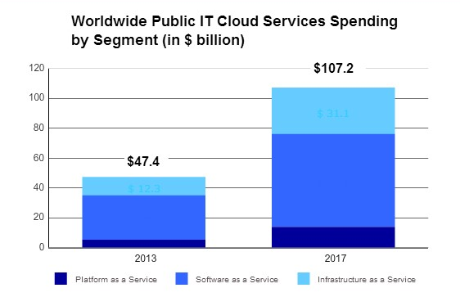
Public Cloud Forecast
Public IT cloud services will grow to $107B in 2017
Public PaaS market expected to grow from $3.8B in 2012 to more than $14B in 2017 (CAGR 30%)
90% of net new software offerings will be built for public cloud delivery in 2014
Source: IDC

Slide 7
PaaS Market Opportunity
Overall PaaS market CAGR is 30%
Cloud platforms will generate $44B in revenue by 2020
Application PaaS
Database PaaS
$14 Billion
2017
Integration PaaS
$7+ Billion
2014
BPM PaaS
PaaS
Market
Source: IDC: New IDC Worldwide Public Platform as a Service Forecast Shows Market Will Grow to Over $14 Billion in 2017, Nov 2013
Forrester: The Public Cloud Market Is Now In Hypergrowth, April 24, 2014

Slide 8
The PaaS Promise
How important are the following perceived benefits to your organization?
88%
87%
Better Use of Resources
Lower Capital Expense
89%
Greater Business Agility
87%
81%
Rapid implementation of
Business Models
Fewer Operational Issues
Source: Computerworld Strategic Marketing Services, February-March 2014 Cloud Survey

Slide 9
Program Agenda
1
The Push to Cloud
The IDE Question
What Oracle is Doing
2
3

Slide 10
Proliferation of Web IDEs
Flux

Slide 11
But, What About….
Deploying
Compiling
Security
Running
Feature Richness
Debugging
Profiling
Performance
Disconnected Editing

Slide 12
First (Mis)steps
Just replicating a Java IDE in the browser bad idea
You sacrifice performance, feature richness, offline mode
What do you gain?
Then again, just relying on git “syncing” doesn’t go far enough
Doesn’t get you any of the cloud benefits

Slide 13
Managed Systems (PaaS/SaaS)
Cloud systems that provide ready-to-use deployment services
No more maintaining app servers, deploying WARs, etc.
Deployment environment, runtime platform, lifecycle management, and standard functionality provided out of the box
Only do coding for customization and extension
Examples:
Lower end: Amazon Elastic Beanstalk, Google AppEngine
Higher end: MBaaS, SalesForce.com
Hard to emulate on local machine
Built-in debuggers, code editors for making small iterative changes a must

Slide 14
Combination with Developer Services
Continuous Integration + Code Analysis + Git
Isolate builds for individual developers
Rule-based propagation based on same code analysis as in tools
Know when coding that something will fail
Configurable rules for your enterprise
Continuous Integration + Indexing + Maven
Stop indexing static libraries!
Produce index during build-time
Store with Maven artifacts

Slide 15
Combination with Your Source Forge
Run code analysis on your Git repository
Tell you when browsing code:
This method called by 200 classes, be careful editing it!
Here are all the classes implementing this method
The test for this class fail 50% more often than the average for this project
Here is the test for this method
Etc.

Slide 16
Configuration Management
Dev environment config is painful, but most of us put up with it
Do we have a choice?
What if you change projects all the time?
Sustaining orgs, contractor-heavy shops, outsourcing firms
Encapsulate development and execution environments
Access and start coding right away
From local IDE or web-based editor

Slide 17
Configuration Management Challenges
What to use for encapsulation?
Full cloud-based VM
One VM per developer gets expensive
Local IDE with remote source directory problematic
Containers on hosted cloud service
Is it really the same as my production environment?
Can I get enough density with big enterprise stacks like WebLogic?
What about security?
Local IDE with remote source directory problematic
Locally downloaded containers
Can I get enough density with big enterprise stacks like WebLogic?
Local IDE with containerized source directory potentially problematic

Slide 18
Who Is Well Positioned to Deliver?
Integration and embedding within various cloud services
IaaS, PaaS, MBaaS, Developer Services (Source management, Bug Tracking, Continuous Integration)
To play in this sandbox you have to:
Have your own full-featured cloud
Partner with others
IaaS providers such as Amazon and Google moving aggressively up-stack

Slide 19
Program Agenda
1
The Push to Cloud
The IDE Question
What Oracle is Doing
2
3

Slide 20
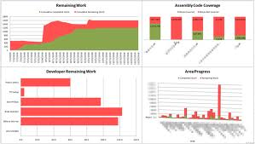
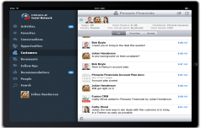
Oracle Cloud: Platform as a Service
App Store
Database
I/T Analytics
Java
BPM
Developer
Integration
Mobile
Big Data
Documents
BI
Social Network
Common Infrastructure Services
Notes:
We are taking a thoughtful and complete approach to platform services so that the various services work together completely seamlessly for a great experience for developers and business users:
Broad platform offering – use as modules, pieces work together
Built on industry standards – SQL, Java, HTML5, Web
Transparently run in the cloud – zero application code changes
Self-service control for users – develop, deploy, manage
Complete data isolation and flexible upgrades
Service-Oriented Architecture – on-premise integration

Slide 21
Java Cloud: Key Features
Java Cloud Service
Full-featured App Server – WebLogic 12c or 11g
Automated customer-controlled provisioning, backup, patching, scaling with cloud tooling
Complete environment control supports any Java application
Full application portability between on-premise & cloud
Easy to use with Storage, Messaging & Developer services
Primary Use Case: Move Dev/Test/Production Java workloads to Oracle
Cloud
Java Cloud Service – SaaS Extension
Pre-configured WebLogic VM for rapid application deployment
Built-in integration to Storage, Messaging & Developer services
Built-in integration into Oracle SaaS applications
Primary Use Case: Java EE extensions for Oracle Cloud SaaS applications

Slide 22
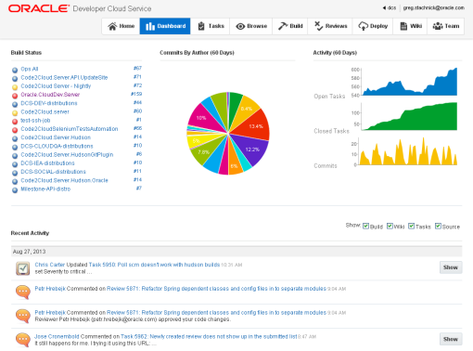
Developer Cloud: Key Features
Integrated tools to manage & track tasks, builds, code reviews, and documentation
Standards-based GIT, Hudson, Maven, JIRA, Bugzilla, Wiki
Integrated into an IDE of your choice
Automatic deployment to Oracle Java Cloud Service or local infrastructure
Primary Use Case: Secure turnkey development on Oracle Cloud

Slide 23
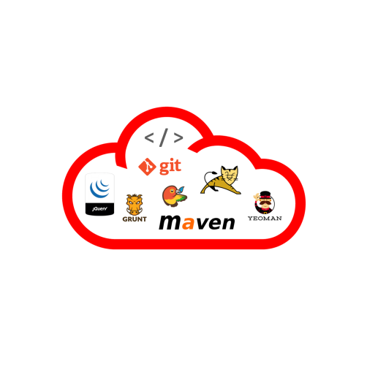
What’s Next – Coding in the Cloud For JavaScript Developers
Powerful code editor
Code insight, documentation, auditing, etc
Initial focus on JavaScript
Client libraries – Knockout, JQuery, Bootstrap, Require.js
Supporting technologies - Node/Express, JSON, XML, Sass/Scss
Build/development tools - git, Maven, Yeoman, Bower, npm, Grunt, Gulp
Embedded in Oracle’s Cloud development offering
Extensible framework
NOT a port of an existing IDE
< / >

Slide 24
What’s Next – Coding in the Cloud For Java Developers
Splitting core NetBeans libs into headless services
Splitting out UI from logic
Adjusting to be multi-tenant
First round of services
Source indexing and dependency analysis
Error checking/hints
Code completion
Maven-based build and deploy
Not forking NetBeans!
Everything is in the public repositories

Slide 25
Notes:
This is a Safe Harbor Front slide, one of two Safe Harbor Statement slides included in this template.
One of the Safe Harbor slides must be used if your presentation covers material affected by Oracle’s Revenue Recognition Policy
To learn more about this policy, e-mail: Revrec-americasiebc_us@oracle.com
For internal communication, Safe Harbor Statements are not required. However, there is an applicable disclaimer (Exhibit E) that should be used, found in the Oracle Revenue Recognition Policy for Future Product Communications. Copy and paste this link into a web browser, to find out more information.
http://my.oracle.com/site/fin/gfo/GlobalProcesses/cnt452504.pdf
For all external communications such as press release, roadmaps, PowerPoint presentations, Safe Harbor Statements are required. You can refer to the link mentioned above to find out additional information/disclaimers required depending on your audience.

