Slide 1
Using Java Flight Recorder
Marcus Hirt Consulting Member of Technical Staff
Michael Avrahamov
Sr. Dir. Software Development

Slide 2
Agenda
Flight Recorder Overview
Creating Recordings
Analyzing Recordings
Customizations
Future

Slide 3
The following is intended to outline our general product direction. It is intended for information purposes only, and may not be incorporated into any contract. It is not a commitment to deliver any material, code, or functionality, and should not be relied upon in making purchasing decisions. The development, release, and timing of any features or functionality described for Oracle’s products remains at the sole discretion of Oracle.

Slide 4
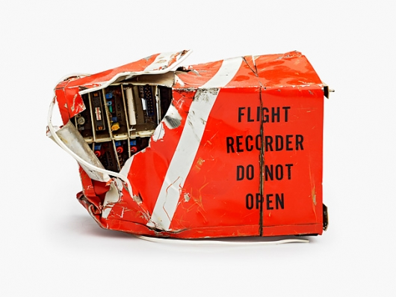
Flight Recorder
101
High Performance Event Recorder
Built into the JVM
Binary recordings
Chunks
Self contained
Self describing

Slide 5
Flight Recorder Advantages
Very detailed information
Extremely low overhead (<= 1%)
Can keep it always on, dump when necessary
Tooling for analysing recordings built into the Oracle JDK (Java Mission Control)
Java APIs available for recording custom information into the Flight Recorder in the Oracle JDK
Third party integration giving wholistic view of the detailed information recorded by the Flight Recorder (WLS, JavaFX)

Slide 6
Java Flight Recorder
Resulted from the JRockit and HotSpot JVM Convergence
Java Mission Control released with the 7u40 JDK
Java Mission Control 5.4.0 released with 8u20
Java Mission Control 5.5.0 to be released with 8u40
Most development effort is spent on Java Mission Control 6.0.0 - more on this later
Notes:
Thread start & stop
Recording metadata

Slide 7
Different Kinds of Recordings
Continuous Recordings
Have no end time
Must be explicitly dumped
Time Fixed Recordings (sometimes known as profiling recordings)
Have a fixed time
Will be automatically downloaded by Mission Control when done (if initiated by Mission Control)
Notes:
Thread start & stop
Recording metadata

Slide 8
How to Think About Recordings
Recordings are collections of event type settings
A “recording” can both mean an ongoing recording on the server side, as well as a recording file. The context usually separates the two.
It might help to think of the server side recording as:
A named collection of event type settings…
…that are active for a certain period of time.

Slide 9
How to Think About Recordings
Example
A continuous recording R₀ is started at T₀ with settings S₀. After a while, a time fixed recording R₁ is started at T₁ with settings S₁, where S₁ ⊃ S₀. The time fixed recording R₁ ends at T₂. This is what will be recorded:
If dumping R₀ for a time range intersecting [T₁,T₂], you will get information that you did not ask for in the settings (S₀). All this in the name of performance. Once T₂ arrives, the settings for R₁ will be popped, and we’re back to just recording S₀.
Time | Settings
T₀→T₁ | S₀
T₁→T₂ | S₀ ∪ S₁
>T₂ | S₀

Slide 10
Different Kinds of Events
Instant Event
Data associated with the time the data was captured
Requestable Event
Polled from separate thread
Has a user configurable period
Duration Event
Has a start time and a stop time
Timed Event
Like Duration Event, but with user configurable threshold

Slide 11
Flight Recorder Inner Workings
Performance, performance, performance
Extremely low overhead
Using data already gathered
High performance recording engine
Testing!
Third party events
WLS
DMS
JavaFX
You can add your own! (Not supported yet.)
Notes:
Thread start & stop
Recording metadata

Slide 12
Creating recordings

Slide 13
Preparations
Hotspot
Start the JVM from which to get recordings with: -XX:+UnlockCommercialFeatures -XX:+FlightRecorder
If remote monitoring is required:
Start with the appropriate com.sun.management flags
In 7u40 JDP can be used for easy discovery of manageable JVMs on the network
Notes:
Thread start & stop
Recording metadata

Slide 14
Creating Recordings Using Mission Control
Easy and intuitive
Find a JVM to do a recording on in the JVM Browser
Double click the Flight Recorder node under the JVM
Follow the wizard (will show demo soon)
Note: Ongoing recordings are listed as nodes under the Flight Recorder node. To dump one, simply drag and drop the ongoing recording to the editor area, or double click it. This is mostly useful for continuous recordings.
Notes:
Thread start & stop
Recording metadata

Slide 15
Creating Recordings Using Startup Flags
Useful for enabling continuous recordings at startup
Documentation of startup flags available in the JDK docs
The following example starts up a 1 minute recording 20 seconds after starting the JVM: -XX:+UnlockCommercialFeatures -XX:+FlightRecorder -XX:StartFlightRecording=delay=20s,duration=60s,name=MyRecording,filename=C:\TEMP\myrecording.jfr,settings=profile
The settings parameter takes either the path to, or the name of, a template
Default templates are located in the jre/lib/jfr folder.
Note: Using the settings parameter will require either a JRockit or a Hotspot 7u40 or later.
To get more information on what is going on, change the log level: -XX:FlightRecorderOptions=loglevel=info
Notes:
Thread start & stop
Recording metadata

Slide 16
The Default Recording
Shorthand for starting a continuous recording. With benefits.
Special short hand to start the JVM with a continuous recording
Started with -XX:FlightRecorderOptions=defaultrecording=true
The default recording will have the recording id 0
Only the default recording can be used with the dumponexit and dumponexitpath parameters
The following example will start up the continuous recording. It will be dumped when the JVM exits to C:\demos\dumponexit.jfr. -XX:+UnlockCommercialFeatures -XX:+FlightRecorder -XX:FlightRecorderOptions=defaultrecording=true,dumponexit=true,dumponexitpath=C:\demos\dumponexit.jfr
Notes:
Thread start & stop
Recording metadata

Slide 17
Creating Recordings Using JCMD
Useful for controlling JFR from the command line
Usage: jcmd <pid> <command>
Example starting a recording: jcmd 7060 JFR.start name=MyRecording settings=profile delay=20s duration=2m filename=c:\TEMP\myrecording.jfr
Example checking on recordings: jcmd 7060 JFR.check
Example dumping a recording: jcmd 7060 JFR.dump name=MyRecording filename=C:\TEMP\dump.jfr
Notes:
Thread start & stop
Recording metadata

Slide 18
Recording creation DEMO

Slide 19
Oracle EM

Slide 20
Enterprise Production Environments
Tight Security protocols with respect to access to JVMs
Large sets of JVMs on different life cycles
Test
Pre production (stage)
Production
Admins top priority: resume service delivery
Automate discovery
Automate and simplify collection
Developers prefer to investigate in their habitat
Notes:
Thread start & stop
Recording metadata

Slide 21
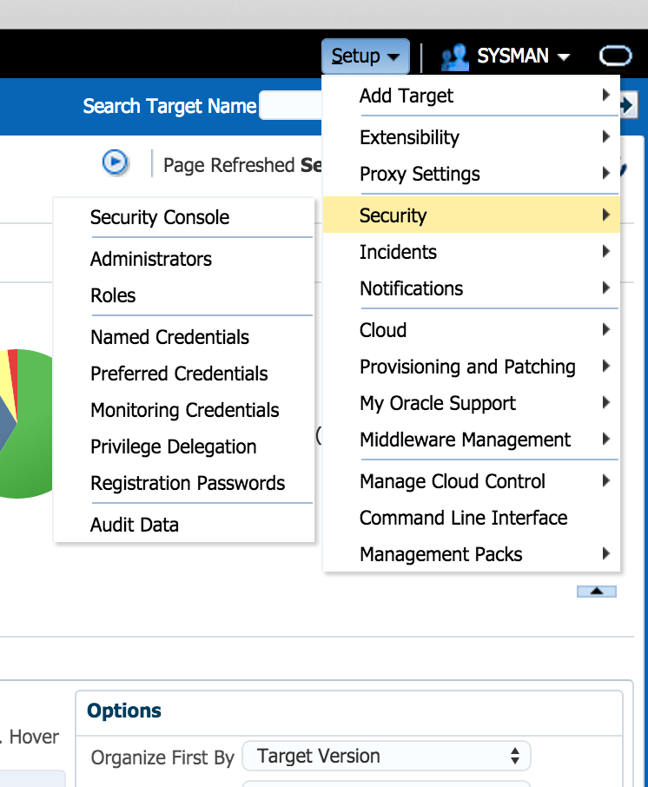
Oracle EM – secure access
Problem:
Dev needs access to JVM/JFR in production
IT Requirements:
Authentication
who is allowed?
Authorization
What can they do?
Which target/objects can they manage/see?
Audit
What have they done?
Benefit:
Admin can allow developers controlled and audited access to JVMs in production
Notes:
Thread start & stop
Recording metadata

Slide 22
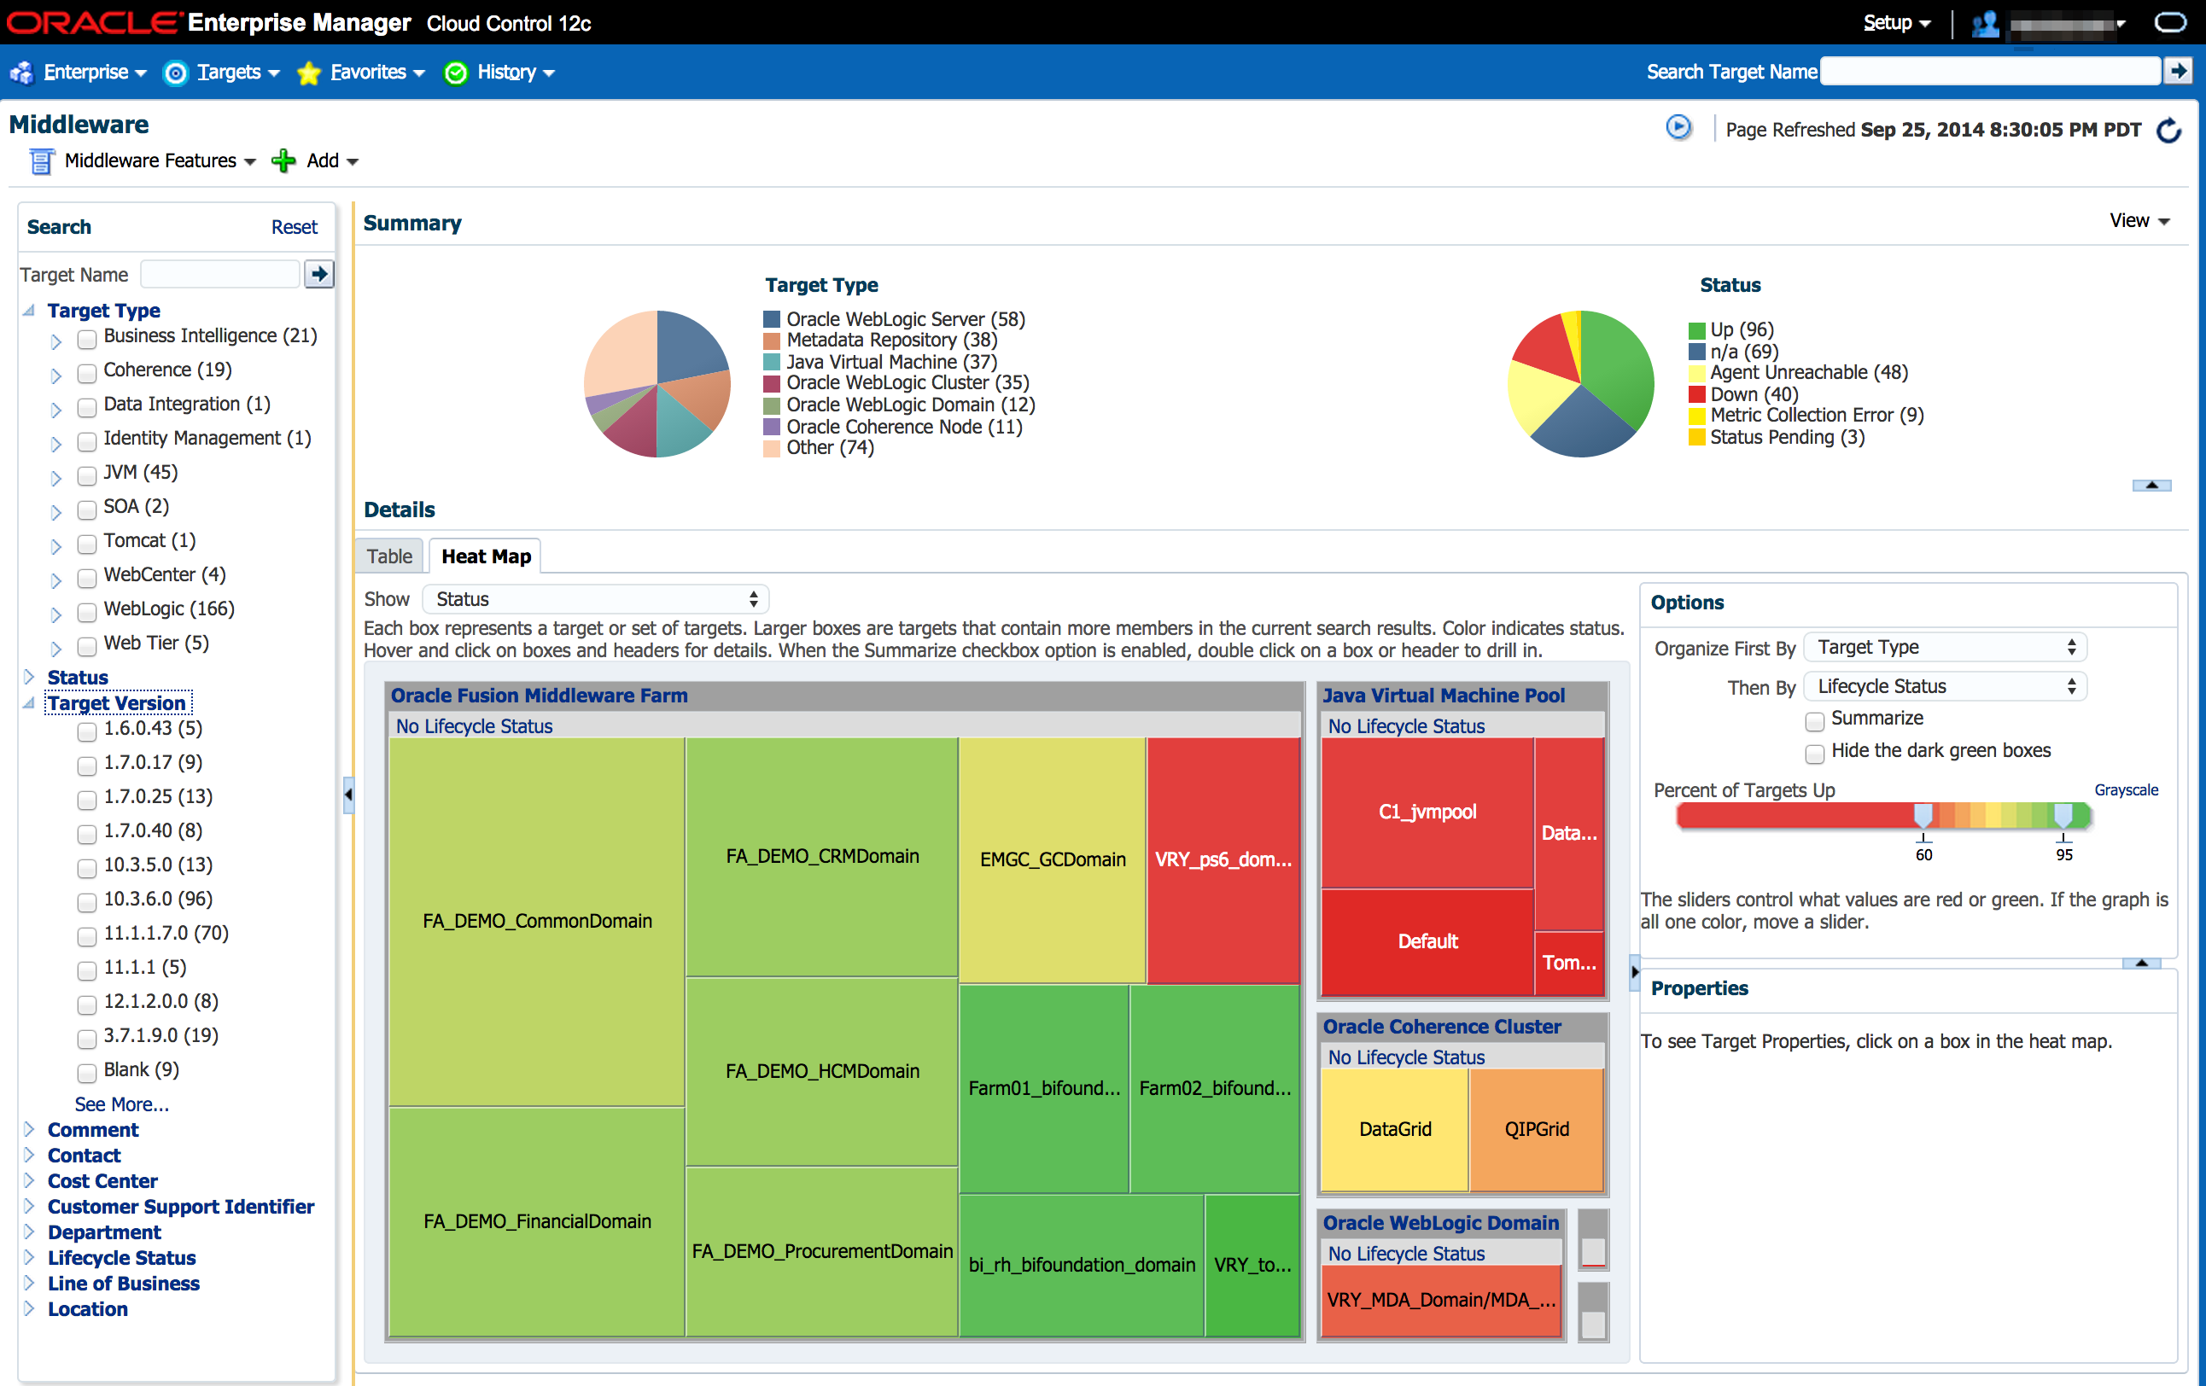
Oracle EM – Enterprise scale
Manage all JVMs across enterprise (monitor, track changes, diagnose)
Notes:
Thread start & stop
Recording metadata

Slide 23
EM JFR Demo

Slide 24
Analyzing Recordings

Slide 25
Analyzing Flight Recordings in JMC
All tab groups except for the general Events tab group are preconfigured to show a certain aspect of the recording (sometimes referred to as static or preconfigured tabs)
The pre-configured tabs highlights various areas of common interest, such as code, memory & GC, threads and IO
General Events tab group - useful for drilling down further and for rapidly homing in on a set of events with certain properties

Slide 26
The Operative Set
Power Feature
The Operative Set is a global set of events
Events can be added or removed to the operative set from the context menu
The Events tabs usually have a check box to only show events in the operative set
Using the Events tabs together with the Operative Set is a powerful way to home in on events with a certain set of properties

Slide 27
Common Features in Most Tabs
Almost all tabs have a range selector at the top
Used to filter on a time range
Can be synchronized between all tabs
Highlights events in the operative set in cyan
The tabs in the Events tab group can be used in conjunction with the Event Types view to filter on Event Types
In filter boxes:
Kleene star can be used as wildcard (*.sun.*)
Start with regexp: if more power is needed (regexp:.*\.sun\..*) (not as performant though)

Slide 28
Analyzing Recordings
DEMO

Slide 29
Some Common Pitfalls
Not accounting for thresholds
Thresholds are very useful for keeping performance up but still detecting outliers
Can be confusing. Example: Thread T has been running for 2 minutes and sum of latencies is a minute. Was the thread T running unblocked for a minute?
Not accounting for CPU load
Don’t make decisions based on method profiling data if there is no load
If you have full load, then looking at latencies may be a waste of time

Slide 30
Programmatically Analyzing Flight Recordings
Using the JMC parser (Unsupported)
The parser included in Mission Control can be used to analyze recordings programmatically
If enough people want to, I can write a blog on how it can be used
The JMC team also have an experimental JDBC bridge

Slide 31
Customization

Slide 32
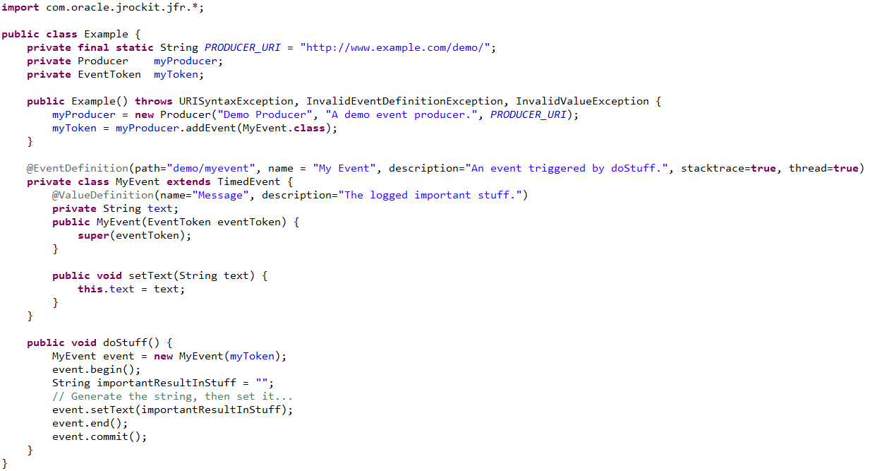
Adding Your Own Events (unsupported)

Slide 33
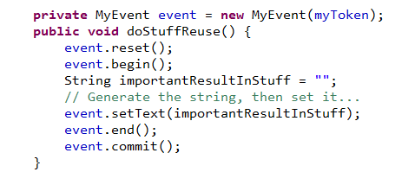
Minimizing Object Creation
Can reuse event objects
Use with care – only where you know it’s thread safe
!

Slide 34
Built in GUI editor (unsupported)
The JMC has a built in designer
Can be used to both customize the existing GUI and produce entirely new GUIs for events
The created GUIs can be exported as plug-ins and shared

Slide 35
Customization DEMOS

Slide 36
Future

Slide 37
Quick roadmap
Near, mid future
JMC 5.5.0 (8u40)
Dynamic enablement of Flight Recorder (no startup flags needed)
Hiding of Lambda Form methods
JMC 6.0.0 (JDK 9)
Automatic analysis of Flight Recordings
Greatly revised user interface (more modern, cleaner)
Continually
New event types (improved I/O events, GC events, loaded libraries)

Slide 38
Other Resources
Plus shameless book plug
JMC Homepage http://oracle.com/missioncontrol
Hirt’s blog http://hirt.se/blog
Twitter @javamissionctrl, @hirt
Shameless Book plug
EM – go to OTN

