Slide 1
Andra Keay
Managing Director @svrobo

Slide 2
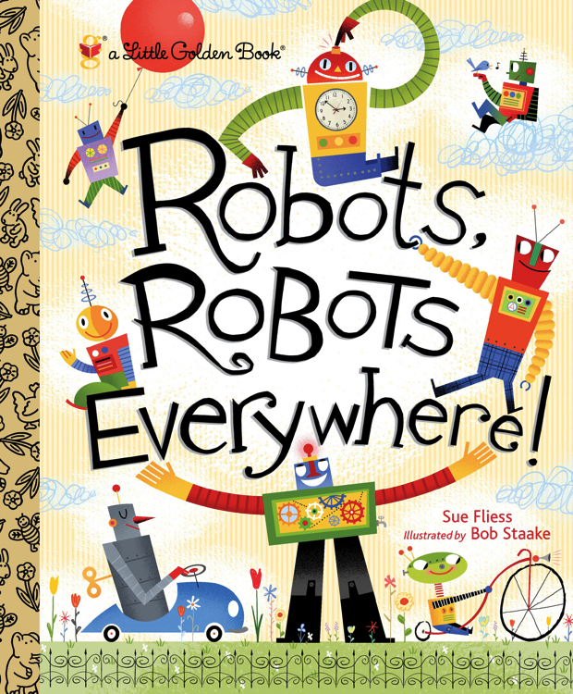
Notes:
On the ground and in the air, robots robots everywhere!
Up in space, beneath the seas, robots make discoveries,
Tractor robots plant and plow, robots even milk a cow!
Robots weld and paint and blast, robots build cars really fast…
The book goes on…
This is a great little book to read to your children if you want them to know some of the things robots are really doing in our world already. It’s a very realistic book. Except for one thing. The robots. In our imagination what do robots look like?

Slide 3
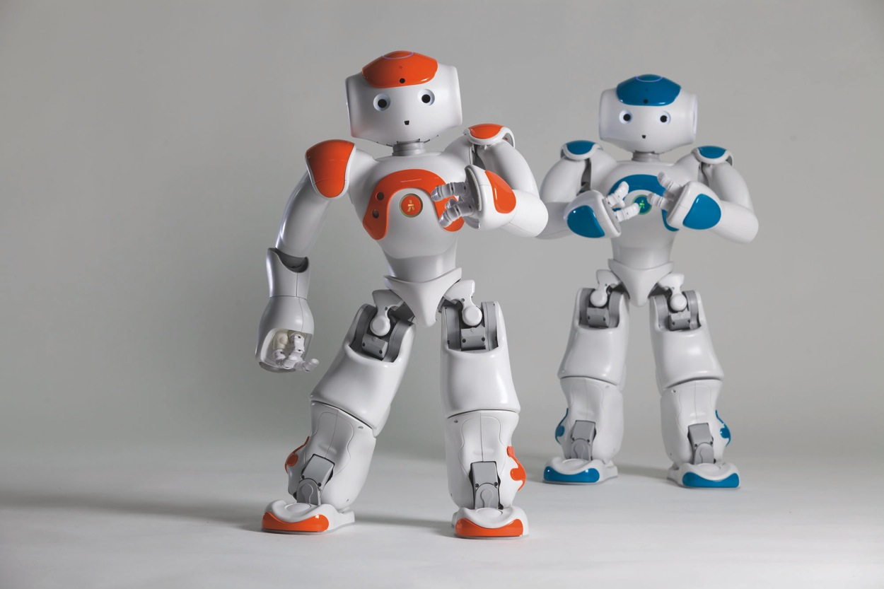
Notes:
Yes, all our robots look a bit like us. Like these cute little guys. In the children’s book the robots are pushing the buttons on the machines. But in the real world, we’re still pushing the buttons. The robots are just the machines, the appliances.
But we always imagine robots to look something like us. Because we are deeply conditioned to pay attention to human or animal sort of objects, things with a bit of movement and something that looks vaguely face like. If a leaf falls, we see a leaf, but if it falls next to a butterfly, we see an interaction. We attribute agency. We see faces in rocks, on clouds, even on toast.
So when we think of robots, those moving acting machines, those lively objects. Well our minds fill in the blanks and we want to embody them and make them playful, interactive.

Slide 4
Robots are everywhere
but they are INVISIBLE
Notes:
Anything else is outside of our evolutional and our emotional frame of reference. Robots really are everywhere but most of them are invisible. While we think we love our humanoids…

Slide 5
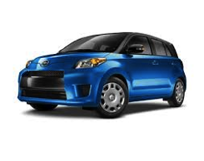
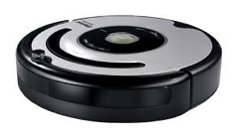
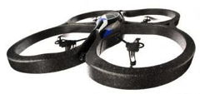
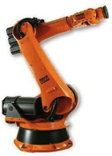
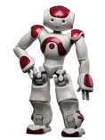
Notes:
Sorry Nao, you and your humanoid friends are really the least popular robots in the world. The boring old industrial robot arms number about 1.5 million operating in the world today. And the consumer and professional drone market has really taken off in the last few years. Parrot’s AR drone alone has sold almost 1 million units. And that’s just one company.
But the most widely distributed robot in the world today is the robot vacuum cleaner, with iRobot shipping 10 million Roombas, and there are a half dozen other robot vacuum cleaners on the market. But even Roombas are just a small fraction of the real robots out there.
Our cars today, and our planes and trains, are just as much a robot as any of these other devices. I’m not talking about our future fully autonomous vehicles. I’m talking about most cars built in the last 6 years. We just don’t call them robots. We call them cars.

Slide 6
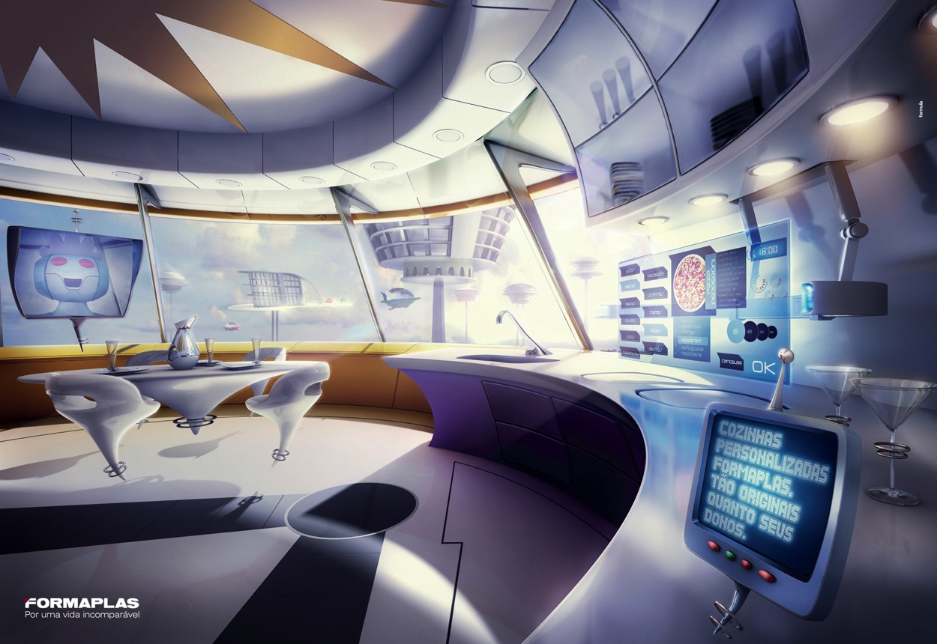
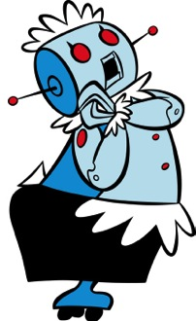
Notes:
South Korea promised a robot in every home by the year 2020. And we all imagined something like Rosie, the robot maid from the Jetsons. The reality will be more like a lot of Nest thermostats and other appliances all talking to each other. The definition of a robot is something that senses, something that thinks and something that actuates.
It’s quite possible for the sensors to be scattered around, and the brain to be in the cloud, or in lots of little nodes, and for all sorts of actions to happen. Things open, close, heat up, cool down, rotate, roll away.
That means we won’t be looking at the robot – we’ll be living inside it.
Yes, your next household robot will BE your house.

Slide 7
Your next household robot
will be your HOUSE
Notes:
It will be like a magic house. Because you won’t notice the robots.
And when Kiva Systems were looking for their first customers for their warehouse delivery robots – before Amazon bought them – they showed a video of objects just arriving magically at the warehouse pickers hands. Because they thought the delivery robots were just a distraction and they wanted their customers to look at the results. Not the robots. The technology wasn’t the issue. The service was.
What will a magic house be like?

Slide 8
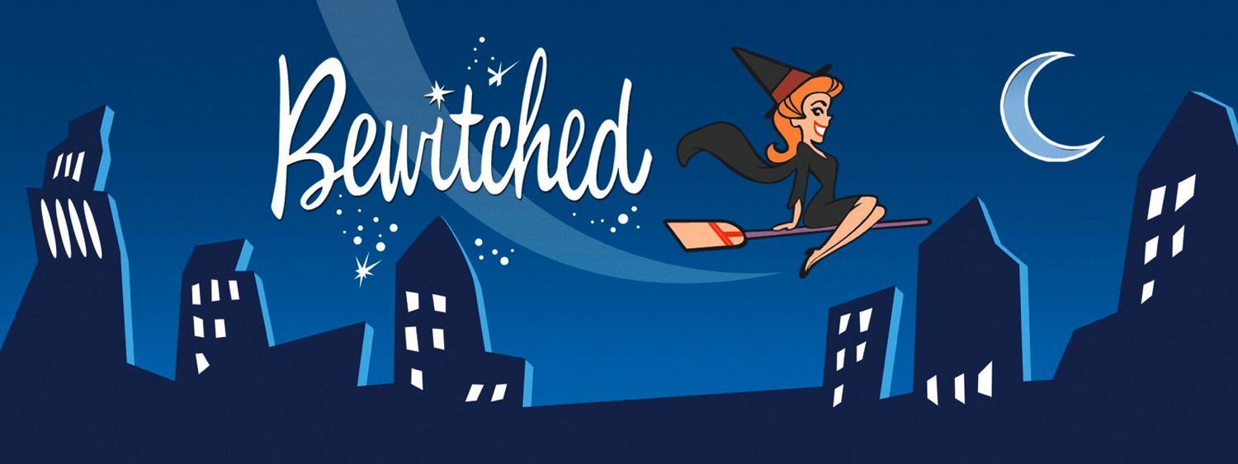
Notes:
Do you remember Bewitched? Bewitched was a popular TV show 50 years ago. And the comedy was that an ordinary human and a witch fall in love, but instead of living in the magic world, they live in the ordinary human world. And Sabrina, the witch, is always getting in trouble using her magic when she isn’t supposed to. So what kind of things does she do with her super power?

Slide 9
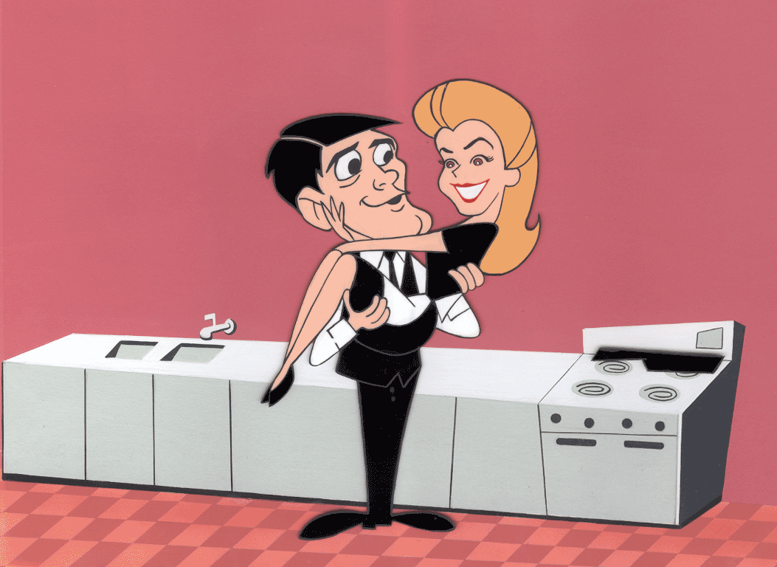
Notes:
Well, most of the time Sabrina cooks meals from fresh ingredients. She hoovers the house. She washes dishes at the sink. She mops the floors. She hangs out washing on a clothes line. She does a lot of housework by hand.
And just occasionally, she’ll twitch her nose and one of the jobs will do itself. As if an invisible person was doing it.
Now, I confess. I don’t cook. I microwave or get hot meals delivered to my door. I use a dishwasher. I have a robot vacuum cleaner. There is no clothes line in my back yard. The shape of my house has changed as more and more machines move in. The house has evolved hugely in the last 100 years.
To have household robots, we may need to imagine a whole different sort of house.

Slide 10
Any sufficiently advanced technology
is indistinguishable from magic
Arthur C. Clarke
Notes:
That’s my call to action. Let’s all engage our imaginations. But not to create imaginary robot friends.
We need to look at every thing in our lives as if it were able to magically be better. Then we need to build the right robot…. And we can.

Slide 11
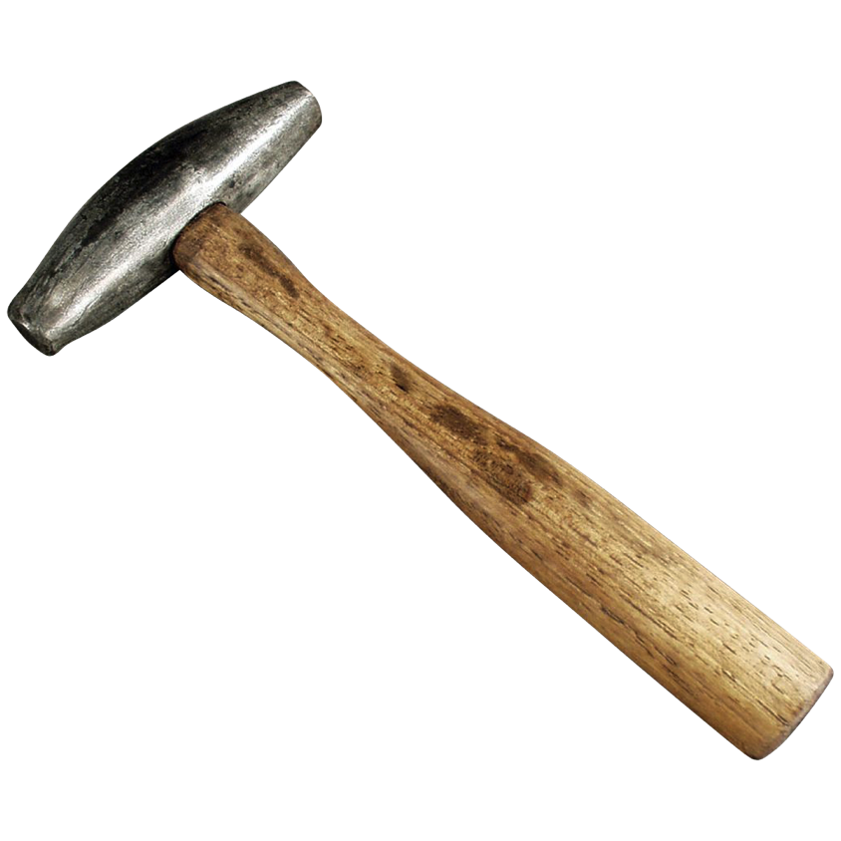
Notes:
I mean .. How did we used to talk to our machines. To start with we used brute force.

Slide 12
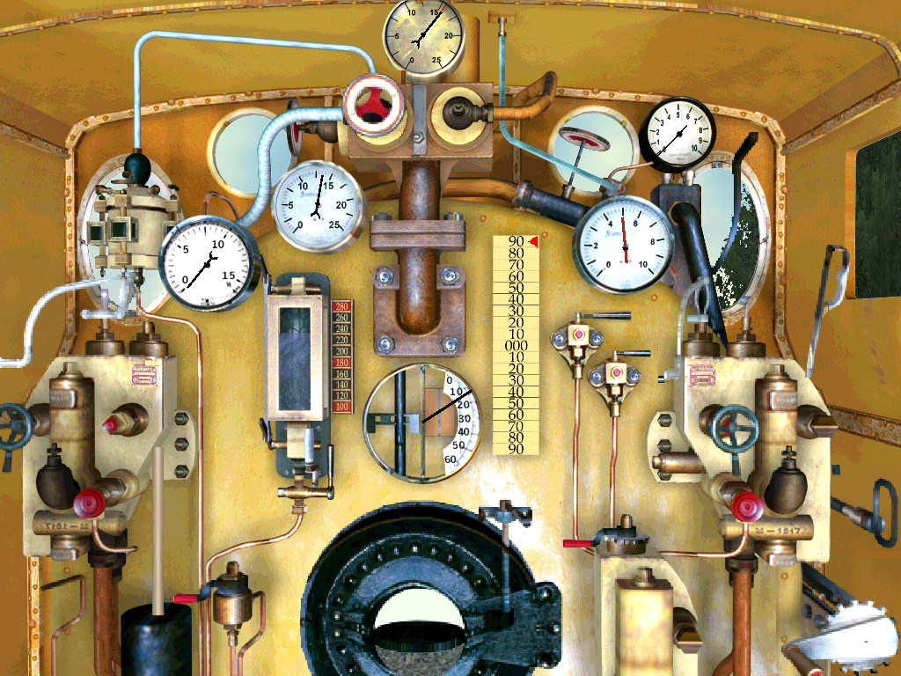
Notes:
Then we introduced cables and gears and wires and wheels and pulleys and levers. And steam and clocks.

Slide 13
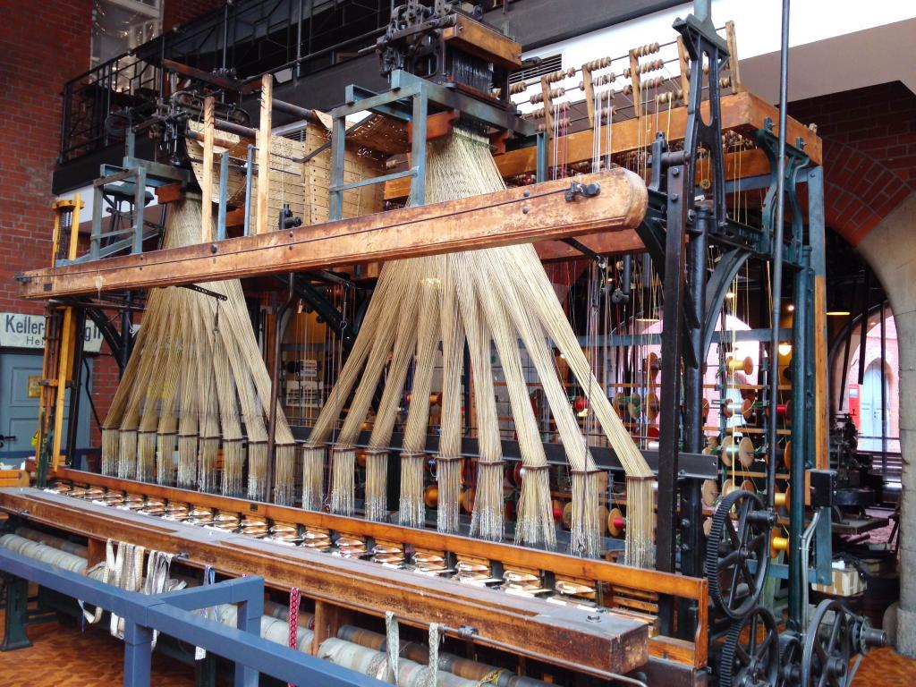
Notes:
And punch cards in the first Jacquard Looms

Slide 14
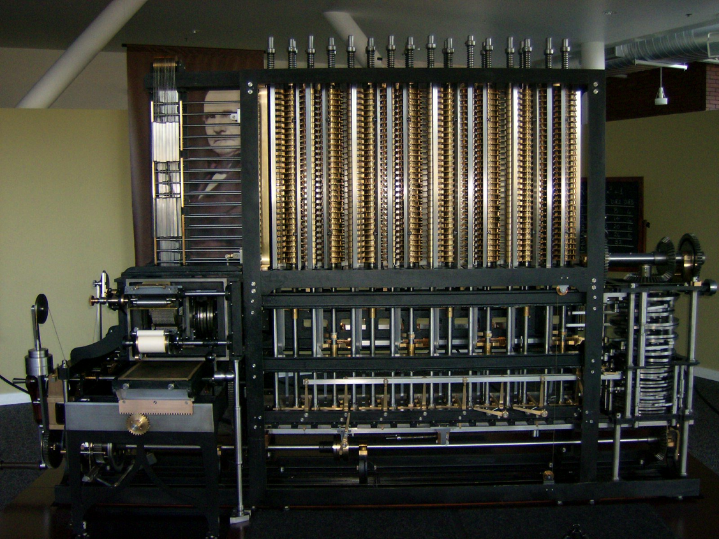
Notes:
Describe the Difference Engine and the input/outputs

Slide 15
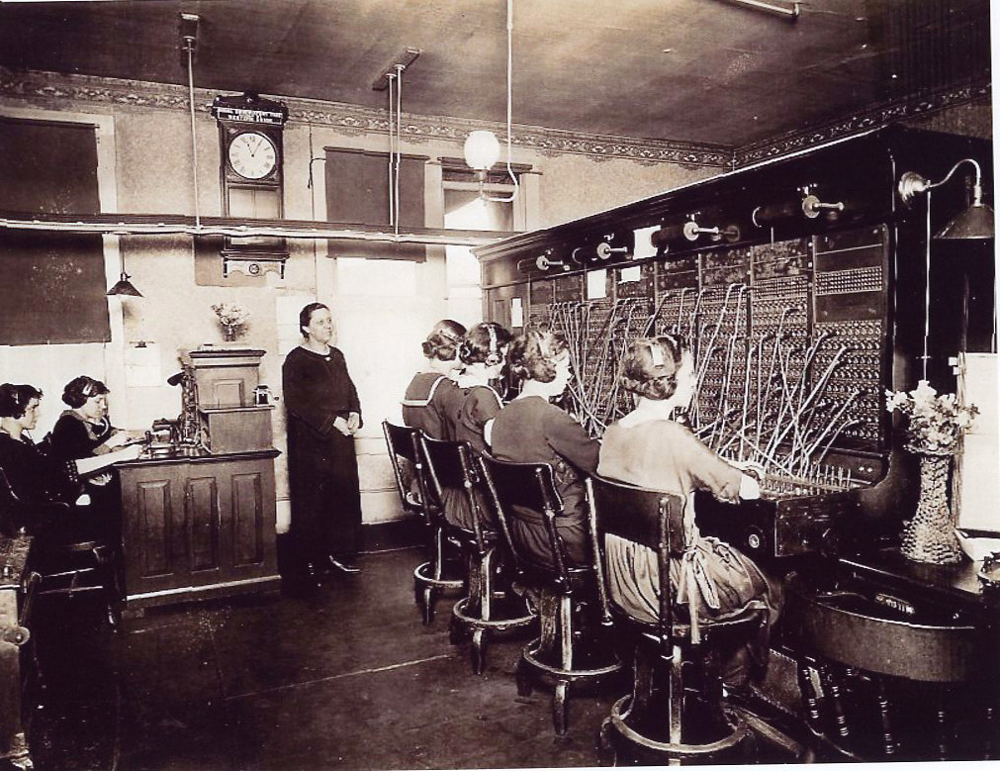
Notes:
Then we added switches and electricity and more wires and sockets.

Slide 16
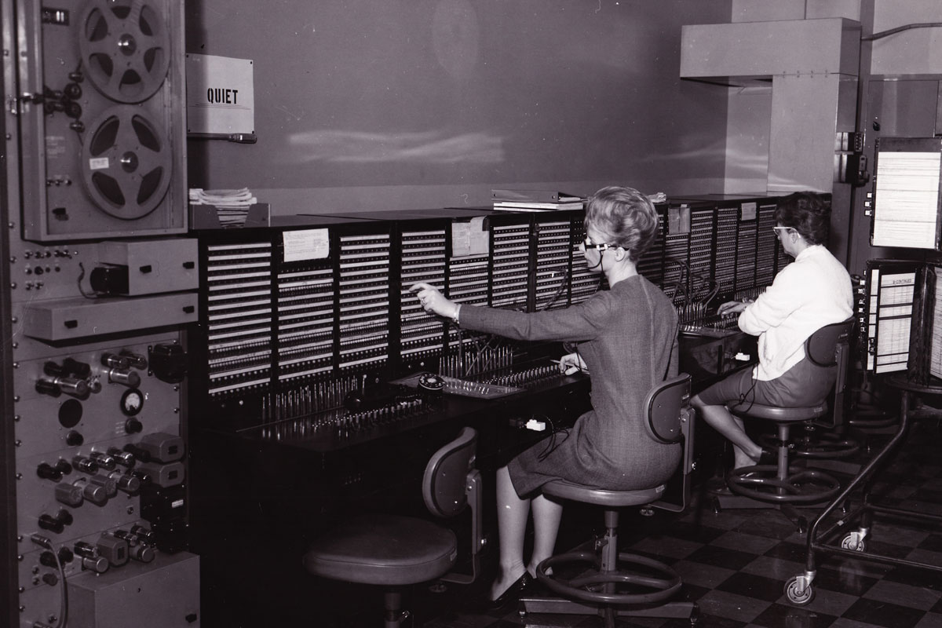
Notes:
And more switches and levers and sound and lights.

Slide 17
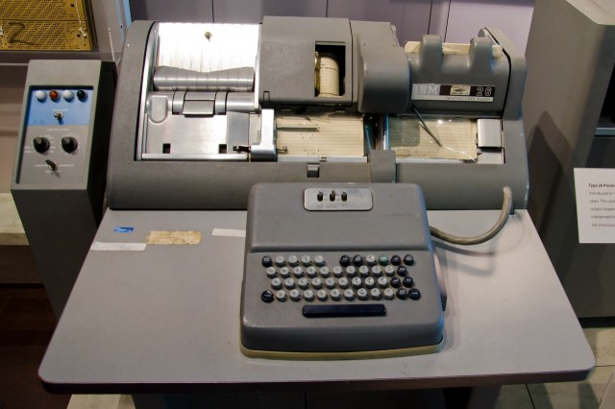
Notes:
And punch cards. With keyboards.

Slide 18
Notes:
And punchcards came back. With keyboards.

Slide 19
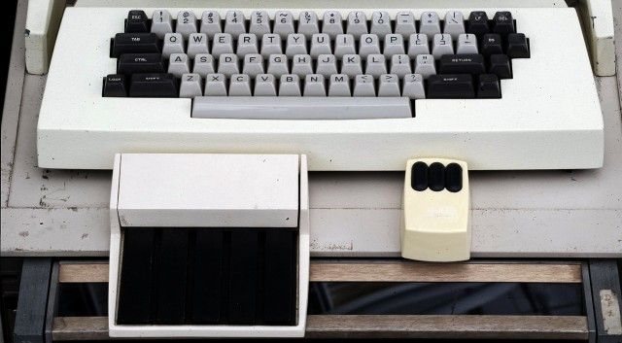
Notes:
And then mice…

Slide 20
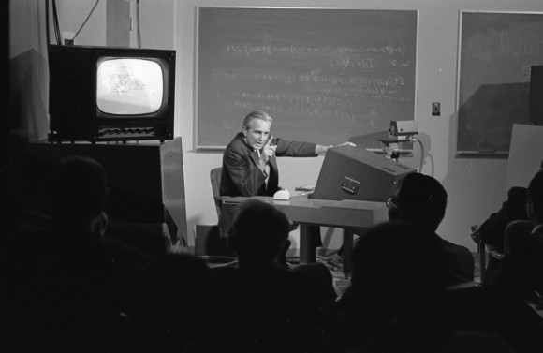
Notes:
And then mice….
1968

Slide 21
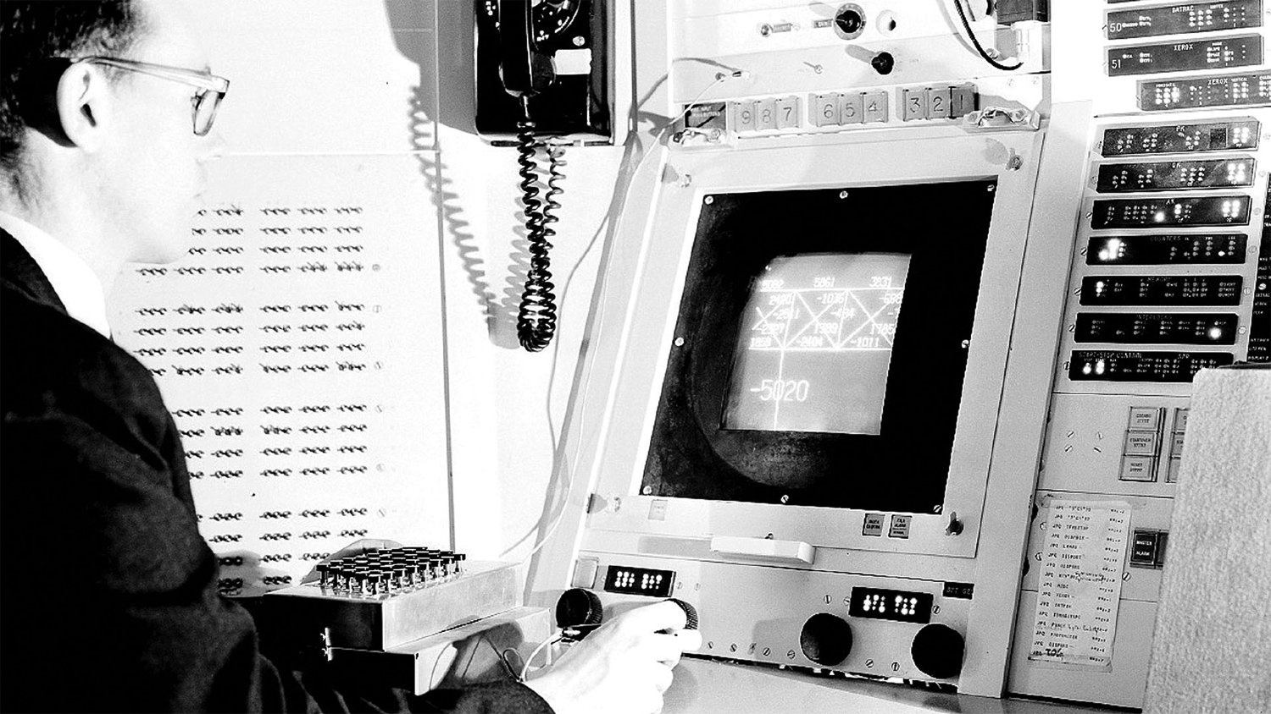
Notes:
Graphical User Interface
Inspired by the work of Vannevar Bush and Ivan Sutherland, Engelbart’s oNLine System (NLS) was the first implementation of a GUI, a virtual desktop incorporating windows, menus, icons, and folders. (and a heck of a lot of other stuff that it’s taken us almost 50 years to live up to!)
Sutherland
While most computer scientists were focusing on making computers smarter, Engelbart and Sutherland were interested in how computers could make humans smarter.

Slide 22
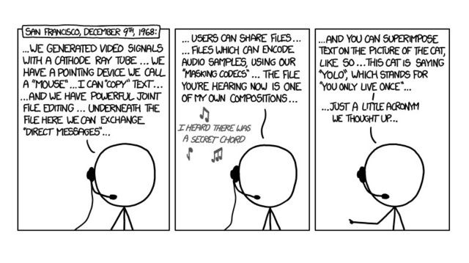
Notes:
Graphical User Interface
Inspired by the work of Vannevar Bush and Ivan Sutherland, Engelbart’s oNLine System (NLS) was the first implementation of a GUI, a virtual desktop incorporating windows, menus, icons, and folders. (and a heck of a lot of other stuff that it’s taken us almost 50 years to live up to!)
Sutherland
While most computer scientists were focusing on making computers smarter, Engelbart and Sutherland were interested in how computers could make humans smarter.

Slide 23
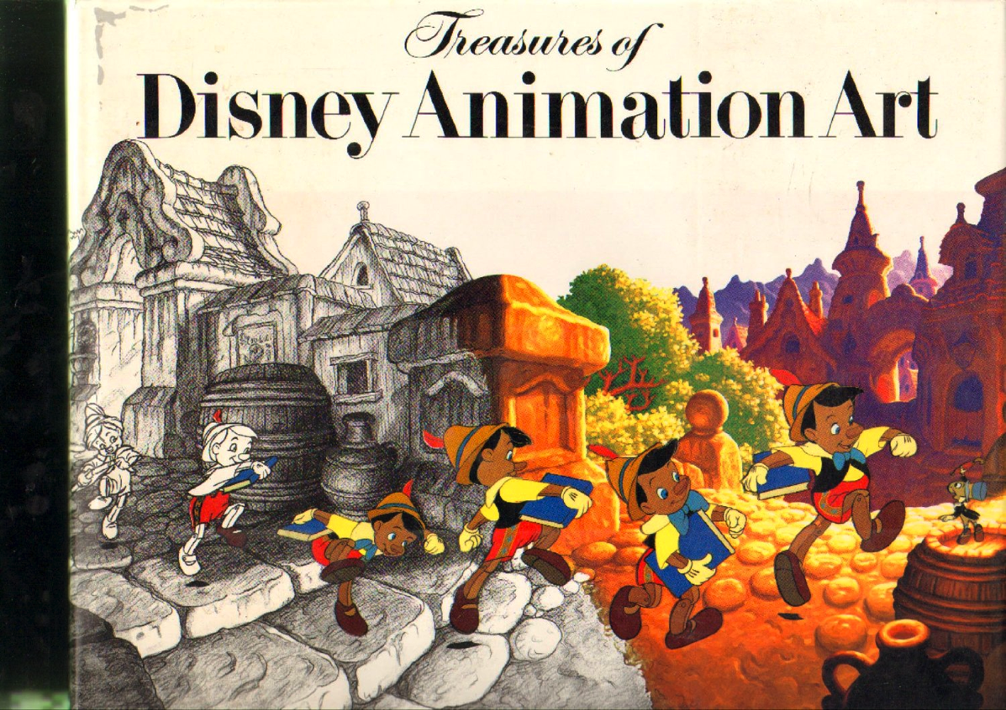

Slide 24
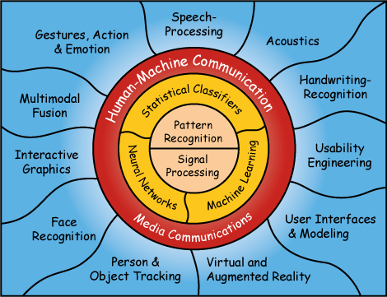

Slide 25
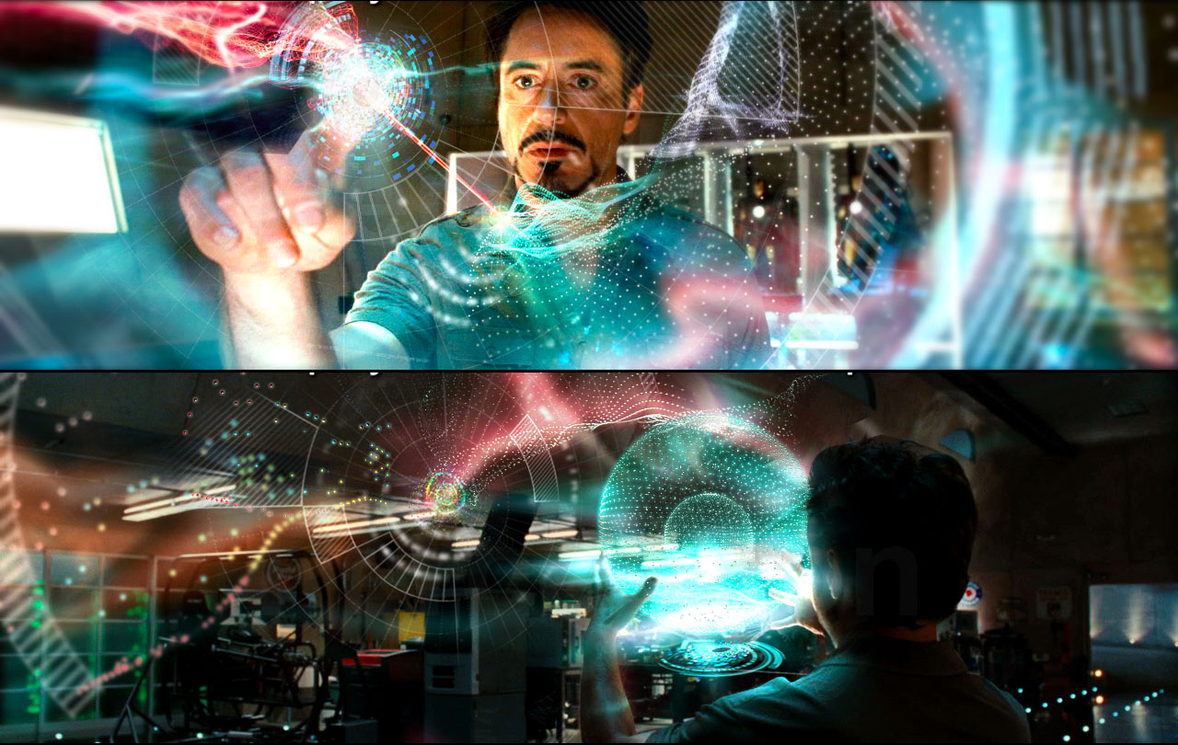

Slide 26
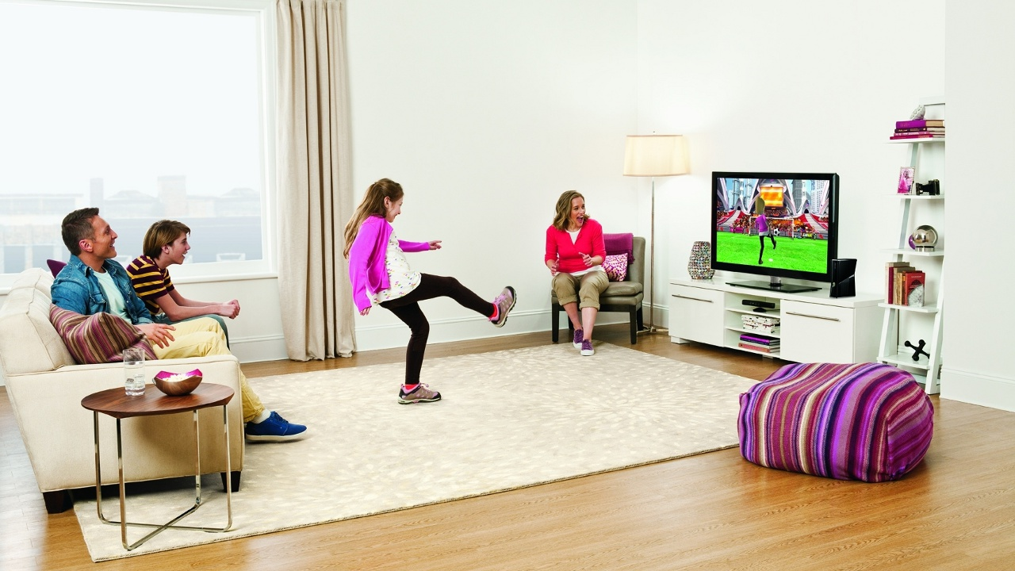

Slide 27
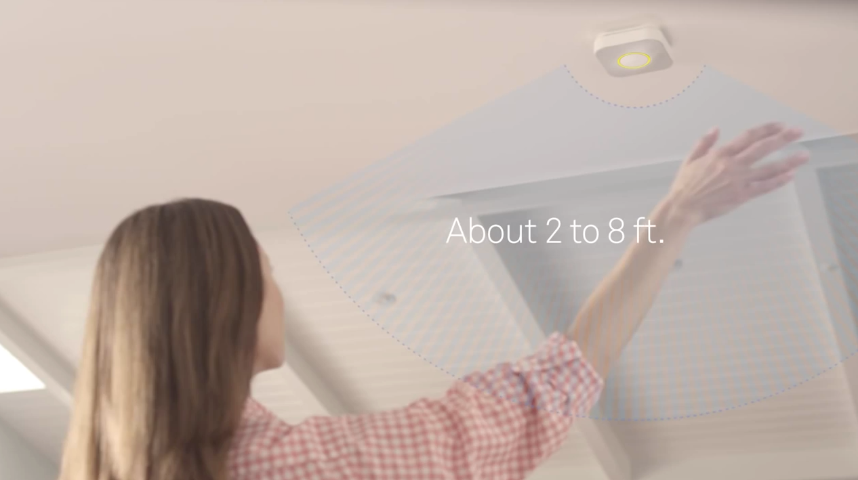
Notes:
Nest recall and then back on market without wave feature.
how many other examples of confuston. “Stop”

Slide 28
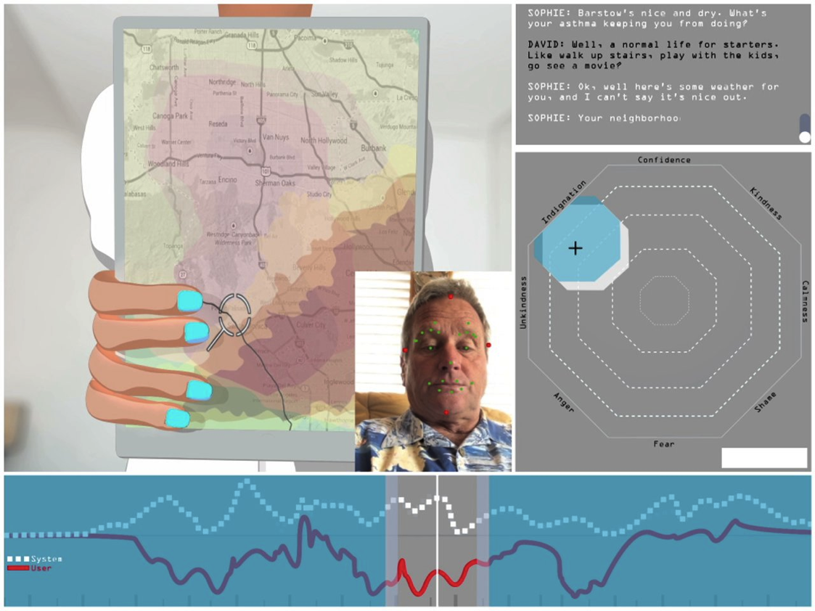
Notes:
Bewitched banana talk –

Slide 29
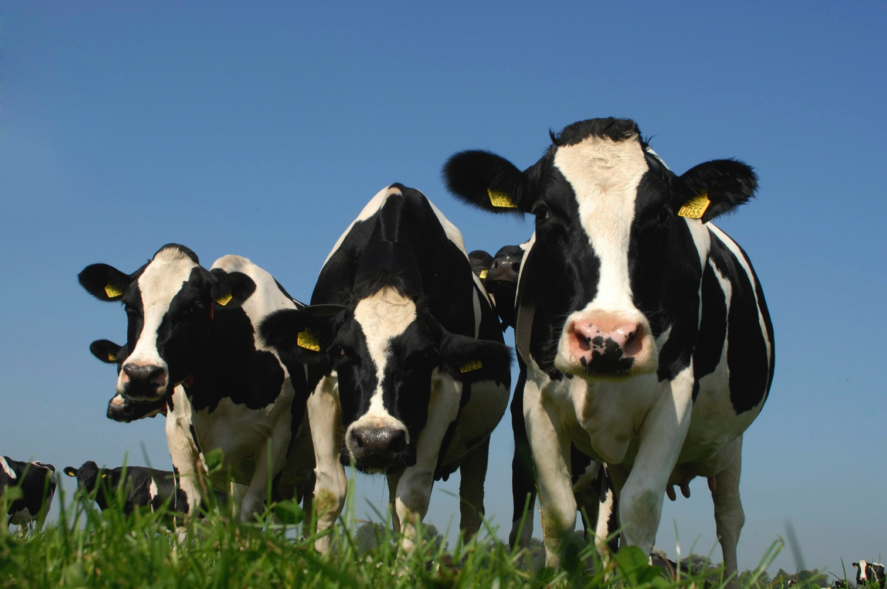
Notes:
And one final message. We are not alone.
A lot of animals are already living with robots. The fastest growing sector of the robotics market is the milking machine. We now have fully automated dairy farms, where it’s possible for the cows to milk and feed themselves. 24/7 Cows are really the queens of the ‘quantified self’ movement. How much milk each cow gives, how often and how active the cow is. It’s all tracked and the cow is steered to the right food and the right paddocks. If a cow shows signs of illness, the farmer or vet is alerted.
It seems very of controlling, but it allows the cows to choose when and how often they are milked. And their milk yield goes up and their stress levels go down. These are happy cows.

Slide 30
We are not the only ones
who will be living with ROBOTS
Notes:
We need to keep it that way. We need to build magic for the whole ecosystem – not just for us.

