Slide 1
Java Speaks the Language of the Internet of Things
September 2014

Slide 2






The Language of IoT
Using Java8 to Build Your Internet of Things Products, Business & Systems
Devices
Applications

Slide 3



Axeda - IoT Cloud Platform for the World’s Leading Companies
History
Founded as an on premise, remote service application in 2005
Cloud service added in 2009
IoT platform launched in 2010
Added channel sales/Axeda Ready in 2012
Added private cloud/OEM offerings in 2013
Highlights
160 + blue-chip customers
Thousands of successful deployments
$30 billion of equipment/assets managed
500+ million daily messages processed
Significant IP
Customers
Thought Leadership

Slide 4
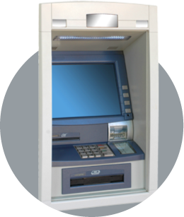
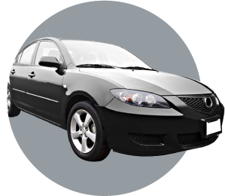
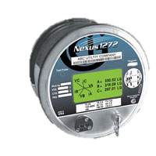
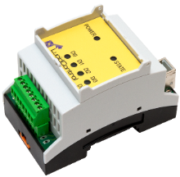


What does Axeda DO?
Connect Things, Collect Data, Change Outcomes
Connected
Car
Connected
Product
Connected
Devices
Intelligently collect and organize
the world's machine and sensor data making it easy to access and use
IoT
Devices
Monitoring/Control
Operations
Predict Insurance
Claim risk
Monitor Performance
& Service
IoT
Applications
Notes:
Things – Actual Axeda customers and connected assets
ATM – Diebold
Connected Car – Allstate/Esurance via Modus
Printing Press – Bureau of Engraving and Printing via Delloitte
Radiosurgery – Elekta
Airport body scanner – Travel Services Administration via Raytheon then General Dynamics

Slide 5


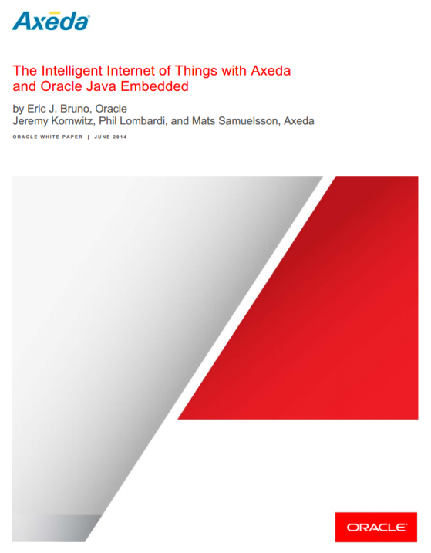

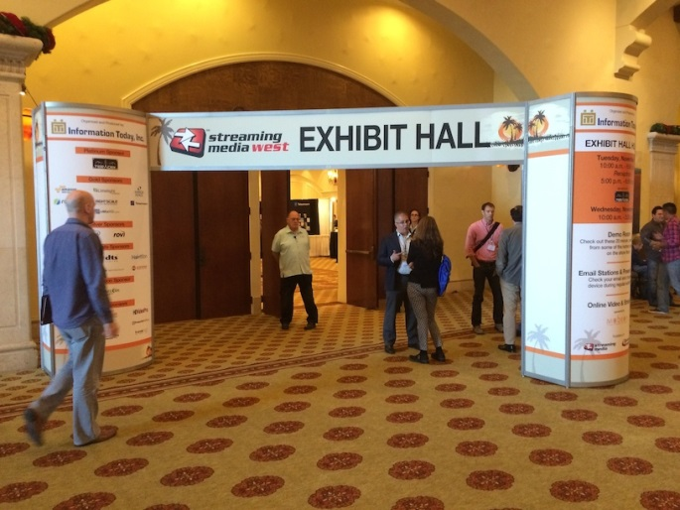
Java 8 Toolkits
Set of Libraries Supporting Axeda’s AMMP IoT Protocol
    Uses Common domain API model
    Fluent Builder API aligning with HTTP client
    Asynchronous Event Handling
    Uses Generic Connection Framework
    Translates Specific I/O Functions into Axeda IoT Model
developer.axeda.com
  Java8 toolkits
  Developers Reference Guide
  www.axeda.com/go-java8
Visit Axeda Kiosk #6009

Slide 6


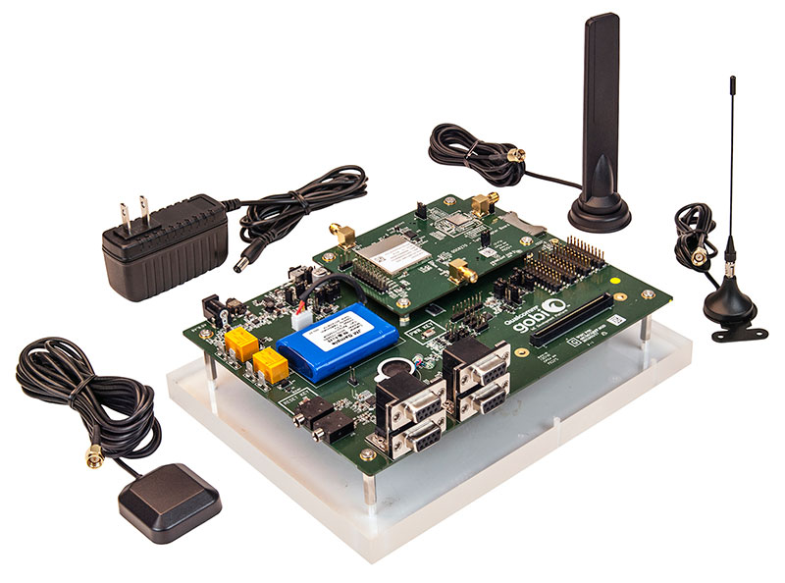
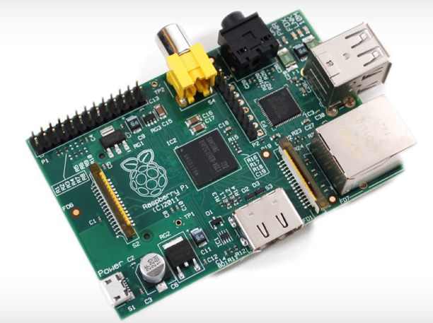


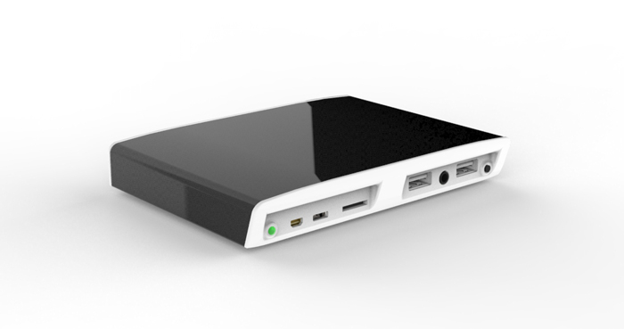

Reference Architectures
What are They
SE 8

Slide 7
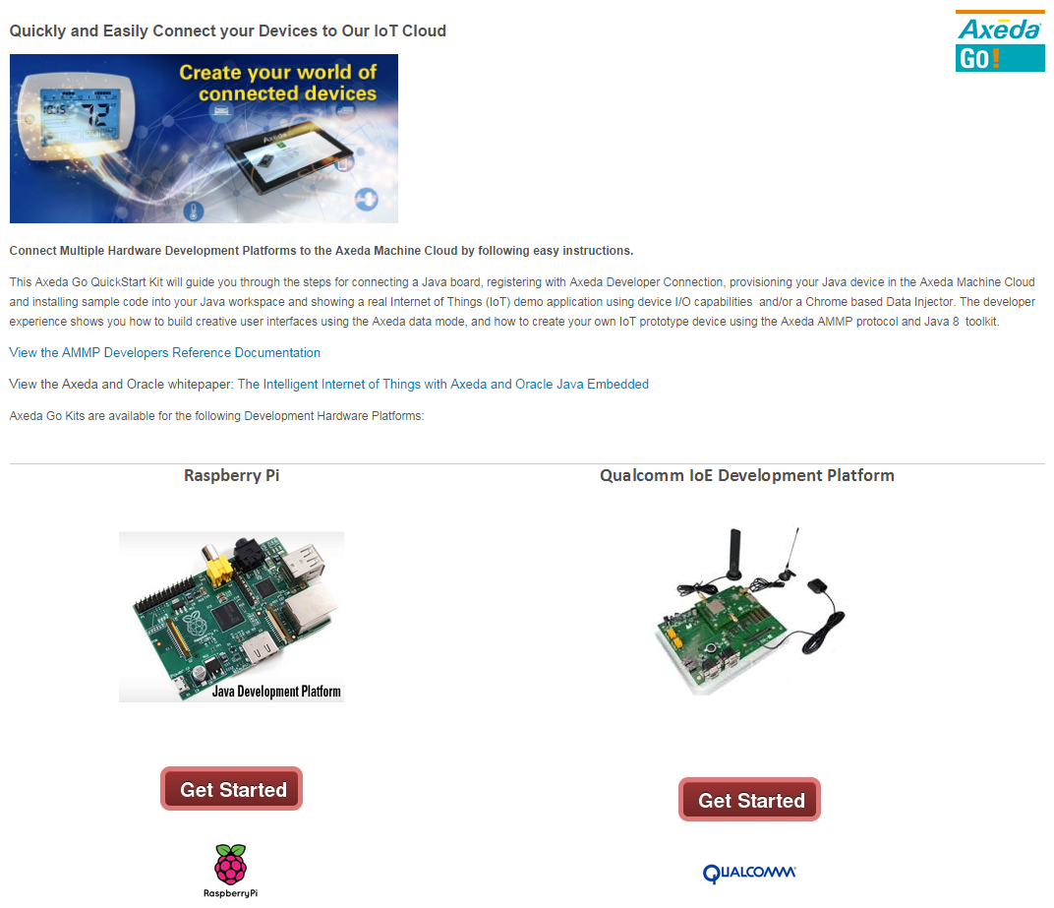
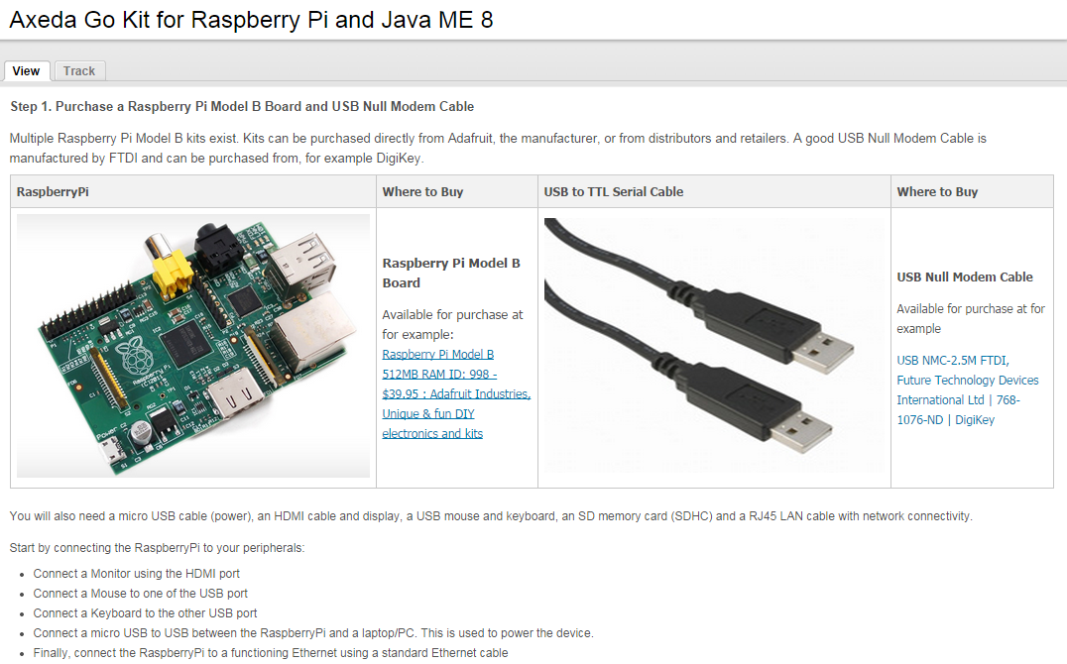
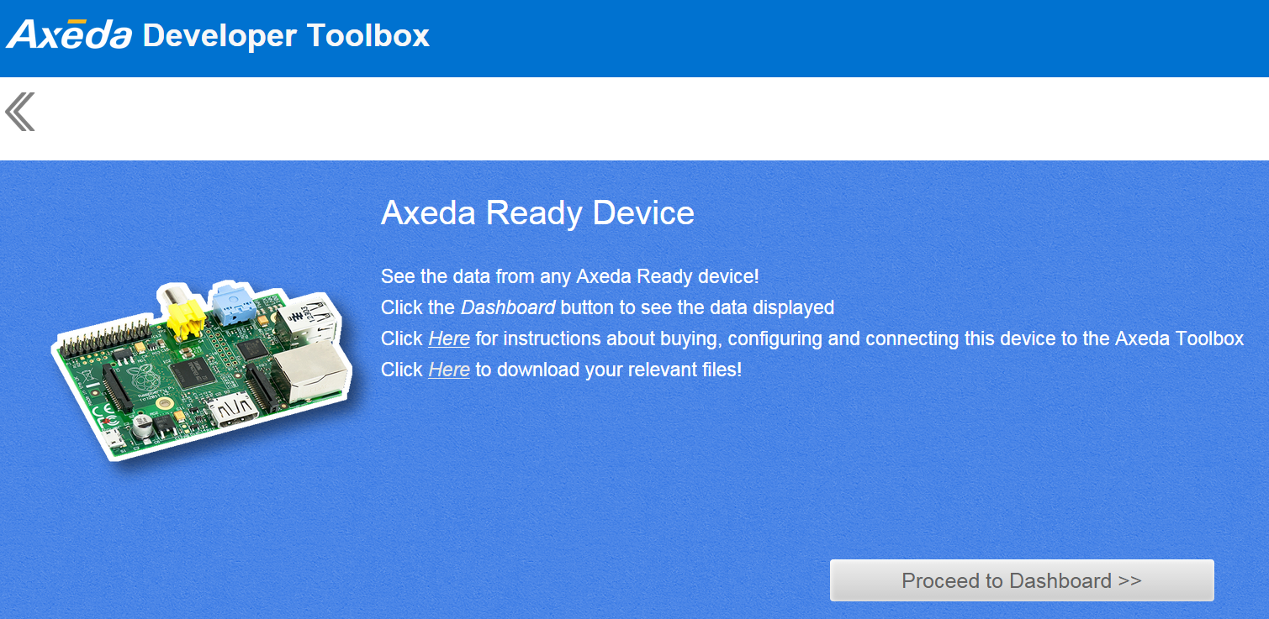
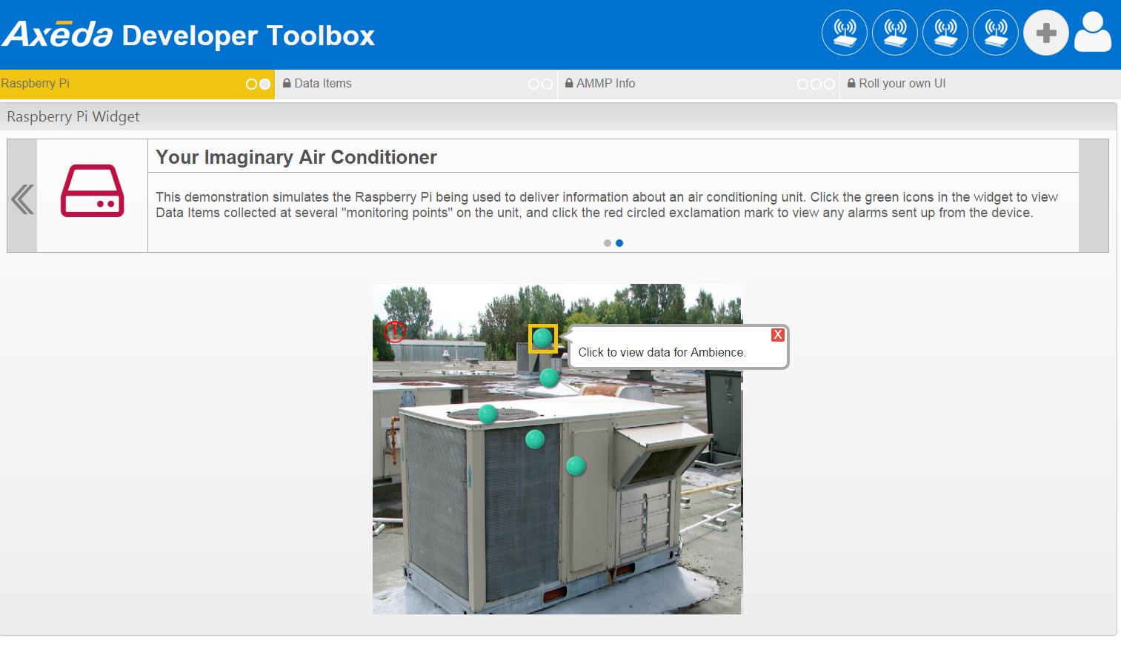
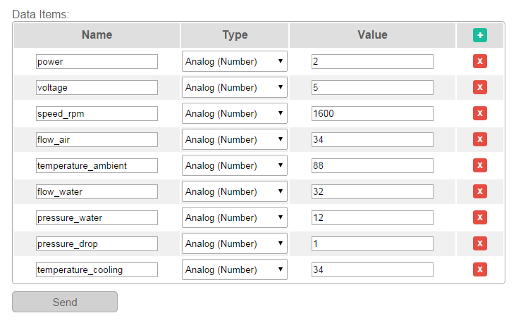
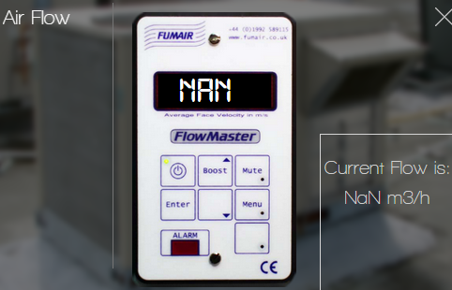
Support Reference Architectures
What Does this Mean?
www.axeda.com/go-java8
Stage 1 - GO Kits
  Easy Step-by-Step Instructions
  Dev Environments
    Java8 sample app jar
    toolbox.axeda.com
  Application Examples
    Imaginary Air Conditioner
    IoT Data Inserter
    Results UIs
Stage 2 – Build POC
  Code Your own IoT Device
  Use IoT Platform
  Develop Complete Apps
    End to End
Stage 3 – Show & Test
Deploy

Slide 8
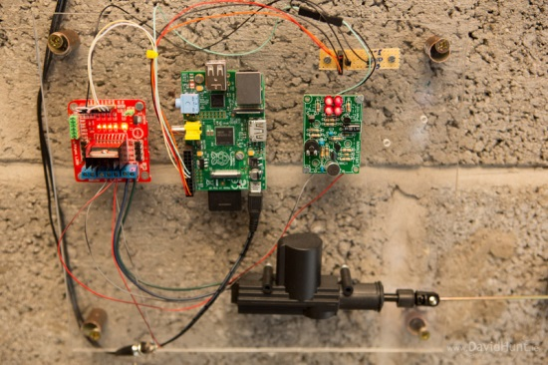
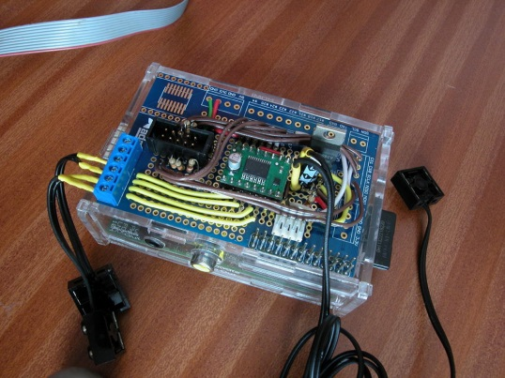
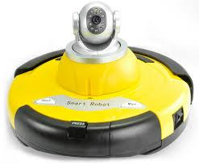
IoT Device Development
Develop Device using Java8 Technologies
POC on Reference Architectures
  GO-kits to get Started
  Java Toolkits to Create POC
Prototype using Axeda Development Environment
  Develop full Prototype Functionality
  Detailed Connectivity and Data Model
Finalize on Product HW/SW
  Port Code to Final Hardware/Software Implementation
  Demo and Test in Marketplace

Slide 9

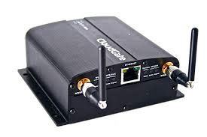

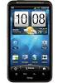

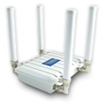







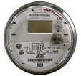




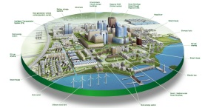


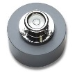
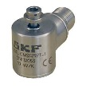










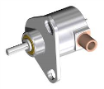




Connectivity
Select Connectivity Solution
IoT Cloud Platform
Wired, Wireless, PAN, NFC, Mobile – Range of IoT Protocols
SmartPhones
M2M/IoT Devices
Gateways
Infrastructures
Systems/Machines
Vehicles
Wearables

Slide 10
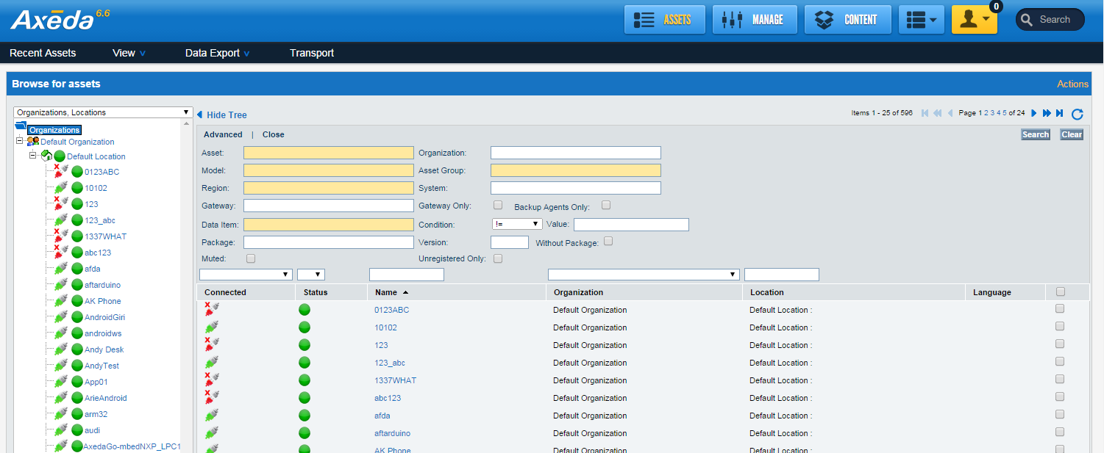
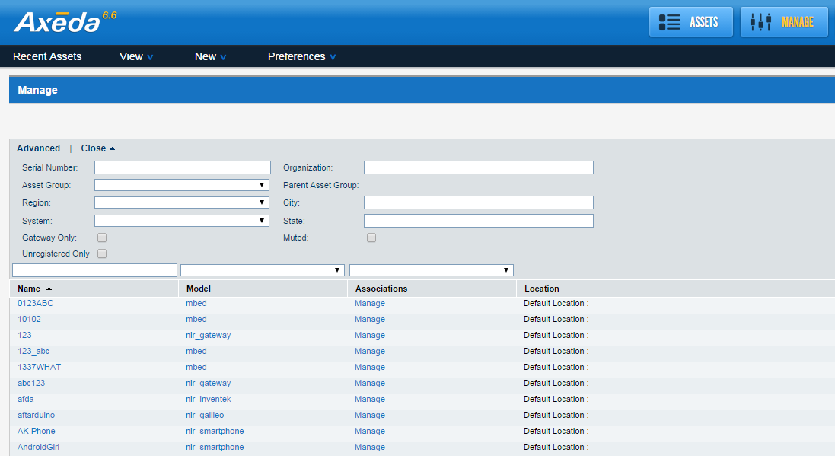
Management
Monitor and Manage Devices
Axeda IoT Dashboards

Slide 11
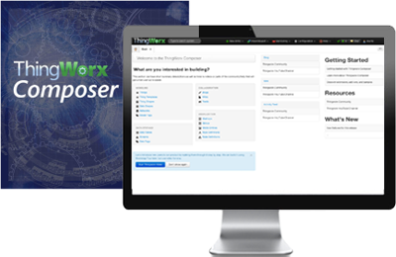
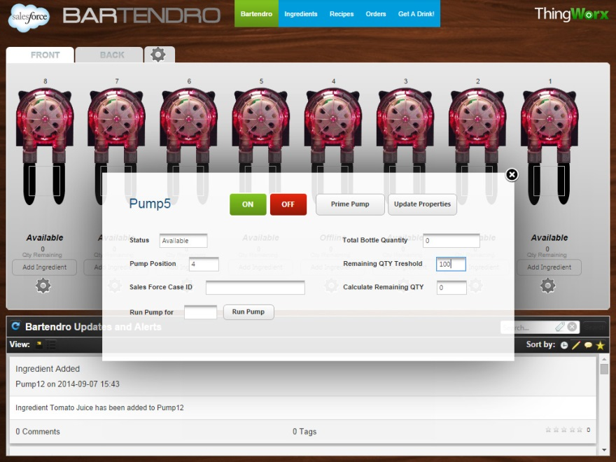
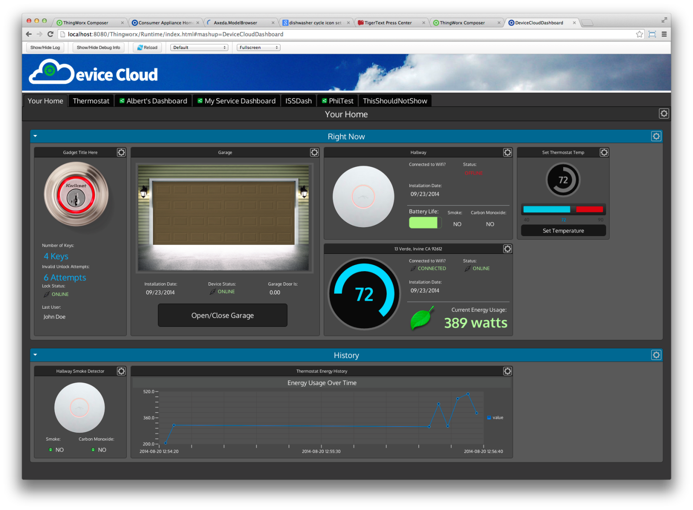
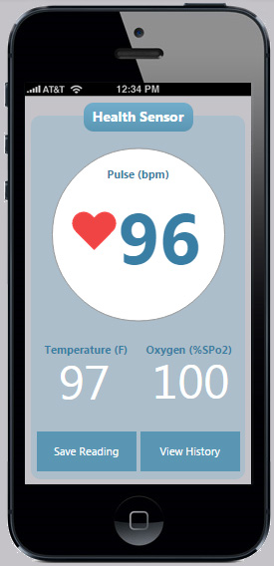
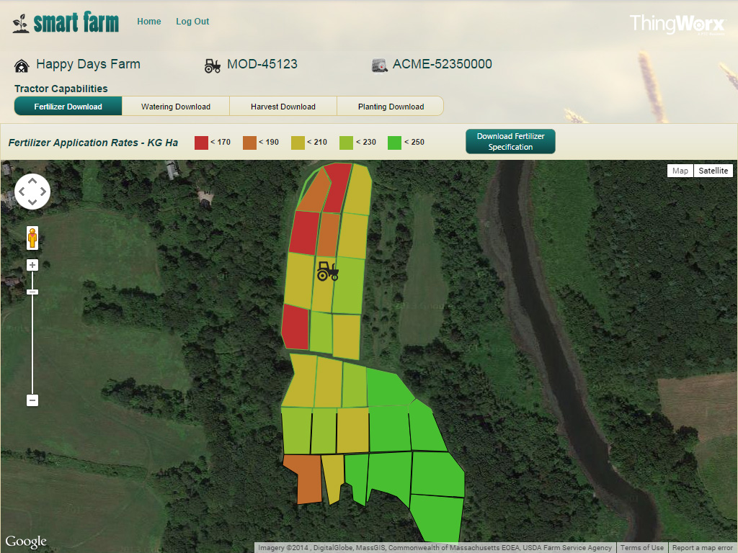
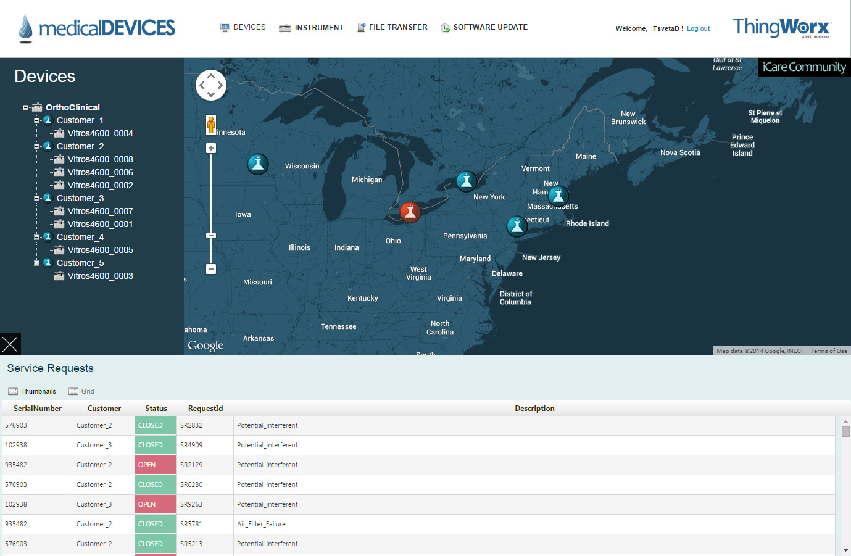
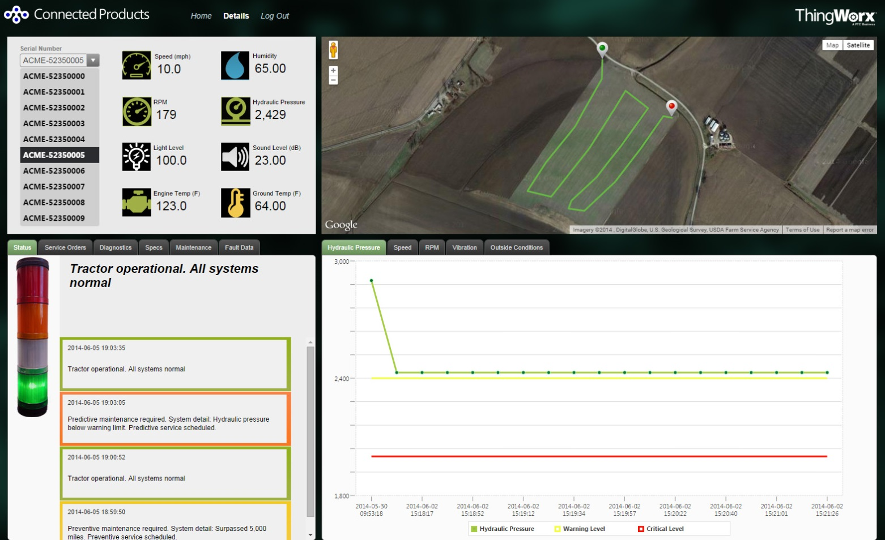
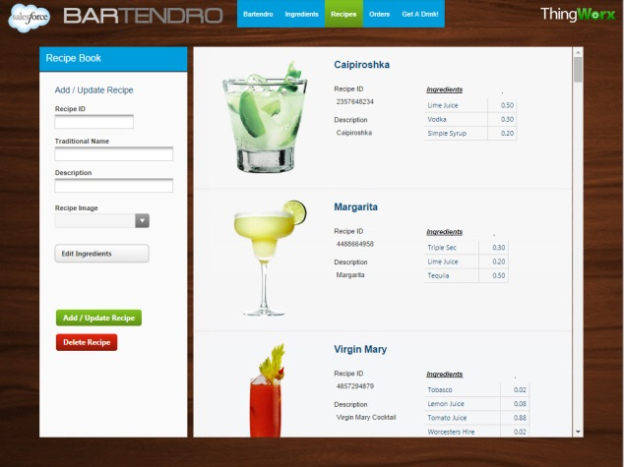
Application
Create Application
ThingWorx Composer & Mashup Builder

Slide 12


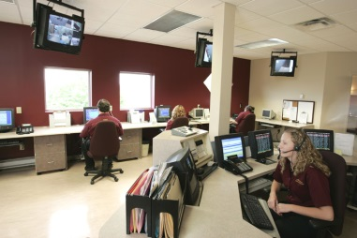
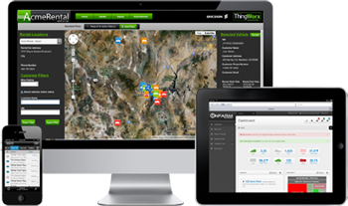


Integration
Integrate Solution

Slide 13
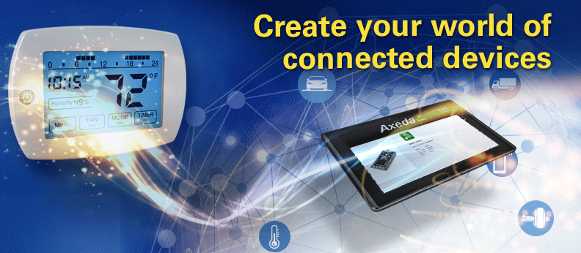

End-To-End IoT Business
Create Your World of Connected Devices

Slide 14
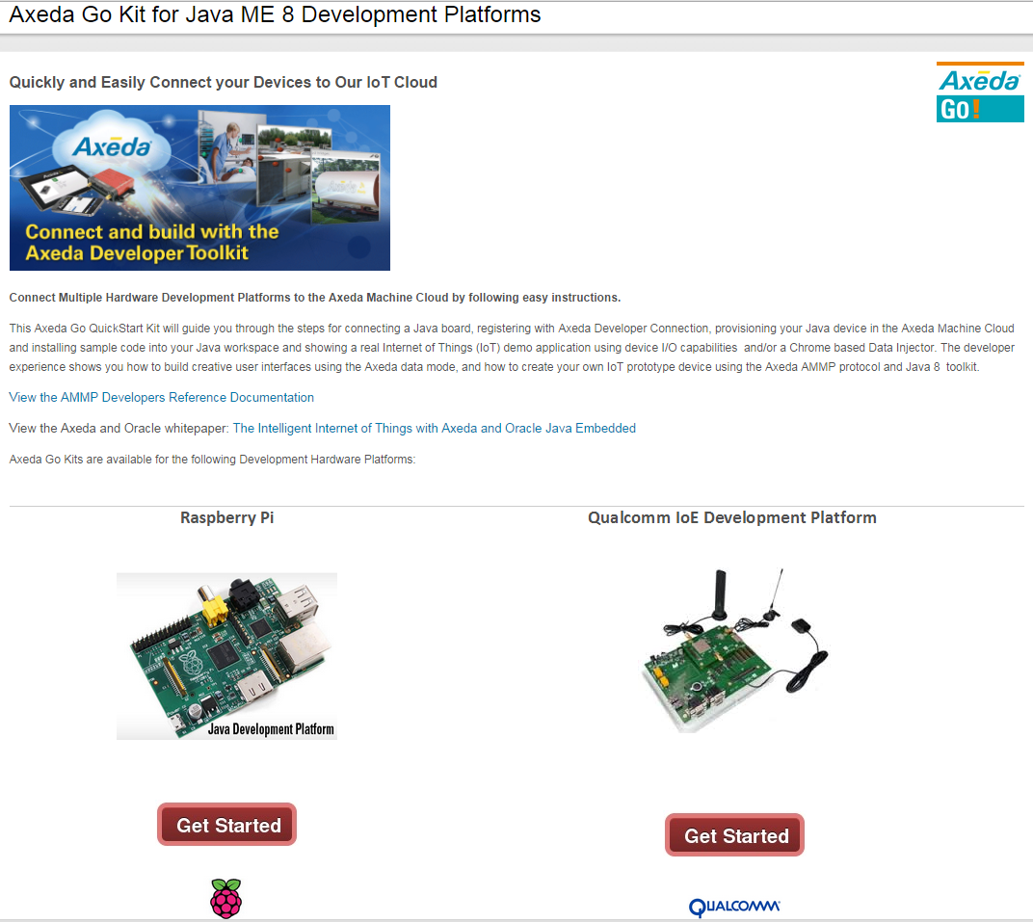
Getting Started
www.axeda.com/go-java8

Slide 15


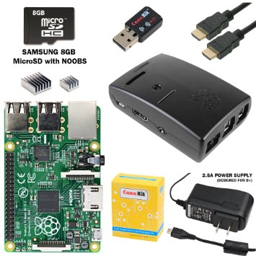
Visit us at Axeda Kiosk #6009
Talk to our Java 8 Toolkit Engineers
Win RaspberryPi Starter Kits – 3 Daily Drawings
Phil
Jeremy

Slide 16



Summary

